Slide 1
Computer Organization & Architecture
Chapter 3 – Basic Input/Output
Junying Chen 陈俊颖

Slide 2
Content of this lecture
3.1 Accessing I/O Devices
3.2 Interrupts
8.4 Direct Memory Access
Summary

Slide 3
Accessing I/O Devices (1)
I/O Devices
  Link to the outside world
  Types
    Human readable
      Monitor
      Printer
    Machine readable
      Disk
      CD ROM
      Scanner
    Communication
      Modem
      Network Interface Card (NIC)

Slide 4
Accessing I/O Devices (2)
Examples of I/O Devices
Device Input/Output Date Rate (Kbytes/s)
Keyboard Input 0.01
Mouse Input 0.02
Voice input (microphone) Input 0.02
Scanner Input 200
Voice output (speaker) Output 0.5
Dot-matrix printer Output 1
Laser printer Output 100
Graphics display Output 30,000
Local area network Input/output 200 – 20,000
Optical disk Storage (I/O) 500
Magnetic tape Storage (I/O) 2,000
Magnetic disk Storage (I/O) 2,000

Slide 5
Accessing I/O Devices (3)
Accessing I/O Devices
  Computer system components communicate through an interconnection network
  Address space and memory access concepts from preceding chapter also apply here
  Locations associated with I/O devices are accessed with Load and Store instructions
  Locations implemented as I/O registers within same address space → memory-mapped I/O

Slide 6
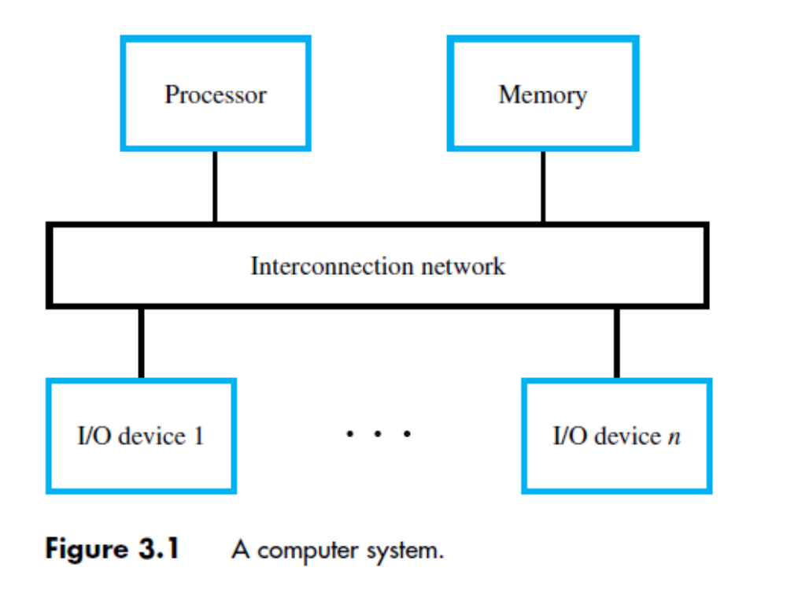
Accessing I/O Devices (4)
Accessing I/O Devices (ctd.)

Slide 7
Accessing I/O Devices (5)
Input/Output Problems
  Wide variety of peripherals
    Delivering different amounts of data
    At different speeds
    In different formats
  All slower than CPU and RAM
  Need I/O modules (interfaces)
Input/Output Module (Interface)
  Interface to CPU and Memory
  Interface to one or more peripherals

Slide 8
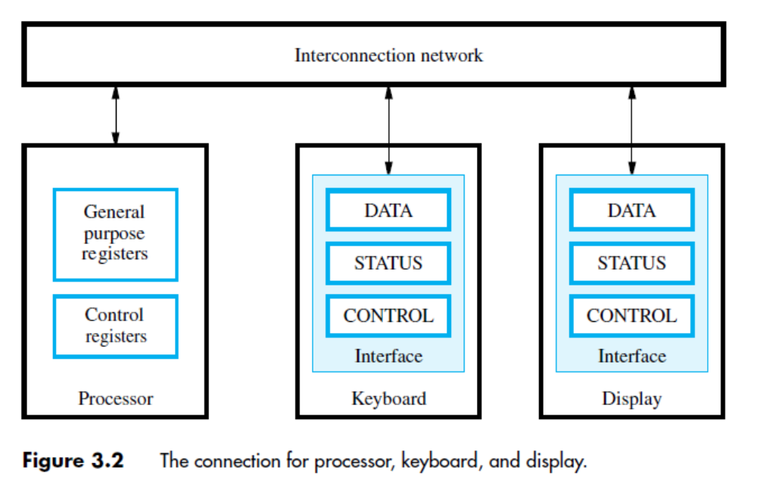
Accessing I/O Devices (6)
I/O Device Interface
  The address decoder, the data and status registers, and the control circuitry constitute the device’s interface circuit.

Slide 9
Accessing I/O Devices (7)
I/O Interface (ctd.)
  Functions of interface
    Device communication
      Control: Determine whether device will send or receive data
      Data: Actual data transferred
      Status: Device is ready, Data is available for transfer or error
    Data buffering
      Must handle varying data rates from memory and I/O device
      Buffer data so that no one gets tied down
    Error detection
      Report to CPU mechanical failure e.g. paper jam
      Report data transmission error

Slide 10
Accessing I/O Devices (8)
I/O Interface (ctd.)
  Functions of interface (ctd.)
    Control and Signaling
      Co-ordinates data transfer based on communication method with the processor
    Communication with CPU
      Programmed a.k.a Polling
      Interrupt driven
      Direct Memory Access (DMA)
Notes:
讲到这里—2018.11.20

Slide 11
Accessing I/O Devices (9)
Addressing Modes of I/O Devices(Interface)
  Memory-mapped I/O
    I/O devices and the memory share the same address space.
    Some memory address values are used to refer to peripheral device interface registers.
    I/O looks just like memory read/write
    Example Load R2, DATAIN
      DATAIN is the address of the input buffer associated with the keyboard.
    Advantage
      Any machine instruction that can access memory can be used to transfer data to or from an I/O device.

Slide 12
Accessing I/O Devices (10)
Addressing Modes of I/O Devices(Interface) (ctd.)
  Memory-mapped I/O (ctd.)
    Disadvantage
      Valuable memory address space is used up.
  Isolated I/O
    Use special In and Out instructions to perform I/O transfers.
    Advantage
      I/O devices deal with few address lines.
    Note
      A separate I/O address space does not necessarily mean that the I/O address lines are physically separate from the memory address lines.

Slide 13
Accessing I/O Devices (11)
Program-controlled I/O
  CPU executes a program that communicates with I/O module
    Read/write commands
    Sensing status
    Transferring data
  CPU waits for I/O module to complete operation
    Disadvantage is that it wastes CPU time
  Example: Consider a task that reads characters typed on a keyboard, stores these data in the memory, and displays the same characters on a display screen.

Slide 14
Accessing I/O Devices (12)
Program-controlled I/O (ctd.)
  Example (ctd.)
    The difference in speed between the processor and I/O devices creates the need for mechanisms to synchronize the transfer of data between them.
      On output, the processor sends the first character and then waits for a signal from the display that the character has been received. It then sends the second character, and so on.
      On input, the processor waits for a signal indicating that a character key has been struck and that its code is available in some buffer register associated with the keyboard. Then the processor proceeds to read that code.

Slide 15
Accessing I/O Devices (13)
Program-controlled I/O (ctd.)
  Example (ctd.)
    Signaling Protocol for I/O Devices
      Assume that the I/O devices have a way to send a ‘ready’ signal to the processor
      For keyboard, indicates character can be read
      so processor uses Load to access data register
      For display, indicates character can be sent so processor uses Store to access data register
      The ‘ready’ signal in each case is a status flag
      in status register that is polled by processor

Slide 16
Accessing I/O Devices (14)
Program-controlled I/O (ctd.)
  Example (ctd.)
    Example I/O Registers
      For sample I/O programs that follow, assume specific addresses & bit positions for registers
      Registers are 8 bits in width and word-aligned
      For example, keyboard has KIN status flag in bit b₁ of KBD_STATUS reg. at address 0x4004
      Processor polls KBD_STATUS register,
      checking whether KIN flag is 0 or 1
      If KIN is 1, processor reads KBD_DATA register

Slide 17
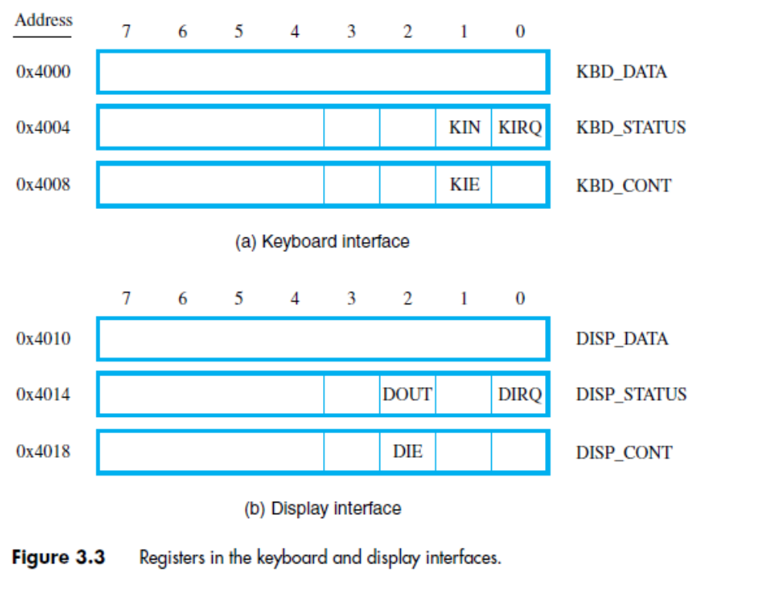
Accessing I/O Devices (15)
Program-controlled I/O (ctd.)
  Example (ctd.)
    Keyboard&Display Interface Register Organization

Slide 18
Accessing I/O Devices (16)
Program-controlled I/O (ctd.)
  Example (ctd.)
    Wait Loop for Polling I/O Status
      Program-controlled I/O implemented with a wait loop for polling keyboard status register:
      READWAIT: LoadByte R4, KBD_STATUS
      And R4, R4, #2
      Branch_if_[R4]=0 READWAIT
      LoadByte R5, KBD_DATA
      Keyboard circuit places character in KBD_DATA and sets KIN flag in KBD_STATUS
      Circuit clears KIN flag when KBD_STATUS read

Slide 19
Accessing I/O Devices (17)
Program-controlled I/O (ctd.)
  Example (ctd.)
    Wait Loop for Polling I/O Status
      Similar wait loop for display device:
      WRITEWAIT: LoadByte R4,DISP_STATUS
      And R4, R4, #4
      Branch_if_[R4]=0 WRITEWAIT
      StoreByte R5, DISP_DATA
      Display circuit sets DOUT flag in DISP_STATUS after previous character has been displayed
      Circuit automatically clears DOUT flag
      when DISP_STATUS register is read

Slide 20
Accessing I/O Devices (18)
Program-controlled I/O (ctd.)
  Example (ctd.)
    RISC- and CISC-style I/O Programs
      Consider complete programs that use polling to read, store, and display a line of characters
      Each keyboard character echoed to display
      Program finishes when carriage return (CR) character is entered on keyboard
      LOC is address of first character in stored line
      CISC has TestBit, CompareByte instructions
      as well as auto-increment addressing mode

Slide 21
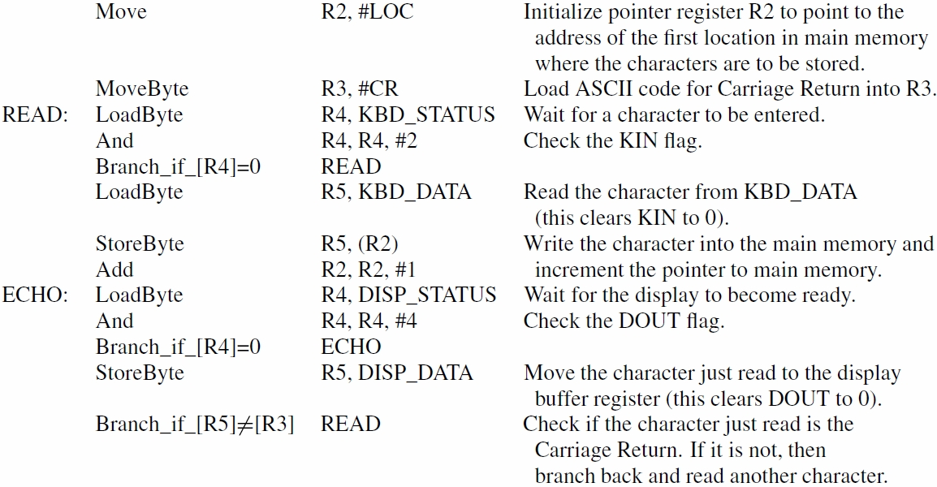
Accessing I/O Devices (19)
Program-controlled I/O (ctd.)
  Example (ctd.) RISC Program
    RISC- and CISC-style I/O Programs

Slide 22
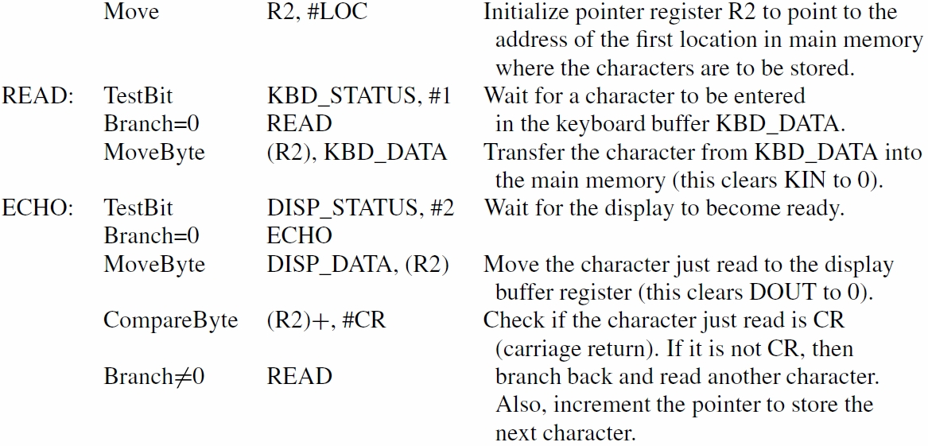
Accessing I/O Devices (20)
Program-controlled I/O (ctd.)
  Example (ctd.) CISC Program
    RISC- and CISC-style I/O Programs

Slide 23
Interrupts (1)
What is Interrupt?
  An interrupt is an event that causes the processor to stop its current program execution and switch to performing an interrupt service routine.
Advantages of Interrupt
  Overcomes CPU waiting
  No repeated CPU checking of device
  I/O module interrupts when ready

Slide 24
Interrupts (2)
Example 3.1
  Consider a task that requires continuous extensive computations to be performed and the results to be displayed on a display device.
  The displayed results must be updated every ten seconds. The 10- second intervals can be determined by a simple timer circuit, which generates an appropriate signal. The processor treats the timer circuit as an input device that produces a signal that can be interrogated. The timer circuit raise an interrupt request once every 10 seconds. In response, the processor displays the latest results.

Slide 25
Interrupts (3)
Example 3.1(ctd.)
  The task can be implemented with a program that consists of two routines, COMPUTE and DISPLAY.
  The processor continuously executes the COMPUTE routine. When it receives an interrupt request from the timer, it suspends the execution of the COMPUTE routine and executes the DISPLAY routine which sends the latest results to the display device. Upon completion of the DISPLAY routine, the processor resumes the execution of the COMPUTE routine. Since the time needed to send the results to the display device is very small compared to the 10-second interval, the processor in effect spends almost all of its time executing the COMPUTE routine.

Slide 26
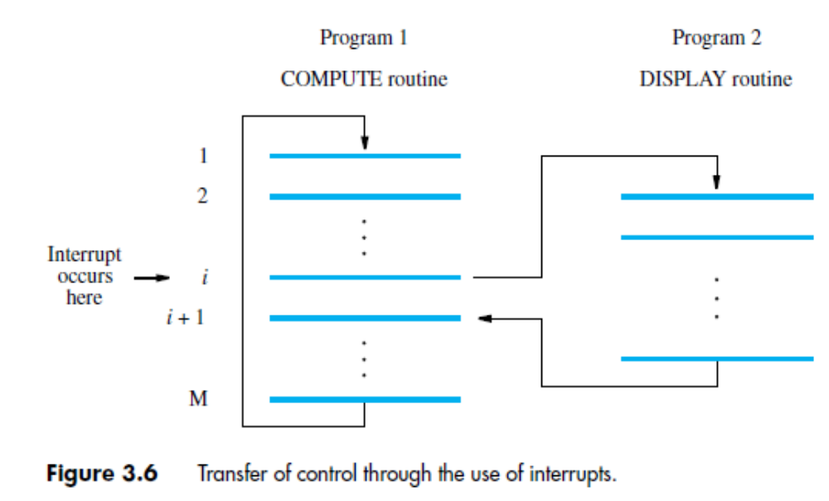
Interrupts (4)
Example 3.1 (ctd.)

Slide 27
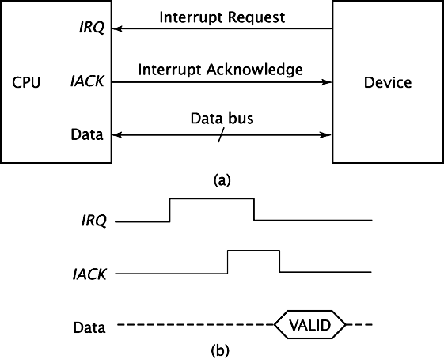
Interrupts (5)
Concepts of Interrupt
  Interrupt Request Signal
    A signal that an I/O device sends to the processor through one of the bus control lines.
  Interrupt Acknowledge Signal
    The CPU issue the signal to acknowledges the interrupt

Slide 28
Interrupts (6)
Concepts of Interrupt (ctd.)
  Interrupt-Service Routine (Interrupt Handler)
    The routine executed in response to an interrupt request is called the interrupt-service routine.
  Interrupt Latency
    The delay between the time an interrupt request is received and the start of execution of the interrupt-service routine.

Slide 29
Interrupts (7)
Concepts of Interrupt (ctd.)
  Difference between subroutine and interrupt-service routine
    A subroutine performs a function required by the program from which it is called. As such, potential changes to status information and contents of registers are anticipated.
    An interrupt-service routine may not have any relation to the portion of the program being executed at the time the interrupt request is received. Therefore, before starting execution of the interrupt service routine, status information and contents of processor registers that may be altered in unanticipated ways during the execution of that routine must be saved. This saved information must be restored before execution of the interrupted program is resumed.

Slide 30
Interrupts (8)
Interrupt Processing
  When an interrupt occurs (and is accepted), the execution of the current program is suspended
  Must save PC, Registers in Process Control Block (PCB)
  Interrupt service routine executes to service the interrupt
  Flowchart (next page)

Slide 31
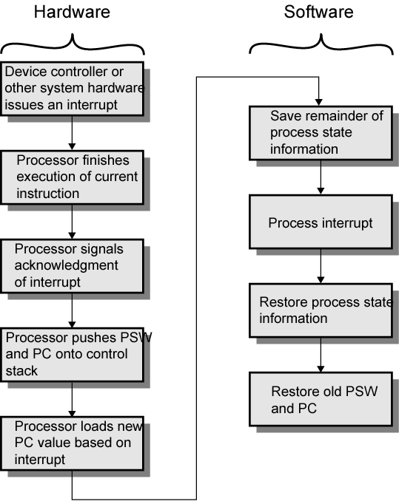
Interrupts (9)
Interrupt Processing (ctd.)

Slide 32
Interrupts (10)
Enabling and Disabling Interrupts
  Enabling and disabling interrupts are fundamental to all computers
    The interruption of program execution must be carefully controlled because interrupts can arrive at any time, they may alter the sequence of events from that envisaged by the programmer.
    It may be necessary to guarantee that a particular sequence of instructions is executed to the end without interruption because the interrupt service routine may change some of the data used by the instructions in question.

Slide 33
Interrupts (11)
Enabling and Disabling Interrupts (ctd.)
  Interrupt Control at Processor End
    Set Interrupt-enable bit in the Program Status register
    Suitable for a simple processor with only one interrupt-request line.
    Have the processor automatically disable interrupts (clear the Interrupt-enable bit) before starting the execution of the interrupt-service routine. (IE=0)
    When a Return-from-interrupt instruction is executed, the contents of the PS are restored from the stack, setting the Interrupt-enable bit back to 1. (IE=1)

Slide 34
Interrupts (12)
Enabling and Disabling Interrupts (ctd.)
  Interrupt Control at I/O Device End
    It is important to ensure that interrupt requests are generated only by those I/O devices that the processor is currently willing to recognize.
    Need a mechanism in the interface circuits of individual devices to control whether a device is allowed to interrupt the processor.
    An interrupt-enable bit in a control register determines whether the device is allowed to generate an interrupt request.

Slide 35
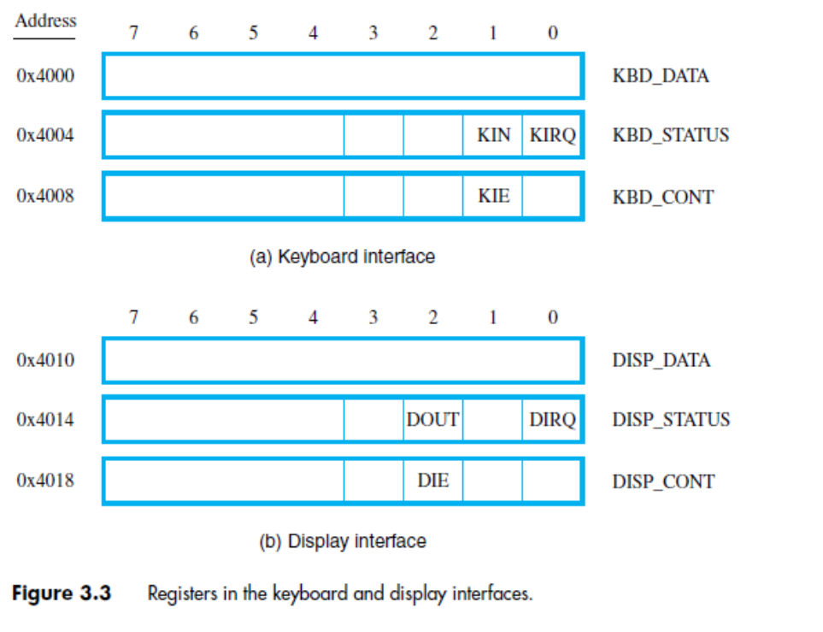
Interrupts (13)
Enabling and Disabling Interrupts (ctd.)
  Interrupt Control at I/O Device End (ctd.)

Slide 36
Interrupts (14)
Multiple Devices Interrupt System Design Issues
  How do you identify the module issuing the interrupt? How the processor obtain the starting address of the appropriate routine of different devices?—Identify Interrupt Source
  Should a device be allowed to interrupt the processor while another interrupt is being serviced? —Multi-level Interrupt
  How should two or more simultaneous interrupt requests be handled? —Simultaneous Interrupt

Slide 37
Interrupts (15)
Identify Interrupt Source
  Common Interrupt-request Line
    Polling (Nonvectored Interrupt)
      The poll could be in the form of a separate command line (e.g., TEST I/O). The processor raises TEST I/O and places the address of a particular I/O interface on the address lines.
      The processor then reads the status register of each I/O interface. (When a device raises an interrupt request, it sets IRQ bit in its status register to 1.)
      Disadvantage
        The time spent interrogating the IRQ bits of all the devices that may not be requesting any service.

Slide 38
Interrupts (16)
Identify Interrupt Source (ctd.)
  Common Interrupt-request Line (ctd.)
    Polling (Nonvectored Interrupt) (ctd.)

Slide 39
Interrupts (17)
Identify Interrupt Source (ctd.)
  Common Interrupt-request Line (ctd.)
    Vectored Interrupt
      An interrupt scheme where the interrupting device identifies itself when generating interrupts.
      Interrupt Vector
        An interrupt vector is the memory address of an interrupt handler, or an index into an array called an interrupt vector table or dispatch table.
        Interrupt vector tables contain the memory addresses of interrupt handlers.
Notes:
A device requesting an interrupt identifies itself directly to the processor by sending Interrupt-vector code to the processor over the bus (typically data bus).
Then, the processor can immediately start executing the corresponding interrupt-service routine.

Slide 40
Interrupts (18)
Identify Interrupt Source (ctd.)
  Common Interrupt-request Line (ctd.)
    Vectored Interrupt (ctd.)
      When a device sends an interrupt request, the processor may not ready to receive the interrupt-vector code immediately.
      When the processor is ready to receive the interrupt-vector code, it activates the interrupt-acknowledge line, INTA
      The I/O device responds by sending its interrupt-vector code and turning off the INTR signal.

Slide 41
Interrupts (19)
Multi-level Interrupt
  Single-level Interrupt
    Whether one device or several I/O devices, interrupts should be disabled during the execution of an interrupt-service routine.
  Multi-level Interrupt (Interrupt Nesting)
    It is necessary to accept another device interrupt during the execution of an interrupt-service routine for a device.
    I/O devices are organized in a priority structure. An interrupt request from a high-priority device should be accepted while the processor is serving another request from a lower-priority device.

Slide 42
Interrupts (20)
Multi-level Interrupt (ctd.)
  Multiple Interrupt (ctd.)
    Multi-Level Priority
      Assign a priority level to the processor that can be changed under program (privileged instructions) control.
      The priority level of the processor is the priority of the program that is currently being executed.
      The processor accepts interrupts only from devices that have priorities higher than its own.
      At the time the execution of an interrupt-service routine for some device is started, the priority of the processor is raised to that of the device.
      The processor’s priority can be encoded in a few bits of the processor status register.

Slide 43
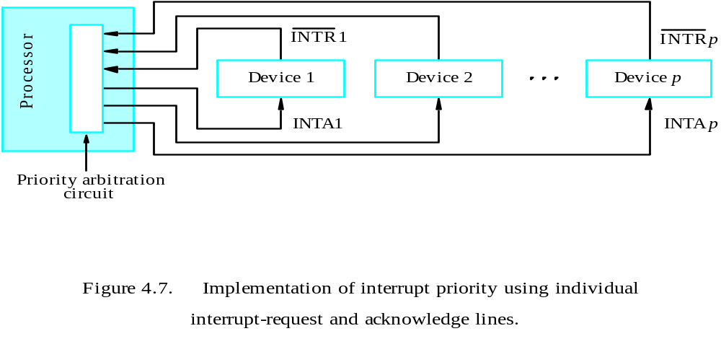
Interrupts (21)
Multi-level Interrupt (ctd.)
  Multi-level Interrupt (ctd.)
    Multi-Level Priority (ctd.)
Implementation of interrupt priority using individual
interrupt-request and acknowledge lines

Slide 44
Interrupts (22)
Simultaneous Interrupt
  Individual device has individual interrupt-request and acknowledge lines
    The processor simply accepts the request having the highest priority.
    It allows the processor to accept interrupt requests from some devices but not from others, depending upon their priorities.
  Several devices share one interrupt-request line
    Software Poll
    Daisy Chain (Hardware Poll)
    Priority Group

Slide 45
Interrupts (23)
Simultaneous Interrupt (ctd.)
  Software Poll
    The processor poll the status register of the I/O device.
    Priority is determined by the order in which the devices are polled.
  Daisy Chain
    In the daisy chain arrangement, the device that is electrically closest to the processor has the highest priority.
    The second device along the chain has second highest priority, and so on.
I
N
T
R
Processor
Device 1
Device 2
Device
n
INTA

Slide 46
Interrupts (24)
Simultaneous Interrupt (ctd.)
  Priority Group
I
N
T
R
1
INTA1
Device
Device
Processor
I
N
T
R
p
INTA
p
Device
Device
Priority arbitration
circuit

Slide 47
Interrupts (25)
Processor Control Registers
  Processor Status Register (PS)
  IPS register is where PS is automatically saved when an interrupt request is recognized
  IENABLE register allows the processor to selectively respond to individual I/O devices.
    Has one bit per device
  IPENDING has one bit per device to indicate if interrupt request has not yet been serviced

Slide 48
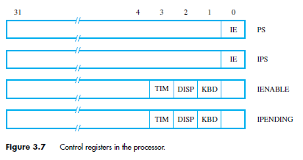
Interrupts (26)
Processor Control Registers (ctd.)

Slide 49
Interrupts (27)
Processor Control Registers (ctd.)
  Accessing Control Registers
    Use special Move instructions that transfer values to and from general-purpose registers
    Transfer pending interrupt requests to R4:
    MoveControl R4, IPENDING
    Transfer current processor IE setting to R2:
    MoveControl R2, PS
    Transfer desired bit pattern in R3 to IENABLE:
    MoveControl IENABLE, R3

Slide 50
Interrupts (28)
Examples of Interrupt Programs
  Example 3.2 Let us consider again the task of reading a line of characters typed on a keyboard, storing the characters in the main memory, and displaying them on a display device. Now, we will use interrupts with the keyboard, but polling with the display.
    Assume that a specific memory location, ILOC, is dedicated for dealing with interrupts, and that it contains the first instruction of the interrupt-service routine.

Slide 51
Interrupts (29)
Examples of Interrupt Programs (ctd.)
  Example 3.2 (ctd.)
    Whenever an interrupt request arrives at the processor, and processor interrupts are enabled, the processor will automatically:
      Save the contents of the program counter, either in a processor register that holds the return address or on the processor stack.
      Save the contents of the status register PS by transferring them into the IPS register, and clear the IE bit in the PS.
      Load the address ILOC into the program counter

Slide 52
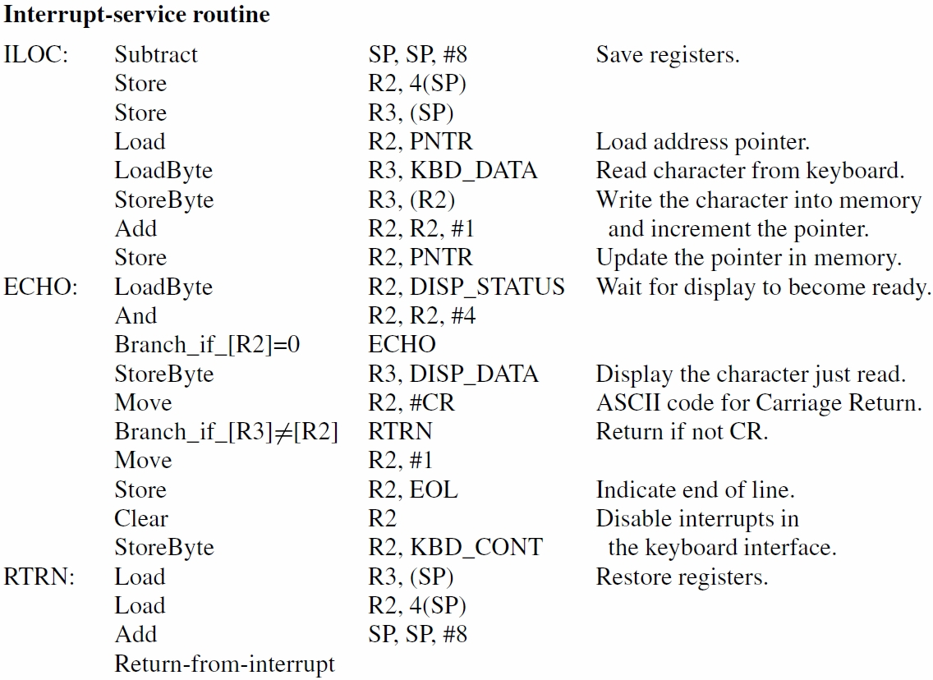
Interrupts (30)
Examples of Interrupt Programs (ctd.)

Slide 53
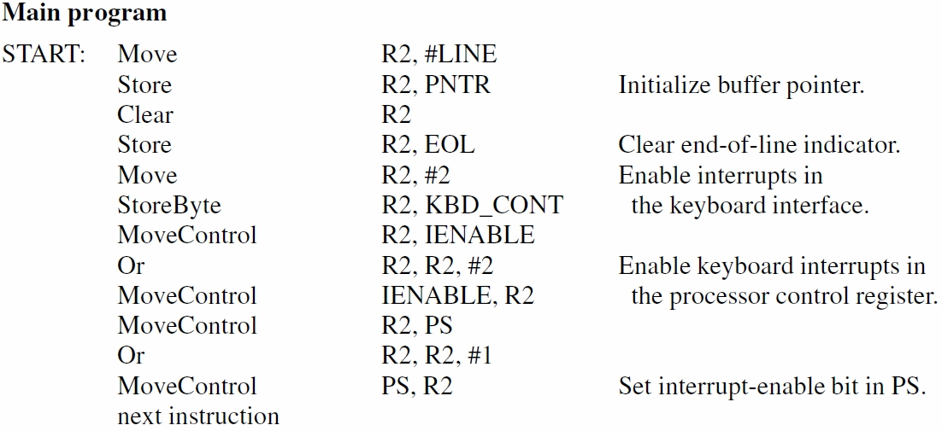
Interrupts (31)
Examples of Interrupt Programs (ctd.)

Slide 54
Interrupts (32)
Examples of Interrupt Programs (ctd.)
  Example 3.3 Suppose a program needs to display a page of text stored in the memory. This can be done by having the processor send a character whenever the display interface is ready, which may be indicated by an interrupt request. Assume that both the display and the keyboard are used by this program, and that both are enabled to raise interrupt requests.

Slide 55
Interrupts (33)
Examples of Interrupt Programs (ctd.)
  Example 3.3 (ctd.)
    To use interrupts for both keyboard & display, call subroutines from ILOC service routine
    Service routine reads IPENDING register
    Checks which device bit(s) is (are) set
    to determine which subroutine(s) to call
    Service routine must save/restore Link register
    Also need separate pointer variable to indicate
    output character for next display interrupt

Slide 56
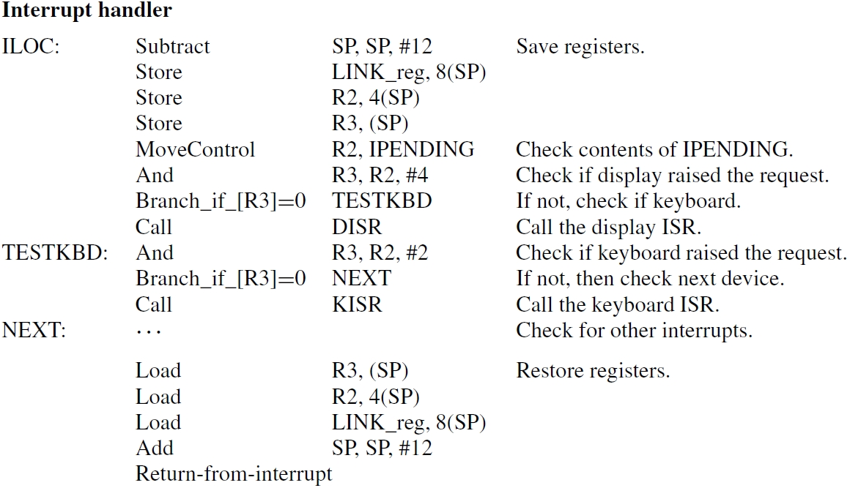
Interrupts (34)
Examples of Interrupt Programs (ctd.)

Slide 57
Direct Memory Access (1)
Interrupt driven and programmed I/O require active CPU intervention
  Transfer rate is limited
  CPU is tied up
Solution: DMA
  Used for high-speed block transfers between a device and memory
  During the transfer, the CPU is not involved
  Typical DMA devices:
    Disk drives, tape drives
  Remember
    Keyboard data rate → 0.01 KB/s (1 byte every 100 ms)
    Disk drive data rate → 2,000 KB/s (1 byte every 0.5 µs)
Transfer rate is too high to be controlled by software executing on the CPU
Notes:
The I/O transfer rate is limited by the speed with which the processor can test and service a device.
2. The processor is tied up in managing an I/O transfer; a number of instructions must be executed for each I/O transfer.

Slide 58
Direct Memory Access (2)
DMA Operation
  1.The CPU “prepares” the DMA operation by transferring information to a DMA controller (DMAC):
    Location of the data on the device
    Location of the data in memory
    Size of the block to transfer
    Direction of the transfer
    Mode of transfer (burst, cycle stealing, transparent)
  2. When the device is ready to transfer data, the DMAC takes control of the system buses (DMA controller deals with transfer)
  3. DMAC sends interrupt when finished

Slide 59
Direct Memory Access (3)
DMA Operation (ctd.)
CPU
Data bus
Address bus
Control bus
Memory
DMAC
The CPU “prepares” the DMAC
Disk
Program-controlled I/O

Slide 60
Direct Memory Access (4)
DMA Operation (ctd.)
CPU
Data bus
Address bus
Control bus
The transfer takes place
Memory
DMAC
Disk

Slide 61
Direct Memory Access (5)
DMA Operation (ctd.)
CPU
Data bus
Address bus
Control bus
IRQ
The DMAC interrupts the CPU when the transfer is complete
Memory
DMAC
Disk
I/O Interrupt

Slide 62
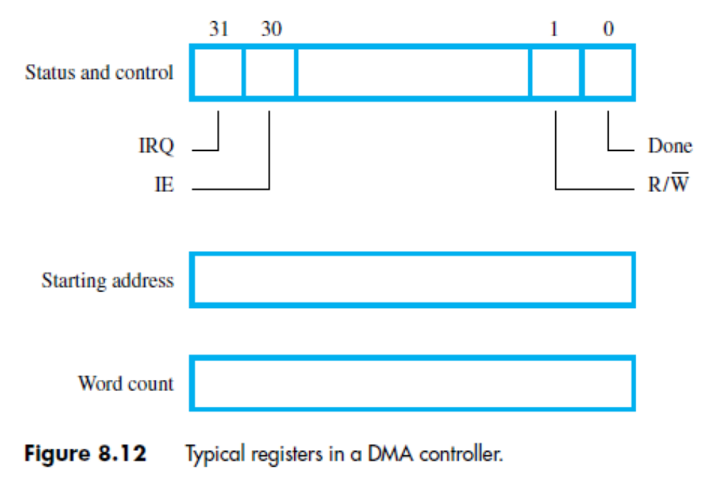
Direct Memory Access (6)
Implementing DMA in a Computer System (ctd.)
  Registers in a DMA Controller (ctd.)

Slide 63
Direct Memory Access (7)
DMA Transfer Mode
  Modes vary by how the DMA controller determines when to transfer data, but the actual data transfer process is the same for all the modes.
  Burst Mode (Block Transfer Mode)
    An entire block of data is transferred in one contiguous sequence.
    Once the DMA controller is granted access to the system buses by the CPU, it transfers all bytes of data in the data block before releasing control of the system buses back to the CPU.

Slide 64
Direct Memory Access (8)
DMA Transfer Mode (ctd.)
  Burst Mode (ctd.)
    DMAC relinquishes control of the system buses by releasing BGACK signal.
    Usage
      It is useful for loading programs or data files into memory.
    Disadvantages
      Render the processor inactive for relatively long periods of time.
      Low memory efficiency

Slide 65
Direct Memory Access (9)
DMA Transfer Mode(ctd.)
  Cycle Stealing Mode
    DMA controller obtains access to the system buses as in burst mode, using BR & BG signals. However, it transfers one byte of data and then deasserts BR, returning control of the system buses to the CPU. It continually issues requests via BR, transferring one byte of data per request, until it has transferred it’s entire block of data.
    A BR-BG-BGACK sequence occurs for every transfer, until the block is completely transferred

Slide 66
Direct Memory Access (10)
DMA Transfer Mode(ctd.)
  Cycle Stealing Mode (ctd.)
    The data block is not transferred as quickly as in burst mode, but the CPU is not idled for as long as in that mode.
    Usage
      Useful for controllers monitoring data in real time.

Slide 67
Summary
I/O Interface
Addressing mode of I/O Interface
  Memory-mapped I/O
  Isolated I/O
Principle of program-controlled I/O
Principle of interrupt
Interrupt processing
Enabling and disabling interrupt
  At processor end
  At device end
Multiple device interrupt system
Principle of DMA

