Slide 1
Computer Organization & Architecture
Chapter 1 – Basic Structure of Computers
Junying Chen 陈俊颖
博士，副教授

Slide 2
Content of this lecture
1.1 Computer Types
1.2 Functional Units
1.3 Basic Operational Concepts
1.6 Performance
1.7 Historical Perspective
Summary

Slide 3
Computer Types (1)
Embedded Computers
  Integrated into a larger device or system
  Specific purpose
  Industrial and home automation, appliances, telecommunication products, and vehicles
Personal Computers
  Dedicated individual use
  General computation, document preparation, computer-aided design, audiovisual entertainment, …
  Desktop computers
  Workstation computers: for engineering and scientific work
  Portable and Notebook computers

Slide 4
Computer Types (2)
Servers and Enterprise Systems
  Shared by a potentially large number of users
  Contain sizable database storage units
  Capable of handling large volumes of requests to access the data
  Business data processing in medium to large corporations, information processing for a government agency,…
Supercomputers and Grid Computers
  Large-scale numerical calculations required in applications weather forecasting, aircraft design and simulation

Slide 5
Functional Units (1)
Basic Functions of a Computer
  Data Processing
    Data means any digital information
  Data Storage
  Data Movement
  Control

Slide 6
Functional Units (2)
Basic Functional Units of a Computer
  Input Unit
  Output Unit
  Memory
  Arithmetic and Logic Unit (ALU)
  Control Unit
I/O Unit
Processor

Slide 7
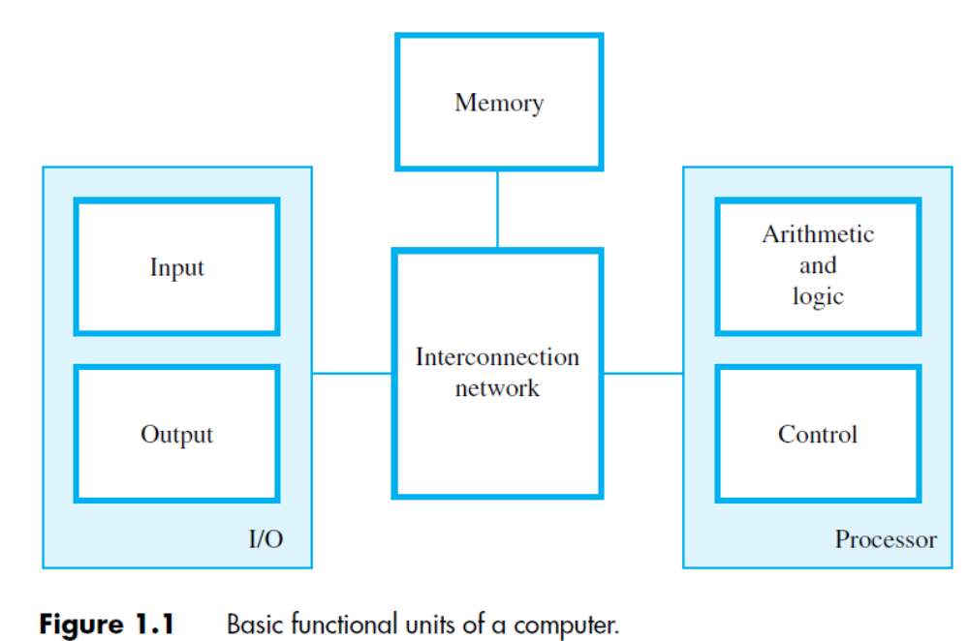
Functional Units (3)

Slide 8
Functional Units (4)
Information Handled by a Computer
  Instructions/Machine Instructions
    Govern the transfer of information within a computer as well as between the computer and its I/O devices
    Specify the arithmetic and logic operations to be performed
    Program: a list of instructions which performs a task
  Data
    Numbers and characters used as operands by the instructions
  Encoded in binary code – 0 and 1

Slide 9
Functional Units (5)
Input Unit
  Function
    Make computer accept coded information
  Input Devices
    Keyboard
    Mouse
    Digital camera
    Joystick
    Touchpad
    Scanner
    Microphone
    …

Slide 10
Functional Units (6)
Output Unit
  Function
    Send processed results to the outside world
  Output Devices
    Video display
    Printer
    …

Slide 11
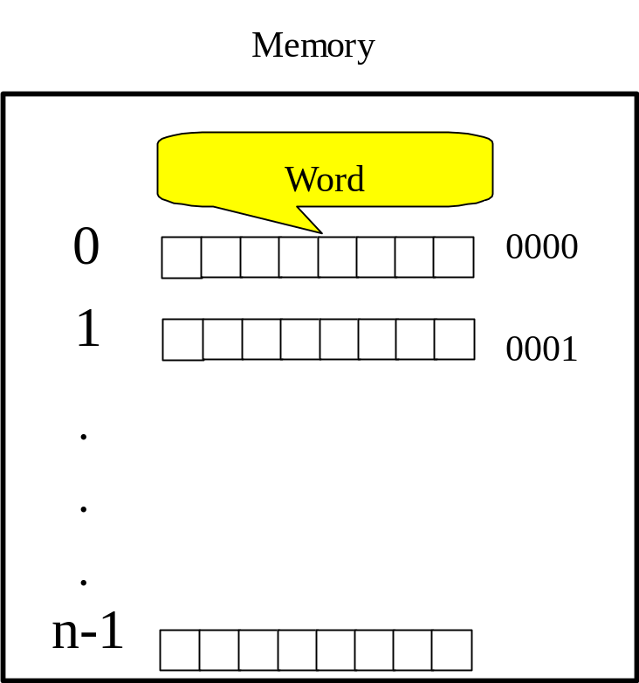
Functional Units (7)
Memory Unit
  Function
    Store instructions and data
  Classification of Storage
    Primary Storage
      Store programs when they are being executed
      Related terms
        Word
        Word length
        Address
        Memory access time
        Random access memory

Slide 12
Functional Units (8)
Memory Unit (ctd.)
  Classification of Storage (ctd.)
    Secondary Storage
      Store many programs and large amounts of data,particularly for information that is accessed infrequently.
      Magnetic Disks and Tapes
        Hard disks
        Floppy disks
      Optical Disks
        CD-ROMs

Slide 13
Functional Units (9)
Arithmetic and Logic Unit
  Function
    Execute arithmetic or logic operations
  Most computer operations are executed in ALU of the processor.
  Load the operands into memory – bring them to the processor – perform operation in ALU – store the result back to memory or retain in the processor.
  Registers in ALU: high speed storage elements

Slide 14
Functional Units (10)
Control Unit
  Function
    Coordinate operations of the other units
    Send control signals to other units and sense their states
Operations of a Computer
  The computer accepts information in the form of programs and data through an input unit and stores it in the memory.
  Information stored in the memory is fetched, under program control, into an arithmetic and logic unit where it is processed.

Slide 15
Functional Units (11)
Operations of a Computer (ctd.)
  Processed information leaves the computer through an output unit.
  All activities inside the machine are directed by the control unit.

Slide 16
Basic Operational Concepts (1)
Program Execution
  Execute instructions specified in the program.
    1.The processor reads (fetch) instructions from memory one at a time, and executes each instruction.
    2.Program execution consists of repeating the process of instruction fetch and instruction execution.

Slide 17
Basic Operational Concepts (2)
Program Execution (ctd.)
0 3
4 15
Opcode
Address
An Example Instruction Format
Fetch Cycle
Execute Cycle
Fetch
Instruction
Execute
Instruction
Start
Halt
Instruction Cycle

Slide 18
Basic Operational Concepts (3)
Program Execution (ctd.)
  Interrupt
    An interrupt is a request from an I/O device for service by the processor.
Fetch Cycle
Execute Cycle
Interrupt Cycle
Fetch Next
Instruction
Execute
Instruction
Check for Interrupt
Process Interrupt
Start
Halt

Slide 19
Basic Operational Concepts (4)
Instruction Execution
  Example: Add LOCA, R0
    Fetch the instruction from the memory into the processor(IR)
    The operand at LOCA is fetched and added to the contents of R0 (combines a memory access operation with an ALU operation)
    The resulting sum is stored in register R0
  Load LOCA, R1
    Add R1, R0

Slide 20
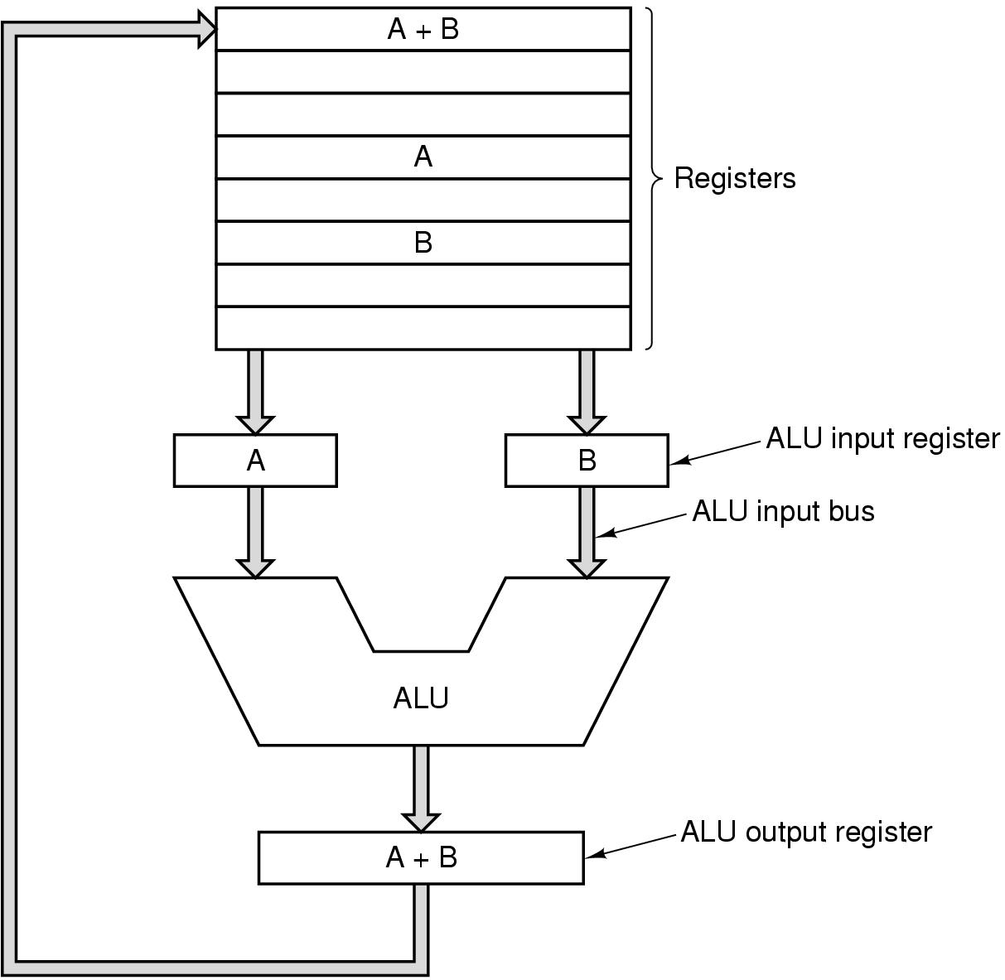
Basic Operational Concepts (5)
Instruction Execution (ctd.)

Slide 21
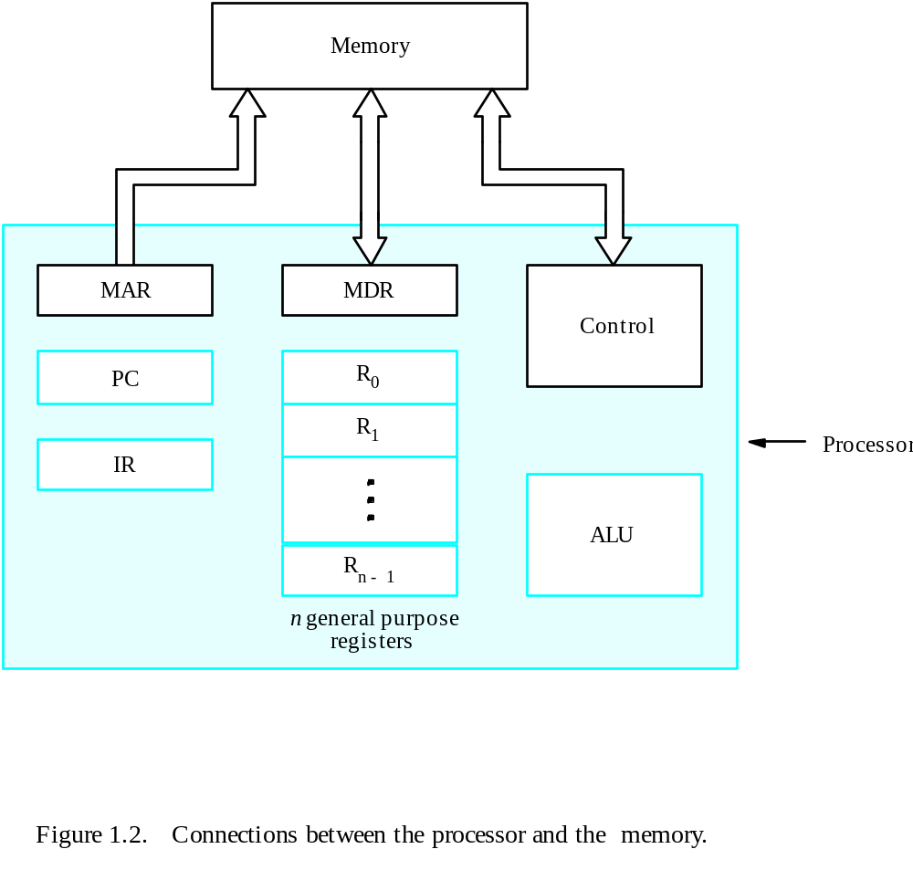
Basic Operational Concepts (6)
Instruction Execution (ctd.)

Slide 22
Basic Operational Concepts (7)
Instruction Execution (ctd.)
  Normal execution of an instruction
(1) MAR← [PC], Read
(2) WMFC, MDR← [MAR], PC← [PC]+1
(3) IR← [MDR]
If an operand resides in the memory, then (4) to (7), else (7)
(4) MAR← LOCA, Read
(5) WMFC, MDR← [MAR]
(6) Ri← [MDR]
(7) ALU performs operation
If the result is to be stored in the memory, then (8)
(8) MDR← result
(9) MAR← address, Write

Slide 23
Performance (1)
Measuring Performance
  How quickly a computer can execute programs.
    Design of instruction set
    Hardware
    Software
    Compiler
Technology
  Moore’s Law: The packaging density of transistors on an integrated circuit increases 2x every 18 months.
  Instructions can be executed faster and more transistor can be placed on a chip.

Slide 24
Performance (2)
Parallelism
  Instruction-level Parallelism
    Pipelining: beginning other waiting instructions before the first finishes
  Multicore Processors
    Problems in Single Core
      To execute the tasks faster you must increase the clock time.
      Increasing clock times too high drastically increases power consumption and heat dissipation to extremely high levels, making the processor inefficient.
  Multiprocessors
    Why multiprocessors?

Slide 25
Performance (3)
Pipelining in a Computer
Fetch + Execution
T
ime
I
1
I
2
I
3
T
ime
Clock cycle
1
2
3
4
F
1
E
1
F
2
E
2
F
3
E
3
Instruction
(a) Sequential execution
I
1
F
1
E
1
I
2
F
2
E
2
Interstage buffer
B1
I
3
F
3
E
3
Instruction
Ex
ecution
fetch
unit
(c) Pipelined execution
unit
(b) Hardware organization
Basic idea of instruction pipelining.

Slide 26
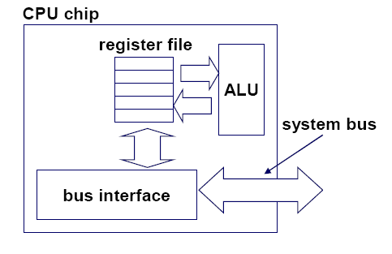
Performance (4)
Single-Core CPU Chip
the single core

Slide 27
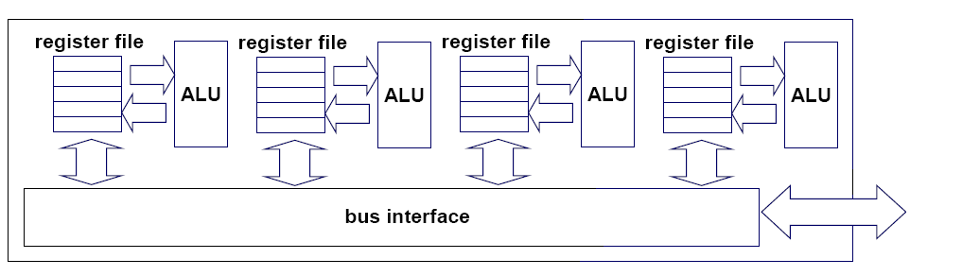
Performance (5)
Multi-Core CPU Chip
Core 1
Core 2
Core 3
Core 4

Slide 28
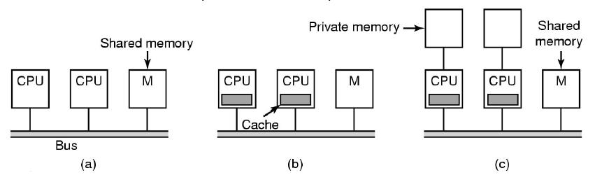
Performance (6)
Shared-Memory Multiprocessor
  (a) Simplest MP: More than one processor on a single bus connect to memory, bus bandwidth becomes a bottleneck.
  (b) Each processor has a cache to reduce the need to access to memory.
  (c) To further scale the number of processors, each processor is given private local memory.

Slide 29
Historical Perspective (1)
Computer Generations
  The Zero Generation : Mechanical Computers (1642-1945)
    The first person to build a working calculating machine (only do addition and subtraction) was Blaise Pascal.
    Leibniz 1672 multiplication and division
    Babbage Difference Engine Analytical Engine
    Late 1930s Electromaganetic relay

Slide 30
Historical Perspective (2)
Computer Generations (ctd.)
  The First Generation : Vacuum Tubes (1945-1955)
    ENIAC(Electronic Numerical Integrator And Computer)
      The world’s first general-purpose electronic digital computer
      The Moore school of the University of Pennsylvania

Slide 31
Historical Perspective (3)
Computer Generations (ctd.)
  The First Generation : Vacuum Tubes (1945-1955) (ctd.)
    Stored-program concept (John von Neumann)
      Data and instructions are stored in a single read-write memory.
      The contents of this memory are addressable by location , without regard to the type of data contained there.
      Execution occurs in a sequential fashion (unless explicitly modified) from one instruction to the next.
    Assembly Language
    Mercury delay-line memory

Slide 32
Historical Perspective (4)
Computer Generations (ctd.)
  The Second Generation : Transistors (1955-1965)
    Magnetic core memories and magnetic drum storage devices
    High-level languages, e.g. Fortran
    Compiler
    Separate I/O processors
    CDC1604, IBM7030, …

Slide 33
Historical Perspective (5)
Computer Generations (ctd.)
  The Third Generation : Integrated Circuits (1965-1975)
    Integrated-circuit memories
    Microprogramming
    Parallelism
    Pipelining
    Cache
    Virtual memories
    IBM360, CDC6600/7600, PDP-8, …

Slide 34
Historical Perspective (6)
Computer Generations (ctd.)
  The Fourth Generation : LSI & VLSI (1975- 1990)
    Complete processors and large sections of the main memory of small computers could be implemented on single chips.
    VAX9000, IBM3090VF, …
  Beyond the Generation (1991- )
    Some computer system that have a dominant organizational or application-driven feature.

Slide 35
Historical Perspective (7)
Evolution of Performance
  Technology
    Vacuum Tubes : 100- to 1000-fold speed increase
    Transistors : 1000-fold speed increase
    LSI & VLSI : 1000-fold speed increase
  Computer Architecture

Slide 36
Summary (1)
Computer Types
Five basic functional units of computers
  Input unit
  Output unit
  Memory
  Arithmetic and logic unit
  Control unit

Slide 37
Summary (2)
Computer Generations
  The first generation: vacuum tubes
  The second generation: transistors
  The third generation: integrated circuits
  The fourth generation: LSI&VLSI

