Slide 1



Statistical Sampling
n Statistical samplinginvolves choosing part of a population of interest for inspection
A statistical technique to determine an appropriate sample size when it is
impractical or impossible to study every member of a population
n Sample size depends on how representative you want it to be. A simple formula for determining sample size:
Sample size = 0.25 * (certainty factor ÷ acceptable error)²
Certainty factor is calculated based on the desired certainty that the sampled data provides the characteristic of the whole population.
Acceptable error specifies a range of acceptable error on the characteristic drawn from the sampled data and is set based on the problem context.
Desired Certainty | Certainty Factor
95% | 1.960
90% | 1.645
80% | 1.281
Table 8-1 Commonly used certainty factors
2

Slide 2


An Example
n Suppose a company wants to develop an electronic data interchange (EDI) system for handling invoice data from all its suppliers. It receives 50,000
invoices from 200 different suppliers in the past year.
Very time consuming and expensive to review every invoice to determine data requirements for the new system.
n Suppose the system developers would accept a 90% certainty that a sample of invoices would contain no variation unless it was present in the population of total invoices. In this context, acceptable error is 10%.
Sample size = 0.25 * (1.645 ÷ 0.10)² = 68.
n So, they only need to randomly examine 68 invoices to determine the type of data the system would need to capture.
Other means of data collection should be used to ensure important user requirements are met.
3

Slide 3


Six Sigma (1 of 2)
n “a comprehensive and flexible system for achieving, sustaining, and
maximizing business success” --- Six Sigma Way
Driven uniquely by close understanding of customer needs, disciplined use of facts, data and statistical analysis, and diligent attention to managing,
improving and reinventing business processes.
n Six Sigma’s target for quality is no more than 3.4 defects, errors or mistakes per million opportunities (to be explained later)
An organization can apply Six Sigma principles to the design and production of a product, a help desk or other customer-service processes.
n Projects using Six Sigma principles for quality control normally follow a five-phase improvement process called DMAIC
Define, Measure, Analyze, Improve, and Control
4

Slide 4
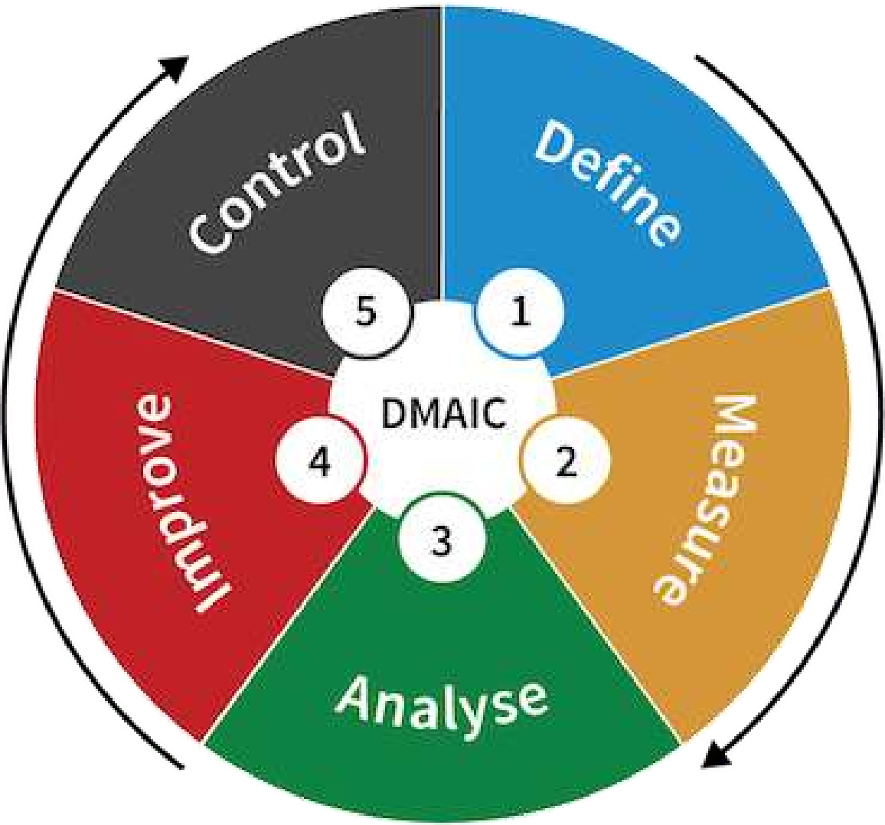
Six Sigma (2 of 2)
n DMAIC
i. Define: Define the problem/opportunity, process, and customer requirements.
ii. Measure: Define measures, then collect,
compile, and display data. Measures are
defined in terms of defects per opportunity.
iii. Analyze: Scrutinize process details to find improvement opportunities.
iv. Improve: Generate solutions and ideas for improving the problem.
v. Control: Track and verify the stability of the improvements and the predictability of the solution.
n DMAIC is a systematic, closed-loop process for continued improvement that is scientific, and fact based
5

Slide 5
How is Six Sigma Quality Control Unique?
n Several new ideas in Six Sigma principles
Six Sigma principles require an organization-wide commitment
Six Sigma training normally follows the “belt” system: Yellow Belt, Green Belt, Black Belt, Master Black Belt.
Organizations have the ability and willingness to adopt seemingly contrary objectives at the same time, such as being creative and rational, reducing errors and getting things done faster.
Six Sigma is an operating philosophy that is customer focused and strives to drive out waste, raise levels of quality, and improve financial performance at breakthrough levels. A Six Sigma organization sets high goals and uses
DMAIC to achieve extraordinary quality improvements.
n Six Sigma brings together many different themes, concepts and tools into a coherent management process used organizational-wide.
6

Slide 6

Six Sigma and Project Selection and Management
n Organizations implement Six Sigma by selecting and managing projects “All improvement takes project by project, and in no other way” – J. M. Juran
n What makes a project a potential Six Sigma project?
i. There must be a quality problem or gap between the current and desired performance.
ii. The project should not have a clearly understood problem.
iii. The solution should not be predetermined, and an optimal solution should not be apparent.
n Once a project is selected as a good candidate for Six Sigma, many PM concepts, tools and techniques come into play.
Six Sigma projects are simply types of projects that focus on supporting Six Sigma philosophy.
7

Slide 7



Six Sigma and Statistics (1 of 5)
n An important concept in Six Sigma is improving quality by reducing variation
n Sigma means standard deviation
Standard deviation measures how much variation exists in a distribution of data, a key factor in determining the acceptable number of defective units found in a population
Statisticians use the Greek symbol σ (sigma) to represent standard deviation
A small σ means that data clusters closely around the mean ofa distribution and there is little variability among the data.
n Six sigma projects strive for no more than 3.4 defects per million opportunities.
8

Slide 8
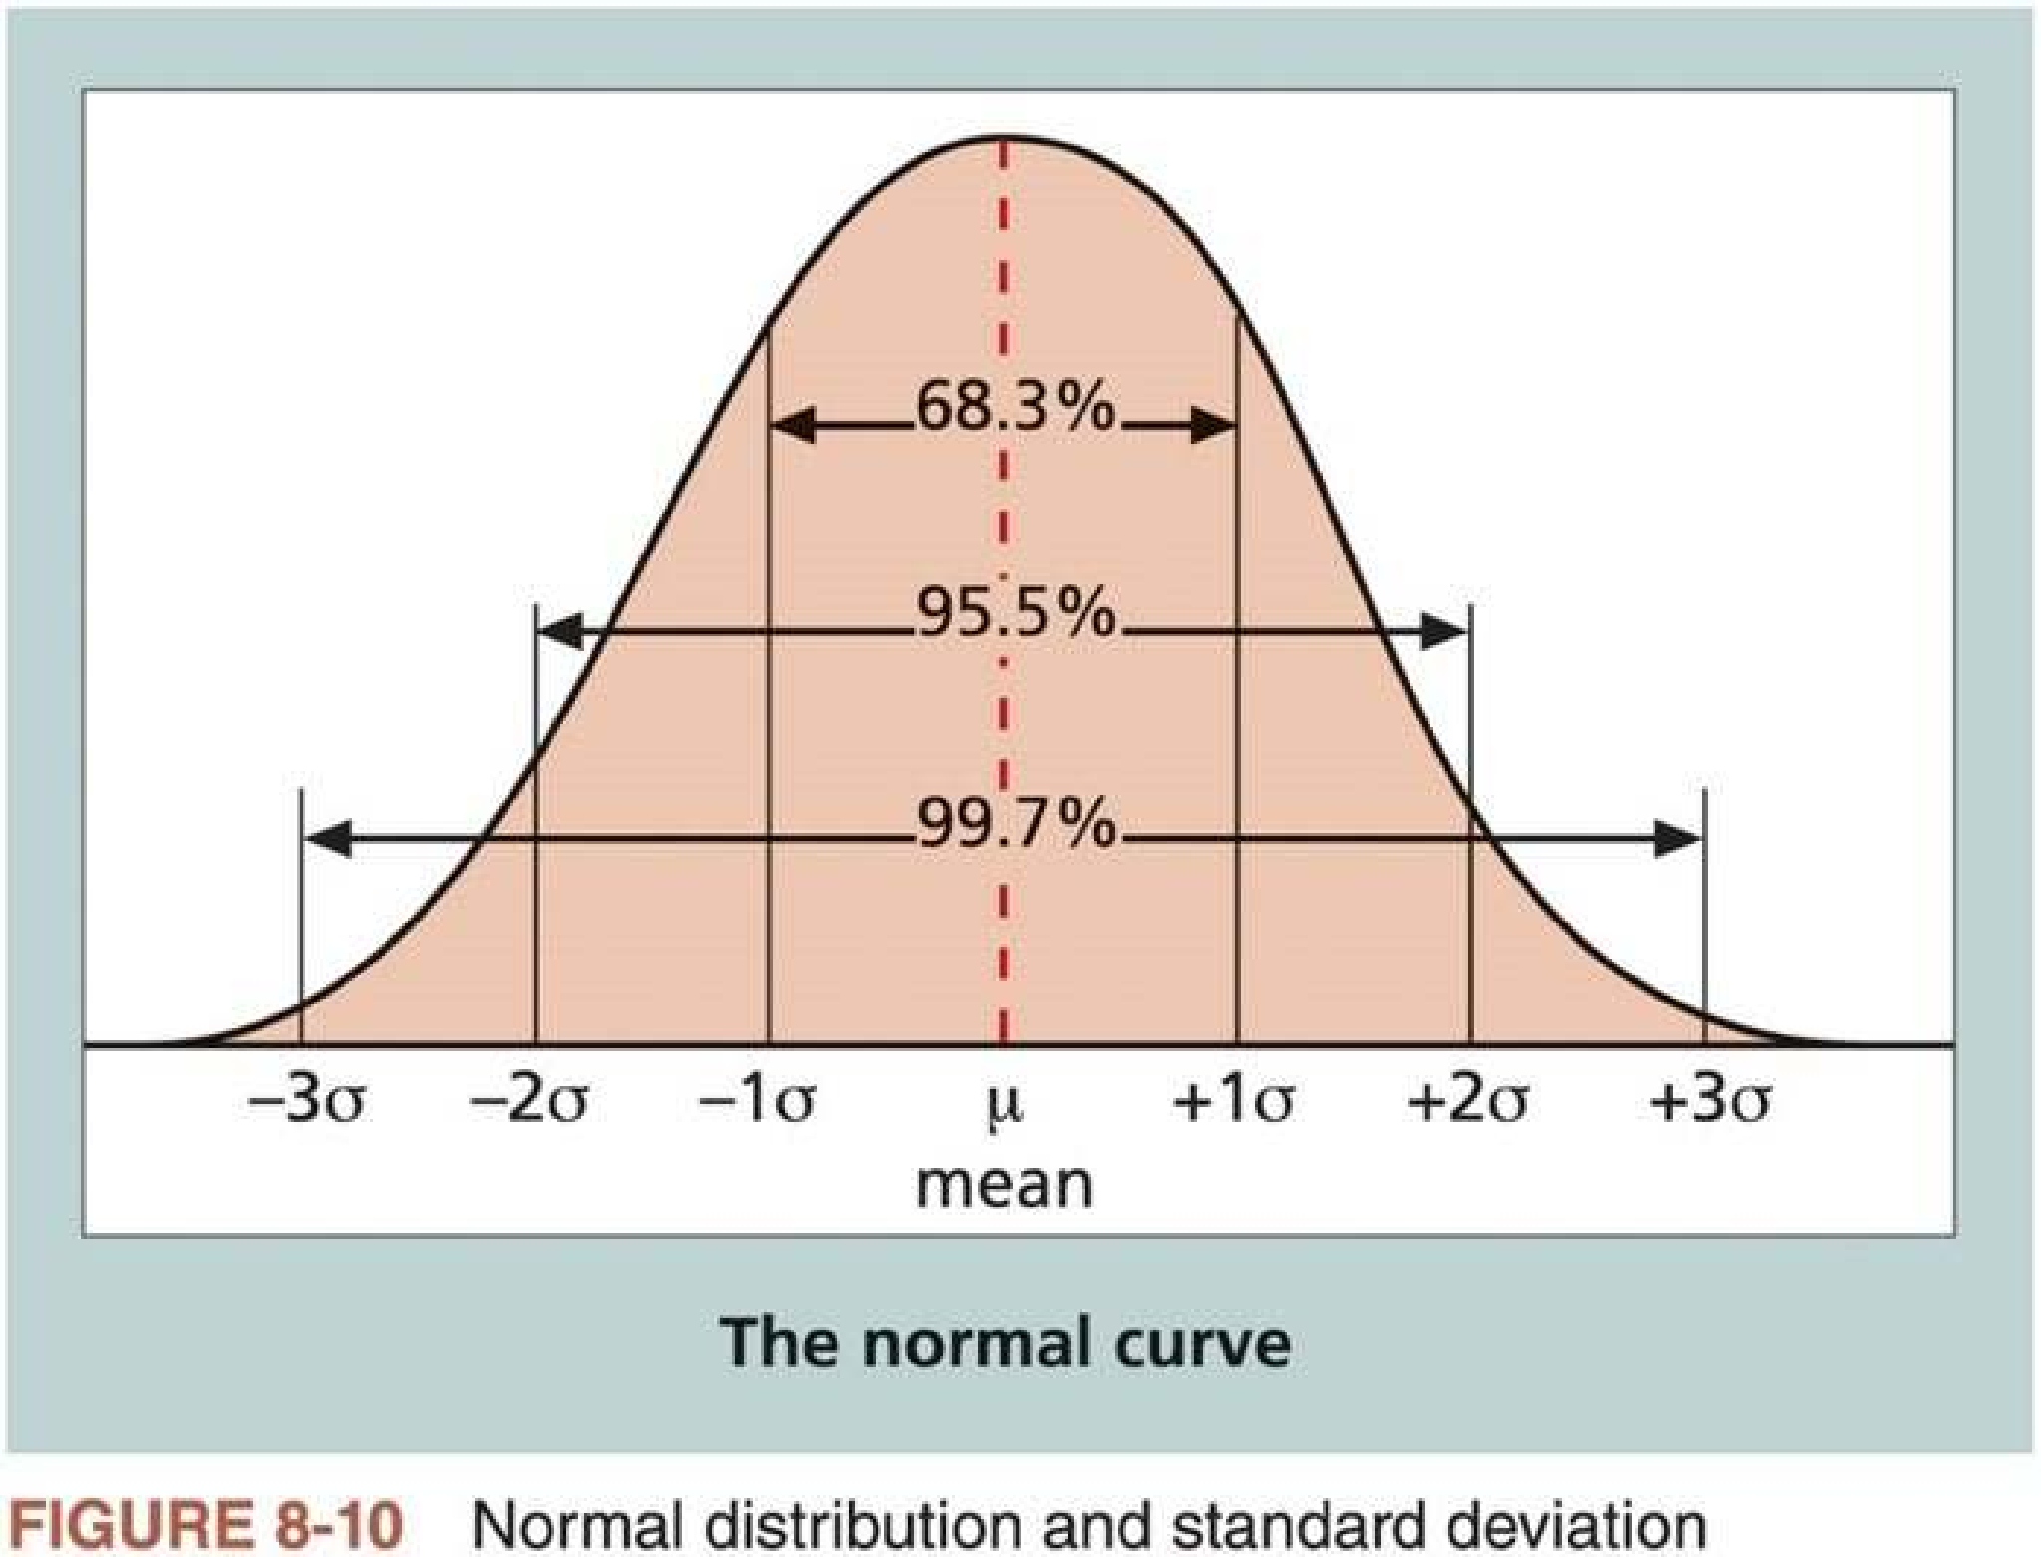
Six Sigma and Statistics (2 of 5)
n Figure 8-10 shows a normal distribution – a bell-shaped curve that is symmetrical around the mean of the population
9

Slide 9
Six Sigma and Statistics (3 of 5)
n Table 8-2 illustrates the relationship between sigma, the percentage of
the population within that sigma range, and the number of defective units per billion
Specification Range (in ± Sigmas) | Percent of Population within Range | Defective Units per Billion
1 | 68.27 | 317,300,000
2 | 95.45 | 45,400,000
3 | 99.73 | 2,700,000
4 | 99.9937 | 63,000
5 | 99.999943 | 57
6
99.9999998
2
Table 8-2 Sigma and defective units
Why is the target for Six Sigma Programs 3.4 defects per million opportunities?
10

Slide 10


Six Sigma and Statistics (4 of 5)
n The convention used for Six Sigma by Motorola in the1980s is a scoring system that accounts for more variation in a process than normal distribution.
n Table 8-3 shows a Six Sigma conversion table applied to Six Sigma projects.
The yield represents the percentage of units handled correctly through the
process steps. A defect is any instance in which the product or service fails to meet customer requirements.
Six Sigma measures the number of defects based on the number of opportunities
Sigma | Yield | Defects per Million Opportunities (DPMO)
1 | 31.0% | 690,000
2 | 69.2% | 308,000
3 | 93.3% | 66,800
4 | 99.4% | 6,210
5 | 99.97% | 230
6
99.99966%
3.4
Table 8-3 Six Sigma conversion table
11

Slide 11
Six Sigma and Statistics (5 of 5)
n Most organizations today use the term “six sigma project” broadly to describe projects that will help them in achieving, sustaining, and
maximizing business success through better business processes.
n Six 9s of quality is a term in the telecommunications industry
A measure of quality control equal to one fault in one million opportunities. In the telecommunications industry, it means 99.9999% service availability or 30 seconds of down time a year.
This level of quality has also been stated as the target goal for the number of errors in a communications circuit, system failures, or errors in lines of code.
Achieving six 9s of quality requires continual testing to find and eliminate
errors or enough redundancy and backup equipment in systems to reduce the overall system failure rate to the required level.
12

Slide 12


Testing (1 of 3)
n Many IT professionals think of testing as a stage that comes near the end of IT product development
Some organizations rely on testing just before a product ships to ensure
some degree of quality, instead of putting serious effort into proper planning, analysis, and design of IT projects.
n Testing needs to be done during almost every phase of the systems
development life cycle (SDLC), not just before the organization ships or hands over a product to the customer
n Figure 8-11 shows one way of portraying SDLC, including 17 main tasks involved in a software development project and showing their
relationships
Tasks 12 to 15 are related to testing
13

Slide 13
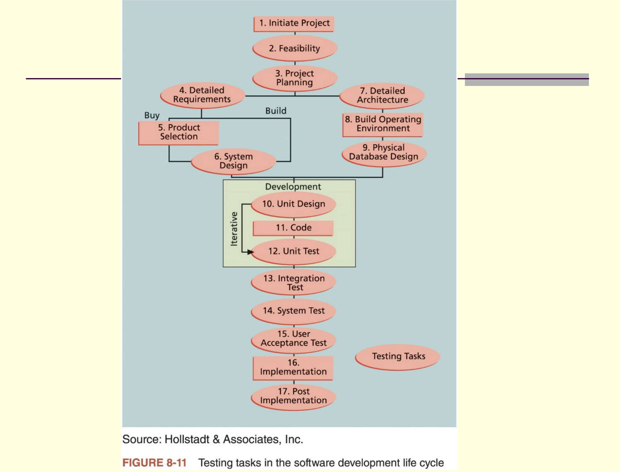
14

Slide 14

Testing (2 of 3)
n Types of testing
1. Unit testing tests each individual component (often a program) to ensure it is as defect-free as possible.
2. Integration testing tests functionally grouped components. It ensures that a subset or subsets ofthe entire system work together.
3. System testing tests the entire system as one entity. It focuses on the big picture to ensure that the entire system is working properly.
4. User acceptance testing is an independent test performed by end users prior to accepting the delivered system.
5. Alpha beta testing, performance testing, and scalability testing
n Important for organizations to follow a thorough and disciplined testing methodology
System developers and testers must make sure that 1) the system meets all project stakeholders’ needs and expectations, and 2) the tests are done
properly.
15

Slide 15
Testing (3 of 3)
n Testing alone cannot always solve software defect problems
W. S. Humphrey, a renowned expert on software quality, defines a software defect as anything that must be changed before delivery of the program
Testing does not sufficiently prevent software defects, because the number of ways to test a complex system is huge
Users will continue to invent new ways to use a system that its developers never considered
n Humphrey suggests that developers be responsible for providing error- free code at each stage of testing
Programmers need to be motivated and excited to do high-quality work and have some control (or freedom) over how they do it
n See more information on software testing at the website for International Software Testing Qualification Board (ISTQB®)
16

Slide 16
Modern Quality Management
n Modern quality management 1) requires customer satisfaction, 2) prefers prevention to inspection, and 2) recognizes management responsibility
for quality
n Six noteworthy quality experts developed theories, tools, and techniques that define modern quality management and provided the foundation for Six Sigma projects
i. W. Edwards Deming: 14 Points for Management
ii. Joseph M. Juran: Stressing the importance of top management to quality
iii. Philip B. Crosby: Striving for zero defects
iv. Kaoru Ishikawa: Quality circles and cause-and-effect diagrams
v. Genichi Taguchi: Robust design methods
vi. Armand V. Feigenbaum: Total quality control (TQC) and workers’ responsibility for quality
17

Slide 17
Malcolm Baldrige National Quality Award
n Originated in 1987 in the U.S. to recognize U.S. organizations in the
business, health care, education, and nonprofit sectors for performance excellence
In honor of Malcolm Baldrige, a former U.S. Secretary of Commerce and a proponent of quality management as a key element in improving the
prosperity and long-term strength of U.S. organizations
The only formal recognition of the performance excellence of both public and private U.S. organizations given by the U.S. President
n The award recognizes achievements in quality & performance and raises awareness about the importance of quality as a competitive edge
n See its Wikipedia entry and official website for more details
n In China, we have 全国质量奖 and 中国质量奖
18

Slide 18

ISO Standards
International Organization for Standardizationn (ISO) is an international standard-setting body composed of representatives from various national standards organizations
Founded in 1947, it develops and publishes worldwide technical, industrial and commercial standards, and works in 165 countries
n ISO offers standards to provide a framework for the assessment of software processes
Overall goals: encourage organizations to employ proven, consistent, and reliable methods for assessing the state of their software development
processes. They can also use their assessment results as part of coherent improvement programs.
One outcome of assessment and improvement programs is reliable, predictable and continuously improving software processes.
19

Slide 19
Improving IT Project Quality
n More suggestions for improving the quality for IT projects
i. Establish strong leadership that promotes quality
ii. Understand the cost of quality
iii. Provide a good workplace to enhance quality
iv. Improve the organization’s overall maturity level in software development and project management
20

Slide 20
Leadership
n A large percentage of quality problems are associated with management,
not technical issues
n Top management must take responsibility for creating, supporting, and promoting quality programs
“It is most important that top management be quality-minded. In the absence of
sincere manifestation of interest at the top, little will happen below.” -- J. M. Juran
n Leadership provides an environment conducive to producing quality
Management must publicly 1) declare the company’s philosophy and
commitment to quality, 2) implement company-wide training programs in quality concepts and principles, 3) implement measurement programs to establish and track quality levels, and 4) actively demonstrate the
importance of quality.
When every employee insists on producing high-quality products, then top management has done a good job of promoting the importance of quality
21

Slide 21

The Cost of Quality (1 of 2)
Cost of quality = cost of conformance + cost of nonconformance
n Conformance means delivering products that meet requirements and fitness for use
Examples include the costs associated with developing a quality plan, costs for analyzing and managing product requirements, and costs for testing.
n Cost of nonconformance means taking responsibility for failures or not meeting quality expectations
n Five major cost categories related to quality
1. Prevention cost: cost of planning and executing a project to ensure it is error-free or within an acceptable error range
2. Appraisal cost: cost of evaluatingprocesses and their outputs to ensure quality
22

Slide 22


The Cost of Quality (2 of 2)
3. Internal failure cost: cost incurred to correct an identified defect before the customer receives the product
4. External failure cost: cost that relates to all errors not detected and corrected before delivery to the customer
5. Measurement and test equipment costs: capital cost of equipment used to perform prevention and appraisal activities
n Unlike many industries, the IT industry traditionally has high cost of nonconformance (in testing, debugging, and maintaining software), for which top management is primarily responsible.
Top managers often rush to develop new systems and do not give project teams enough time or resources to do a project right the first time
To correct these quality problems, top management must create a culture that embraces quality.
23

Slide 23

Impact of Organizational Influences and Workplace Factors on Quality
n A study by DeMarco and Lister showed that organizational issues had a much greater influence on programmer productivity than the technical environment or programming languages
Programming productivity varied by a factor of one to ten across organizations, but only by 21% within the same organization
No correlation between productivity and programming language, years of experience, or salary
Providing a dedicated workspace and a quiet work environment were key factors to improving programmer productivity
n In their book Peopleware, DeMarco and Lister suggest
Minimizing office politics and giving people physical space, intellectual responsibility and strategic direction, and then just letting them work
The manager’s function is not to make people work but make it possible for people to work by removing political roadblocks
24

Slide 24





Expectations and Cultural Differences in
Quality
n Managing expectations is crucial for project quality management
Different stakeholders (e.g., sponsors, customers, users) have different expectations about various aspects of projects.
Crucial to understand these expectations and manage conflicts that might occur due to differences in expectations.
Project managers and their teams must consider quality-related expectations as they define the project scope
n Expectations vary based on an organization’s culture or geographic region
Expectations may not be the same in different parts of an organization. For example, different schools in a university may have very different
expectations on professors’ performances.
Important to realize that different countries or cities are at different stages of development in terms of quality. Do Not Take Things for Granted!
25

Slide 25


Advice for Young Professionals
n Managing expectations is a critical skill
Important to understand other people’s expectations as well as your own.
This is especially true when you start a new job.
Ask your immediate supervisor to describe what is expected of you at work (e.g., dress code, work speed and quality, breaks, career path). Also discuss your own expectations.
If there’s a big disconnect or discrepancy, it may be difficult for you to fit in and perform well. Hopefully, you did some of this before accepting the job.
n Too many people, including experienced project managers, make assumptions about expectations and get surprised when they do not match those of their stakeholders.
Never be afraid to ask what is expected of you!
26

Slide 26

Maturity Models (1 of 4)
n Maturity models are frameworks for helping organizations improve their processes and systems
They describe an evolutionary path of increasingly organized and systematically more mature processes
Many maturity models have five levels, with the 1st level describing
characteristics of the least organized or mature organizations, and the 5th level describing characteristics of the most organized or mature
organizations.
n Three popular maturity models
1. Software Quality Function Deployment (SQFD)
2. Capability Maturity Model Integration (CMMI)
3. Project Management Maturity models
27

Slide 27

Maturity Models (2 of 4)
1. Software Quality Function Deployment (SQFD) focuses on defining user requirements and planning software projects
The result of SQFD is a set of measurable technical product specifications and their priorities
Having clearer requirements can lead to fewer design changes, increased
productivity, and, ultimately, software products that are more likely to satisfy stakeholder requirements
2. Capacity Maturity Model Integration (CMMI) is a process improvement approach that provides organizations with the essential elements of
effective processes
Used to guide process improvement across a project, a division or an entire organization
Five capacity levels: 1) Initial; 2) Managed; 3) Defined; 4) Quantitatively managed; and 5) Optimizing.
28

Slide 28
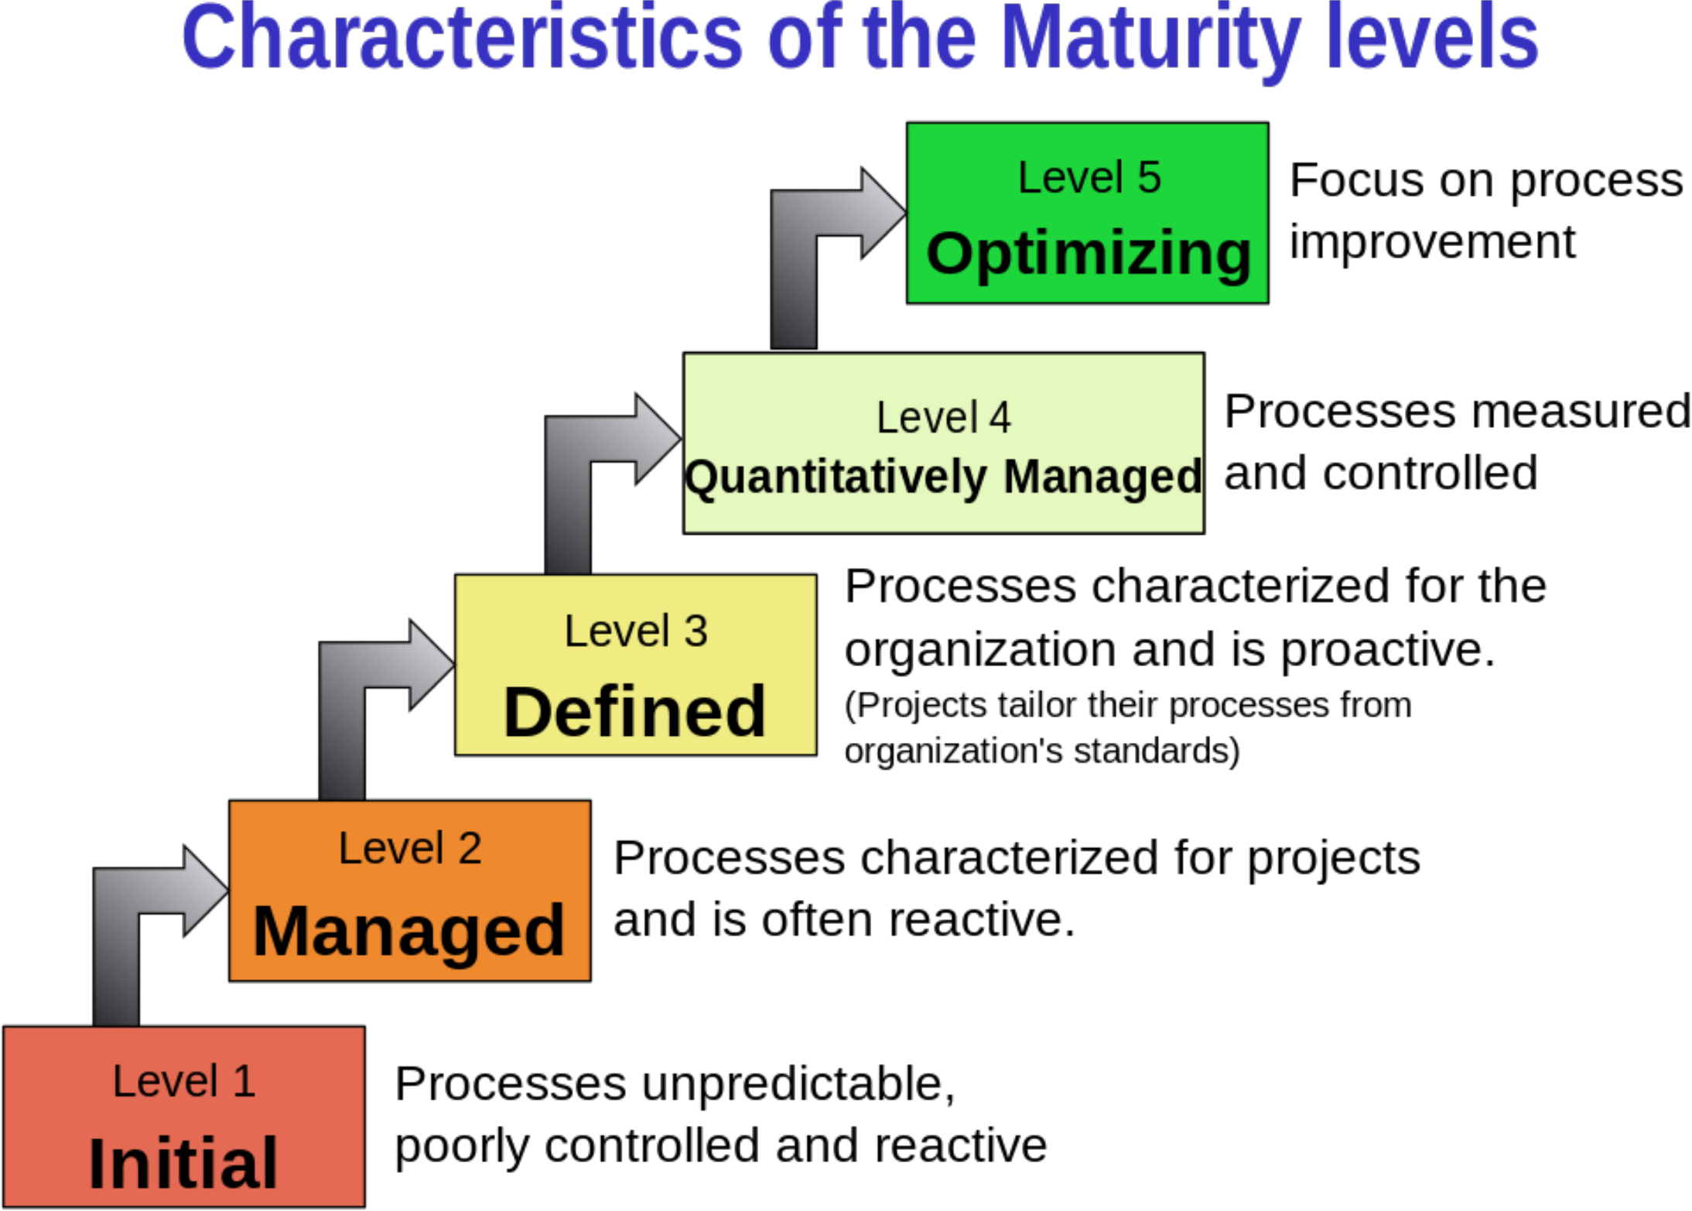
Maturity Models (3 of 4)
Source: https://en.wikipedia.org/wiki/Capability_Maturity_Model_Integration
29

Slide 29
Maturity Models (4 of 4)
3. PMI published the 1st version of the Organizational Project Management Maturity Model (OPM3®) in 2003 and the third version in 2013
Incorporates 180 best practices and more than 2,400 capabilities, outcomes, and key performance indicators.
Sets the standard for excellence in project, program, and portfolio
management best practices, and explains the capabilities necessary to achieve those best practices.
n Many organizations are assessing where they stand in terms of project
management maturity, just as they did for software development maturity with the SQFD and CMMI maturity models
Organizations must make a commitment to the discipline of project management to improve project quality
30

Slide 30
Using Software to Assist in Project Quality Management
n Software can be used to assist with tools and techniques for quality control
i. Spreadsheet and charting software helps create charts and diagrams for many of the Seven Basic Tools of Quality
ii. Statistical software packages help perform statistical analysis
iii. PM software creates Gantt charts, helping plan and track work related to project quality management
iv. Specialized software products help manage Six Sigma projects, create quality control charts, and assess maturity levels
n Project teams need to decide what types of software will help them manage their unique projects
31

Slide 31
Complementary Reading
n Chapter 8 “Project Quality Management” of Schwalbe (2018)
n Chapter 8 “Project Quality Management” in Part 1 of PMBOK® Guide (2017)
32

