Slide 1
Chapter 2 :: Combinational Logic Design
Digital Design and Computer Architecture
David Money Harris and Sarah L. Harris

Slide 2
Chapter 2 :: Topics
Introduction
Boolean Equations
Boolean Algebra
From Logic to Gates
Multilevel Combinational Logic
X’s and Z’s, Oh My
Karnaugh Maps
Combinational Building Blocks
Timing

Slide 3

Introduction
A logic circuit is composed of:
Inputs
Outputs
Functional specification
Timing specification

Slide 4
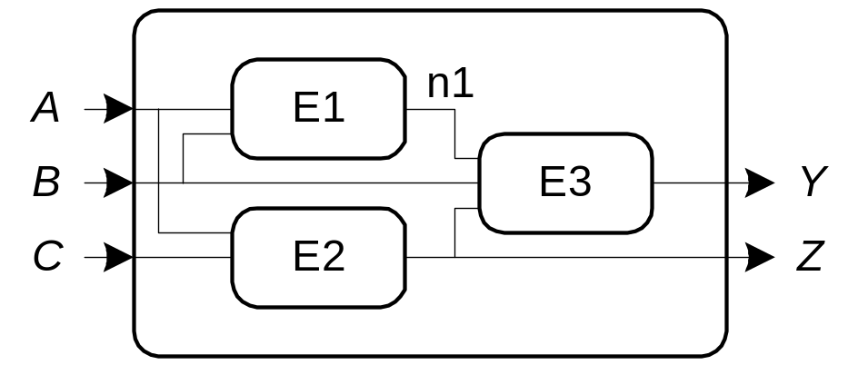
Circuits
Nodes
  Inputs: A, B, C
  Outputs: Y, Z
  Internal: n1
Circuit elements
  E1, E2, E3
  Each a circuit

Slide 5
Types of Logic Circuits
Combinational Logic
  Memoryless
  Outputs determined by current values of inputs
Sequential Logic
  Has memory
  Outputs determined by previous and current values of inputs

Slide 6
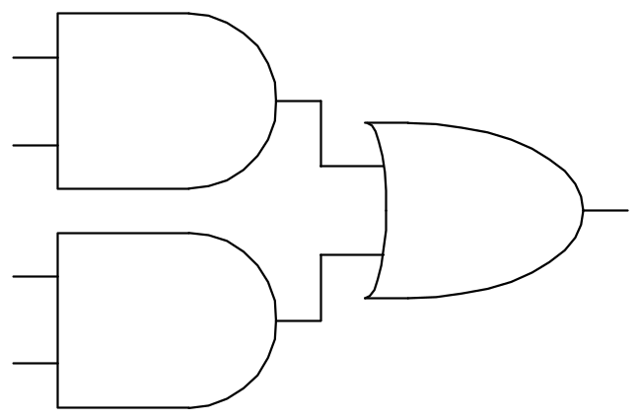
Rules of Combinational Composition
Every circuit element is itself combinational
Every node of the circuit is either designated as an input to the circuit or connects to exactly one output terminal of a circuit element
The circuit contains no cyclic paths: every path through the circuit visits each circuit node at most once
Example:

Slide 7
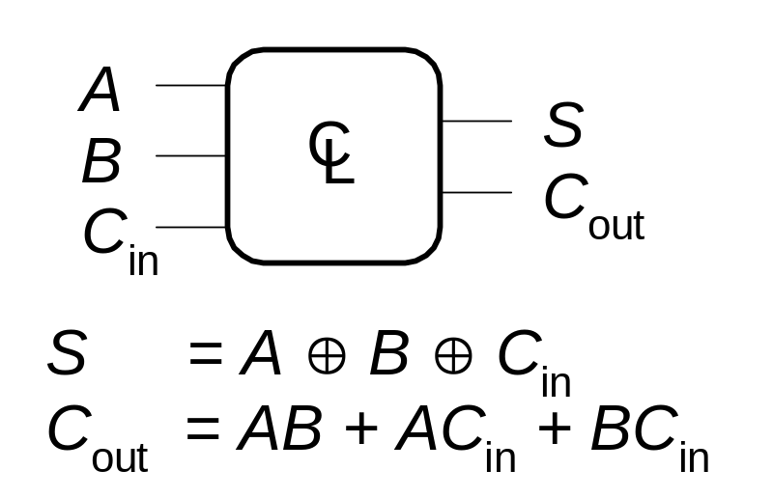
Boolean Equations
Functional specification of outputs in terms of inputs
Example:
S = F(A, B, C_{in})
C_{out} = F(A, B, C_{in})

Slide 8
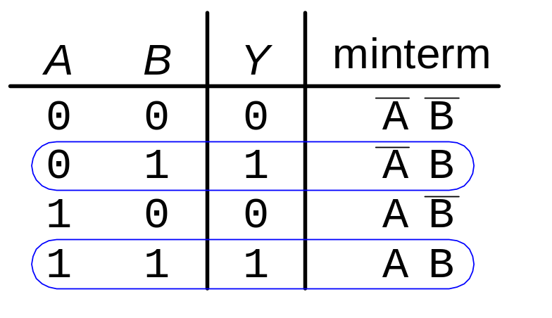
Sum-of-Products Form
Sum-of-Products (SOP) Form
All Boolean equations can be written in SOP form
Each row in a truth table has a minterm
A minterm is a product (AND) of literals
Each minterm is TRUE for that row (and only that row)
The function is formed by ORing the minterms for which the output is TRUE
Thus, a sum (OR) of products (AND terms)
Y = F(A, B, C) = AB + AB

Slide 9
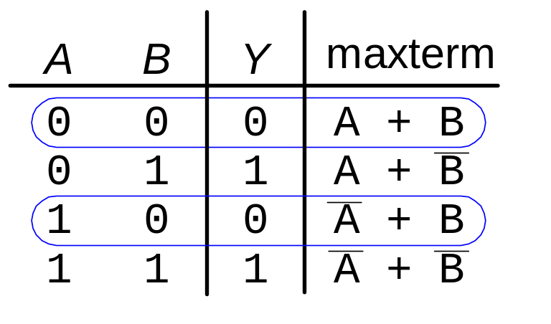
Sum-of-Products Form
Product-of-Sums (POS) Form
All Boolean equations can be written in POS form
Each row in a truth table has a maxterm
A maxterm is a sum (OR) of literals
Each maxterm is FALSE for that row (and only that row)
The function is formed by ANDing the maxterms for which the output is FALSE
Thus, a product (AND) of sums (OR terms)
Y = F(A, B, C) = (A + B)(A + B)

Slide 10
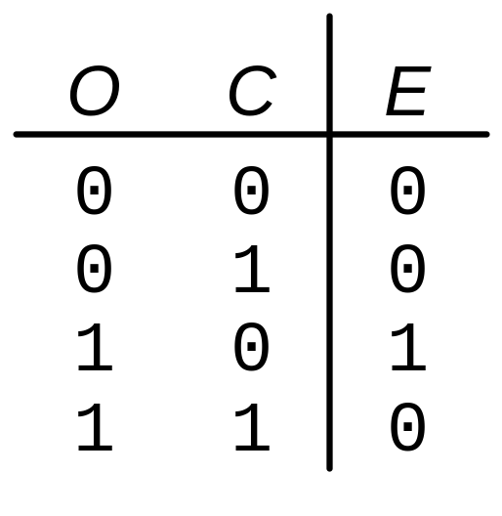
Boolean Equations Example
You are going to the cafeteria for lunch
  You won’t eat lunch (E)
  If it’s not open (O) or
  If they only serve corndogs (C)
Write a truth table for determining if you will eat lunch (E).

Slide 11
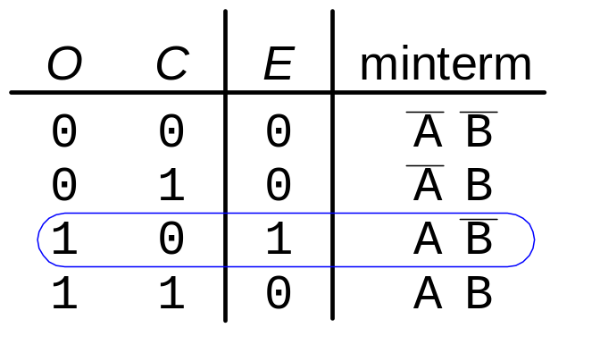
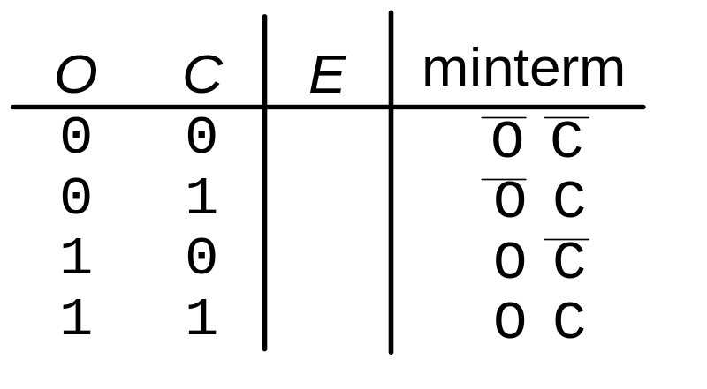
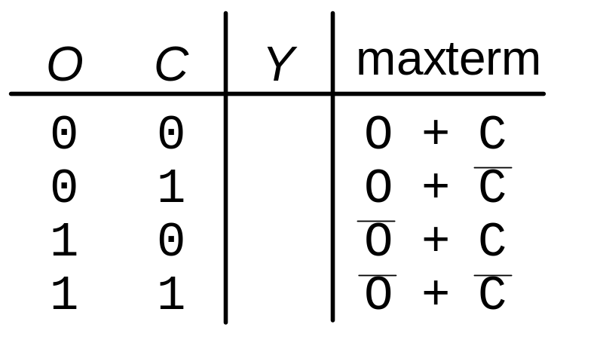
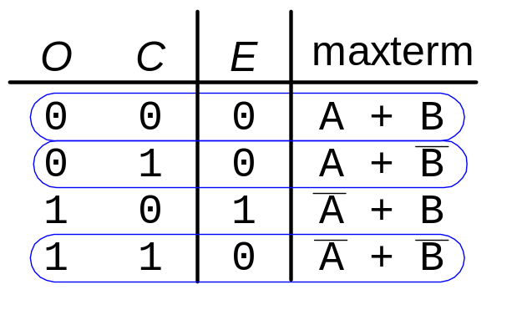
SOP & POS Form
SOP – sum-of-products
POS – product-of-sums
Y = AB
Y = (A + B)(A + B)(A + B)

Slide 12
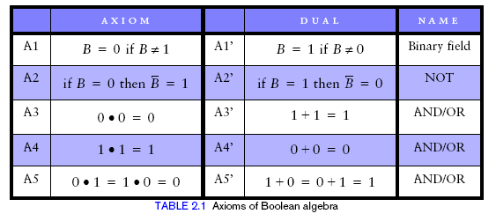
Boolean Algebra
Set of axioms and theorems to simplify Boolean equations
Like regular algebra, but in some cases simpler because variables can have only two values (1 or 0)
Axioms and theorems obey the principles of duality:
  ANDs and ORs interchanged, 0’s and 1’s interchanged

Slide 13
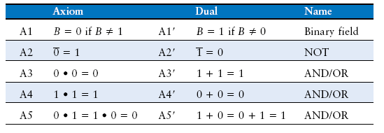
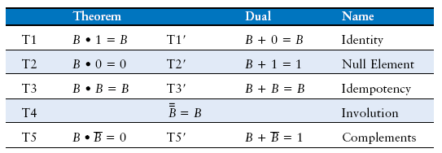
Boolean Axioms and Theorems

Slide 14
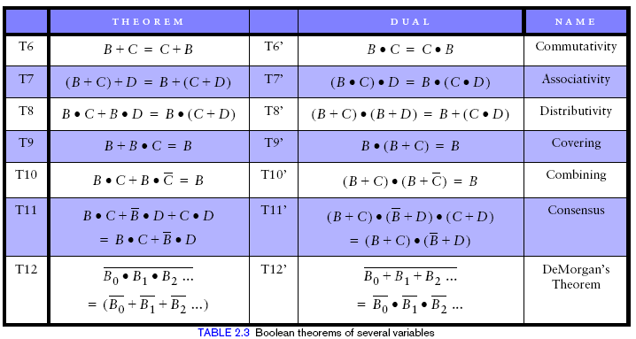
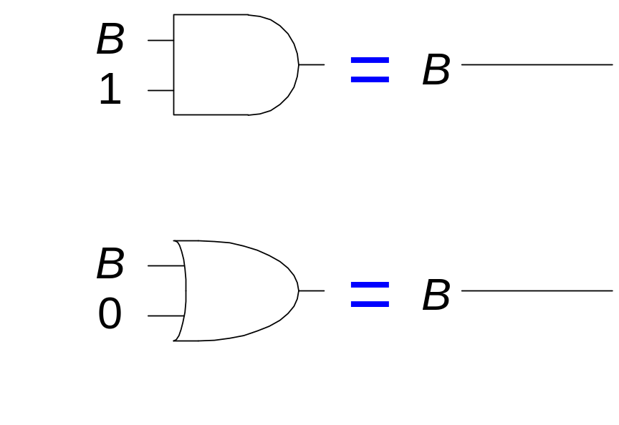
T1: Identity Theorem
B 1 = B
B + 0 = B

Slide 15
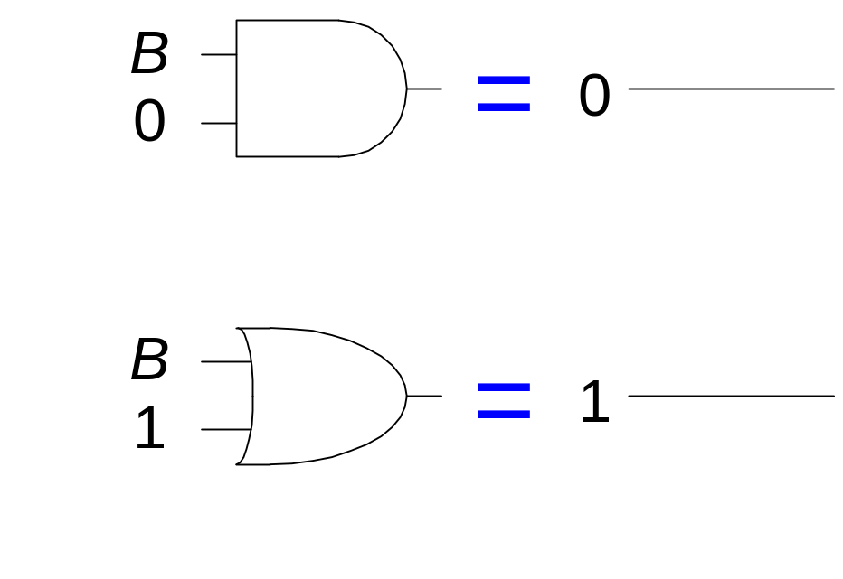
T2: Null Element Theorem
B 0 = 0
B + 1 = 1

Slide 16
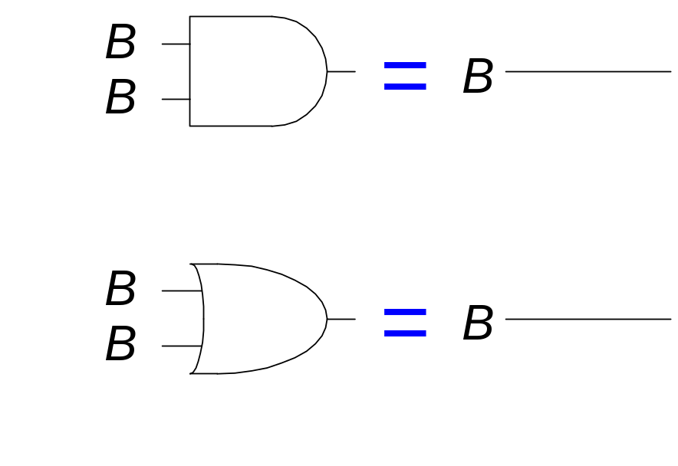
T3: Idempotency Theorem
B B = B
B + B = B

Slide 17
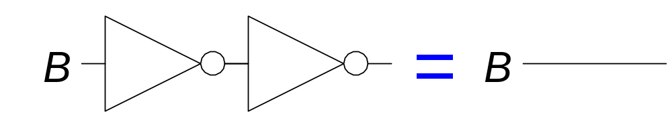
T4: Identity Theorem
B = B

Slide 18
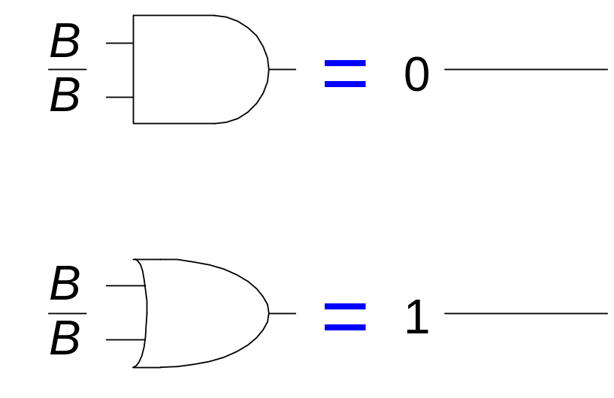
T5: Complement Theorem
B B = 0
B + B = 1

Slide 19
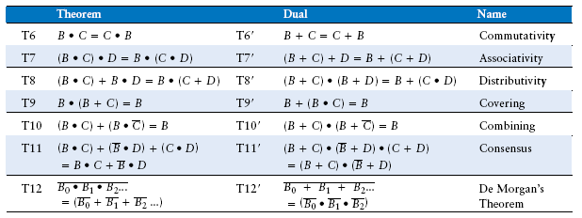
Boolean Theorems of Several Variables

Slide 20
Simplifying Boolean Expressions: Example 1
Y = AB + AB
= B(A + A) T8
= B(1) T5’
= B T1

Slide 21
Simplifying Boolean Expressions: Example 2
Y = B(AB + ABC)
= A(AB(1 + C)) T8
= A(AB(1)) T2’
= A(AB) T1
= (AA)B T7
= AB T3

Slide 22
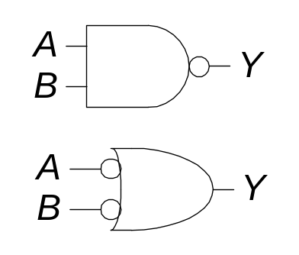
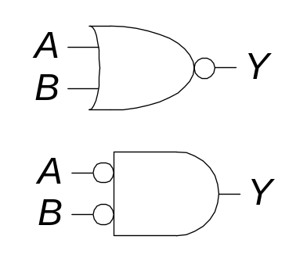
DeMorgan’s Theorem
Y = AB = A + B
Y = A + B = A B

Slide 23
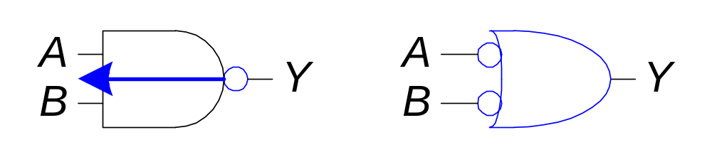
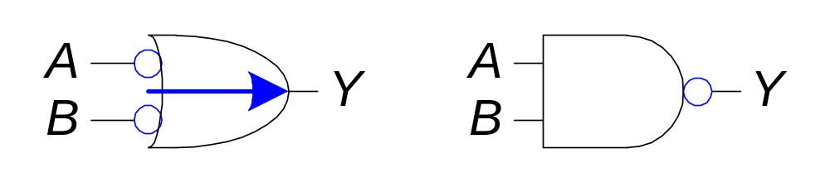
Bubble Pushing
Pushing bubbles backward (from the output) or forward (from the inputs) changes the body of the gate from AND to OR or vice versa.
Pushing a bubble from the output back to the inputs puts bubbles on all gate inputs.
Pushing bubbles on all gate inputs forward toward the output puts a bubble on the output and changes the gate body.

Slide 24
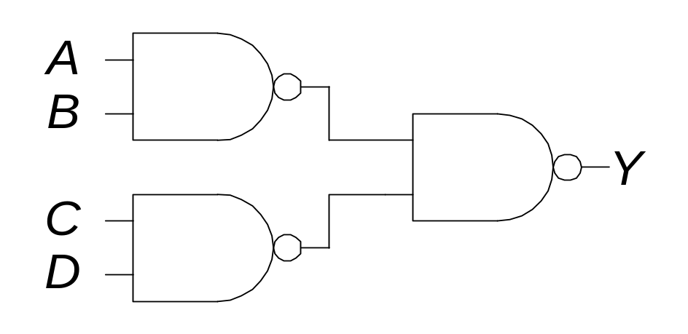
Bubble Pushing
What is the Boolean expression for this circuit?

Slide 25
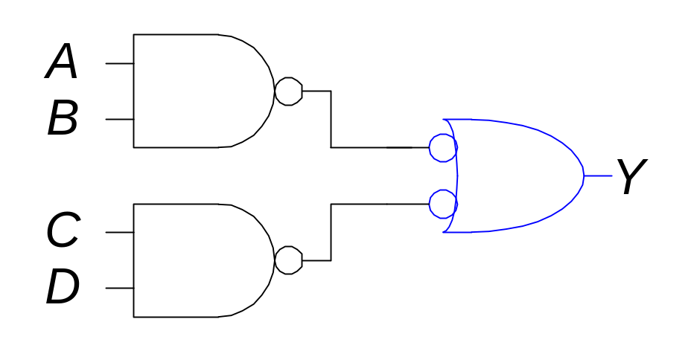
Bubble Pushing
What is the Boolean expression for this circuit?
Y = AB + CD

Slide 26
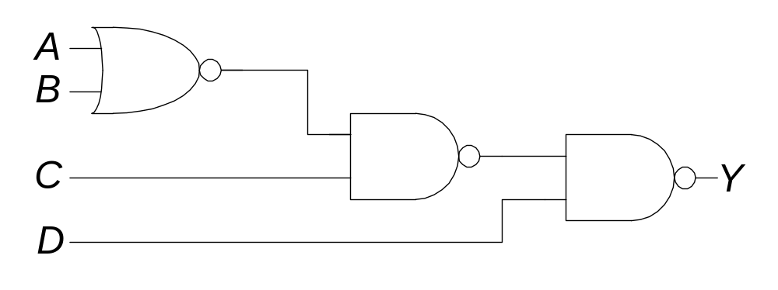
Bubble Pushing Rules
Begin at the output of the circuit and work toward the inputs.
Push any bubbles on the final output back toward the inputs.
Working backward, draw each gate in a form so that bubbles cancel.

Slide 27
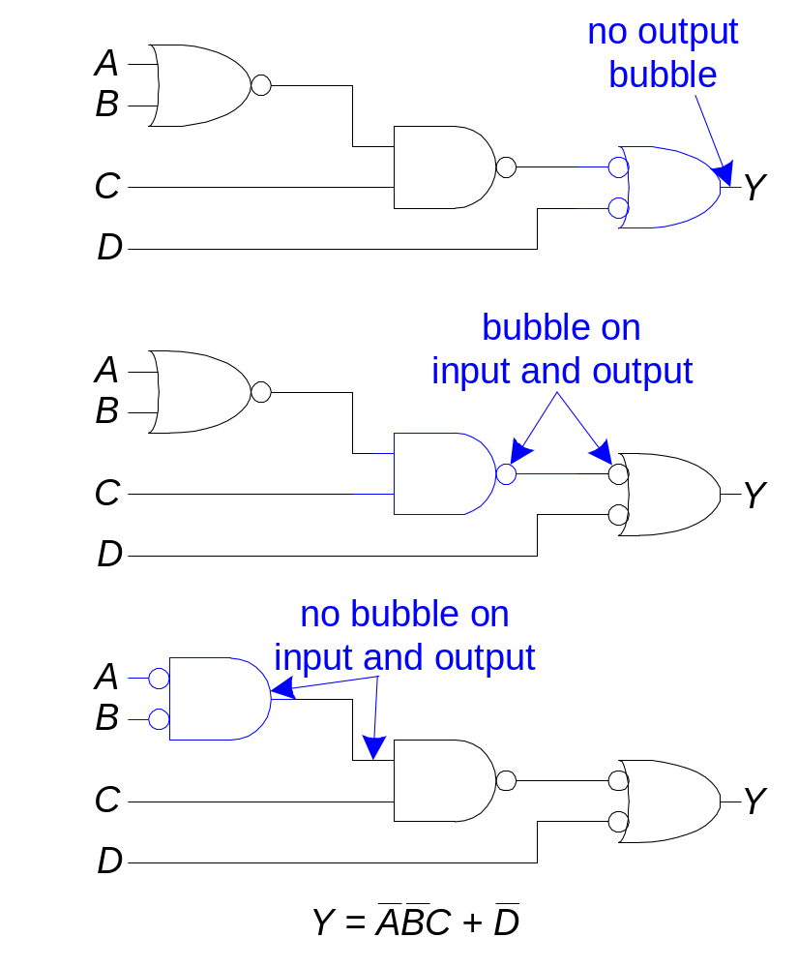
Bubble Pushing Rules

Slide 28
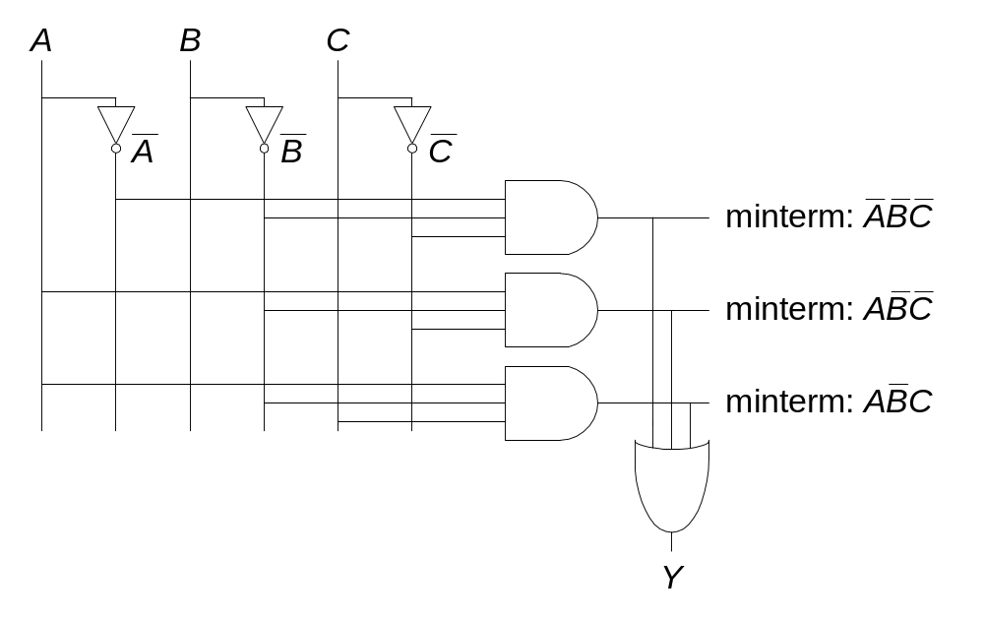
From Logic to Gates
Two-level logic: ANDs followed by Ors
Example: Y = ABC + ABC + ABC

Slide 29
Circuit Schematic Rules
Inputs are on the left (or top) side of a schematic
Outputs are on the right (or bottom) side of a schematic
Whenever possible, gates should flow from left to right
Straight wires are better to use than wires with multiple corners

Slide 30
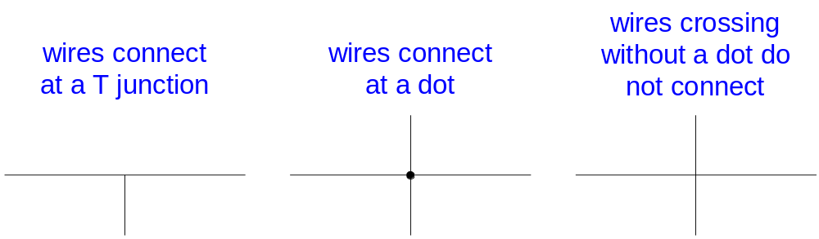
Circuit Schematic Rules (cont.)
Wires always connect at a T junction
A dot where wires cross indicates a connection between the wires
Wires crossing without a dot make no connection

Slide 31
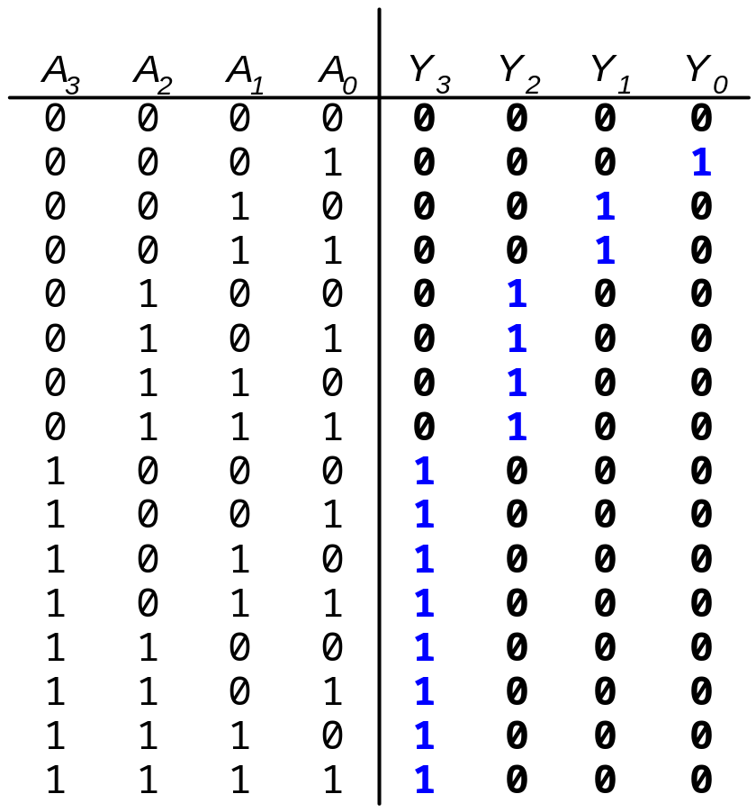
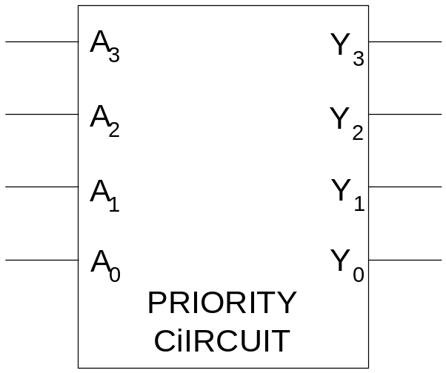
Multiple Output Circuits

Slide 32
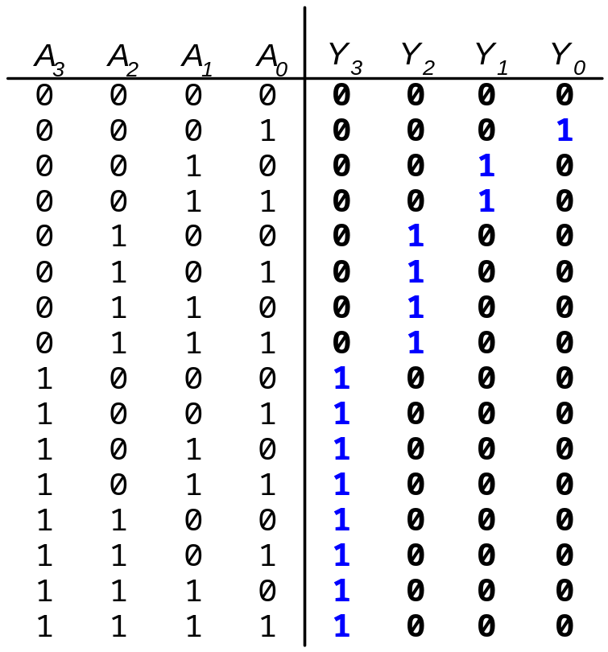
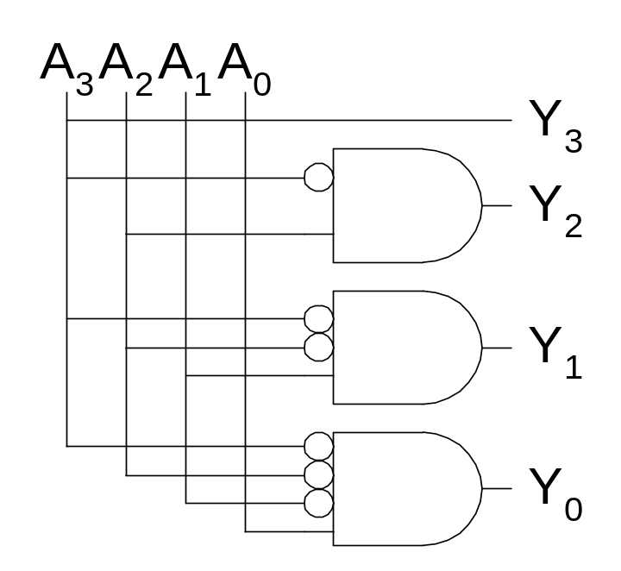
Priority Encoder Hardware

Slide 33
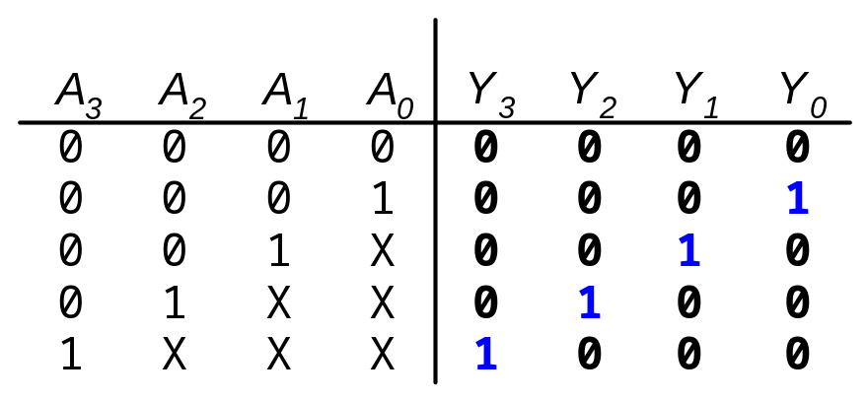
Don’t Cares

Slide 34
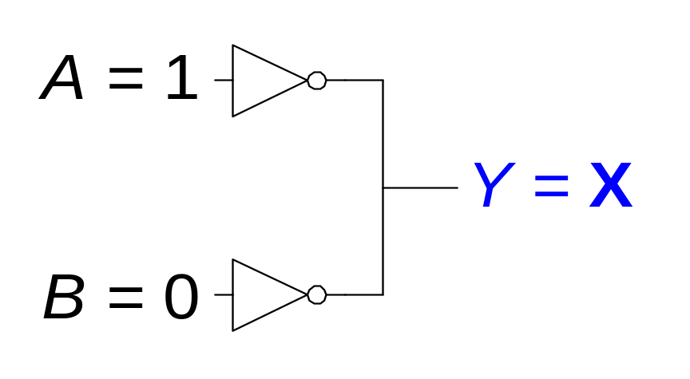

Contention: X
Contention: circuit tries to drive the output to 1 and 0

Slide 35
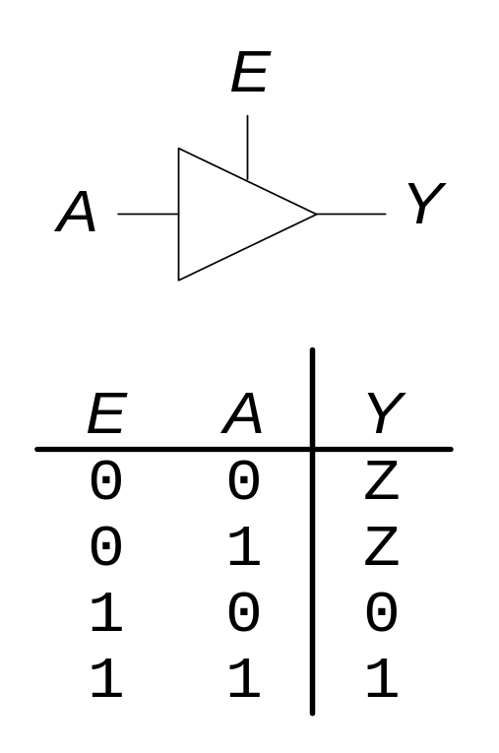
Floating: Z
Floating, high impedance, open, high Z
Output is not connected to the input
Tristate Buffer

Slide 36
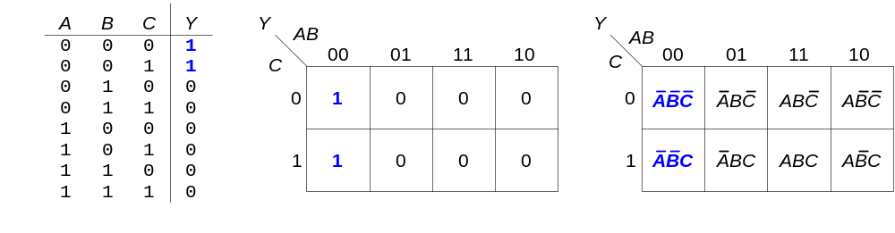
Karnaugh Maps (K-Maps)
Boolean expressions can be minimized by combining terms
K-maps minimize equations graphically
PA + PA = P

Slide 37
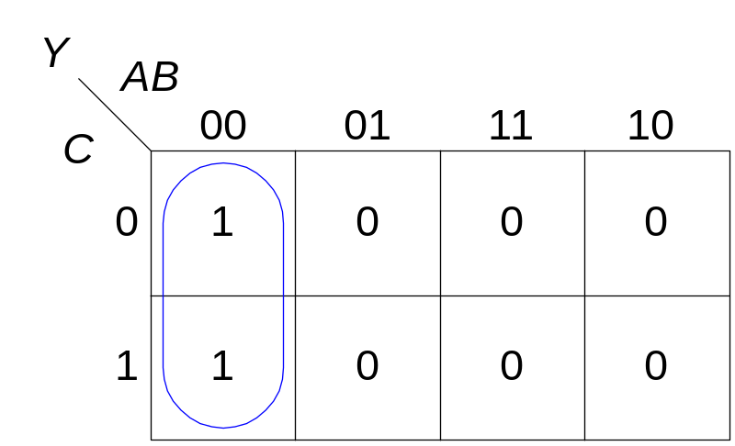
K-map
Circle 1’s in adjacent squares
In the Boolean expression, include only the literals whose true and complement form are not in the circle
Y = AB

Slide 38
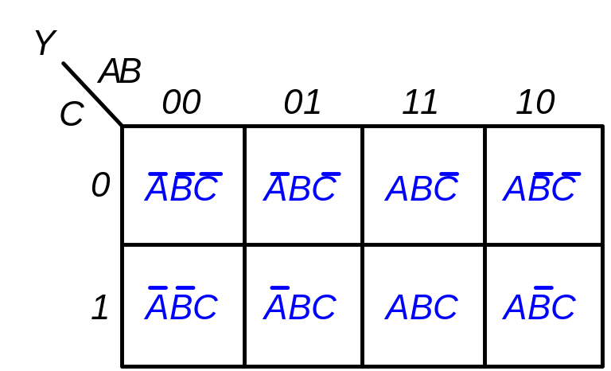
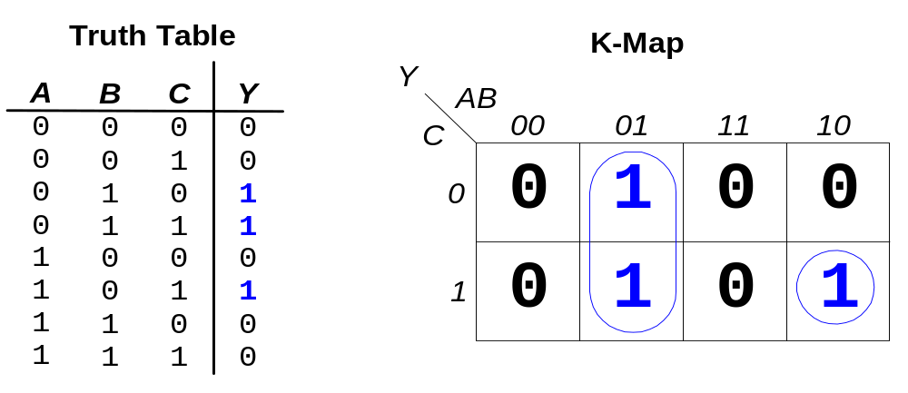
K-map Example
Y = AB + ABC

Slide 39
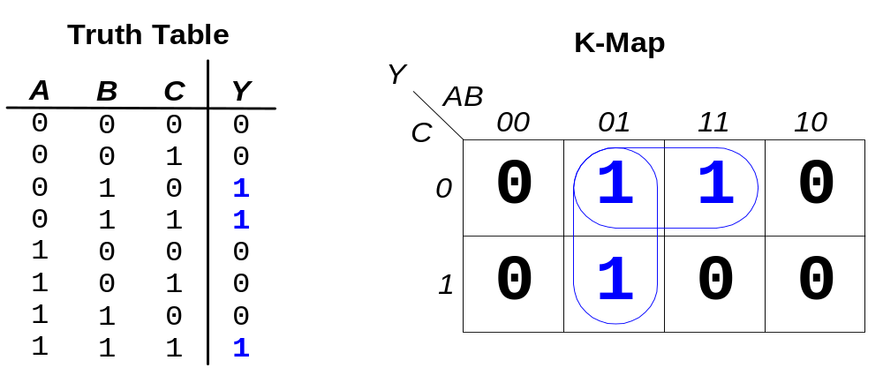
3-input K-map
Y = AB + BC

Slide 40
K-map Definitions
Complement: variable with a bar over it
A, B, C
Literal: variable or its complement
A, A, B, B, C, C
Implicant: product of literals
ABC, AC, BC
Prime implicant: implicant corresponding to the largest circle in a K-map

Slide 41
K-map Rules
Each circle must span a power of 2 (i.e. 1, 2, 4) squares in each direction
Each circle must be as large as possible
A circle may wrap around the edges of the K-map
A one in a K-map may be circled multiple times
A “don't care” (X) is circled only if it helps minimize the equation

Slide 42
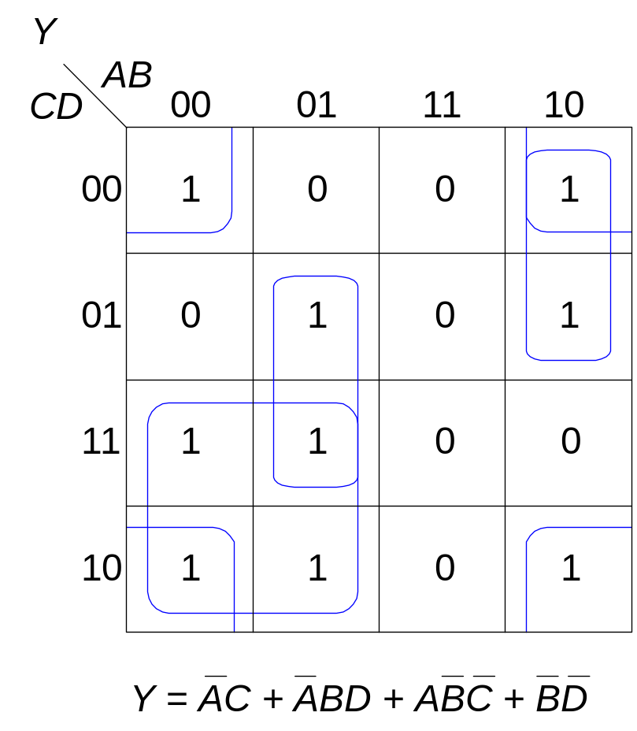
4-input K-map

Slide 43
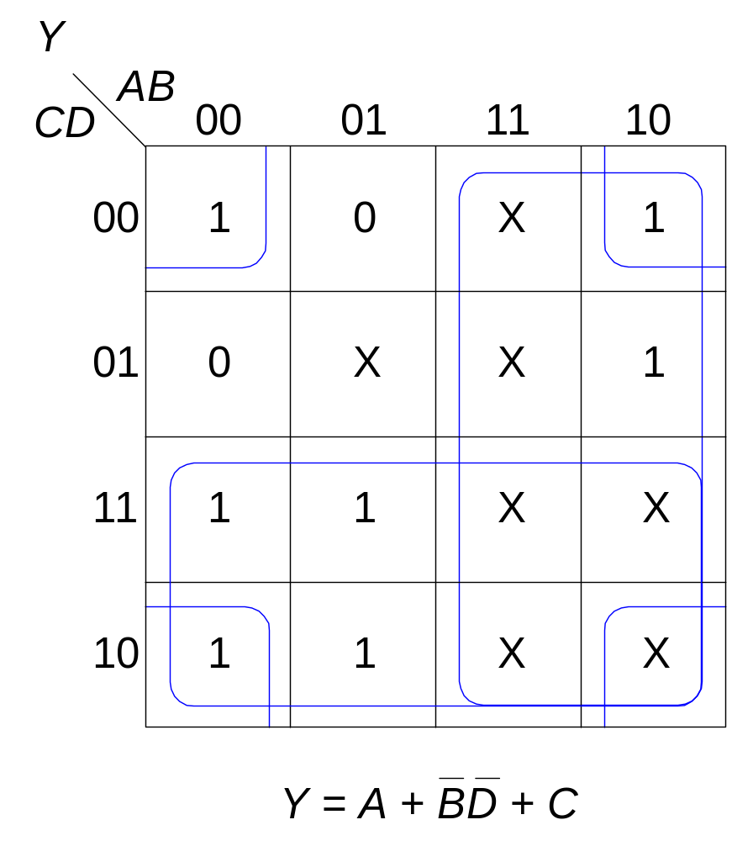
K-Maps with Don’t Cares

Slide 44
Combinational Building Blocks
Multiplexers
Decoders

Slide 45
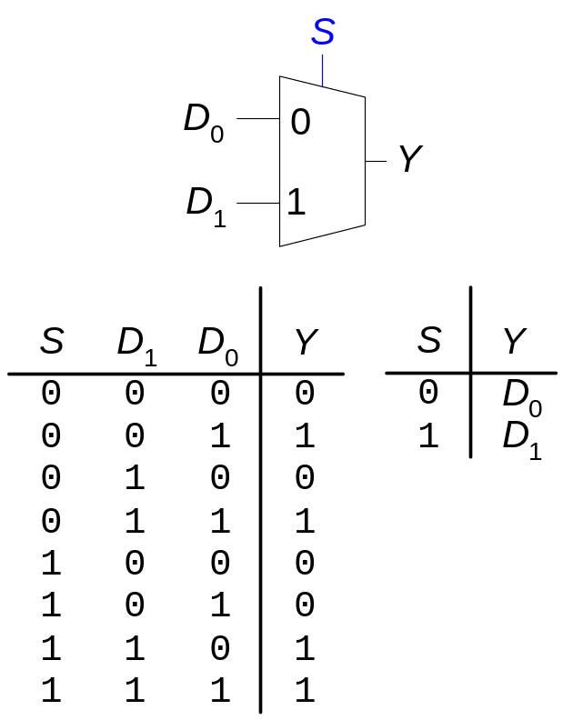
Multiplexer (Mux)
Selects between one of N inputs to connect to the output.
log₂N-bit select input – control input
Example: 2:1 Mux

Slide 46
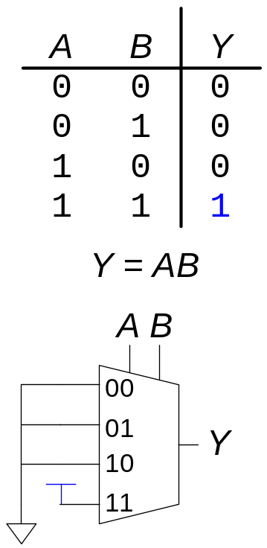
Logic using Multiplexers
Using the mux as a lookup table

Slide 47
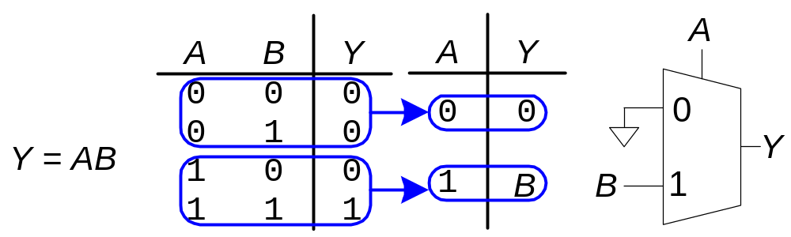
Logic using Multiplexers
Reducing the size of the mux

Slide 48
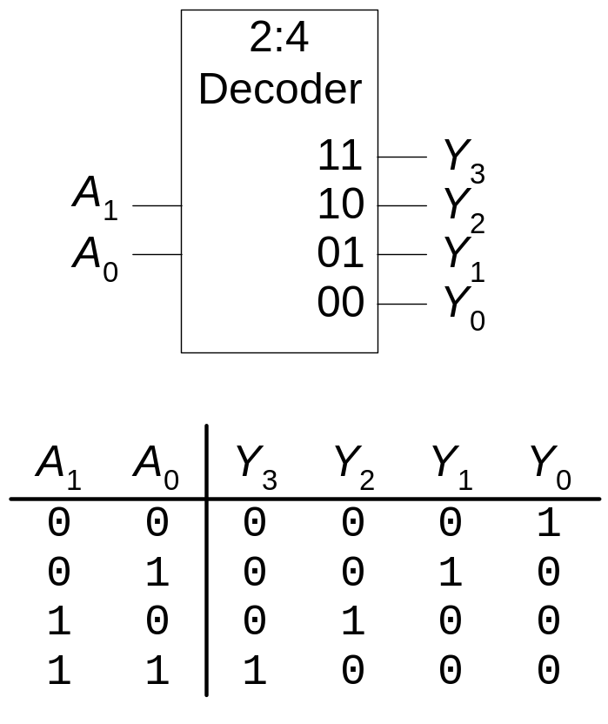
Decoders
N inputs, 2^{N} outputs
One-hot outputs: only one output HIGH at once

Slide 49
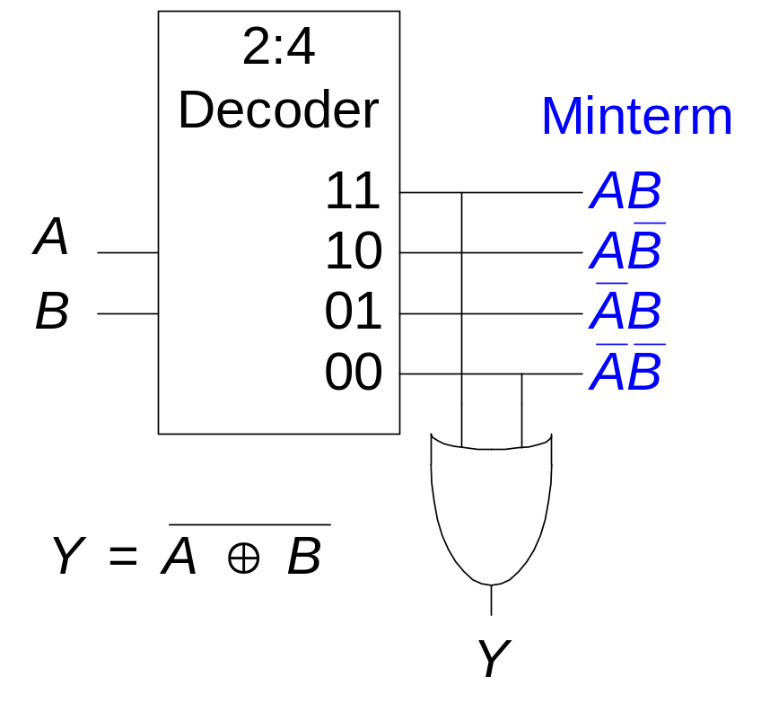
Logic using Decoders
OR minterms

Slide 50
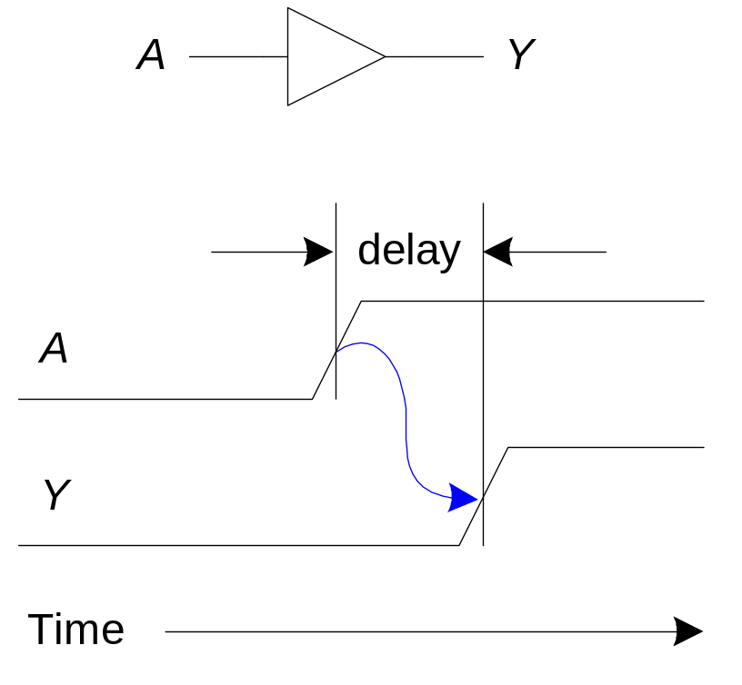
Timing
Delay between input change and output changing
One of the biggest challenges in circuit design: making the circuit fast

Slide 51


Propagation & Contamination Delay
Propagation Delay: t_{pd} = max delay from input to output
Contamination Delay: t_{cd} = min delay from input to output
Propagation delay: t_{pd} = max delay from input to output
Contamination delay: t_{cd} = min delay from input to output

Slide 52
Propagation & Contamination Delay
Delay is caused by
  Capacitance and resistance in a circuit
  Speed of light limitation
Reasons why t_{pd} and t_{cd} may be different:
  Different rising and falling delays
  Multiple inputs and outputs, some of which are faster than others
  Circuits slow down when hot and speed up when cold
Delay is caused by
  Capacitance and resistance in a circuit
  Speed of light limitation
Reasons why tpd and tcd may be different:
  Different rising and falling delays
  Multiple inputs and outputs, some of which are faster than others
  Circuits slow down when hot and speed up when cold

Slide 53


Critical (Long) and Short Path
Critical and Short Paths
Critical (Long) Path: t_{pd} = 2t_{pd_AND} + t_{pd_OR}
Short Path: t_{cd} = t_{cd_AND}

Slide 54
Glitches
Glitches
Glitch: when a single input change causes multiple output changes
Glitches don’t cause problems because of synchronous design conventions (which we’ll talk about in a bit)
But it’s important to recognize a glitch when you see one in timing diagrams
A glitch occurs when a single input change causes multiple output changes
Glitches don’t cause problems because of synchronous design conventions (which we’ll talk about in Chapter 3)
But it’s important to recognize a glitch when you see one in simulations or on an oscilloscope

Slide 55


Glitch Example

Slide 56

Glitch Example (cont.)

Slide 57




Glitches: Example
Glitch Example (cont.)

Slide 58
Glitches: Example
Why Understand Glitches?
Recognize them when look at timing diagrams in (simulations or on an oscilloscope)
Can’t get rid of all glitches – simultaneous transitions on multiple inputs can also cause glitches

