Slide 1
Chapter 3 :: Sequential Logic Design
Digital Design and Computer Architecture
David Money Harris and Sarah L. Harris

Slide 2
Chapter 3 :: Topics
Introduction
Latches and Flip-Flops
Synchronous Logic Design
Finite State Machines
Timing of Sequential Logic
Parallelism

Slide 3
Introduction
Outputs of sequential logic depend on current and prior input values.
Sequential logic thus has memory.
Some definitions:
  State: contains all the information about a circuit necessary to explain its future behavior
  Latches and flip-flops: state elements that store one bit of state
  Synchronous sequential circuits: combinational logic followed by a bank of flip-flops

Slide 4
Sequential Circuits
give sequence to events
have memory (short-term)
use feedback from output to input to store information

Slide 5
State Elements
The state of a circuit determines its future behavior
State elements store state
  Bistable circuit
  SR Latch
  D Latch
  D Flip-flop

Slide 6
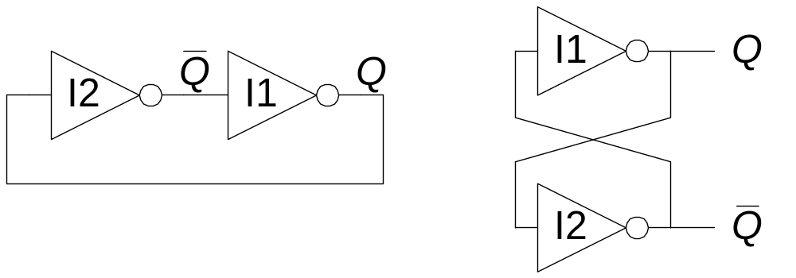
Bistable Circuit
Fundamental building block of other state elements
Two outputs: Q, Q
No inputs

Slide 7
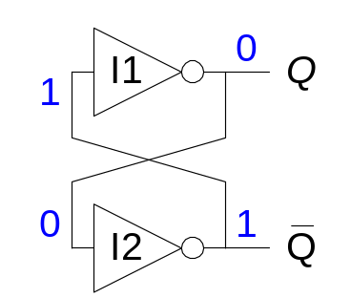
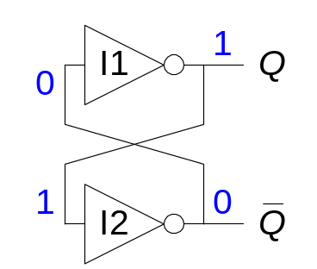
Bistable Circuit Analysis
Consider the two possible cases:
  Q = 0: then Q = 1 and Q = 0 (consistent)
  Q = 1: then Q = 0 and Q = 1 (consistent)
Bistable circuit stores 1 bit of state in the state variable, Q (or Q )
But there are no inputs to control the state

Slide 8
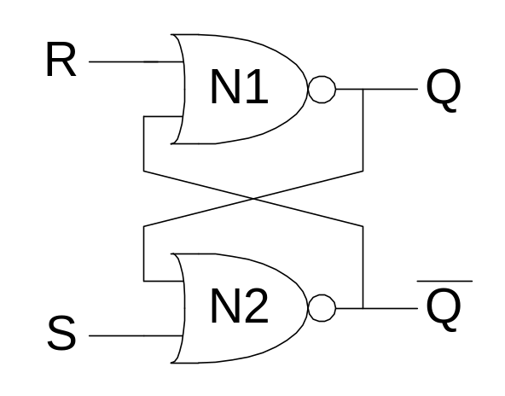
SR Latch
Set/Reset Latch (SR Latch)
Definitions
  Set: Make the output 1
  Reset: Make the output 0
When the set input, S, is 1 (and R = 0), Q is set to 1
When the reset input, R, is 1 (and S = 0), Q is reset to 0

Slide 9
SR Latch Analysis
Consider the four possible cases:
  S = 1, R = 0
  S = 0, R = 1
  S = 0, R = 0
  S = 1, R = 1

Slide 10
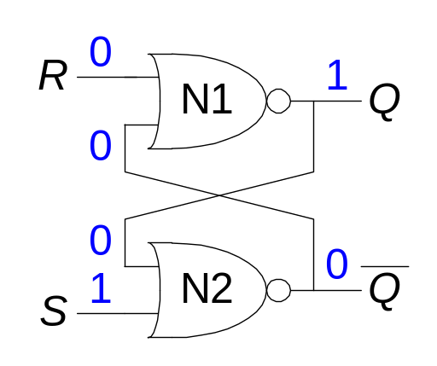
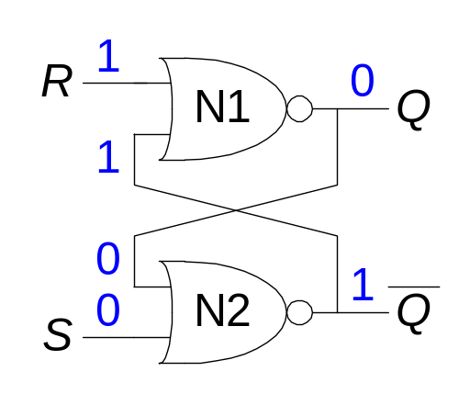
SR Latch Analysis
  S = 1, R = 0: then Q = 1 and Q = 0
  S = 0, R = 1: then Q = 0 and Q = 1

Slide 11
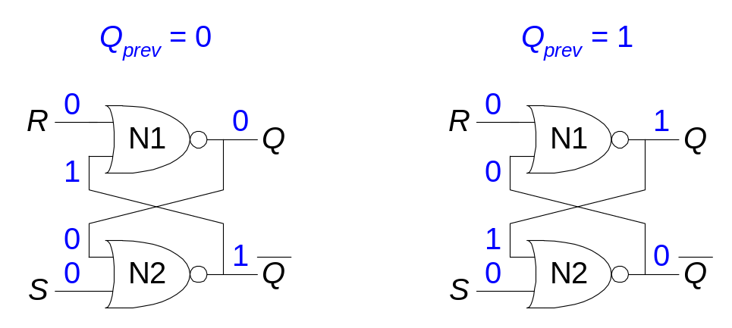
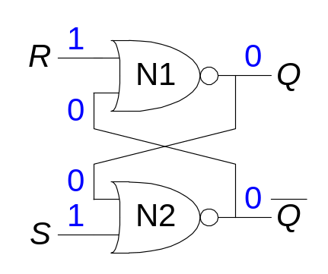
SR Latch Analysis
  S = 0, R = 0: then Q = Q_{prev} and Q = Q_{prev} (memory!)
  S = 1, R = 1: then Q = 0 and Q = 0 (invalid state: Q ≠ NOT Q)

Slide 12
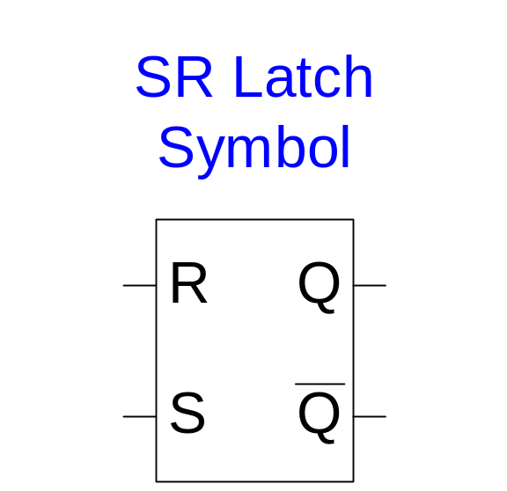
SR Latch Symbol
Stores one bit of state (Q)
Can control what value is being stored with S, R inputs
Invalid state when S = R = 1

Slide 13
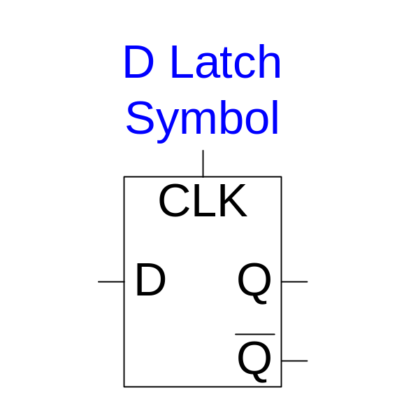
D Latch
Two inputs: CLK, D
CLK: controls when the output changes
D (the data input): controls what the output changes to
Avoids invalid case when Q ≠ NOT Q
When CLK = 1, D passes through to Q (the latch is transparent)
When CLK = 0, Q holds its previous value (the latch is opaque)

Slide 14
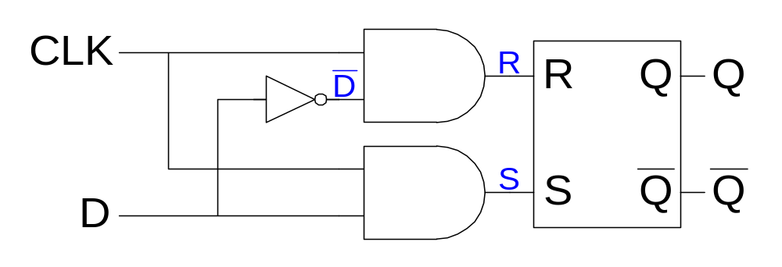
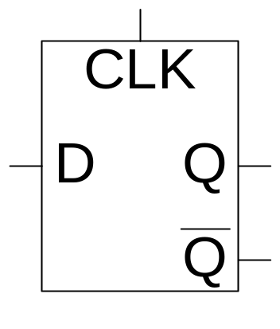
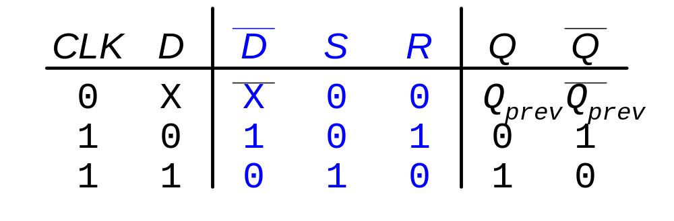
D Latch Internal Circuit

Slide 15
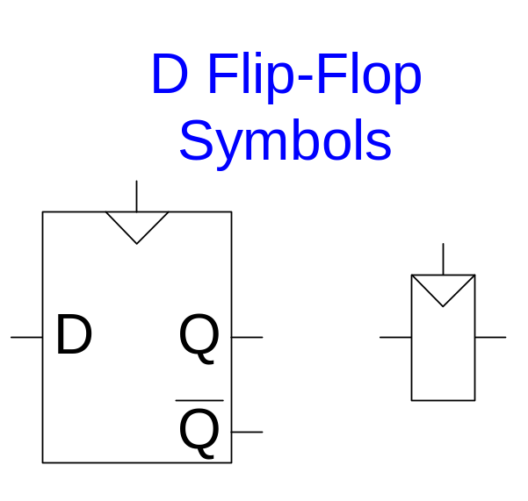
D Flip-Flop
Two inputs: CLK, D
Q changes only on the rising edge of CLK
The flip-flop “samples” D on the rising edge of CLK
  When CLK rises from 0 to 1, D passes through to Q
  Otherwise, Q holds its previous value
Thus, a flip-flop is called an edge-triggered device because it is activated on the clock edge

Slide 16
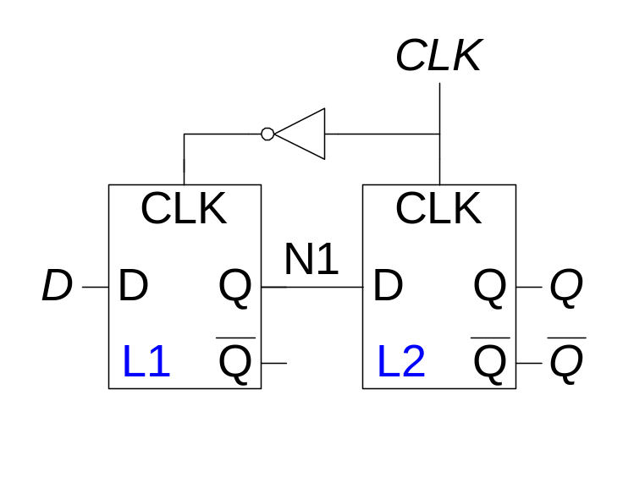
D Flip-Flop Internal Circuit
Two back-to-back latches (L1 and L2) controlled by complementary clocks
When CLK = 0
  L1 is transparent
  L2 is opaque
  D passes through to N1
When CLK = 1
  L2 is transparent
  L1 is opaque
  N1 passes through to Q
Thus, on the edge of the clock (when CLK rises from 0 1)
  D effectively passes through to Q

Slide 17
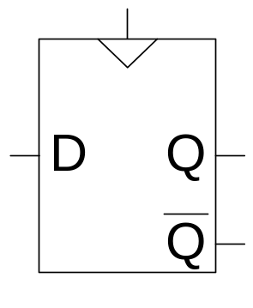
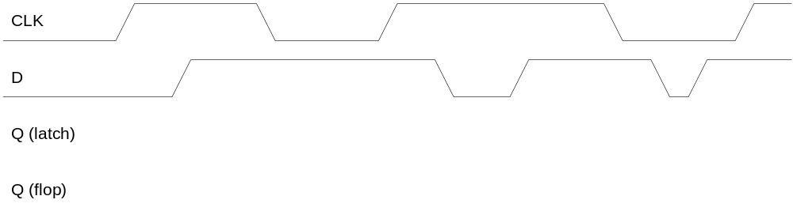
D Flip-Flop vs. D Latch

Slide 18
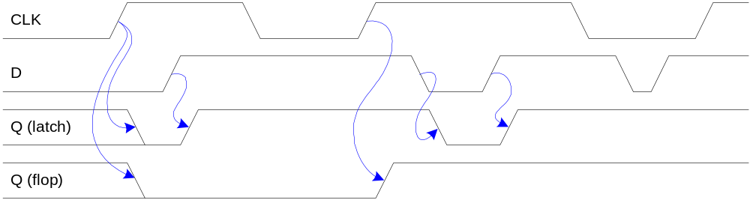
D Flip-Flop vs. D Latch

Slide 19
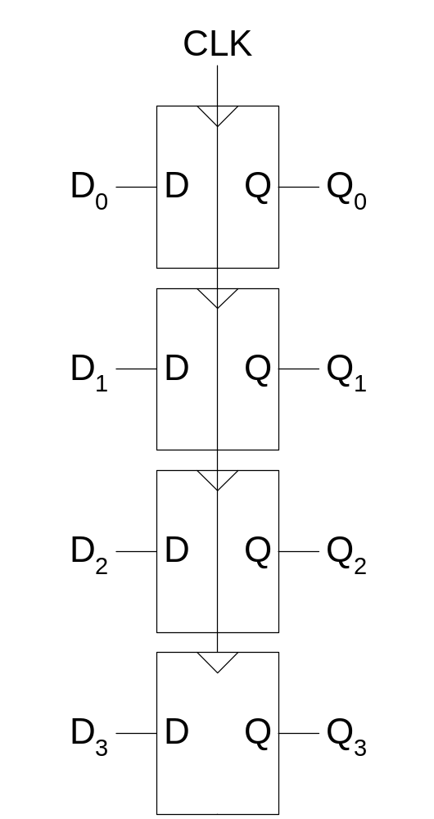
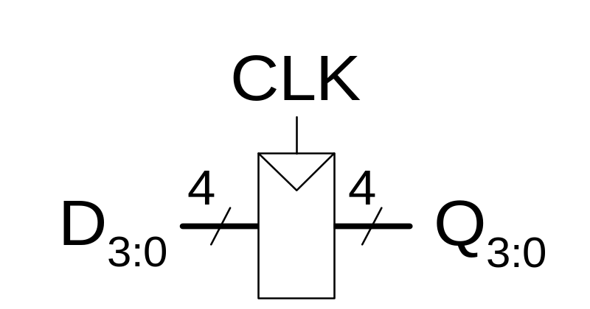
Registers

Slide 20
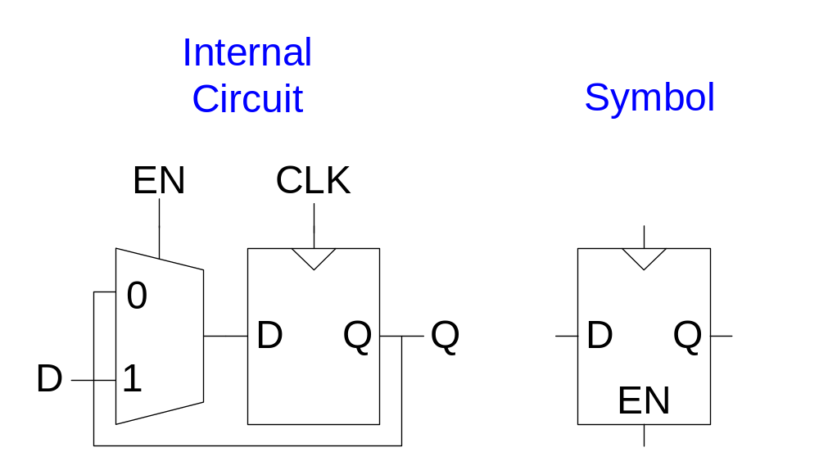
Enabled Flip-Flops
Inputs: CLK, D, EN
The enable input (EN) controls when new data (D) is stored
When EN = 1
  D passes through to Q on the clock edge
When EN = 0
  the flip-flop retains its previous state

Slide 21
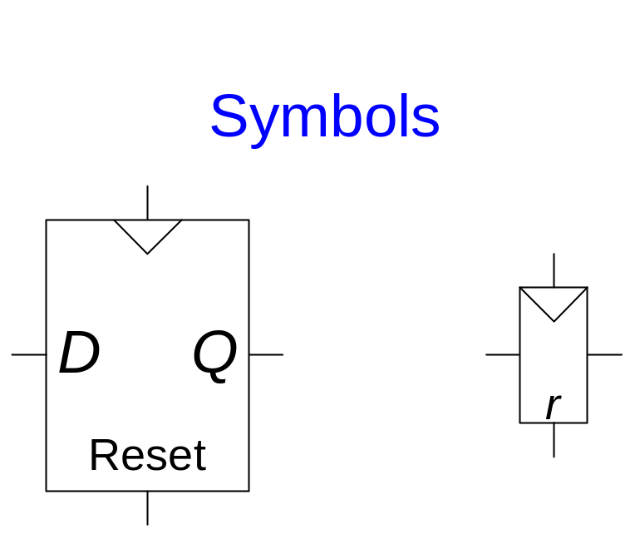
Resettable Flip-Flops
Inputs: CLK, D, Reset
When Reset = 1
  Q is reset to 0
When Reset = 0
  the flip-flop behaves like an ordinary D flip-flop

Slide 22
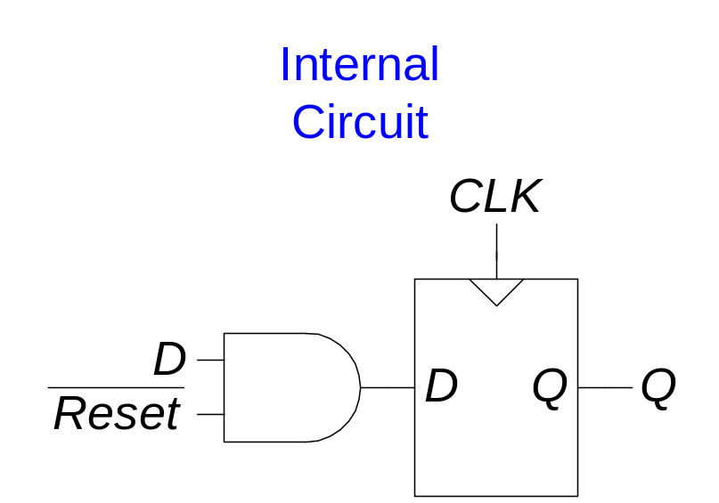
Resettable Flip-Flops
Two types:
  Synchronous: resets at the clock edge only
  Asynchronous: resets immediately when Reset = 1
Synchronously resettable flip-flop requires changing the internal circuitry of the flip-flop (see Exercise 3.10)
Asynchronously resettable flip-flop:

Slide 23
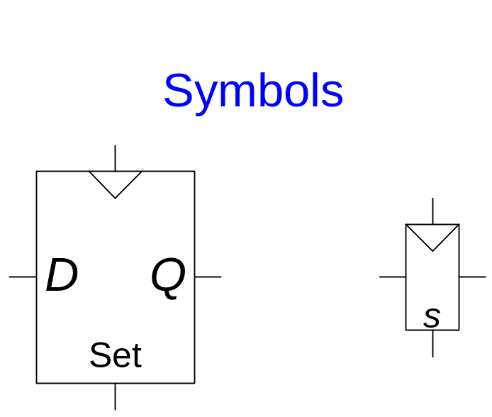
Settable Flip-Flops
Inputs: CLK, D, Set
When Set = 1
  Q is set to 1
When Set = 0
  the flip-flop behaves like an ordinary D flip-flop

Slide 24
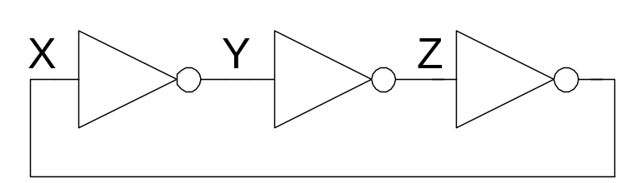
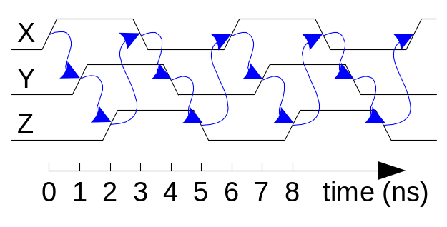
Sequential Logic
Sequential circuits: all circuits that aren’t combinational
A problematic circuit:
This circuit has no inputs and 1-3 outputs.
It is an astable circuit that oscillates.
Its period depends on the delay of the inverters – which depends on the manufacturing process, temperature, etc.
The circuit has a cyclic path: output fed back to input

Slide 25
Synchronous Sequential Logic Design
Breaks cyclic paths by inserting registers
These registers contain the state of the system
The state changes at the clock edge, so we say the system is synchronized to the clock
Rules of synchronous sequential circuit composition:
  Every circuit element is either a register or a combinational circuit
  At least one circuit element is a register.
  All registers receive the same clock signal.
  Every cyclic path contains at least one register.
Two common synchronous sequential circuits
  Finite state machines (FSMs)
  Pipelines

Slide 26
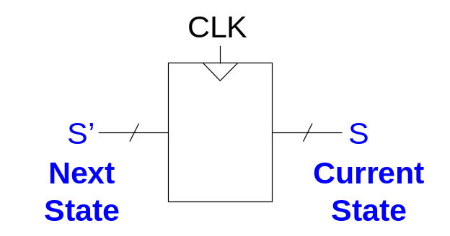
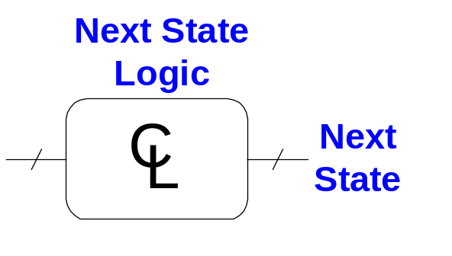
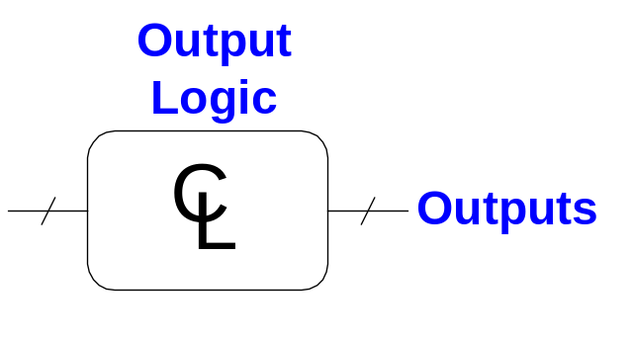
Finite State Machine (FSM)
Consists of:
  State register that
    Store the current state and
    Load the next state at the clock edge
  Combinational logic that
    Computes the next state
    Computes the outputs

Slide 27
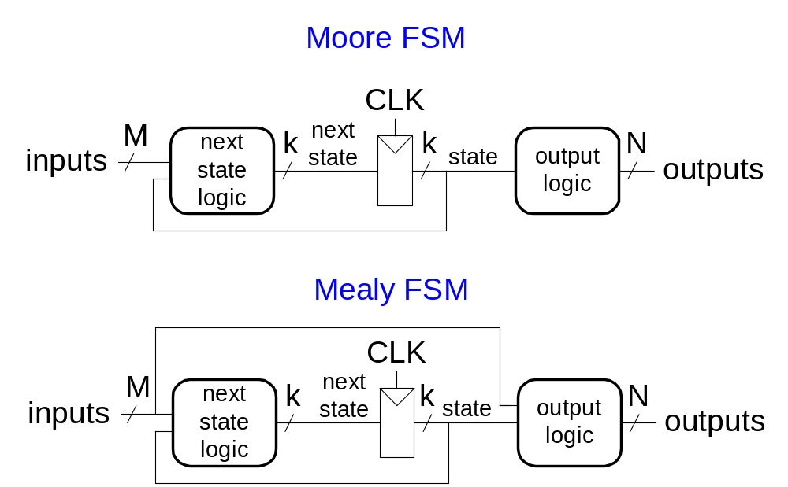
Finite State Machines (FSMs)
Next state is determined by the current state and the inputs
Two types of finite state machines differ in the output logic:
  Moore FSM: outputs depend only on the current state
  Mealy FSM: outputs depend on the current state and the inputs

Slide 28
Edward F. Moore, 1925 - 2003
Together with Mealy, developed automata theory, the mathematical underpinnings of state machines, at Bell Labs.
Not to be confused with Intel founder Gordon Moore
Published seminal article, Gedanken-experiments on Sequential Machines in 1956

Slide 29
George H. Mealy
Published A Method of Synthesizing Sequential Circuits in 1955
Wrote the first Bell Labs operating system for the IBM 704 computer

Slide 30
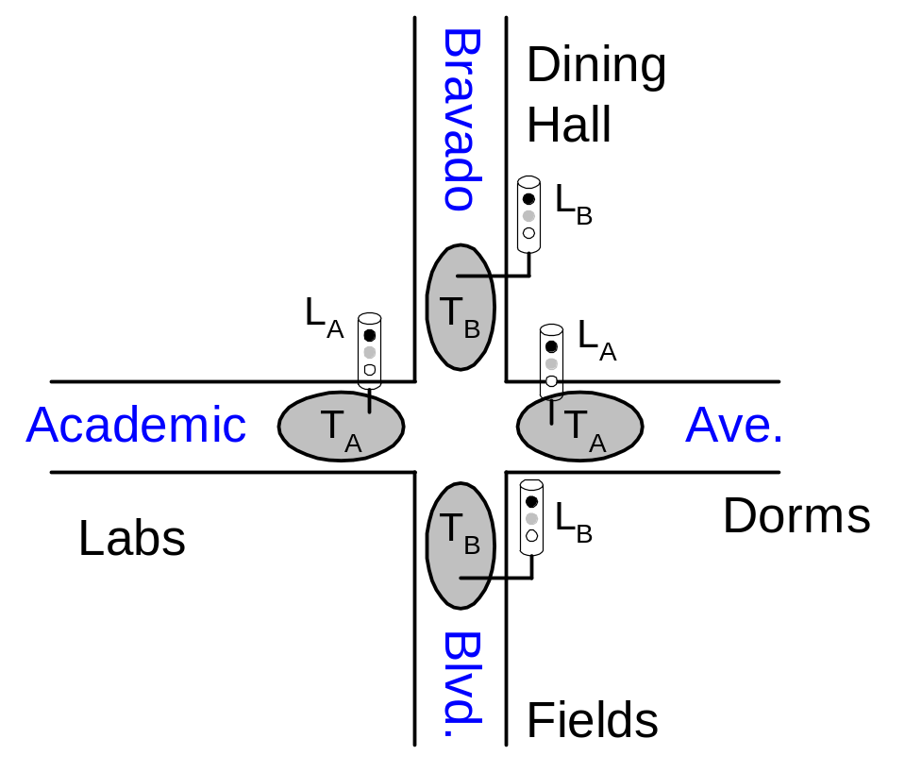
Finite State Machine Example
Traffic light controller
  Traffic sensors: T_{A}, T_{B} (TRUE when there’s traffic)
  Lights: L_{A}, L_{B}

Slide 31
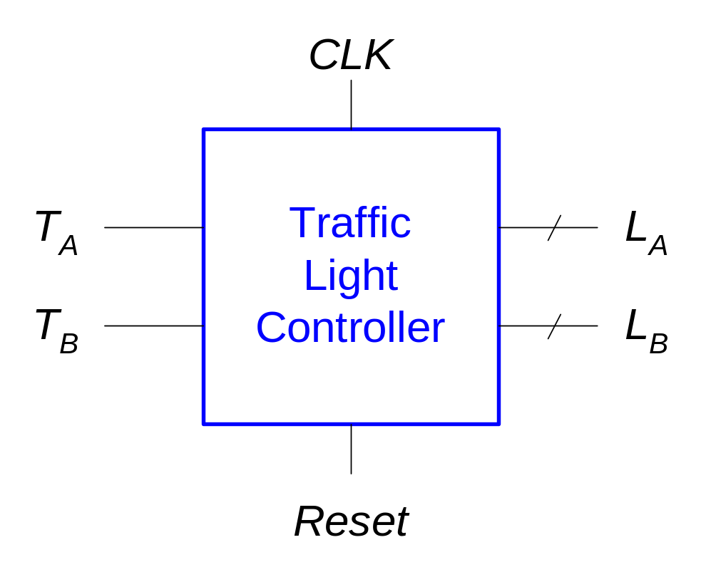
FSM Black Box
Inputs: CLK, Reset, T_{A}, T_{B}
Outputs: L_{A}, L_{B}

Slide 32
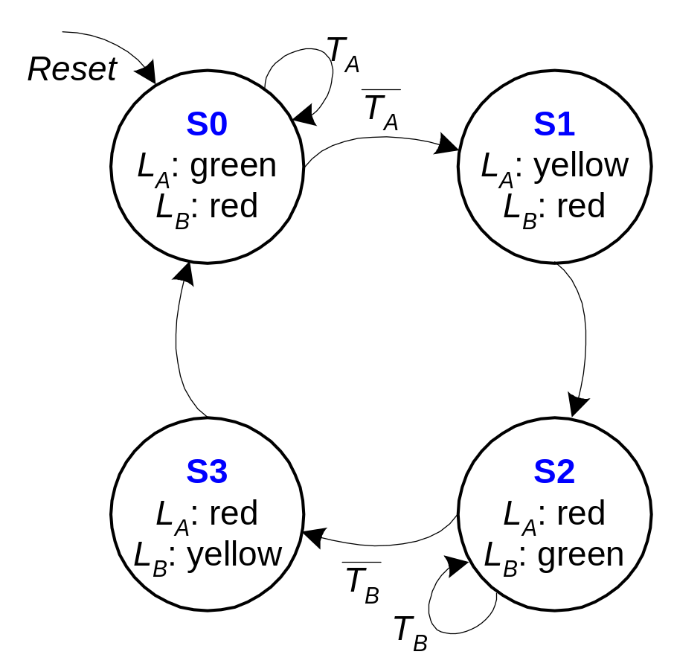
FSM State Transition Diagram
Moore FSM: outputs labeled in each state
States: Circles
Transitions: Arcs

Slide 33
FSM State Transition Table
Current State | Inputs |  | Next State
S | T_{A} | T_{B} | S'
S0 | 0 | X | S1
S0 | 1 | X | S0
S1 | X | X | S2
S2 | X | 0 | S3
S2 | X | 1 | S2
S3 | X | X | S0

Slide 34
FSM Encoded State Transition Table
Current State |  | Inputs |  | Next State
S₁ | S₀ | T_{A} | T_{B} | S'₁ | S'₀
0 | 0 | 0 | X | 0 | 1
0 | 0 | 1 | X | 0 | 0
0 | 1 | X | X | 1 | 0
1 | 0 | X | 0 | 1 | 1
1 | 0 | X | 1 | 1 | 0
1 | 1 | X | X | 0 | 0
State | Encoding
S0 | 00
S1 | 01
S2 | 10
S3 | 11
S'₁ = S₁ ⊕ S₀
S'₀ = S₁S₀T_{A} + S₁S₀T_{B}

Slide 35
FSM Output Table
Current State |  | Outputs
S₁ | S₀ | L_{A1} | L_{A0} | L_{B1} | L_{B0}
0 | 0 | 0 | 0 | 1 | 0
0 | 1 | 0 | 1 | 1 | 0
1 | 0 | 1 | 0 | 0 | 0
1 | 1 | 1 | 0 | 0 | 1
Output | Encoding
green | 00
yellow | 01
red | 10
L_{A1} = S₁
L_{A0} = S₁S₀
L_{B1} = S₁
L_{B0} = S₁S₀

Slide 36
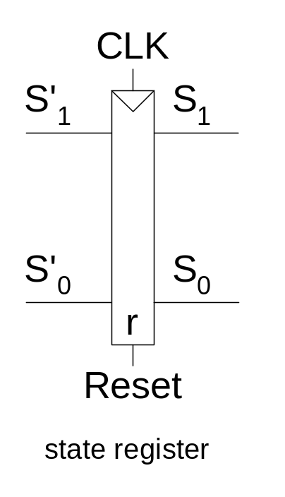
FSM Schematic: State Register

Slide 37
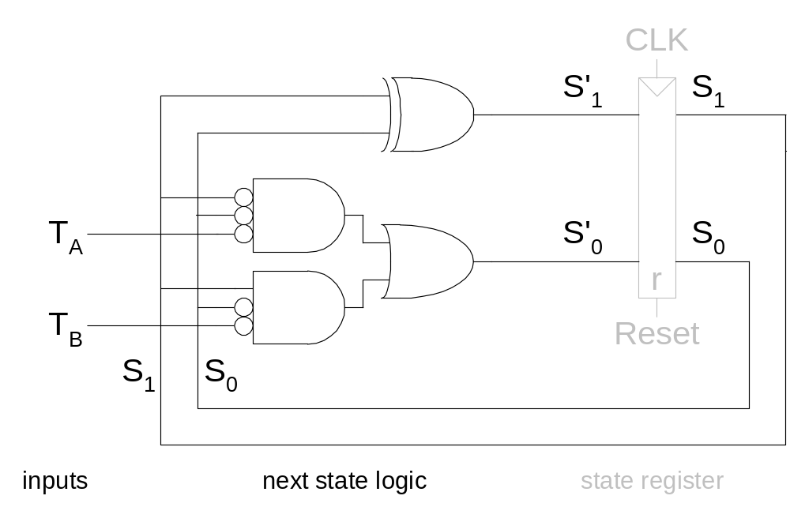
FSM Schematic: Next State Logic

Slide 38
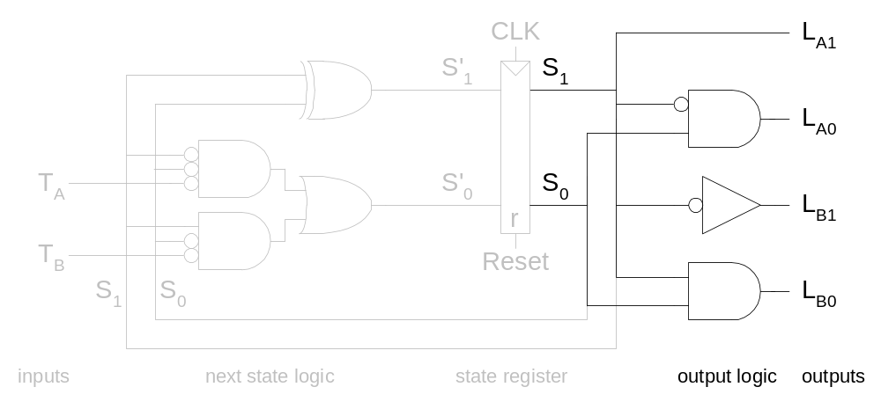
FSM Schematic: Output Logic

Slide 39
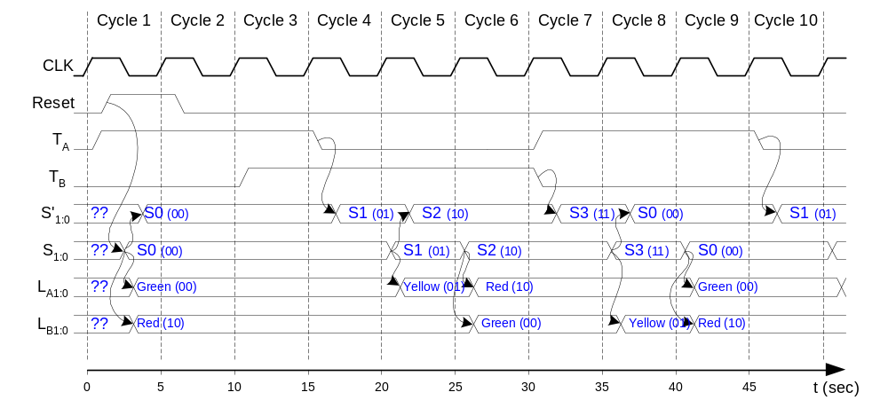
FSM Timing Diagram

Slide 40
FSM State Encoding
Binary encoding: i.e., for four states, 00, 01, 10, 11
One-hot encoding
  One state bit per state
  Only one state bit is HIGH at once
  I.e., for four states, 0001, 0010, 0100, 1000
  Requires more flip-flops
  Often next state and output logic is simpler

Slide 41
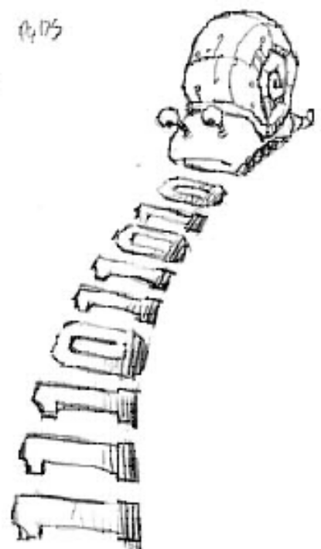
Moore vs. Mealy FSM
Alyssa P. Hacker has a snail that crawls down a paper tape with 1’s and 0’s on it. The snail smiles whenever the last four digits it has crawled over are 1101. Design Moore and Mealy FSMs of the snail’s brain.

Slide 42
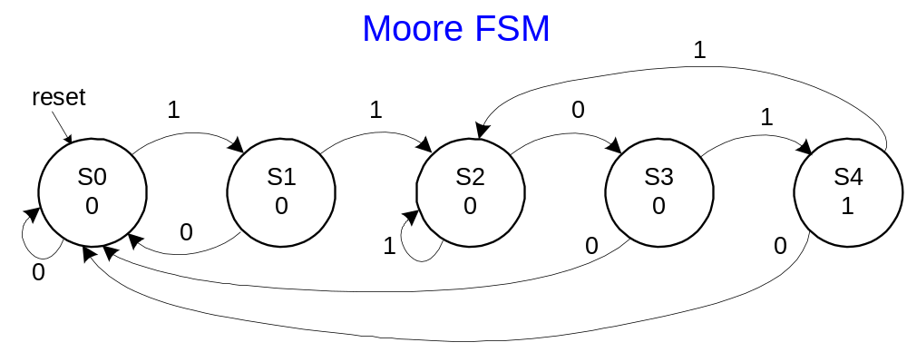
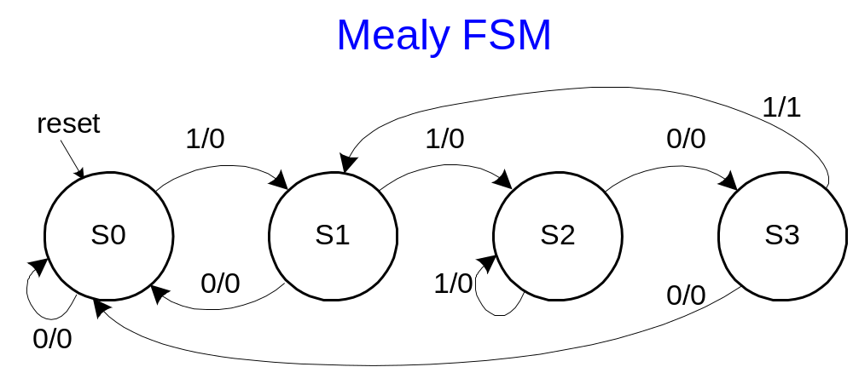
State Transition Diagrams
Mealy FSM: arcs indicate input/output

Slide 43
Moore FSM State Transition Table
Current State |  |  | Inputs | Next State
S₂ | S₁ | S₀ | A | S'₂ | S'₁ | S'₀
0 | 0 | 0 | 0 | 0 | 0 | 0
0 | 0 | 0 | 1 | 0 | 0 | 1
0 | 0 | 1 | 0 | 0 | 0 | 0
0 | 0 | 1 | 1 | 0 | 1 | 0
0 | 1 | 0 | 0 | 0 | 1 | 1
0 | 1 | 0 | 1 | 0 | 1 | 0
0 | 1 | 1 | 0 | 0 | 0 | 0
0 | 1 | 1 | 1 | 1 | 0 | 0
1 | 0 | 0 | 0 | 0 | 0 | 0
1 | 0 | 0 | 1 | 0 | 1 | 0
State | Encoding
S0 | 000
S1 | 001
S2 | 010
S3 | 011
S4 | 100

Slide 44
Moore FSM Output Table
Current State |  |  | Output
S₂ | S₁ | S₀ | Y
0 | 0 | 0 | 0
0 | 0 | 1 | 0
0 | 1 | 0 | 0
0 | 1 | 1 | 0
1 | 0 | 0 | 1
Y = S₂

Slide 45
Mealy FSM State Transition and Output Table
Current State |  | Input | Next State |  | Output
S₁ | S₀ | A | S'₁ | S'₀ | Y
0 | 0 | 0 | 0 | 0 | 0
0 | 0 | 1 | 0 | 1 | 0
0 | 1 | 0 | 0 | 0 | 0
0 | 1 | 1 | 1 | 0 | 0
1 | 0 | 0 | 1 | 1 | 0
1 | 0 | 1 | 1 | 0 | 0
1 | 1 | 0 | 0 | 0 | 0
1 | 1 | 1 | 0 | 1 | 1
State | Encoding
S0 | 00
S1 | 01
S2 | 10
S3 | 11

Slide 46
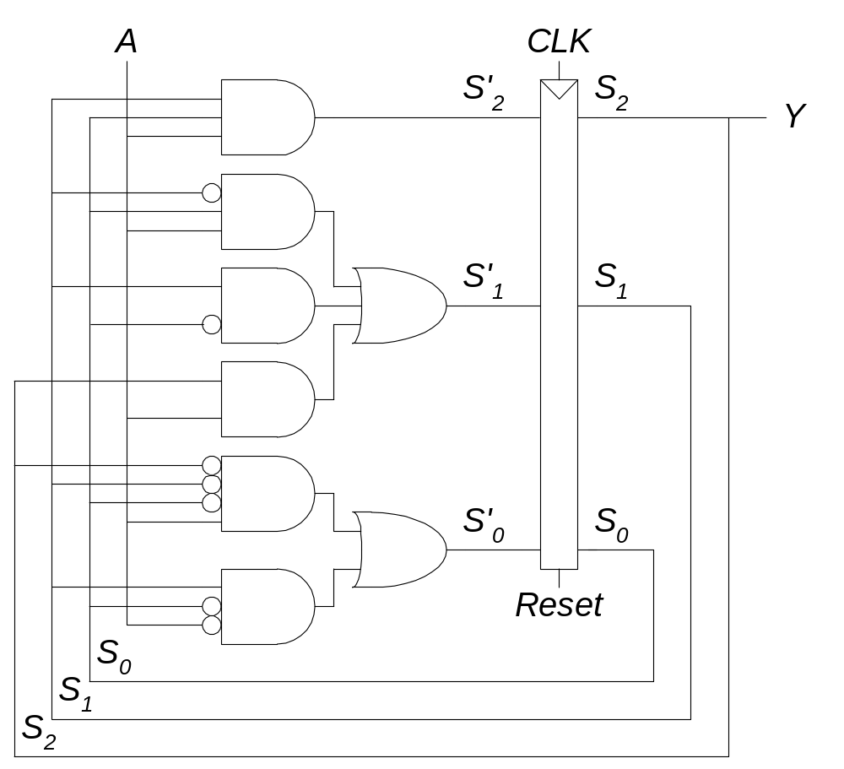
Moore FSM Schematic

Slide 47
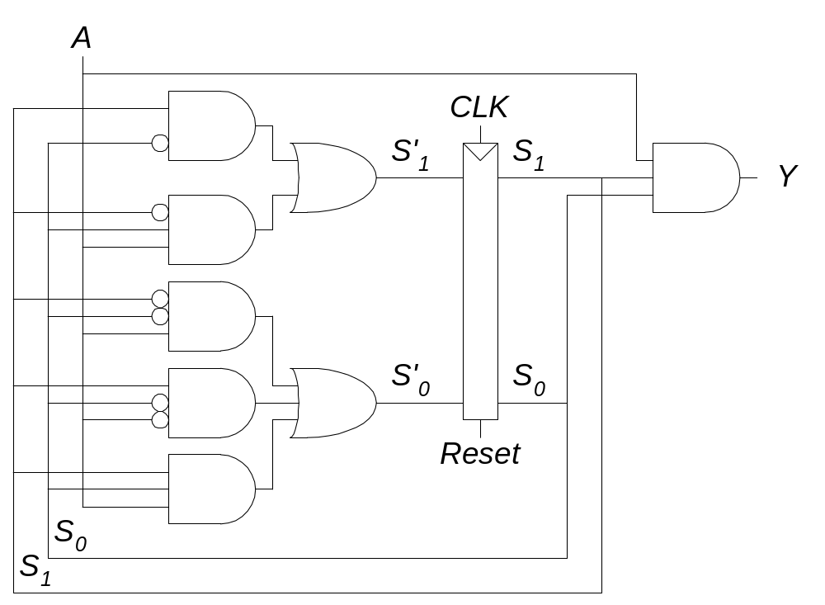
Mealy FSM Schematic

Slide 48
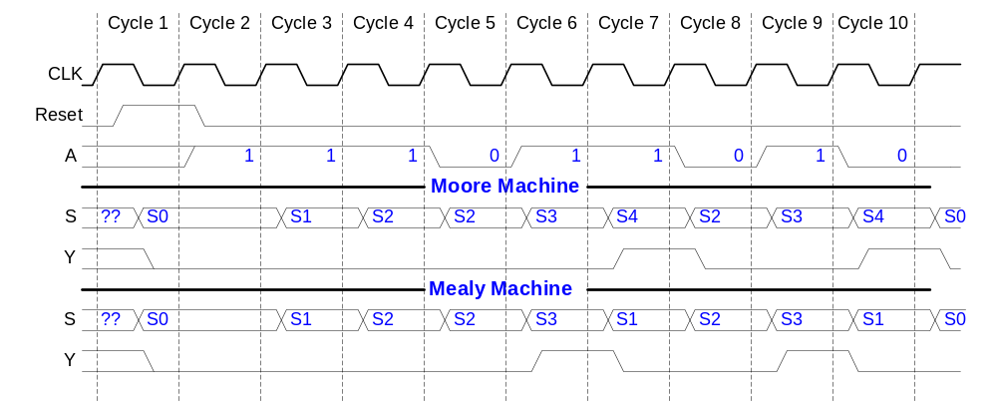
Moore and Mealy Timing Diagram

Slide 49
Factoring State Machines
Break complex FSMs into smaller interacting FSMs
Example: Modify the traffic light controller to have a Parade Mode.
The FSM receives two more inputs: P, R
When P = 1, it enters Parade Mode and the Bravado Blvd. light stays green.
When R = 1, it leaves Parade Mode

Slide 50
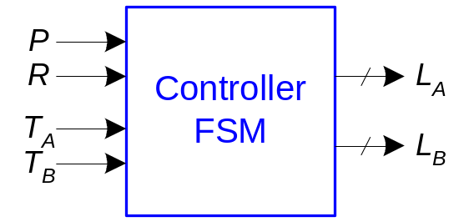
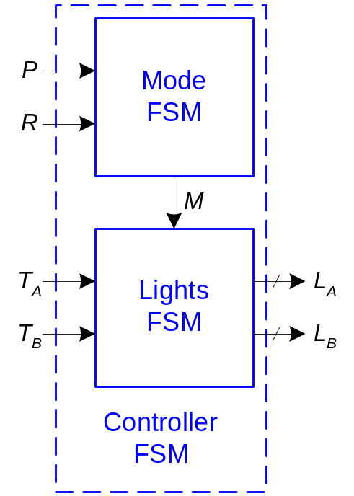
Parade FSM
Unfactored FSM
Factored FSM

Slide 51
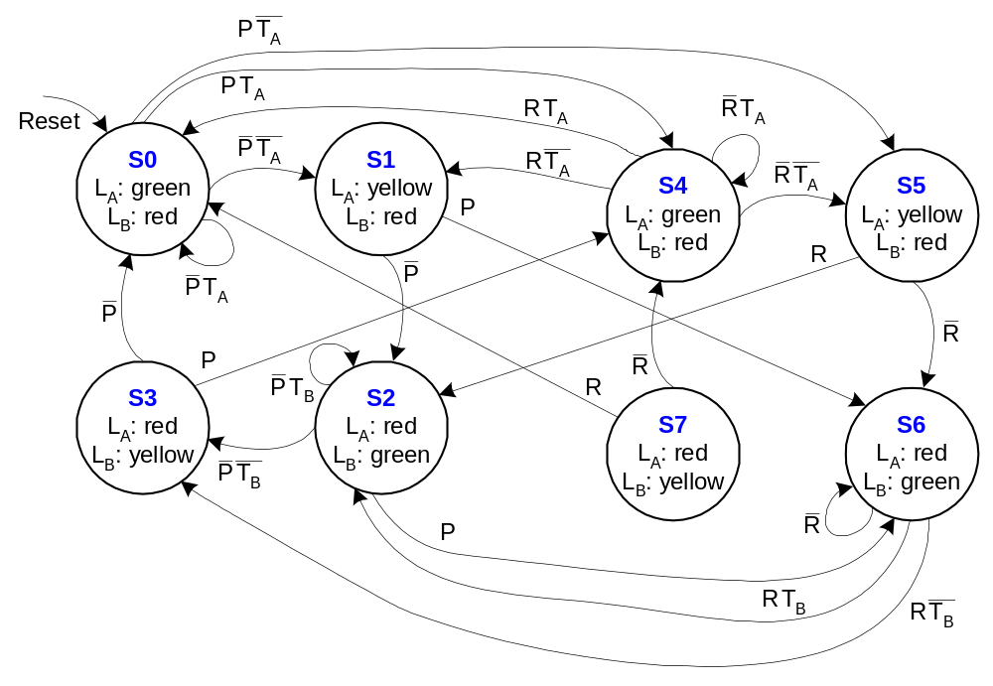
Unfactored FSM State Transition Diagram

Slide 52
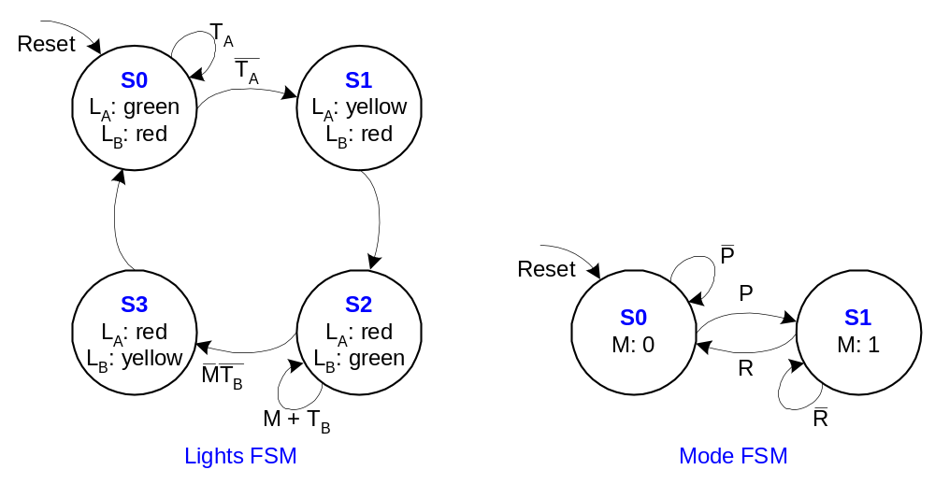
Factored FSM State Transition Diagram

Slide 53
FSM Design Procedure
Identify the inputs and outputs
Sketch a state transition diagram
Write a state transition table
Select state encodings
For a Moore machine:
  Rewrite the state transition table with the selected state encodings
  Write the output table
For a Mealy machine:
  Rewrite the combined state transition and output table with the selected state encodings
Write Boolean equations for the next state and output logic
Sketch the circuit schematic

Slide 54
Timing
Flip-flop samples D at clock edge
D must be stable when it is sampled
Similar to a photograph, D must be stable around the clock edge
If D is changing when it is sampled, metastability can occur

Slide 55
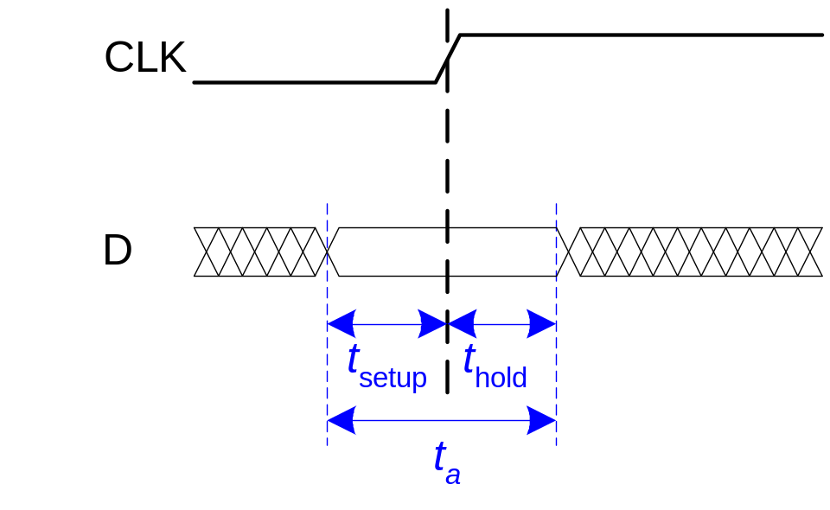
Input Timing Constraints
Setup time: t_{setup} = time before the clock edge that data must be stable (i.e. not changing)
Hold time: t_{hold} = time after the clock edge that data must be stable
Aperture time: t_{a} = time around clock edge that data must be stable (t_{a} = t_{setup} + t_{hold})

Slide 56
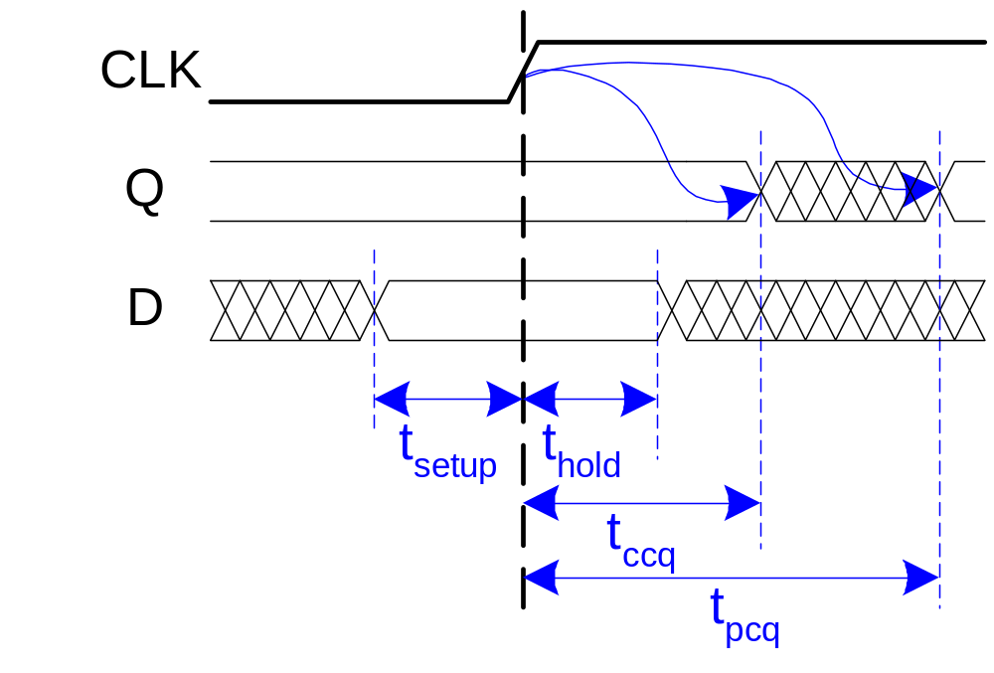
Output Timing
Propagation delay: t_{pcq} = time after clock edge that the output Q is guaranteed to be stable (i.e., to stop changing)
Contamination delay: t_{ccq} = time after clock edge that Q might be unstable (i.e., start changing)

Slide 57
Dynamic Discipline
The input to a synchronous sequential circuit must be stable during the aperture (setup and hold) time around the clock edge.
Specifically, the input must be stable
  at least t_{setup} before the clock edge
  at least until t_{hold} after the clock edge

Slide 58
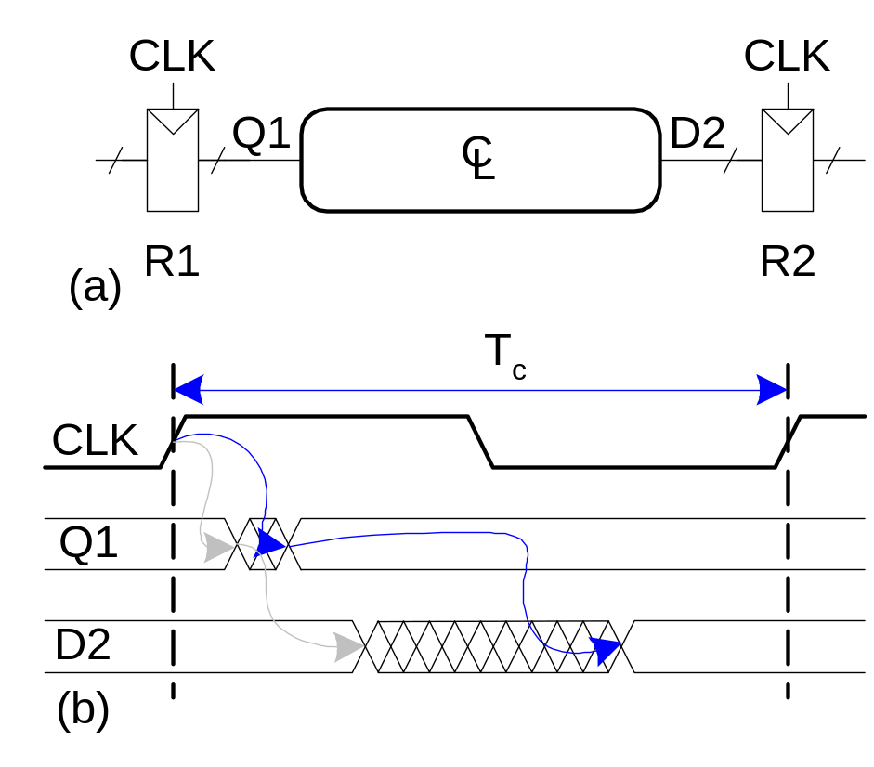
Dynamic Discipline
The delay between registers has a minimum and maximum delay, dependent on the delays of the circuit elements

Slide 59

Setup Time Constraint
The setup time constraint depends on the maximum delay from register R1 through the combinational logic.
The input to register R2 must be stable at least t_{setup} before the clock edge.
T_{c} ≥ t_{pcq} + t_{pd} + t_{setup}
t_{pd} ≤ T_{c} – (t_{pcq} + t_{setup})

Slide 60

Hold Time Constraint
The hold time constraint depends on the minimum delay from register R1 through the combinational logic.
The input to register R2 must be stable for at least t_{hold} after the clock edge.
t_{ccq} + t_{cd} > t_{hold}
t_{cd} > t_{hold} - t_{ccq}

Slide 61



Timing Analysis
Timing Characteristics
t_{ccq} = 30 ps
t_{pcq} = 50 ps
t_{setup} = 60 ps
t_{hold} = 70 ps
t_{pd} = 35 ps
t_{cd} = 25 ps

Slide 62
Timing Analysis
Timing Characteristics
t_{ccq} = 30 ps
t_{pcq} = 50 ps
t_{setup} = 60 ps
t_{hold} = 70 ps
t_{pd} = 35 ps
t_{cd} = 25 ps
t_{pd} = 3 x 35 ps = 105 ps
t_{pd} = 25 ps
Setup time constraint:
T_{c} ≥ (50 + 105 + 60) ps = 175 ps
f_{c} = 1/T_{c} = 5.7 GHz
Hold time constraint:
t_{ccq} + t_{pd} > t_{hold} ?
(30 + 25) ps > 70 ps ? No!

Slide 63

Fixing Hold Time Violation
Add buffers to the short paths:
Timing Characteristics
t_{ccq} = 30 ps
t_{pcq} = 50 ps
t_{setup} = 60 ps
t_{hold} = 70 ps
t_{pd} = 35 ps
t_{cd} = 25 ps
t_{pd} = 3 x 35 ps = 105 ps
t_{pd} = 2 x 25 ps = 50 ps
Setup time constraint:
T_{c} ≥ (50 + 105 + 60) ps = 175 ps
f_{c} = 1/T_{c} = 5.7 GHz
Hold time constraint:
t_{ccq} + t_{pd} > t_{hold} ?
(30 + 50) ps > 70 ps ? Yes!

Slide 64

Clock Skew
The clock doesn’t arrive at all registers at the same time
This may be caused by delay or other timing noise
Skew is the difference between two clock edges
Because there may be many registers in a system, we examine the worst case for each case to guarantee that the dynamic discipline is not violated for any register

Slide 65

Setup Time Constraint with Clock Skew
In the worst case, the CLK2 is earlier than CLK1
T_{c} – t_{skew} ≥ t_{pcq} + t_{pd} + t_{setup}
t_{pd} ≤ T_{c} – (t_{pcq} + t_{setup} + t_{skew})

Slide 66

Hold Time Constraint with Clock Skew
In the worst case, CLK2 is later than CLK1
t_{ccq} + t_{cd} > t_{hold} + t_{skew}
t_{cd} > t_{hold} + t_{skew} – t_{ccq}

Slide 67

Violating the Dynamic Discipline
Asynchronous (for example, user) inputs might violate the dynamic discipline

Slide 68


Violating the Dynamic Discipline
Asynchronous (for example, user) inputs might violate the dynamic discipline

Slide 69

Metastability
Any bistable device has two stable states and a metastable state between them
A flip-flop has two stable states (1 and 0) and one metastable state
If a flip-flop gets stuck in the metastable state, it could stay there for an undetermined amount of time

Slide 70

Flip-flop Internals
Because the flip-flop has feedback, if Q is somewhere between 1 and 0, the cross-coupled nand gates will eventually drive the output to either rail (1 or 0, depending on which one it is closer to).
A signal is considered metastable if it hasn’t resolved to 1 or 0
The probability that the output Q is still metastable after waiting a time, t, is:
P(t_{res} > t) = (T₀/T_{c} ) e^{-t/τ}
t_{res} : time to resolve to 1 or 0
T₀, τ : properties of the circuit

Slide 71
Metastability
Intuitively:
  T₀/T_{c} describes the probability that the input changes at a bad time, i.e., during the aperture time
P(t_{res} > t) = (T₀/T_{c} ) e^{-t/τ}
  τ is a time constant indicating how fast the flip-flop moves away from the metastable state; it is related to the delay through the cross-coupled gates in the flip-flop
P(t_{res} > t) = (T₀/T_{c} ) e^{-t/τ}
In short, if a flip-flop samples a metastable input, if you wait long enough (t), the output will have resolved to 1 or 0 with high probability.

Slide 72

Synchronizers
Asynchronous inputs (D) are inevitable (user interfaces, systems with different clocks interacting, etc.).
The goal of a synchronizer is to make the probability of failure (the output Q still being metastable) low.
A synchronizer cannot make the probability of failure 0.

Slide 73

Synchronizer Internals
A synchronizer can be built with two back-to-back flip-flops.
Suppose the input D is transitioning when it is sampled by flip-flop 1, F1.
The amount of time the internal signal D2 can resolve to a 1 or 0 is (T_{c} - t_{setup}).

Slide 74
Synchronizer Probability of Failure
For each sample, the probability of failure of this synchronizer is:
P(failure) = (T₀/T_{c} ) e^{-(T}_{c} ^{- t}_{setup}^{)/τ}

Slide 75
Synchronizer Mean Time Before Failure
If the asynchronous input changes once per second, the probability of failure per second of the synchronizer is simply P(failure):
In general, if the input changes N times per second, the probability of failure per second of the synchronizer is:
P(failure)/second = (NT₀/T_{c}) e^{-(T}_{c} ^{- t}_{setup}^{)/τ}
Thus, the synchronizer fails, on average, 1/[P(failure)/second]
This is called the mean time between failures, MTBF:
MTBF = 1/[P(failure)/second] = (T_{c}/NT₀) e^{(T}_{c} ^{- t}_{setup}^{)/τ}

Slide 76

Example Synchronizer
Suppose: T_{c} = 1/500 MHz τ = 200 ps
T₀ = 150 ps t_{setup} = 100 ps
N = 1 time per second
What is the probability of failure? MTBF?
P(failure) = (150 ps/2 ns) e^{-(1.9 ns)/200 ps}
= 5.6 × 10⁻⁶
P(failure)/second = 1 (5.6 × 10⁻⁶ )
= 5.6 x 10⁻⁶ / second
MTBF = 1/[P(failure)/second] ≈ 50 hours

Slide 77
Parallelism
Some definitions:
  Token: A group of inputs processed to produce a group of outputs
  Latency: Time for one token to pass from start to end
  Throughput: The number of tokens that can be produced per unit time
The purpose of parallelism is to increase throughput.
Two types of parallelism:
  Spatial parallelism
    duplicate hardware performs multiple tasks at once
  Temporal parallelism
    task is broken into multiple stages
    also called pipelining
    for example, an assembly line

Slide 78
Parallelism Example
Ben Bitdiddle is baking cookies to celebrate the installation of his traffic light controller. It takes 5 minutes to roll the cookies and 15 minutes to bake them. After finishing one batch he immediately starts the next batch. What is the latency and throughput if Ben doesn’t use parallelism?
Latency = 5 + 15 = 20 minutes = 1/3 hour
Throughput = 1 tray/ 1/3 hour = 3 trays/hour

Slide 79
Parallelism Example
What is the latency and throughput if Ben uses parallelism?
  Spatial parallelism: Ben asks Allysa P. Hacker to help, using her own oven
  Temporal parallelism: Ben breaks the task into two stages: roll and baking. He uses two trays. While the first batch is baking he rolls the second batch, and so on.

Slide 80

Spatial Parallelism
Latency = 5 + 15 = 20 minutes = 1/3 hour
Throughput = 2 trays/ 1/3 hour = 6 trays/hour

Slide 81

Temporal Parallelism
Latency = 5 + 15 = 20 minutes = 1/3 hour
Throughput = 1 trays/ 1/4 hour = 4 trays/hour
Using both techniques, the throughput would be 8 trays/hour

