Slide 1
Chapter 5 :: Digital Building Blocks
Digital Design and Computer Architecture
David Money Harris and Sarah L. Harris

Slide 2
Chapter 5 :: Topics
Introduction
Arithmetic Circuits
Number Systems
Sequential Building Blocks
Memory Arrays
Logic Arrays

Slide 3
Introduction
Digital building blocks include:
  Gates, multiplexers, decoders, registers, arithmetic circuits, counters, memory arrays, logic arrays
Building blocks are important in their own right and they demonstrate hierarchy, modularity, and regularity:
  They are built from a hierarchy of simpler components.
  They have well-defined interfaces and functions.
  Their regular structure is easily extended to different sizes.
We’ll use many of these building blocks to build a microprocessor in Chapter 7

Slide 4
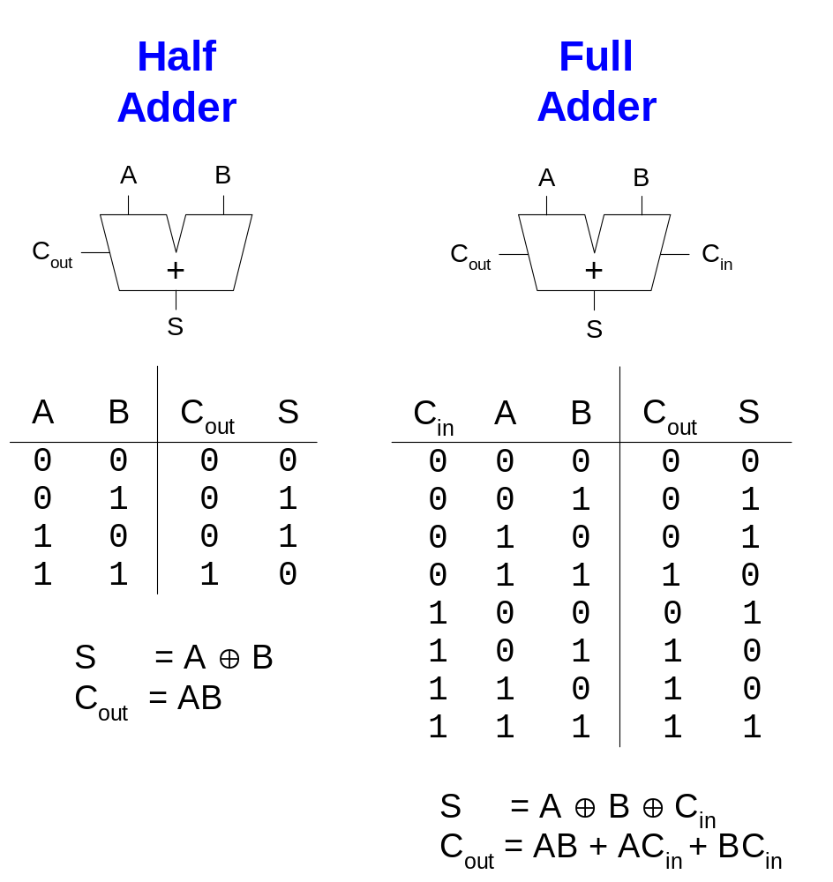
1-Bit Adders

Slide 5
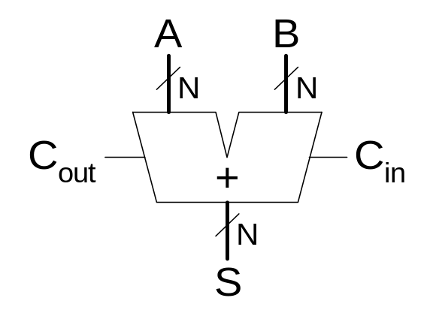
Multibit Adder, also called CPA
Several types of carry propagate adders (CPAs) are:
  Ripple-carry adders (slow)
  Carry-lookahead adders (fast)
  Prefix adders (faster)
Carry-lookahead and prefix adders are faster for large adders but require more hardware.
  Symbol

Slide 6
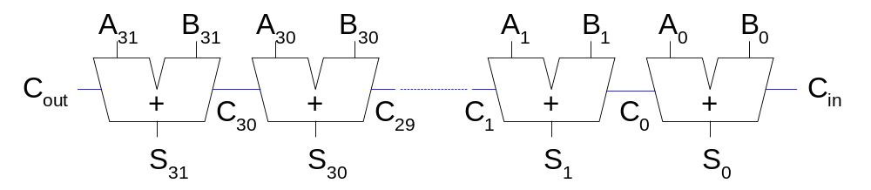
Ripple-Carry Adder
Chain 1-bit adders together
Carry ripples through entire chain
Disadvantage: slow

Slide 7
Ripple-Carry Adder Delay
The delay of an N-bit ripple-carry adder is:
t_{ripple} = Nt_{FA}
where t_{FA} is the delay of a full adder

Slide 8
Carry-Lookahead Adder
Computes the carry out (C_{out}) for N-bit blocks first, so the carry doesn’t have to ripple through the entire chain.
Does this by computing generate (G) and propagate (P) signals for columns and then N-bit blocks.
A column (bit i) can produce a carry out by either generating a carry out or propagating a carry in to the carry out.
We define generate (G_{i}) and propagate (P_{i}) signals for each column:
  A column will generate a carry out if A_{i} AND B_{i} are both 1.
  G_{i} = A_{i} B_{i}
  A column will propagate a carry in to the carry out if A_{i} OR B_{i} is 1.
  P_{i} = A_{i} + B_{i}
We compute the carry out of a column (C_{i}) as:
  C_{i} = A_{i} B_{i} + (A_{i} + B_{i} )C_{i-1} = G_{i} + P_{i} C_{i-1}

Slide 9
Carry-Lookahead Adder
Now we compute generate and propagate signals for N-bit blocks.
For example, we can calculate generate and propagate signals for a 4-bit block (G_{3:0} and P_{3:0}) :
  A 4-bit block will generate a carry out if column 3 generates a carry (G₃) or if column 3 propagates a carry (P₃) that was generated or propagated in a previous column as described by the following equation:
  G_{3:0} = G₃ + P₃ (G₂ + P₂ (G₁ + P₁G₀ )
  A 4-bit block will propagate a carry in to the carry out if all of the columns propagate the carry:
  P_{3:0} = P₃P₂ P₁P₀
We compute the carry out of the 4-bit block (C_{i}) as:
  C_{i} = G_{i:j} + P_{i:j} C_{i-1}

Slide 10
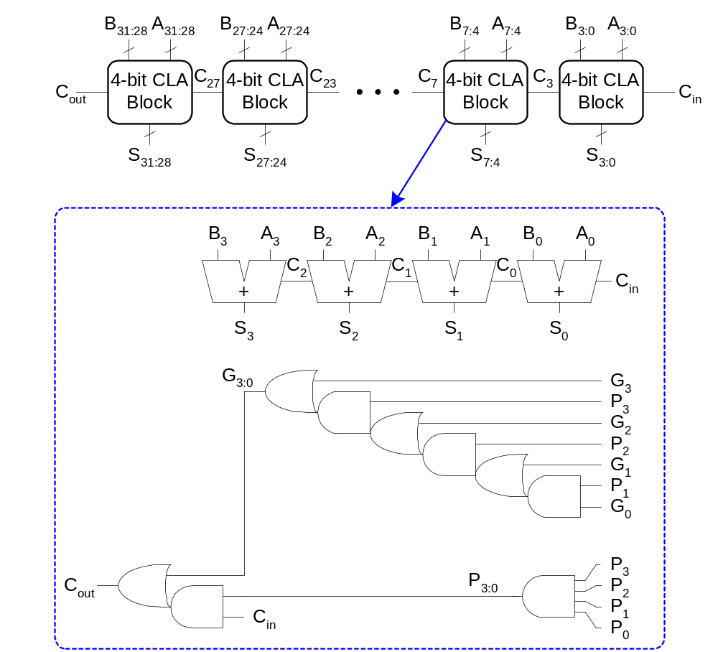
32-bit CLA with 4-bit blocks

Slide 11
Carry-Lookahead Adder Delay
The delay of an N-bit carry-lookahead adder with k-bit blocks is:
t_{CLA} = t_{pg} + t_{pg_block} + (N/k – 1)t_{AND_OR} + kt_{FA}
where
  t_{pg} is the delay of the column generate and propagate gates
  t_{pg_block} is the delay of the block generate and propagate gates
  t_{AND_OR} is the delay from C_{in} to C_{out} of the final AND/OR gate in the k-bit CLA block
The delay of an N-bit carry-lookahead adder is generally much faster than a ripple-carry adder for N > 16

Slide 12
Prefix Adder
Computes generate and propagate signals for all of the columns to perform addition even faster.
Computes G and P for 2-bit blocks, then 4-bit blocks, then 8-bit blocks, etc. until the generate and propagate signals are known for each column.
Thus, the prefix adder has log₂N stages.
The strategy is to compute the carry in (C_{i-1}) for each of the columns as fast as possible and then to compute the sum:
S_{i} = (A_{i} ⊕ B_{i}) ⊕ C_{i-1}

Slide 13
Prefix Adder
A carry is generated by being either generated in a column or propagated from a previous column.
Define column -1 to hold C_{in}, so
  G₋₁ = C_{in}, P₋₁ = 0
Then,
  C_{i-1} = G_{i-1:-1}
because there will be a carry out of column i-1 if the block spanning columns i-1 through -1 generates a carry.
Thus, we can rewrite the sum equation as:
  S_{i} = (A_{i} ⊕ B_{i}) ⊕ G_{i-1:-1}

Slide 14
Prefix Adder
The generate and propagate signals for a block spanning bits i:j are:
  G_{i:j} = G_{i:k} + P_{i:k} G_{k-1:j}
  P_{i:j} = P_{i:k}P_{k-1:j}
These signals are called the prefixes because they must be precomputed before the final sum computation can complete.
In words, these prefixes describe that:
  A block will generate a carry if the upper part (i:k) generates a carry or of the upper part propagates a carry generated in the lower part (k-1:j)
  A block will propagate a carry if both the upper and lower parts propagate the carry.

Slide 15
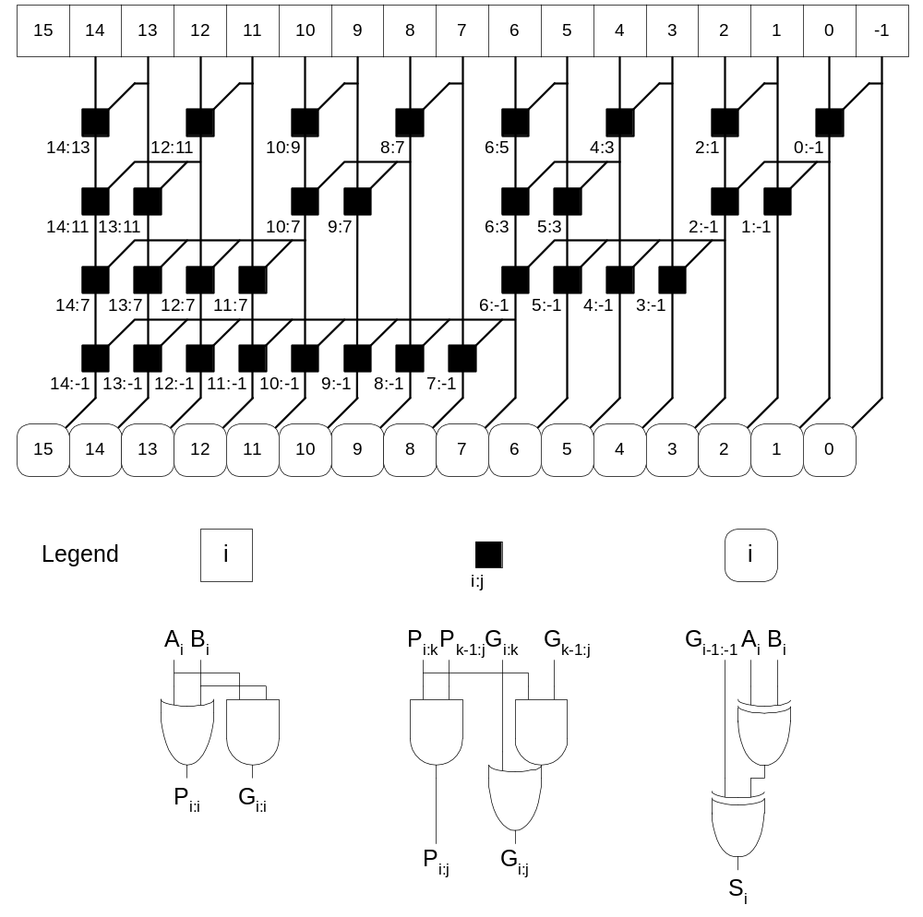
Prefix Adder Schematic

Slide 16
Prefix Adder Delay
The delay of an N-bit prefix adder is:
t_{PA} = t_{pg} + log₂N(t_{pg_prefix} ) + t_{XOR}
where
  t_{pg} is the delay of the column generate and propagate gates
  t_{pg_prefix} is the delay of the black prefix cell

Slide 17
Adder Delay Comparisons
Compare the delay of 32-bit ripple-carry, carry-lookahead, and prefix adders. The carry-lookahead adder has 4-bit blocks. Assume that each two-input gate delay is 100 ps and the full adder delay is 300 ps.

Slide 18
Adder Delay Comparisons
Compare the delay of 32-bit ripple-carry, carry-lookahead, and prefix adders. The carry-lookahead adder has 4-bit blocks. Assume that each two-input gate delay is 100 ps and the full adder delay is 300 ps.
t_{ripple} = Nt_{FA} = 32(300 ps)
= 9.6 ns
t_{CLA} = t_{pg} + t_{pg_block} + (N/k – 1)t_{AND_OR} + kt_{FA}
= [100 + 600 + (7)200 + 4(300)] ps
= 3.3 ns
t_{PA} = t_{pg} + log₂N(t_{pg_prefix} ) + t_{XOR}
= [100 + log₂32(200) + 100] ps
= 1.2 ns

Slide 19
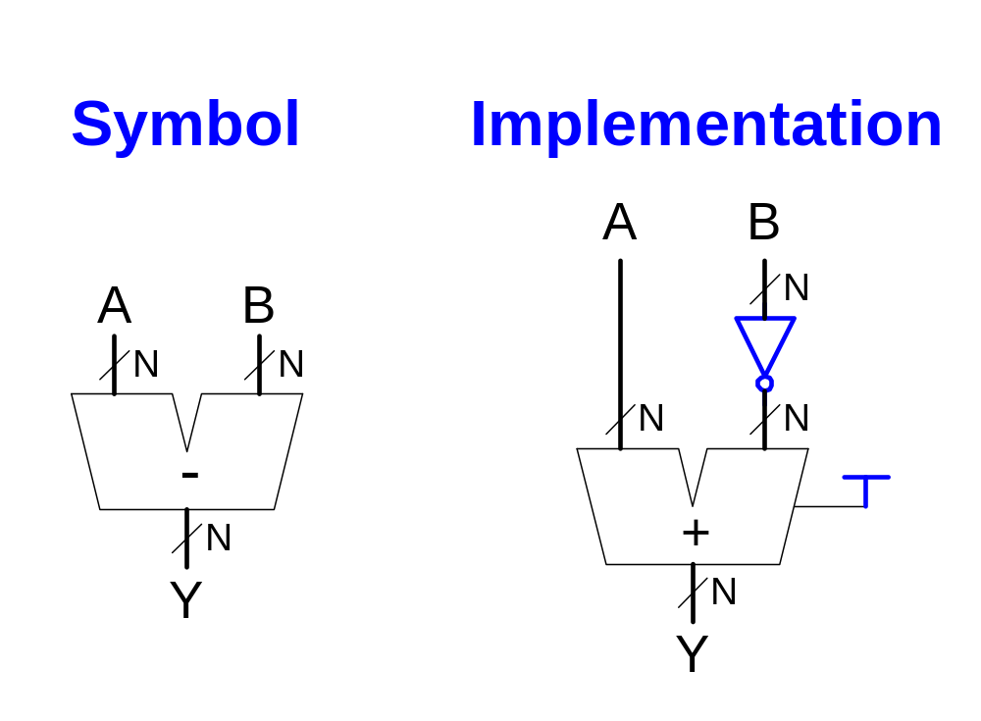
Subtracter

Slide 20
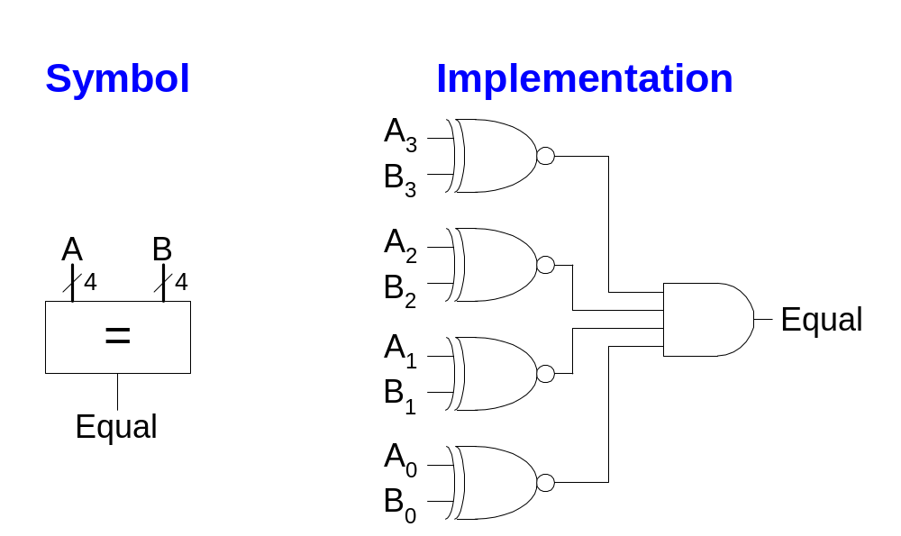
Comparator: Equality

Slide 21
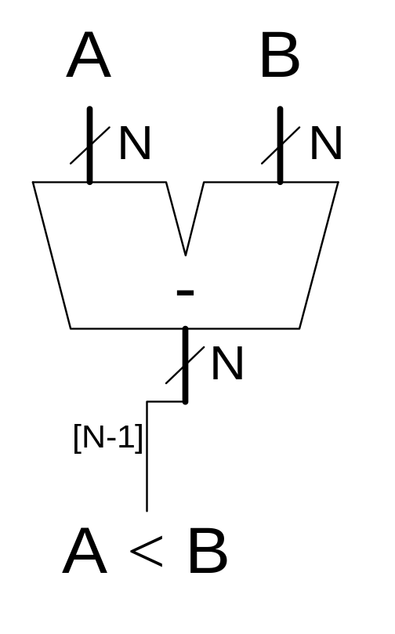
Comparator: Less Than

Slide 22
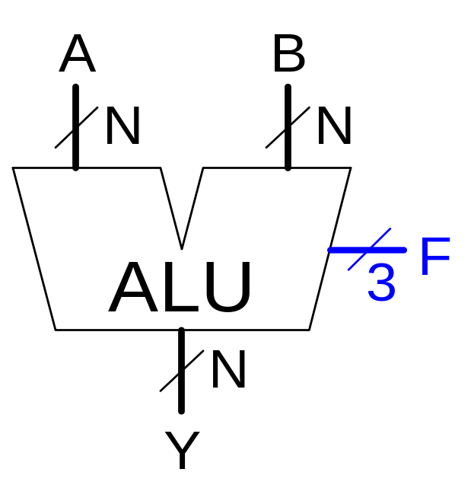
Arithmetic Logic Unit (ALU)
F_{2:0} | Function
000 | A & B
001 | A | B
010 | A + B
011 | not used
100 | A & B
101 | A | ~B
110 | A - B
111 | SLT

Slide 23
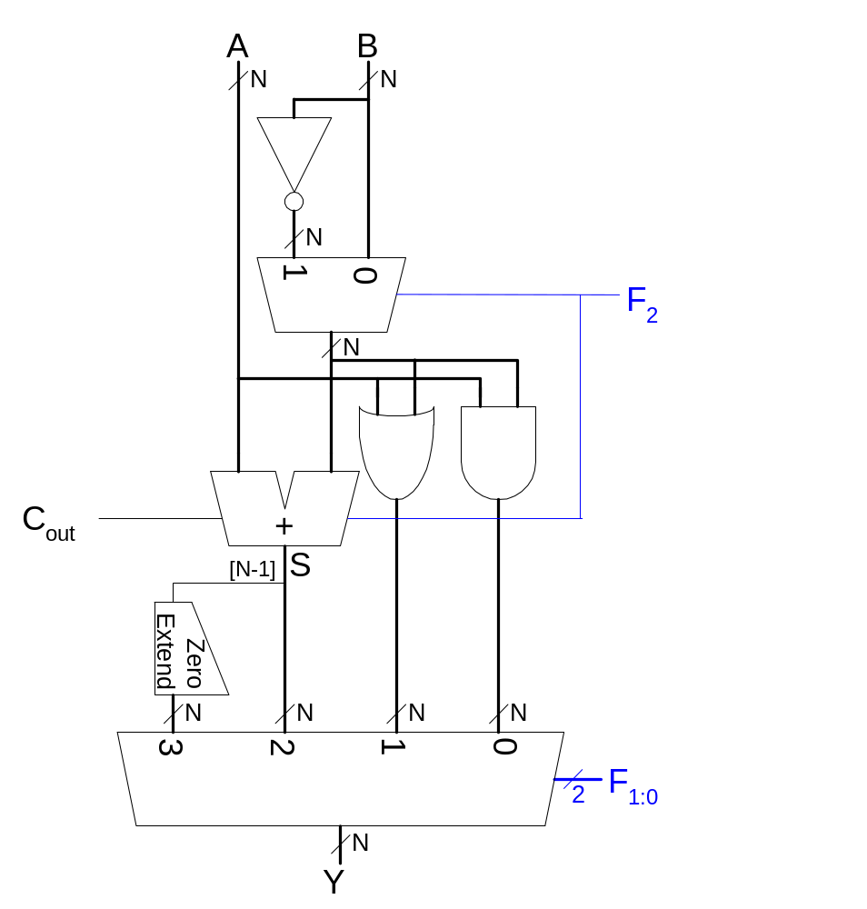
ALU Design

Slide 24
ALU Function
F_{2:0} | Function
000 | A & B
001 | A | B
010 | A + B
011 | not used
100 | A & B
101 | A | ~B
110 | A - B
111 | SLT

Slide 25

Set Less Than (SLT) Example
Configure a 32-bit ALU for the set if less than (SLT) operation. Suppose A = 25 and B = 32.

Slide 26
Set Less Than (SLT) Example
Configure a 32-bit ALU for the set if less than (SLT) operation. Suppose A = 25 and B = 32.
  Because A is indeed less than B, we expect Y to be the 32-bit representation of 1 (0x00000001).
  For SLT, F_{2:0} = 111.
  F₂ = 1 configures the adder unit as a subtracter. So 25 - 32 = -7.
  The two’s complement representation of -7 has a 1 in the most significant bit, so S₃₁ = 1.
  With F_{1:0} = 11, the final multiplexer selects Y = S₃₁ = 1.

Slide 27
Shifters
Logical shifter: shifts value to left or right and fills empty spaces with 0’s
  Ex: 11001 >> 2 = 00110
  Ex: 11001 << 2 = 00100
Arithmetic shifter: same as logical shifter, but on right shift, fills empty spaces with the old most significant bit (msb).
  Ex: 11001 >>> 2 = 11110
  Ex: 11001 <<< 2 = 00100
Rotator: rotates bits in a circle, such that bits shifted off one end are shifted into the other end
  Ex: 11001 ROR 2 = 01110
  Ex: 11001 ROL 2 = 00111

Slide 28
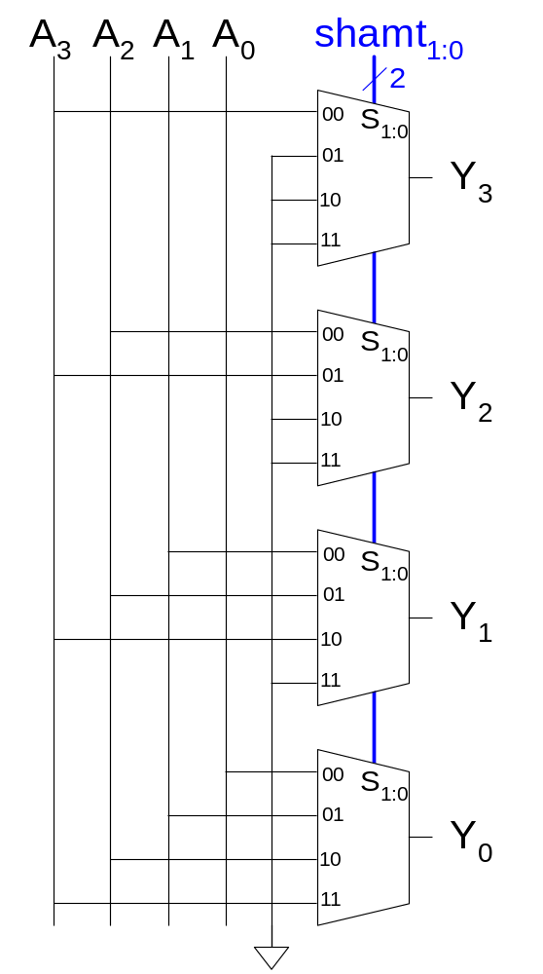
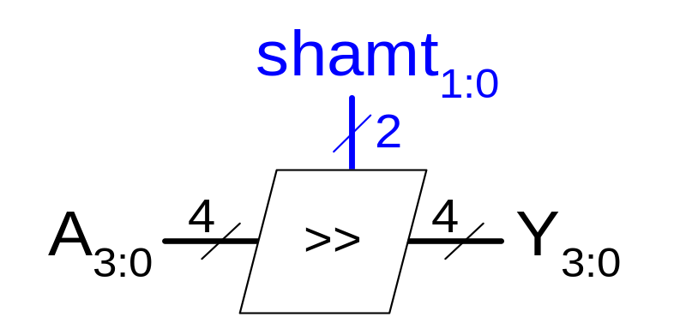
Shifter Design

Slide 29
Shifters as Multipliers and Dividers
A left shift by N bits multiplies a number by 2^{N}
  Ex: 00001 << 2 = 00100 (1 × 2² = 4)
  Ex: 11101 << 2 = 10100 (-3 × 2² = -12)
The arithmetic right shift by N divides a number by 2^{N}
  Ex: 01000 >>> 2 = 00010 (8 ÷ 2² = 2)
  Ex: 10000 >>> 2 = 11100 (-16 ÷ 2² = -4)

Slide 30
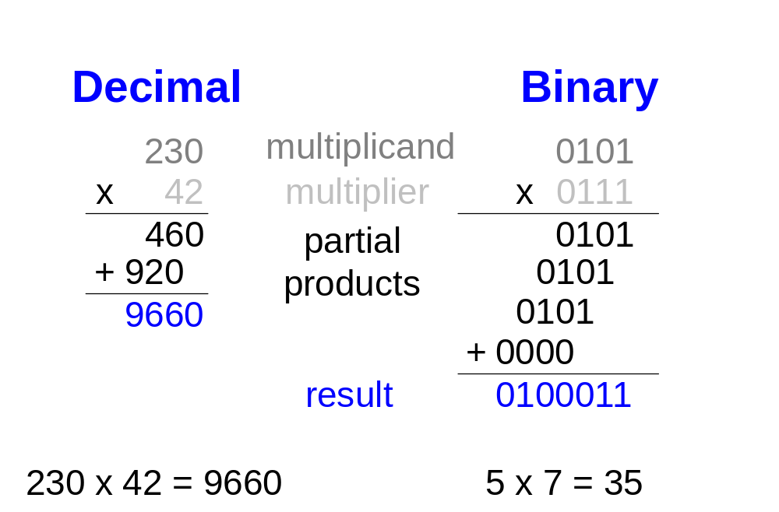
Multipliers
Steps of multiplication for both decimal and binary numbers:
  Partial products are formed by multiplying a single digit of the multiplier with the entire multiplicand
  Shifted partial products are summed to form the result

Slide 31
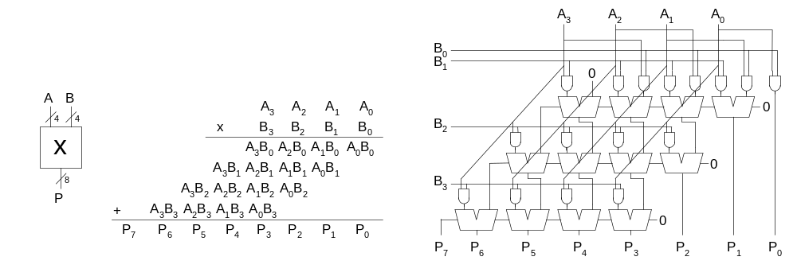
4 x 4 Multiplier

Slide 32
Division Algorithm
Q = A/B
R: remainder
D: difference
R = A
for i = N-1 to 0
D = R - B
if D < 0 then Q_{i} = 0, R’ = R // R < B
else Q_{i} = 1, R’ = D // R ≥ B
R = 2R’

Slide 33
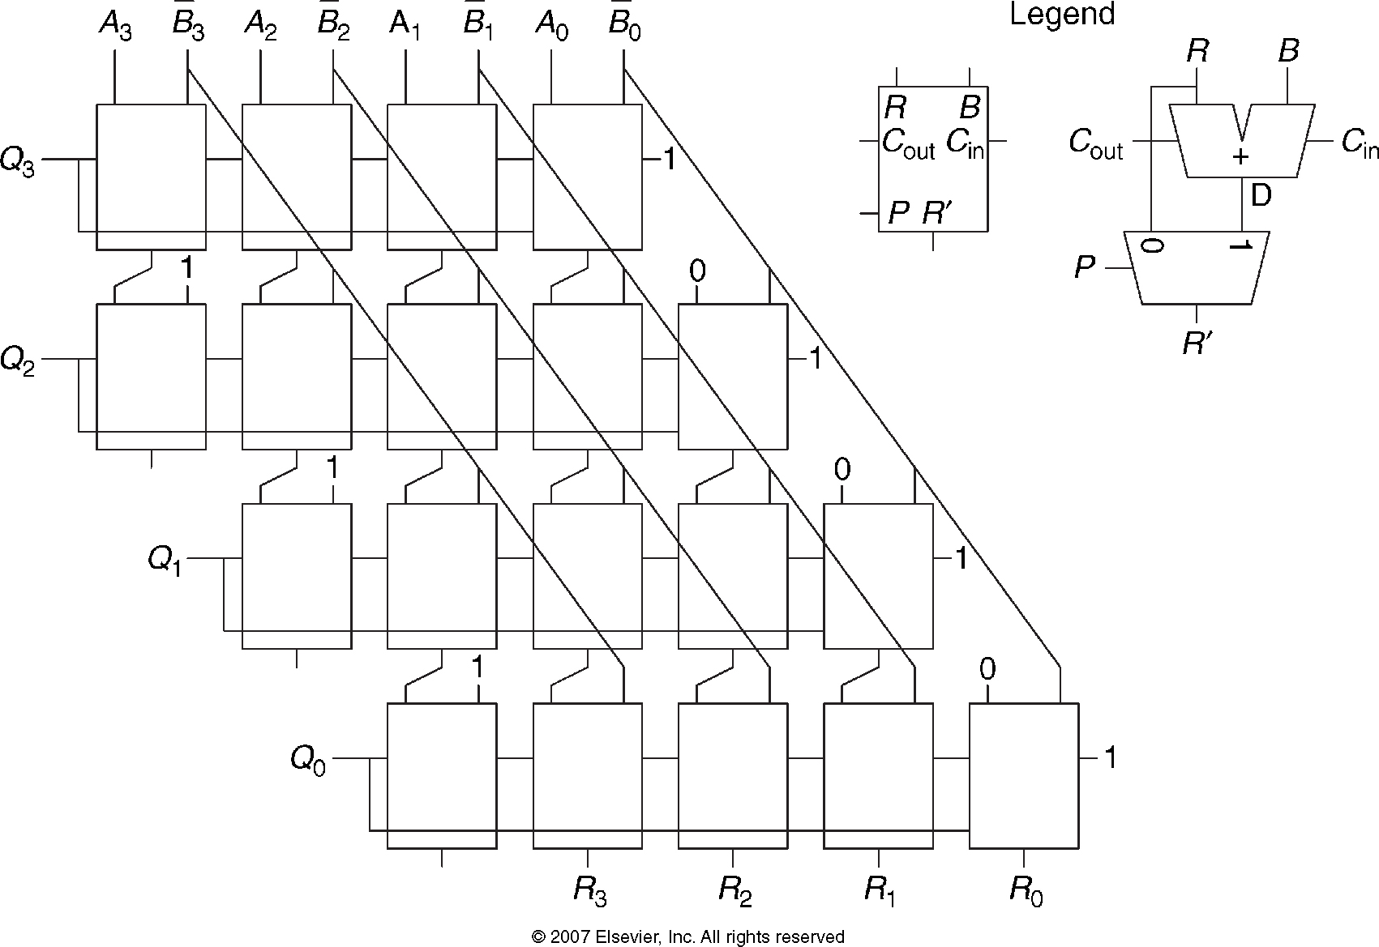
4 x 4 Divider

Slide 34
Number Systems
What kind of numbers do you know how to represent using binary representations?
  Positive numbers
    Unsigned binary
  Negative numbers
    Two’s complement
    Sign/magnitude numbers
What about fractions?

Slide 35
Numbers with Fractions
Two common notations:
  Fixed-point:
  the binary point is fixed
  Floating-point:
  the binary point floats to the right of the most significant 1

Slide 36
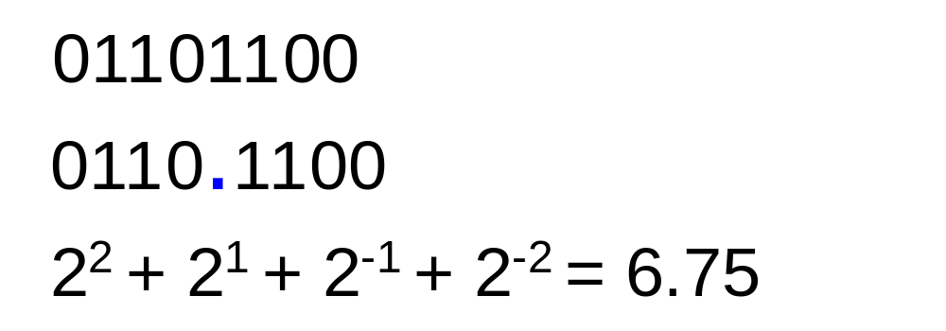
Fixed-Point Numbers
Fixed-point representation of 6.75 using 4 integer bits and 4 fraction bits:
The binary point is not a part of the representation but is implied.
The number of integer and fraction bits must be agreed upon by those generating and those reading the number.

Slide 37
Fixed-Point Numbers
Represent 6.5₁₀ using an 8-bit binary representation with 4 integer bits and 4 fraction bits.
  01101000

Slide 38
Signed Fixed-Point Numbers
As with whole numbers, negative fractional numbers can be represented two ways:
  Sign/magnitude notation
  Two’s complement notation
Represent -6.5₁₀ using an 8-bit binary representation with 4 integer bits and 4 fraction bits.
  Sign/magnitude:
  11101000
  Two’s complement:
  1. Invert bits: 10010111
  2. Add 1 to lsb: + 1
  10011000

Slide 39
Floating-Point Numbers
The binary point floats to the right of the most significant 1.
Similar to decimal scientific notation.
For example, write 273₁₀ in scientific notation:
  Move the decimal point to the left of the most significant digit and increase the exponent:
  273 = 2.73 × 10²
In general, a number is written in scientific notation as:
± M × B^{E}
Where,
  M = mantissa
  B = base
  E = exponent
  In the example, M = 2.73, B = 10, and E = 2

Slide 40
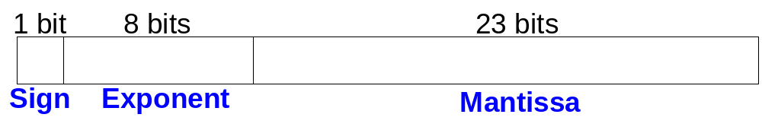
Floating-Point Numbers
We represent floating-point numbers using 32 bits: 1 sign bit, 8 exponent bits, and the remaining 23 bits for the mantissa.
Example: represent the value 228₁₀ using a 32-bit floating point representation.
The following slides show three versions of floating-point representation for 228₁₀.
The final version is called the IEEE 754 floating-point standard.

Slide 41
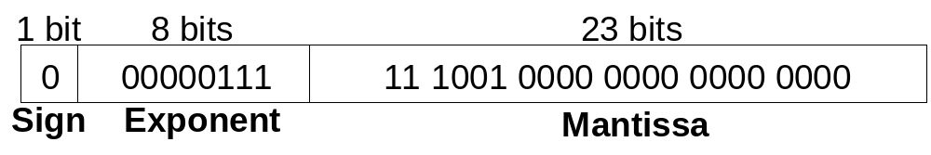
Floating-Point Representation 1
First, convert the decimal number to binary:
  228₁₀ = 11100100₂ = 1.11001 × 2⁷
Next, fill in each field in the 32-bit number:
  The sign bit is positive (0)
  The 8 exponent bits give the value 7
  The remaining 23 bits are the mantissa

Slide 42
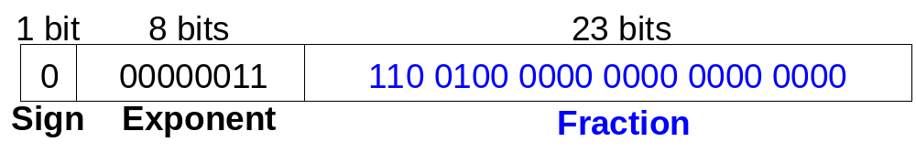
Floating-Point Representation 2
You may have noticed that the first bit of the mantissa is always 1, since the binary point floats to the right of the most significant 1:
  228₁₀ = 11100100₂ = 1.11001 × 2⁷
Thus, storing the most significant 1, also called the implicit leading 1, is redundant information.
We can store just the fraction bits in the 23-bit field. The leading 1 is implied.

Slide 43
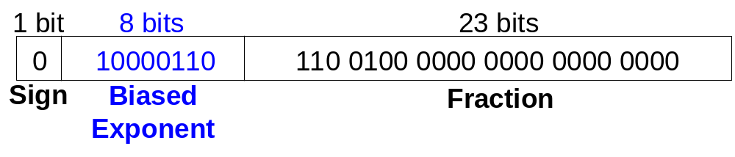
Floating-Point Representation 3
The final change is to store a biased exponent. The IEEE 754 standard uses a bias of 127.
  Biased exponent = bias + exponent
  For example, an exponent of 7 would be stored as:
  127 + 7 = 134 = 0x10000110₂
Thus, the IEEE 754 32-bit floating-point representation of 228₁₀ is:

Slide 44
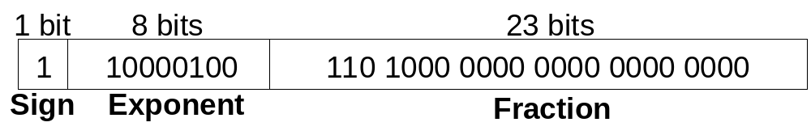
Floating-Point Example
Write the value -58₁₀ using the IEEE 754 32-bit floating-point standard.
First, convert the decimal number to binary:
  58₁₀ = 111010₂ = 1.1101 × 2⁵
Next, fill in each field in the 32-bit number:
  The sign bit is negative (1)
  The 8 exponent bits are (127 + 5) = 132 = 10000100₂
  The remaining 23 bits are the fraction bits: 11010000..
Written in hexadecimal, this 32-bit value is: 0xC2680000

Slide 45
Floating-Point Numbers: Special Cases
The IEEE 754 standard includes special cases for numbers that are difficult to represent, such as 0 because it lacks an implicit leading 1.
NaN is used for numbers that don’t exist, such as √-1 or log(-5).
Number | Sign | Exponent | Fraction
0 | X | 00000000 | 00000000000000000000000
∞ | 0 | 11111111 | 00000000000000000000000
- ∞ | 1 | 11111111 | 00000000000000000000000
NaN | X | 11111111 | non-zero

Slide 46
Floating-Point Number Precision
Single-Precision:
  32-bit notation
  1 sign bit, 8 exponent bits, 23 fraction bits
  bias = 127
Double-Precision:
  64-bit notation
  1 sign bit, 11 exponent bits, 52 fraction bits
  bias = 1023

Slide 47
Floating-Point Numbers: Rounding
Overflow: when the number is too large to be represented
Underflow: when the number is too tiny to be represented
Rounding modes:
  Down
  Up
  Toward zero
  To nearest
Example: round 1.100101 (1.578125) so that it uses only 3 fraction bits.
  Down: 1.100
  Up: 1.101
  Toward zero: 1.100
  To nearest: 1.101 (1.625 is closer to 1.578125 than 1.5 is)

Slide 48
Floating-Point Addition
Extract exponent and fraction bits
Prepend leading 1 to form mantissa
Compare exponents
Shift smaller mantissa if necessary
Add mantissas
Normalize mantissa and adjust exponent if necessary
Round result
Assemble exponent and fraction back into floating-point format

Slide 49
Floating-Point Addition: Example
Add the following floating-point numbers:
0x3FC00000
0x40500000

Slide 50
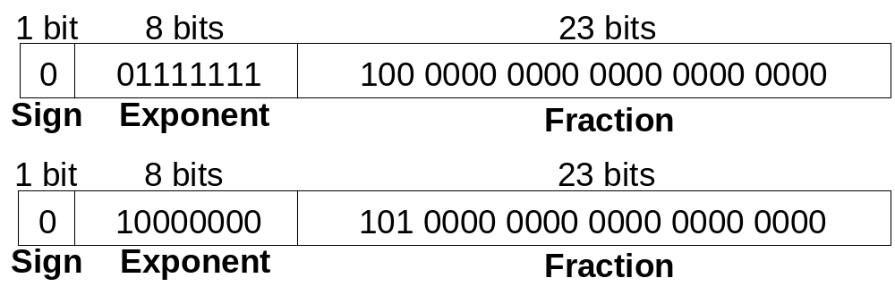
Floating-Point Addition: Example
1. Extract exponent and fraction bits
For first number (N1): S = 0, E = 127, F = .1
For second number (N2): S = 0, E = 128, F = .101
2. Prepend leading 1 to form mantissa
N1: 1.1
N2: 1.101

Slide 51
Floating-Point Addition: Example
3. Compare exponents
127 – 128 = -1, so shift N1 right by 1 bit
4. Shift smaller mantissa if necessary
shift N1’s mantissa: 1.1 >> 1 = 0.11 (× 2¹)
5. Add mantissas
0.11 × 2¹
+ 1.101 × 2¹
10.011 × 2¹

Slide 52
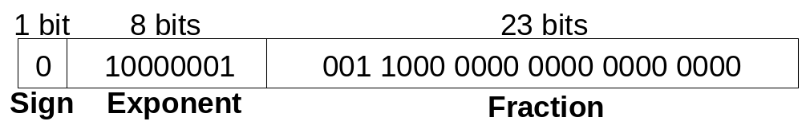
Floating-Point Addition: Example
6. Normalize mantissa and adjust exponent if necessary
10.011 × 2¹ = 1.0011 × 2²
7. Round result
No need (fits in 23 bits)
8. Assemble exponent and fraction back into floating-point format
S = 0, E = 2 + 127 = 129 = 10000001₂, F = 001100..
Written in hexadecimal: 0x40980000

Slide 53
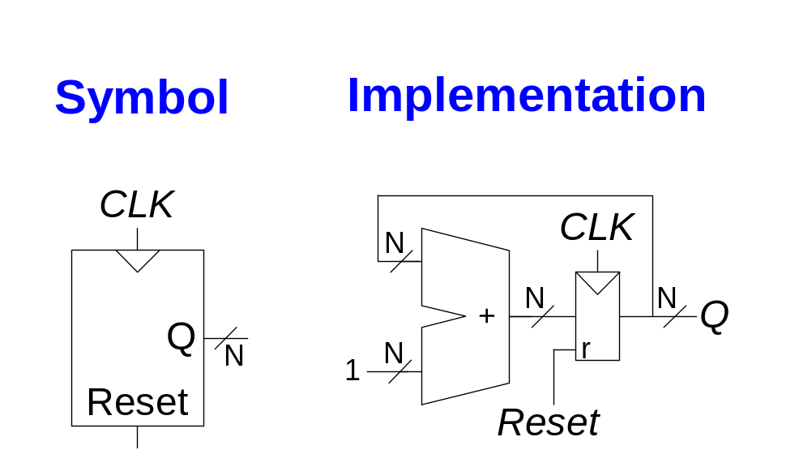
Counters
Increments on each clock edge.
Used to cycle through numbers. For example,
  000, 001, 010, 011, 100, 101, 110, 111, 000, 001…
Counters are used in many digital systems, for example:
  Digital clock displays
  Program counter: used in computers to keep track of the current instruction that is executing

Slide 54
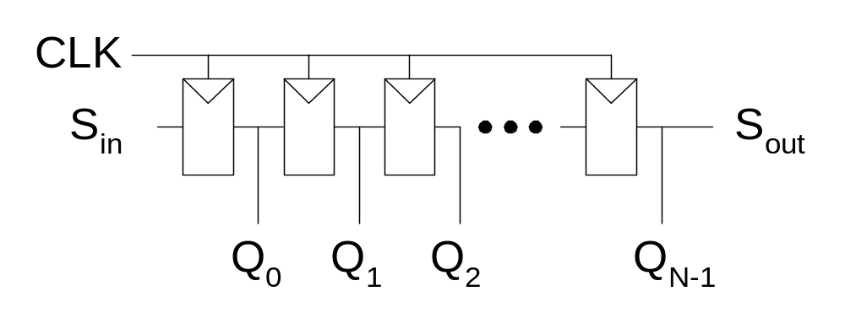
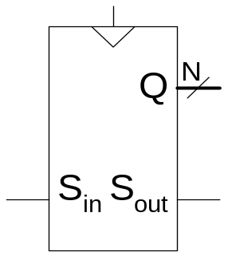
Shift Register
Shift a new value in on each clock edge
Shift a value out on each clock edge
Serial-to-parallel converter: converts serial input (S_{in}) to parallel output (Q_{0:N-1})
Symbol:
Implementation:

Slide 55
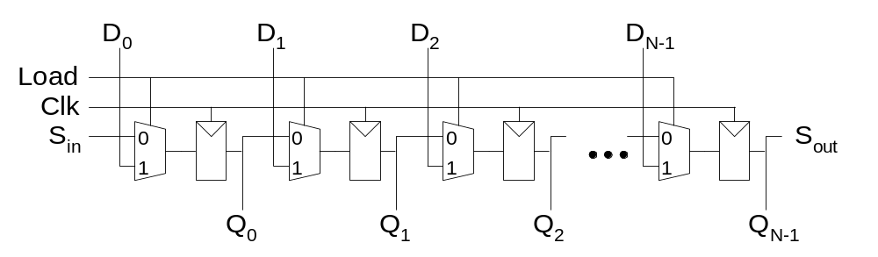
Shift Register with Parallel Load
When Load = 1, acts as a normal N-bit register
When Load = 0, acts as a shift register
Now can act as a serial-to-parallel converter (S_{in} to Q_{0:N-1}) or a parallel-to-serial converter (D_{0:N-1} to S_{out})

Slide 56
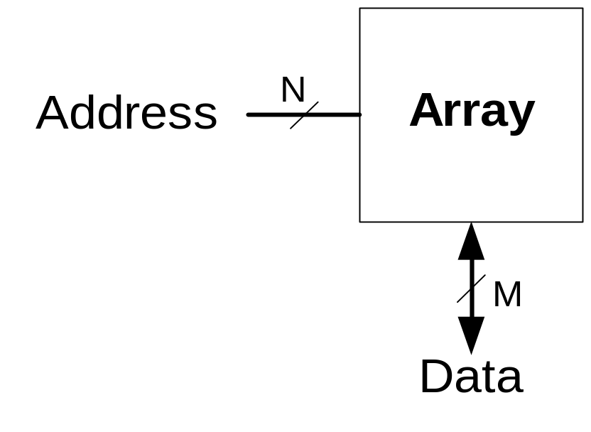
Memory Arrays
Memory arrays efficiently store large amounts of data.
Three common types of memory arrays:
  Dynamic random access memory (DRAM)
  Static random access memory (SRAM)
  Read only memory (ROM)
An M-bit data value can be read or written at each unique N-bit address.

Slide 57
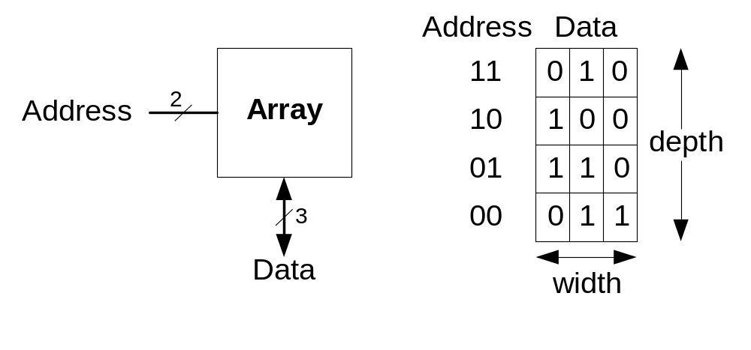
Memory Arrays
Memory arrays are organized as a two-dimensional array of bit cells. Each bit cell stores one bit.
An array with N address bits and M data bits has 2^{N} rows and M columns. Each row of data is called a word.
  Depth: number of rows in a memory array
  Width: number of columns in a memory array (the word size)
  Array size is given as depth × width

Slide 58
Memory Array: Example
The memory array below is a 2² × 3-bit array.
The word size is 3-bits.
For example, the 3-bit word stored at address 10 is 100.
Example:

Slide 59
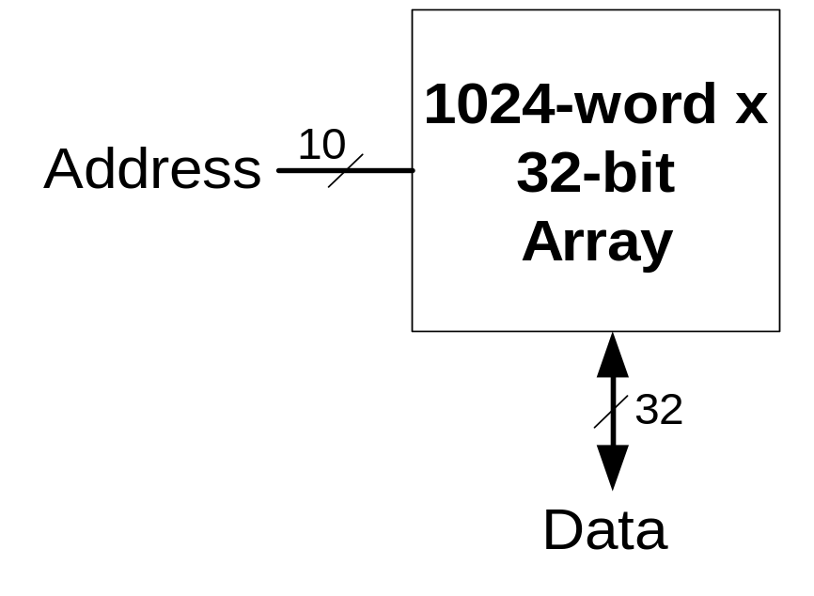
Memory Arrays

Slide 60
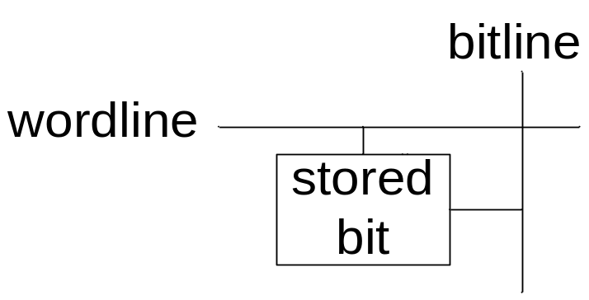
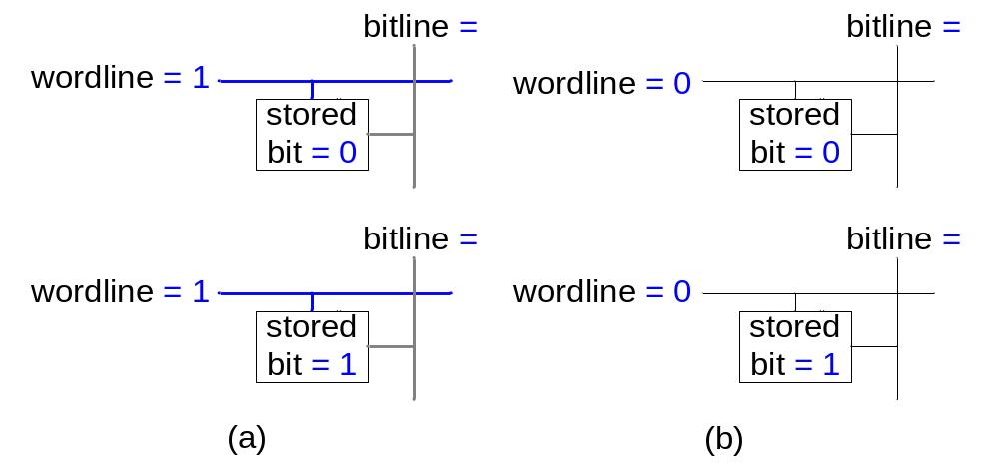
Memory Array Bit Cells
Example:

Slide 61
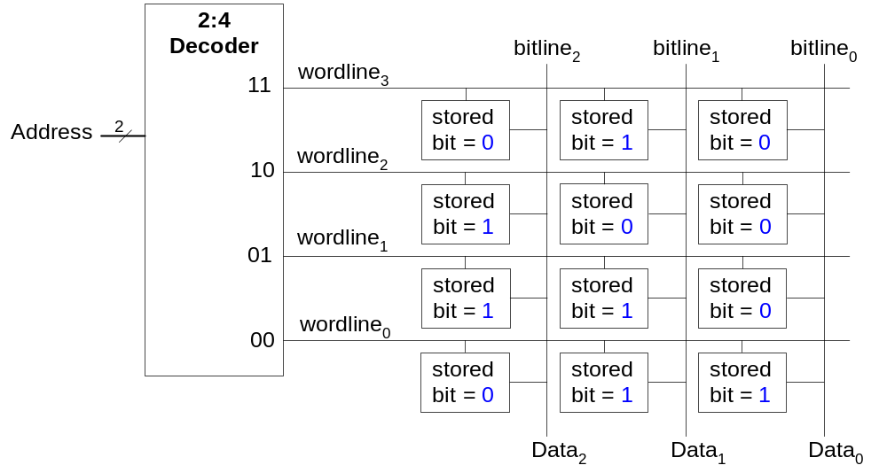
Memory Array
The wordline, similar to an enable, allows a single row in the memory array to be read or written at once.
Each wordline corresponds to a unique address – only one wordline is HIGH at any given time

Slide 62
Types of Memory
Random access memory (RAM): volatile
Read only memory (ROM): nonvolatile

Slide 63
RAM
Random access memory
  Volatile: loses its data when the power is turned off
  Can be read and written quickly
  Main memory in your computer is RAM (specifically, DRAM)
  Historically called random access memory because any data word can be accessed as easily as any other (in contrast to sequential access memories such as a tape recorder).

Slide 64
Types of Memory
Read only memory (ROM)
  Nonvolatile: retains its data when power is turned off
  Can be read quickly, but writing is slow
  Memory in cameras, thumb drives, and digital cameras are all ROMs
  Historically called read only memory because ROMs were written by burning fuses. Once the fuses were written by the manufacturer, they could not be written again. This is no longer the case.

Slide 65
Types of RAM
The two main types of RAM are:
  Dynamic random access memory (DRAM)
  Static random access memory (SRAM)
They differ in how they store data:
  DRAM uses a capacitor
  SRAM uses cross-coupled inverters

Slide 66

Robert Dennard, 1932 -
Invented DRAM in 1966 at IBM
Others were skeptical that the idea would work
By the mid-1970’s DRAM was in virtually all computers

Slide 67
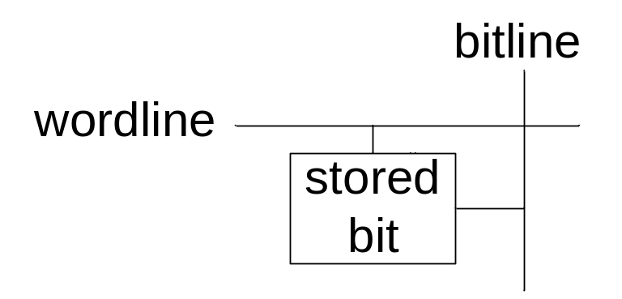
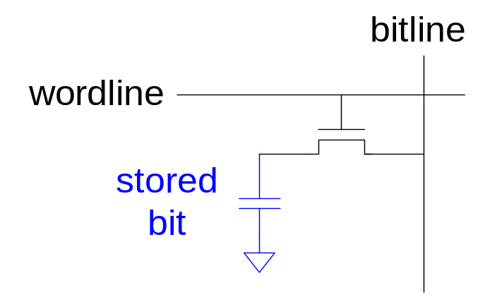
DRAM
Data bits are stored on a capacitor.
DRAM is called dynamic because the value needs to be refreshed (rewritten) periodically and after being read because:
  Charge leakage from the capacitor degrades the value
  Reading destroys the stored value

Slide 68
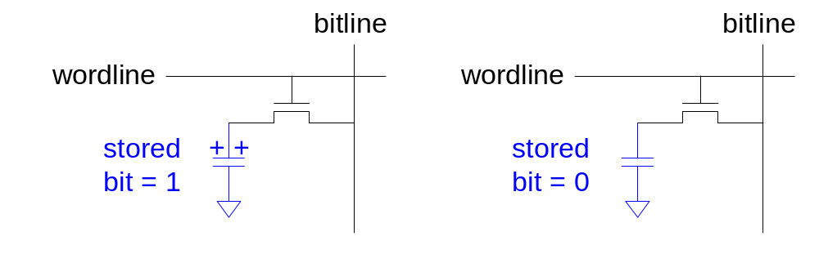
DRAM

Slide 69
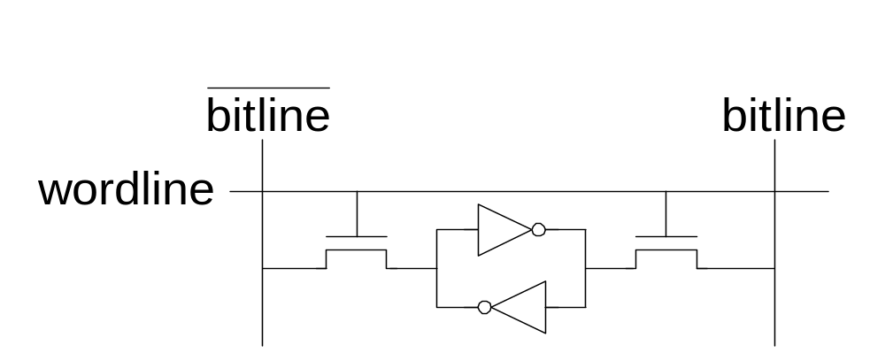
SRAM

Slide 70
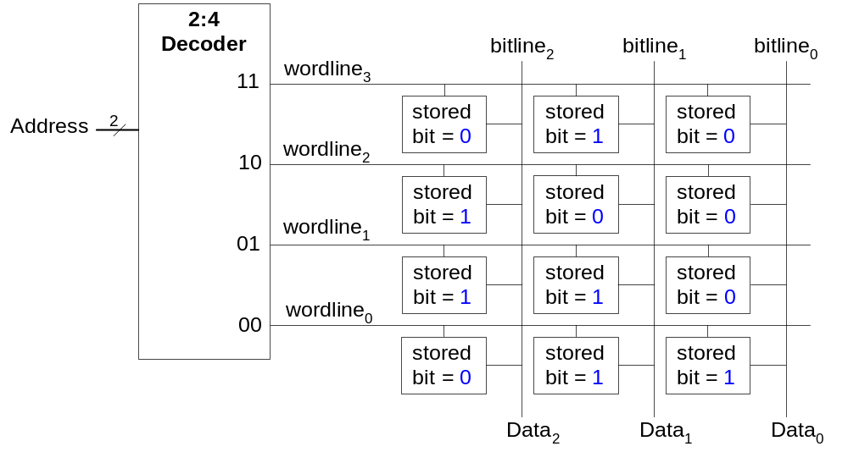
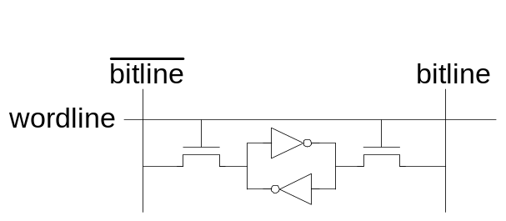
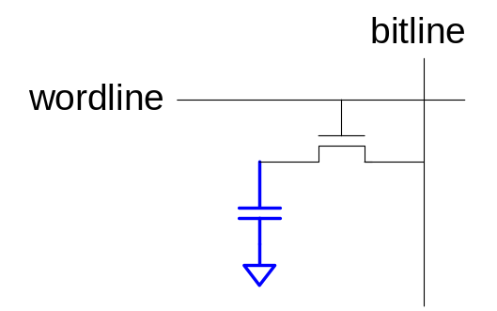
Memory Arrays
DRAM bit cell:
SRAM bit cell:

Slide 71
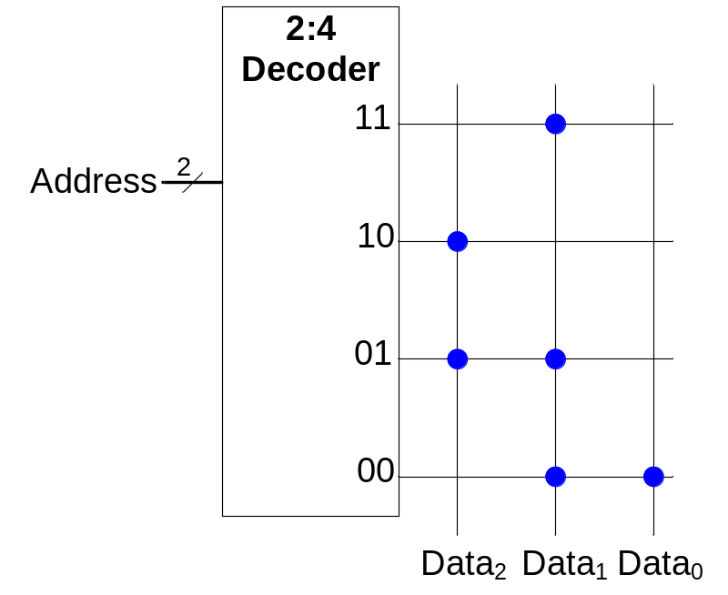
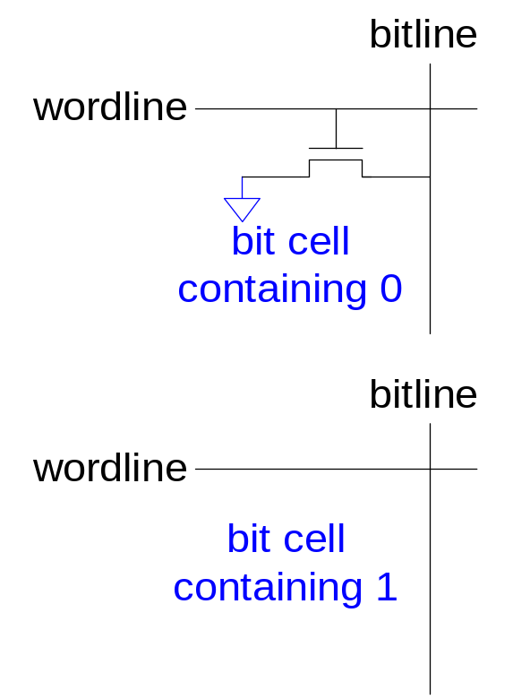
ROMs

Slide 72
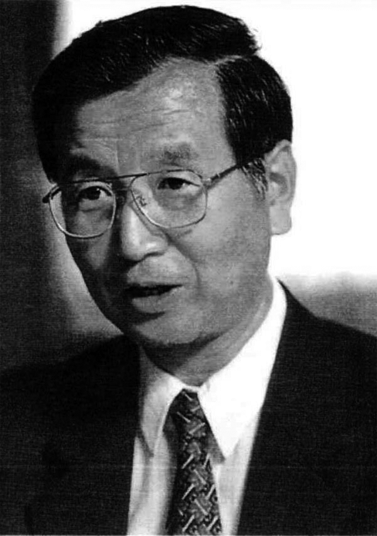
Fujio Masuoka, 1944-
Developed memories and high speed circuits at Toshiba from 1971-1994.
Invented Flash memory as an unauthorized project pursued during nights and weekends in the late 1970’s.
The process of erasing the memory reminds one of the flash of a camera
Toshiba slow to commercialize the idea; Intel was first to market in 1988
Flash has grown into a $25 billion per year market.

Slide 73
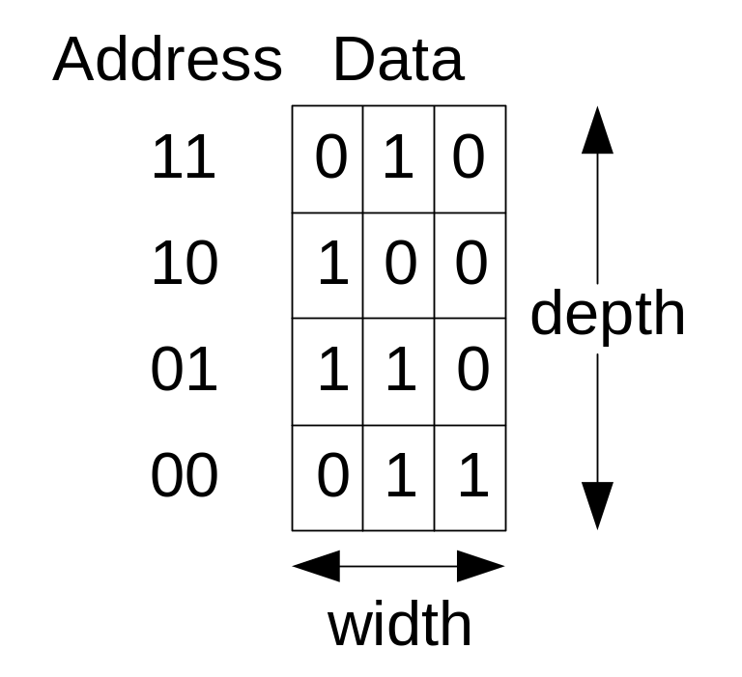
ROM Storage

Slide 74
ROM Logic
Data₂ = A₁ ⊕ A₀
Data₁ = A₁ + A₀
Data₀ = A₁A₀

Slide 75
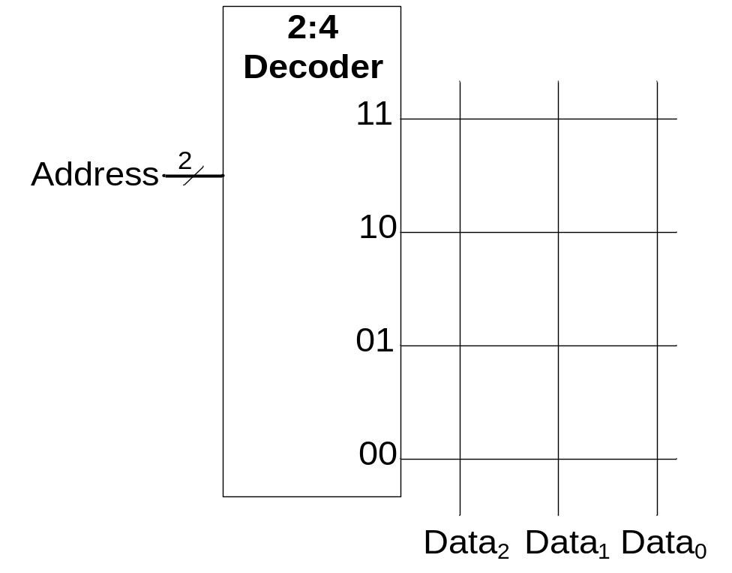
Example: Logic with ROMs
Implement the following logic functions using a 2² × 3-bit ROM:
  X = AB
  Y = A + B
  Z = AB

Slide 76
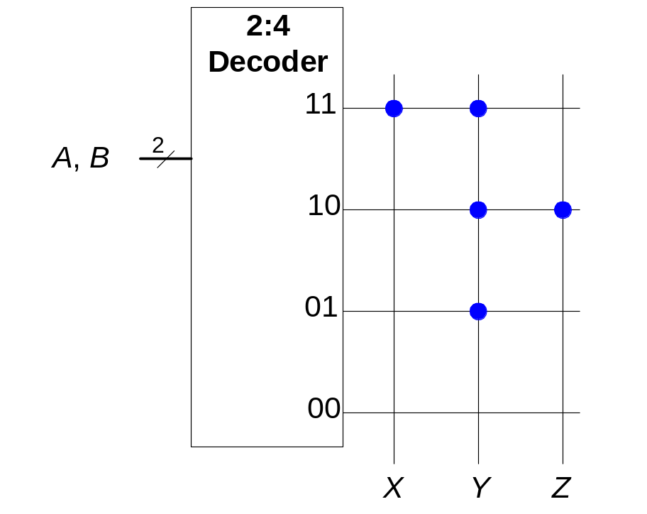
Example: Logic with ROMs
Implement the following logic functions using a 2² × 3-bit ROM:
  X = AB
  Y = A + B
  Z = AB

Slide 77
Logic with Memory Arrays
Data₂ = A₁ ⊕ A₀
Data₁ = A₁ + A₀
Data₀ = A₁A₀

Slide 78
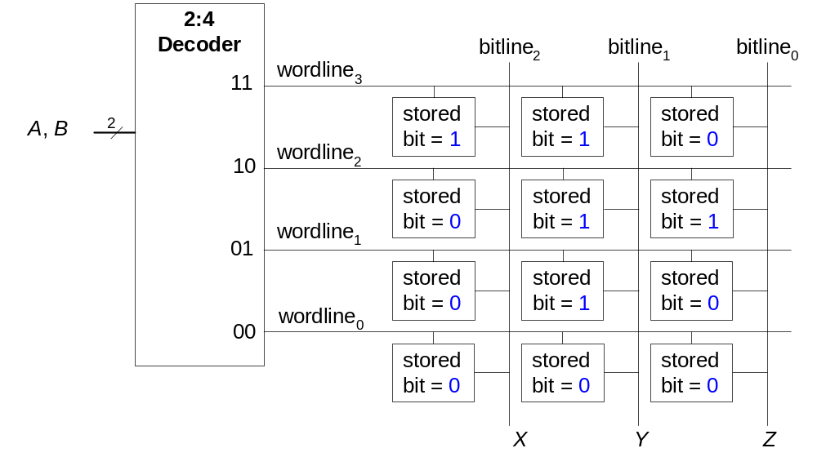
Logic with Memory Arrays
Implement the following logic functions using a 2² × 3-bit memory array:
  X = AB
  Y = A + B
  Z = AB

Slide 79
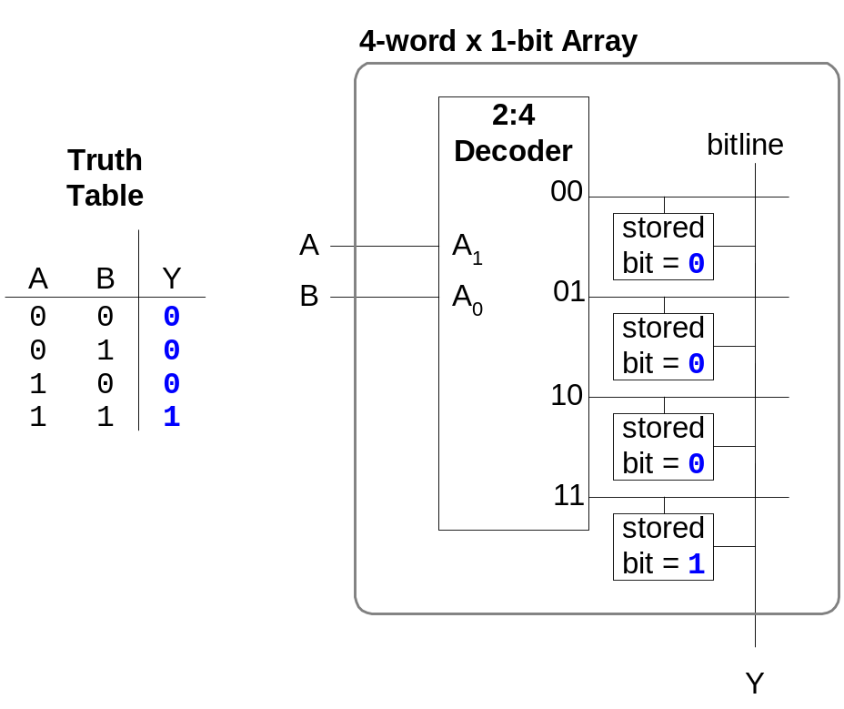
Logic with Memory Arrays
Memory arrays used to perform logic are called lookup tables (LUTs).
The user looks up the value of the output at each input combination (address).

Slide 80
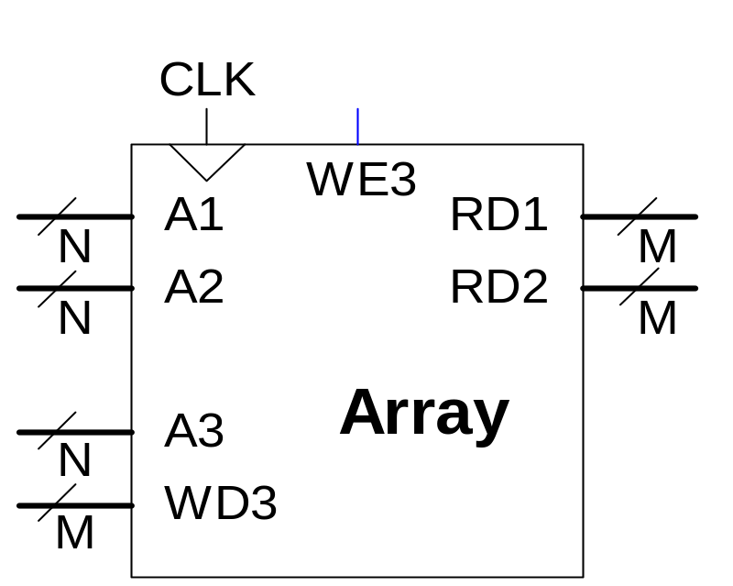
Multi-ported Memories
Port: address/data pair
3-ported memory
  2 read ports (A1/RD1, A2/RD2)
  1 write port (A3/WD3, WE3 enables writing)

Slide 81
Verilog Memory Arrays
// memory module with one read/write port
module dmem( input clk, we,
input [7:0] a
input [2:0] wd,
output [2:0] rd);
reg [2:0] RAM[255:0];
assign rd = RAM[a];
always @ (posedge clk)
if (we)
RAM[a] <= wd;
endmodule

Slide 82
Logic Arrays
Programmable logic arrays (PLAs)
  AND array followed by OR array
  Perform combinational logic only
  Fixed internal connections
Field programmable gate arrays (FPGAs)
  Array of configurable logic blocks (CLBs)
  Perform combinational and sequential logic
  Programmable internal connections

Slide 83
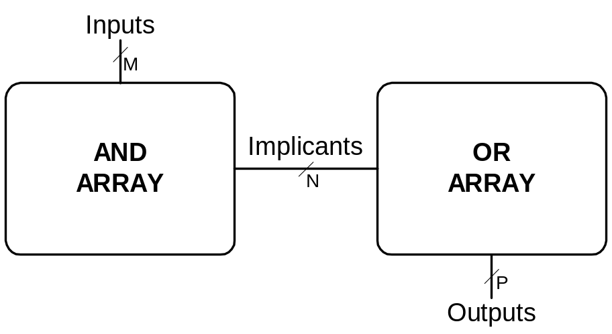

PLAs

Slide 84

PLAs

Slide 85
FPGAs
Composed of:
  CLBs (Configurable logic blocks): to perform logic
  IOBs (Input/output buffers): to interface with outside world
  Programmable interconnection: to connect CLBs and IOBs
  Some FPGAs include other building blocks such as multipliers and RAMs

Slide 86

Xilinx Spartan 3 FPGA Schematic

Slide 87
CLBs
Composed of:
  LUTs (lookup tables): to perform combinational logic
  Flip-flops: to perform sequential functions
  Multiplexers: to connect LUTs and flip-flops

Slide 88

Xilinx Spartan CLB

Slide 89
Xilinx Spartan CLB
The Spartan CLB has:
  3 LUTs:
    F-LUT (2⁴ x 1-bit LUT)
    G-LUT (2⁴ x 1-bit LUT)
    H-LUT (2³ x 1-bit LUT)
  2 registered outputs:
    XQ
    YQ
  2 combinational outputs:
    X
    Y

Slide 90
CLB Configuration Example
Show how to configure the Spartan CLB to perform the following functions:
  X = ABC + ABC
  Y = AB

Slide 91

CLB Configuration Example
Show how to configure the Spartan CLB to perform the following functions:
  X = ABC + ABC
  Y = AB

Slide 92
FPGA Design Flow
A CAD tool (such as Xilinx Project Navigator) is used to design and implement a digital system.
The user enters the design using schematic entry or an HDL.
The user simulates the design.
A synthesis tool converts the code into hardware and maps it onto the FPGA.
The user uses the CAD tool to download the configuration onto the FPGA
This configures the CLBs and the connections between them and the IOBs.

