Slide 1
Outline
n Importance of Resource Management
n What is Project Resource Management?
n Keys to Managing and Leading People
n Six Main Processes
1. Developing Resource Management Plan and Team Charter
2. Estimating Activity Resources
3. Acquiring Resources
4. Developing the Project Team
5. Managing the Project Team
6. Controlling Resources
n Using Software to Assist in Resource Management
2

Slide 2


Importance of Resource Management
n Many corporate executives have said
“People are our most important asset.”
People determine the success and failure of organizations and projects
n Most project managers agree that managing human resources effectively is one of the toughest challenges they face
Managing people is a vital component of project resource management, especially in the IT field, in which qualified people are often hard to find and retain
n To implement IT projects successfully, organizations need to understand project resource management and make effective use of people
Proactive organizations are addressing current and future human resource needs by improving benefits, redefining work hours and incentives, and
finding future workers
3

Slide 3


What is Project Resource Management (P.R.M.)? (1 of 2)
n P.R.M. includes the processes required to make the most effective use of the human and physical resources involved with a project
Human resources include all project stakeholders: sponsors, customers, project team members, support staff, suppliers, etc.
Physical resources include facilities, equipment, materials, and supplies
n Six main processes
1. Planning resource management: decide how to estimate, acquire, manage, and use project resources.
2. Estimating activity resources: estimate human and physical resources needed to complete project work.
3. Acquiring resources: obtain team members, facilities, equipment, materials, supplies, and other resources as needed.
4. Developing the project team: build individual and group skills to enhance project performance.
4

Slide 4
What is Project Resource Management (P.R.M.)? (2 of 2)
n Six main processes (cont’d)
5. Managing the project team: track team member performance, motivate team members, provide timely feedback, resolve issues and conflicts, and coordinate changes to help enhance project performance.
6. Controlling resources: ensure that a project’s physical resources are
available as planned, monitor the planned versus actual resource utilization, and take corrective action when needed.
n Refer to Figure 9-1 of textbook for summaries of the input, tools and techniques, and outputs of P.R.M.
n Topics related to P.R.M. are introduced in Lecture 1 and will also be introduced in Lecture 11 “Project Stakeholder Management”
5

Slide 5
Keys to Managing and Leading People
n Psychologists and management theorists have devoted much research and thought to the field of managing and leading people at work
n Psychosocial issues affecting how people work and how well they work include motivation, influence and power, effectiveness, emotional
intelligence, and leadership
n In this section, we briefly review
i. Contributions ofAbraham Maslow, Frederick Herzberg, David
McClelland, and Douglas McGregor to an understanding of motivation
ii. Work ofThamhain and Wilemon on influencing workers and reducing conflict, and the effect of power on project teams
iii. Work of Stephen Covey on how people and teams can be more effective
iv. Gardner and Goleman’s focus on emotional intelligence
v. Recent research on leadership
6

Slide 6
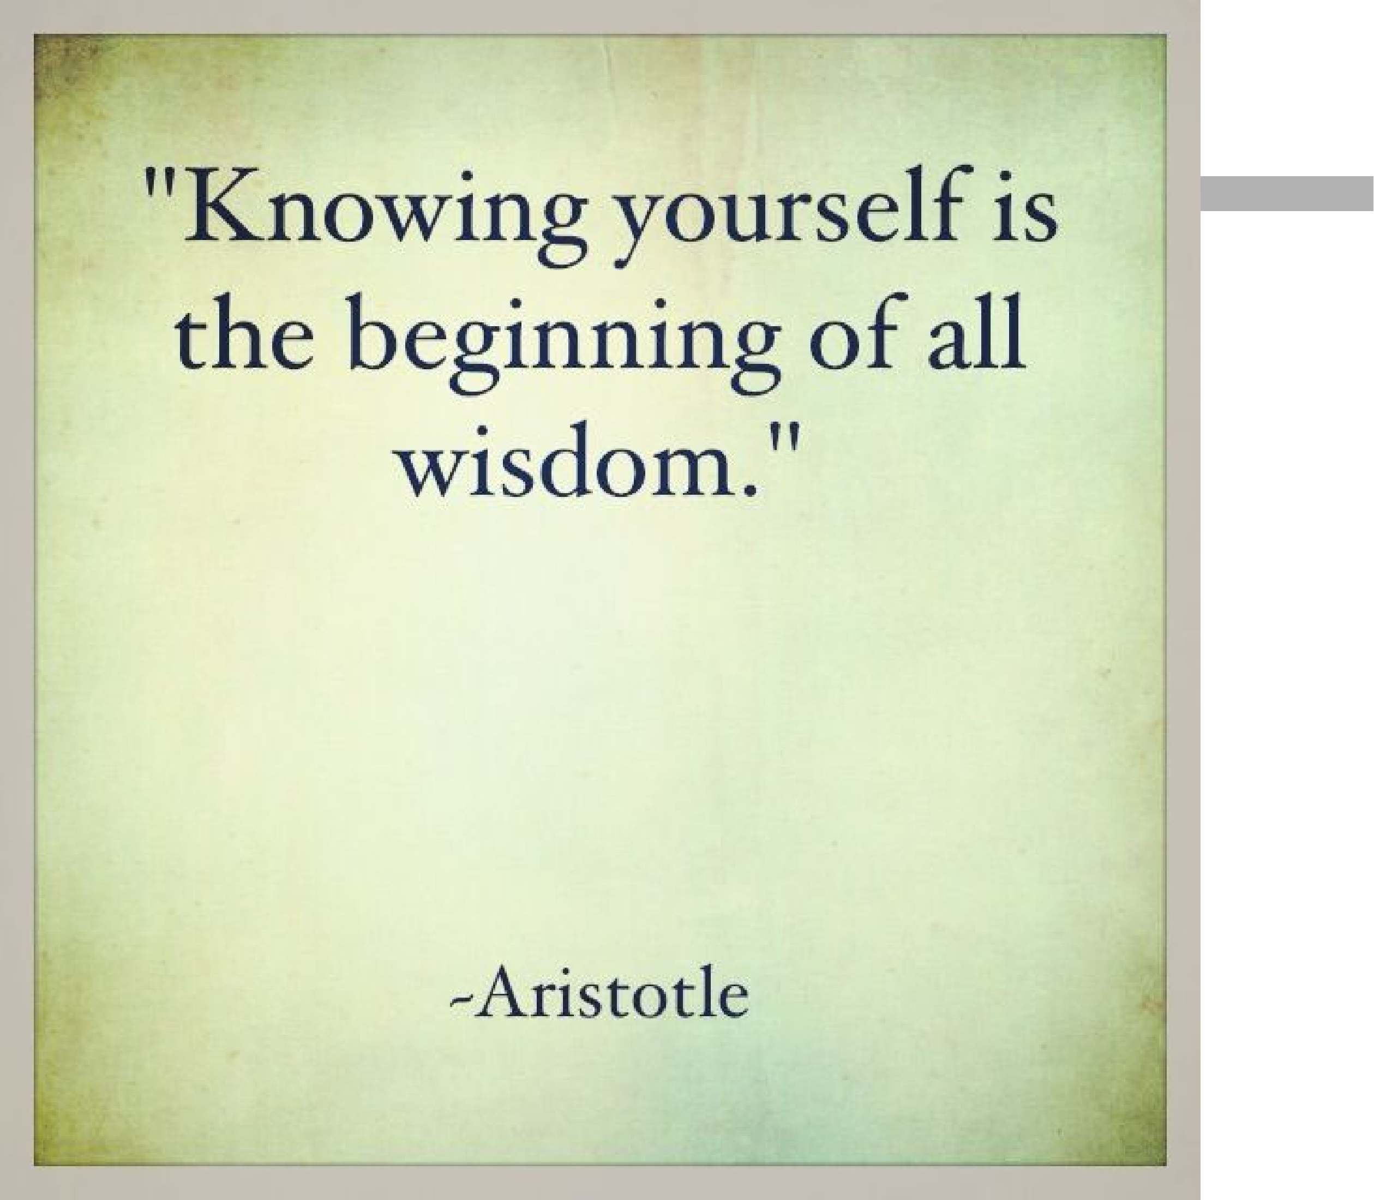
Why Aristotle said: knowing yourself is the beginning of allwisdom
7

Slide 7



Motivation Theories
n Most people struggle to understand what motivates people to do what they do
n Two types of motivations
Intrinsic motivation causes people to participate in an activity (e.g., read, write, or play piano) for their own enjoyment.
Extrinsic motivation causes people to do something for a reward or to avoid a penalty. For example, some children would prefer not to do homework, but they do for receiving a reward or avoiding a punishment.
天下熙熙皆为利来，天下攘攘皆为利往 --- 《史记·货殖列传》
n A basic understanding of motivation theories will help us understand ourselves as well as others
n This section provides brief summaries of different motivation theories
Refer to the textbook and other texts for more discussions
8

Slide 8
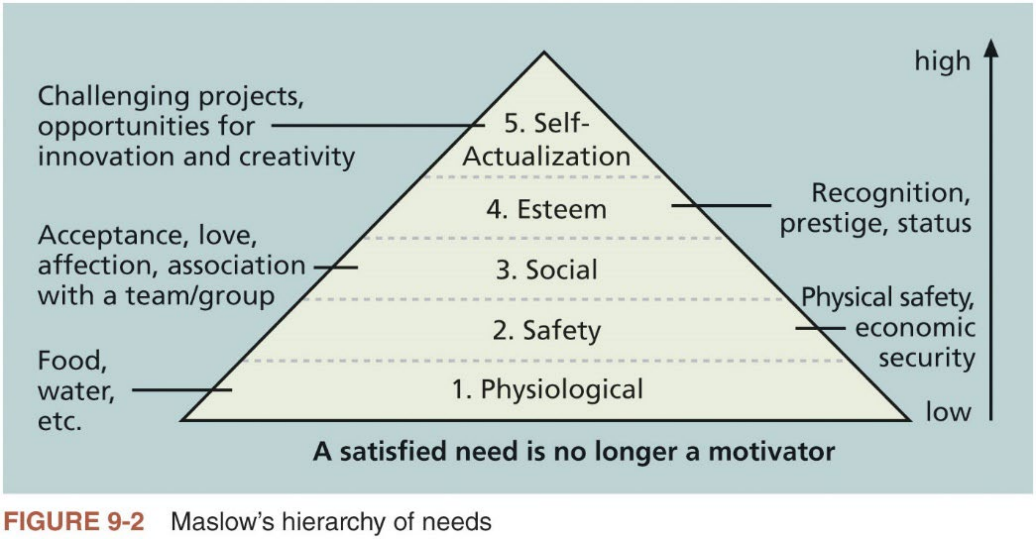
Maslow’s Hierarchy of Needs (1 of 2)
n Abraham Maslow is best known for developing a hierarch of needs (需 求层次), which states that people’s behaviors are guided or motivated by a sequence of needs
n Figure 9-2 shows its basic pyramid structure
9

Slide 9

Maslow’s Hierarchy of Needs (2 of 2)
n Maslow suggests that each level of the hierarchy is a prerequisite for the higher levels. Once a particular need is satisfied, however, it no longer serves as a potent motivator of behavior.
仓廪实则知礼节，衣食足则知荣辱 --- 《管子·牧民》
n The bottom four needs are referred to as deficiency needs. The highest level, self-actualization, is considered a growth need.
Self-actualized people are problem-focused, have an appreciation for life, are concerned about personal growth and able to have peak experiences.
n Project manager needs to understand each team member’s motivation, especially on the top three needs
Focus on meeting project goals, but also understand team members’
personal goals and needs to provide appropriate motivation and maximize team performance
10

Slide 10
Herzberg’s Motivational-Hygiene Theory
n Frederick Herzberg is best known for distinguishing between motivational factors (motivators) and hygiene factors for motivation in work settings
i. Motivators are factors that cause job satisfaction.
ii. Hygiene factors are factors that could cause job dissatisfaction if NOT present, but they would not motivate workers to do more if present.
n Table 9-1 shows examples of two types offactors
Hygiene Factors | Motivators
Larger salaries | Achievement
More supervision | Recognition
More attractive work environment | Work itself
Computer or other required equipment | Responsibility
Health benefits | Advancement
Training | Growth
Table 9-1 Examples of Herzberg’s hygiene factorsand motivators
11

Slide 11

McClelland’s Acquired-Needs Theory (1 of 2)
n David McClelland proposed that a person’s specific needs are acquired or learned over time and shaped by life experiences. Three categories of acquired needs are achievement, affiliation, and power
n Achievement
People who have a high need for achievement seek to excel and tend to avoid both low-risk and high-risk situations to improve their chances for achieving something worthwhile
Managers should give high achievers challenging projects with achievable goals, and frequent performance feedback
n Affiliation
People with a high need for affiliation desire harmonious relationships with other people and need to feel accepted by others.
Managers should try to create a cooperative work environment to meet their needs.
12

Slide 12

McClelland’s Acquired-Needs Theory (2 of 2)
n Power
People with a need for power desire personal or institutional power.
People who need personal power want to direct others and can be seen as
bossy. People who need institutional power or social power want to organize others to further the goals of the organization.
Managers should provide such employees with the opportunity to manage others, emphasizing the importance of meeting organizational goals.
Thematic Apperception Testn(TAT) is a tool to measure the individual needs of different people using McClelland’s categories
TAT presents subjects with a series of ambiguous pictures and asks them to develop a spontaneous story for each picture, assuming that they will project (投射) their own needs into the story.
13

Slide 13



McGregor’s Theory X and Y
n Douglas McGregor is best known for developing Theory X and Theory Y in the 1960s
Theory X assumes that workers dislike and avoid work if possible. Thus, managers must use coercion, threats, and various control schemes to have workers make adequate efforts to meet objectives.
Theory Y assumes that individuals do not inherently dislike work but
consider it as natural as play or rest. The most significant rewards are the satisfaction of esteem and self-actualization needs, echoing Maslow.
McGregor urged managers to motivate people based on Theory Y (do you agree with him?)
n William Ouchi introduced Theory Z in 1981 based on the Japanese approach to motivating workers
Theory Z emphasizes trust, quality, collective decision making, and cultural values.
14

Slide 14
Influence and Power (1 of 3)
n Many people working on a project do not report directly to project
managers. On the other hand, project managers often do not have control over project staff who report to them
n Thamhain and Wilemon identified nine influence bases available to project mangers to deal with workers
1. Authority: legitimate hierarchical right to issue orders
2. Assignment: ability to influence a worker’s later work assignments
3. Budget: ability to authorize others' use of discretionary funds
4. Promotion: ability to improve a worker’s position
5. Money: ability to increase a worker’s pay and benefits
6. Penalty: ability to cause punishment
7. Work challenge: ability to assign work that capitalizes on a worker’s enjoyment of doing a particular task
8. Expertise: perceived special knowledge that others deem important
9. Friendship: ability to establish friendly personal relationships between the project manager and others
15

Slide 15

Influence and Power (2 of 3)
n Ways to influence
Projects are more likely to fail when project managers rely too heavily on authority, money, or penalty to influence people
Projects are more likely to succeed when project managers use work challenges and expertise to influence people
n People issues have the strongest impact on project performance
Managers cannot succeed by simply issuing work orders, preparing plans, or providing guidelines. They must emphasize common values and goals to
focus and unify global teams.
n Power (权力) is the potential ability to influence behavior to get people to do things they would not do otherwise
Power is related to but much stronger than influence, because it is often used to force people to change their behavior
16

Slide 16

Influence and Power (3 of 3)
n Five main types of power
1. Coercive power: use punishment, threats, or other negative approaches to get people to do things they do not want to do
2. Legitimate power: get people to do things based on a position of authority
3. Expert power: use personal knowledge and expertise to get people to change their behavior
4. Reward power: use incentives to induce people to do things
5. Referent power is based on a person’s own charisma (个人魅力)
n Important for project managers to understand what types of influence and power they can use in different situations
New project managers often overemphasize their legitimate power or
authority influence, but neglect the importance of reward power or work challenge influence
17

Slide 17
Covey and Improving Effectiveness (1 of 2)
n Stephen Covey developed an approach in his book The 7 Habits of Highly Effective People for helping people and teams become more effective
n Project managers can apply Covey’s seven habits to improve effectiveness on projects
i. Be proactive
ii. Begin with the end in mind
iii. Put first things first
iv. Think win-win
v. Seek first to understand, then to be understood
vi. Synergize
vii. Sharpen the saw
n Douglas Ross related Covey’s habits to PM in his article Applying Covey’s Seven Habits to a Project Management Career
18

Slide 18



Covey and Improving Effectiveness (2 of 2)
n Ross suggests that Habit 5 differentiates good project managers from average or poor ones
Empathic listening (共情聆听) is listening with the intent to understand. It can help project managers and team members to find out w hat
motivates different people.
n Rapport (融洽的关系) is a relation of harmony, conformity, accord, or affinity
Without rapport, people cannot begin to communicate.
Mirroring is a technique for establishing rapport, which matches certain behaviors ofthe other person.
People tend to like others who are like themselves. Mirroring helps you take on some of the other person’s characteristics.
n IT professionals need to develop empathic listening and other people skills to improve relationships with users and other stakeholders
19

Slide 19


Emotional Intelligence
n Howard Gardner introduced the concept of using more than one way to think of and measure human intelligence
Interpersonal intelligence: capacity to understand the motivations, intentions, and desires of others.
Intrapersonal intelligence: capacity to understand oneself, one’s own feelings, and motivations.
n Emotional intelligence (E.I.): know and manage one’s own emotions and understand the emotions of others for improved performance
n The need for project managers to develop their E.I.
E.I. comes into play when project managers work on team building, collaboration, negotiation, and relational development
E.I. becomes a more sought-after characteristic (e.g., many hiring managers in the U.S. value E.I. more than IQ)
20

Slide 20


Leadership
n A leader focuses on long-term goals and big-picture objectives while inspiring people to reach those goals
n Leadership is a soft skill and no one best way to be a leader
There are many different leadership styles
The best leaders can adapt their style to needs of the situation
“The goal for leaders should be to develop a solid understanding of the
different styles of leadership and their implications and reach the point where choosing the right one for the situation becomes second nature to them. ”
Primary Leadership by Daniel Goleman
n Important to understand and pay attention to concepts of motivation,
influence, power, effectiveness, emotional intelligence, and leadership in all project processes
21

Slide 21
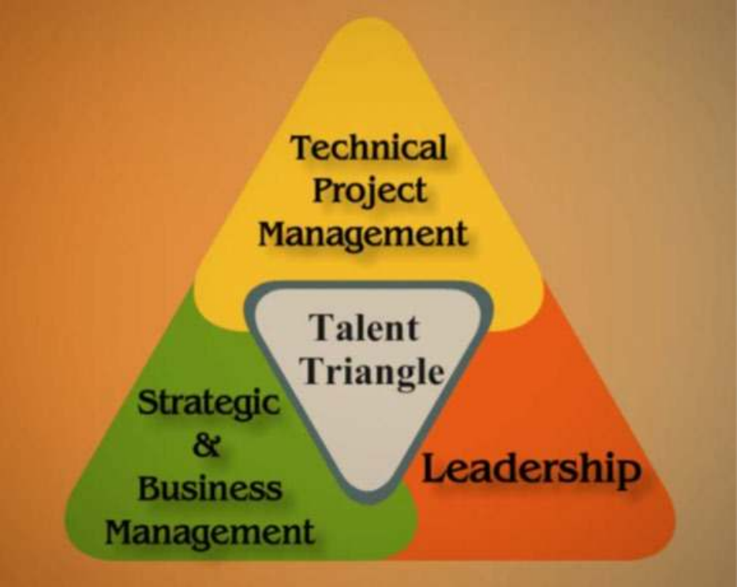
What Went Right?
n PMI introduced Talent Triangle® in 2015 to
emphasize the need for more than technical
skills for project managers
i. Technical project management
ii. Strategic and business management
iii. Leadership
n In a recent PMI report, 75% of organizations ranked leadership skills as most important for successful navigation of complexity in projects
“Managing complex projects requires project managers who are able to
establish the vision, mission and expected outcomes in a way that is broad enough to be complete yet simple enough to understand. It also requires the skill to align the team to that vision.
These are project managers who have become project executives with the
leadership skill and business acumen to drive success.”
22

