Slide 1
Chapter 4 Mathematical Functions, Characters, and Strings

Slide 2
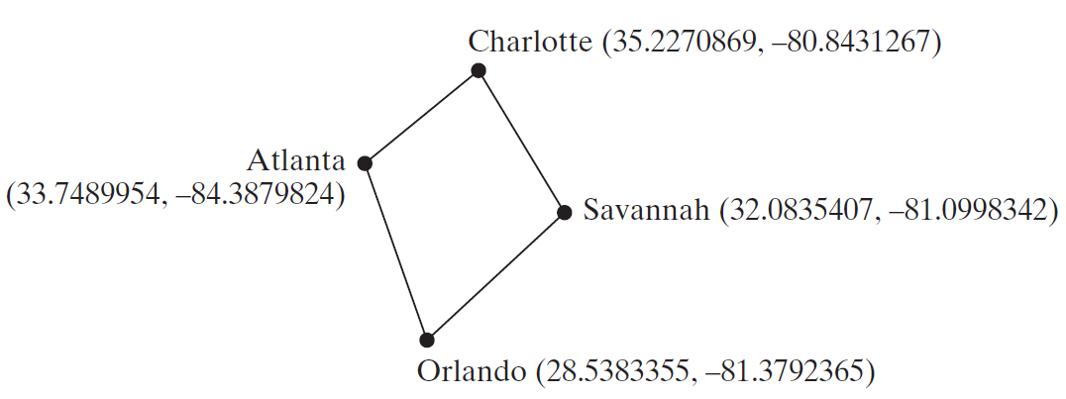
Motivations
Suppose you need to estimate the area enclosed by four cities, given the GPS locations (latitude and longitude) of these cities, as shown in the following diagram. How would you write a program to solve this problem? You will be able to write such a program after completing this chapter.

Slide 3
Objectives
To solve mathematics problems by using the methods in the Math class (§4.2).
To represent characters using the char type (§4.3).
To encode characters using ASCII and Unicode (§4.3.1).
To represent special characters using the escape sequences (§4.4.2).
To cast a numeric value to a character and cast a character to an integer (§4.3.3).
To compare and test characters using the static methods in the Character class (§4.3.4).
To introduce objects and instance methods (§4.4).
To represent strings using the String objects (§4.4).
To return the string length using the length() method (§4.4.1).
To return a character in the string using the charAt(i) method (§4.4.2).
To use the + operator to concatenate strings (§4.4.3).
To read strings from the console (§4.4.4).
To read a character from the console (§4.4.5).
To compare strings using the equals method and the compareTo methods (§4.4.6).
To obtain substrings (§4.4.7).
To find a character or a substring in a string using the indexOf method (§4.4.8).
To program using characters and strings (GuessBirthday) (§4.5.1).
To convert a hexadecimal character to a decimal value (HexDigit2Dec) (§4.5.2).
To revise the lottery program using strings (LotteryUsingStrings) (§4.5.3).
To format output using the System.out.printf method (§4.6).

Slide 4
Mathematical Functions
Java provides many useful methods in the Math class for performing common mathematical functions.

Slide 5
The Math Class
Class constants:
  PI
  E
Class methods:
  Trigonometric Methods
  Exponent Methods
  Rounding Methods
  min, max, abs, and random Methods

Slide 6
Trigonometric Methods
sin(double a)
cos(double a)
tan(double a)
acos(double a)
asin(double a)
atan(double a)
Examples:
Math.sin(0) returns 0.0
Math.sin(Math.PI / 6) returns 0.5
Math.sin(Math.PI / 2) returns 1.0
Math.cos(0) returns 1.0
Math.cos(Math.PI / 6) returns 0.866
Math.cos(Math.PI / 2) returns 0
Radians
toRadians(90)

Slide 7
Exponent Methods
exp(double a)
  Returns e raised to the power of a.
log(double a)
  Returns the natural logarithm of a.
log10(double a)
  Returns the 10-based logarithm of a.
pow(double a, double b)
  Returns a raised to the power of b.
sqrt(double a)
  Returns the square root of a.
Examples:
Math.exp(1) returns 2.71
Math.log(2.71) returns 1.0
Math.pow(2, 3) returns 8.0
Math.pow(3, 2) returns 9.0
Math.pow(3.5, 2.5) returns 22.91765
Math.sqrt(4) returns 2.0
Math.sqrt(10.5) returns 3.24

Slide 8
Rounding Methods
double ceil(double x)
  x rounded up to its nearest integer. This integer is returned as a double value.
double floor(double x)
  x is rounded down to its nearest integer. This integer is returned as a double value.
double rint(double x)
  x is rounded to its nearest integer. If x is equally close to two integers, the even one is returned as a double.
int round(float x)
  Return (int)Math.floor(x+0.5).
long round(double x)
  Return (long)Math.floor(x+0.5).

Slide 9
Rounding Methods Examples
Math.ceil(2.1) returns 3.0
Math.ceil(2.0) returns 2.0
Math.ceil(-2.0) returns –2.0
Math.ceil(-2.1) returns -2.0
Math.floor(2.1) returns 2.0
Math.floor(2.0) returns 2.0
Math.floor(-2.0) returns –2.0
Math.floor(-2.1) returns -3.0
Math.rint(2.1) returns 2.0
Math.rint(2.0) returns 2.0
Math.rint(-2.0) returns –2.0
Math.rint(-2.1) returns -2.0
Math.rint(2.5) returns 2.0
Math.rint(-2.5) returns -2.0
Math.round(2.6f) returns 3
Math.round(2.0) returns 2
Math.round(-2.0f) returns -2
Math.round(-2.6) returns -3

Slide 10
min, max, and abs
max(a, b)and min(a, b)
  Returns the maximum or minimum of two parameters.
abs(a)
  Returns the absolute value of the parameter.
random()
  Returns a random double value
  in the range [0.0, 1.0).
Examples:
Math.max(2, 3) returns 3
Math.max(2.5, 3) returns 3.0
Math.min(2.5, 3.6) returns 2.5
Math.abs(-2) returns 2
Math.abs(-2.1) returns 2.1

Slide 11

The random Method
Generates a random double value greater than or equal to 0.0 and less than 1.0 (0 <= Math.random() < 1.0).
Examples:
In general,

Slide 12
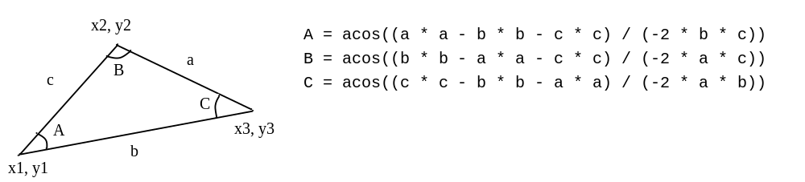
Case Study: Computing Angles of a Triangle
Write a program that prompts the user to enter the x- and y-coordinates of the three corner points in a triangle and then displays the triangle’s angles.
IMPORTANT NOTE: If you cannot run the buttons, see www.cs.armstrong.edu/liang/javaslidenote.doc.
ComputeAngles
Run

Slide 13
Character Data Type
Four hexadecimal digits.
char letter = 'A'; (ASCII)
char numChar = '4'; (ASCII)
char letter = '\u0041'; (Unicode)
char numChar = '\u0034'; (Unicode)
NOTE: The increment and decrement operators can also be used on char variables to get the next or preceding Unicode character. For example, the following statements display character b.
  char ch = 'a';
  System.out.println(++ch);

Slide 14

Unicode Format
Java characters use Unicode, a 16-bit encoding scheme established by the Unicode Consortium to support the interchange, processing, and display of written texts in the world’s diverse languages. Unicode takes two bytes, preceded by \u, expressed in four hexadecimal numbers that run from '\u0000' to '\uFFFF'. So, Unicode can represent 65535 + 1 characters.
Unicode \u03b1 \u03b2 \u03b3 for three Greek letters

Slide 15
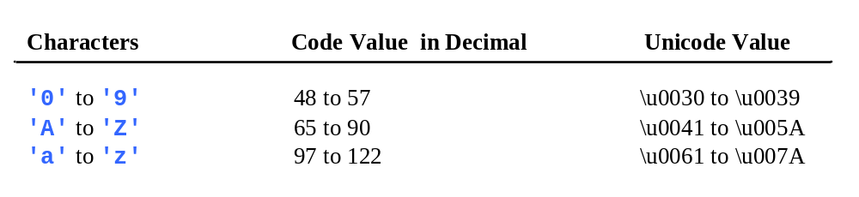
ASCII Code for Commonly Used Characters

Slide 16
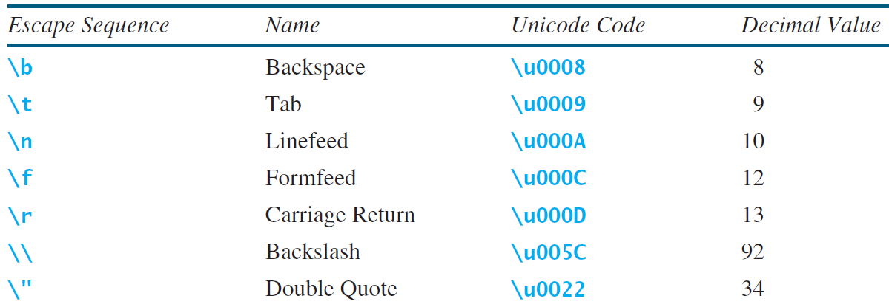
Escape Sequences for Special Characters

Slide 17

Appendix B: ASCII Character Set
ASCII Character Set is a subset of the Unicode from \u0000 to \u007f

Slide 18

ASCII Character Set, cont.
ASCII Character Set is a subset of the Unicode from \u0000 to \u007f

Slide 19
Casting between char and Numeric Types
int i = 'a'; // Same as int i = (int)'a';
char c = 97; // Same as char c = (char)97;

Slide 20
Comparing and Testing Characters
if (ch >= 'A' && ch <= 'Z')
System.out.println(ch + " is an uppercase letter");
else if (ch >= 'a' && ch <= 'z')
System.out.println(ch + " is a lowercase letter");
else if (ch >= '0' && ch <= '9')
System.out.println(ch + " is a numeric character");

Slide 21
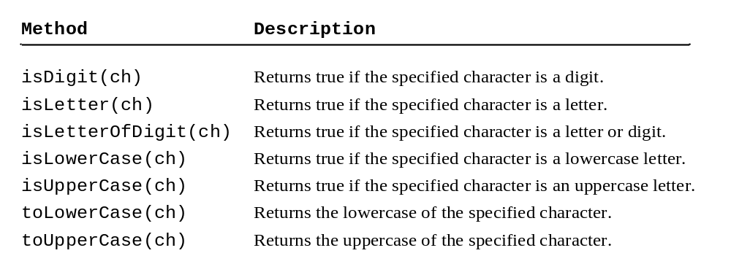
Methods in the Character Class

Slide 22
The String Type
The char type only represents one character. To represent a string of characters, use the data type called String. For example,
String message = "Welcome to Java";
String is actually a predefined class in the Java library just like the System class and Scanner class. The String type is not a primitive type. It is known as a reference type. Any Java class can be used as a reference type for a variable. Reference data types will be thoroughly discussed in Chapter 9, “Objects and Classes.” For the time being, you just need to know how to declare a String variable, how to assign a string to the variable, how to concatenate strings, and to perform simple operations for strings.

Slide 23
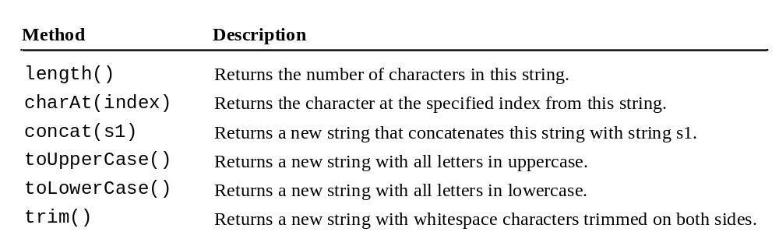
Simple Methods for String Objects

Slide 24
Simple Methods for String Objects
Strings are objects in Java. The methods in the preceding table can only be invoked from a specific string instance. For this reason, these methods are called instance methods. A non-instance method is called a static method. A static method can be invoked without using an object. All the methods defined in the Math class are static methods. They are not tied to a specific object instance. The syntax to invoke an instance method is
referenceVariable.methodName(arguments).

Slide 25
Getting String Length
String message = "Welcome to Java";
System.out.println("The length of " + message + " is "
+ message.length());

Slide 26
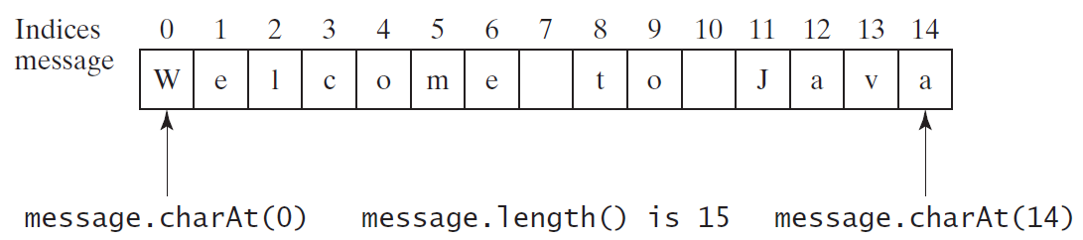
Getting Characters from a String
String message = "Welcome to Java";
System.out.println("The first character in message is "
+ message.charAt(0));

Slide 27
Converting Strings
"Welcome".toLowerCase() returns a new string, welcome.
"Welcome".toUpperCase() returns a new string, WELCOME.
" Welcome ".trim() returns a new string, Welcome.

Slide 28
String Concatenation
String s3 = s1.concat(s2); or String s3 = s1 + s2;
// Three strings are concatenated
String message = "Welcome " + "to " + "Java";
// String Chapter is concatenated with number 2
String s = "Chapter" + 2; // s becomes Chapter2
// String Supplement is concatenated with character B
String s1 = "Supplement" + 'B'; // s1 becomes SupplementB

Slide 29
Reading a String from the Console
Scanner input = new Scanner(System.in);
System.out.print("Enter three words separated by spaces: ");
String s1 = input.next();
String s2 = input.next();
String s3 = input.next();
System.out.println("s1 is " + s1);
System.out.println("s2 is " + s2);
System.out.println("s3 is " + s3);

Slide 30
Reading a Character from the Console
Scanner input = new Scanner(System.in);
System.out.print("Enter a character: ");
String s = input.nextLine();
char ch = s.charAt(0);
System.out.println("The character entered is " + ch);

Slide 31
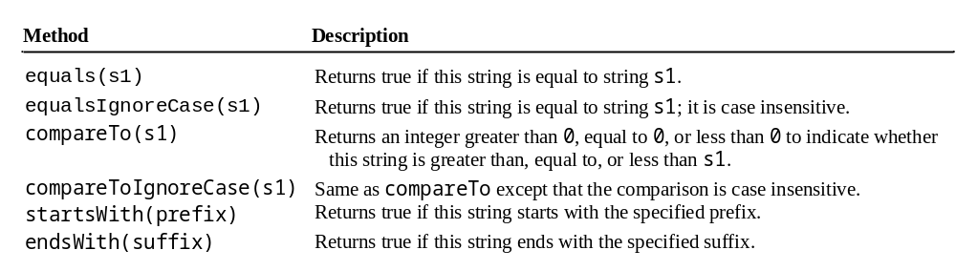
Comparing Strings
OrderTwoCities
Run

Slide 32
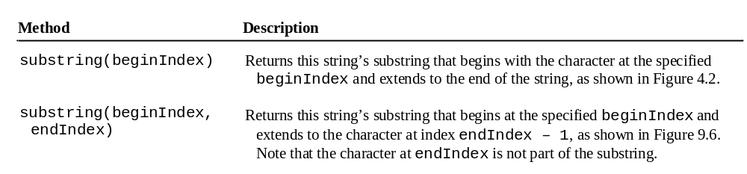
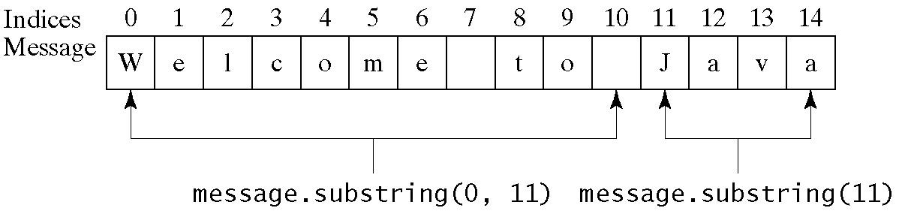
Obtaining Substrings

Slide 33
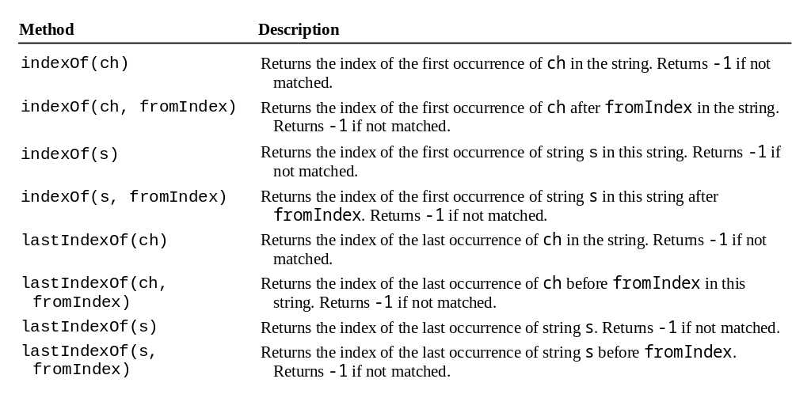
Finding a Character or a Substring in a String

Slide 34
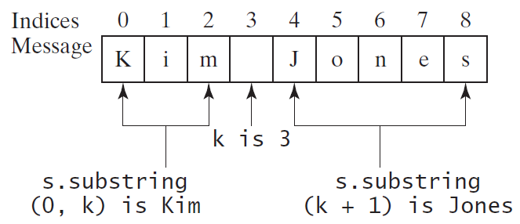
Finding a Character or a Substring in a String
int k = s.indexOf(' ');
String firstName = s.substring(0, k);
String lastName = s.substring(k + 1);

Slide 35
Conversion between Strings and Numbers
int intValue = Integer.parseInt(intString);
double doubleValue = Double.parseDouble(doubleString);
String s = number + "";

Slide 36
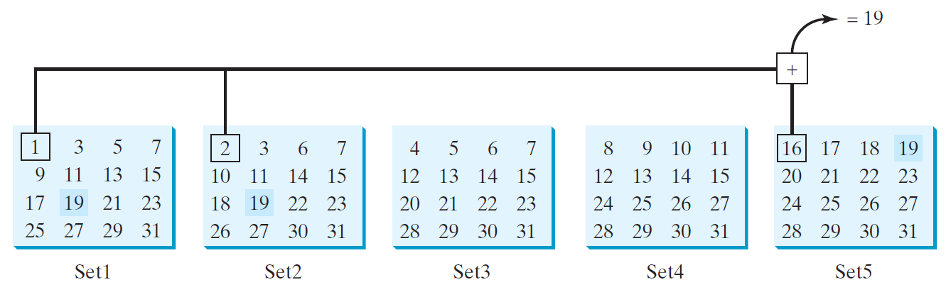

Problem: Guessing Birthday
The program can guess your birth date. Run to see how it works.
GuessBirthday

Slide 37
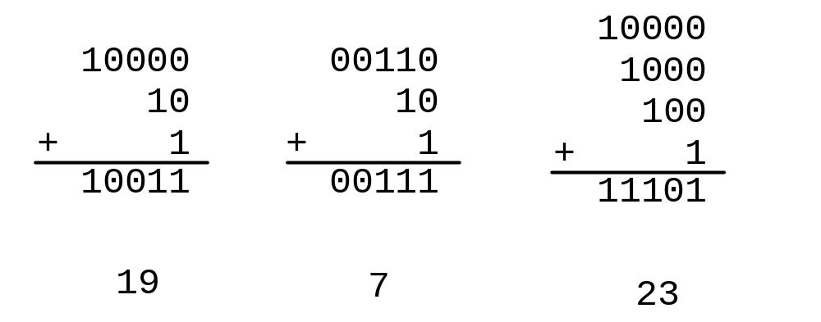
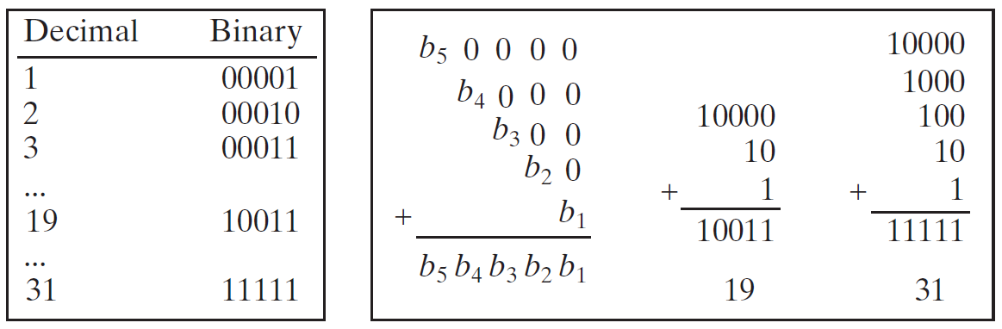
Mathematics Basis for the Game
19 is 10011 in binary. 7 is 111 in binary. 23 is 11101 in binary

Slide 38
Case Study: Converting a Hexadecimal Digit to a Decimal Value
Write a program that converts a hexadecimal digit into a decimal value.
HexDigit2Dec
Run

Slide 39
Case Study: Revising the Lottery Program Using Strings
A problem can be solved using many different approaches. This section rewrites the lottery program in Listing 3.7 using strings. Using strings simplifies this program.
Chapter3：Lottery
LotteryUsingStrings
Run

Slide 40
Formatting Output
Use the printf statement.
  System.out.printf(format, items);
Where format is a string that may consist of substrings and format specifiers. A format specifier specifies how an item should be displayed. An item may be a numeric value, character, boolean value, or a string. Each specifier begins with a percent sign.

Slide 41

Frequently-Used Specifiers
Specifier Output Example
%b a boolean value true or false
%c a character 'a'
%d a decimal integer 200
%f a floating-point number 45.460000
%e a number in standard scientific notation 4.556000e+01
%s a string "Java is cool"

Slide 42
FormatDemo
The example gives a program that uses printf to display a table.
FormatDemo
Run

