Slide 1
1. Computation and Analysis
(5 x 8’ = 40’)

Slide 2
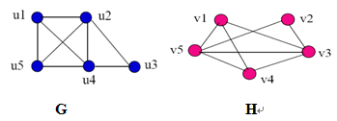
(1) Find out whether G and H are isomorphic. No matter what the judgment is, please give your explanation and argument.

Slide 3
Answer of (1)
deg(u3) = deg(v2) = 2 so f(u3) = v2 is our only choice.
deg(u1) = deg(u5) = deg(v1 ) = deg(v4) = 3 so we must have either f(u1) = v1 and f(u5) = v4 or f(u1) = v4 and f(u5) = v1.
Finally since deg(u2) = deg(u4) = deg(v3) =deg(v5) = 4 we must have either f(u2) = v3 and f(u4) = v5 or f(u2) = v5 and f(u4) = v3.
We first try the relabeling using in each case to get the function
f(u3)=v2, f(u1)=v1, f(u5)=v4, f(u2)=v3, f(u4)=v5. Thus, G and H are isomorphic.

Slide 4
（2）Prove
is a tautology.
Answer:

Slide 5
( 3 ) Construct an argument using rules of inference to show that the hypotheses:
“Ellen, a student in this class, owns a red convertible. Everyone who owns a red convertible has gotten at least one speeding ticket.”
imply the conclusion “someone in this class has gotten a speeding ticket.”

Slide 6
Answer of (3)
①Let: S(x): x is a student in this class; R(x): x is a red convertible. O(x, y): x owns y; T(x): x is a speeding ticket. The universe of discourse x, y, z is all people and things respectively.
Then: H1: S(Ellen)∧∃y(R(y)∧O(Ellen,y)); H2: ∀x(∃y (O(x,y)∧R(y)) → ∃z(T(z)∧ O(x,z))); C: ∃x∃y(S(x)∧T(y)∧ O(x,y))
Proof：H2 use UI, x：Ellen；with H12；∃Z (T (z)∧ O (Ellen, z)) with H11 use EI then C

Slide 7
Answer of (3)
②Let S(x): x is a student in this class, C(x): x owns a red convertible.
P(x, y): x has gotten y.T(x): x is a speeding ticket.
Imply the conclusion “someone in this class has gotten a speeding ticket.” Then the premises are
S(Linda) ∧ C(Linda) , ∀x[ C(x) ® ∃y(T(y) ∧ P(x,y))]; The conclusion is ∃x ∃y[S( x) ∧ T(y) ∧P(x,y)].

Slide 8
Answer of (3)
The proof is
1. ∀x[ C(x) ® ∃y(T(y) ∧ P(x,y))] premise
2. C(Linda) ® ∃y(T(y) ∧ P(Linda,y)) step 1 and UI
3. S(Linda) ∧ C(Linda) premise
4. C(Linda) step 3 and simplification
5. ∃y(T(y) ∧ P(Linda,y)) step 4 and step 3 and I11
6. S(Linda) step 3 and simplification
7. S(Linda) ∧ ∃y(T(y) ∧ P(Linda,y)) step 6 and step 5 and conjunction
8. ∃x ∃y[S(x) ∧ T(y) ∧P(x, y)] step 7 and EG

Slide 9
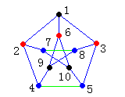
( 4 ) Prove that Petersen graph is non-planar graphs.

Slide 10
Answer of (4)
The sub-graph H of the Petersen shown in Figure (b) obtained by deleting 3 and the three edges that have 3 as an endpoint,
is homeomorphic to K3,3.
Hence, the Petersen graph is non-planar.

Slide 11
(5) Show that the relation R on the set of all bit strings such that s R t if and only if s and t contain the same odd- or even-property number of 1s is an equivalence relation.
(For example, one has 2 1s and the other also has even number of 1s )

Slide 12
Answer of (5)
5. Proof.
①x R x，S is reflexive.
②If x R y, they have odd (or even) number of 1s, Hence, y R x, symmetric.
③ If x R y and y R z, R is transitive.

Slide 13
2. Application of Discrete Mathematics.
(5 x 12’ = 50’)

Slide 14
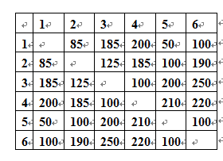
(1) How many different channels are needed for six stations located at the distances shown in the table, if two stations can not use the same channel when they are within 180 miles of each other?

Slide 15
Answer of (1)
Solution: This schedule problem can be solved using a graph model, with vertices representing stations and with edges between two vertices if the distances are within 180 miles. Chromatic number is 3.

Slide 16
(2) There are twenty SCUT students of which 8 persons are volunteers of Asian Games 2010 (VAG), 6 persons are volunteers of Asian Para Games 2010 (VAPG) and 2 persons are both VAGs and VAPGs.
Question: How many persons are neither VAGs nor VAPGs?

Slide 17
Answer of (2)
Solution: W is the set of VAGs. S is the set of VAPGs.
So |W| = 8, |S| = 6, |W ∩ S| = 2
Therefore,

Slide 18
(3) If a person is a university student, he is either a liberal-arts student or a science student.
Some university student is an outstanding student. John is not a liberal-arts student, but he is an outstanding student.
John is a university student.
Use rules of inference to show that John is a science student.

Slide 19

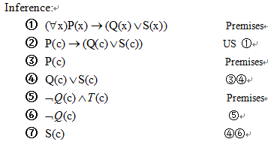
Answer of (3)

Slide 20
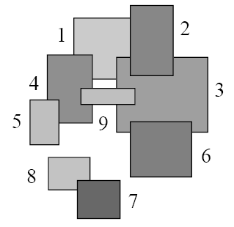
(4) Consider the rectangles T={1,…,9} and the relation R such that i R j = “i is more distant than j from the viewer.” Then R is a partial order on the set of rectangles. Please show an order of topological sorting according to the following figure.

Slide 21
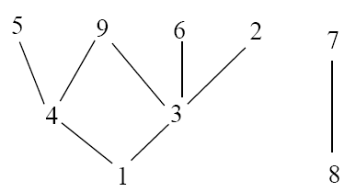
Answer of (4)
Then 1R2, 1R4, 1R3, 4R9, 4R5, 3R2, 3R9, 3R6, 8R7.
The Hasse diagram for R is
An order of topological sorting is “1 4 3 8 5 9 6 2 7”.

Slide 22
(5) n cities are connected by k roads. A road is incident with only two cities, which is defined as an edge between two vertices (cities).
A property of the roads and cities is k>(n-1)(n-2)/2.
The question is whether people can travel between any two cities through the roads.

Slide 23
Answer of (5)
Supposed that a graph of the given n cities and k roads is G, the question can be considered to be the proof that G is connected.
Given simple graph G=(V,E), |V|=n cities and |E|=k roads, please prove that G is connected when k>(n-1)(n-2)/2.

Slide 24
Supposed that G is unconnected, G has at least 2 connected component, signed as G1=(V1, E1) and G2=(V2, E2), where |V1|=n1, |V2|=n2 and n1+n2=n.
Because G is a simple graph, |E1|<=n1(n1-1)/2 and |E2|<=n2(n2-1)/2.
Therefore, k<=n1(n1-1)/2+n2(n2-1)/2.

Slide 25
Since n1<=n-1 and n2<=n-1, k<=(n-1)(n1-1+n2-1)=(n-1)(n-2)/2.
This is contradictory to the condition that k>(n-1)(n-2)/2.
Thus, G is connected, so people can travel between any two cities through the roads.

