Slide 1
Go implementation of DOTS (waiting for go-dots)
IETF 99 Hackathon

Slide 2
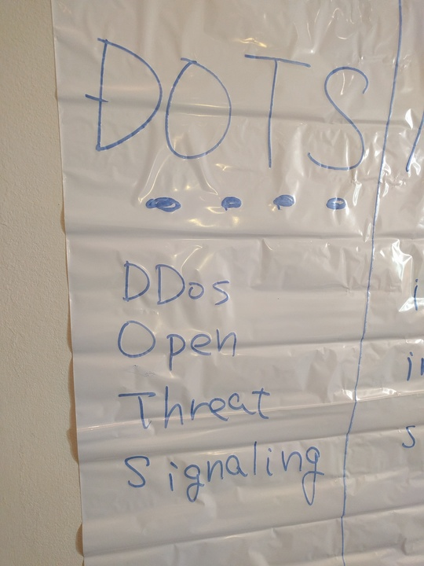
What is DOTS?

Slide 3
Signaling for DDoS Protection
Automation and Standardization of signaling for DDoS protection
“ask for help!” from a victim to upstream
inter-organization
include authN/authZ in spec
Protection status information from the upstream provider to the victim

Slide 4
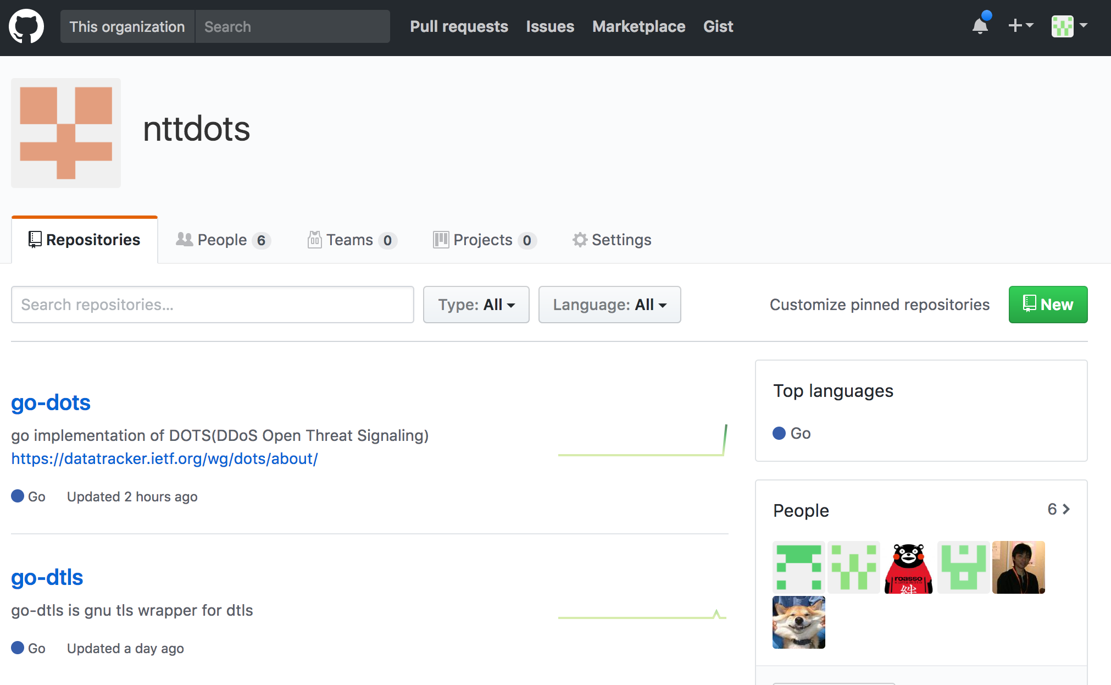
We opened the code
https://github.com/nttdots

Slide 5
What was developed in hackathon
made the code easy to be deployed in various environments
made docker-compose files for each services
refined configuration part
clarified the documents
for newcomers to this field

Slide 6
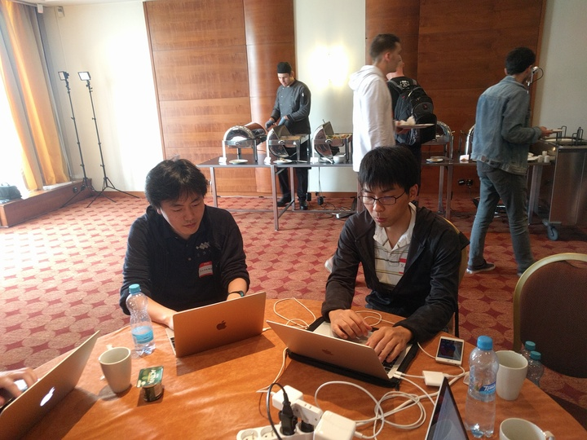
Demos and Interests
made a demonstration of one user scenario
on a portable docker environment
triggering “blackhole routing” from victim side
attracted 4 people and showed them demo

Slide 7
Next Step
As an OSS,
adopt to the various deployment scenario
keep going on the implementation of WG drafts and make feedback to the spec
your feedback is welcome☺

Slide 8
DOTS is getting popular!
DDoS protection is one of the biggest issues among network operators.
DOTS WG is aiming to have interoperability testing at the next hackathon in IETF100

