Slide 1
Deliverables of MILE@Hackathon
IETF MILE Meeting
16-17 July 2017 (Prague)
Takeshi Takahashi and Mio Suzuki

Slide 2
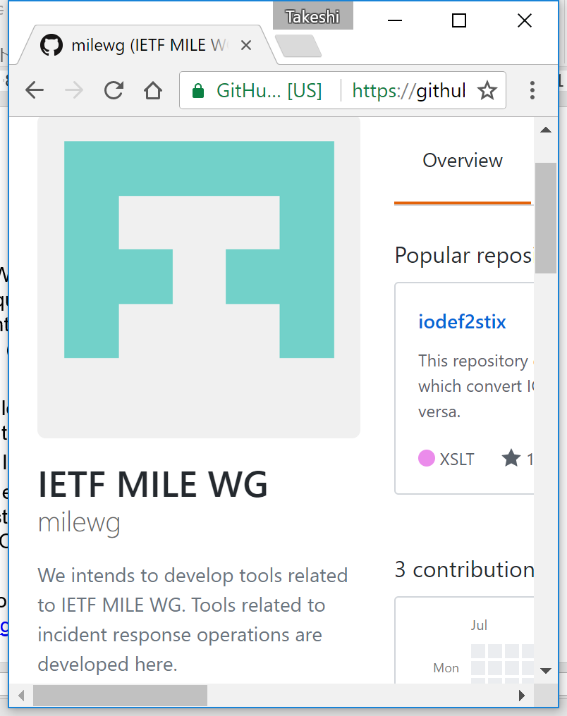
Project Overview
MILE WG develops a set of standard techniques for efficiently exchanging incident-related information among parties (e.g., RFC7970)
The following tools were developed during this Hachathon.
An IODEF-STIX converter (PoC)
An extension tool of NICT’s darknet system that provides security alerts in IODEFv2
Our tools are available online https://github.com/milewg

Slide 3
Status of the work
An IODEF-STIX converter
Deliverable:
PoC versions of Iodef2stix and stix2iodef were produced.
Status and Notes:
It is still a simple PoC, and the number of supported classes are minimal.
The classes of IODEF and STIX are not necessarily corresponding each other. Some information needs to be put in a placeholder that is produced by extending several classes.
An extension to NICT’s security alerting system
Deliverable:
We finished producing the plugin during this Hackathon.

