Slide 1

Toodaloo
Final Presentation
Nadir Abdusemed, Lloyd Castro, Jose Flores, Patrick Sangalang

Slide 2
Project Overview
What is Toodaloo?
Who is it For?
Features We’ve Built
Software Architecture
Design Process
Technical Highlights
Challenges and Decisions
Teamwork Process
Improvements
Nadir Abdusemed

Slide 3
What is Toodaloo?
To-do list extension
Make list’s and create tasks to keep track
Remind you about self-imposed deadlines
Ease of use and integration to Firefox
Nadir Abdusemed

Slide 4
Who is it For?
Students or anyone with bad time management
Helps users keep track of task and be more organized
People who want to discipline themselves into a schedule
Provide a sense of accomplishment
Increase of productivity
Set a priority and focus on a goal
Nadir Abdusemed

Slide 5
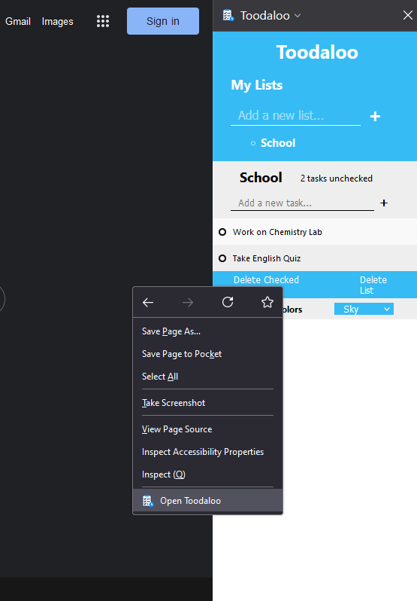
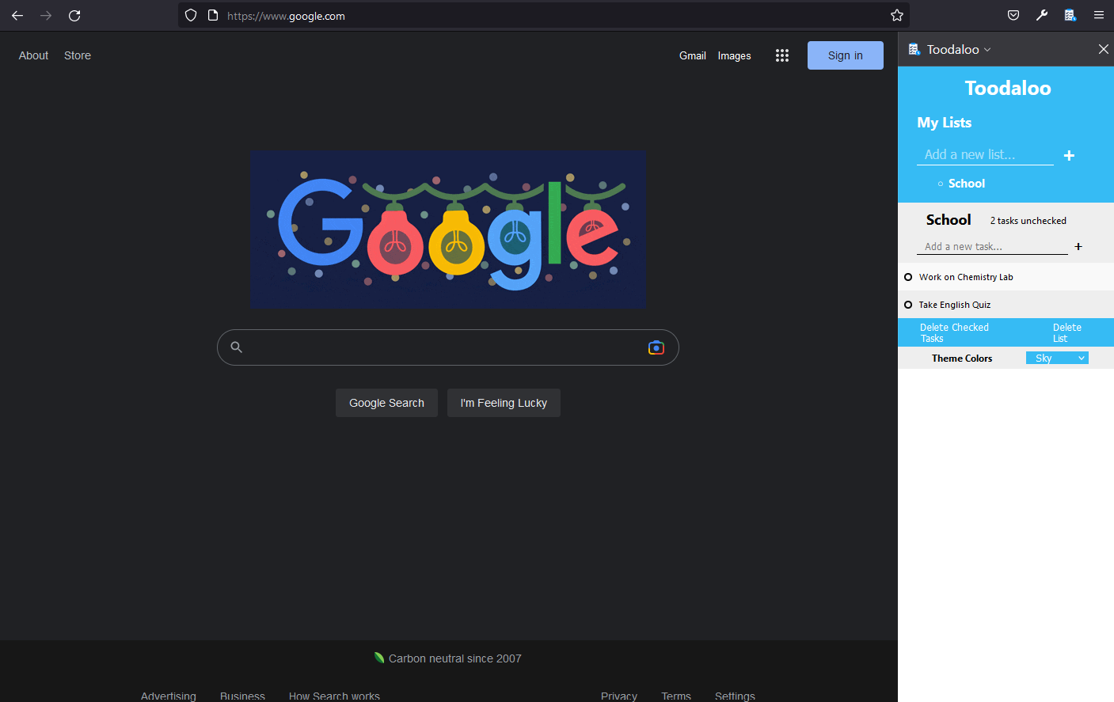
Features
Sidebar to display the extension
Context menu (alternative to open extension)
Sidebar
Context Menu
Patrick Sangalang
Notes:
So as far as the features go, we decided to go with a sidebar design to display the extension we have created. We felt that it looked cleaner implementing it this way as it allows the users of the extension to keep whatever they are working on the main priority taking up their screen space. We also added a context menu as another way to open the extension so that the users had a faster way of opening up their to do list and get to jotting down their tasks quickly, although it can be opened through the browser as well.

Slide 6
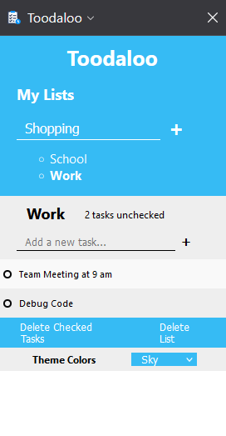
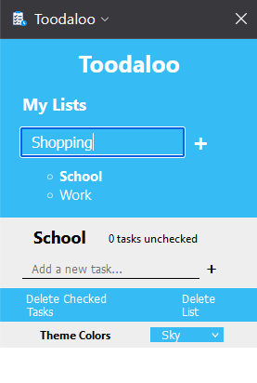
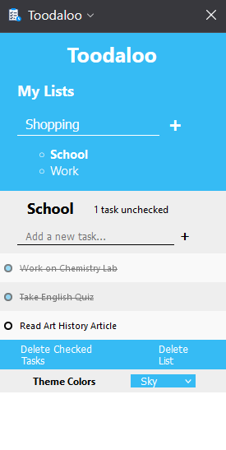
Features (cont.)
Create Multiple Lists
Add Tasks
Check off Tasks
Task Count
Create Multiple Lists
Add Tasks
Task Count
Check off Tasks
Patrick Sangalang
Notes:
We also added the ability for users to create multiple lists. The idea behind the implementation of this feature is to keep everything organized. For example, users are able to make specific lists solely for Shopping, containing things to buy from the grocery store, one for school containing what assignments and projects are needed to be worked on, and one for work to keep track of things such as meetings. On top of that, users have the ability of adding tasks to the appropriate list and are also able to check off these tasks once completed. We also added a task counter feature which essentially keeps track of how many tasks remains incomplete for each created list respectively.

Slide 7
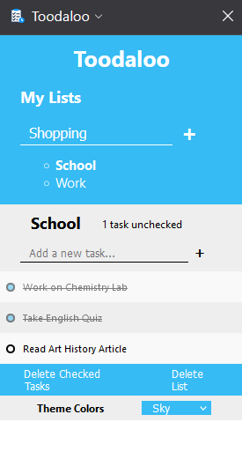
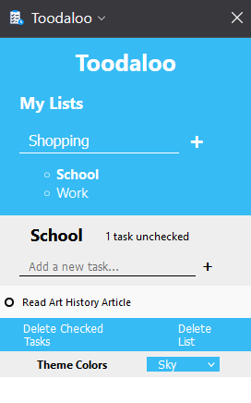
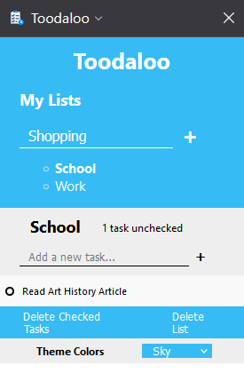
Features (cont.)
Save Lists and Tasks when closing extension
Delete Lists
Delete Checked Tasks
Delete Checked Tasks
Delete List
Patrick Sangalang
Notes:
The users are also able to save their lists and tasks before closing the extension. This feature allows the users to pick up from where they left off, or revisit tasks they have completed sometime later in the day or week as an example. Another feature we implemented is the deletion of lists to give the user ability to delete lists that they may deem not important anymore or ones that they have fully completed and would like to get rid off. In addition, we also have a delete checked tasks which essentially deletes all checked tasks within the list for easier organization.

Slide 8
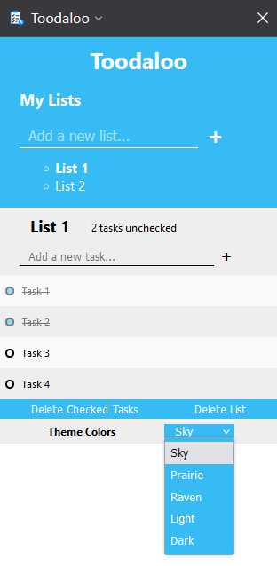
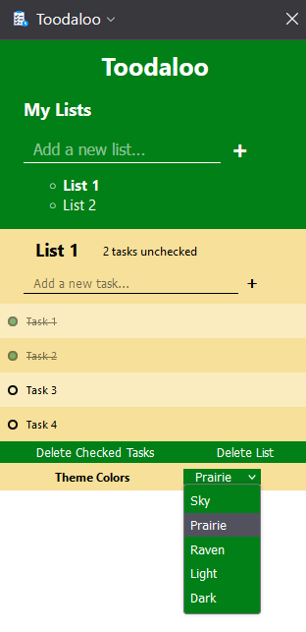
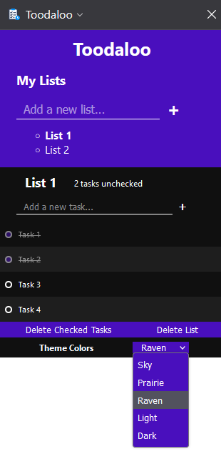
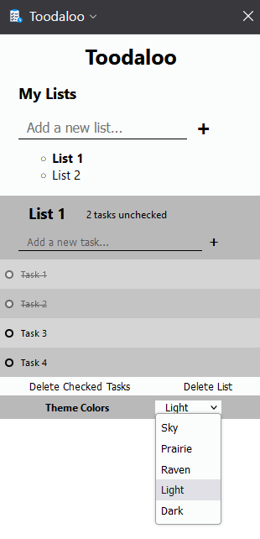
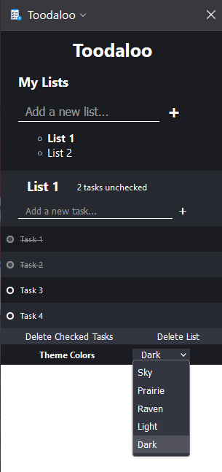
Features (cont.)
Change Theme Colors
Patrick Sangalang
Notes:
Finally, we also gave the users the ability to change theme colors to their liking. As we can see in the examples, there are 5 color schemes to choose from which give the extension a distinct look.

Slide 9
Features Outline Over Two Phases
Second Phase
Third/Final Phase
Sidebar
Context Menu
Add tasks
Check off tasks
Delete Tasks
Create/Add Multiple Lists
Save Lists and Tasks when closing an extension
Delete Lists
Delete Checked Tasks
Task Count
Change Theme Colors
Patrick Sangalang
Notes:
Here we could see the features outline over the two phases of the assignment and the corresponding tasks that were implemented in each respective phase.

Slide 10
Software Architecture
Local Storage
User Input
HTML
User interface
Application
Patrick Sangalang
Notes:
So here is the representation of how our software is structured. First the user interacts with the UI from the html which tells the application the request the user is making which then leads to the application storing the user data in a local storage while simultaneously accessing the localized storage when displaying the list.

Slide 11
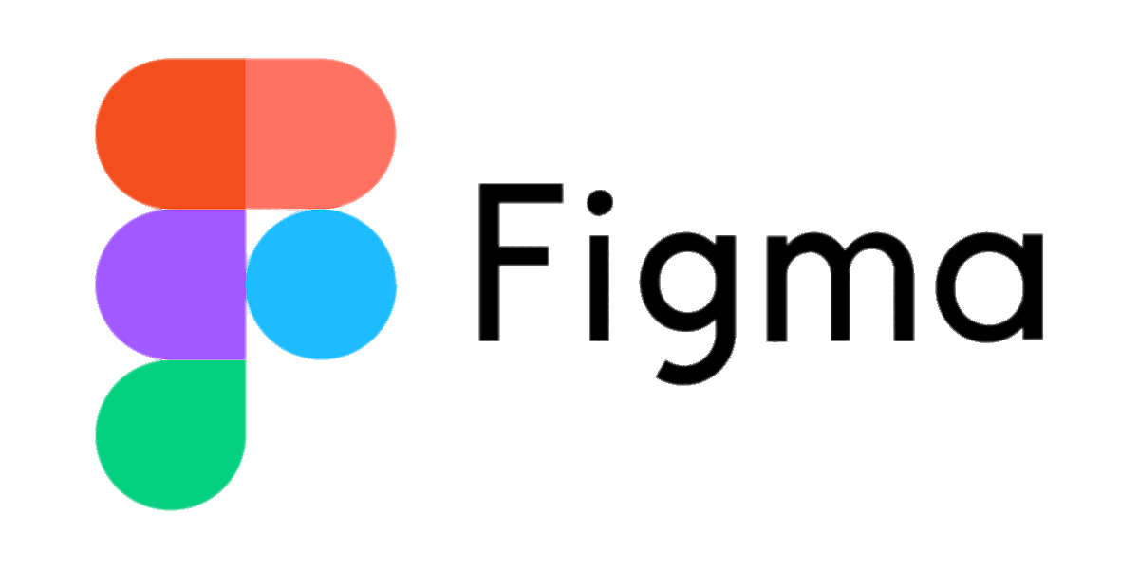
Design Process
Figma for UI designs of Toodaloo
Easy to learn
Team members have used it before
Simplistic Design
Lloyd Castro
Notes:
For our design process throughout the project’s development, we used a web application called Figma to create drafts of our extension’s design. We decided to add this program to our development process because it’s very accessible and its features are easy to learn. Also, some of our team members have used Figma before so this was brought to our attention in the beginning stages of our project’s development. Using Figma has helped us plan out how we want to design our extension so we would have a basis to refer to implementing our user interface using HTML and CSS. For our designs we came stuck with a simplistic design so it would look user-friendly for our new ones

Slide 12
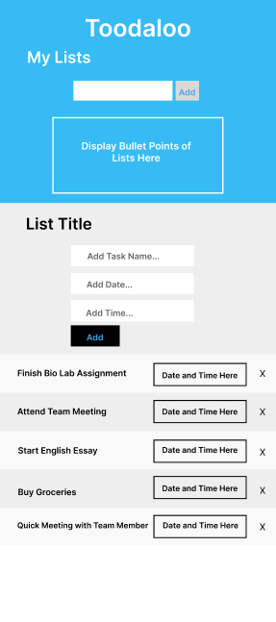
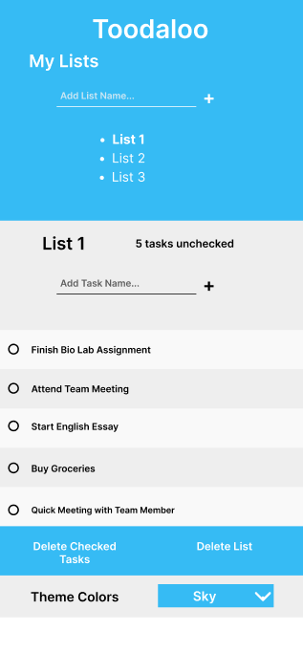
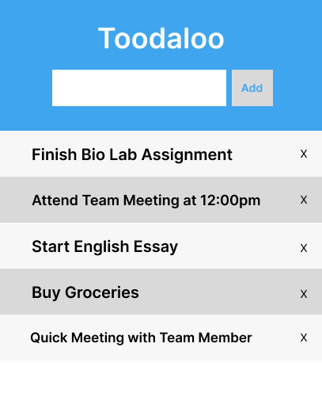
Design Process (cont.)
Lloyd Castro
Notes:
These designs are the drafts we created over the course of the project’s development. The first draft was very bare bones and we had the idea of implementing a basic todo list that allowed users to add tasks and delete tasks. Our second draft included the plan to implement features that included creating multiple lists and inputting a date and time when adding a task. However throughout the course of the project’s development, decisions were made to make changes to certain features and to cut off features that couldn’t be implemented in time. Because of that, that leads to our final draft which is what our extension looks like currently. It includes features such as creating multiple lists, deleting checked tasks, deleting lists, and changing theme colors. We also made some cosmetic changes such as the add button to make it more user friendly. What all these three design have in common is a simplistic look, which we decide to stick with for the entire project development.

Slide 13
Technical Highlights/Insights
Implement Javascript objects for the list and task
Dynamic CSS (css variables)
Multiple lists feature led to implementing a delete list feature
Lloyd Castro
Notes:
Some technical highlights that we came across with is implementing objects for structuring how we set up properties for a list and task. Instead of combining HTML and Javascript like we did for our first demo, we thought of using objects to separate the functionality of Javascript from the user interface of HTML so we would be able to store information and manipulate information pertaining to a list or task. We also were able to make our CSS more dynamic to help us make changes to our CSS more efficiently when needed to. This also was helpful in implementing the theme colors feature because it allowed us to create more and more

Slide 14
Challenges and Decisions
Unfamiliarity with Javascript or HTML/CSS
Object-Oriented Implementation
Implementing planned features led to more new features
Time Constraints (Not implement Date/Time Input and Import Tasks)
Change Delete Task to Delete Checked Tasks
Jose Flores
Notes:
When we started the project some of our members were unfamiliar with html and javascript thus when we first began it was a lot of us learning and adapting to these new languages. When we started the project we relied heavily on the html side but we knew going forward we would have to shift to a more object oriented style relying more on the javascript portion if we wanted to make future improvements. One problem we had was time constraints as this was our first major project we were a bit ambitious with the timeline and what we thought we could do that combined with the final being moved a week forward meant towards the the we had to make tough decisions and what we can and can’t do within out time frame. A major example was the time and date feature which we thought would be a luxury to add to the to do list but as the deadline approached we had to cut as we only want to improve quality features in our extension not rushed or unfinished features. Another key decision we made was to remove our delete task feature in favor of a delete checked task feature, despite it being less freedom for the user we felt that would more user friendly and intuitive for our user to use but it was a tought decision at the time where we decided that we sould move in this direction.

Slide 15


Teamwork Process
Discord for meetings and messaging
Github/Github Desktop for code collaboration
Meeting Notes
Jose Flores
Notes:
Most of our teamwork was conducted on discord as that is where we communicated and met for our meetings. We uploaded our work to our separate github branches as to not allow more than one of use to edit the same branch at the same time as we saw that as a possibility for error and compatibility issues to come up. After our meetings we would upload our meeting details onto a google docs where we kept track of our meeting minutes.

Slide 16
Weaknesses/Future Improvements
Inefficiency of tracking progress
Use Jira in the future
More conservative timeline and feature list
Jose Flores
Notes:
Our main weakness was keeping track of progress in order to meet our self imposed deadlines as looking back there are things we could have done to improve our team progress such as being more conservative in what we could achieve given our timeline and keeping track of our progress as if we were start over we probably would have used an application like Jira to track our progress but by the time we released this we were to deep into our project. These are positives though as these all lessons we learned while throughout the development progress of our project that we will embrace and take with us going forward into our projects that will make us better developers in the future.

Slide 17
Thank You Q&A

