Slide 1

gWaves Team
{
“name”: “gWaves”,
“motto”: “The sky calls to us.”,
“challenge”: “1D, 2D, 3D, GO!”,
“description”: “Web-based App Radiation Management”, “gitHub" : “https://github.com/4543386CanadaInc/SpaceApps2017", "email" : “vroch@edu.uwaterloo.ca", "mobile" : "(613) 408-2495" }
“The sky calls to us.”
Carl Sagan

Slide 2


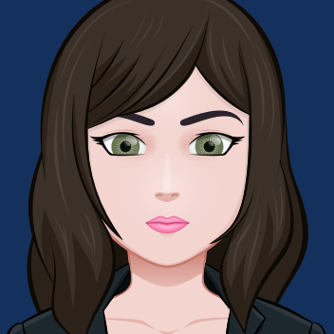
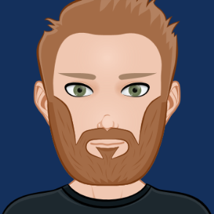
gWaves Team Members
{
“name”: “Vincent Roch”,
“role”: “team leader”, “occupation" : “University of Waterloo Student Software Engineering", "email" : “vroch@edu.uwaterloo.ca", "mobile" : "(613) 408-2495" }
{
“name”: “Johanne Bordeleau, P.Eng.”,
“role”: “software engineer having fun”, “occupation" : “Senior Software Engineer,", "email" : “johannebordeleau@bell.net", "mobile" : "(613) 791-6655" }
{
“name”: “Johnny Slater”,
“role”: “SME day dreaming”, "title" : “System Architect", "email" : “slater_johnny@hotmail.com", "mobile" : "(613) 762-4015" }

Slide 3
WARM Solution Overview

Slide 4
WARM Mock-Up

Slide 5
WARM System Context

Slide 6
Component Architecture

Slide 7
Sequence Diagram

