Slide 1

gWaves Team
{
“name”: “gWaves”,
“motto”: “The sky calls to us.”,
“challenge”: “Mayday, Mayday, Mayday!”,
“description”: “Web-based App Radiation Management”, “gitHub" : “https://github.com/4543386CanadaInc/SpaceApps2017", "email" : “vroch@edu.uwaterloo.ca", "mobile" : "(613) 408-2495" }
“The sky calls to us.”
Carl Sagan

Slide 2



gWaves Team Members
{
“name”: “Vincent Roch”,
“role”: “team leader”, “occupation" : “uWaterloo Student - Software Engineering", "email" : “vroch@edu.uwaterloo.ca", "mobile" : "(613) 408-2495" }
{
“name”: “Johanne Bordeleau, P.Eng.”,
“role”: “software engineer having fun”, “occupation" : “Senior Software Engineer,", "email" : “johannebordeleau@bell.net", "mobile" : "(613) 791-6655" }
{
“name”: “Johnny Slater”,
“role”: “SME day dreaming”, "title" : “System Architect", "email" : “slater_johnny@hotmail.com", "mobile" : "(613) 762-4015" }

Slide 3
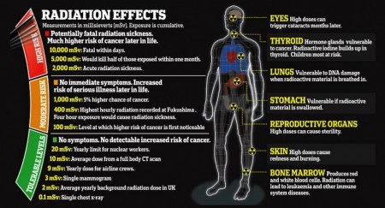
The Opportunity
Calculate radiation exposure for crew and passengers per flight
Manage cumulative radiation exposure for flight crews (year to date, over last 5 years)
Notify when crew radiation exposure thresholds are about to be exceeded
Incorporate radiation exposure considerations in the elaboration of flight routes
Incorporate notifications of events that may impact radiation exposure, such as space weather events

Slide 4
System Context

Slide 5
System Use Cases

Slide 6
WARM Solution Overview
Deployment on private Domain requiring authorization of REST web services with OAUTH
Channel App Client
REST Integration APIs and adapters for Radiation/…
Hotspot{flightId}
AlternateRoute{flightId}
IonizingRadiation{flightId}
GalacticCosmicRadiation{flightId}
SolarCosmicRadiation{flightId}

Slide 7
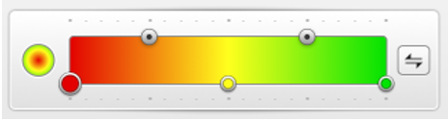
WARM Original Mock-Up
Layers and overlay controls
Mouse Hover over waypoint displays Data over a pop-up
WayPoint Data
Adjustable gradient based on radiation level threshold

Slide 8
Lessons Learned
Some API Enterprise servers enforce quota management and rate limiting API calls in a too limiting way
Some visual APIs should provide standard-based visual API specs (Swagger).
No security was implemented (no OAUTH)
No API management (product lifecycle) was implemented
ArcGIS API for JavaScript is really easier to learn
It would have been preferable to use a framework such as Bluemix and/or API Connect, Loopback, etc
2 days is really short for advanced analytics

