Slide 1
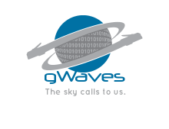
gWaves Team
{
“name”: “gWaves”,
“motto”: “The sky calls to us.”,
“challenge”: “1D, 2D, 3D, GO!”,
“description”: “Web-based Space Mission Visualization and Situational Awareness App”, “gitHub" : “https://github.com/4543386CanadaInc/SpaceApps2017", "email" : “vroch@edu.uwaterloo.ca", "mobile" : "(613) 408-2495" }
“The sky calls to us.”
Carl Sagan

Slide 2




gWaves Team Members
{
“name”: “Vincent Roch”,
“role”: “team leader”, “occupation" : “Student Software Engineering", "company" : “Waterloo University", "email" : “vroch@edu.uwaterloo.ca", "mobile" : "(613) 408-2495" }
{
“name”: “Johanne Bordeleau, P.Eng.”,
“role”: “software engineer having fun”, “occupation" : “Senior Software Engineer, Data Architect", "company" : "IBM", "email" : “johannebordeleau@bell.net", "mobile" : "(613) 791-6655" }
{
“name”: “Johnny Slater”,
“role”: “SME day dreaming”, "title" : “System Architect", "company" : “DND", "email" : “slater_johnny@hotmail.com", "mobile" : "(613) 762-4015" }

Slide 3
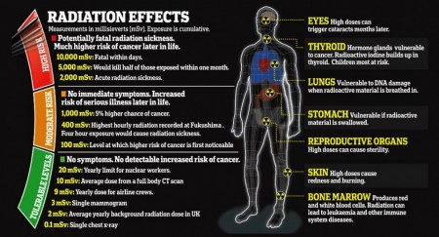
The Challenge
Your challenge is to develop interactive 3D tools that display trajectories, spacecraft, instrumentation, Earth coverage, and data visualizations! Research previous and ongoing Earth science missions and available data, and develop a tool that explains the mission or visualizes the data collected. Design your tool to engage the general public, especially teachers and students!

Slide 4
The Opportunity

Slide 5
The Solution Overview
Used technologies:
JSON
HTTP / REST
Node.js
3D WebGL
OAUTH (?)
JavaScript / Java

Slide 6
System Context

Slide 7
Component Architecture

Slide 8
Sequence Diagram

