Slide 1
Data Structure and Algorithms: An Overview
Adane Letta (PhD)
April 2026

Slide 2
Outline
Background on DSA
Arrays
Sorting
Stacks and Queues
Linked Lists
Tree
Hash tables
Heaps
Graphs

Slide 3
Background
The focus of the course :
Algorithms for solving problems efficiently
Data structures for efficiently storing, accessing, and modifying data
We will see that all data structures have trade-offs
There is no ultimate data structure...
The choice depends on our requirements

Slide 4
Data Structure and Algorithms
A data structure is an arrangement of data in a computer’s memory
Data structures include arrays, linked lists, stacks, binary trees, and hash tables, among others.
Algorithms manipulate the data in these structures in various ways, such as searching for a particular data item and sorting the data.
The correct choice of data structure allows major improvements in program efficiency.

Slide 5
Data Structure and Algorithms
Any form of information processing or communication requires that data must be stored in and accessed from either main or secondary memory
There are two questions we should ask:
What do we want to do?
How can we do it?
This topic will cover Abstract Data Types:
Models of the storage and access of information
The most abstract data types are container
A container describes structures that store and give access to objects

Slide 6
Data Structure and Algorithms
The operations we may wish to perform on a container are:
Create a new container, copy or destroy an existing container, empty a container, query how many objects are in a container, query what is the maximum number of objects a container can hold, given two containers, find the union (merge), find the intersection
In software in storing objects and relationships in containers, there are reoccurring containers of objects and associated relationships where the actual queries and operations are restricted
We model such containers by Abstract Data Types or ADTs
Any of the Abstract Data Types we will discuss can be implemented as either a simple container or an associative container
Another design requirement may be to either: require that all objects in the container are unique, or allow duplicate objects

Slide 7
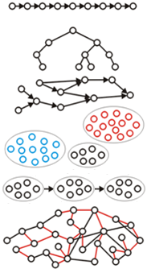
Data Structure and Algorithms
We will look at six relationships:
Linear orderings
Hierarchical orderings
Partial orderings
Equivalence relations
Weak orderings
Adjacency relations
Notes:
- A linear ordering is any relationship where any two objects x and y that can be compared

Slide 8
Data Structure and Algorithms
In abstract data types any time you are intending to store objects, you must ask:
What are the relationships on the objects?
What queries will be made about the objects in the container?
What operations will be performed on the objects in the container?
What operations may be performed on the container as a whole?
What queries will be made about the relationships between the objects in the container?
What operations may be made on the relationships themselves between the objects in the container?

Slide 9
Algorithms Analysis
Suppose we have two algorithms, how can we tell which is better?
We could implement both algorithms, run them both
Expensive and error prone
Preferably, we should analyze them mathematically
Algorithm analysis
We will begin with one variable:
The number of items n currently stored in an array or other data structure
The number of items expected to be stored in an array or other data structure
The dimensions of an n × n matrix

Slide 10
Algorithms Analysis
Notation | Mathematical Name | What it tells you | Real-world Analogy
O(n) | Big-O | Upper Bound | "It will take 1 hour or less."
Ω(n) | Big-Omega | Lower Bound | "It will take at least 1 hour."
Θ(n) | Big-Theta | Tight Bound | "It will take exactly 1 hour."

Slide 11
Algorithms Analysis
Big Theta (Θ) used to describe the Time Complexity of an algorithm—essentially answering: "How much slower does this get as the input ($n$) gets bigger?
The most common classes are given names:
Θ(1) constant
Θ(ln(n)) logarithmic
Θ(n) linear
Θ(n ln(n)) “n log n”
Θ(n²) quadratic
Θ(n³) cubic
2^{n}, e^{n}, 4^{n}, ... exponential

Slide 12
Algorithms Analysis
We will use Landau symbols to describe the complexity of algorithms
E.g., adding a list of n doubles will be said to be a Θ(n) algorithm
An algorithm is said to have polynomial time complexity if its run-time may be described by O(n^{d}) for some fixed d ≥ 0
We will consider such algorithms to be efficient
Problems that have no known polynomial-time algorithms are said to be intractable
Traveling salesman problem: find the shortest path that visits n cities
Best run time: Θ(n² 2^{n})

Slide 13
Algorithms Analysis
The time required for any operator is Θ(1) including:
Retrieving/storing variables from memory
Variable assignment =
Integer operations + - * / % ++ --
Logical operations && || !
Bitwise operations & | ^ ~
Relational operations == != < <= => >
Memory allocation and deallocation new delete

Slide 14
Algorithms Analysis
Suppose you have now analyzed a number of blocks of code run in sequence
template <typename T>
void update_capacity( int delta ) {
T *array_old = array;
int capacity_old = array_capacity; array_capacity += delta;
array = new T[array_capacity];
for ( int i = 0; i < capacity_old; ++i ) {
array[i] = array_old[i];
}
delete[] array_old;
}
To calculate the total run time, add the entries: Θ(1 + n + 1) = Θ(n)
Θ(1)
Θ(n)
Θ(1) or Ω(n)

Slide 15
Algorithms Analysis
Given a condition-controlled loops example
int sum = 0;
for ( int i = 0; i < n; ++i ) {
for ( int j = 0; j < n; ++j ) {
sum += 1; Theta(1)
}
}
What is the time complexity?
Notes:
The previous example showed that the inner loop is Q(n), thus the outer loop is
Θ(n·n) = Q(n2)

Slide 16
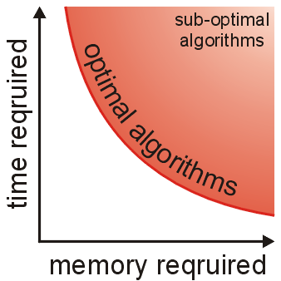
Memory usage versus run times
As well as determining run times, we are also interested in memory usage
There is an interesting relationship between memory and time efficiency
For a data structure/algorithm:
Improving the run time usually requires more memory
Reducing the required memory usually requires more run time
Warning: programmers often mistake this to suggest that given any solution to a problem, any solution which may be faster must require more memory

Slide 17
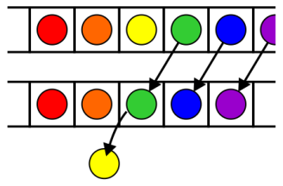

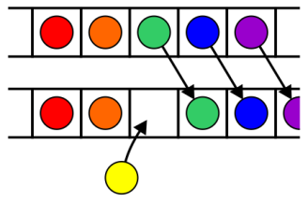
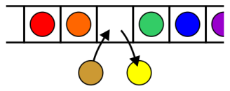
Operations
Operations at the k^{th} entry of the list include:
Access to the object Erasing an object
Insertion of a new object Replacement of the object

Slide 18
Overview of Data Structures
Data Structure | Advantages | Disadvantages
Array | Quick insertion, very fast access if index known. | Slow search, slow deletion,
Ordered array | Quicker search than unsorted array. | Slow insertion and deletion, fixed size.
Stack | Provides last-in, first-out access. | Slow access to other items.
Queue | Provides first-in, first-out access. | Slow access to other items.
Linked list | Quick insertion, quick deletion. | Slow search.
Binary tree | Quick search, insertion, deletion (if tree (if tree is remains balanced). | Deletion algorithm is complex.
Red-black tree | Quick search, insertion, deletion. Tree always balanced. | Complex.

Slide 19
Overview of Data Structures
Data Structure | Advantages | Disadvantages
2-3-4 tree | Quick search, insertion, deletion. Tree always balanced. Similar trees good for disk storage. | Complex
Hash table | Very fast access if key known. Fast insertion. | Slow deletion, access slow if key not known, inefficient
Heap | Fast insertion, deletion, access to largest item. | Slow access to other items.
Graph | Models real-world situations. | Some algorithms are slow and complex.

Slide 20
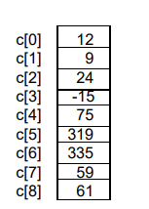
Arrays
Is the most commonly used data storage structure; it’s built into most programming languages.
Consists of data items of the same type
An Array is:
A collection of contiguous memory locations
Same name
Same type
Locations (elements) in the array are referenced by
Array name
Position within the array
Index notation: c[0] refers to the first element of array c, c[1] refers to the second element of array c, etc.

Slide 21
Arrays
Before using arrays, we must reserve space for all elements in the computer memory…. Int [10]….. An array of 10 integers
Three operations:
Insertion,
Searching, and
Deletion— the fundamental ones in most of the data storage structures

Slide 22
Searching Arrays
Searching for information in large data structures is an important part of many computer applications
Searching is usually much more efficient if the data is sorted into some order.
Imagine trying to look up a number in the phone book if the listings were not in alphabetical order
Linear search vs. binary search
Searches an array using the search key

Slide 23
Searching Arrays
Linear search compares each array element with the search key until it is found (or entire array is searched without success)
Linear search works fine for small, unsorted arrays
Inefficient for large arrays, especially if many searches must be performed

Slide 24
Searching Arrays
Binary search works best for larger, sorted arrays
Eliminates half of the remaining elements in the searched array after each comparison
Locates the middle element of the remaining portion of the array and compares to search key portion of the array and compares to search key
If search key is less than the middle element then the first half of the array is searched
Otherwise, the second half is searched
Very fast; at most n steps, where 2n > number of elements

Slide 25
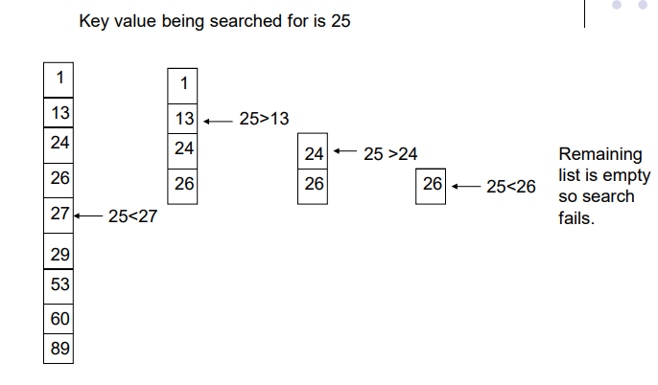
Sorting and Searching Arrays
Binary Search Works (The "Divide and Conquer" Logic)
Instead of checking every number one by one (Linear Search), Binary Search jumps to the middle of the list and eliminates half of the remaining options in every step.

Slide 26
Efficiency of Binary Search
Linear search: Proportional to N
Binary search: Proportional to log(N)
Consider a sorted array with 1,000,000 elements
How many comparisons are required to search for a given key value?
Average case:
Linear search: 1,000,000/2 = 500K
Binary search: <= log2(1,000,000) = 20
Worst case:
Linear search: 1,000,000
Binary search: 20

Slide 27
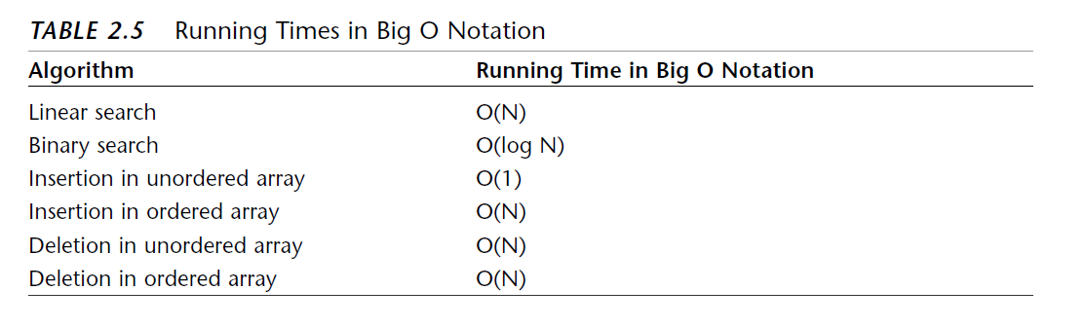
Efficiency of Binary Search
Big O notation provides a convenient way to compare the speed of algorithms.
Big O notation uses the uppercase letter O, which you can think of as meaning “order of.” In Big O notation, we would say that a linear search takes O(N) time, and a binary search takes O(log N) time. Insertion into an unordered array takes O(1), or constant time.
An algorithm that runs in O(1) time is the best, O(log N) is good, O(N) is fair, and O(N2) is pretty bad.
Notes:
Why we do not use arrays for everything?
- Their size is fixed:- other data structures are more flexible and can expand to hold the number of items inserted in them.

Slide 28
Questions
The maximum number of elements that must be examined to complete a binary search in an array of 200 elements is
200 B. 8 C.1 D.13
Big O notation tells
How the speed of an algorithm relates to the number of items.
The running time of an algorithm for a given size data structure.
The running time of an algorithm for a given number of items.
How the size of a data structure relates to the number of items.

Slide 29
Sorting
As soon as you create a significant database, you’ll probably think of reasons to sort it in various ways.
Sorting: Placing the data into some particular order
E.g. Ascending or descending order.
Very important computing operation… when an input is sorted, many problems become easy
Because sorting is so important and potentially so time consuming, it has been the subject of extensive research in computer science, and some very sophisticated methods have been developed.

Slide 30
Sorting
Types of sorting
Iterative sorting algorithms
Bubble Sort
Selection Sort
Insertion Sort
Recursive sorting algorithms
Merge Sort
Quick Sort

Slide 31
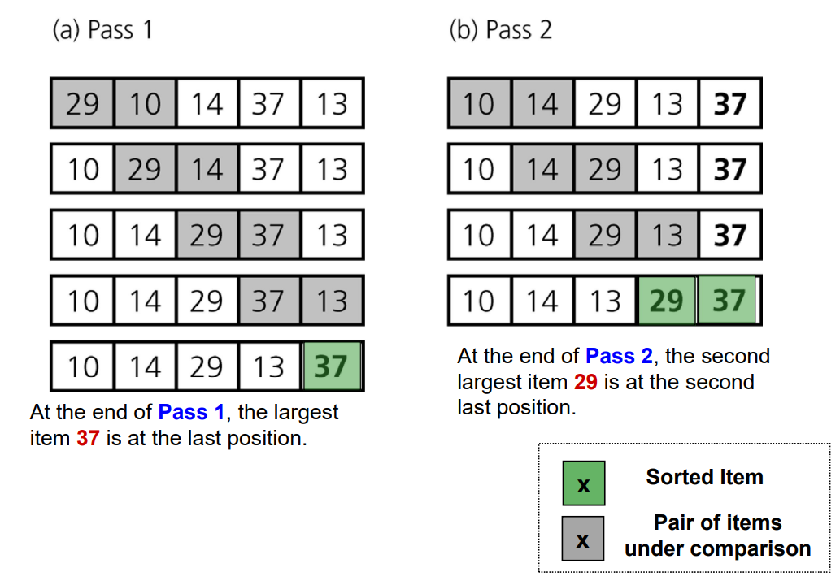
Sorting : Bubble Sort
Given an array of n items
Compare pair of adjacent items
Swap if the items are out of order
Repeat until the end of array
The largest item will be at the last position
Reduce n by 1 and go to Step 1
Analogy :- Large item is like “bubble” that floats to the end of the array

Slide 32
Sorting : Bubble Sort
The simplest of the sorting algorithms, but notoriously slow
In general, where N is the number of items in the array, there are N-1 comparisons on the first pass, N-2 on the second, and so on.
Worst-case
Input is in descending order
Running time remains the same: O(n^2)
Best-case
Input is already in ascending order
The algorithm returns after a single outer iteration
Running time: O(n)

Slide 33
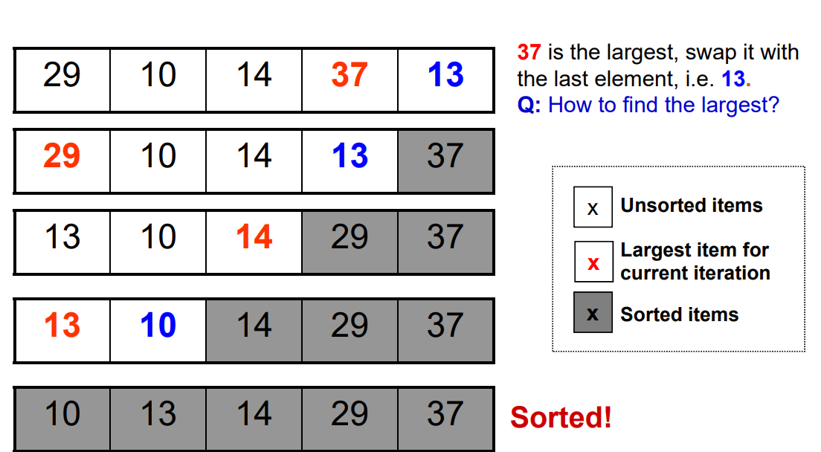
Sorting : Selection Sort
Given an array of n items
1. Find the largest item x, in the range of [0…n−1]
2. Swap x with the (n−1)th item
3. Reduce n by 1 and go to Step 1
The selection sort improves on the bubble sort by reducing the number of swaps necessary from O(N^2) to O(N).
Unfortunately, the number of comparisons remains O(N^2).
However, the selection sort can still offer a significant improvement for large records that must be physically moved around in memory, causing the swap time to be much more important than the comparison time.
The selection sort performs the same number of comparisons as the bubble sort: N*(N-1)/2. For 10 data items, this is 45 comparisons. However, 10 items require fewer than 10 swaps. With 100 items, 4,950 comparisons are required, but fewer than 100swaps.

Slide 34
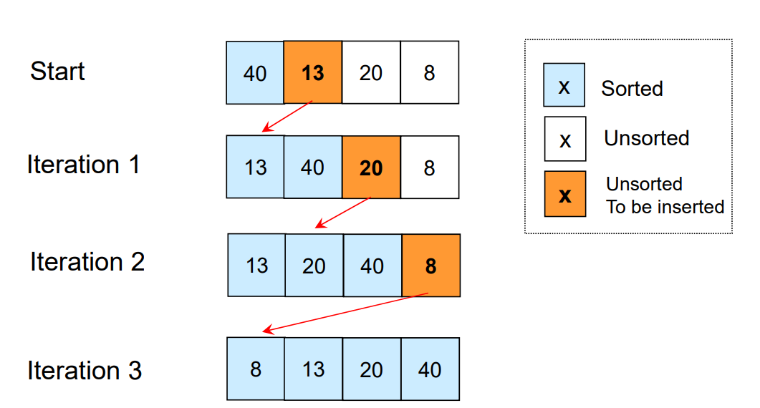
Sorting : Insertion Sort
Similar to how most people arrange a hand of poker cards
Start with one card in your hand
Pick the next card and insert it into its proper sorted order
Repeat previous step for all cards

Slide 35
Sorting : Insertion Sort
Insertion sort is the best of the elementary sorts
It still executes in O(N^2) time, but it’s about twice as fast as the bubble sort and somewhat faster than the selection sort in normal situations.
It is slightly more involved than the bubble and selection sorts.
How many comparisons and copies does this algorithm require? On the first pass, it compares a maximum of one item. On the second pass, it’s a maximum of two items, and so on, up to a maximum of N-1 comparisons on the last pass.
The best-case time is O(n)
And the worst-case time is O(n^2)

Slide 36
Merge Sort: Idea
Suppose we only know how to merge two sorted sets of elements into one
Merge {1, 5, 9} {1, 5, 9} with {2, 11} {2, 11} -> {1, 2, 5, 9, 11}
Idea (use merge to sort n items)
Merge each pair of elements into sets of 2
Merge each pair of sets of 2 into sets of 4
Repeat previous step for sets of 4 …
Final step: merge 2 sets of n/2 elements to obtain a fully sorted set

Slide 37
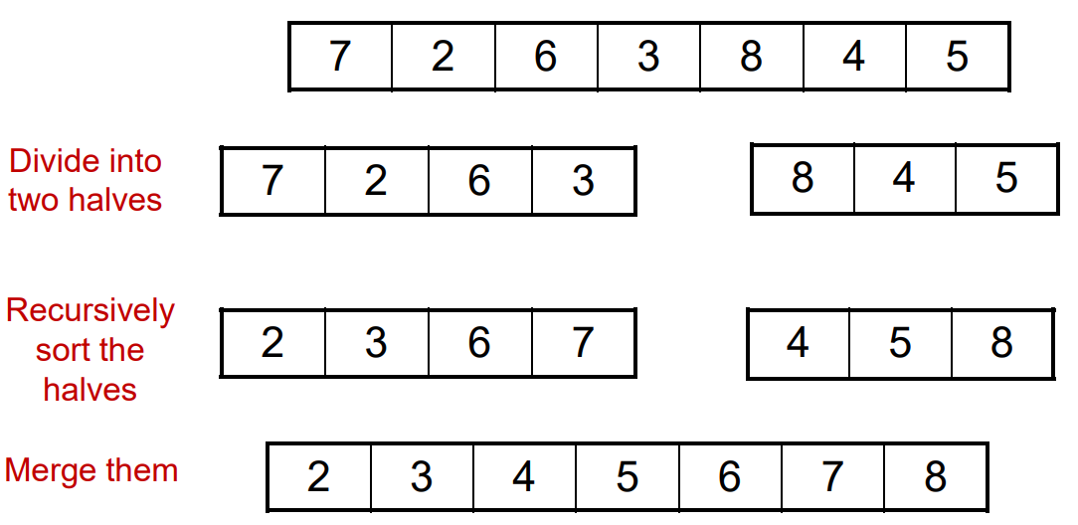
Merge Sort: Idea
Merge Sort is a divide-and-conquer sorting algorithm
Divide step
Divide the array into two (equal) halves
Recursively sort the two halves
Conquer step
Merge the two halves to form a sorted array
Total time complexity = O(n log(n))
Optimal comparison-based sorting method

Slide 38
Merge Sort: Idea
Pros
The performance is guaranteed, i.e. unaffected by original ordering of the input
Suitable for extremely large number of inputs
Can operate on the input portion by portion
Cons
Not easy to implement
Requires additional storage during merging operation
O(n) extra memory storage needed

Slide 39
Quick Sort
Quick Sort is a divide-and-conquer algorithm
Divide step
Choose an item p (known as pivot) and partition the items of a[i...j] into two parts
Items that are smaller than p
Items that are greater than or equal to p
Recursively sort the two parts
Conquer step
Do nothing!
In comparison, Merge Sort spends most of the time in conquer step but very little time in divide step

Slide 40
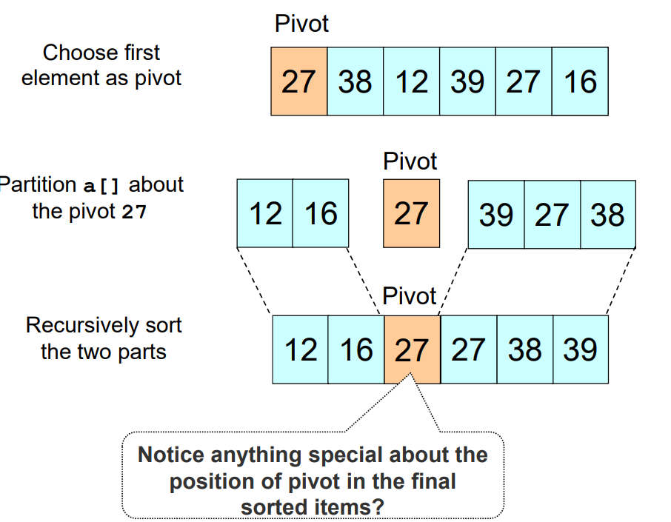
Quick Sort

Slide 41
Quick Sort
Best case occurs when partition always splits the array into two equal halves
Depth of recursion is log(n)
Each level takes n or fewer comparisons, so the time complexity is O(n log (n))
In practice, worst case is rare, and on the average we get some good splits and some bad ones
Average time is O(n log n)

Slide 42
Shell Sort
Based on the insertion sort, but adds a new feature that dramatically improves the insertion sort’s performance.
The pivot value is the value that determines into which group an item will go during partitioning. Items smaller than the pivot value go in the left group….. Larger items go in the right group.
The Shellsort is good for medium-sized arrays, perhaps up to a few thousand items, depending on the particular implementation.
Not quite as fast as quicksort and other O(N*log(N)) sorts, so it’s not optimum for very large files.
However, it’s much faster than the O(N^2) sorts like the selection sort and the insertion sort

Slide 43
Comparing the Simple Sorts
The bubble sort is so simple that you can write it from memory.
The selection sort minimizes the number of swaps, but the number of comparisons is still high. This sort might be useful when the amount of data is small and swapping data items is very time-consuming.
The insertion sort is the most versatile of the three and is the best bet in most situations, assuming the amount of data is small or the data is almost sorted.
All three of the algorithms carry out their sort in place, meaning that, besides the initial array, very little extra memory is required. All the sorts require an extra variable to store an item temporarily while it is being swapped.
Bubble, Selection and Insertion

Slide 44
Questions
True or False: The bubble sort always ends up comparing every item with every other item.
The bubble sort algorithm alternates between
Comparing and swapping.
Moving and copying.
Moving and comparing.
Copying and comparing.
In the insertion sort, “partially sorted” means that
Some items are already sorted, but they may need to be moved.
Most items are in their final sorted positions, but a few still need to be sorted.
Only some of the items are sorted.
Group items are sorted among themselves, but items outside the group may need to be inserted in it.

Slide 45
Stacks and Queues
Arrays used for personnel records, inventories, financial data, and so on—data that corresponds to real-world objects or activities.
These structures facilitate access to data: They make it easy to insert, delete, and search for particular items.
In arrays, access is restricted
Stacks, queues, and priority queues are more abstract entities than arrays and many other data storage structures.

Slide 46
Stacks and Queues
Stacks
A stack is a container of objects that are inserted and removed according to the last-in first-out (LIFO) principle.
In the pushdown stacks only two operations are allowed: push the item into the stack, and pop the item out of the stack.
A stack is a limited access data structure - elements can be added and removed from the stack only at the top.
Push adds an item to the top of the stack, pop removes the item from the top.
A helpful analogy is to think of a stack of books; you can remove only the top book, also you can add a new book on the top.

Slide 47
Stacks and Queues
Stacks
A stack allows access to only one data item: the last item inserted.
If you remove this item, you can access the next-to-last item inserted, and so on.
Most microprocessors use a stack-based architecture.
Items can be both pushed and popped from the stack implemented in the in constant O(1) time. That is, the time is not dependent on how many items are in the stack and is therefore very quick. No comparisons or moves are necessary.

Slide 48
Stacks and Queues
Queues
A queue is like a stack, except that in a queue the first item inserted is the first to be removed (First-In-First-Out, FIFO).
The two basic queue operations are inserting an item, which is placed at the rear of the queue, and removing an item, which is taken from the front of the queue.
Enqueue means to insert an item into the back of the queue, dequeue means removing the front item.
An excellent example of a queue is a line of students in the food court of the UC. New additions to a line made to the back of the queue, while removal (or serving) happens in the front.

Slide 49
Stacks and Queues
Queues
As with a stack, items can be inserted and removed from a queue in O(1) time.
A priority queue is a more specialized data structure than a stack or a queue.
Like an ordinary queue, a priority queue has a front and a rear, and items are removed from the front. However, in a priority queue, items are ordered by key value so that the item with the lowest key (or in some implementations the highest key) is always at the front.
In the priority-queue implementation we show here, insertion runs in O(N) time, while deletion takes O(1) time.

Slide 50
Question
The term priority in a priority queue means that
The highest priority items are inserted first.
The programmer must prioritize access to the underlying array.
The underlying array is sorted by the priority of the items.
The lowest priority items are deleted first.

Slide 51
Linked Lists
“Arrays,” we saw that arrays had certain disadvantages as data storage structures.
In an unordered array, searching is slow, whereas in an ordered array, insertion is slow.
In both kinds of arrays, deletion is slow. Also, the size of an array can’t be changed after it’s created.
Linked lists are probably the second most commonly used general purpose storage structures after arrays.
Is a versatile mechanism suitable for use in many kinds of general-purpose databases

Slide 52
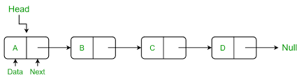
Linked Lists
A linked list consists of one linkedList object and a number of Link objects.
The linkedList object contains a reference to the first link in the list.
Each Link object contains data and a reference, often called next, to the next link in the list.
A next value of null signals the end of the list.
Inserting an item at the beginning of a linked list involves changing the new link’s next field to point to the old first link and changing first to point to the new item.

Slide 53
Linked Lists
In a linked list, each data item is embedded in a link.
A linked list is a sequential access data structure, where each element can be accessed only in particular order.
A typical illustration of sequential access is a roll of paper or tape - all prior material must be unrolled in order to get to data you want.
A Simple Linked List
Inserting an item at the beginning of the list
Deleting the item at the beginning of the list
Iterating through the list to display its contents

Slide 54
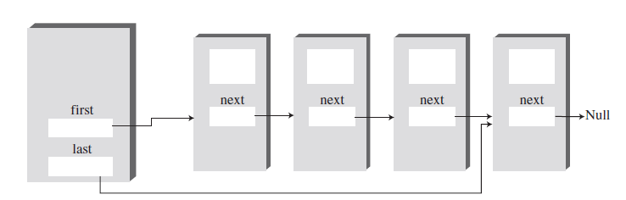
Linked Lists
Double-Ended Lists
A potential problem with ordinary linked lists is that it’s difficult to traverse backward along the list.
A double-ended list is similar to an ordinary linked list, but it has one additional feature: a reference to the last link as well as to the first.
It allows you to traverse backward as well as forward through the list.
Access to the end of the list as well as the beginning makes the double-ended list suitable for certain situations that a single-ended list can’t handle efficiently.
The insertion and deletion routines are similar to those in a single-ended list.

Slide 55
Linked Lists
Insertion and deletion at the beginning of a linked list are very fast. They involve changing only one or two references, which takes O(1) time… O(1) means that it takes a constant time
Finding, deleting, or inserting next to a specific item requires searching through, on the average, half the items in the list. This requires O(N) comparisons.
An array is also O(N) for these operations, but the linked list is nevertheless faster because nothing needs to be moved when an item is inserted or deleted.
Another important advantage of linked lists over arrays is that a linked list uses exactly as much memory as it needs and can expand to fill all of available memory.
The size of an array is fixed when it’s created; this usually leads to inefficiency because the array is too large, or to running out of room because the array is too small.

Slide 56
Binary Trees
Why might you want to use a tree?
Usually, because it combines the advantages of two other structures: an ordered array and a linked list.
Slow Insertion in an Ordered Array: if you do insertion and deletiaton arrays are a bad choice
Slow Searching in a Linked List:
Insertions and deletions are quick to perform on a linked list. They are accomplished simply by changing a few references. These operations require O(1) time (the fastest Big O time).
You can search a tree quickly, as you can an ordered array, and you can also insert and delete items quickly, as you can with a linked list.

Slide 57
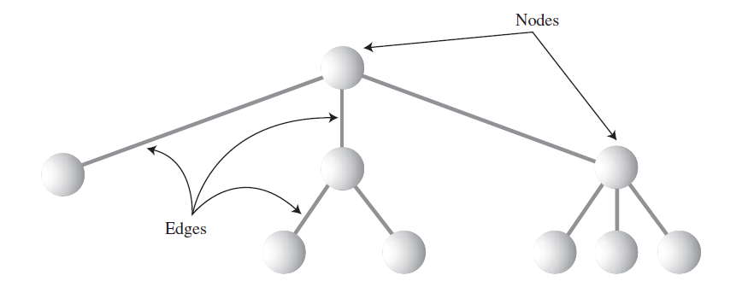
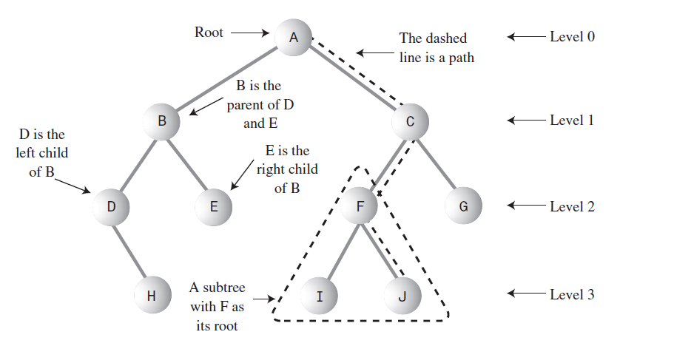
What Is a Tree?
A tree consists of nodes connected by edges.
Tree is actually an instance of a more general category called a graph

Slide 58
Binary Trees
If every node in a tree can have at most two children, the tree is called a binary tree.
The two children of each node in a binary tree are called the left child and the right child
Finding a Node
Finding a node with a specific key is the simplest of the major tree operations
The time required to find a node depends on how many levels down it is situated.
This is O(logN) time, or more specifically O(log_2N) time, the logarithm to the base 2.
An unbalanced tree is one whose root has many more left descendents than right descendants, or vice versa.

Slide 59
Binary Trees
Inserting a Node
To insert a node, we must first find the place to insert it.
Deleting a Node
Deleting a node is the most complicated common operation required for binary search trees. However, deletion is important in many tree applications, and studying the details builds character.

Slide 60
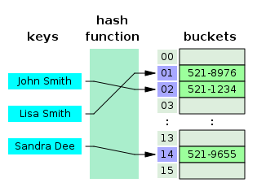
Hash Tables
A hash table is a data structure that offers very fast insertion and searching.
Is a data structure that implements an associative array, also called a dictionary, which is an abstract data type that maps keys to values.
In an array of buckets or slots, from which the desired value can be found.

Slide 61
Hash Tables
Hash tables do have several disadvantages: they’re based on arrays, and arrays are difficult to expand after they’ve been created.
However, if you don’t need to visit items in order, and you can predict in advance the size of your database, hash tables are unparalleled in speed and convenience.
No matter how many data items there are, insertion and searching (and sometimes deletion) can take close to constant time: O(1) in big O notation.
Hash tables are significantly faster than trees, which, operate in relatively fast O(logN) time. Not only are they fast, hash tables are relatively easy to program.

Slide 62
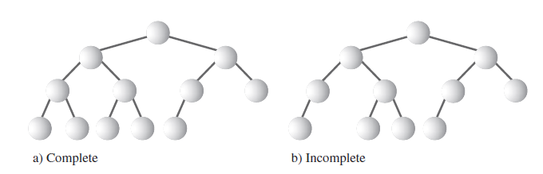
Heaps
Heap is a binary tree with these characteristics:
It’s a complete binary tree implies that there are no “holes” in the array used to represent it. Every cell is filled, from 0 to N-1.
It’s (usually) implemented as an array
Each node in a heap satisfies the heap condition, which states that every node’s key is larger than (or equal to) the keys of its children.

Slide 63
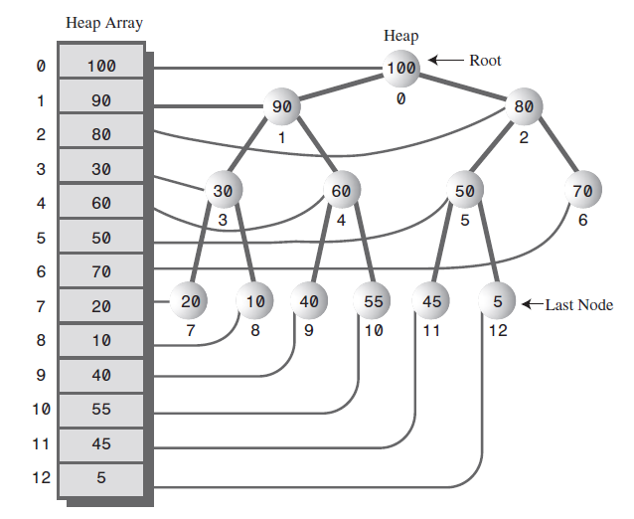
Heaps
Weak ordering
A heap is weakly ordered compared with a binary search tree, in which all a node’s left descendants have keys less than all its right descendants.
In a heap, traversing the nodes in order is difficult because the organizing principle (the heap condition) is not as strong as the organizing principle in a tree.
Because heaps are weakly ordered, some operations are difficult or impossible.
Heap and underline array

Slide 64
Heaps
Besides its failure to support traversal, a heap also does not allow convenient searching for a specified key.
This is because there’s not enough information to decide which of a node’s two children to pick in trying to descend to a lower level during the search.
Heapsort runs in O(NlogN) time. Although it may be slightly slower than quicksort, an advantage over quicksort is that it is less sensitive to the initial distribution of data.
Certain arrangements of key values can reduce quicksort to slow O(N^2) time, whereas heapsort runs in O(NlogN) time no matter how the data is distributed.

Slide 65
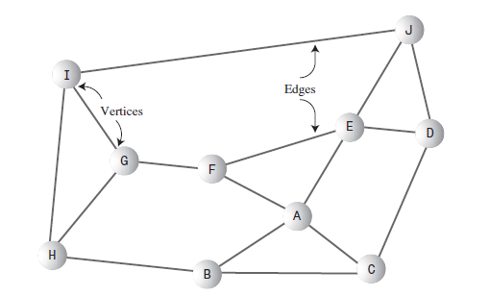
Graphs
Graphs are one of the most versatile structures used in computer programming.
Graphs are data structures rather like trees. In fact, in a mathematical sense, a tree is a kind of graph. In computer programming, however, graphs are used in different ways than trees.

Slide 66
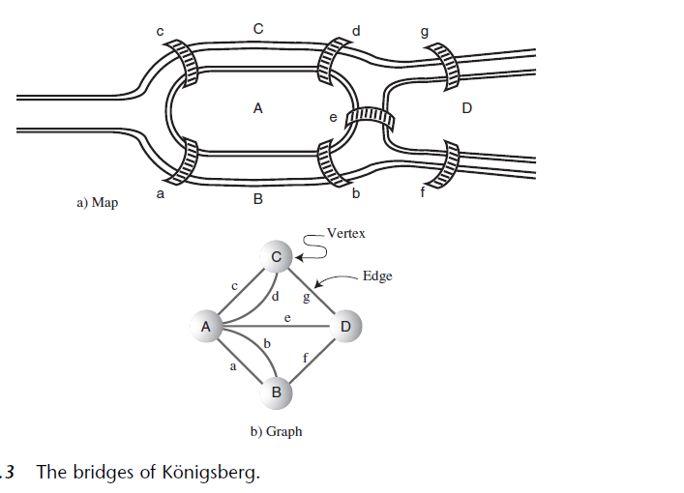
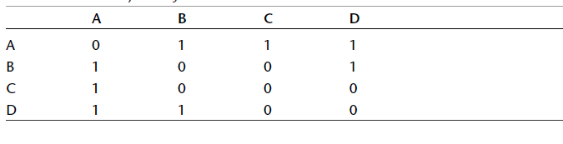
Graphs
The Adjacency Matrix: An adjacency matrix is a two-dimensional array in which the elements indicate whether an edge is present between two vertices.

Slide 67
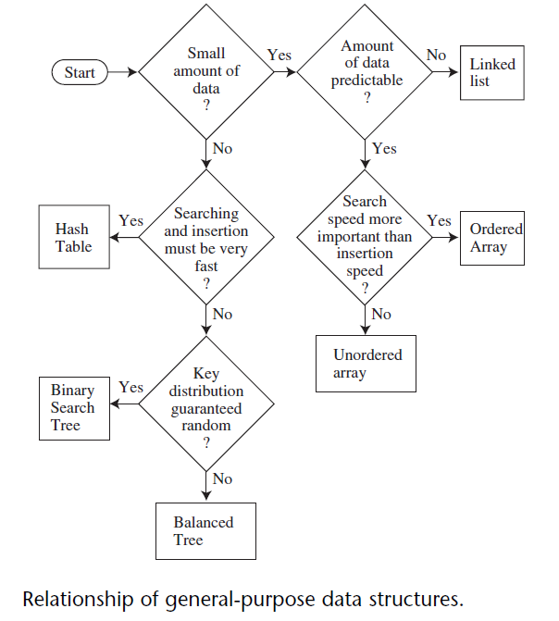
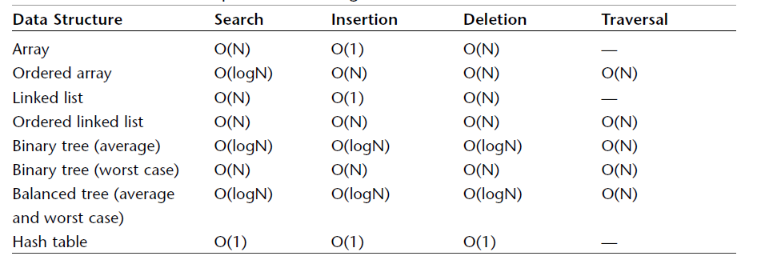
When to Use What?
General-purpose data structures: arrays, linked lists, trees, hash tables
If you need to store real-world data such as personnel records, inventories, contact lists, or sales data, you need a general-purpose data structure.

Slide 68
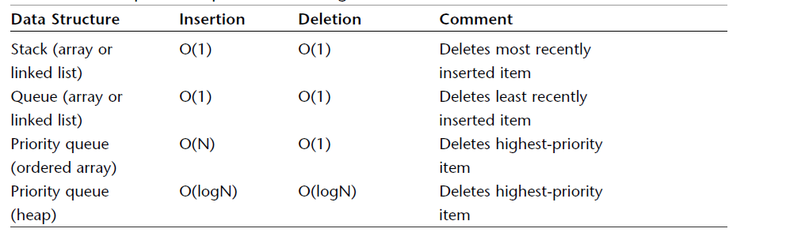
When to Use What?
Specialized data structures: stacks, queues, priority queues, graphs
These structures, rather than supporting a database of useraccessible data, are usually used by a computer program to aid in carrying out some algorithm.
Stacks, queues, and priority queues are Abstract Data Types (ADTs).

Slide 69
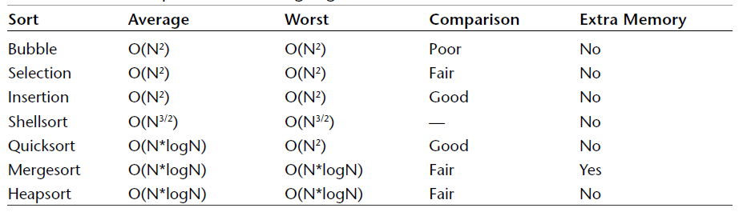
When to Use What?
Sorting: insertion sort, Shellsort, quicksort, mergesort, heapsort

Slide 70
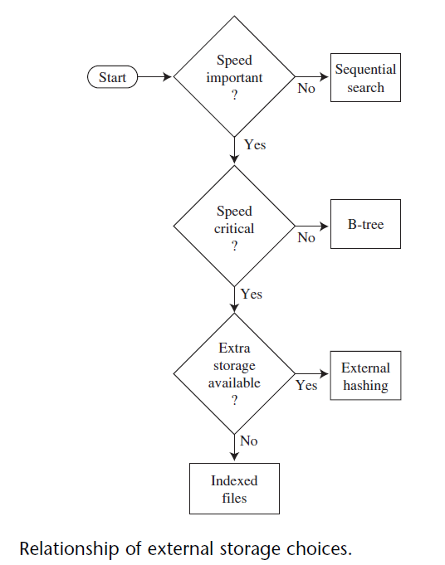
When to Use What?
External Storage
Amounts of data too large to store in memory must be stored in external storage, which generally means disk files.

