Slide 1
automation

Slide 2
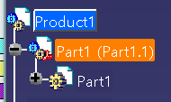
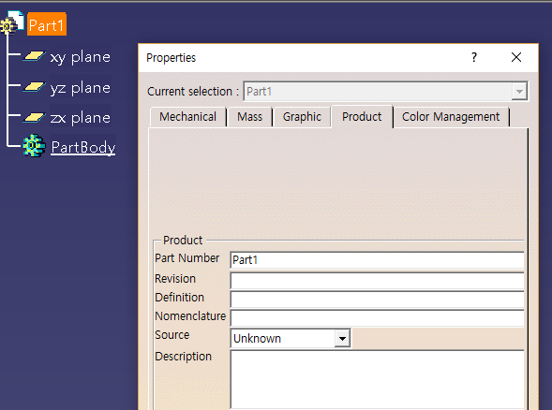
Document 구조
Product()
Products
Prd
Product
prd
Prds
prt
product
products
prd
Products.item(1).products.item(21)
Prt doc -root
Products.item(1)
Product always has a products

Slide 3
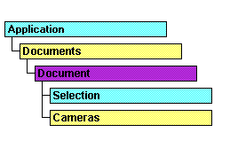
prd
Reference Prd
prt
->parent -> document
-> prt
->save…

Slide 4
product
part
//product - prt,prt,prt,prt
//active ducument -> 최상위(root) document
---→prd = products.item(int32);
aprtDocument -> prt

Slide 5
Documents -> 열려있는 모든 document 포함

Slide 6
Prt num – 유일하다/ 중요하다

Slide 7
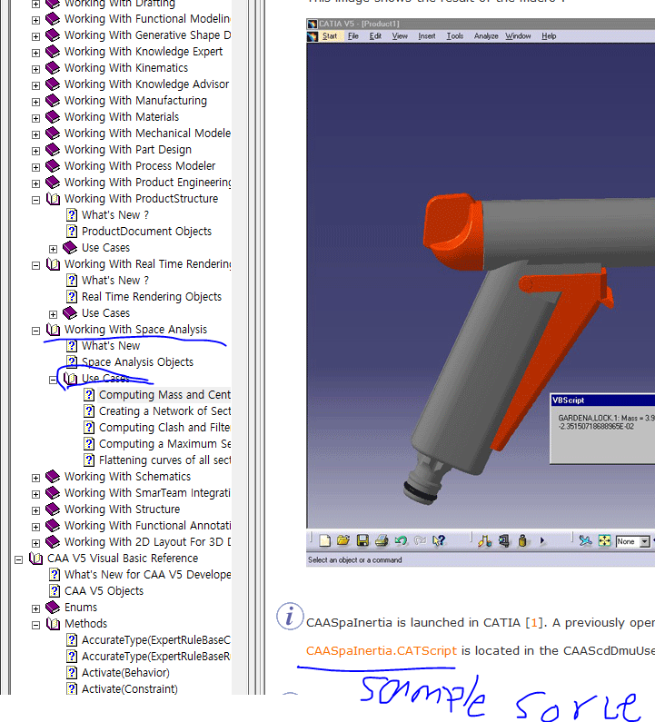

Slide 8
selection
sel = catia.ActiveDocument.Selection; //selection가져오기
object[] inputObjectType = { "Point" };
string Status;
sel.Clear();
Status = sel.SelectElement2(inputObjectType, "Select a Point", true);
if (Status != "Normal" || sel.Count < 1)
{
MessageBox.Show("선택한 point가 없습니다.");
return;
}
INFITF.SelectedElement selItem;
selItem = sel.Item(1);

Slide 9
Drowing

Slide 10
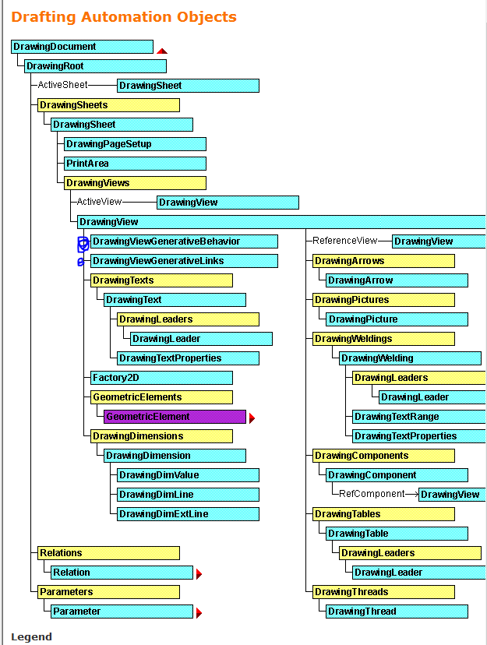

Slide 11
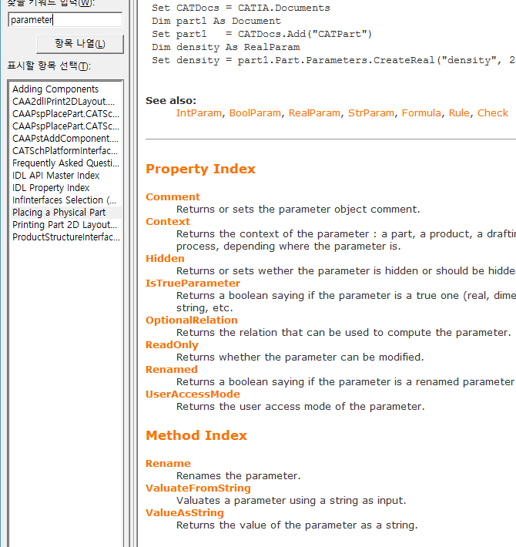
parameter
중요한게; type
Mm, cm…

Slide 12
