Slide 1
automation

Slide 2
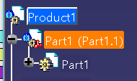
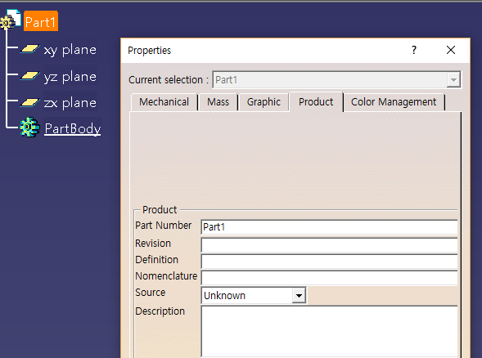
Document 구조
Product()
Products
Prd
Product
prd
Prds
prt
product
products
prd
Products.item(1).products.item(21)
Prt doc -root
Products.item(1)
Product always has a products

Slide 3
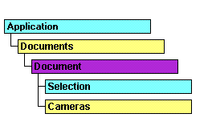
prd
Reference Prd
prt
->parent -> document
-> prt
->save…

Slide 4
product
part
//product - prt,prt,prt,prt
//active ducument -> 최상위(root) document
---→prd = products.item(int32);
aprtDocument -> prt

Slide 5
Documents -> 열려있는 모든 document 포함

Slide 6
Prt num – 유일하다/ 중요하다

Slide 7
