Slide 1
CA2 PROJECT
Cloud-Native Monitoring
& Autoscaling
FitMotion Web Application on Kubernetes
Student: Pranav Kumar Reg No: 12209660 Roll: 42 Section: 4OM05
DevOps — Kubernetes · Docker · Prometheus · Grafana · HPA

Slide 2
Project Overview
02
🐳 Containerize
☸ Deploy on K8s
Dockerized the FitMotion React app using a multi-stage Dockerfile (build → Nginx serve)
Ran on Minikube (local Kubernetes) with deployment + service manifests
📊 Monitor
⚡ Auto-Scale
Full observability via Kube-Prometheus-Stack (Prometheus + Grafana) installed with Helm
HPA automatically scales pods from 2 → 10 when CPU exceeds the threshold
Pranav Kumar | Reg: 12209660 | Sec: 4OM05
2/10

Slide 3
System Architecture
03
FitMotion (React + Vite)
Key Tools Used
Frontend Web App
🐳 Docker
Kubernetes / Minikube
☸ Minikube
Container Orchestration Platform
⎈ Helm
Prometheus + Grafana
🔥 Prometheus
Metrics Collection & Visualisation
📈 Grafana
HPA – Horizontal Pod Autoscaler
⚡ HPA
Auto-scales pods based on CPU metrics
Pranav Kumar | Reg: 12209660 | Sec: 4OM05
3/10

Slide 4
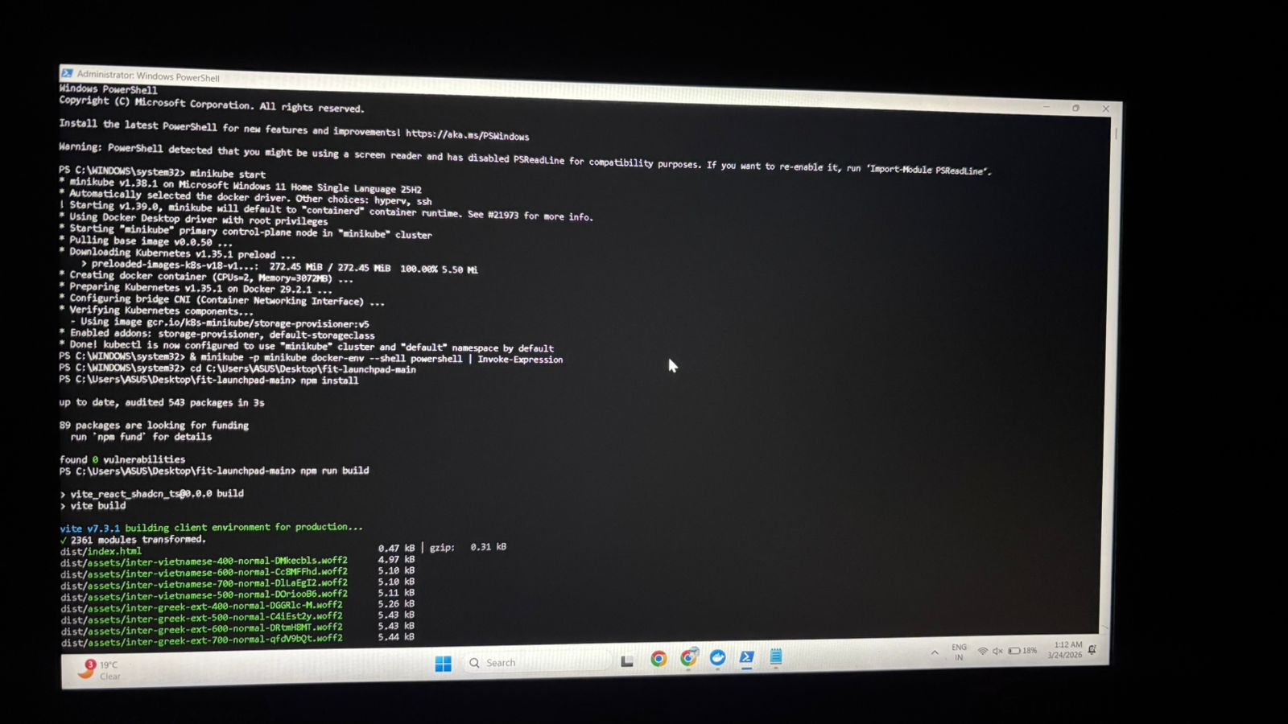
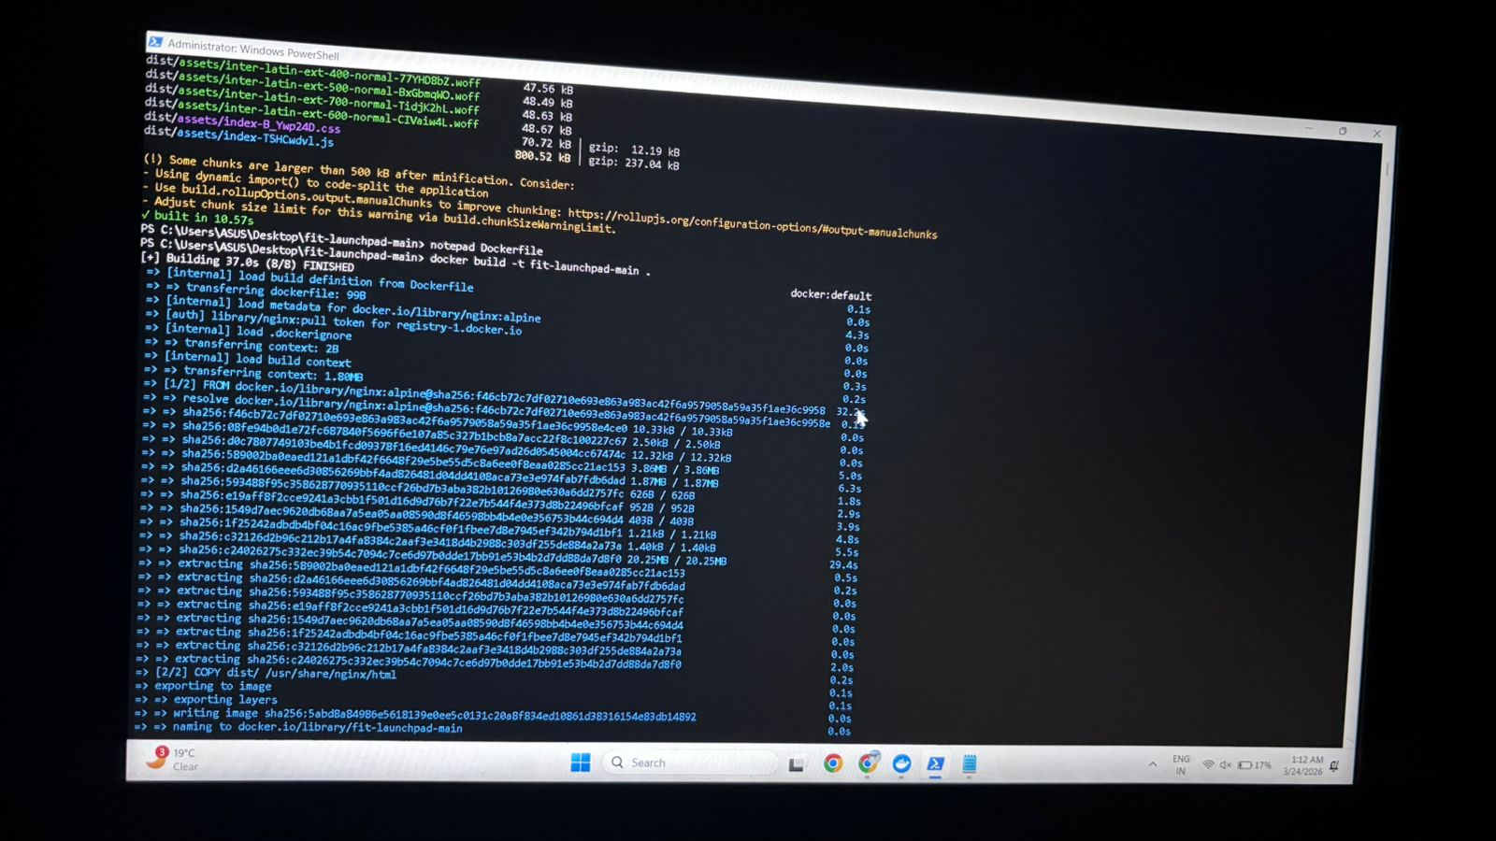
Step 1 — Environment Setup & App Build
04
Minikube cluster started on Windows 11 + FitMotion React app built with npm → Vite
Minikube start + npm install + build
Docker image build (multi-stage → Nginx)
Commands: minikube start | npm run build | docker build -t fit-launchpad-main .
Pranav Kumar | Reg: 12209660 | Sec: 4OM05
4/10

Slide 5
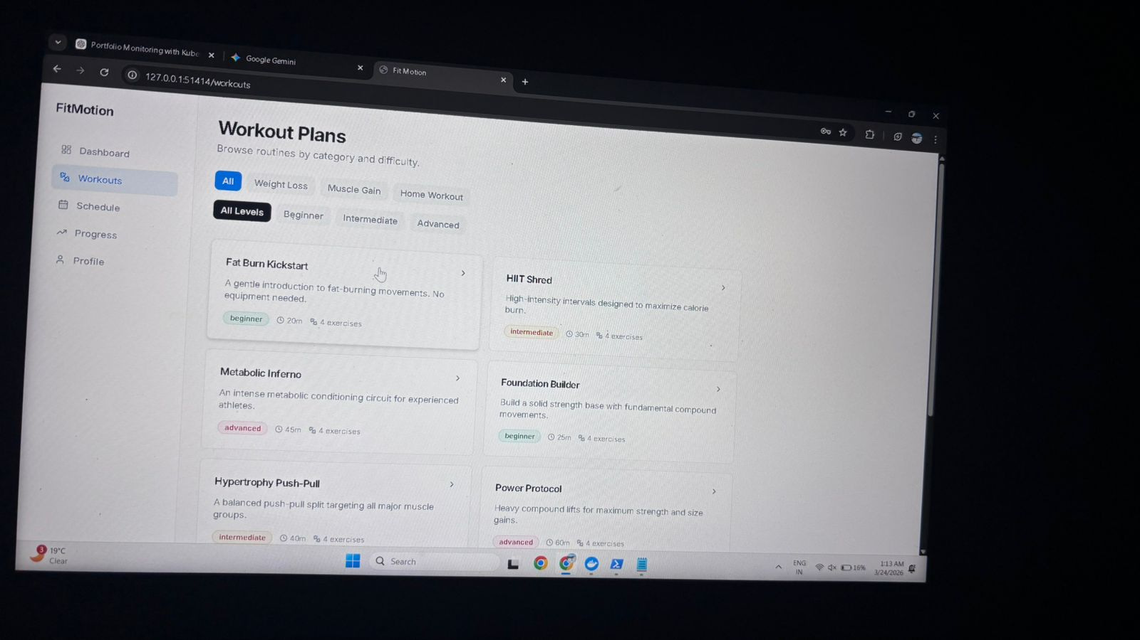
Step 2 — Application Deployment & Verification
05
01
kubectl apply -f deployment.yaml
02
kubectl apply -f service.yaml
03
kubectl port-forward svc/fit-launchpad-service 1414:80
04
App verified at http://127.0.0.1:1414
FitMotion app running at localhost via port-forward
✅ App Deployed Successfully!
Pranav Kumar | Reg: 12209660 | Sec: 4OM05
5/10

Slide 6
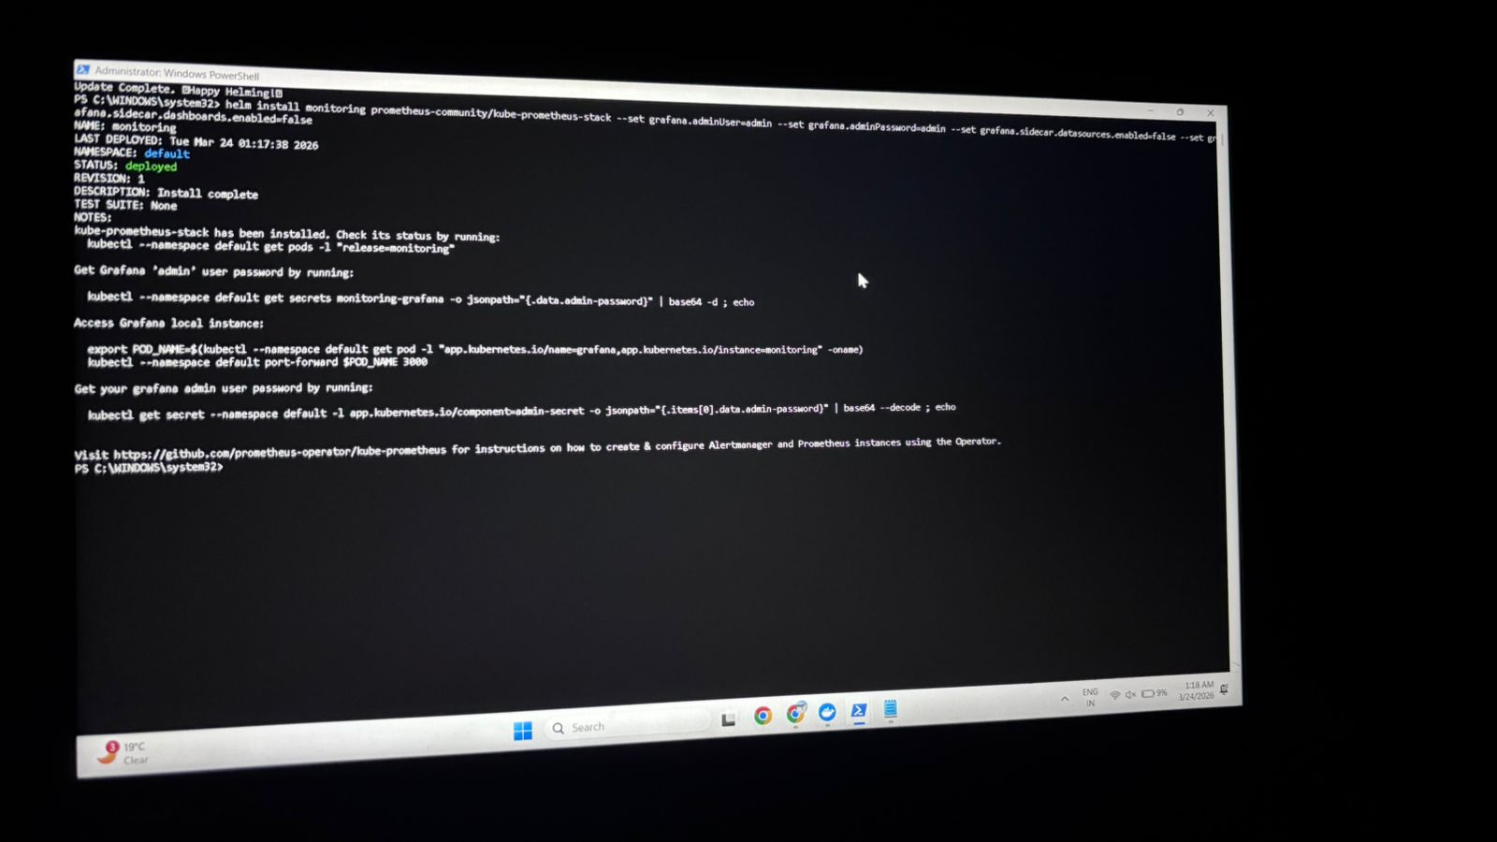
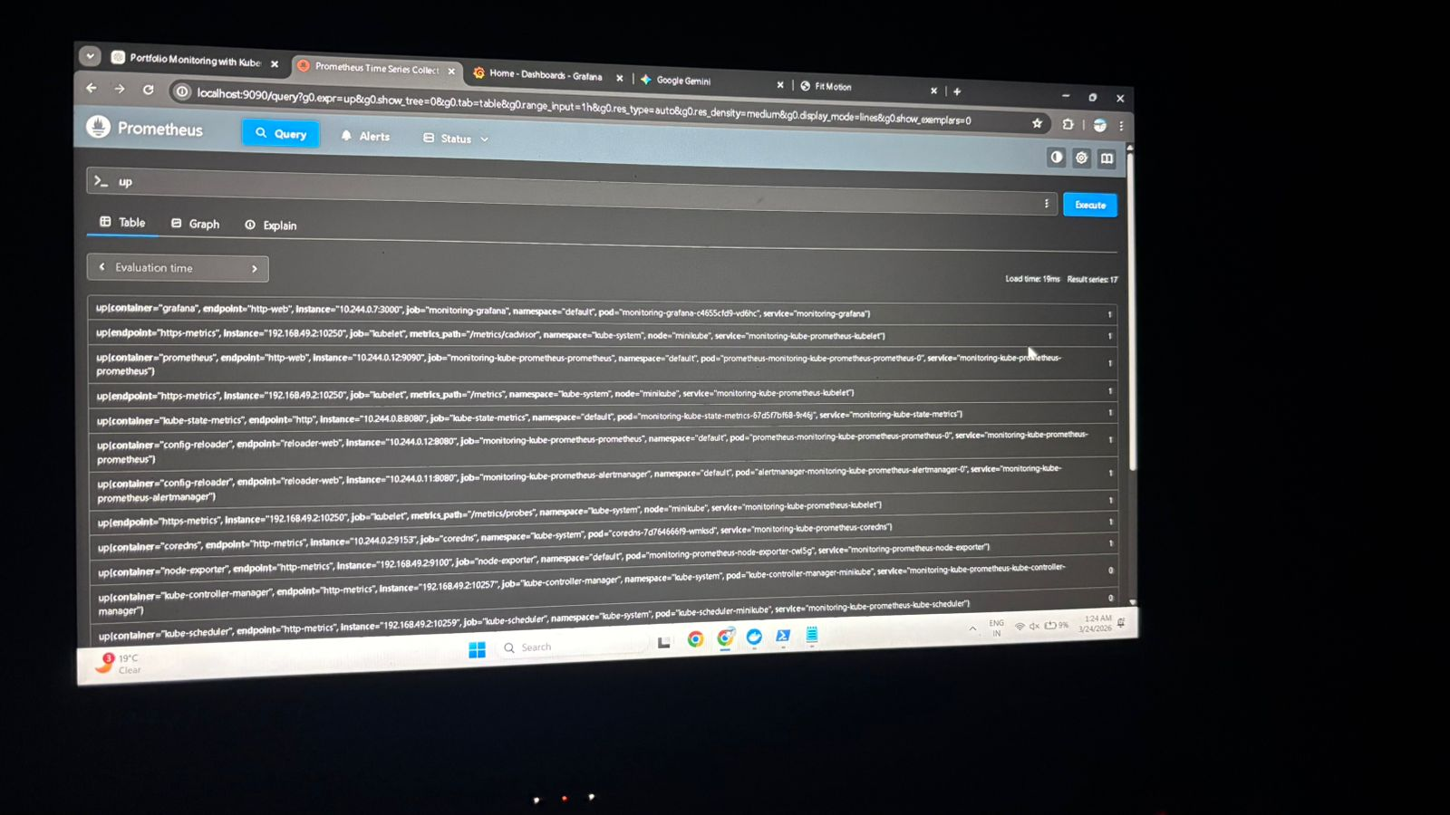
Step 3 — Monitoring Stack: Prometheus & Grafana
06
Kube-Prometheus-Stack deployed via Helm. Prometheus scrapes all cluster components; Grafana visualises metrics.
Helm install – STATUS: deployed ✔
Prometheus – 17 scrape targets all UP ✔
Helm command: helm install monitoring prometheus-community/kube-prometheus-stack
Pranav Kumar | Reg: 12209660 | Sec: 4OM05
6/10

Slide 7
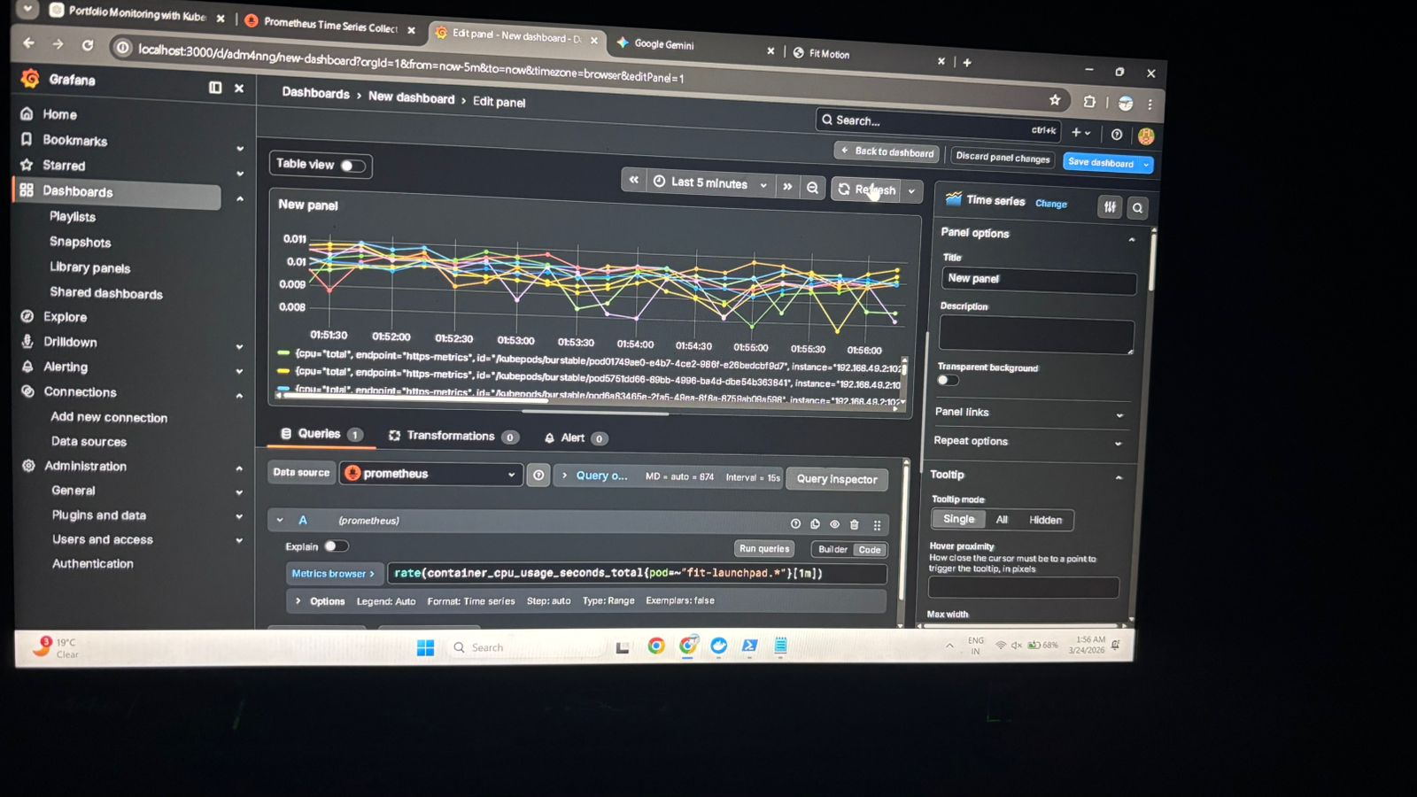
Step 4 — Grafana Dashboard (Custom PromQL)
07
Dashboard Details
Data Source:
Prometheus
Query (PromQL):
rate(container_cpu_usage_seconds_total{pod=~"fit-launchpad.*"}[1m])
Refresh:
Every 15s
Chart type:
Time Series
Purpose:
Live CPU tracking per pod
Pranav Kumar | Reg: 12209660 | Sec: 4OM05
7/10

Slide 8
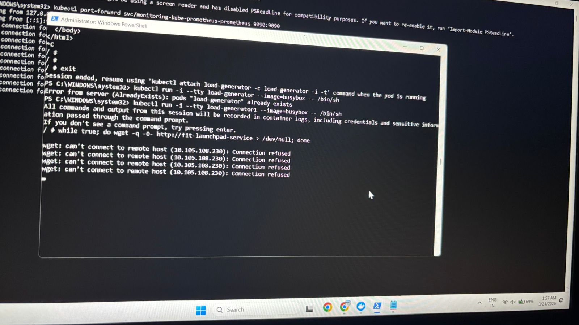
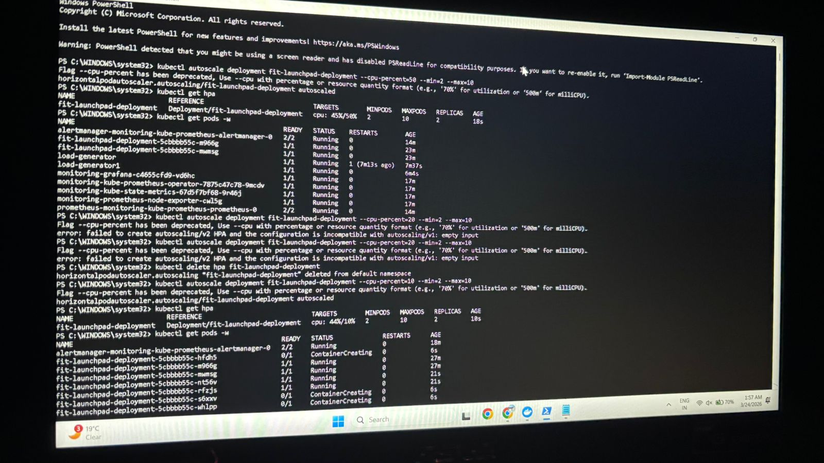
Step 5 — Load Testing & Troubleshooting
08
A busybox load-generator pod sent infinite HTTP requests to stress the app and trigger HPA.
⚠ Connection refused errors during load test
HPA API version errors → fixed with autoscaling/v2
Issue 1: Service ClusterIP not reachable from busybox pod — fixed service selector. Issue 2: --cpu-percent deprecated → replaced with autoscaling/v2 format.
Pranav Kumar | Reg: 12209660 | Sec: 4OM05
8/10

Slide 9
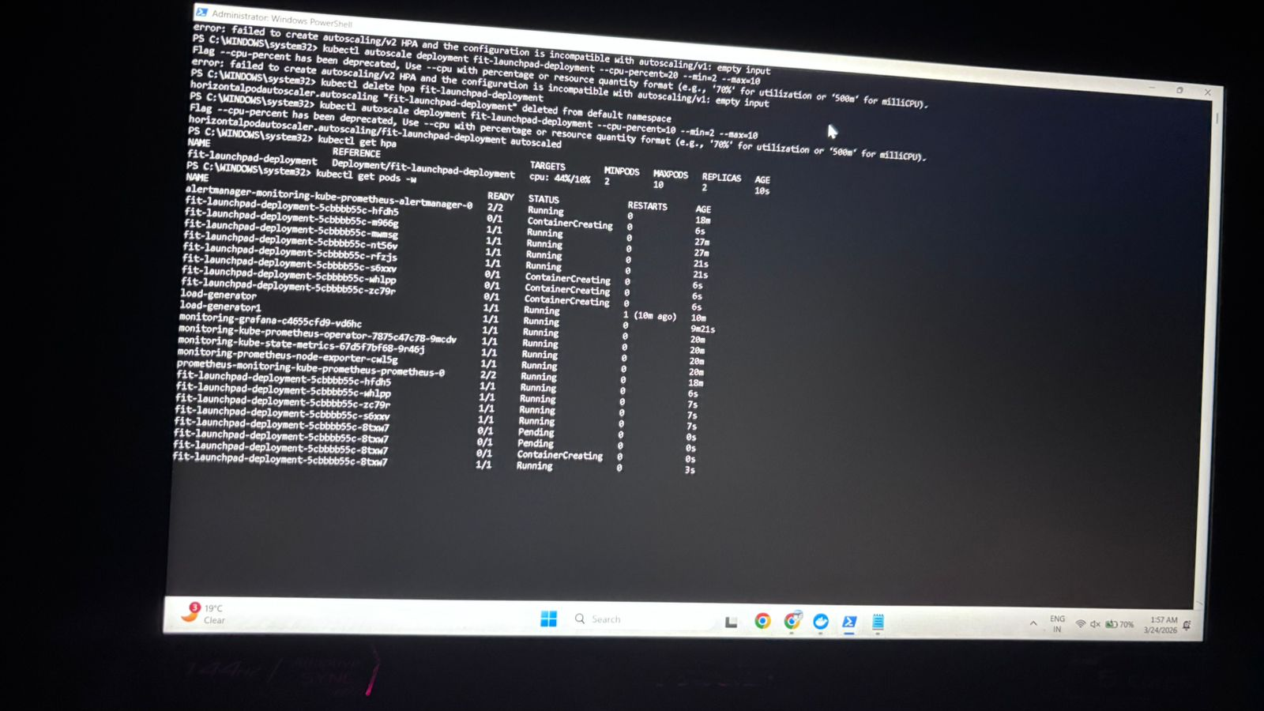
Step 6 — Autoscaling in Action (HPA)
09
2
Min Replicas
10
Max Replicas
10%
CPU Trigger
44/10%
Actual / Target CPU
Pods scaling up from 2 → 10 in real-time
HPA working perfectly ✔
Pranav Kumar | Reg: 12209660 | Sec: 4OM05
9/10

Slide 10
CONCLUSION & OUTCOMES
What We Achieved
Key
Learnings
✅ Successfully containerized FitMotion with Docker & Nginx
✅ Deployed on Kubernetes (Minikube) with zero manual intervention
DevOps Pipeline
✅ Full observability via Prometheus (17 targets) + Grafana dashboard
Cloud-Native Design
✅ HPA auto-scaled deployment from 2 → 10 pods under load
Real-time Metrics
✅ Resolved real-world issues: network config & API versioning
✅ Zero downtime during high-traffic simulation
Self-Healing Infra
Pranav Kumar | Reg: 12209660 | Roll: 42 | Section: 4OM05

