Slide 1
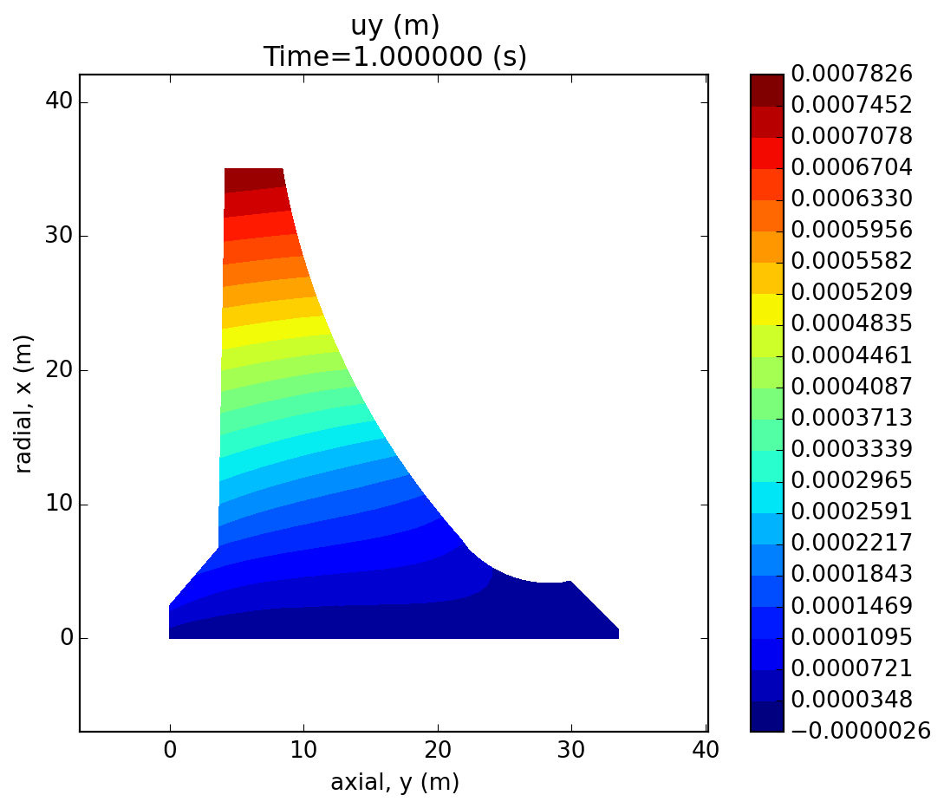
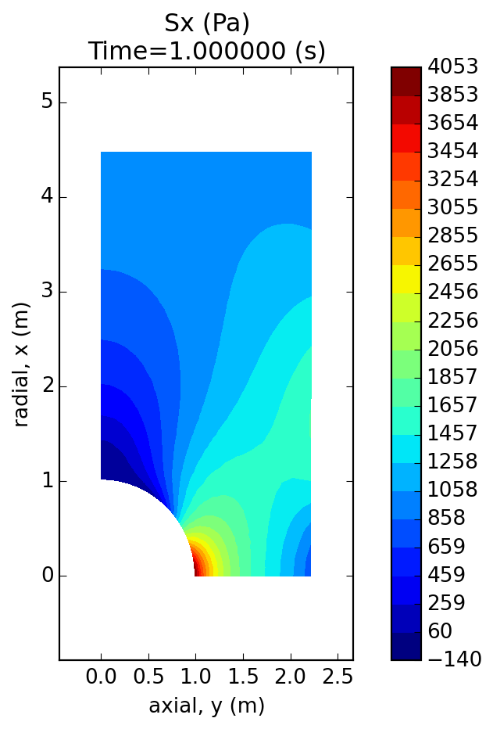
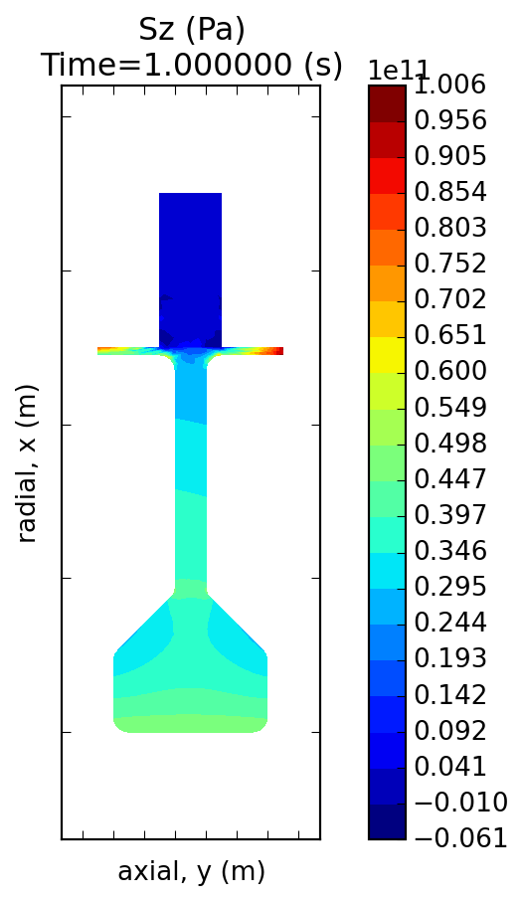
Wrapping Existing Tools in Python: Pycalculix https://github.com/spacether/pycalculix
Presentation to Boston Python User Group
2014-12-11
Justin Black
Mechanical Engineer
Justin.a.black@gmail.com
www.justinablack.com

Slide 2
What and Why
What:
Python API to build, solve and analyze mechanical engineering Finite Element Analysis (FEA) models of parts
Forces, displacements, gravity etc can be applied to a part and displacements and stresses can be displayed and queried
Why?
Existing free tools are very capable but not very automatable or user friendly
With current workflow you have to learn 4 programs, I reduced that to one

Slide 3
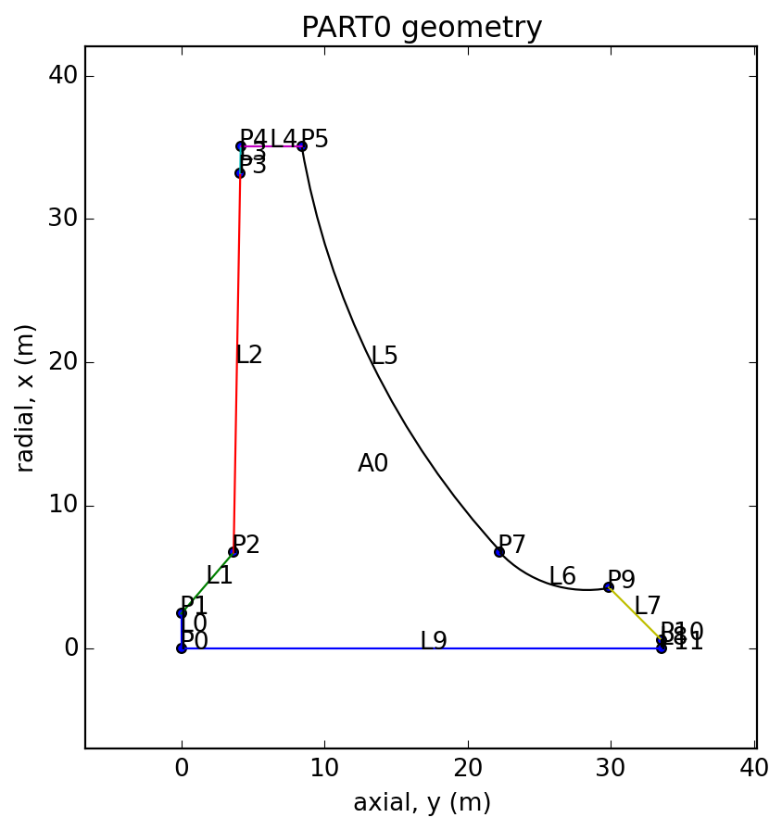
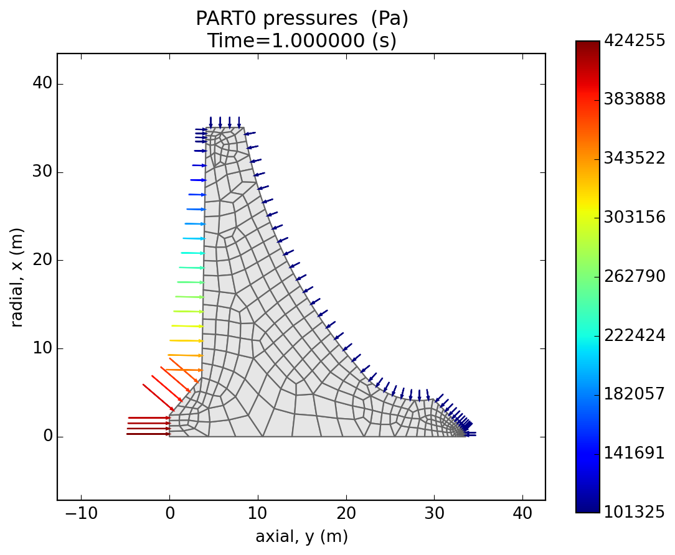
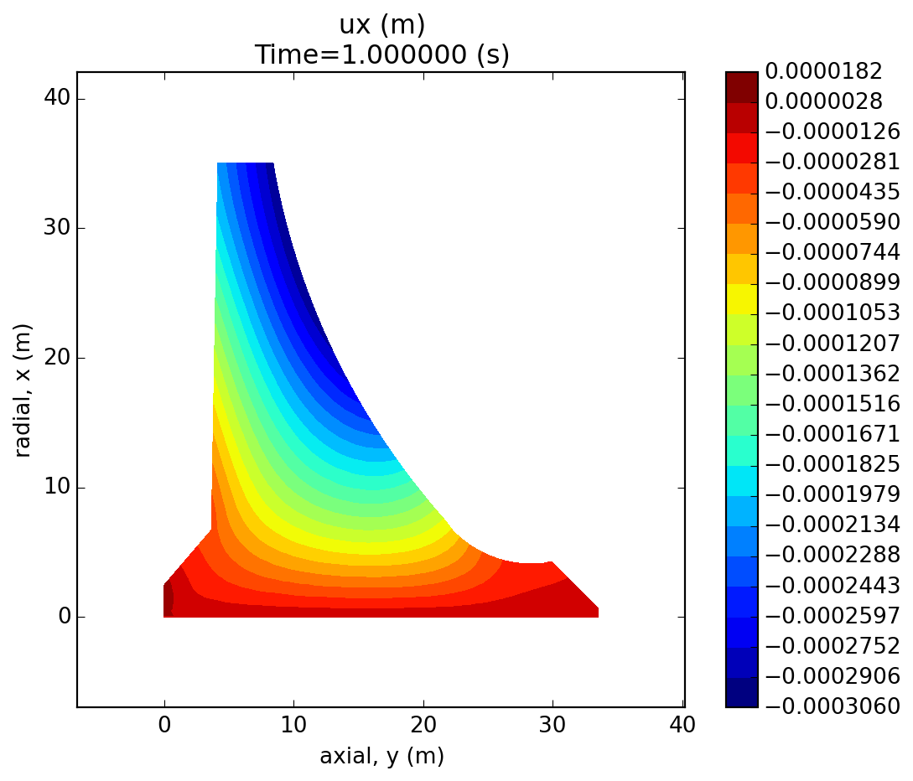
Example: Analyzing a concrete dam
Make part
Assign material
Mesh part
Apply constraints
Apply pressures
Apply gravity
Solve model
View Results

Slide 4
Program Requirements + Tactics
When I started I wrote pseudocode of how I wanted to call my library
Below are lower level requirements
GEOMETRY: store points, lines, areas, groups of areas
MESH: export geometry file to be meshed and import results of meshing
MODEL: apply loads + constraints to geometry
SOLVER: write solver input file
RESULTS: import and query results

Slide 5
Key Challenges
All geometry items must have unique ids and have child nodes elements, faces
How do we plot just our part and not an interpolation blob?
Results file format must be brought back into python for querying and plotting

Slide 6
Uniquely Identify Geometry, pg1
Geometry is made of primitives:
Part → Areas → Lines → Points
Each primitive must have a unique identity so the mesher knows which lines make an area.
I chose to number each primitive: 0,1,2,3 etc
A dict sounds like a great way to store them, but what if we need to renumber them later. What if we delete item #1?
Instead, I opted for lists of items, where each item has an id number

Slide 7
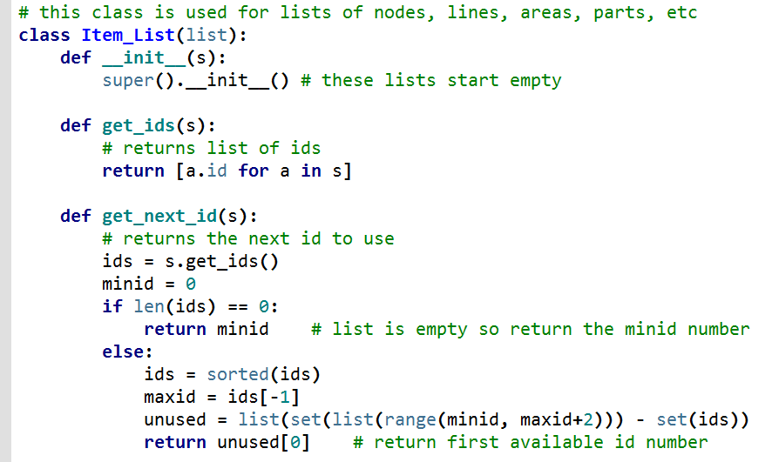
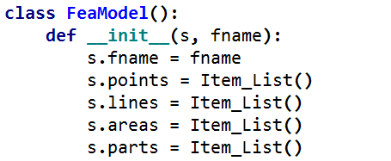
Uniquely Identify Geometry, pg2
a = FeaModel(‘dam’)

Slide 8
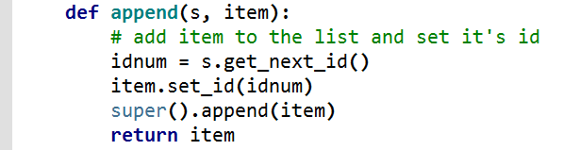
Uniquely Identify Geometry, pg3
item.id = -1 by default
When an item is added to the list the next available id number is found
We set that id number in the item
Then add the item to the list

Slide 9
Plotting selected element results, pg 1
When we plot results, we need to use interpolation to make the results look good.
The usual way to plot unstructured data in matplotlib is to make a regular grid using numpy and map our results onto it, using something like scipy griddata.
But that interpolates over large areas, and is not limited to the boundaries of our part and elements. Instead let’s use pyplot: tripcolor or tricontourf

Slide 10
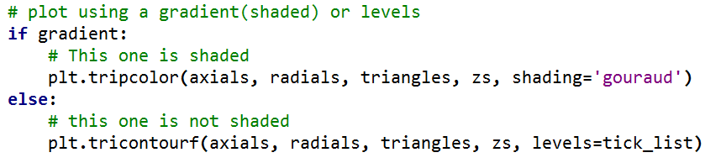
Plotting selected element results, pg 2
Each of these functions lets us plot unstructured data from a triangular mesh.
Tripcolor allows us to plot with continuous contours
Tricontourf allows us to plot filled contours

Slide 11
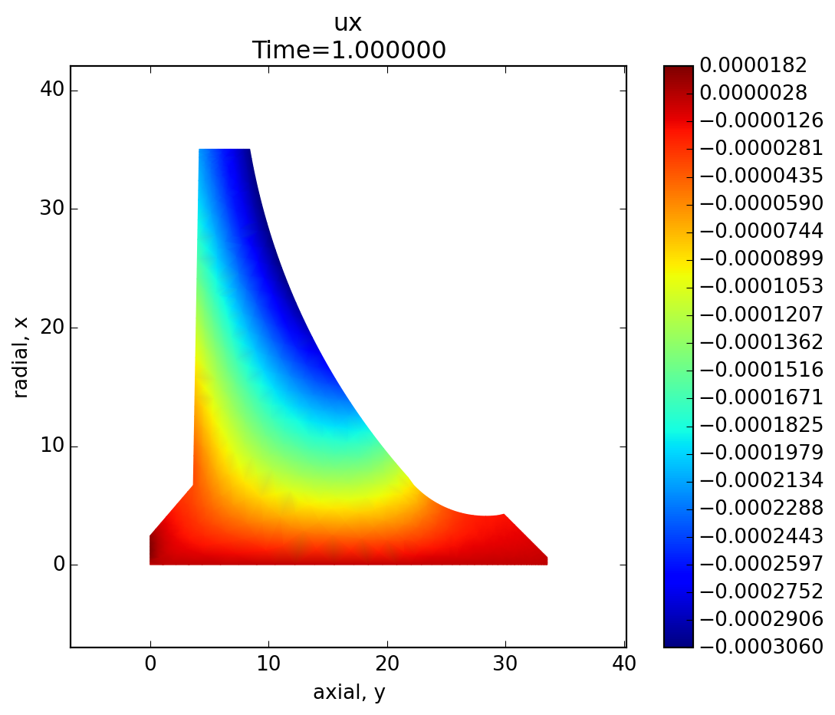

Plotting selected element results, pg 2
The only other trick we need to do is to have each element return its triangles. For a triangular element this is easy. For a quad element, we just have it split itself into two triangles.
tripcolor
tricontourf

Slide 12
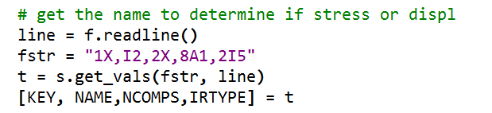
Import Results, Pg 1
The documentation listed results file formatting and variable names.
I wrote a function where I could pass in the format string, and the line
And get out a list of variables, correctly typed
This made data import very easy

Slide 13
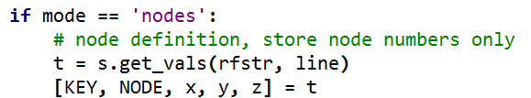
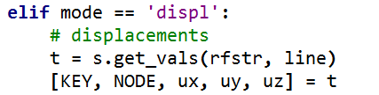
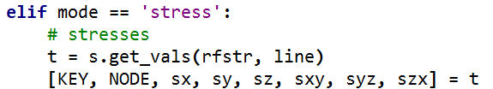
Import Results, PG 2
Results were very easy to process with my get_vals method

Slide 14
Download pycalculix on Github
https://github.com/spacether/pycalculix
Future distribution may be through PiPi or my website.

Slide 15
APPENDIX

Slide 16
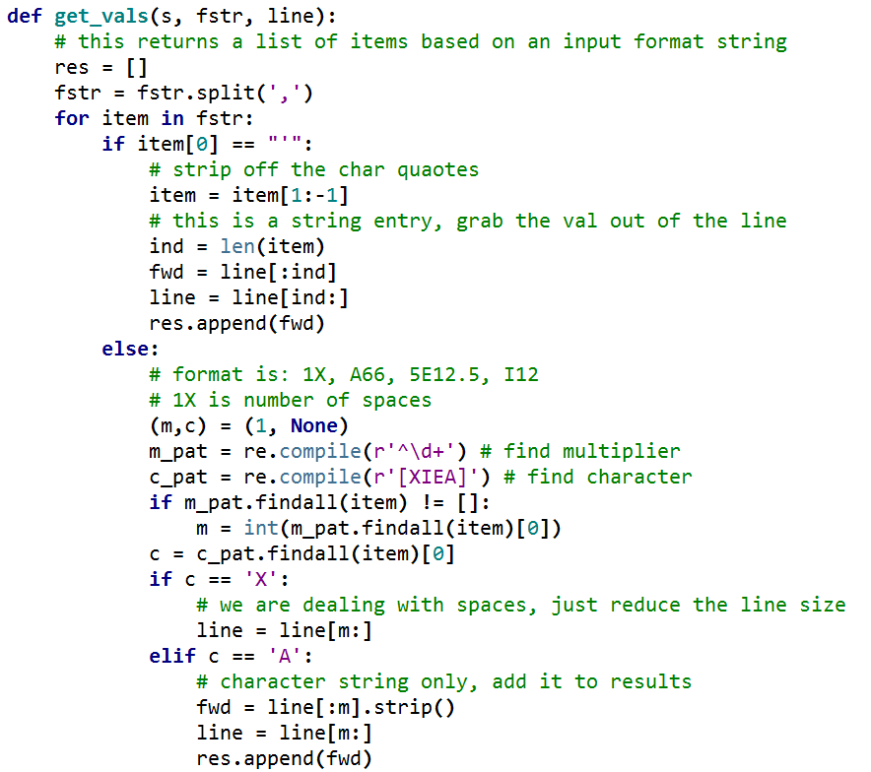
Import Results, Pg 2
This block is for quoted strings only
Add this portion of the line to the results
Format is mc
m = multiple
c = character
Add string to results

Slide 17
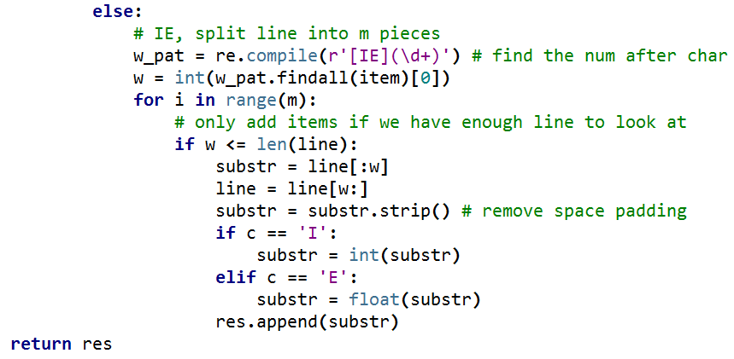
Import Results, Pg 3
Format is mcw
m = multiple
c = character is I or E
w = width
Cast as int or float
Add to results

Slide 18
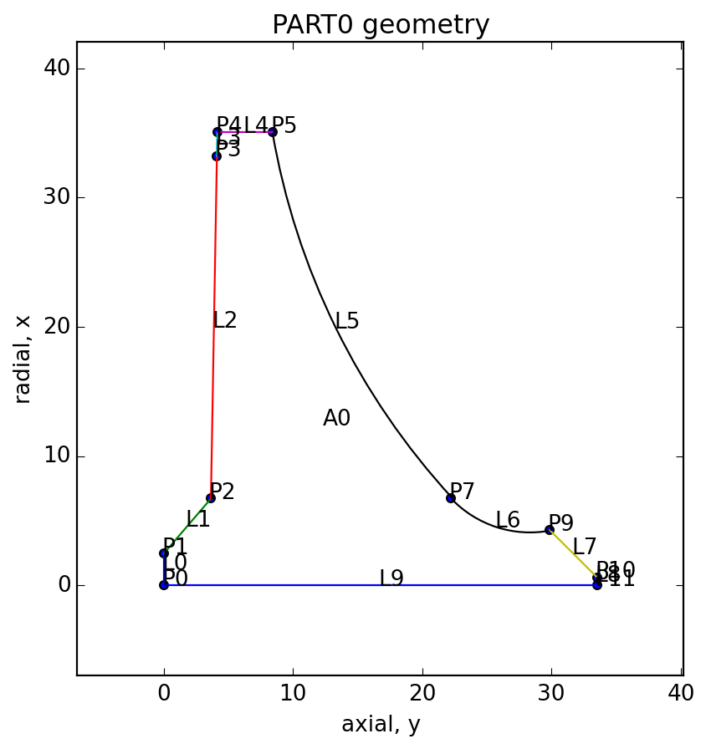
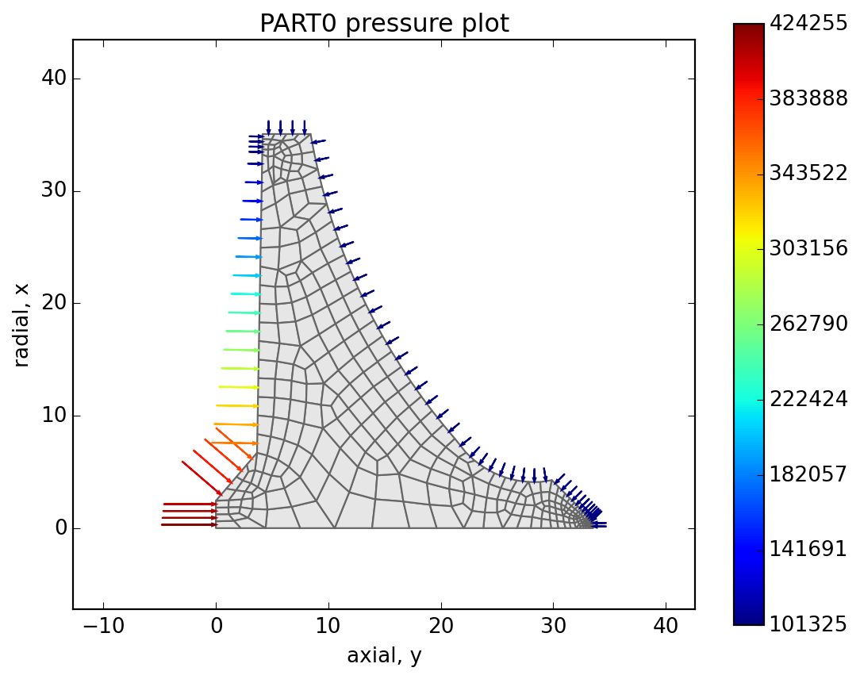
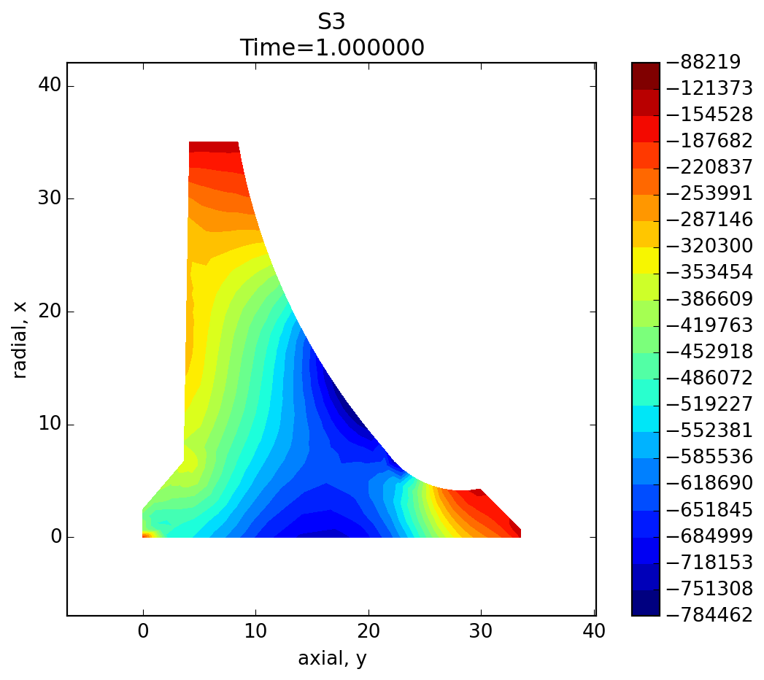
Example: Analyzing a dam (BEETALOO DAM) Plane Strain
File: dam.py
(meters)
(Pa = N/(m^2))
(Pa = N/(m^2))
Make part
Assign material
Mesh part
Apply constraints
Apply pressures
Apply gravity
Solve model
View Results

Slide 19
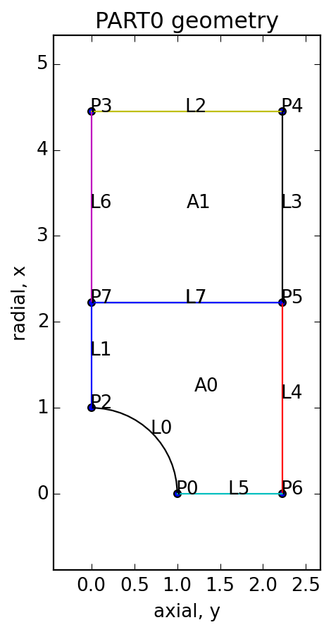
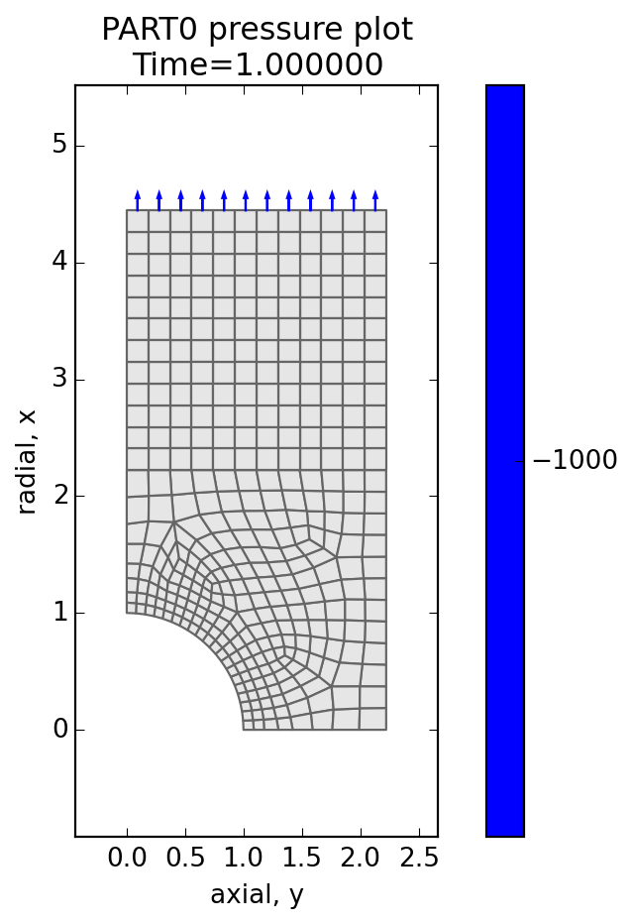

Example: Hole In PlatE UNDER TENSION plane Stress
File: hole_model.py
(meters)
(Pa = N/(m^2))
(Pa = N/(m^2))
Make part
Assign material
Mesh part
Apply constraints
Apply pressures
Solve model
View Results

Slide 20
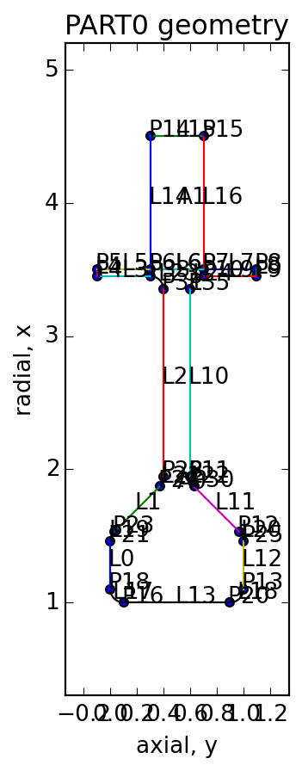
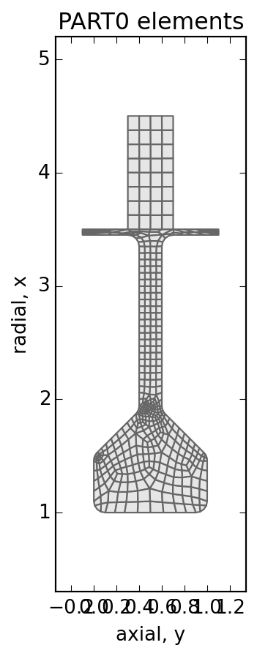
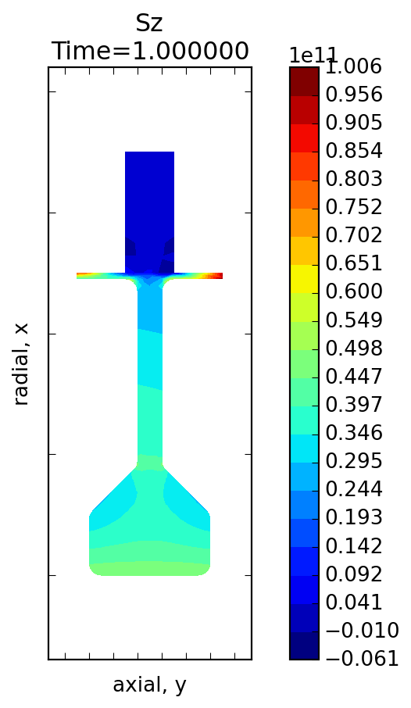
Example: Compressor disk or turbine disk Axisymmetric
File: compr_rotor_stage.py
(meters)
(Pa = N/(m^2))
Make part
Assign material
Mesh part, set thickness on airfoil
Apply constraints
Apply speed
Solve model
View Results

Slide 21
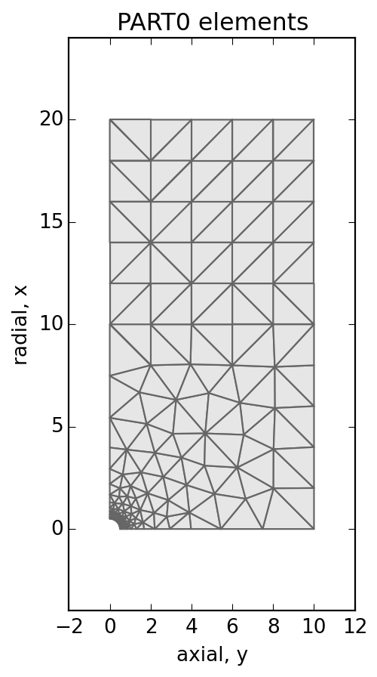
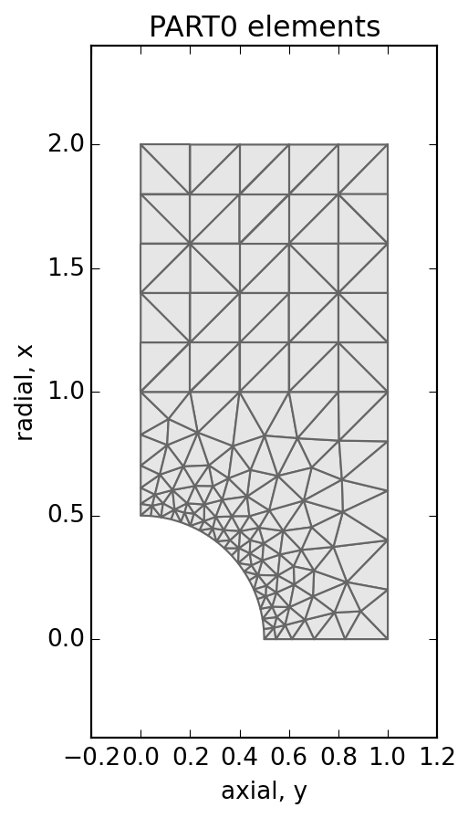
Example: Design Study Peterson Tension Hole in Plate, pg 1
File: hole_kt.py
(meters)
(Pa = N/(m^2))
Make part
Assign material
Mesh Part
Apply constr + press
Solve model
Extract Kt
Run multiple models with a range of plate widths, using a constant hole size.
Compare Calculix FEA results with Peterson predicted results.

Slide 22
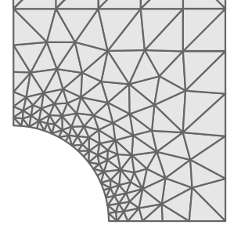
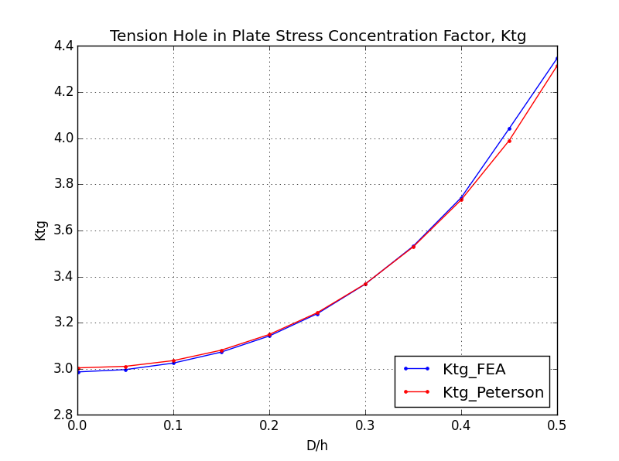
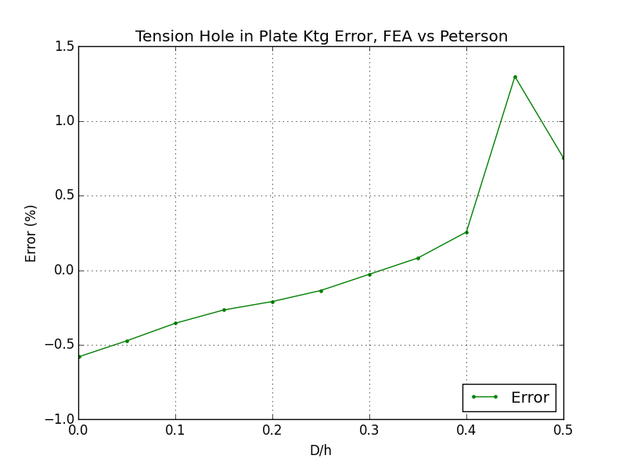
Example: Design Study Peterson Tension Hole in Plate, pg 2
File: hole_kt.py
D/h = .45
Error may be higher
Because only one element
on this corner
All other runs had 2 like below
D/h = .50
Run multiple models with a range of plate widths, using a constant hole size.
Compare Calculix FEA results with Peterson predicted results.
Calculix FEA results are accurate to within 1.5% of Peterson’s results. Error jump is probably due to layout of local elements.
19 elements used on arc, 2nd order tris used

Slide 23
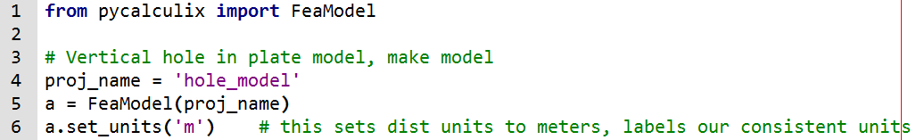
Walk Through, Hole In Plate, pg1
File: hole_model.py
Import the pycalculix library and define a model
This model will hold all of our geometry, materials, loads, constraints, elements, and nodes.

Slide 24
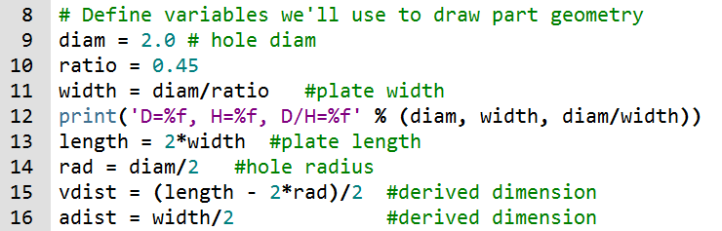
Walk Through, Hole In Plate, pg2
File: hole_model.py
Define the variables that we’ll use to draw the part

Slide 25
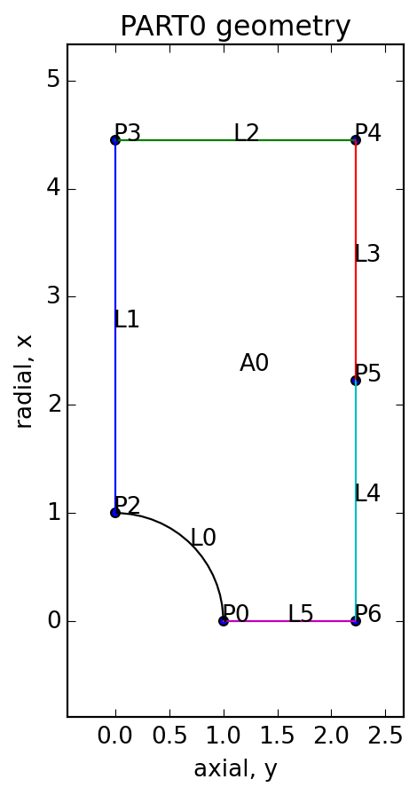
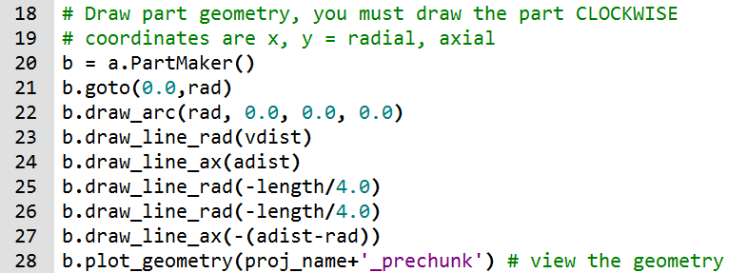
Walk Through, Hole In Plate, pg3
File: hole_model.py
Draw the part. We have to make a PartMaker instance to store the part. Part must be drawn in CLOCKWISE direction x = vertical axis, also known as the ‘radial’ axis y = horizontal axis, also known as the ‘axial’ axis Draw_line_rad = draw radial line (vertical) Draw_line_ax = draw axial line (horizontal)

Slide 26
Walk Through, Hole In Plate, pg4
File: hole_model.py
Chunking tells the program to try to cut the area into smaller pieces
It cuts the part at points. It draws a perpendicular line then cuts the part with it.
Chunking can help you make a better quality mesh. It is required for CGX meshing, but not for GMSH meshing.
Area was chunked at P5

Slide 27
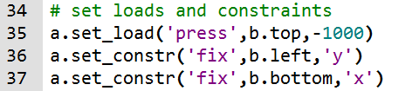
Walk Through, Hole In Plate, pg5
File: hole_model.py
Sets the loads and constraints
Positive pressures push on the part. Negative pressures pull on the part.
Note: we can do this either before or after meshing because the program stores loads on geometry (points, lines, areas) rather than the mesh.

Slide 28
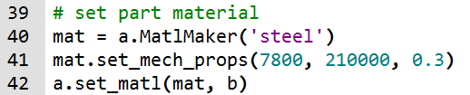
Walk Through, Hole In Plate, pg6
File: hole_model.py
Set the part material

Slide 29

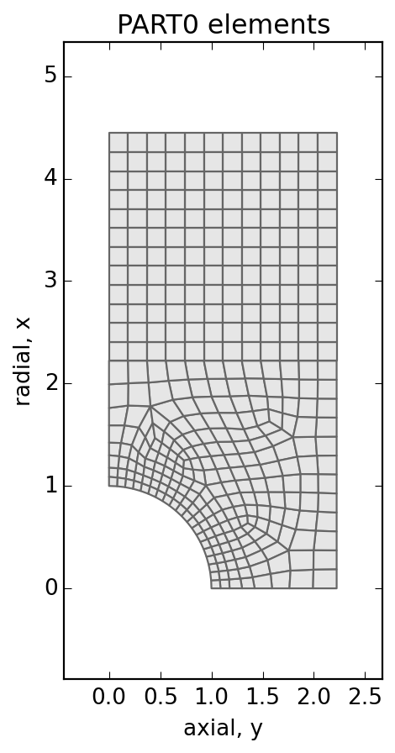
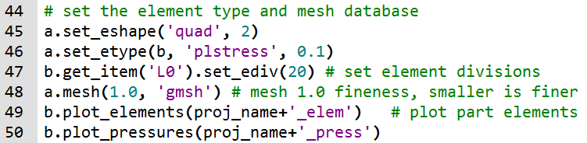
Walk Through, Hole In Plate, pg7
File: hole_model.py
Mesh the part
set_eshape(shape=‘quad’ or ‘tri’, order=1 or 2) set_etype(part, etype, thickness) etype: ‘plstress’ = plane stress, thickness is required ‘plstrain’ = plane strain, thickness is required ‘axisym’ = axisymmetric, thickness is not required

Slide 30

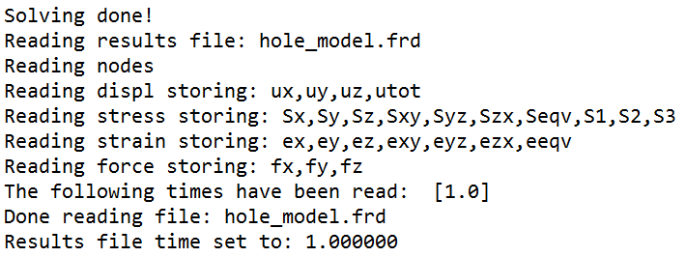
Walk Through, Hole In Plate, pg8
File: hole_model.py
Make and solve the model.
Python console output on the right.

Slide 31
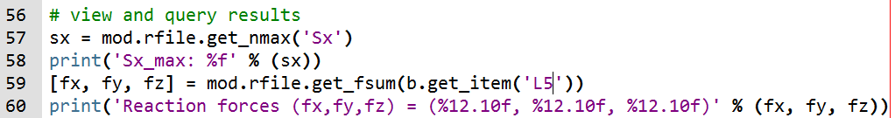
Walk Through, Hole In Plate, pg9
File: hole_model.py
Query our results. Check the max stress and the reaction forces.
Python console output below
The reaction force output shouldn’t be zero here.
These results come directly from the results FRD file.
This is a bug which needs to be fixed in the solver.

Slide 32
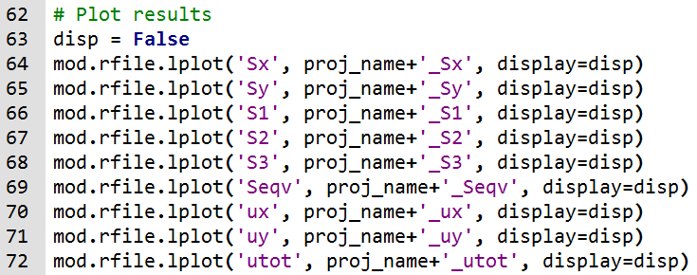
Walk Through, Hole In Plate, pg10
File: hole_model.py
Plot our results.
Interactive plotting is suppressed with the display variable, but files are saved.

Slide 33
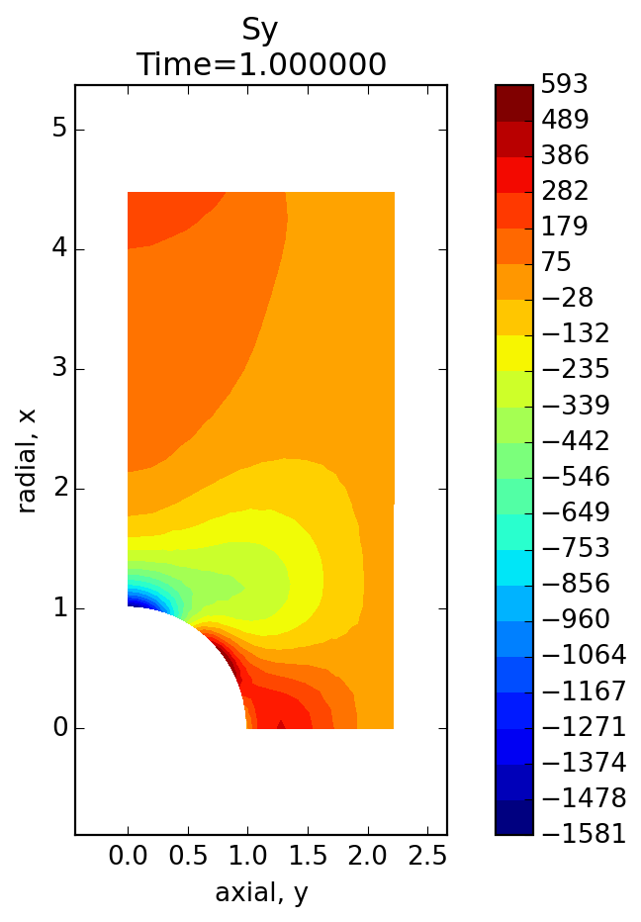
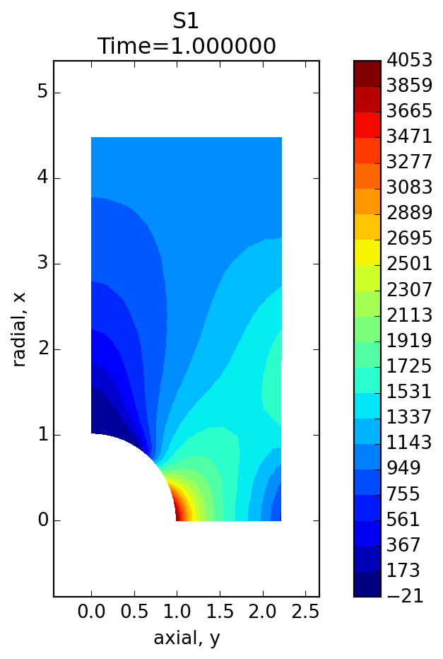
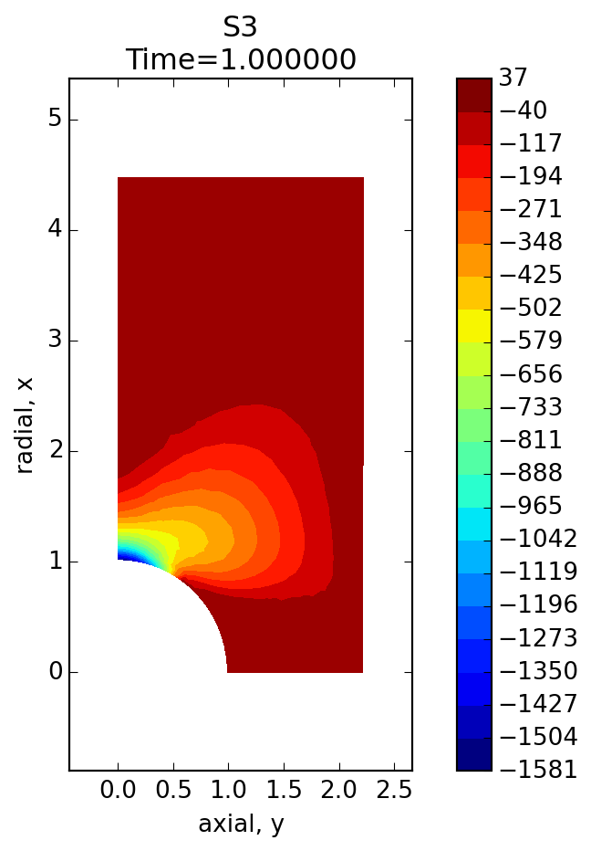
Walk Through, Hole In Plate, pg11, Plots
File: hole_model.py

Slide 34
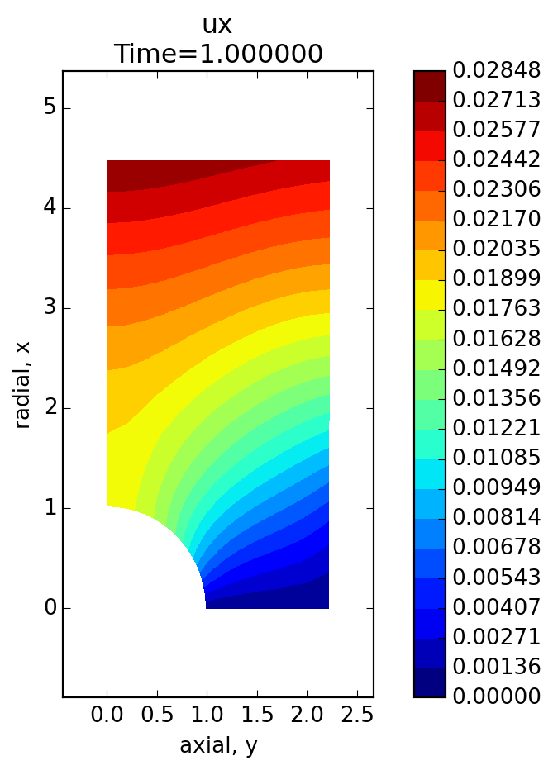
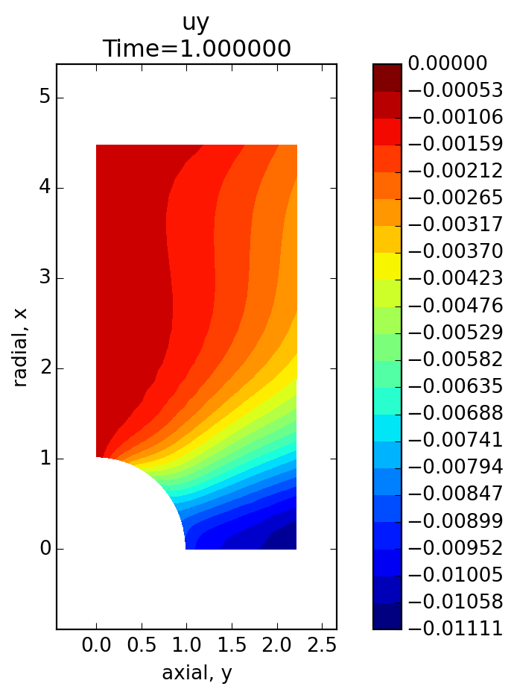
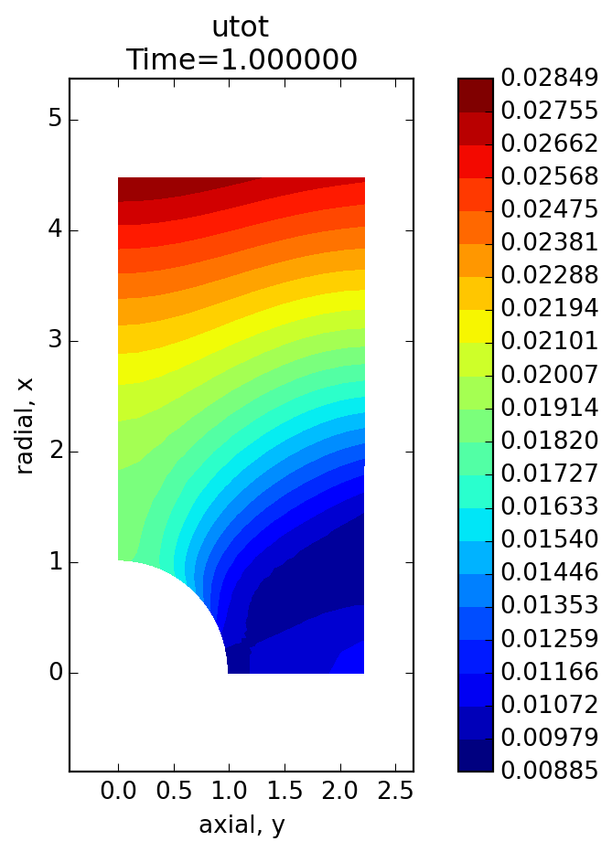
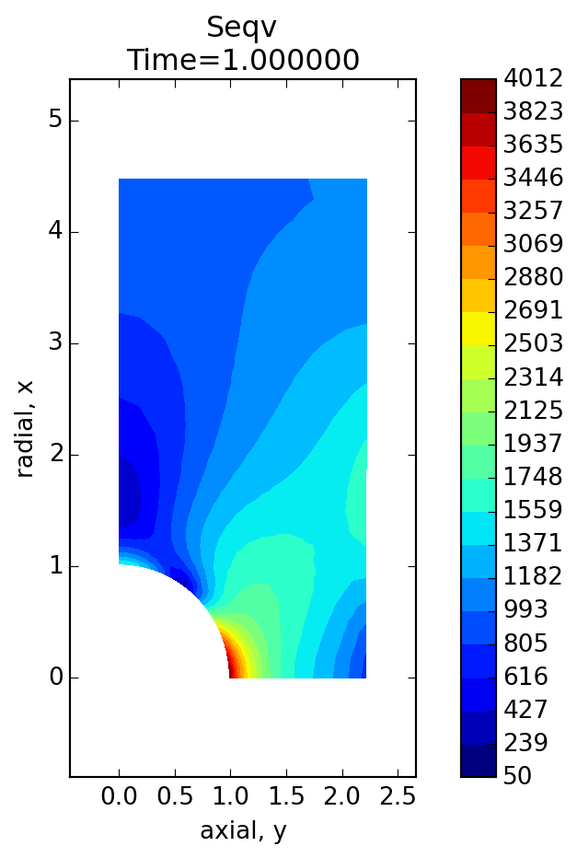
Walk Through, Hole In Plate, pg12, Plots
File: hole_model.py

