Slide 1
단국대 소〮중 데이터 분석 AI 경진대회
미정
팀원 : 김동현(32160507), 김찬휘(32161149),
김형욱(32161269), 송준섭(32162330),
이중호(32163571)

Slide 2
목 차
01
Feature 찾기
02
Feature 적용시키기
Model 적용
Stacking 적용
03
04

Slide 3
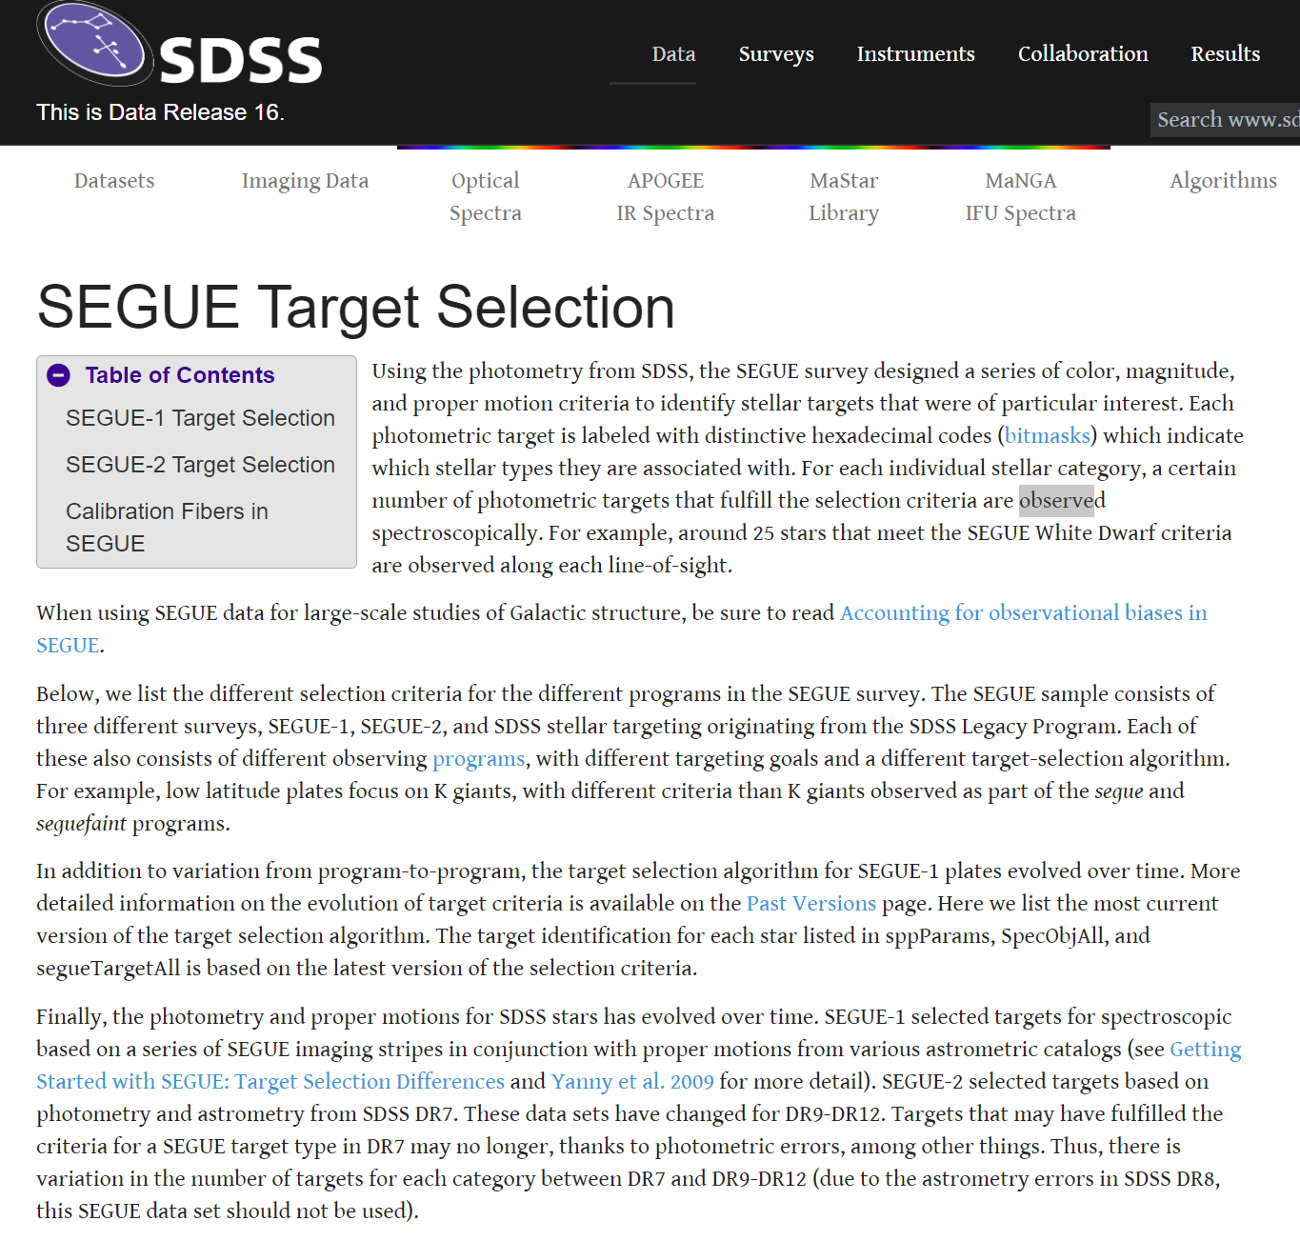

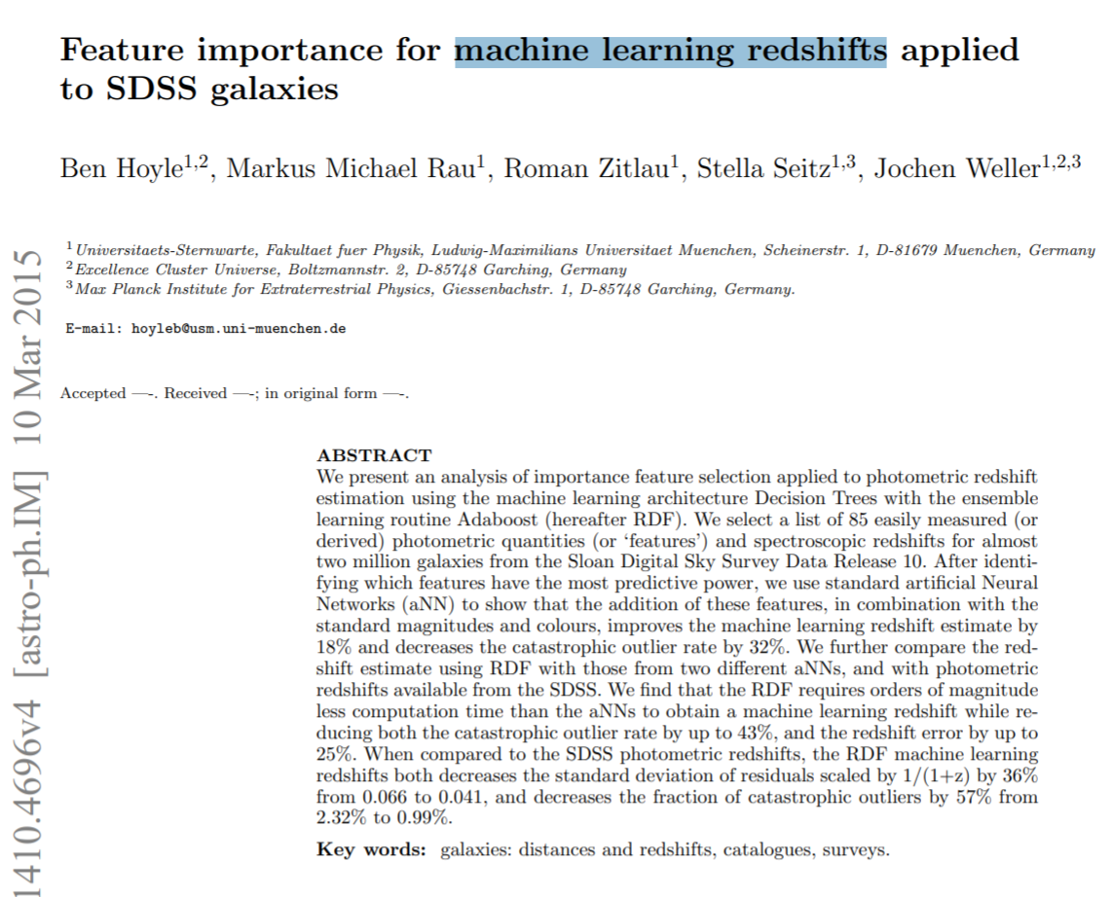
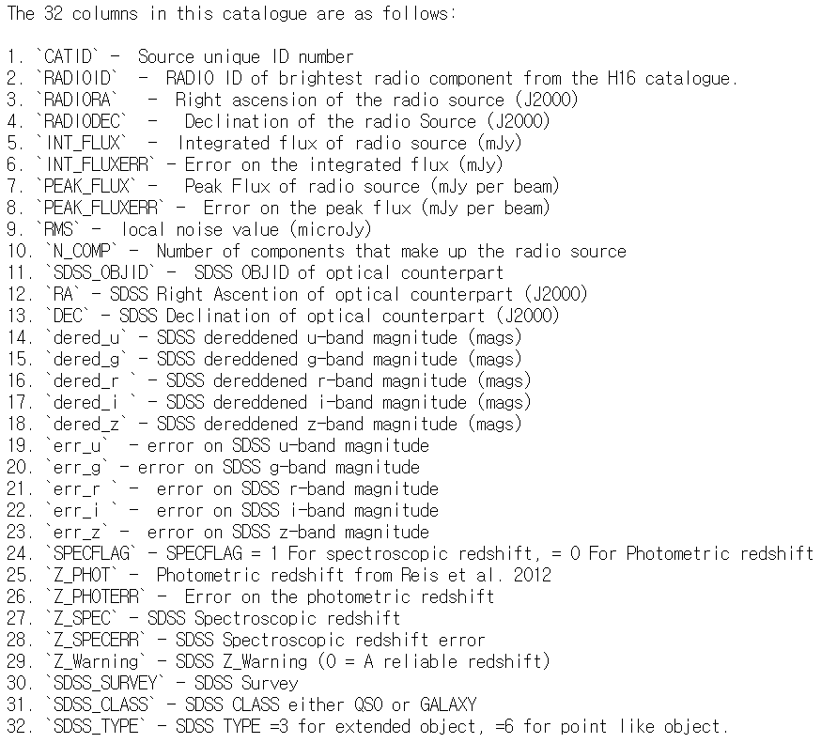
1. Feature 찾기

Slide 4
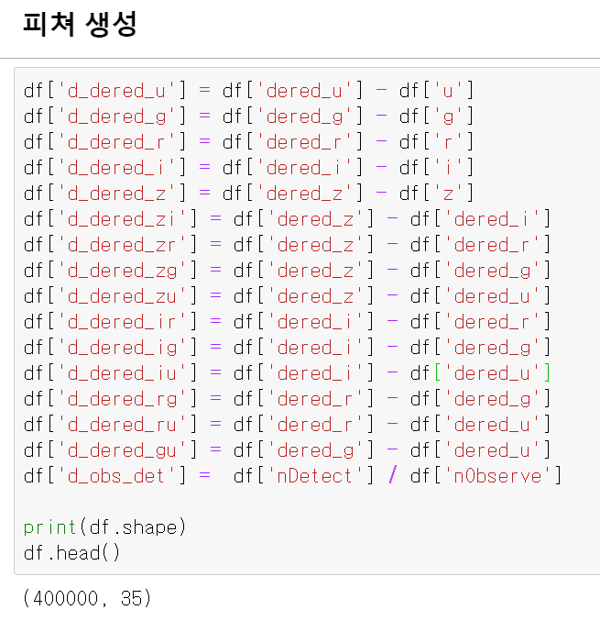
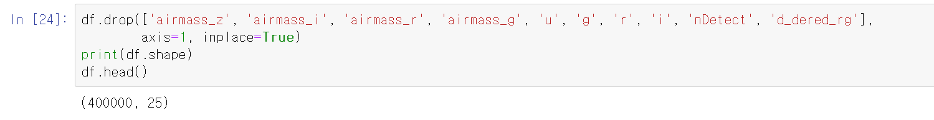
2. Feature 적용시키기

Slide 5
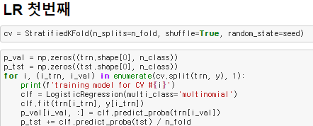
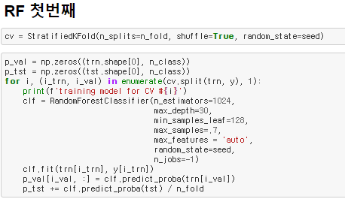
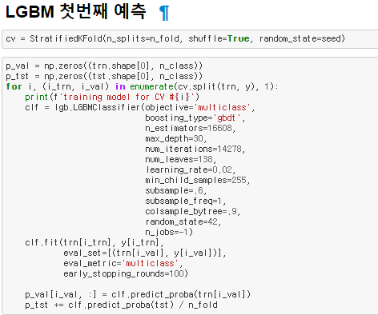
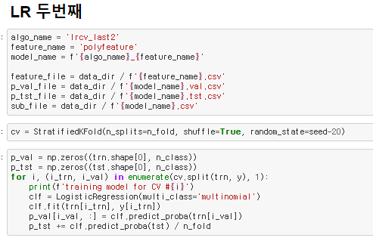
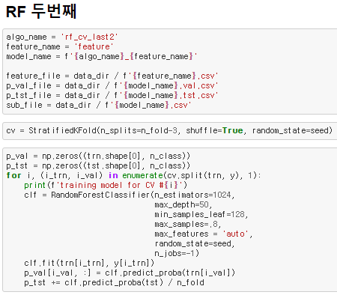
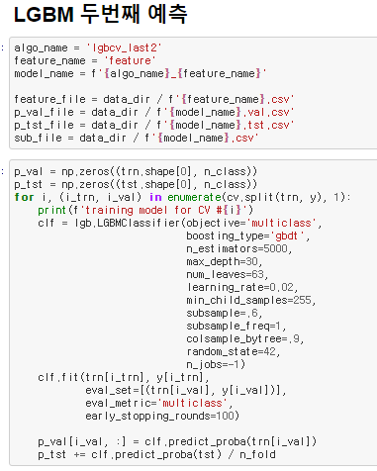
3. Model 적용
LR_CV
RF_CV
LGBM_CV

Slide 6

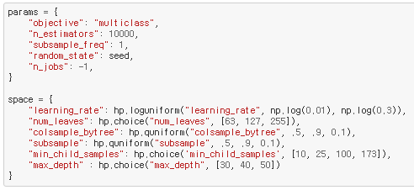
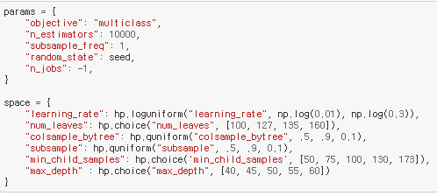
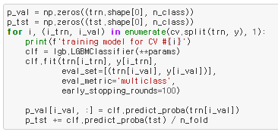
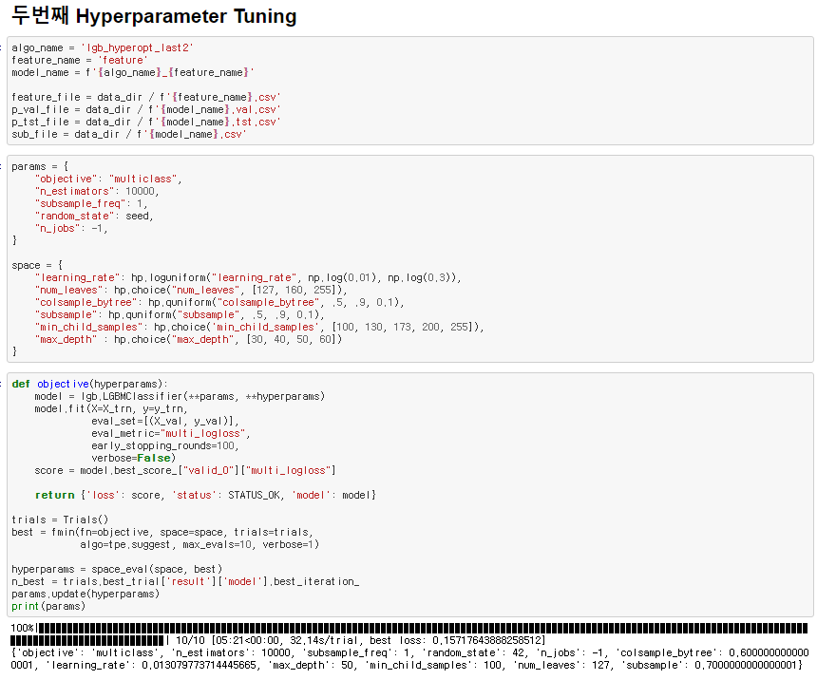

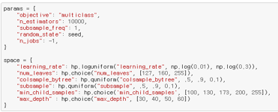
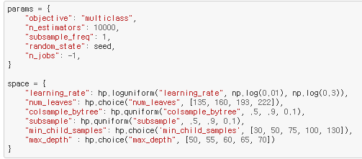
3. Model 적용
-결과-
learning_rate : 0.0142, num_leaves : 255
colsample_bytree : 0.6, subsample : 0.7
min_child_samples : 173, max_depth : 30
-결과-
learning_rate : 0.0145, num_leaves : 160
colsample_bytree : 0.9, subsample : 0.7
min_child_samples : 50, max_depth : 60
LGBM
_Hyperopt
-결과-
learning_rate : 0.01307, num_leaves : 127
colsample_bytree : 0.6, subsample : 0.7
min_child_samples : 100, max_depth : 50
-결과-
learning_rate : 0.01843, num_leaves : 135
colsample_bytree : 0., subsample : 0.6
min_child_samples : 50, max_depth : 60

Slide 7
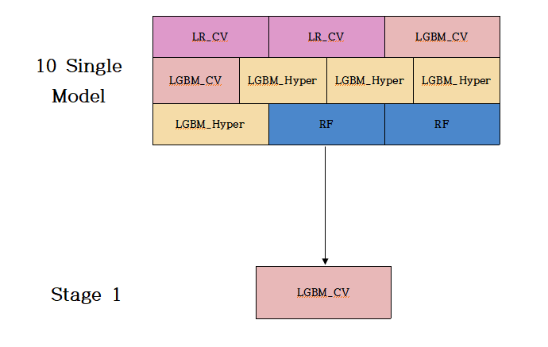

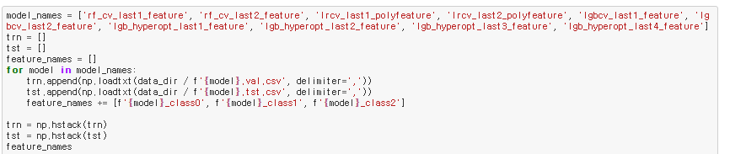
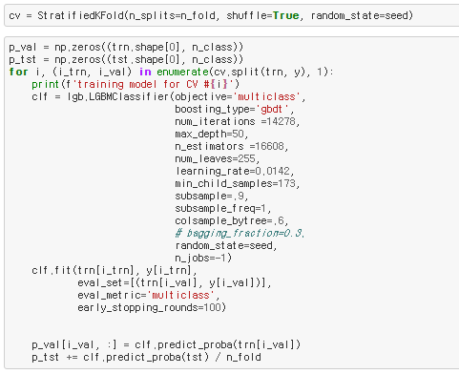
4. Stacking

Slide 8
감사합니다.

