Slide 1


Blind Remote Exploitation Ighor Augusto
Edição 2017
Rio de Janeiro
18 de maio

Slide 2
Abstract

Slide 3

whoami
Ighor Augusto Barreto Candido
Founder and CTO at Intruder Security

Slide 4
Objective
How to write a generic exploit
How to build a ROP chain in time of exploitation
How to hack proprietary closed-binary services
How to bypass anti-exploitation techniques

Slide 5
Disclaimer
Security really exists?
How do you expect to get security without understanding the hacker’s mind?
For whom is this talk?
Penetration testers nowadays

Slide 6
Requirements
What must we know?
Linux syscalls
x86 architecture
C programming
Sockets and network programming
Basics of software exploitation
Return Oriented Programming
The same idea can be ported to another Operational Systems!

Slide 7
Introduction

Slide 8
Scenarios
Hacking an open-source server for which the binary is unknown
Hacking a known vulnerability in a library thought to be used in a proprietary closed-binary software
Hacking a proprietary closed-binary services

Slide 9
Scenario example
Hacking an open-source server for which the binary is unknown
Proftpd Telnet IAC buffer overflow (CVE-2010-4221) vulnerability as example
Hacking a known vulnerability in a library thought to be used in a proprietary closed-binary software
Hacking a proprietary closed-binary services

Slide 10
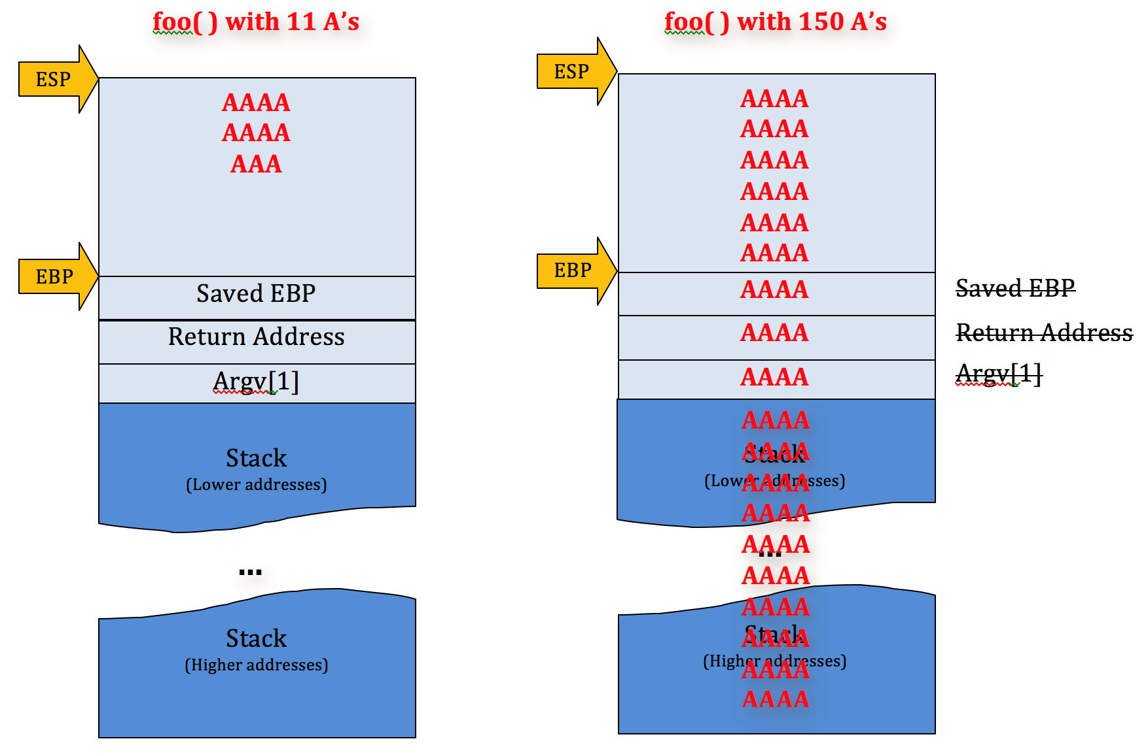
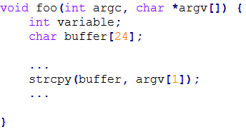
Stack Overflow overview
Linux uses cdecl as function call convention

Slide 11
Anti-exploitation techniques
NX – non-executable stack
AAAS – ASCII Armored Address Space
ASLR – Address Space Layout Randomization
Stack Canary (or stack cookie)

Slide 12
Bypass Anti-Exploitation

Slide 13
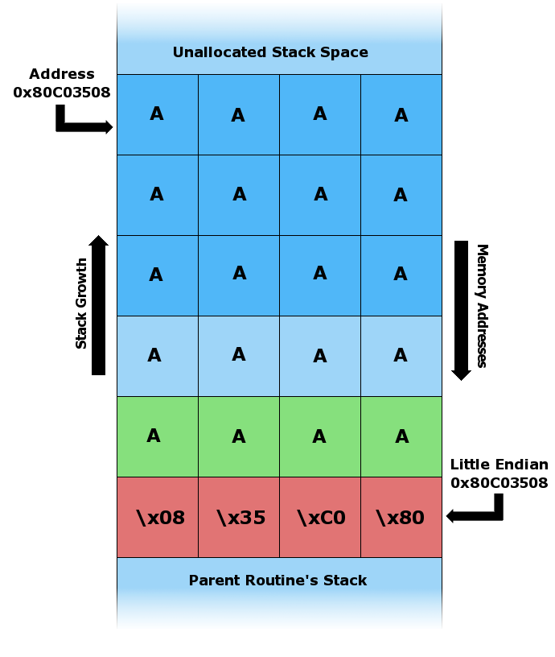
Bypassing stack canary
Process that fork() each connection
Bruteforce byte-by-byte
1020 possible combinations to discover the canary on 32-bits system
fork() followed by execve() will not work!

Slide 14
Return Oriented Programming
Chain gadgets to execute malicious code
A gadget is a suite of instructions which end by the branch instruction ret (Intel) or the equivalent on ARM.
- Intel examples:
pop eax ; ret
xor ebx, ebx ; ret
ARM examples:
pop {r4, pc}
str r1, [r0] ; bx lr
Objective: Use gadgets instead of classical shellcode

Slide 15
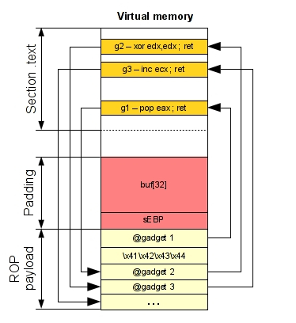
Attack using ROP
Gadget1 is executed and returns
Gadget2 is executed and returns
Gadget3 is executed and returns
And so on until all instructions that you want are executed
So, the real execution is:
pop eax
xor edx, edx
inc ecx

Slide 16
Blind Return Oriented Programming
Perform ROP in time of exploitation
The target server must restart after crash
Bruteforce byte-by-byte to find write() PLT address
Perform ret2plt with write() function to leak the server’s binary
Find more gadgets to build our ROP chain to exploit

Slide 17
Blind Remote Exploitation

Slide 18
CVE-2010-4221
Stack overflow on function pr_netio_telnet_gets() from the file "src/netio.c”
The server fork() each connection
The server restore after crash

Slide 19
BROP on CVE-2010-4221
Bruteforce byte-by-byte write() PLT address
ret2plt with write(1, 0x080532d8, 0xffffff);
Leak server’s binary
Search mmap64() and memcpy() PLT entry
Search gadgets:
pop; pop; pop; ret;
add esp, 20h; pop; pop; ret;
Search byte offsets from our shellcode copy routine

Slide 20
Exploiting CVE-2010-4221
Execute mmap64() to map a read, write and executable memory
Use memcpy() to copy our shellcode copy routine to the memory mapped
The shellcode copy routine will copy our shellcode from stack to a executable memory and will pass the flow to the shellcode.

Slide 21
Exploiting CVE-2010-4221
ROP chain:
mmap() plt address
add esp 20h; pop; pop; ret;
\x00\x00\x00\x10 ----> start address
\x00\x10\x00\x00 ----> length 1000 bytes
\x07\x00\x00\x00 ----> 07 = set read, write and executable permission
\x32\x00\x00\x00 ----> 32 bit flag
\xff\xff\xff\xff ----> file descriptor (0xffffffff probably will not be in use)
\x00\x00\x00\x00 --|
\x00\x00\x00\x00 |
\x00\x00\x00\x00 |-> offset
\x00\x00\x00\x00 |
\x00\x00\x00\x00 |
\x00\x00\x00\x00 --|

Slide 22
Exploiting CVE-2010-4221
First ROP chain:
memcpy() plt address
pop; pop; pop; ret;
\x00\x00\x00\x10 ----> destiny
xxxx ----> found byte addr (from shellcode copy routine)
\x02\x00\x00\x00 ----> number of bytes to copy
Second ROP chain:
memcpy() plt address
pop; pop; pop; ret;
\x02\x00\x00\x10 ----> destiny
yyyy ----> found byte addr (from shellcode copy routine)
\x01\x00\x00\x00 ----> number of bytes to copy

Slide 23
DEMO
Talk is cheap, show me the code!!!

Slide 24
Pros
We will be able to inject any shellcode that we want with the same technique
We will be able to exploit any server that runs the vulnerable application, even if it runs on a different distro with different compiling parameters
We will be able to bypass all principals anti-exploitation methods
The same technique will works on our another scenarios

Slide 25
Cons
The server can restart after crash
In other words: the server must be fork() for each connection
The server cannot use fork() followed by execve() on creating a child connection
This type of exploitation may make some noise!
This attack may take a while to get success

Slide 26
Conclusion

Slide 27
Hacker’s vision
We can build generic ways to exploit applications
We can attack even with old vulnerabilities
We can attack a library vulnerability, even if we can’t replicate the server’s scenario
We can defeat anti-exploitation protections
We can attack a application that we don’t have the binary

Slide 28
Security really exists?
Computer vulnerabilities are conceptual
Always will exist vulnerabilities
Always will have a way to exploit them
Security is an illusion!!!

Slide 29
What we can do now?
Security is a continuous process
Security is: hardware + software + people
The attacker’s vision shows our weakness
We should always be steps ahead of the attackers!!!

Slide 30
References
Scraps of notes on remote stack overflow exploitation – by pi3
http://phrack.org/issues/67/13.html#article
Uncovering Zero-Days and advanced fuzzing – by Kingcope
http://www.exploit-db.com/docs/18924.pdf
nginx Exploit Documentation About a Generic Way to Exploit Linux Targets – by Kingcope
http://www.exploit-db.com/docs/27074.pdf
An introduction to the Return Oriented Programming and ROP chain generation – by Jonathan Salwan
http://shell-storm.org/talks/ROP_course_lecture_jonathan_salwan_2014.pdf
Hacking Blind – by Andrea Bittau
http://www.scs.stanford.edu/brop/bittau-brop.pdf

Slide 31


OBRIGADO!
Ighor Augusto Barreto Candido
ighor@intruder-security.com
https://www.facebook.com/ighorabcandido
www.intruder-security.com

