Slide 1
Go CRMS
Wenzhe Liu
A simple Cluster Manager implementation written in Go

Slide 2
grpc / protobuf
Cluster structure
Master
Master
Worker
Go Client
raft
Worker
etcd
etcd
Python Client
etcd
Worker
etcd
etcd
Worker
Web Service
Master
Worker
Worker
REST
Web Client

Slide 3
Data nodes
crms
worker
assign
job
master
weliu
wen
2
zhe
3
wen
zhe
1
pwd
2
ls -l
3
go test
1
2
2
3
State
State
State
wen
done
wen
running
zhe
new
zhe
fail
stdouterr
/home/weliu
stdouterr
rwxr-x--- weliu
stdouterr
…

Slide 4
Worker
worker
wen
2
zhe
3
Start
Register temp data node: crms/worker/<name> (expired: 5 seconds)
Set data: parallel ability (how many jobs the worker can run at the same time)
Data node expired: 5 seconds
Feed dog:
Extend the data node’s life every 2 seconds
Crash
Data node remove automatically, listeners knows
Watch temp data node
If receive value: “close”, then shutdown itself gracefully
Watch prefix of crms/assign/<worker-name>/
Run jobs whose id is on “crms/assign/<worker-name>/<job-id>”
If running jobs count >= parallel ability, wait
If done/fail, remove node “crms/assign/<worker-name>/<job-id>”

Slide 5
Assign
assign
Run some job on some worker
Create node: crms/assign/<worker-name>/<job-id>
Check jobs that are being handled by a worker
Get node with prefix: crms/assign/<worker-name>/
wen
zhe
1
2
2
3

Slide 6
Job
job
Create
Register on crms/job/<jobid>
Set data: job command
Get job status
Read: crms/job/<jobid>/state/<worker-name>
Get job output
Read: crms/job/<jobid>/state/<worker>/stdouterr
Merge status and output by different worker
1
pwd
2
ls -l
State
State
wen
done
wen
running
zhe
new
stdouterr
/home/weliu
stdouterr
rwxr-x--- weliu

Slide 7
Python Client
Python Client
grpc
etcd
Python
protobuf
raft
>>> import crmscli
>>> crms = crmscli.CrmsCli()
>>> crms.createJob("1256", ["java", "-version"])
>>> crms.getJobs()
{'1256': <crmscli.Job object at 0x03140B70>, '8081': <crmscli.Job object at 0x03140E90>, '1847': <crmscli.Job object at 0x03140BB0>, '4059': <crmscli.Job object at 0x03140D30>, '1': <crmscli.Job object at 0x031404B0>, '3': <crmscli.Job object at 0x03140CB0>, '2': <crmscli.Job object at 0x03140B30>, '7887': <crmscli.Job object at 0x03140DD0>}
>>> crms.getWorkers()
{'worker/wenzhe': '2', 'worker/qiqi': '1'}
>>> crms.runJob("1256", ["wenzhe"])
>>> job = crms.getJob("1256")
>>> job.stateOfWorkers
{'wenzhe': <crmscli.JobState object at 0x0313FAF0>}
>>> job.stateOfWorkers['wenzhe'].status
'done'
>>> job.stateOfWorkers['wenzhe'].stdouterr
'java version "1.8.0_60"\r\nJava(TM) SE Runtime Environment (build 1.8.0_60-b27)\r\nJava HotSpot(TM) 64-Bit Server VM (build 25.60-b23, mixed mode)\r\nPicked up _JAVA_OPTIONS: -Djava.net.preferIPv4Stack=true\n'

Slide 8
Go Client
Go Client
grpc
etcd
Go
protobuf
raft
gore> :import github.com/WenzheLiu/GoCRMS/gocrmscli
gore> :import time
gore> crms, err := gocrmscli.New([]string{"localhost:2379"}, 5 * time.Second, 10 * time.Second)
&gocrmscli.CrmsCli{cli:(*clientv3.Client)(0xc04201ea80), requestTimeout:10000000000, workers:map[string]*gocrmscli.Worker{}, jobs:map[string]*gocrmscli
.Job{}, cancelWatchWorkers:(context.CancelFunc)(nil), cancelWatchJobs:(context.CancelFunc)(nil), cancelWatchAssign:(context.CancelFunc)(nil)}
<nil>
gore> workers, err := crms.GetWorkers()
map[string]*gocrmscli.Worker{"qiqi":(*gocrmscli.Worker)(0xc0421e2020), "wenzhe":(*gocrmscli.Worker)(0xc042002120)}
<nil>
gore> wenzhe, exist, err := crms.GetWorker("wenzhe")
&gocrmscli.Worker{Name:"wenzhe", ParellelAbility:2, Jobs:map[string]bool{}}
true
<nil>
gore> crms.CreateJob("9876", []string{"go", "version"})
<nil>

Slide 9
Go Client
Go Client
grpc
etcd
Go
protobuf
raft
gore> jobs, err := crms.GetJobs()
map[string]*gocrmscli.Job{"7887":(*gocrmscli.Job)(0xc04219a870), "8081":(*gocrmscli.Job)(0xc04219a8d0), "9876":(*gocrmscli.Job)(0xc04219a930), "1256":(
*gocrmscli.Job)(0xc04219a690), "1847":(*gocrmscli.Job)(0xc04219a6f0), "2":(*gocrmscli.Job)(0xc04219a750), "3":(*gocrmscli.Job)(0xc04219a7b0), "4059":(*
gocrmscli.Job)(0xc04219a810), "1":(*gocrmscli.Job)(0xc04219a630)}
<nil>
gore> job, exist, err := crms.GetJob("9876")
&gocrmscli.Job{ID:"9876", Command:[]string{"go", "version"}, StateOfWorkers:map[string]*gocrmscli.JobState{}}
true
<nil>
gore> crms.RunJob("9876", "wenzhe")
<nil>
gore> job
&gocrmscli.Job{ID:"9876", Command:[]string{"go", "version"}, StateOfWorkers:map[string]*gocrmscli.JobState{"wenzhe":(*gocrmscli.JobState)(0xc0421316c0)
}}
gore> jobState, exist := job.StateOfWorkers["wenzhe"]
&gocrmscli.JobState{Status:"done", Stdouterr:"go version go1.9.3 windows/amd64\n"}
true

Slide 10
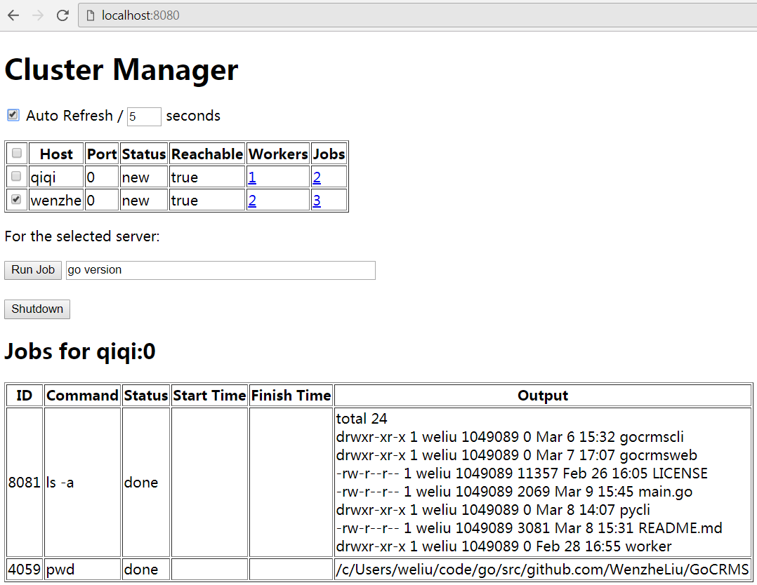
Web Client
./gocrmsweb
Web Client
Angular
http
REST
Web Service
Go
protobuf
grpc
etcd
raft

Slide 11
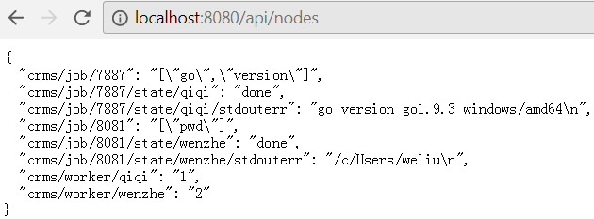


Web Service REST API

Slide 12
TODO
Master
Load balance
Persistence and recover
Integrate into current system by adaptor
Based on Python Client that shown in Page 7
Stress test
Unit Test
Better look and feel web site
Configure management
Start worker by client api
Kill job
Job group

Slide 13
Master
master
weliu
lose
crms/master
wenzhe
master wenzhe
win
Leader election
The first one write the temp node “crms/master” success
The node value is the master name
Winner:
Node life extension
Loser:
Watch node “crms/master”, if deleted, election again

Slide 14
Load balance
Each worker register its workload info to etcd periodically
Master watched the workload info select the most idle worker
When run job, if not specify worker, assign to the most idle worker
worker
weliu
put
crms/workload/weliu
Workload info
Watched by
crms/workload
wenzhe
put
master leader
worker wenzhe
put
crms/workload/wenzhe
Workload info
Watched by

Slide 15
Persistence and recover
Etcd can export snapshot to a file automatically
More control, we can use data base

Slide 16
Thank you!

