Slide 1
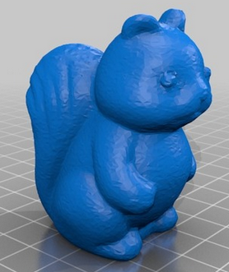
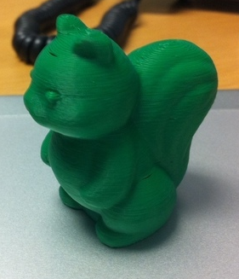
STL
Slicer
GCO
GPX
X3G
Sailfish

