Slide 1
TD-DFTB+ Surface hopping dynamics of spirobenzopyran linker
By Austin hill
Cyber training workshop 2021
University of south Carolina department of chemistry and biochemistry

Slide 2
outline
Introduction
Photochromic materials
Computational approach
Methods / Results
Electronic structure calculations
Dynamics
Conclusion / Future Work
Summation of findings

Slide 3
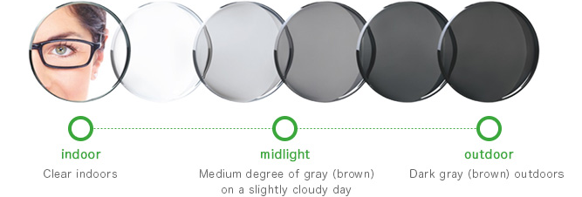
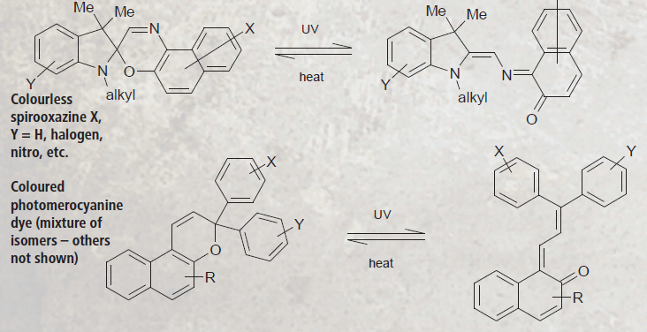
Photochromic materials
Transparent materials that exhibit increased light absorption
Found in toys, cosmetics, glasses, footwear, glassware, etc.
Also used in optical switches, data storage, energy conservation, etc.
Just one exampled text
Zhu, M.; Zhou, H. Azobenzene-Based Small Molecular Photoswitches for Protein Modulation. Organic & Biomolecular Chemistry 2018, 16 (44), 8434–8445.
The Ultimate Guide on How Photochromic Lenses Work https://www.weetect.com/how-photochromic-lenses-work/ (accessed Mar 29, 2021).

Slide 4
Photochromic materials - Advantages
High spatial and temporal precision input
No chemical contaminants
Light can be delivered at a specific wavelength
Actuation of closed systems

Slide 5
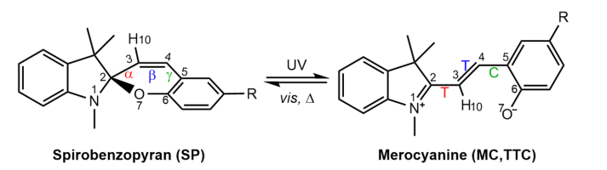
Photoswitching - Spiropyran
Undergoes reversible structural isomerization
More than a photoswitch…?

Slide 6
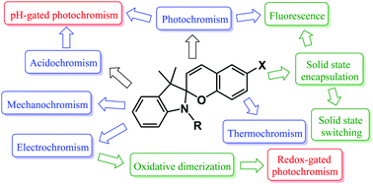
Photoswitching - spiropyran
Needs to be covalently attached to a support
No leaching
Improved processability
Solvent capatability
Enables biocompatibility
Prevents MC aggregation
Reduced photodegredation (fatigue)
Improved fluorescence
Kortekaas, L.; Browne, W. R. Correction: The Evolution of Spiropyran: Fundamentals and Progress of an Extraordinarily Versatile Photochrome. Chemical Society Reviews 2021, 50 (3), 2211–2211.
Klajn, R. ChemInform Abstract: Spiropyran-Based Dynamic Materials. Chem. Soc. Rev., 2014, 43, 148

Slide 7
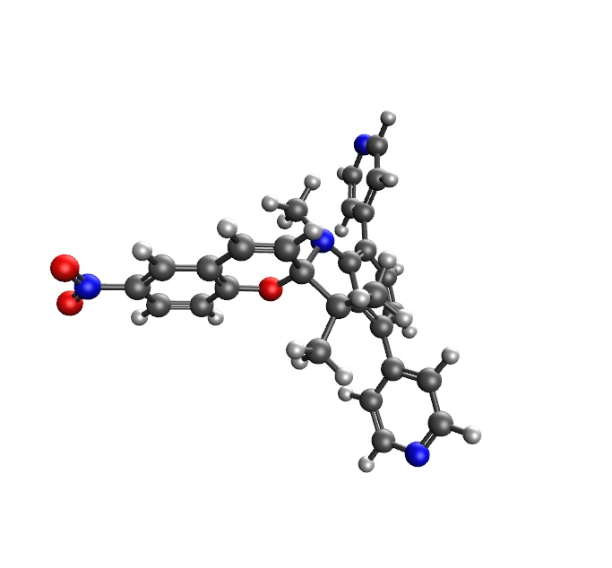
SP-Linker

Slide 8
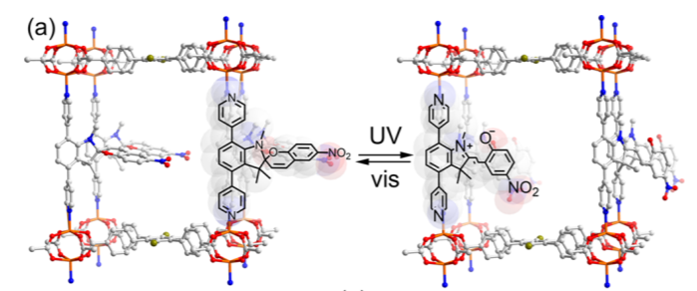
Metal organic frameworks (MOFs)
SP-based MOF
How does the MOF change the SP?
How does the SP change the MOF?

Slide 9
Computational approach
Why study SP computationally?
Polychromic
Many potential applications
Desired results out of scope for current experimental methods

Slide 10
Methods Overview
Molecular Structure Optimization
Q-Chem 5.3
Normal Modes Calculations
DFTB+ 20.2.1-ARPACK
Initial Conditions / Spectrum Gen / Dynamics
Newton-X 2.2-B09
https://osf.io/w4dkc/

Slide 11
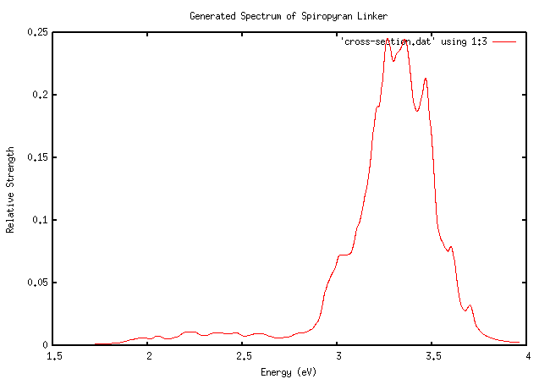
Results – generated spectrum

Slide 12
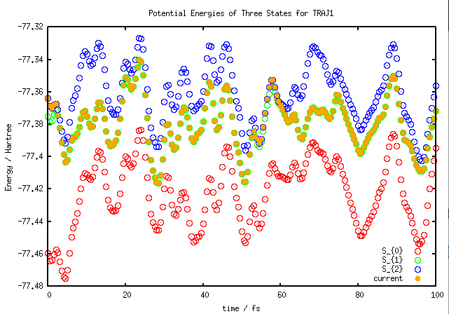
Results – TRAJ1

Slide 13
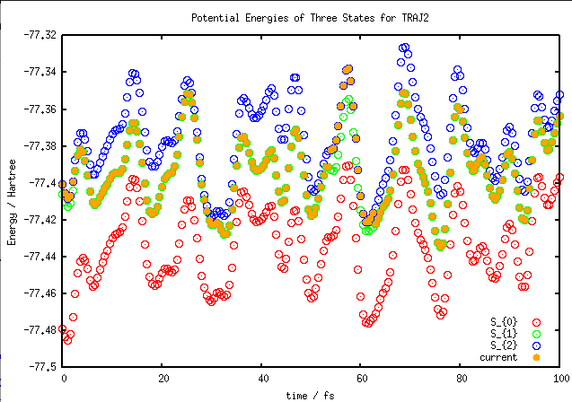
Results - TRAJ2

Slide 14
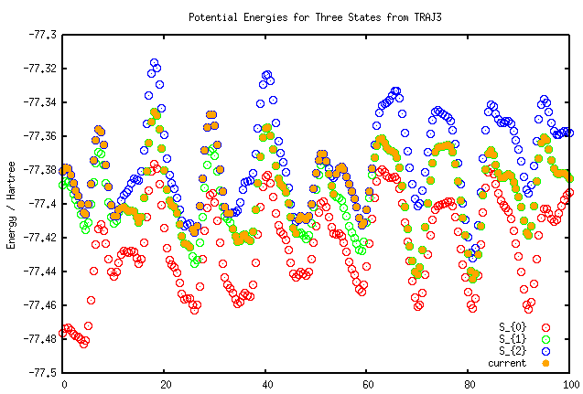
RESULTS - TRAJ3

Slide 15
Conclusions / Future Work
Trajectories show clear indication of surface hopping from state 3 to 2
Longer trajectories
Increase total number of trajectories

Slide 16
References
Zhu, M.; Zhou, H. Azobenzene-Based Small Molecular Photoswitches for Protein Modulation. Organic & Biomolecular Chemistry 2018, 16 (44), 8434–8445.
The Ultimate Guide on How Photochromic Lenses Work https://www.weetect.com/how-photochromic-lenses-work/ (accessed Mar 29, 2021).
Kortekaas, L.; Browne, W. R. Correction: The Evolution of Spiropyran: Fundamentals and Progress of an Extraordinarily Versatile Photochrome. Chemical Society Reviews 2021, 50 (3), 2211–2211.
Klajn, R. ChemInform Abstract: Spiropyran-Based Dynamic Materials. Chem. Soc. Rev., 2014, 43, 148
Zhang, Y.-H.; Sun, X.-W.; Zhang, T.-S.; Liu, X.-Y.; Cui, G. Nonadiabatic Dynamics Simulations on Early-Time Photochemistry of Spirobenzopyran. The Journal of Physical Chemistry A 2020, 124 (13), 2547–2559

