Slide 1

Hierarchy equations of motion
Amber Jain
amberj@chem.iitb.ac.in
Excited States and Nonadiabatic Dynamics CyberTraining Workshop 2021

Slide 2
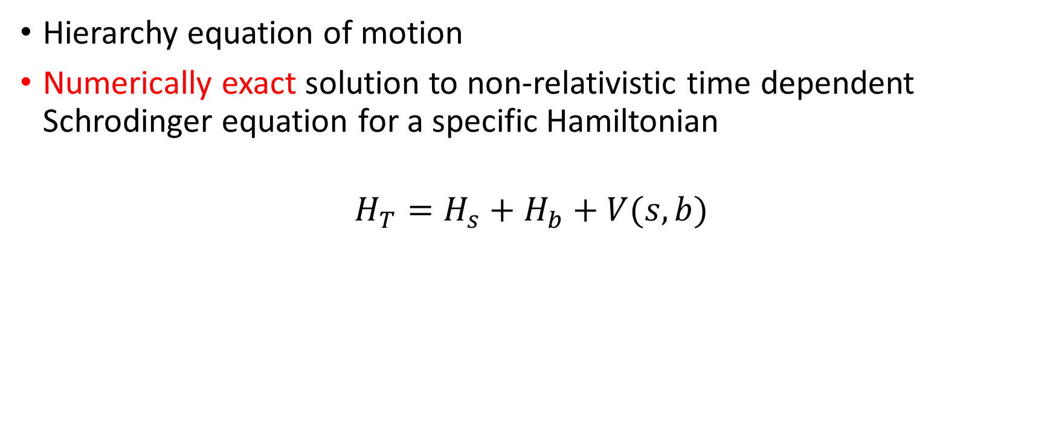
What is HEOM?
Hierarchy equation of motion
Numerically exact solution to non-relativistic time dependent Schrodinger equation for a specific Hamiltonian
$$H_{T}=H_{s}+H_{b}+V(s,b)$$

Slide 3

Density matrix
Let $|ψ⟩$ be the wavefunction of any system
Density matrix is an operator: $\hat{ρ}=$ $|ψ⟩⟨ψ|$
It is an equally complete description of the state as $|ψ⟩$

Slide 4
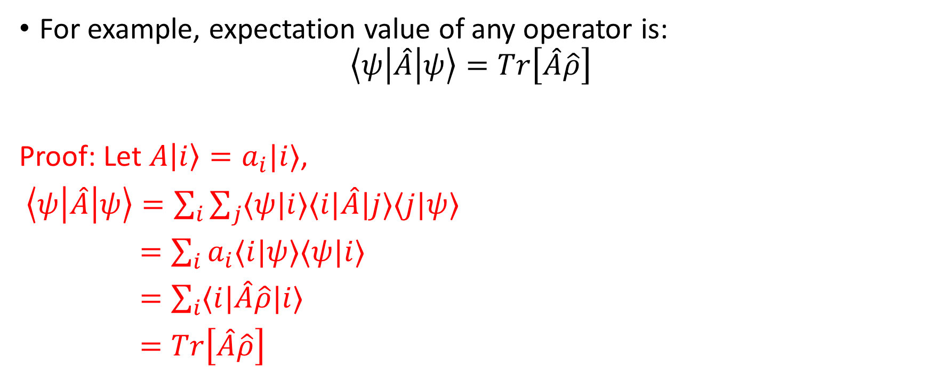
Density matrix
For example, expectation value of any operator is:
$$\left\langle ψ\left|\hat{A}\right|ψ\right\rangle =Tr\left[\hat{A}\hat{ρ}\right]$$
Proof: Let $A\left|i\right\rangle =a_{i}|i⟩$,
$\left\langle ψ\left|\hat{A}\right|ψ\right\rangle =\sum_{i}{\sum_{j}{⟨ψ|i⟩⟨i|\hat{A}|j⟩⟨j|ψ⟩}}$
$=\sum_{i}{a_{i}⟨i|ψ⟩⟨ψ|i⟩}$
$=\sum_{i}{⟨i|\hat{A}\hat{ρ}|i⟩}$
$=Tr\left[\hat{A}\hat{ρ}\right]$

Slide 5

Density matrix properties
$Tr\left[\hat{ρ}\right]=1$
${\hat{ρ}}^{2}=\hat{ρ}$ (for a pure system, i.e. system has a wavefunction)
$\frac{d\hat{ρ}}{dt}=−\frac{i}{ℏ}\left[\hat{H},\hat{ρ}\right]$

Slide 6
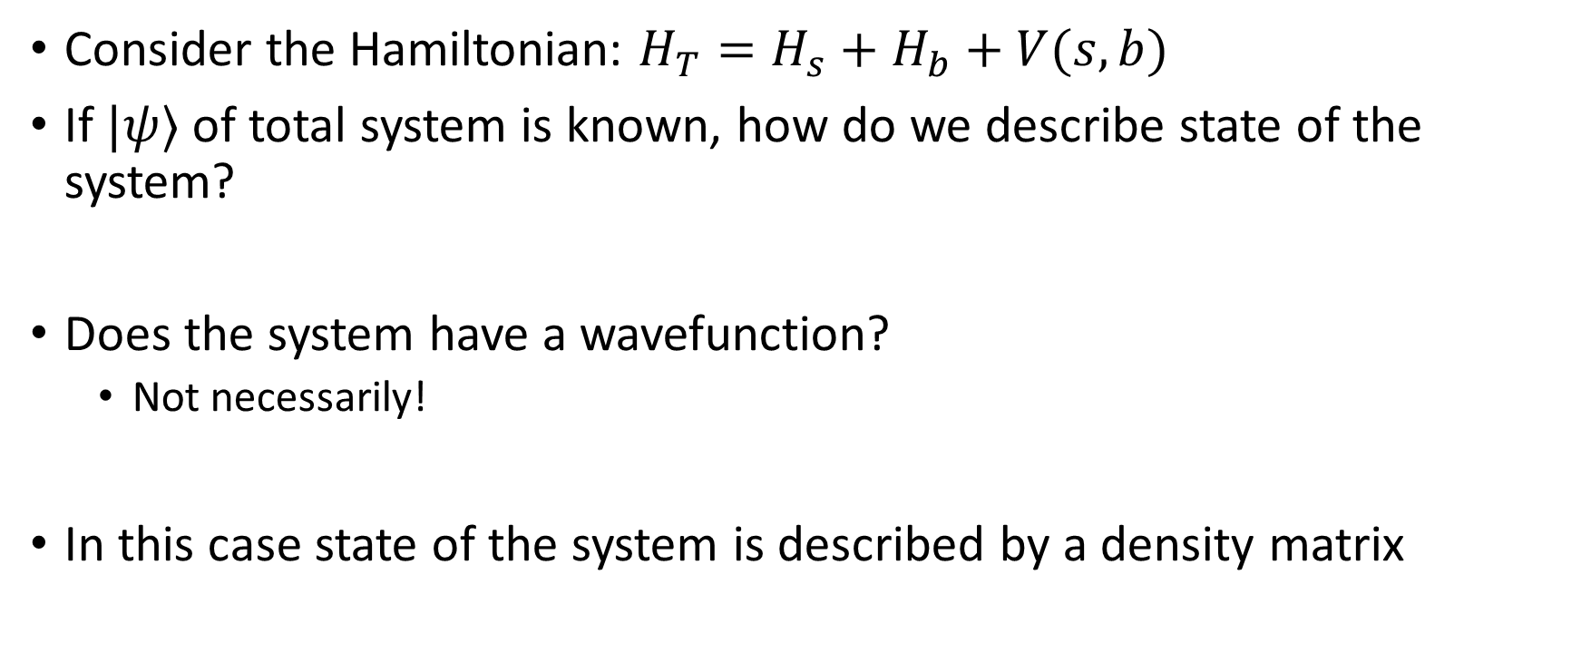
Reduced density matrix
Consider the Hamiltonian: $H_{T}=H_{s}+H_{b}+V(s,b)$
If $|ψ⟩$ of total system is known, how do we describe state of the system?
Does the system have a wavefunction?
Not necessarily!
In this case state of the system is described by a density matrix

Slide 7
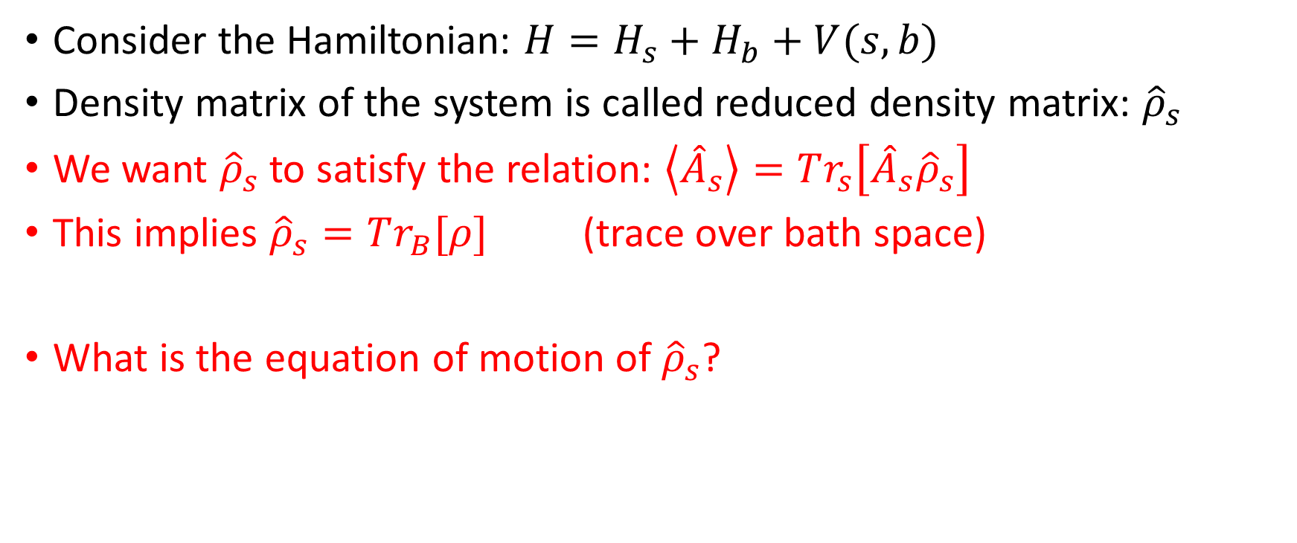
Reduced density matrix
Consider the Hamiltonian: $H=H_{s}+H_{b}+V(s,b)$
Density matrix of the system is called reduced density matrix: ${\hat{ρ}}_{s}$
We want ${\hat{ρ}}_{s}$ to satisfy the relation: $\left\langle {\hat{A}}_{s}\right\rangle =Tr_{s}\left[{\hat{A}}_{s}{\hat{ρ}}_{s}\right]$
This implies ${\hat{ρ}}_{s}=Tr_{B}[ρ]$ (trace over bath space)
What is the equation of motion of ${\hat{ρ}}_{s}$?

Slide 8
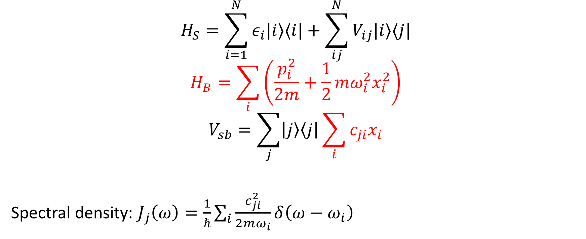
Hierarchy Equation Of Motion
$$H_{S}=\sum_{i=1}^{N}{ε_{i}|i⟩⟨i|+\sum_{ij}^{N}{V_{ij}|i⟩⟨j|}}$$
$$H_{B}=\sum_{i}{\left(\frac{p_{i}^{2}}{2m}+\frac{1}{2}mω_{i}^{2}x_{i}^{2}\right)}$$
$$V_{sb}=\sum_{j}{\left|j\right\rangle \left\langle j\right|\sum_{i}{c_{ji}x_{i}}}$$
Spectral density: $J_{j}\left(ω\right)=\frac{1}{ℏ}\sum_{i}{\frac{c_{ji}^{2}}{2mω_{i}}δ\left(ω−ω_{i}\right)}$
Tanimura and Kubo, JPSJ 58, 1199 (1989)

Slide 9
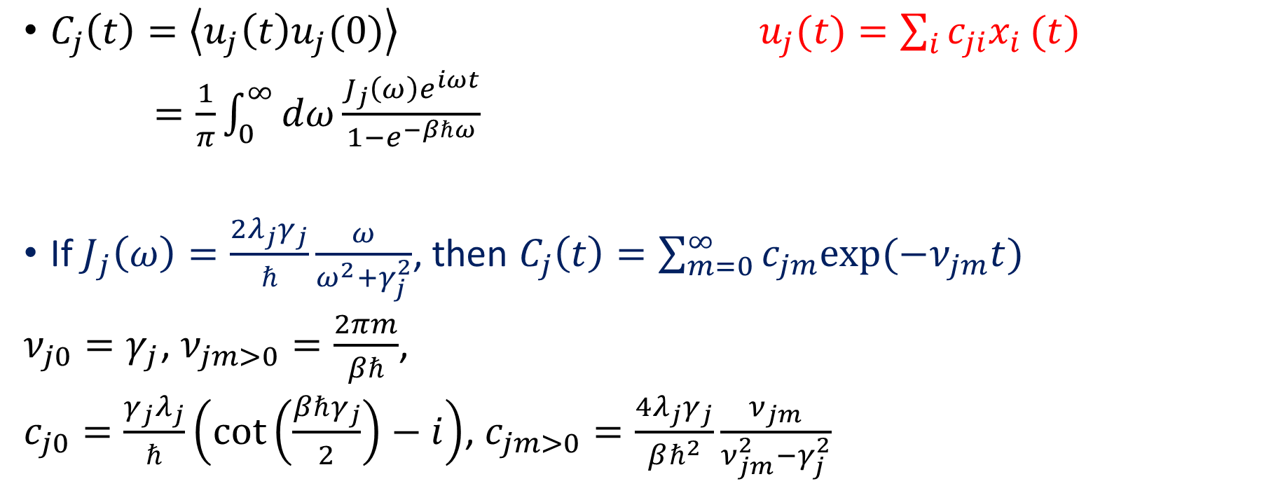
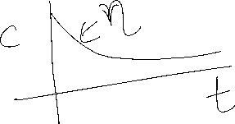
Bath correlation function
$C_{j}\left(t\right)=\left\langle u_{j}\left(t\right)u_{j}(0)\right\rangle$ $u_{j}(t)=\sum_{i}{c_{ji}x_{i}}(t)$
$=\frac{1}{π}\int_{0}^{∞}{dω\frac{J_{j}\left(ω\right)e^{iωt}}{1−e^{−βℏω}}}$
If $J_{j}\left(ω\right)=\frac{2λ_{j}γ_{j}}{ℏ}\frac{ω}{ω^{2}+γ_{j}^{2}}$, then $C_{j}\left(t\right)=\sum_{m=0}^{∞}{c_{jm}exp⁡(−ν_{jm}t)}$
$ν_{j0}=γ_{j}$, $ν_{jm>0}=\frac{2πm}{βℏ}$,
$c_{j0}=\frac{γ_{j}λ_{j}}{ℏ}\left(\cot\left(\frac{βℏγ_{j}}{2}\right)−i\right)$, $c_{jm>0}=\frac{4λ_{j}γ_{j}}{βℏ^{2}}\frac{ν_{jm}}{ν_{jm}^{2}−γ_{j}^{2}}$
Yan and Xu, ARPC 56, 187 (2005)

Slide 10
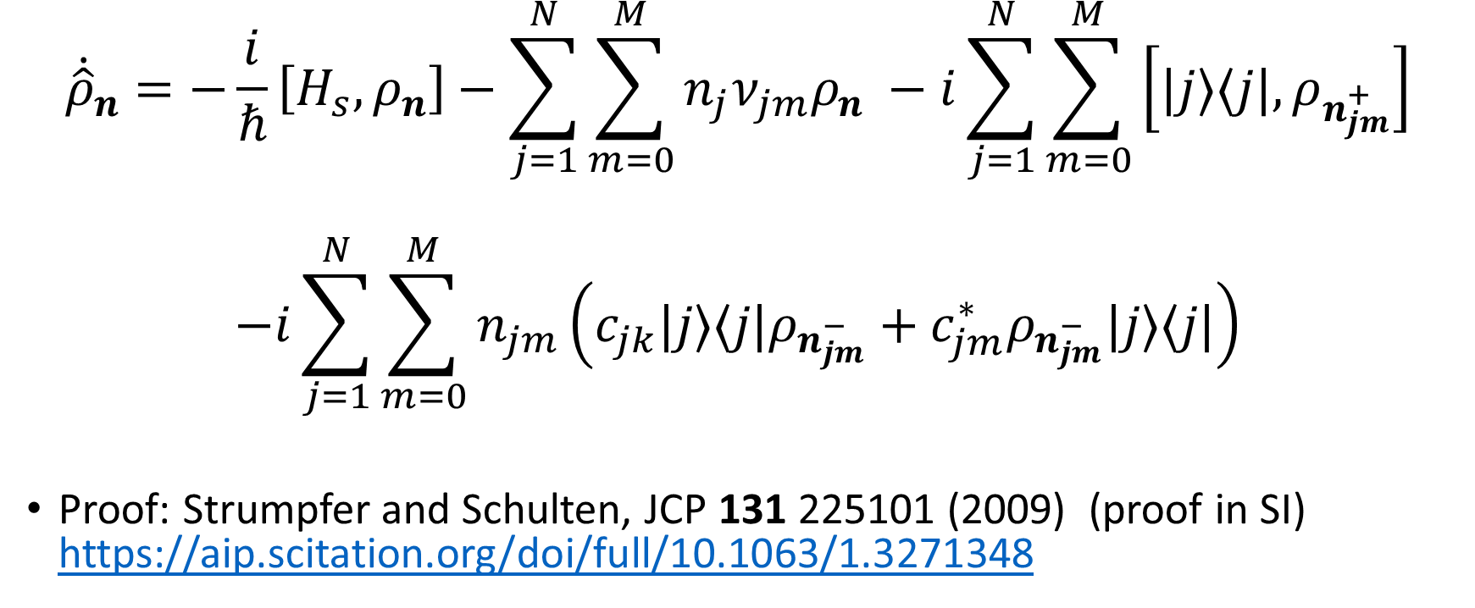
Hierarchy Equation Of Motion
$${\dot{\hat{ρ}}}_{n}=−\frac{i}{ℏ}\left[H_{s},ρ_{n}\right]−\sum_{j=1}^{N}{\sum_{m=0}^{M}{n_{j}ν_{jm}ρ_{n} }}−i\sum_{j=1}^{N}{\sum_{m=0}^{M}{\left[|j⟩⟨j|,ρ_{n_{jm}^{+}}\right] }}$$
$$−i\sum_{j=1}^{N}{\sum_{m=0}^{M}{n_{jm}\left(c_{jk}|j⟩⟨j|ρ_{n_{jm}^{−}}+c_{jm}^{∗}ρ_{n_{jm}^{−}}|j⟩⟨j|\right) }}$$
Proof: Strumpfer and Schulten, JCP 131 225101 (2009) (proof in SI) https://aip.scitation.org/doi/full/10.1063/1.3271348
Tanimura and Kubo, JPSJ 58, 1199 (1989)

Slide 11

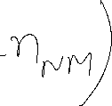


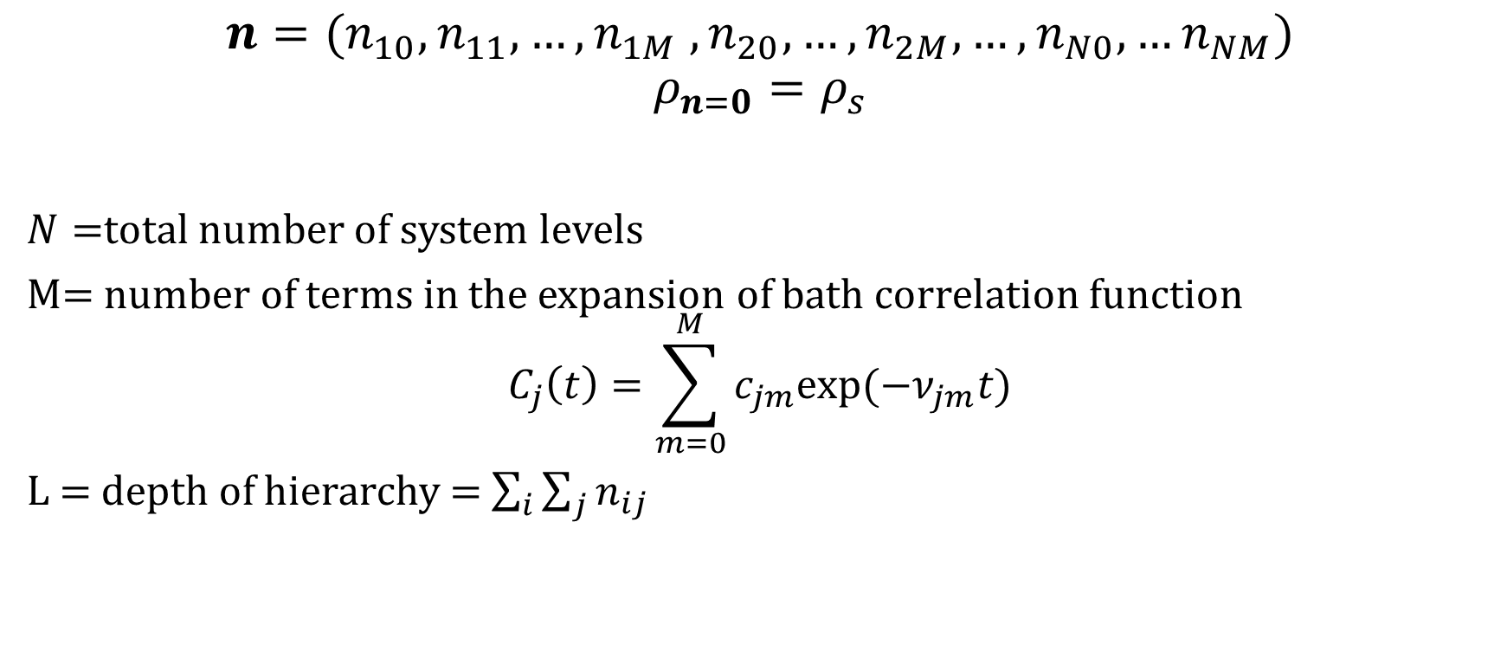









Hierarchy
$$n=(n_{10},n_{11},…, n_{1M} , n_{20}, …, n_{2M}, …, n_{N0}, …n_{NM})$$
$$ρ_{n=0}=ρ_{s}$$
$N=$total number of system levels
M= number of terms in the expansion of bath correlation function
$$C_{j}\left(t\right)=\sum_{m=0}^{M}{c_{jm}exp⁡(−ν_{jm}t)}$$
L = depth of hierarchy = $\sum_{i}{\sum_{j}{n_{ij}}}$

Slide 12
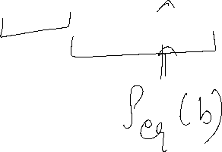

Initial Condition
$ρ\left(t=0\right)=ρ_{s}\left(0\right) \frac{e^{−βH_{B}}}{Tr\left[e^{−βH_{B}}\right]}$
$ρ_{n≠0}\left(0\right)=0$

Slide 13
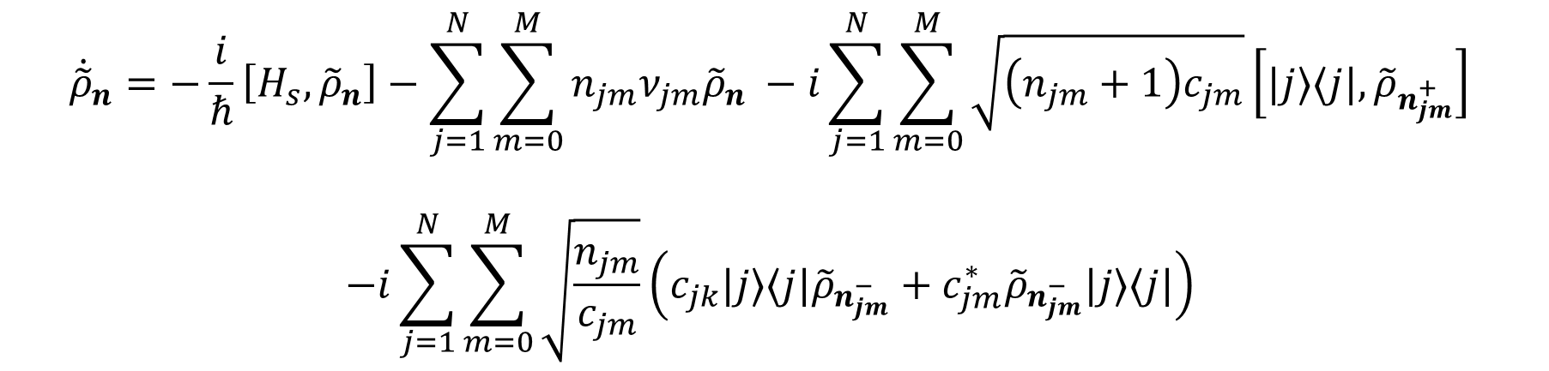

Faster converging HEOM!
$${\tilde{ρ}}_{n}={\left(\prod_{k}{n_{k}! }{\left|c_{k}\right|}^{n_{k}}\right)}^{−\frac{1}{2}}ρ_{n}(t)$$
$${\tilde{ρ}}_{n=0}=ρ_{n=0}$$
$${\dot{\tilde{ρ}}}_{n}=−\frac{i}{ℏ}\left[H_{s},{\tilde{ρ}}_{n}\right]−\sum_{j=1}^{N}{\sum_{m=0}^{M}{n_{jm}ν_{jm}{\tilde{ρ}}_{n} }}−i\sum_{j=1}^{N}{\sum_{m=0}^{M}{\sqrt{\left(n_{jm}+1\right)c_{jm}}\left[|j⟩⟨j|,{\tilde{ρ}}_{n_{jm}^{+}}\right] }}$$
$$−i\sum_{j=1}^{N}{\sum_{m=0}^{M}{\sqrt{\frac{n_{jm}}{c_{jm}}}\left(c_{jk}|j⟩⟨j|{\tilde{ρ}}_{n_{jm}^{−}}+c_{jm}^{∗}{\tilde{ρ}}_{n_{jm}^{−}}|j⟩⟨j|\right) }}$$
Shi, Chen, Nan, Xu, and Yan, JCP 130, 084105 (2009)

Slide 14
