Slide 1

Nonadiabatic Dynamics with the Libra code
Department of Chemistry, University at Buffalo, The State University of New York, Buffalo, NY 14260-3000
Alexey Akimov
“Excited States and Nonadiabatic Dynamics CyberTraining Workshop”
June 15, 2021

Slide 2
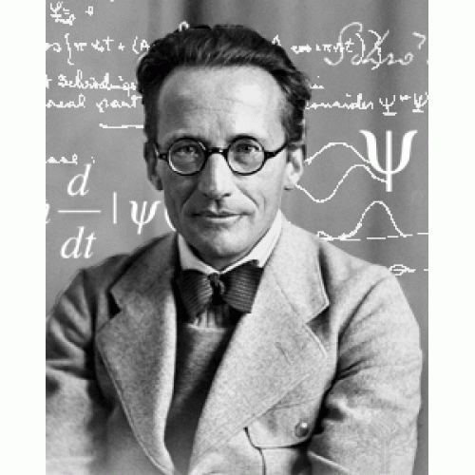
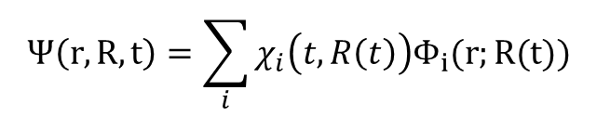

What is Nonadiabatic Dynamics?
$$iℏ\frac{∂Ψ(r,R,t)}{∂t}=H(r,R,t)Ψ(r,R,t)$$
$$Ψ\left(r,R,t\right)=\sum_{i}{χ_{i}\left(t,R\left(t\right)\right)Φ_{i}(r;R(t))}$$
1 term is sufficient
Need more than 1 state
Adiabatic
Non-Adiabatic
Energy
Reaction coordinate

Slide 3
TSH in the nutshell
Initialization
Nuclear dynamics
$\dot{p_{i}}=−\frac{∂H}{∂r_{i}}$ $\dot{r_{i}}=\frac{∂H}{∂p_{i}}$
Stationary adiabatic states
$${\hat{H}}_{el}ψ_{i}=E_{i}ψ_{i}$$
Non-adiabatic Couplings
$$d_{ij}=\frac{\left\langle ψ_{i}(t) | ψ_{j}(t+dt)\right\rangle −\left\langle ψ_{i}(t+dt) | ψ_{j}(t)\right\rangle }{2dt}$$
Electronic Dynamics
$$Ψ\left(r,R,t\right)=\sum_{i}{c_{i}\left(t\right)ψ_{i}(r;R(t))}$$
$$iℏ\frac{∂c_{i}(t)}{∂t}=\sum_{j}{\left(E_{i}δ_{ij}−iℏd_{ij}\right)}c_{j}$$
NBRA
Decoherence 1
$$c_{i}→c_{i}\exp\left(−\frac{Δt}{τ_{ij}}\right), ∀i≠j$$
as in SDM
Proposed Hops
Decoherence 2
$$P_{i→j}=Δt∗Re\left(\frac{2{\frac{p}{m}d}_{ij}c_{i}^{∗}c_{j}}{c_{i}^{∗}c_{i}}\right)$$
or as in DISH
based on energy conservation or
$$P_{i→f}^{A}=\min\left(1, \exp\left(−\frac{ΔE}{k_{B}T}\right)\right)$$
Accept Hops
Change state
change active electronic state, rescale velocity

Slide 4



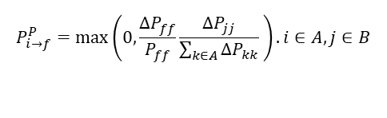

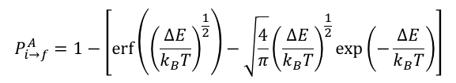

Many ways of doing the dynamics
Hop proposal probabilities
FSSH
GFSH
MSSH
$$P_{i→f}^{P}=max\left(0,\frac{ΔP_{ff}}{P_{ff}}\frac{ΔP_{jj}}{\sum_{k∈A}{ΔP_{kk}}} \right). i∈A,j∈B$$
$$P_{i→f}^{P}(t,t+Δt)=P_{ff}(t+Δt)$$
$$P_{i→f}^{P}=max\left(0,\frac{Δt}{ℏP_{ii}}Im\left[P_{i,f}H_{f,i }^{vib} −H_{i,f }^{vib}P_{f,i}\right]\right)$$
Akimov, A. V.; Trivedi, D.; Wang, L.; Prezhdo, O. V. J. Phys. Soc. Jpn. 2015, 84, 094002
Tully, J. C. J. Chem. Phys. 1990, 93, 1061
Wang, L.; Trivedi, D.; Prezhdo, O. V. JCTC 2014, 10, 3598
Hop acceptance probabilities
Boltzmann
Maxwell-Boltzmann
Trivial
$$P_{i→f}^{A}=\min\left(1, \exp\left(−\frac{ΔE}{k_{B}T}\right)\right)$$
$$P_{i→f}^{A}=1−\left[\operatorname{erf}\left({\left(\frac{ΔE}{k_{B}T}\right)}^{\frac{1}{2}}\right)−\sqrt{\frac{4}{π}}{\left(\frac{ΔE}{k_{B}T}\right)}^{\frac{1}{2}}\exp\left(−\frac{ΔE}{k_{B}T}\right)\right]$$
$$P_{i→f}^{A}=1$$
Prezhdo, O. V.; Duncan, W. R.; Prezhdo, V. V. Prog. Surf. Sci. 2009, 84, 30
Smith, B.; Akimov, A. V. J. Chem.Phys. 2019, 151, 124107
Energy conservation
Can rescale along NACs?
Can rescale along other vectors?
(e.g. excited state forces difference)
$$P_{i→f}^{A}=Θ\left(E_{kin}+E_{f}−E_{f}\right)$$
Tully, J. C. J. Chem. Phys. 1990, 93, 1061

Slide 5

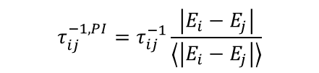

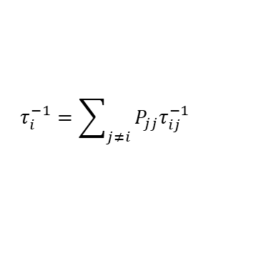


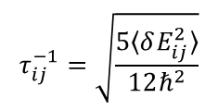


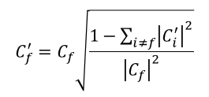

Many ways of doing the dynamics
Decoherence schemes
SDM
DISH
ID-A
Jaeger, H. M.; Fischer, S.; Prezhdo, O. V. J. Chem. Phys. 2012, 137, 22A545
Nelson, T.; Fernandez-Alberti, S.; Roitberg, A. E.; Tretiak, S. J. Chem. Phys. 2013, 138, 224111.
Granucci, G.; Persico, M. J. Chem. Phys. 2007, 126, 134114.
gradually change the amplitudes
collapse amplitudes at an event:
$$C_{i}^{′}=C_{i}\exp\left(−\frac{Δt}{τ_{if}}\right), ∀i≠f$$
at a decoherence event: $t_{i}≥t_{decoh}$
on a successful hop (ID-S)
on an attempted hop (ID-A)
at every timestep (ID-C)
Wavefunction reduction
$$C_{f}^{′}=C_{f}\sqrt{\frac{1−\sum_{i≠f}{{\left|C_{i}^{′}\right|}^{2}}}{{\left|C_{f}\right|}^{2}}}$$
$$C_{i}^{′}=C_{i}\sqrt{\frac{1}{{1−\left|C_{f}\right|}^{2}}}, ∀i≠f$$
$$C_{f}^{′}=0$$
Wavefunction reduction
Hops with quantum probabilities
$$C_{f}=1, C_{i}=0, ∀i≠f$$
$$P_{i→f}^{P}\left(t,t+Δt\right)={\left|C_{f}\left(t\right)\right|}^{2}$$
Decoherence times/rates
DISH
SDM/EDC
mSDM
Decoherence interval
$$τ_{ij}^{EDC}=\frac{ℏ}{\left|E_{i}−E_{j}\right|}\left(1+\frac{C}{E_{kin}}\right)$$
$$τ_{ij}^{−1}=\sqrt{\frac{5〈δE_{ij}^{2}〉}{12ℏ^{2}}}$$
Akimov, A. V.; Prezhdo, O. V. J. Phys. Chem. Lett. 2013, 4, 3857
Smith, B.; Akimov, A. V. J. Chem.Phys. 2019, 151, 124107
$$τ_{i}^{−1}=\sum_{j≠i}{P_{jj}τ_{ij}^{−1}}$$
Jaeger, H. M.; Fischer, S.; Prezhdo, O. V. J. Chem. Phys. 2012, 137, 22A545
Granucci, G.; Persico, M. J. Chem. Phys. 2007, 126, 134114.
Phase-informed Decoherence times
$$τ_{ij}^{−1,PI}=τ_{ij}^{−1}\frac{\left|E_{i}−E_{j}\right|}{\left\langle \left|E_{i}−E_{j}\right|\right\rangle }$$
Sifain, A. E.; Wang, L.; Tretiak, S.; Prezhdo, O. V.

Slide 6
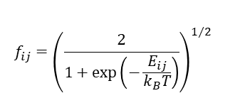

Many ways of doing the dynamics
Corrections
BBCE
thermal Ehrenfest
State tracking (e.g. mincost)
Phase corrections (Akimov, A. V J. Phys. Chem. Lett. 2018, 9, 6096)
$$H_{ij}^{Bastida, adi}=\left|c_{j}\right|f_{ij}V_{ij}+\left|c_{i}\right|f_{ji}V_{ji}$$
$$f_{ij}={\left(\frac{2}{1+\exp\left(−\frac{E_{ij}}{k_{B}T}\right)}\right)}^{1/2}$$
Bastida, A. et al. Chem. Phys. Lett. 2006, 417, 53
Forces & Nuclear Dynamics
Frustrated hops:
Reverse momenta
Keep momenta
Accepted hops:
Don’t rescale momenta
Rescale along NACs
Rescale along force difference
Adiabatic (NBRA, various states)
TSH
Ehrenfest
Quantized nuclei (Bohmian trajectories?)
Bath: Langevin, Nose-Hoover, etc.

Slide 7

Libra as a workhorse of our developments
Implemented in Libra: https://quantum-dynamics-hub.github.io/libra/index.html
https://github.com/Quantum-Dynamics-Hub/libra-code
Akimov JCC, 2016, 37, 1626
Examples& Tutorials: https://github.com/compchem-cybertraining
Some of the implemented methods:
Methods | Paper
Surface hopping schemes | Tully, J. C. J. Chem. Phys. 1990, 93, 1061 (FSSH); Wang, L., et al. JCTC 2014, 10, 3598 (GFSH); Akimov, A. V. et al. J. Phys. Soc. Jpn. 2015, 84, 094002 (MSSH)
Decoherence schemes | Granucci, G.; Persico, M. J. Chem. Phys. 2007, 126, 134114 (SDM); Nelson, T. et al. J. Chem. Phys. 2013, 138, 224111. (ID-A, ID-S); Jaeger, H. M. et al. J. Chem. Phys. 2012, 137, 22A545 (DISH)
Dephasing times calculations | Smith, B.; Akimov, A. V. J. Chem.Phys. 2019, 151, 124107 Akimov, A. V.; Prezhdo, O. V. J. Phys. Chem. Lett. 2013, 4, 3857 Sifain, A. E.; Wang, L.; Tretiak, S.; Prezhdo, O. V. Granucci, G.; Persico, M. J. Chem. Phys. 2007, 126, 134114.
Neglect of back-reaction (NBRA) | Prezhdo, O. V.; Duncan, W. R.; Prezhdo, V. V. Prog. Surf. Sci. 2009, 84, 30
Boltzmann-corrected Ehrenfest | Bastida, A. et al. Chem. Phys. Lett. 2006, 417, 53 Smith, B.; Akimov, A. V. J. Chem.Phys. 2019, 151, 124107
Phase corrections | Akimov, A. V J. Phys. Chem. Lett. 2018, 9, 6096
State tracking | Fernandez-Alberti, S.; et al. J. Chem. Phys. 2012, 137, 014512 (mincost); Temen, S.; AVA. JPCL 2021, 12, 10587-10597 (stochastic)
Interfaces with ES codes | DFTB+ (Smith, B.; AVA JPCL. 2020, 11, 1456), QE (Pradhan et al. JPCM, 2018, 30, 484002), CP2K (Smith, B. A. et al. JCTC, 2021, 17, 678), Gaussian, GAMESS (Sato et al. PCCP, 2018, 20, 25275)
Exact dynamics | Kosloff, D. and Kosloff, R. J. Chem. Phys. 1983, 52, 35-53 (SOFT); Colbert, D. T. and Miller, W. H. 1992, 96, 1982-1991 (Colert-Miller DVR)
HEOM | Temen et al. Int. J. Quant. Chem., 2020, 120, e26373

Slide 8
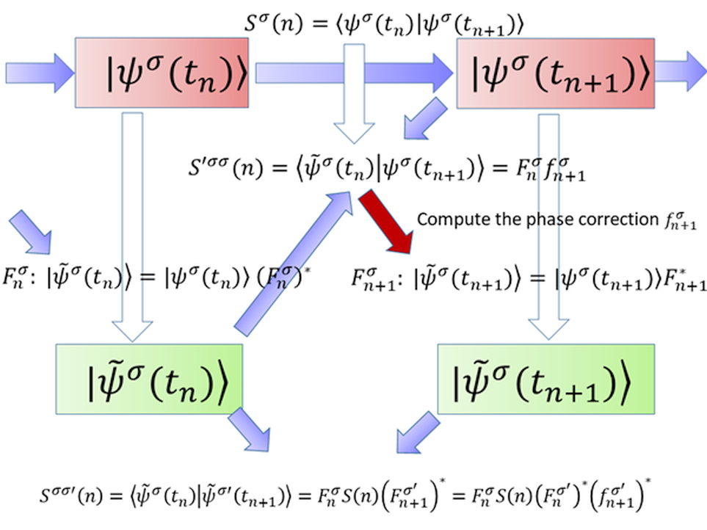
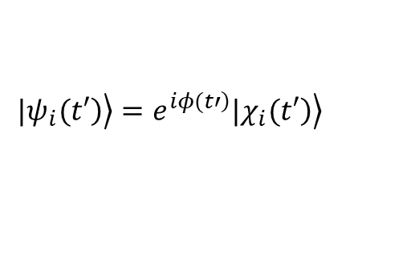
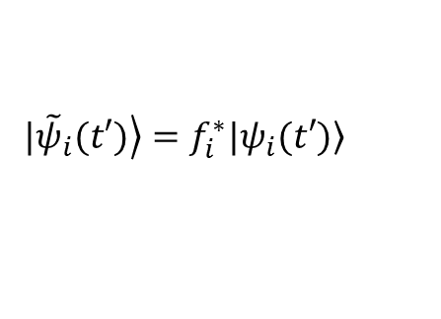
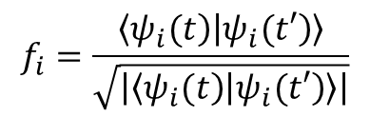
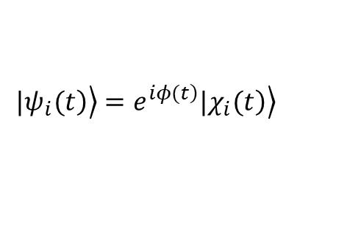


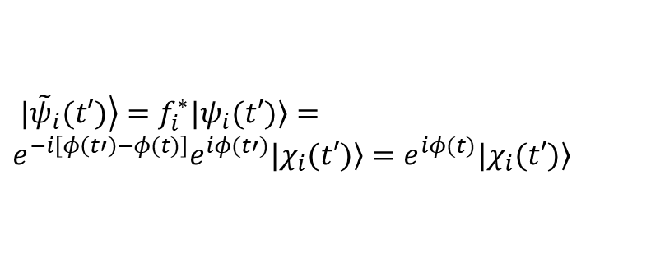

Phase correction
Akimov, A. V. J. Phys. Chem. Lett. 2018 9, 6096-6102
$$d_{ij}=\frac{\left\langle ψ_{i}(t) | ψ_{j}(t+dt)\right\rangle −\left\langle ψ_{i}(t+dt) | ψ_{j}(t)\right\rangle }{2dt}$$
Hammes-Schiffer, S.; Tully, J. C. J. Chem. Phys. 1994, 101, 4657–4667
But states are defined only up to a complex phase!
$$f_{i}=\frac{\left\langle \left.ψ_{i}(t\right) | \left.ψ_{i}(t′\right)\right\rangle }{\sqrt{\left|\left\langle \left.ψ_{i}(t\right) | \left.ψ_{i}(t′\right)\right\rangle \right|}}$$
$\left.|{\tilde{ψ}}_{i}(t′)\right\rangle =f_{i}^{∗}\left.|ψ_{i}(t′)\right\rangle$
Phase correction:
$$C_{adi,i}→{\tilde{C}}_{adi,i}=f_{i}C_{adi,i}$$
Indeed:
Implementation in Libra:
$$\left.\left.|ψ_{i}(t\right)\right\rangle =e^{\left.iφ(t\right)}\left.\left.|χ_{i}(t\right)\right\rangle$$
$$\left.\left.|ψ_{i}(t′\right)\right\rangle =e^{\left.iφ(t′\right)}\left.\left.|χ_{i}(t′\right)\right\rangle$$
Then:
$\left.|{\tilde{ψ}}_{i}(t′)\right\rangle =f_{i}^{∗}\left.|ψ_{i}(t′)\right\rangle =e^{−i\left[φ\left(t′\right)−φ(t)\right]}e^{iφ(t′)}\left.|χ_{i}(t′)\right\rangle =e^{iφ(t)}\left.|χ_{i}(t′)\right\rangle$
Phase-correct other properties:
$$d_{ij}^{α}=\left\langle ψ_{i} | ∇_{α} | ψ_{j}\right\rangle →f_{i}\left\langle ψ_{i} | ∇_{α} | ψ_{j}\right\rangle f_{j}^{∗}$$

Slide 9
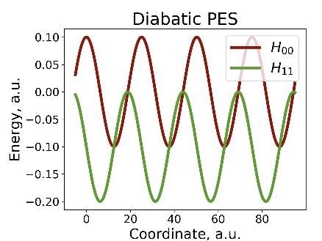
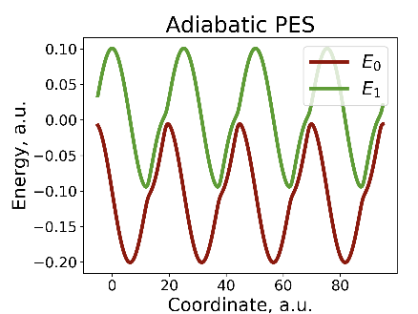
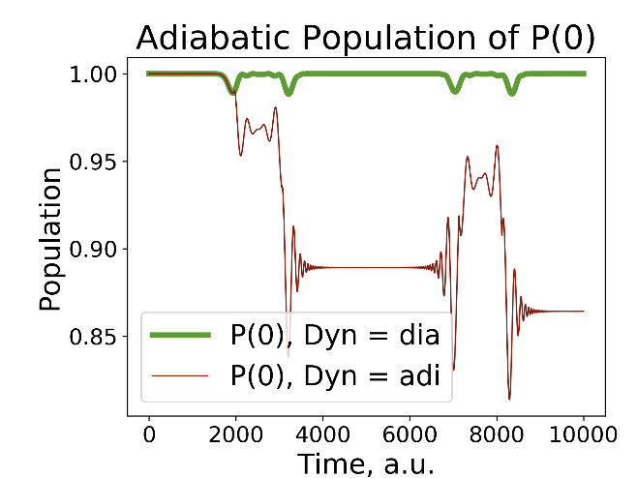
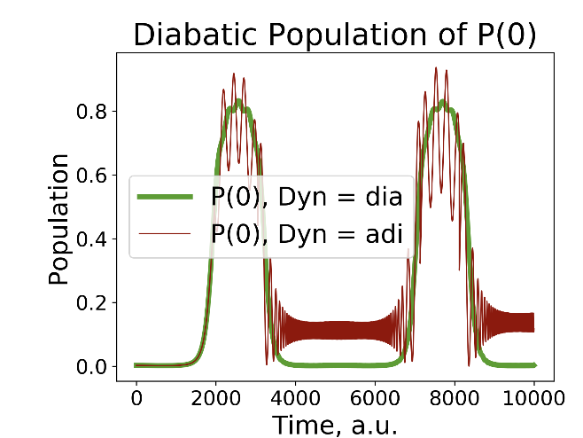
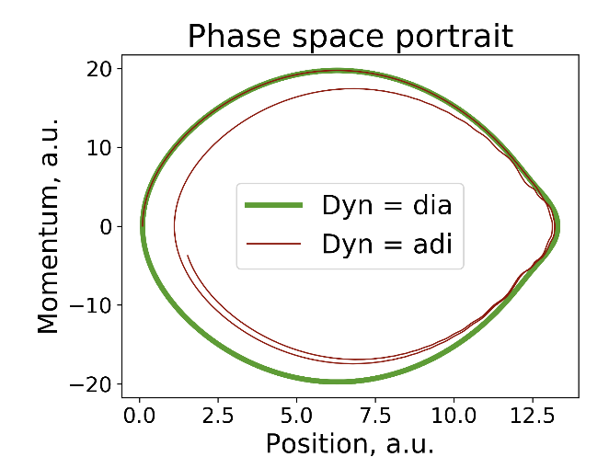
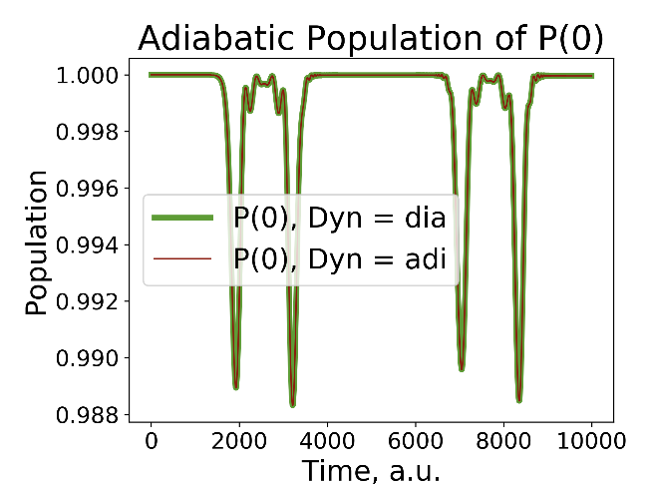
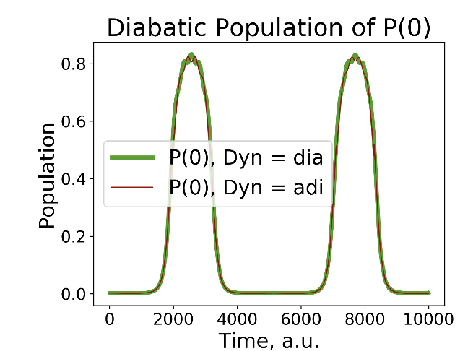
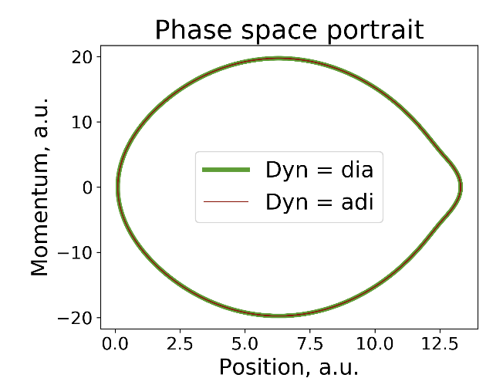
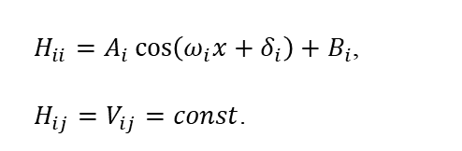

Phase correction
Akimov, A. V. J. Phys. Chem. Lett. 2018 9, 6096-6102
$H_{ii}=A_{i}\cos\left(ω_{i}x+δ_{i}\right)+B_{i}$,
$H_{ij}=V_{ij}=const$.
$$Ψ\left(t=0\right)=ψ_{0}$$
No
Yes

Slide 10
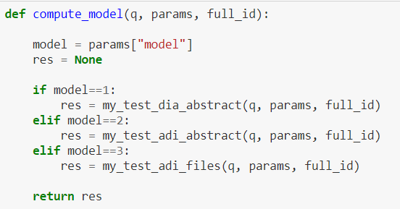
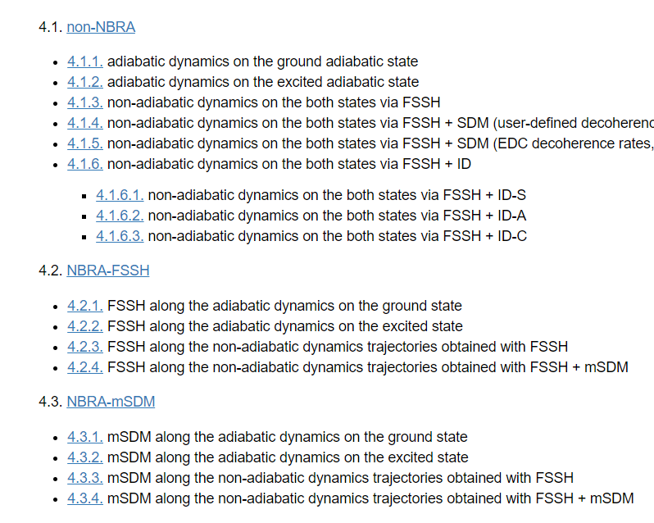
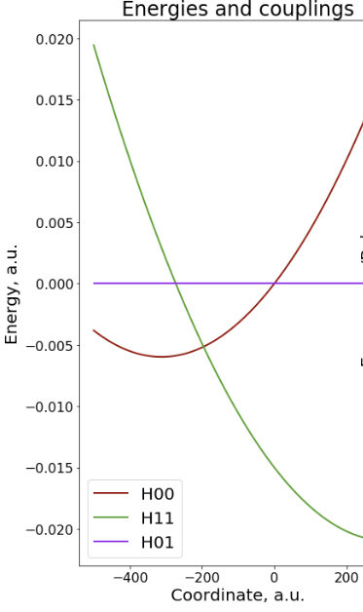
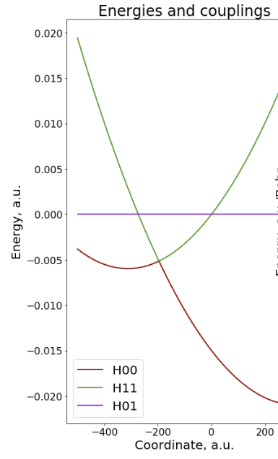
Comparing methods
use various representations
define properties via external way
Options
Marcus-type (spin-Boson Hamiltonian)

Slide 11
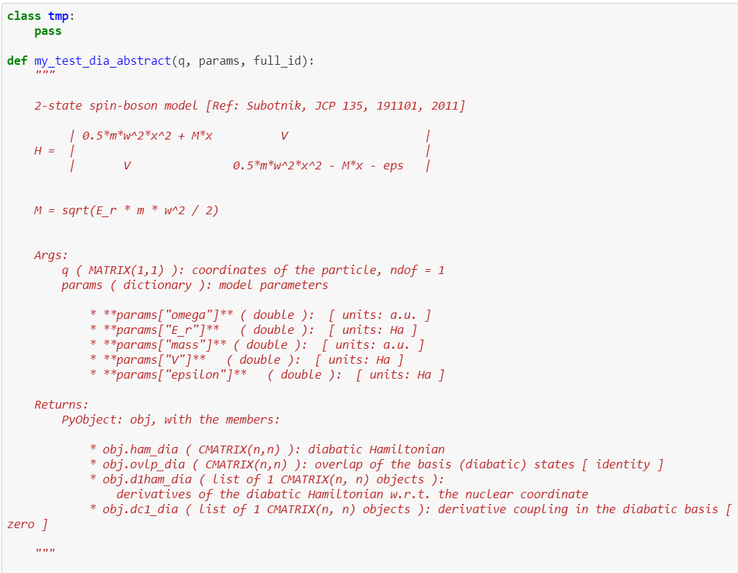
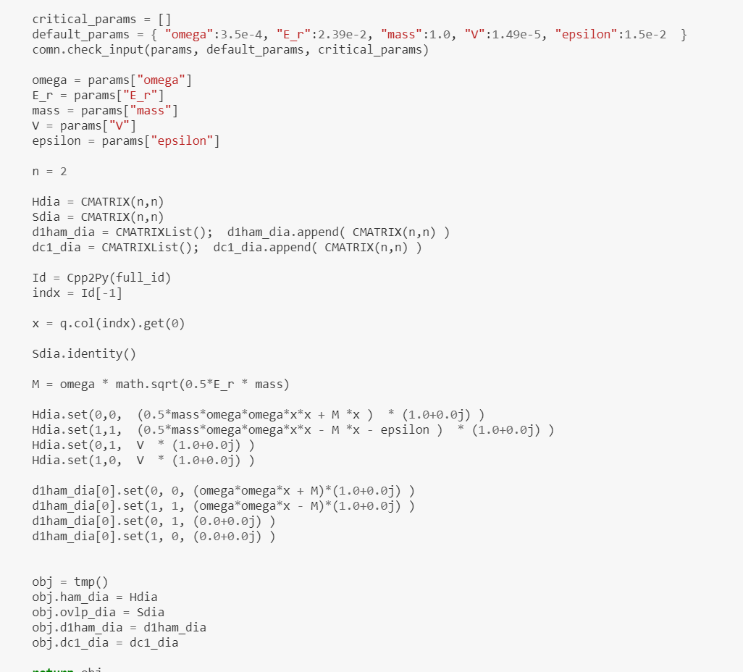
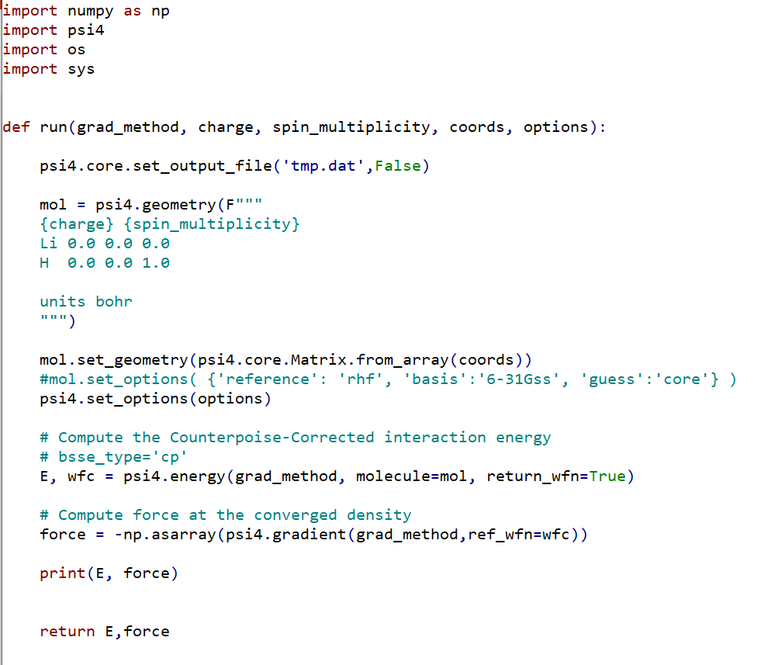
How to define your model

Slide 12
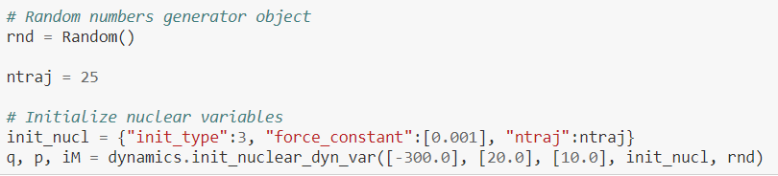
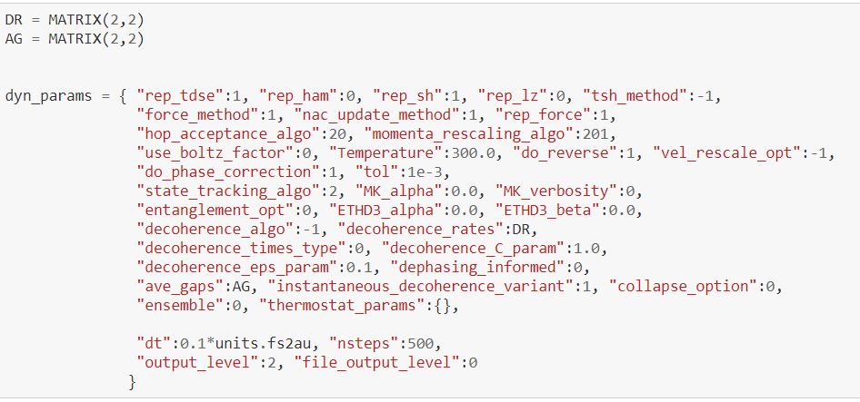
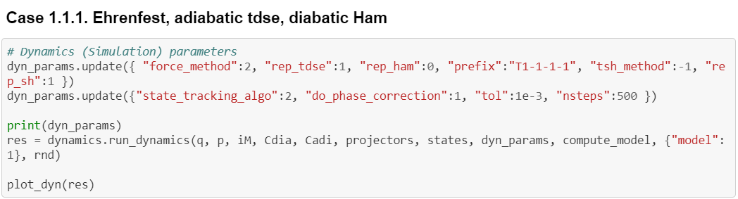
Simplicity

Slide 13
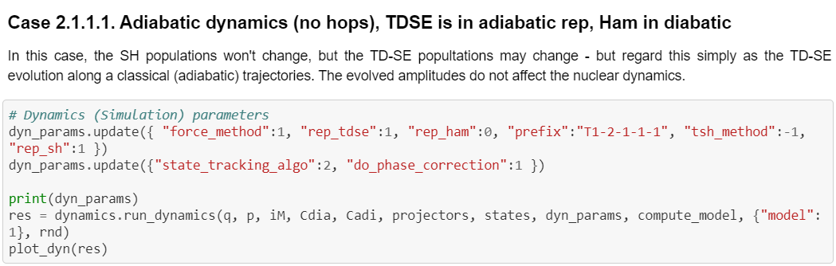
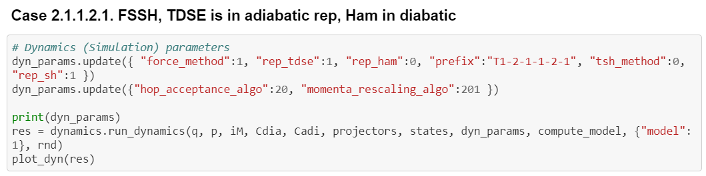
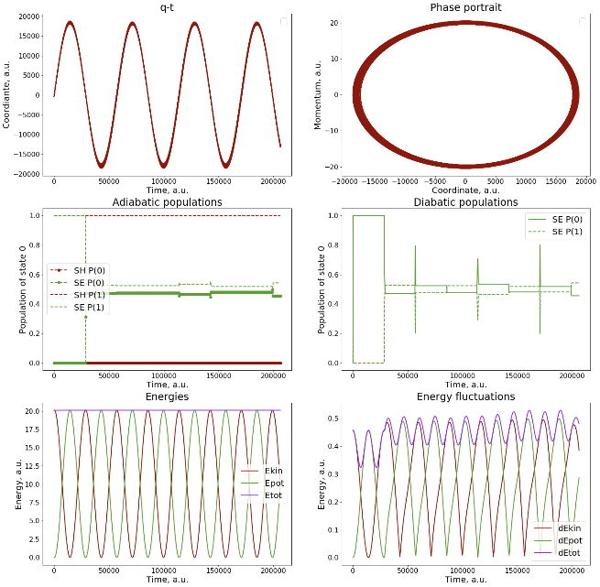
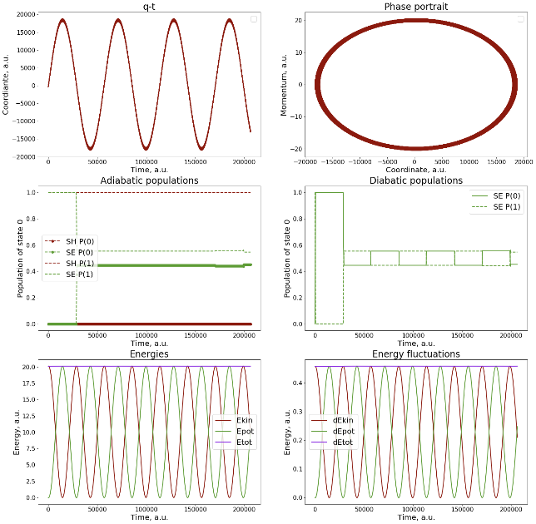
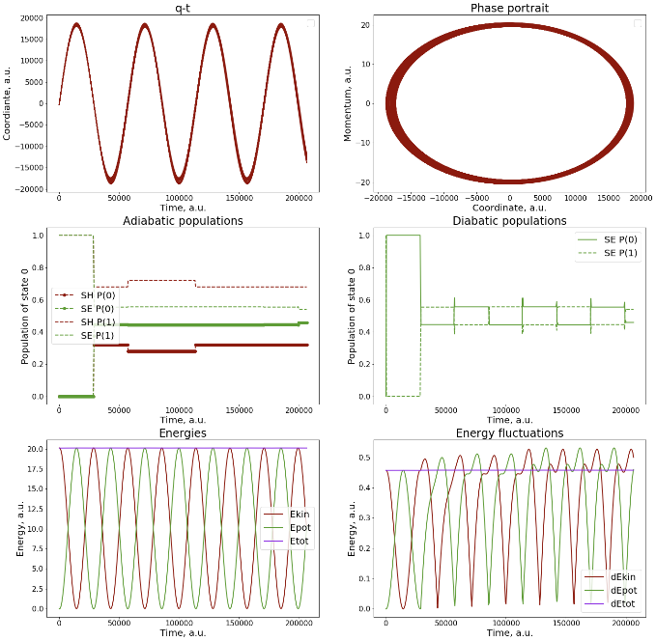
Variety of options
Initialization, sampling
Model, methods, common options
Ehrenfest
Adiabatic MD
FSSH dynamics

Slide 14


Acknowledgements
Funds:
Computing resources:
UB startup
OAC-NSF
Thank you! Questions?

