Slide 1

Molecular Dynamics (adiabatic)
Department of Chemistry, University at Buffalo, The State University of New York, Buffalo, NY 14260-3000
Alexey Akimov
“Excited States and Nonadiabatic Dynamics CyberTraining Workshop”
June 14, 2021

Slide 2
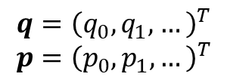
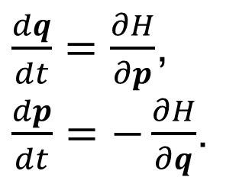
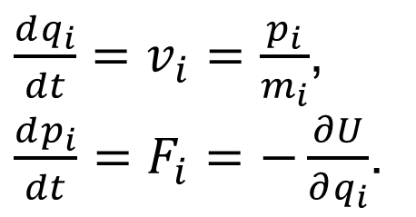
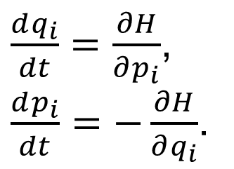

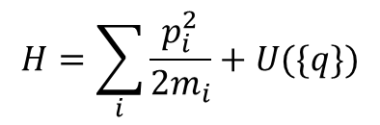
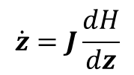
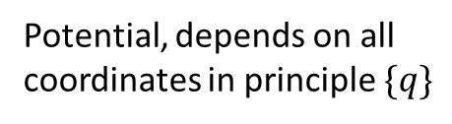

What is it?
Solving Newtonian equations of motion
$\frac{dq_{i}}{dt}=v_{i}=\frac{p_{i}}{m_{i}}$,
$\frac{dp_{i}}{dt}=F_{i}=−\frac{∂U}{∂q_{i}}$.
Potential, depends on all
coordinates in principle $\{q\}$
Definition!
$$H=\sum_{i}{\frac{p_{i}^{2}}{2m_{i}}}+U(\{q\})$$
If we recall
Hamiltonian dynamics!
Vectorized notation
Phase space coordinate representation
$\frac{dq_{i}}{dt}=\frac{∂H}{∂p_{i}}$,
$\frac{dp_{i}}{dt}=−\frac{∂H}{∂q_{i}}$.
$$q={\left(q_{0},q_{1},…\right)}^{T}$$
$$p={\left(p_{0},p_{1},…\right)}^{T}$$
$\frac{dq}{dt}=\frac{∂H}{∂p}$,
$\frac{dp}{dt}=−\frac{∂H}{∂q}$.
$$z=(q,p)$$
$$\dot{z}=J\frac{dH}{dz}$$
We realize
$$J=\left(\begin{matrix}I & 0 \\ 0 & −I\end{matrix}\right)$$

Slide 3
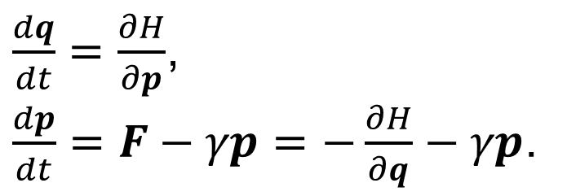
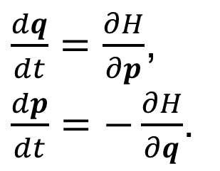
Hamiltonian vs non-Hamiltonian dynamics
Hamiltonian dynamics (e.g. isolated systems): there exists a function $H(q,p)$ ($∃H)$ such that EOM are given by:
$\frac{dq}{dt}=\frac{∂H}{∂p}$,
$\frac{dp}{dt}=−\frac{∂H}{∂q}$.
The energy is conserved. The system’s Hamiltonian is its energy
The Hamiltonian yields EOMs
Non-Hamiltonian dynamics (e.g. open/dissipative systems): $∄H$ that would yield EOMs in Hamiltonian form
$\frac{dq}{dt}=\frac{∂H}{∂p}$,
$\frac{dp}{dt}=F−γp=−\frac{∂H}{∂q}−γp$.
Example: add friction
The energy is not! conserved. There may exist conserved quantities, but they are not system’s Hamiltonian
The EOMs are not derived from the Hamiltonian via the $\dot{z}=J\frac{dH}{dz}$ equation

Slide 4
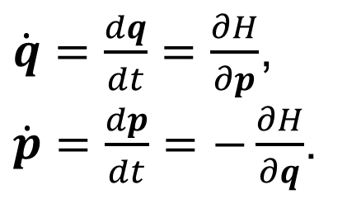
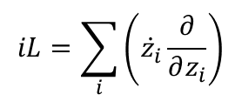
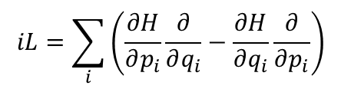
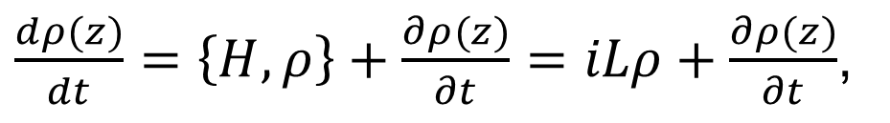
Equations of motion
Hamiltonian EOM
(“Schrodinger” picture)
Evolve the system’s state
CM: q and p; QM: wavefunction
Liouville’s equation
(“density matrix” picture)
$\dot{q}=\frac{dq}{dt}=\frac{∂H}{∂p}$,
$\dot{p}=\frac{dp}{dt}=−\frac{∂H}{∂q}$.
$\frac{dρ(z)}{dt}=\left\{H,ρ\right\}+\frac{∂ρ(z)}{∂t}=iLρ+\frac{∂ρ(z)}{∂t}$,
Classical Poisson bracket
$$\frac{dρ(z)}{dt}=\sum_{i}{\left(\frac{∂ρ}{∂q_{i}}\dot{q_{i}}+\frac{∂ρ}{∂p_{i}}\dot{p_{i}}\right)}+\frac{∂ρ(z)}{∂t}=\sum_{i}{\left(\frac{∂ρ}{∂q_{i}}\frac{∂H}{∂p_{i}}−\frac{∂ρ}{∂p_{i}}\frac{∂H}{∂q_{i}}\right)}+\frac{∂ρ(z)}{∂t}=\sum_{i}{\left(\frac{∂H}{∂p_{i}}\frac{∂ρ}{∂q_{i}}−\frac{∂H}{∂q_{i}}\frac{∂ρ}{∂p_{i}}\right)}+\frac{∂ρ(z)}{∂t}=iLρ+\frac{∂ρ(z)}{∂t}$$
$$iL=\sum_{i}{\left({\dot{z}}_{i}\frac{∂}{∂z_{i}}\right)}$$
$$iL=\sum_{i}{\left(\frac{∂H}{∂p_{i}}\frac{∂}{∂q_{i}}−\frac{∂H}{∂q_{i}}\frac{∂}{∂p_{i}}\right)}$$
Liouville’s operator (Liouvillian)

Slide 5
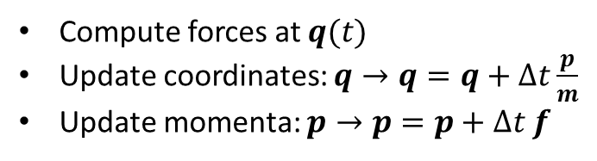
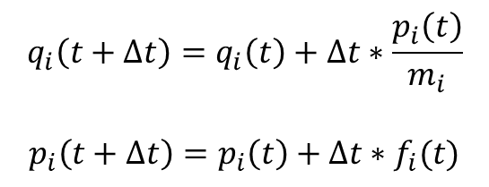
Integrating equations of motion: Euler
Naïve approach: Euler, Verlet
Predictor-corrector approaches
Geometric integrators
$$\frac{dq\left(t\right)}{dt}≈\frac{q\left(t+Δt\right)−q\left(t\right)}{Δt}=\frac{p\left(t\right)}{m}⇒q\left(t+Δt\right)=q\left(t\right)+Δt∗\frac{p\left(t\right)}{m}$$
same for momentum update
need to coordinate timing
More accurately: $q\left(t+Δt\right)≈q\left(t\right)+\frac{p\left(t\right)}{m}Δt+\frac{1}{2!}\frac{\dot{p}\left(t\right)}{m}Δt^{2}+…$
Euler scheme
Algorithm
$$q_{i}\left(t+Δt\right)=q_{i}\left(t\right)+Δt∗\frac{p_{i}\left(t\right)}{m_{i}}$$
$$p_{i}\left(t+Δt\right)=p_{i}\left(t\right)+Δt∗f_{i}(t)$$
Compute forces at $q(t)$
Update coordinates: $q→q=q+Δt\frac{p}{m}$
Update momenta: $p→p=p+Δt f$
Note: $f_{i}\left(t\right)=f\left(q\left(t\right)\right)$ - the force is computed for the starting coordinates

Slide 6
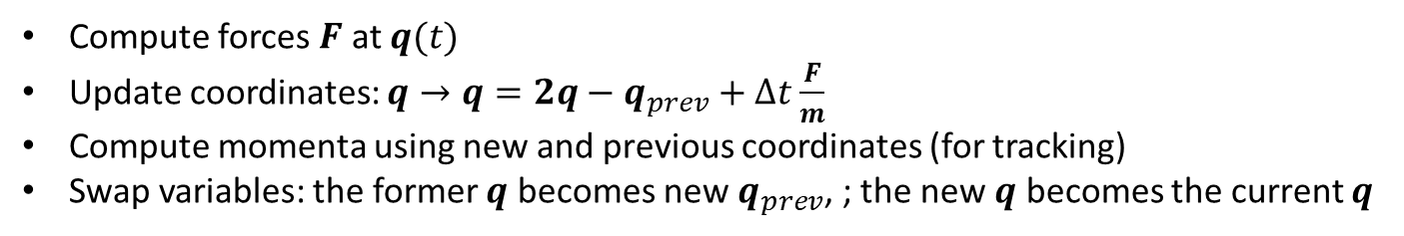
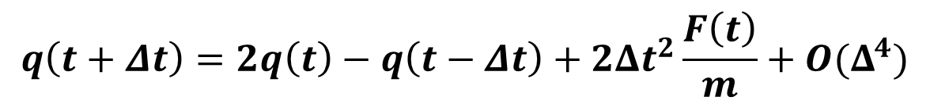
Integrating equations of motion:
(coordinate) Verlet/Leapfrog
$$q\left(t+Δt\right)≈q\left(t\right)+\dot{q}\left(t\right)Δt+\frac{1}{2!}\ddot{q}\left(t\right)Δt^{2}+\frac{1}{3!} \overset{⃛}{q}\left(t\right)Δt^{3}+O(Δt^{4})…$$
$$q\left(t−Δt\right)≈q\left(t\right)−\dot{q}\left(t\right)Δt+\frac{1}{2!}\ddot{q}\left(t\right)Δt^{2}−\frac{1}{3!} \overset{⃛}{q}\left(t\right)Δt^{3}+O(Δt^{4})…$$
$$q\left(t+Δt\right)+q\left(t−Δt\right)=2q\left(t\right)+\ddot{q}\left(t\right)Δt^{2}+O(Δt^{4})=2q\left(t\right)+\frac{F\left(t\right)}{m}Δt^{2}+O(Δt^{4})$$
Leap-Frog
$$q\left(t+Δt\right)=2q\left(t\right)−q\left(t−Δt\right)+2Δt^{2}\frac{F\left(t\right)}{m}+O(Δ^{4})$$
Compute forces $F$ at $q(t)$
Update coordinates: $q→q=2q−q_{prev}+Δt\frac{F}{m}$
Compute momenta using new and previous coordinates (for tracking)
Swap variables: the former $q$ becomes new $q_{prev}$, ; the new $q$ becomes the current $q$
Algorithm:

Slide 7
Exercises
Implement Euler integration
Implement the leap-frog integration
Utilize the Runge-Kutta 4-th order integrator

Slide 8
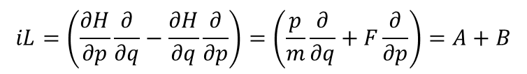

Integrating equations of motion:
Geometric integration (velocity Verlet)
$\frac{dρ(z(t))}{dt}=iLρ\left(t\right)⇒ρ\left(t+Δt\right)=\exp\left(iLΔt\right)ρ\left(t\right)$
No explicit time-dependence
What is this?
$$\exp\left(iLΔt\right)$$
For 1D:
$$iL=\left(\frac{∂H}{∂p}\frac{∂}{∂q}−\frac{∂H}{∂q}\frac{∂}{∂p}\right)=\left(\frac{p}{m}\frac{∂}{∂q}+F\frac{∂}{∂p}\right)=A+B$$
Trotter factorization: $\exp\left(\left(A+B\right)Δt\right)≈\exp\left(A\frac{Δt}{2}\right)\exp\left(BΔt\right)\exp\left(A\frac{Δt}{2}\right)$
$$\exp\left(iLΔt\right)≈\exp\left(\frac{pΔt}{2m}\frac{∂}{∂q}\right)\exp\left(ΔtF\frac{∂}{∂p}\right)\exp\left(\frac{pΔt}{2m}\frac{∂}{∂q}\right)=\exp\left(a\frac{∂}{∂q}\right)\exp\left(b\frac{∂}{∂p}\right)\exp\left(a\frac{∂}{∂q}\right)$$

Slide 9
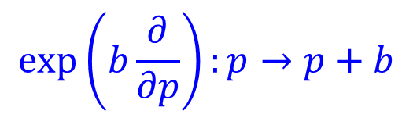
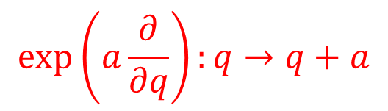
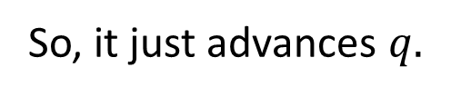
What do these operators do?
$$\exp\left(a\frac{∂}{∂q}\right)ρ\left(q,p\right)=\left[1+a\frac{∂}{∂q}+\frac{a^{2}}{2!}\frac{∂^{2}}{∂q^{2}}+…\right]ρ\left(q,p\right)=\left[ρ\left(q,p\right)+a\frac{∂ρ\left(q,p\right)}{∂q}+\frac{a^{2}}{2!}\frac{∂^{2}ρ\left(q,p\right)}{∂q^{2}}+…\right]≈ρ\left(q+a,p\right)$$
$$\exp\left(a\frac{∂}{∂q}\right):q→q+a$$
So, it just advances $q.$
Important: this is possible because a doesn’t depend on q!
$$\exp\left(b\frac{∂}{∂p}\right):p→p+b$$
Likewise:

Slide 10
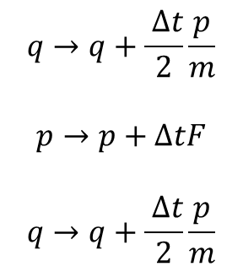
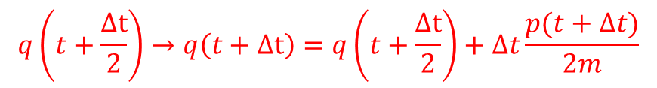
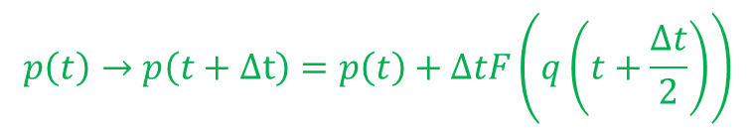
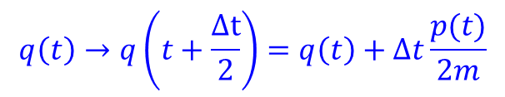
Building an algorithm
$$ρ\left(t+Δt\right)=\exp\left(iLΔt\right)ρ\left(t\right)≈\exp\left(\frac{pΔt}{2m}\frac{∂}{∂q}\right)\exp\left(ΔtF\frac{∂}{∂p}\right)\exp\left(\frac{pΔt}{2m}\frac{∂}{∂q}\right)ρ\left(t\right)$$
Operations:
With the explicit timing:
$$q\left(t\right)→q\left(t+\frac{Δt}{2}\right)=q\left(t\right)+Δt\frac{p(t)}{2m}$$
$$q→q+\frac{ Δt}{2}\frac{p}{m}$$
$$p→p+ΔtF$$
$$q→q+\frac{ Δt}{2}\frac{p}{m}$$
$$p\left(t\right)→p\left(t+Δt\right)=p\left(t\right)+ΔtF\left(q\left(t+\frac{Δt}{2}\right)\right)$$
$$q\left(t+\frac{Δt}{2}\right)→q\left(t+Δt\right)=q\left(t+\frac{Δt}{2}\right)+Δt\frac{p(t+Δt)}{2m}$$

Slide 11
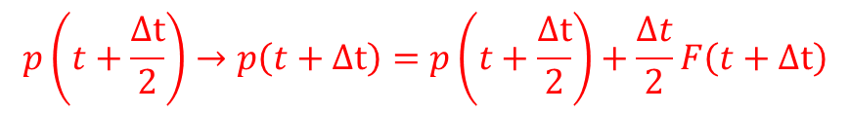
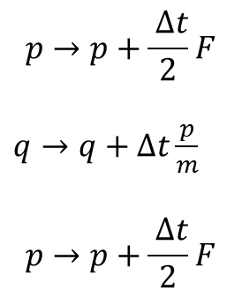
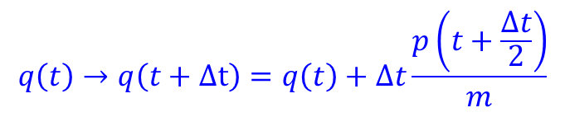
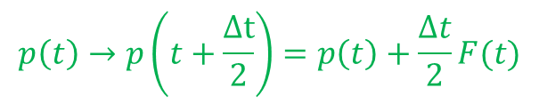
Alternative (more common) factorization
$$ρ\left(t+Δt\right)=\exp\left(iLΔt\right)ρ\left(t\right)≈\exp\left(\frac{Δt}{2}F\frac{∂}{∂p}\right)\exp\left(Δt\frac{p}{m}\frac{∂}{∂q}\right)\exp\left(\frac{Δt}{2}F\frac{∂}{∂p}\right)ρ\left(t\right)$$
Operations:
With the explicit timing:
$$p\left(t\right)→p\left(t+\frac{Δt}{2}\right)=p\left(t\right)+\frac{Δt}{2}F(t)$$
$$p→p+\frac{ Δt}{2}F$$
$q→q+Δt\frac{p}{m}$
$$p→p+\frac{ Δt}{2}F$$
$$q\left(t\right)→q\left(t+Δt\right)=q\left(t\right)+Δt\frac{p\left(t+\frac{Δt}{2}\right)}{m}$$
$$p\left(t+\frac{Δt}{2}\right)→p\left(t+Δt\right)=p\left(t+\frac{Δt}{2}\right)+\frac{Δt}{2}F\left(t+Δt\right)$$

