Slide 1
扫描电路
EE 2022/4/24

Slide 2
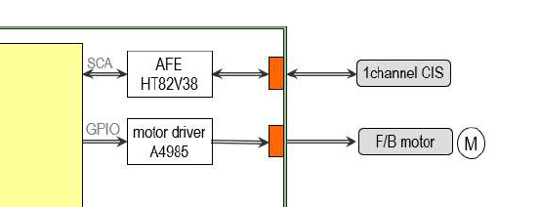
扫描电路

Slide 3
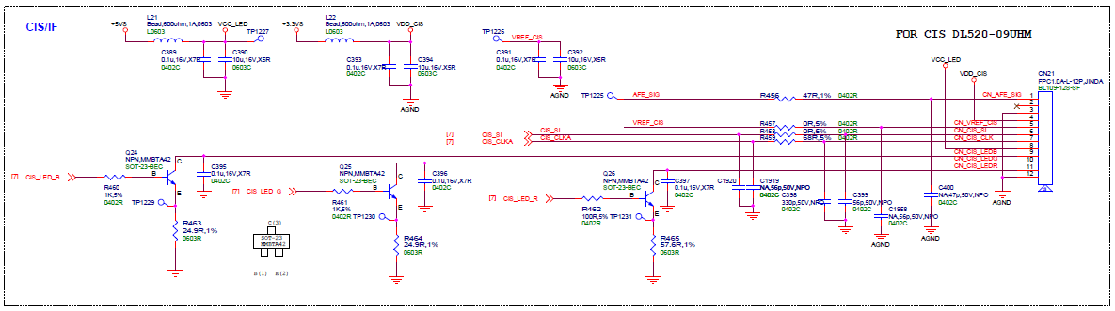
CIS电路

Slide 4
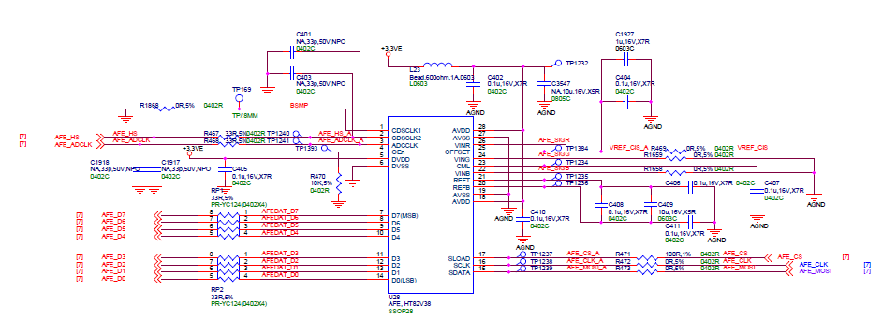
AFE电路

Slide 5
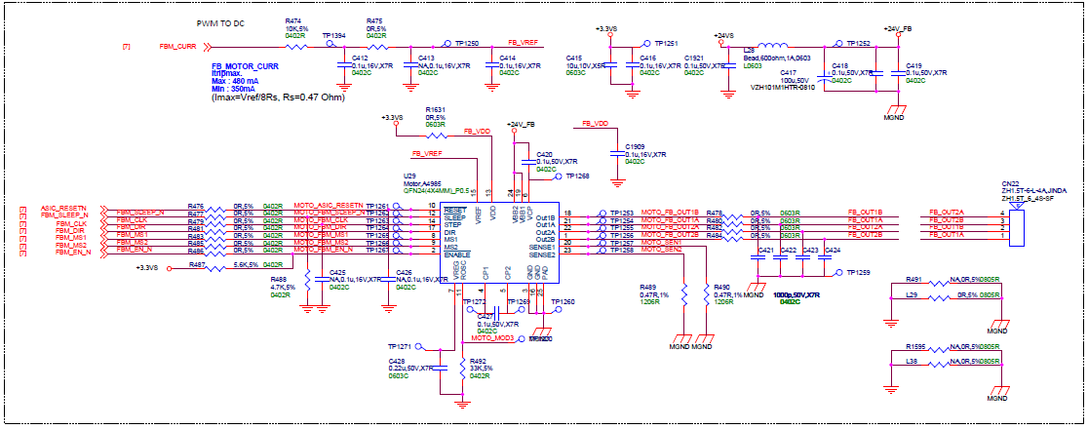
马达电路

Slide 6
Thanks
造就中国的世界品牌，为民族争光，成为不断创新、追求卓越、基业常青的企业。
To create a global brand from China that win glory for the nation, to build an enterprise ever striving for innovation, excellence and sustainable growth.

Slide 7
Thanks
造就中国的世界品牌，为民族争光，成为不断创新、追求卓越、基业常青的企业。
To create a global brand from China that win glory for the nation, to build an enterprise ever striving for innovation, excellence and sustainable growth.

