Slide 1

CS 5/7320 Artificial Intelligence Adversarial Search and Games AIMA Chapter 5
Slides by Michael Hahsler with figures from the AIMA textbook
This work is licensed under a Creative Commons Attribution-ShareAlike 4.0 International License.
"Reflected Chess pieces" by Adrian Askew

Slide 2

Games
Games typically confront the agent with a competitive (adversarial) environment affected by an opponent.
We will focus on deterministic two-player zero-sum games with perfect information.
We call the two players:
Max tries to maximize his utility.
Min tries to minimize Max’s utility since it is a zero-sum game.

Slide 3

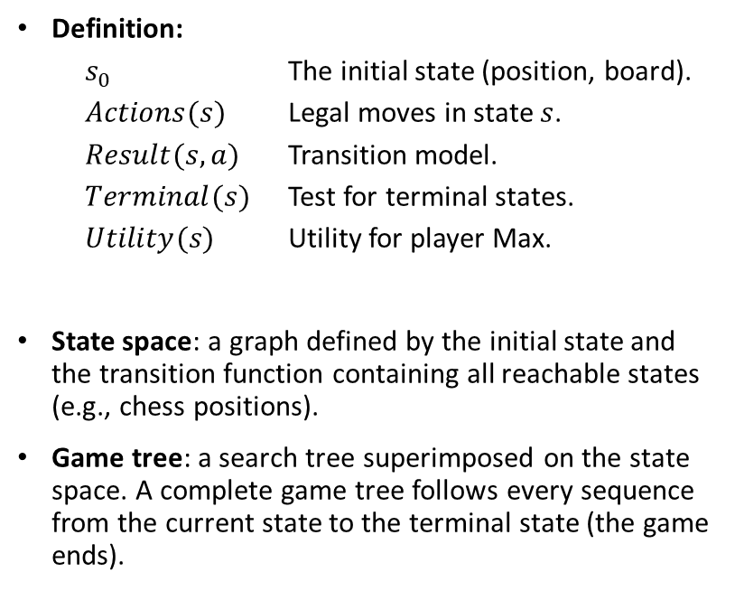
Definition of a Game
Definition:
$s_{0}$ The initial state (position, board).
$Actions(s)$ Legal moves in state $s$.
$Result(s,a)$ Transition model.
$Terminal(s)$ Test for terminal states.
$Utility(s)$ Utility for player Max.
State space: a graph defined by the initial state and the transition function containing all reachable states (e.g., chess positions).
Game tree: a search tree superimposed on the state space. A complete game tree follows every sequence from the current state to the terminal state (the game ends).

Slide 4
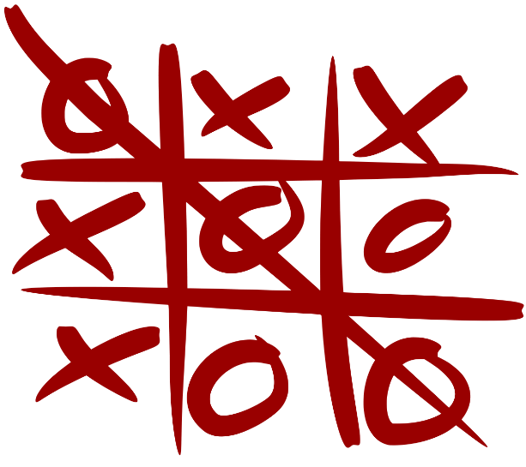
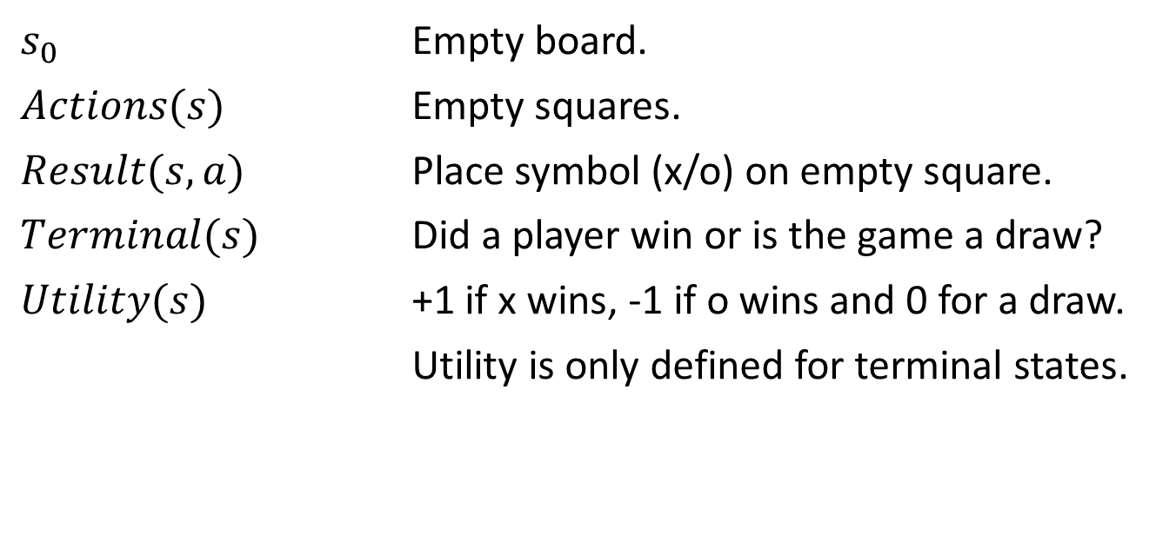
Example: Tic-tac-toe
$s_{0}$ Empty board.
$Actions(s)$ Empty squares.
$Result(s,a)$ Place symbol (x/o) on empty square.
$Terminal(s)$ Did a player win or is the game a draw?
$Utility(s)$ +1 if x wins, -1 if o wins and 0 for a draw.
Utility is only defined for terminal states.
Here player x is Max and player o is Min.

Slide 5
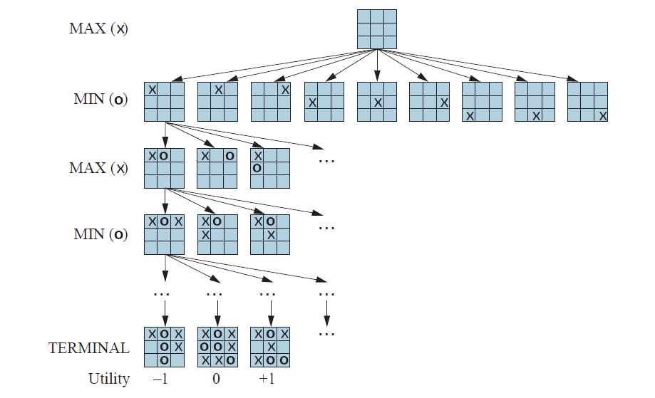
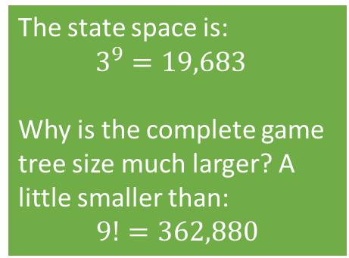
Tic-tac-toe: Partial Game Tree
The state space is:
$$3^{9}=19,683$$
Why is the complete game tree size much larger? A little smaller than:
$$9!=362,880$$

Slide 6
Methods for Adversarial Games
Exact Methods
Model as nondeterministic actions: The opponent is seen as part of an environment with nondeterministic actions. Non-determinism is the result of the unknown moves by the opponent. We consider all possible moves by the opponent.
Find optimal decisions: Minimax search and Alpha-Beta pruning where each player plays optimal to the end of the game.
Heuristic Methods (state space is too large)
Heuristic Alpha-Beta Tree Search:
Cut off search tree and use heuristic for utility.
Forward Pruning: ignore poor moves.
Monte Carlo Tree search: Estimate utility of a state by simulating complete games and average the utility.

Slide 7
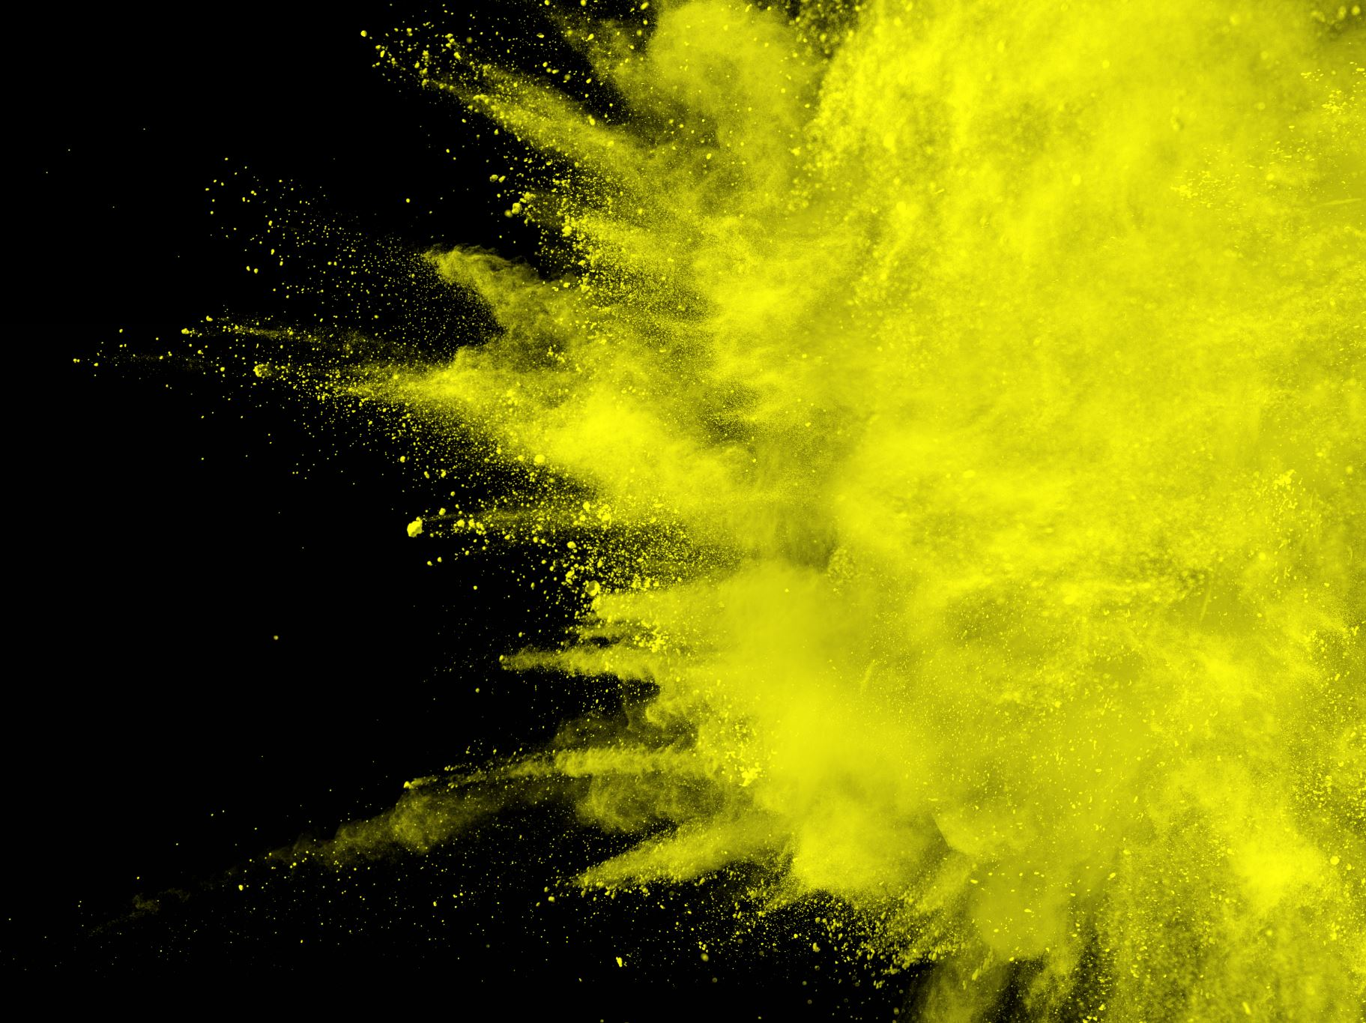
Nondeterministic Actions
Recall And-Or Search from AIMA Chapter 4

Slide 8
Methods for Adversarial Games
Exact Methods
Model as nondeterministic actions: The opponent is seen as part of an environment with nondeterministic actions. Non-determinism is the result of the unknown moves by the opponent. We consider all possible moves by the opponent.
Find optimal decisions: Minimax search and Alpha-Beta pruning where each player plays optimal to the end of the game.
Heuristic Methods (state space is too large)
Heuristic Alpha-Beta Tree Search:
Cut off search tree and use heuristic for utility.
Forward Pruning: ignore poor moves.
Monte Carlo Tree search: Estimate utility of a state by simulating complete games and average the utility.

Slide 9
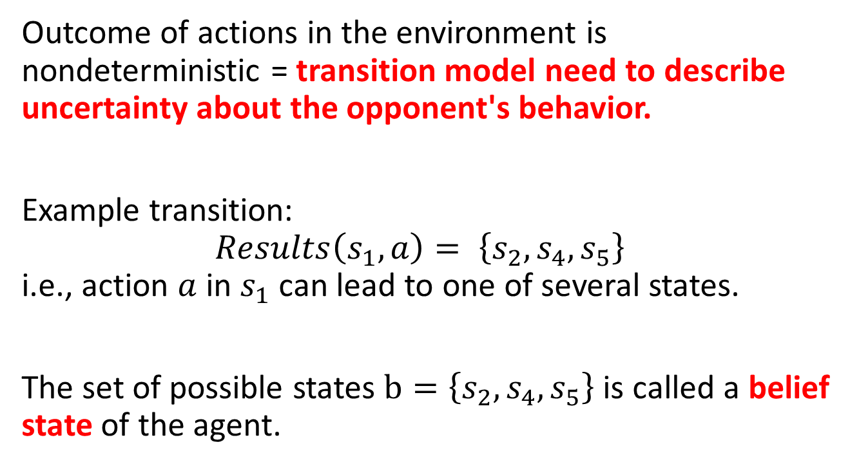
Nondeterministic Actions
Each action consists of the move by the player and all possible (i.e., nondeterministic) responses by the opponent.
Outcome of actions in the environment is nondeterministic = transition model need to describe uncertainty about the opponent's behavior.
Example transition: $Results\left(s_{1},a\right)= \left\{s_{2},s_{4},s_{5}\right\}$ i.e., action $a$ in $s_{1}$ can lead to one of several states.
The set of possible states $b=\left\{s_{2},s_{4},s_{5}\right\}$ is called a belief state of the agent.

Slide 10
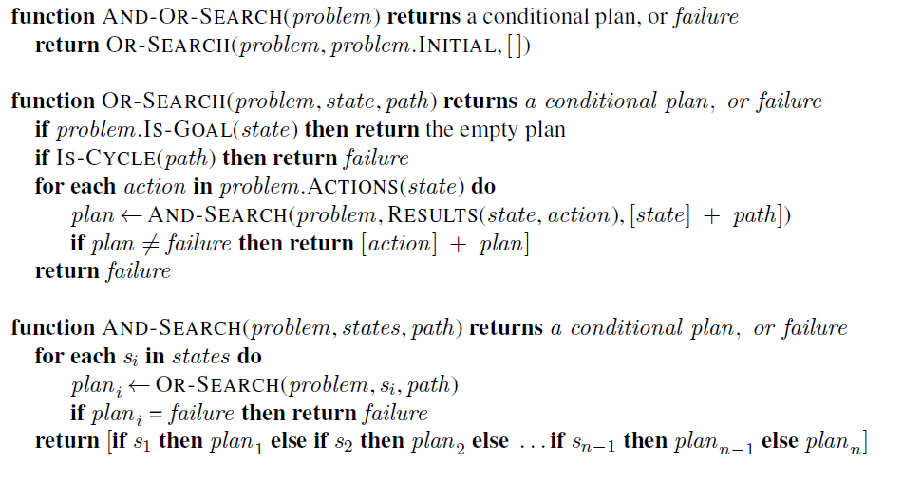
AND-OR DFS Search Algorithm
= nested If-then-else statements
// don’t follow loops
my moves
// check all possible actions
// check all states in belief state
opponent
moves
And-Or Search searches the whole tree till it finds a subtree that leads only to goal nodes.
BFS and A* search can also be used to search an AND-OR tree.

Slide 11

Optimal Decisions
Minimax Search and Alpha-Beta Pruning

Slide 12
Methods for Adversarial Games
Exact Methods
Model as nondeterministic actions: The opponent is seen as part of an environment with nondeterministic actions. Non-determinism is the result of the unknown moves by the opponent. We consider all possible moves by the opponent.
Find optimal decisions: Minimax search and Alpha-Beta pruning where each player plays optimal to the end of the game.
Heuristic Methods (state space is too large)
Heuristic Alpha-Beta Tree Search:
Cut off search tree and use heuristic for utility.
Forward Pruning: ignore poor moves.
Monte Carlo Tree search: Estimate utility of a state by simulating complete games and average the utility.

Slide 13
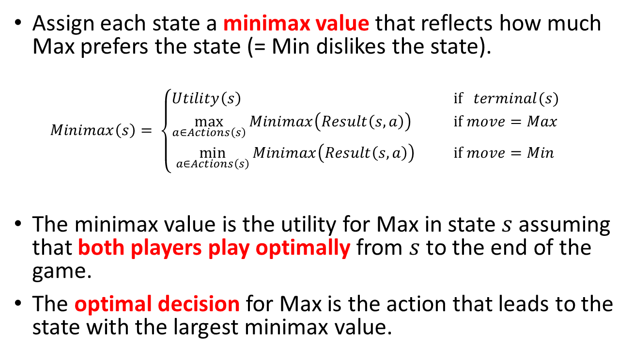
Idea: Minimax Decision
Assign each state a minimax value that reflects how much Max prefers the state (= Min dislikes the state).
$$Minimax\left(s\right)= \left\{\begin{aligned}Utility\left(s\right) \text{if} terminal(s) \\ \max_{a∈Actions\left(s\right)}{Minimax\left(Result\left(s,a\right)\right)}{} \text{if} move=Max \\ \min_{a∈Actions\left(s\right)}{Minimax\left(Result\left(s,a\right)\right) } \text{if} move=Min\end{aligned}\right.$$
The minimax value is the utility for Max in state $s$ assuming that both players play optimally from $s$ to the end of the game.
The optimal decision for Max is the action that leads to the state with the largest minimax value.

Slide 14
Minimax Search
= minimax value (MV)

Slide 15
Minimax Search : Back-up Minimax Values
MV
MV
MV
MV
MV
MV
MV
MV
MV
min
MV
MV
MV
max
MV
MV
MV
min
…
= minimax value (MV)

Slide 16
Minimax Search: Decision
Pick action that leads to the largest MV
MV
MV
MV
MV
MV
MV
MV
MV
MV
MV
MV
MV
MV
MV
MV
= minimax value (MV)

Slide 17
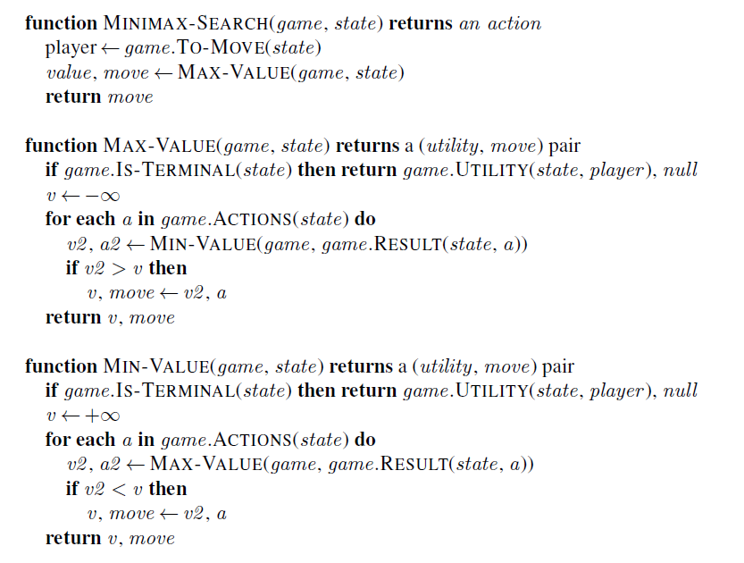
Approach: Follow tree to each terminal node and back up minimax value.
Note: This is just a generalization of the And-Or Tree Search and returns first action of the conditional plan.
Represents OR Search
Represents AND Search

Slide 18
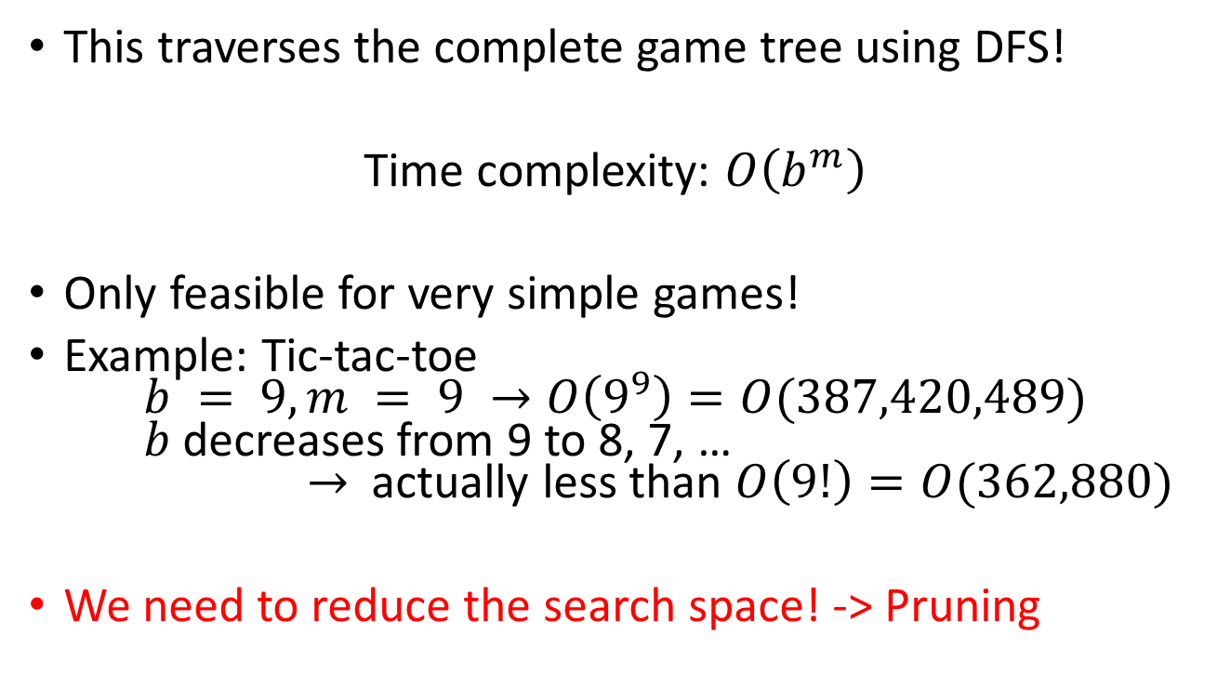
Issue: Game Tree Size
This traverses the complete game tree using DFS!
Time complexity: $O\left(b^{m}\right)$
Only feasible for very simple games!
Example: Tic-tac-toe $b = 9, m = 9 →O\left(9^{9}\right)=O(387,420,489)$ $b$ decreases from 9 to 8, 7, … $→$ actually less than $O\left(9!\right)=O(362,880)$
We need to reduce the search space! -> Pruning

Slide 19
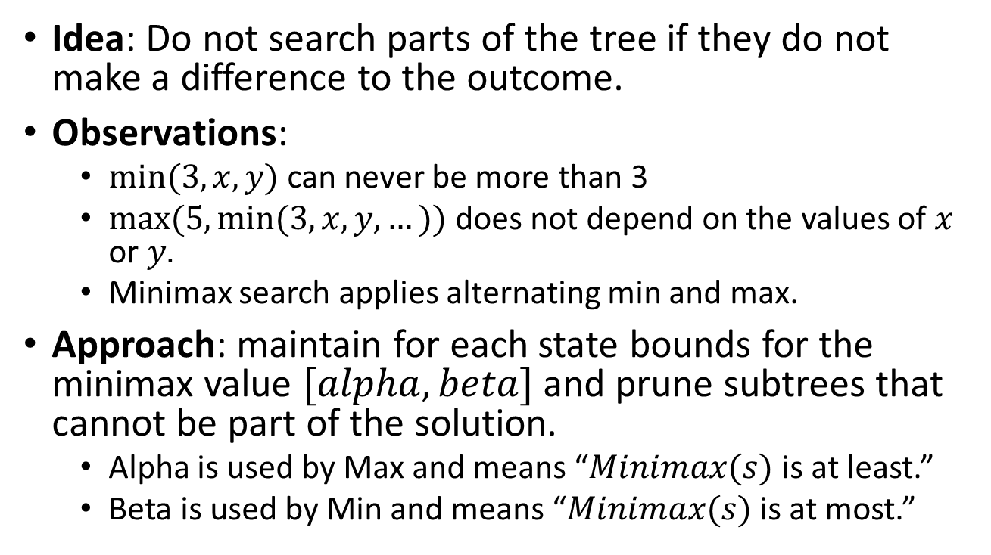
Alpha-Beta Pruning
Idea: Do not search parts of the tree if they do not make a difference to the outcome.
Observations:
$min⁡(3, x, y)$can never be more than 3
$max⁡(5, min⁡(3, x, y, …))$does not depend on the values of $x$ or $y.$
Minimax search applies alternating min and max.
Approach: maintain for each state bounds for the minimax value $[alpha, beta]$and prune subtrees that cannot be part of the solution.
Alpha is used by Max and means “$Minimax(s)$is at least.”
Beta is used by Min and means “$Minimax(s)$is at most.”

Slide 20
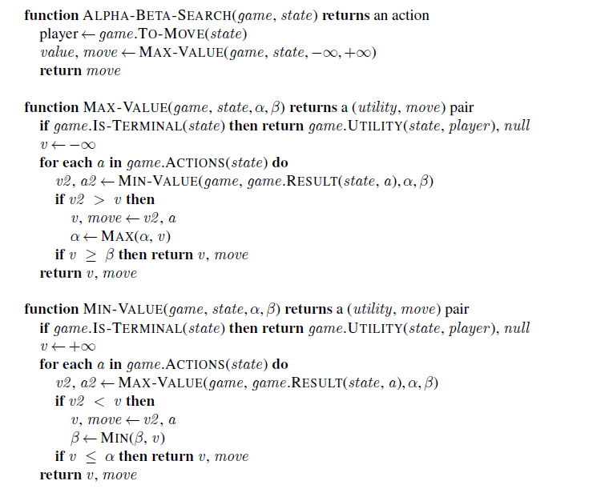
=minimax search + pruning.
Note: Pruning can be made more effective by move ordering: Check known good moves first to get a good bound early.
Optimal decision algorithms still scale poorly!

Slide 21

Heuristic Alpha-Beta Tree Search

Slide 22
Methods for Adversarial Games
Exact Methods
Model as nondeterministic actions: The opponent is seen as part of an environment with nondeterministic actions. Non-determinism is the result of the unknown moves by the opponent. We consider all possible moves by the opponent.
Find optimal decisions: Minimax search and Alpha-Beta pruning where each player plays optimal to the end of the game.
Heuristic Methods (state space is too large)
Heuristic Alpha-Beta Tree Search:
Cut off search tree and use heuristic for utility.
Forward Pruning: ignore poor moves.
Monte Carlo Tree search: Estimate utility of a state by simulating complete games and average the utility.

Slide 23
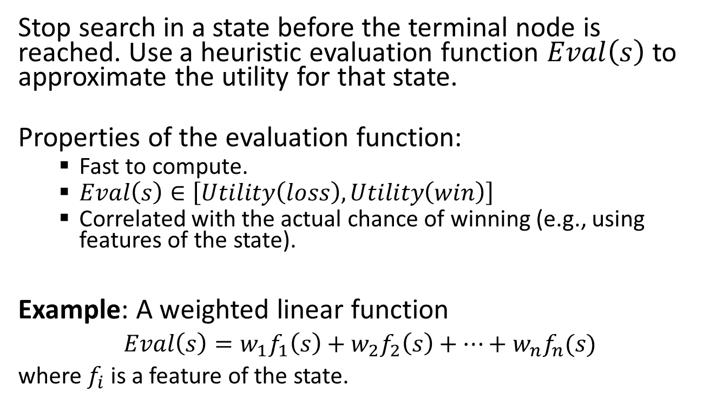
Idea: Cutting off search
Stop search in a state before the terminal node is reached. Use a heuristic evaluation function $Eval\left(s\right)$ to approximate the utility for that state.
Properties of the evaluation function:
Fast to compute.
$Eval\left(s\right)∈\left[Utility\left(loss\right),Utility\left(win\right)\right]$
Correlated with the actual chance of winning (e.g., using features of the state).
Example: A weighted linear function
$Eval\left(s\right)=w_{1}f_{1}\left(s\right)+w_{2}f_{2}\left(s\right)+⋯+w_{n}f_{n}(s)$
where $f_{i}$is a feature of the state.

Slide 24
Heuristic Alpha-Beta Tree Search: Cutting off search
HMV = heuristic minimax value
HMV
HMV
HMV
HMV
HMV
HMV
HMV
HMV
HMV
Eval
Eval = heuristic to estimate of the minimax value/ utility of the state.
Eval
Eval
Cut search off at depth =2

Slide 25
Idea: Forward pruning
Prune moves that appear poor. Poor can be evaluated in several ways:
Low evaluation value after shallow search.
Past experience.
Issue: May prune important moves.

Slide 26
Heuristic Alpha-Beta Tree Search: Forward Pruning Example
x
x
x
x
x
x
HMV
HMV
HMV
HMV
HMV
HMV
HMV
HMV
HMV
Eval
Eval
Eval
Perform Cut-off search.
Choose the x best actions using the heuristic minimax value.
Explore the chosen actions using regular Alpha-Beta Tree search with move ordering.
Cut search off at depth =2

Slide 27
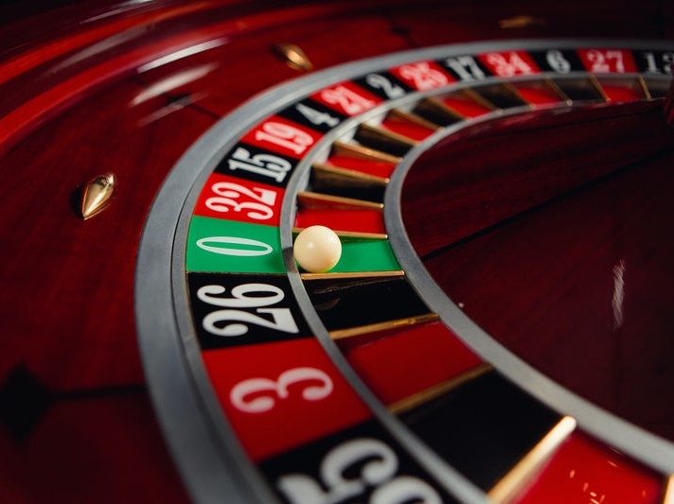
Monte Carlo Tree Search (MCTS)

Slide 28
Methods for Adversarial Games
Exact Methods
Model as nondeterministic actions: The opponent is seen as part of an environment with nondeterministic actions. Non-determinism is the result of the unknown moves by the opponent. We consider all possible moves by the opponent.
Find optimal decisions: Minimax search and Alpha-Beta pruning where each player plays optimal to the end of the game.
Heuristic Methods (state space is too large)
Heuristic Alpha-Beta Tree Search:
Cut off search tree and use heuristic for utility.
Forward Pruning: ignore poor moves.
Monte Carlo Tree search: Estimate utility of a state by simulating complete games and average the utility.

Slide 29
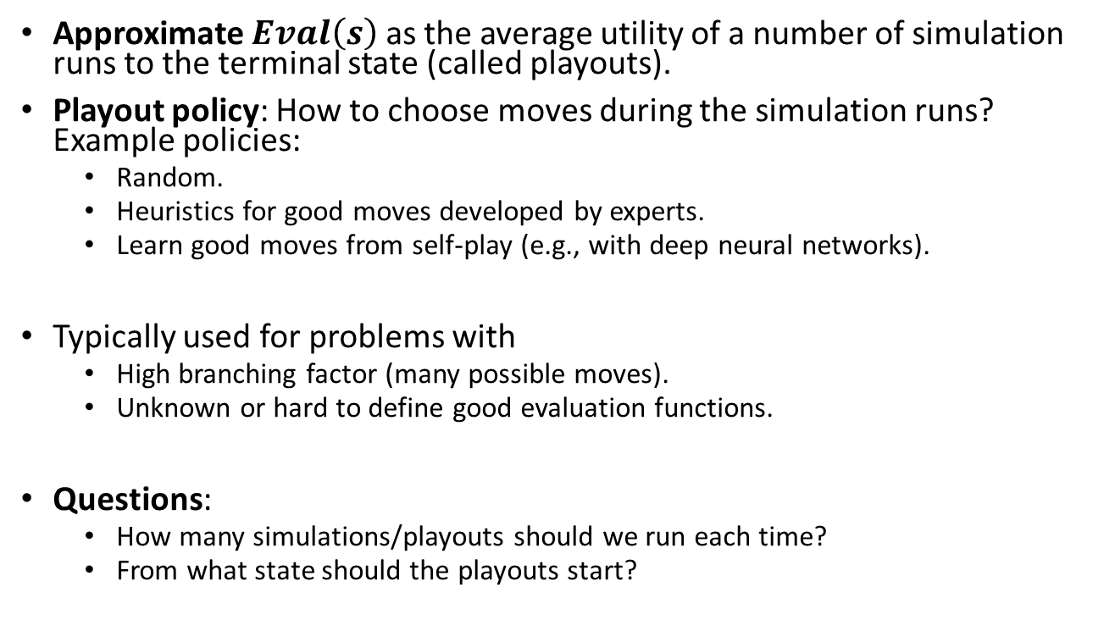
Idea
Approximate $Eval\left(s\right)$ as the average utility of a number of simulation runs to the terminal state (called playouts).
Playout policy: How to choose moves during the simulation runs? Example policies:
Random.
Heuristics for good moves developed by experts.
Learn good moves from self-play (e.g., with deep neural networks).
Typically used for problems with
High branching factor (many possible moves).
Unknown or hard to define good evaluation functions.
Questions:
How many simulations/playouts should we run each time?
From what state should the playouts start?

Slide 30
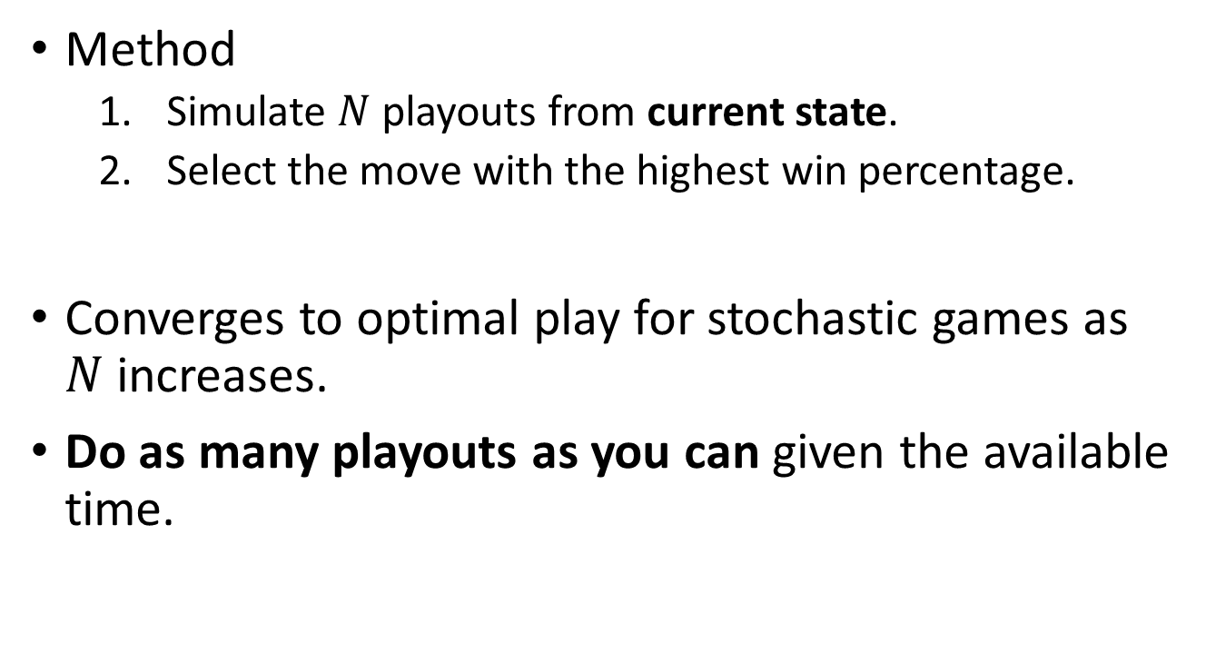
Pure Monte Carlo Search
Method
Simulate $N$ playouts from current state.
Select the move with the highest win percentage.
Converges to optimal play for stochastic games as $N$increases.
Do as many playouts as you can given the available time.

Slide 31
Selection Policy
Select the starting state for playouts to focus on important parts of the game tree. It is a tradeoff between:
Exploration: search from states that have few playouts.
Exploitation: more playouts for states that have done well to get more accurate estimates.

Slide 32
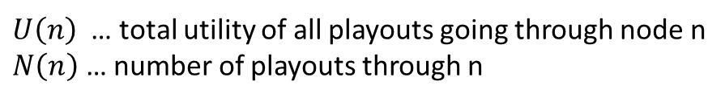
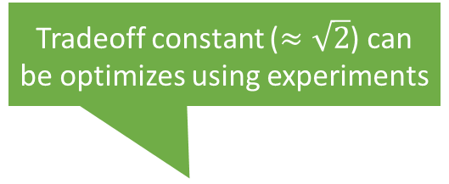
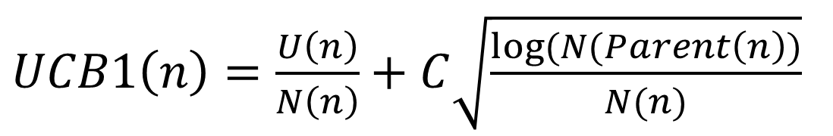
Selection using Upper Confidence Bounds applied to Trees (UCT)
Tradeoff constant ($≈\sqrt{2}$) can be optimizes using experiments
$UCB1\left(n\right)=\frac{U\left(n\right)}{N\left(n\right)}+C\sqrt{\frac{log⁡(N(Parent\left(n\right))}{N(n)}}$
Average utility (=exploitation)
High for nodes with few playouts (=exploration)
$U\left(n\right)$ … total utility of all playouts going through node n
$N\left(n\right)$ … number of playouts through n
Policy: Select leaf with highest UCB1 score.

Slide 33
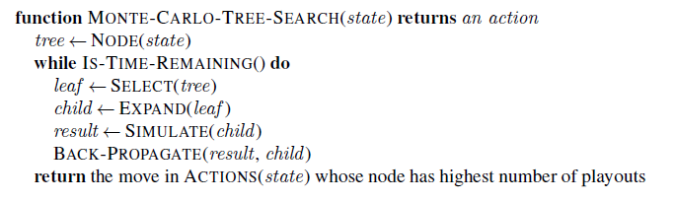
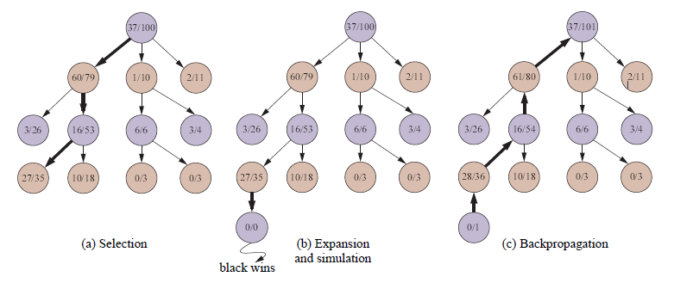
Highest UCB1 score
UCB1 selection favors win percentage more and more.
White
Wins/Playouts
Black
White
Black
White
Note: the simulation path is not recorded!

Slide 34

Stochastic Games
Games With Random Events

Slide 35
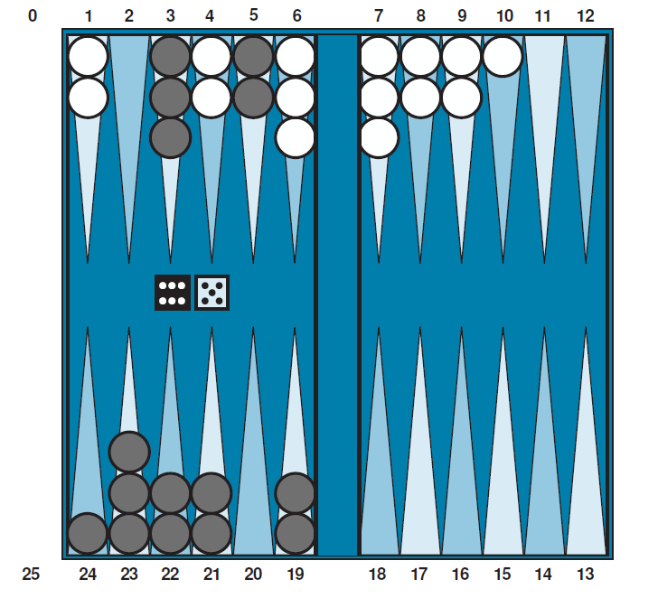
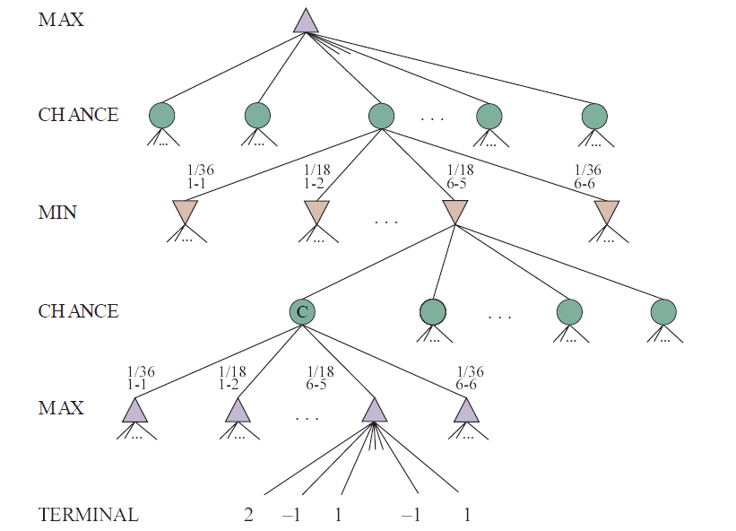
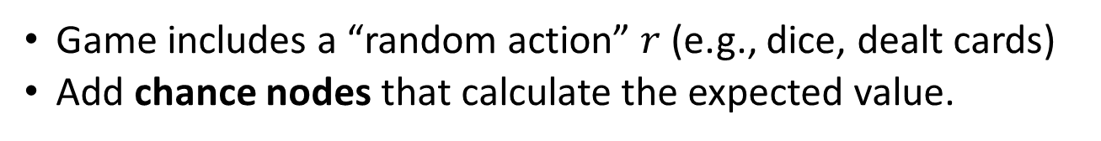
Stochastic Games
Game includes a “random action” $r$ (e.g., dice, dealt cards)
Add chance nodes that calculate the expected value.
Backgammon

Slide 36
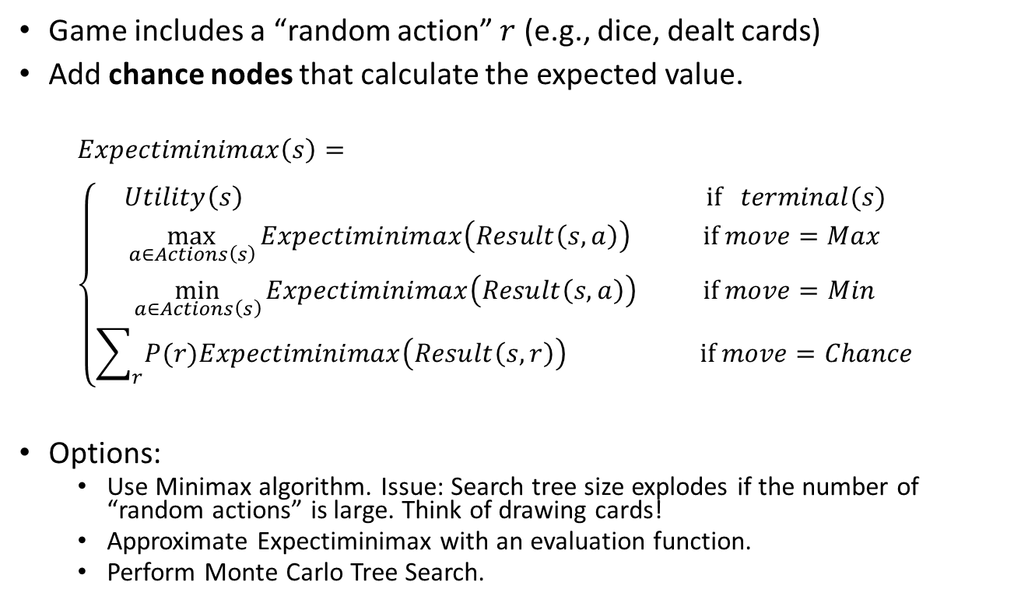
Expectiminimax
Game includes a “random action” $r$ (e.g., dice, dealt cards)
Add chance nodes that calculate the expected value.
$$Expectiminimax\left(s\right)= \\ \left\{\begin{aligned}Utility\left(s\right) \text{if} terminal(s) \\ \max_{a∈Actions\left(s\right)}{Expectiminimax\left(Result\left(s,a\right)\right)}{} \text{if} move=Max \\ \min_{a∈Actions\left(s\right)}{Expectiminimax\left(Result\left(s,a\right)\right) } \text{if} move=Min \\ \sum_{r}{P(r)Expectiminimax\left(Result\left(s,r\right)\right) } \text{if} move=Chance\end{aligned}\right.$$
Options:
Use Minimax algorithm. Issue: Search tree size explodes if the number of “random actions” is large. Think of drawing cards!
Approximate Expectiminimax with an evaluation function.
Perform Monte Carlo Tree Search.

Slide 37
Conclusion
Nondeterministic actions:
The opponent is seen as part of an environment with nondeterministic actions. Non-determinism is the result of the unknown moves by the opponent.
Optimal decisions:
Minimax search and Alpha-Beta pruning where each player plays optimal to the end of the game.
Choice nodes and Expectiminimax for stochastic games.
Heuristic Alpha-Beta Tree Search:
Cut off search tree and use heuristic evaluation function for utility (based on state features).
Forward Pruning: ignore poor moves.
Monte Carlo Tree search:
Simulate complete games and average the results.
Learn playout policy using self-play and deep learning.
Use modified UCB1 scores.
Scale only for tiny problems!
State of the Art

