Slide 1
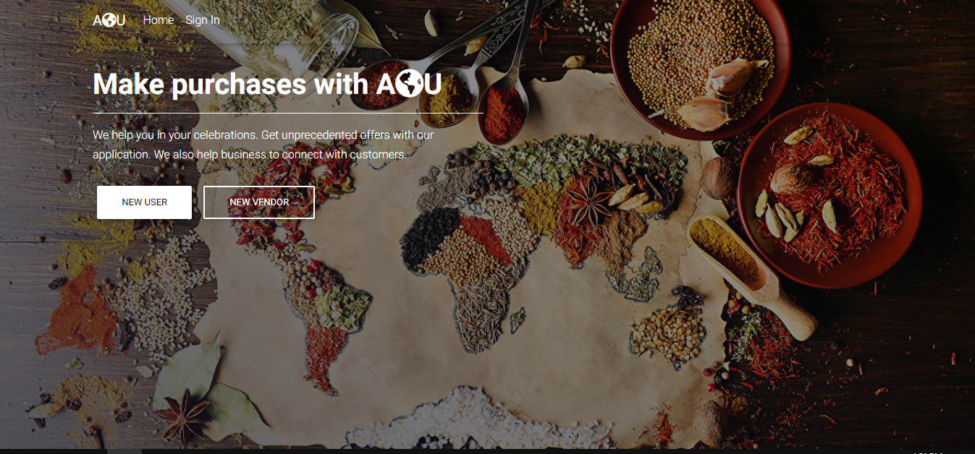
AOU

Slide 2
Overview
The application helps users find the resources around them and receive brokerage help for bulk orders from the participating businesses.
Application focuses on 2 categories and brokerage of Bulk Ordering
1. Restaurants
2. Markets/Grocery stores

Slide 3
Functionality
The User selects a category and radius of search (AOU/ALL) and the application lists down the Category information (i.e., restaurants/market names ) near the user based on his zip code.
If users wish to purchase any quantity in bulk, they may fill a form and submit it (here expected date of the event or deadline can be posted). The admin along with his team can negotiate with the dealer and get back to the customer with an offer.
Only the restaurants/markets registered will be shown to the user. User can choose from which restaurants/markets he wishes to hear from.

Slide 4
Technologies
Components | Technologies Considered | Inclusion
Server Side | J2EE | Yes
Client Side | HTML5, CSS3, JS | Yes
Database | MySQL | Yes
Frameworks | Spring MVC, Hibernate, Spring Security, Bootstrap | Yes
Build Automation | MAVEN | Yes
Version Control | GIT | Yes
JS Frameworks | jQuery,Wow,Font-awesome,Material | Yes
IDE | Spring Tool Suite 3 | Yes

Slide 5
DEMO

Slide 6



