Slide 1
Group Three: Augur Zapier Notification System
Noah Backman, Jeffrey Merkel, Caroline Lewis

Slide 2

What is zapier?
Founded in Columbia, Missouri by Mizzou students
Zapier is an automation tool that lets you create workflows involving common web apps and services like Discord, Gmail, YouTube, etc.
Our project uses Zapier to send notifications to users about Augur

Slide 3




How we did it
First, we created an integration with Zapier that uses our Augur instance’s REST API endpoints to retrieve data
Next, we made an automated task in Zapier which consists of a trigger and an action
The trigger is hitting an Augur API endpoint and the action is sending the endpoint results
Notes:
https://developer.zapier.com/app/150412/version/1.0.0/triggers/top_insights/api
https://oss-augur.readthedocs.io/en/main/rest-api/api.html#operation/Get%20Top%20Insights
http://augur.resumespace.tech/api/unstable/repo-groups/10/top-insights
https://oss-augur.readthedocs.io/en/main/rest-api/api.html#operation/Issue%20Comments%20Mean%20(Repo)

Slide 4
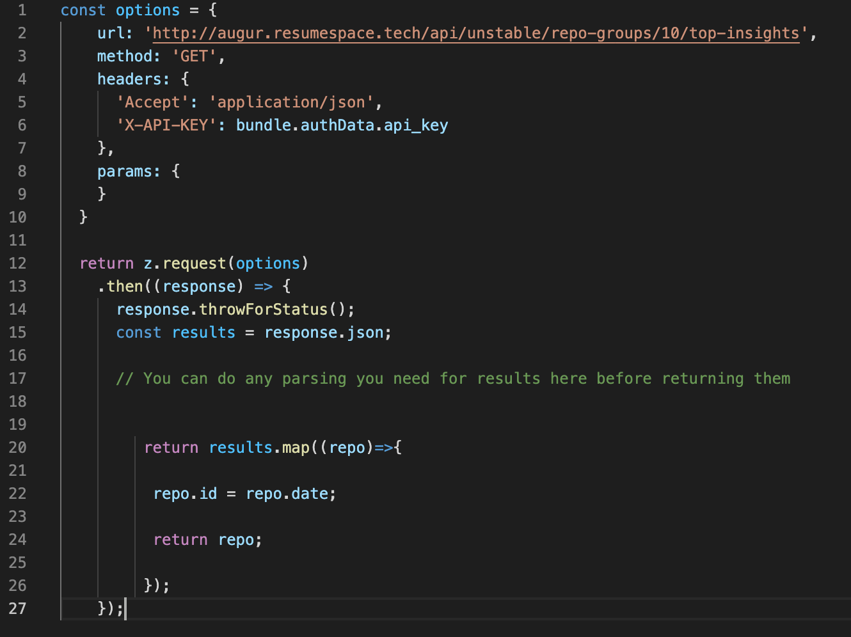
Triggers
The triggers are what "listen" to changes in Augur's API endpoints
If they detect a change, the trigger will be executed, and the action(s) it's linked to will be performed
For this to happen, you need to tell the trigger what kind of data it should expect so it can be properly formatted in the action.

Slide 5
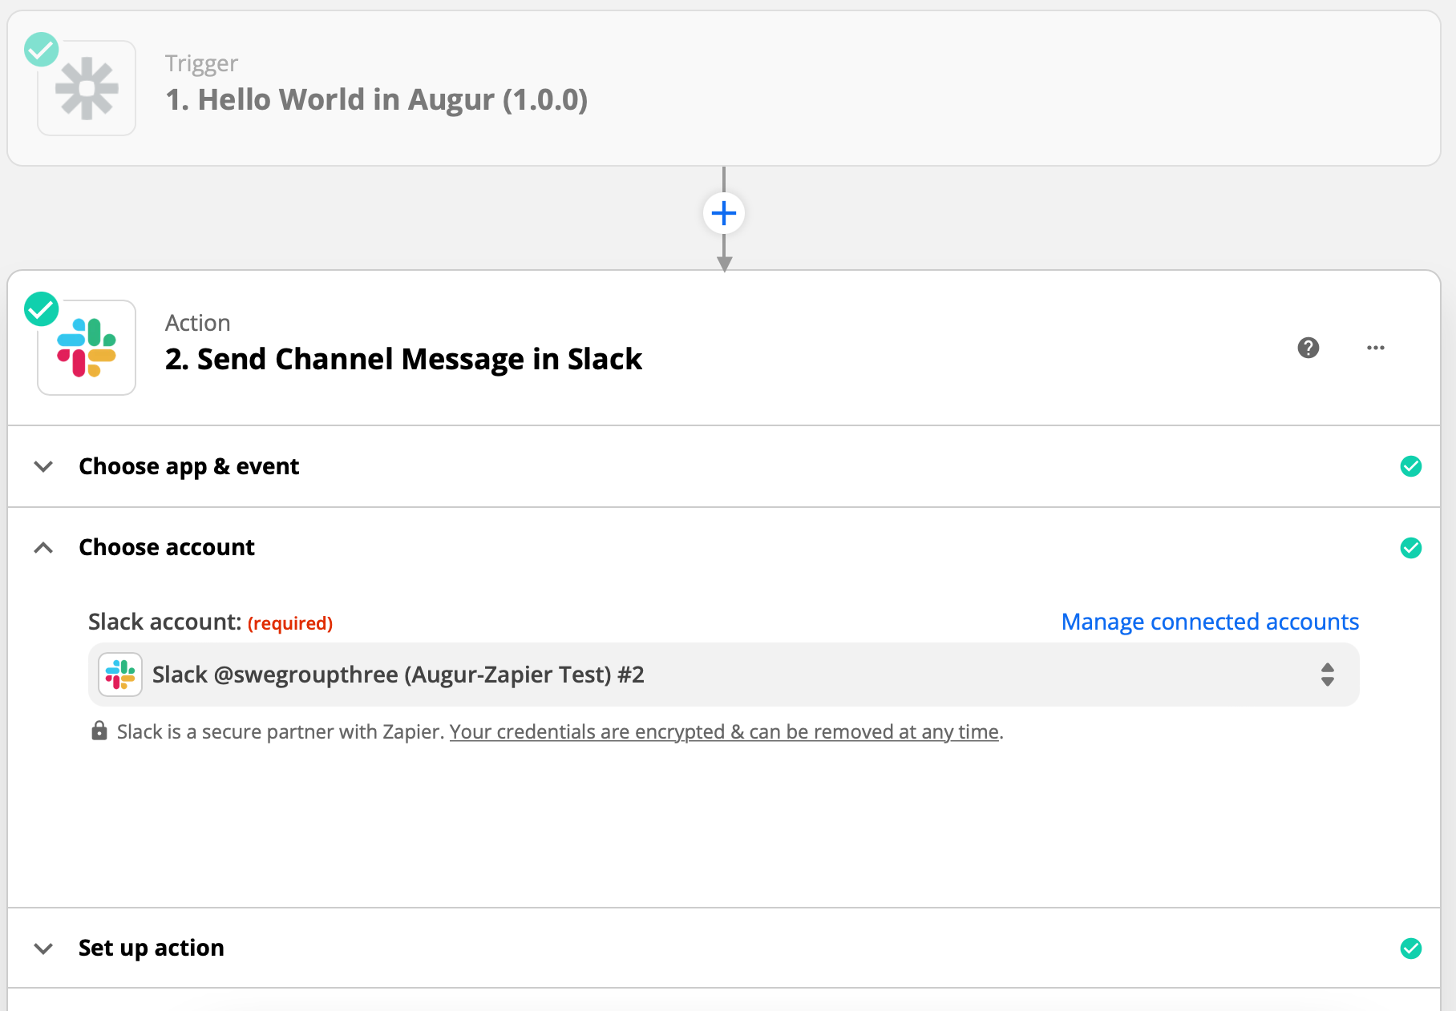
Actions
Provide lots of flexibility
While we used one that posts in a Slack channel, you can use actions that send emails, post in a Discord server, etc.
Simply provide proper authentication and format the data the trigger receives, and it should "just work".

