Slide 1
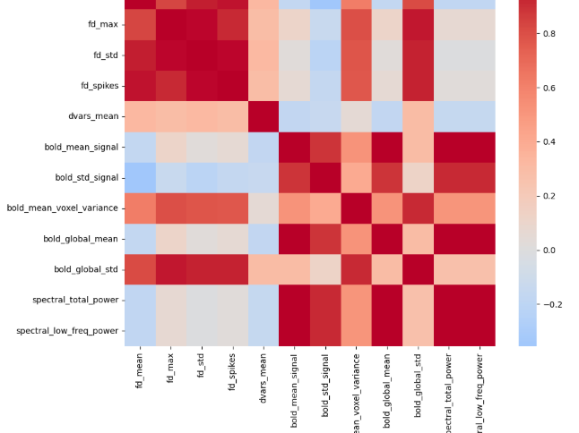
DeepPrep-Based Spectral and Temporal Analysis of BOLD Signal Dynamics in Healthy Adults
Shokhsanam Uktamova, Caroline Lewis, Scott Harris
Results
Problem / Motivation / Research Gap
Implementation
Low FD and DVARS indicate stable, low-motion cohort
Strong ALFF dominance (>99% low-frequency power) confirms expected resting-state physiology
Spectral features are largely independent of motion artifacts
Correlation structure shows clear separation between:
motion metrics cluster
spectral features cluster
Regression confirms no systematic motion-driven inflation of signal variance
Traditional fMRI analysis focuses on spatial activation maps and overlooks temporal + spectral dynamics of BOLD signals
Motion artifacts and preprocessing variability reduce reproducibility in neuroimaging studies
Need for a scalable, reproducible pipeline to extract high-dimensional BOLD features in HPC environments
FABRIC compute environment (Ubuntu, 8-core, 32GB RAM)
Automated DeepPrep execution pipeline
HTML QC reports + workflow validation logs
Post-processing scripts for motion + spectral feature extraction
Correlation + regression analysis of extracted features
Discussion / Conclusions / Future Work
Feature Correlation Matrix
Pipeline successfully separates neural signal from motion-induced noise
Spectral features provide robust representation of resting-state brain activity
FABRIC + DeepPrep enables scalable, reproducible neuroimaging workflows
Future work: apply pipeline to nicotine-dependent cohort and evaluate spectral shifts (ALFF/fALFF)
Extend analysis with ML models for clinical prediction
Methodology
DeepPrep pipeline deployed on FABRIC HPC infrastructure
BIDS-compliant OpenNeuro dataset (healthy adult cohort, n = 9)
Preprocessing: alignment, normalization, and QC
Feature extraction: Framewise Displacement (FD), DVARS, FC matrices, ALFF, spectral power metrics
Containerized workflow (Docker) + Python analysis (Nilearn, NumPy, Pandas)
Team Contributions
Scott Harris – Power analysis, sample size estimation, statistical support, ran 3 subjects in pipeline, co-authored report
Caroline Lewis – Pipeline design, integration of DeepPrep workflow, mock presentation, demo recording, final submission, ran 3 subjects in pipeline
Shokhsanam Uktamova – Wrote 2-Pager proposal, ran 3 subjects in pipeline, co-authored report
Notes:
COLUMN A - Scott
Problem / Motivation / Research Gap
Methodology
COLUMN B - Caroline
Implementation
Feature Correlation Matrix
COLUMN C – Noor
Results
Discussion / Conclusions / Future Work
Team Contributions

