Slide 1

Six Weeks Summer Training
Basic of
Data Science

Slide 2
Content
Leaning Outcomes
What is Data Science?
Excel
Types of Chart and Functions in excel
Fundamental of Python
Libraries
SQL & MYSQL
Statistics for Data Science
Conclusion

Slide 3
Learning Outcomes
Knowledge of Basic Data Science & their implementation
Learned Basic Python language

Slide 4

What is Data Science ?
Data science is the field of study that combines domain expertise, programming skills, and knowledge of mathematics and statistics to extract meaningful insights from data.

Slide 5
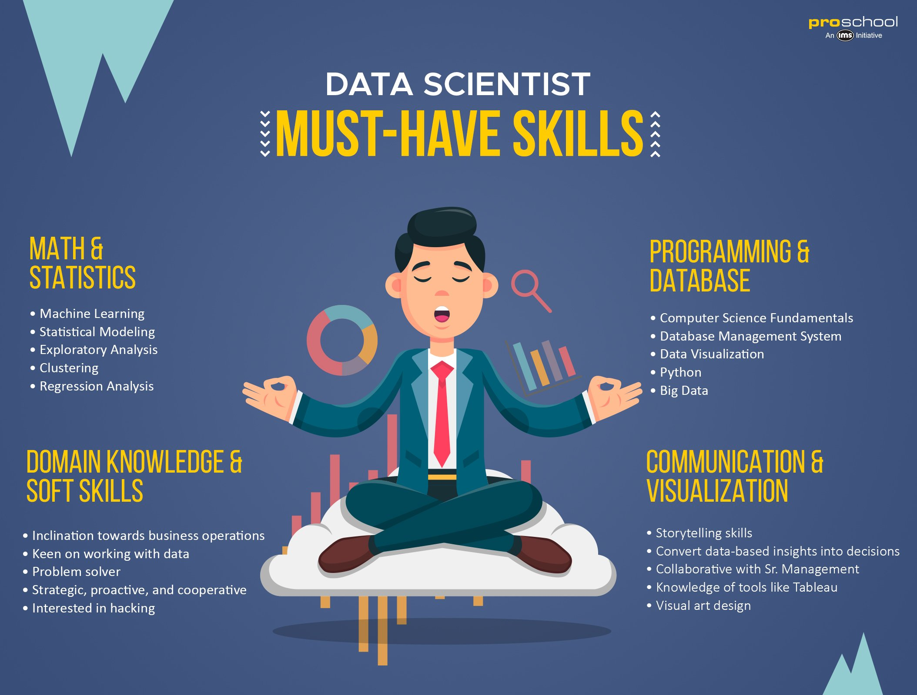

Slide 6


Excel
Excel is a spreadsheet program from Microsoft and a component of its Office product group for business applications.

Slide 7
Types Of Chart & Tables
Excel
Chart
Column
Tables
Simple
Pie
Area
Line
Excel
Pivot
Bars
Surface

Slide 8

Python
Python is a high-level, general-purpose programming language. Its design philosophy emphasizes code readability with the use of significant indentation.

Slide 9
Basic Libraries in Python
NumPy
pandas
SciPy

Slide 10

SQL
SQL is a domain-specific language used in programming and designed for managing data held in a relational database management system, or for stream processing in a relational data stream management system.

Slide 11

MySQL
MySQL is an open-source relational database management system. It is an open-source platform that allows one to store, retrieve and manage relational databases.

Slide 12
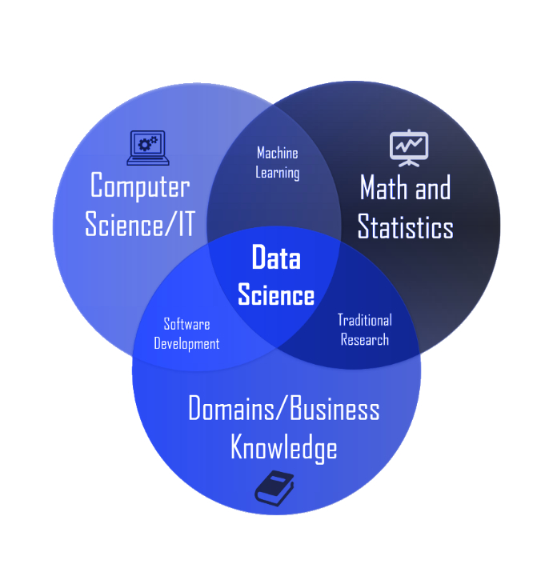
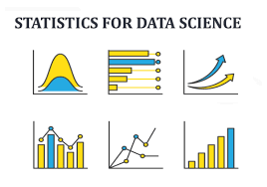
Statistics in Data Science
Statistics is the study of Data Collection, Analysis, Interpretation, Presentation, and organizing in a specific way.
They are: (i) Mean, (ii) Median, and (iii) Mode.

Slide 13
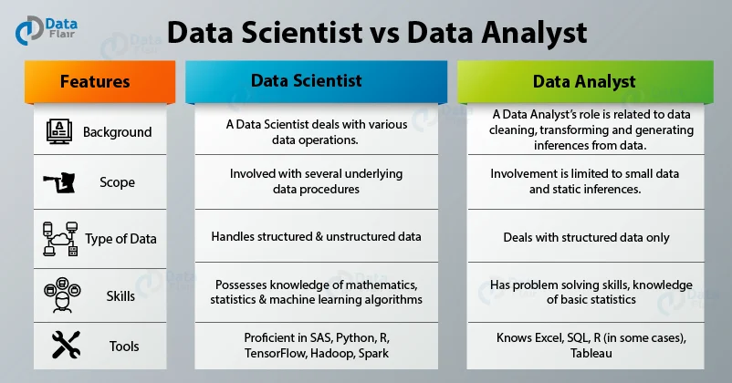
Conclusion
Data science is vital in almost every field. It needs to develop and progress within its systems to handle emerging issues in every industry, business, and organization. The system which solves problems should be advanced enough to provide simple solutions.
This will also have the need for data scientists, data engineers ,and data analysts. Data scientist will even be further high demand.

Slide 14
Thank You….

