Slide 1


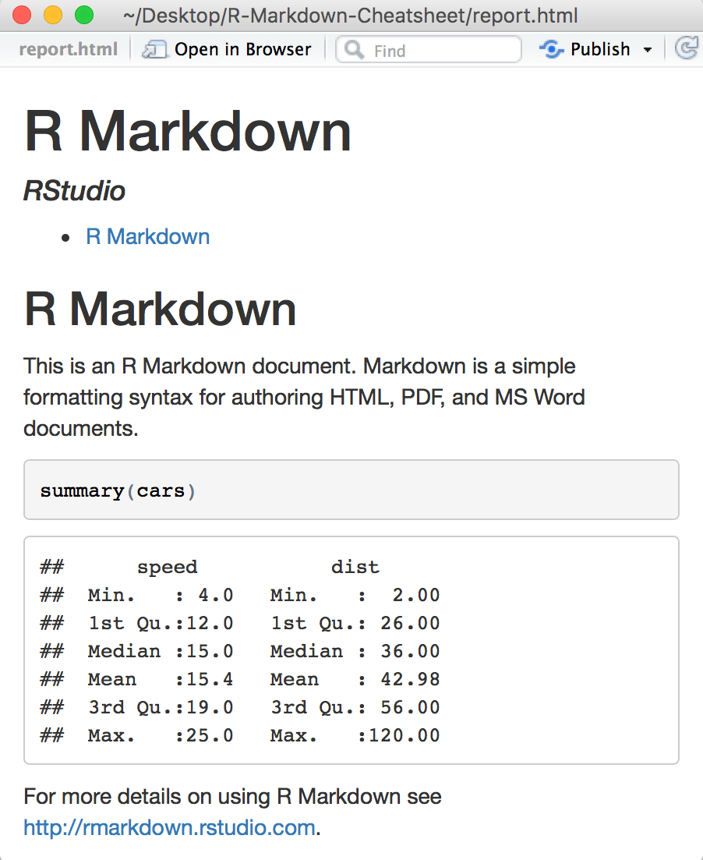

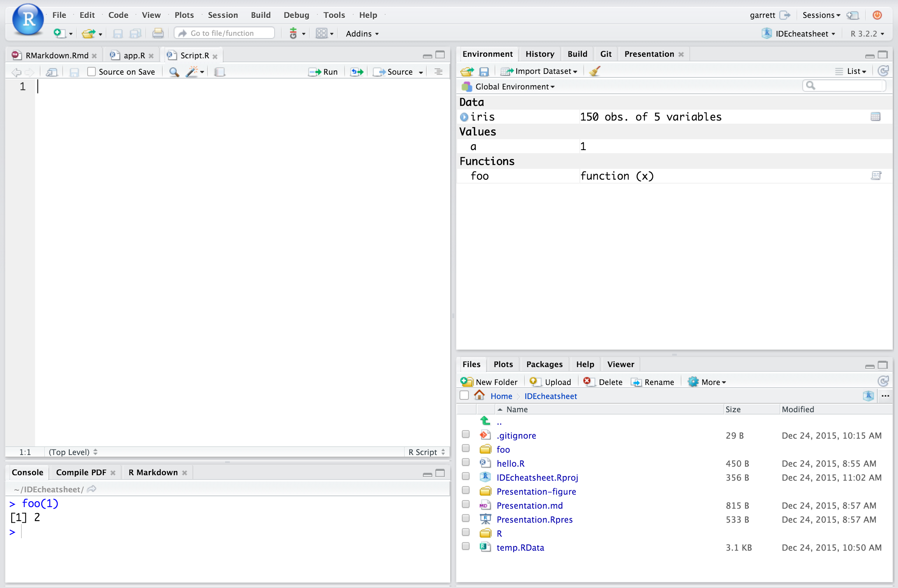
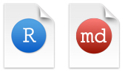
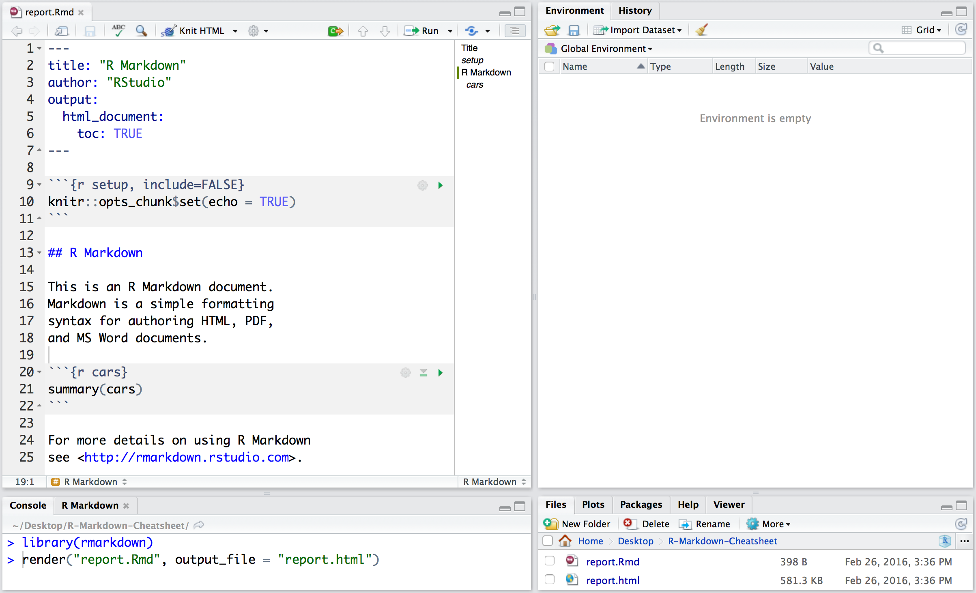

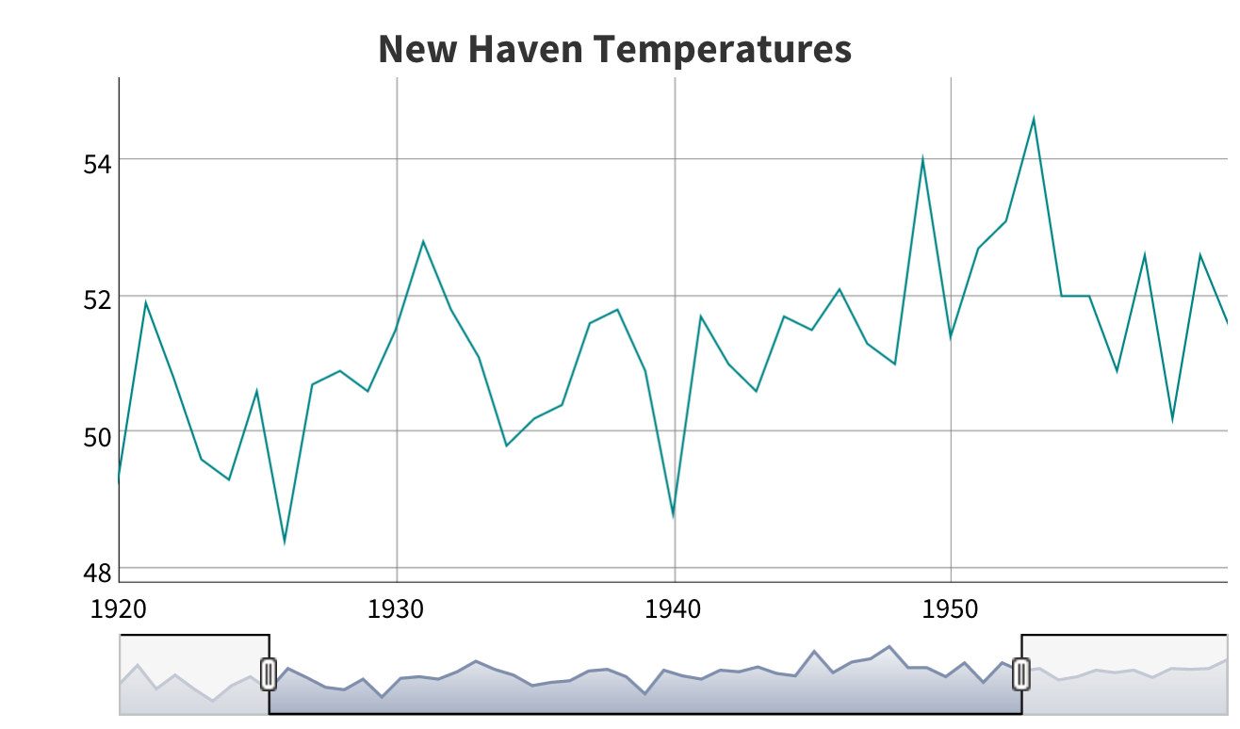
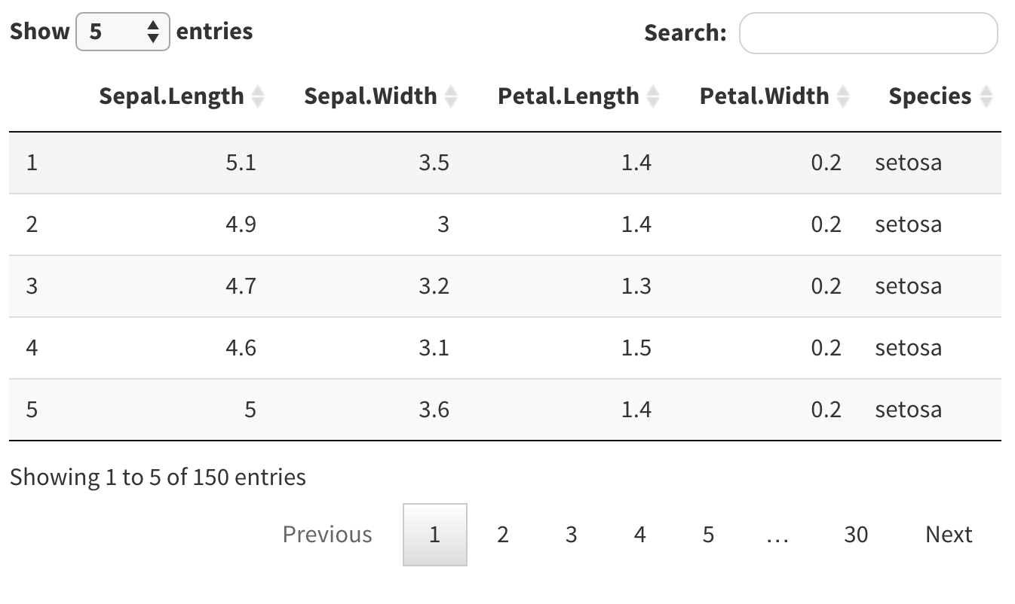
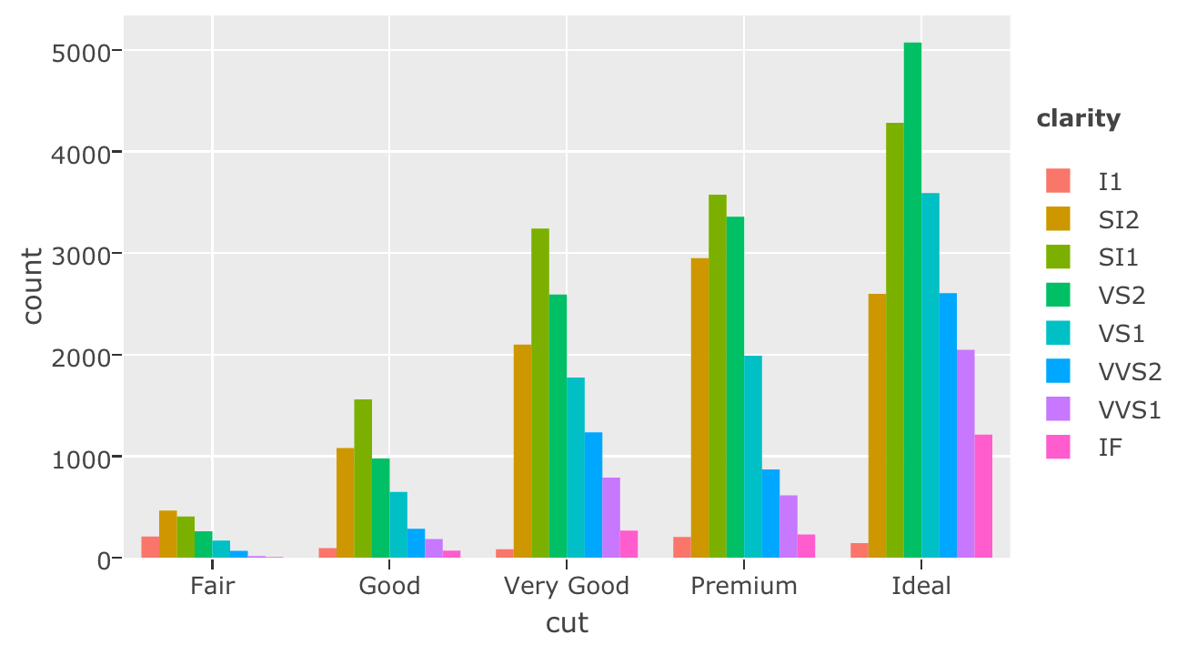






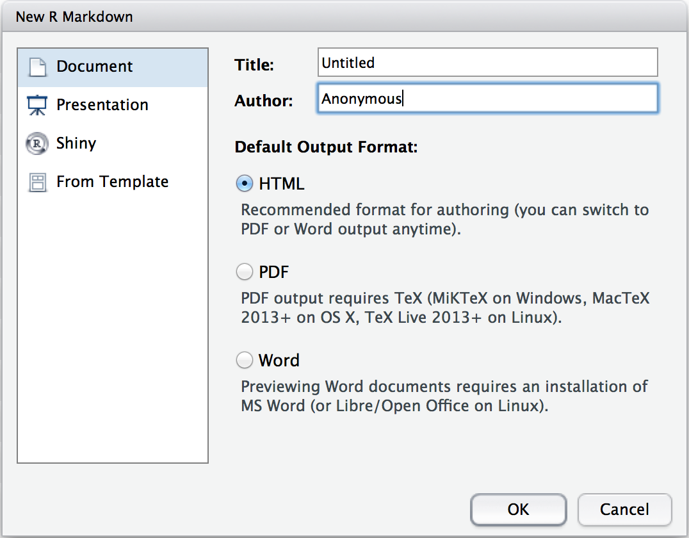
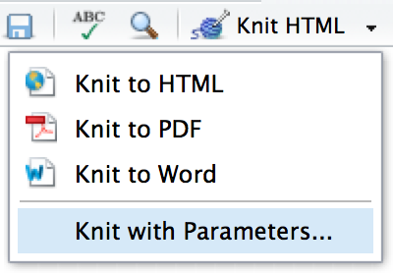

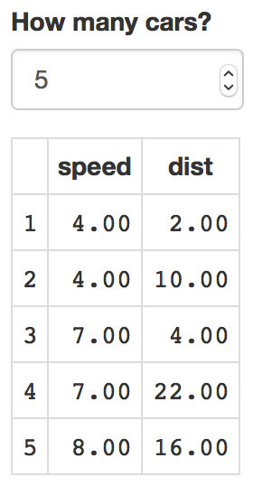
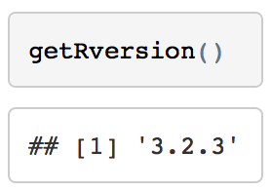


R Markdown : : CHEAT SHEET
File path to output document
5
What is R Markdown?
1
Find in document
synch publish button to accounts at
rpubs.com,
shinyapps.io
RStudio Connect
.rmd Structure
.Rmd files · An R Markdown
(.Rmd) file is a record of your
research. It contains the code that a scientist needs to reproduce your work along with the narration that a reader needs to understand your work.
Reproducible Research · At the click of a button, or the type of a command, you can rerun the code in an R Markdown file to reproduce your work and export the results as a finished report.
Dynamic Documents · You can choose to export the finished report in a variety of formats, including html, pdf, MS Word, or RTF documents; html or pdf based slides, Notebooks, and more.
3
4
YAML Header Optional section of render (e.g. pandoc)
options written as key:value pairs (YAML).
At start of file
Between lines of - - -
Text Narration formatted with markdown, mixed with:
Code Chunks Chunks of embedded code. Each chunk:
Begins with ```{r}
ends with ```
R Markdown will run the code and append the results to the doc.
It will use the location of the .Rmd file as the working directory
Rmd
set preview location
insert code chunk
go to code chunk
run code chunk(s)
2
publish
Reload document
show outline
run all previous chunks
Parameters
Workflow
modify chunk options
run current chunk
Parameterize your documents to reuse with different inputs (e.g., data, values, etc.)
---
params:
n: 100
d: !r Sys.Date()
---
1. Add parameters · Create and set parameters in the header as sub-values of params
2. Call parameters · Call parameter values in code as params$<name>
3. Set parameters · Set values wth Knit with parameters or the params argument of render():
render("doc.Rmd", params = list(n = 1, d = as.Date("2015-01-01"))
6
Today’s date
is `r params$d`
1
Open a new .Rmd file at File ▶︎ New File ▶︎ R Markdown. Use the wizard that opens to pre-populate the file with a template
Write document by editing template
Knit document to create report; use knit button or render() to knit
Preview Output in IDE window
Publish (optional) to web server
Examine build log in R Markdown console
Use output file that is saved along side .Rmd
2
7
3
render
Interactive Documents
4
Use rmarkdown::render() to render/knit at cmd line. Important args:
5
input - file to render
output_format
output_options - List of render options (as in YAML)
output_file
output_dir
params - list of params to use
envir - environment to evaluate code chunks in
encoding - of input file
6
Turn your report into an interactive Shiny document in 4 steps
1. Add runtime: shiny to the YAML header.
2. Call Shiny input functions to embed input objects.
3. Call Shiny render functions to embed reactive output.
4. Render with rmarkdown::run or click Run Document in RStudio IDE
7
Embed code with knitr syntax
INLINE CODE
CODE CHUNKS
GLOBAL OPTIONS
Insert with `r <code>`. Results appear as text without code.
One or more lines surrounded with ```{r} and ```. Place chunk options within curly braces, after r. Insert with
Set with knitr::opts_chunk$set(), e.g.
Built with `r getRversion()` Built with 3.2.3
```{r echo=TRUE}
getRversion()
```
```{r include=FALSE}
knitr::opts_chunk$set(echo = TRUE)
```
---
output: html_document
runtime: shiny
---
```{r, echo = FALSE}
numericInput("n",
"How many cars?", 5)
renderTable({
head(cars, input$n)
})
```
IMPORTANT CHUNK OPTIONS
cache - cache results for future knits (default = FALSE)
cache.path - directory to save cached results in (default = "cache/")
child - file(s) to knit and then include (default = NULL)
collapse - collapse all output into single block (default = FALSE)
comment - prefix for each line of results (default = '##')
dependson - chunk dependencies for caching (default = NULL)
echo - Display code in output document (default = TRUE)
engine - code language used in chunk (default = 'R')
error - Display error messages in doc (TRUE) or stop render when errors occur (FALSE) (default = FALSE)
eval - Run code in chunk (default = TRUE)
fig.align - 'left', 'right', or 'center' (default = 'default')
fig.cap - figure caption as character string (default = NULL)
fig.height, fig.width - Dimensions of plots in inches
highlight - highlight source code (default = TRUE)
include - Include chunk in doc after running (default = TRUE)
message - display code messages in document (default = TRUE)
results (default = 'markup') 'asis' - passthrough results 'hide' - do not display results 'hold' - put all results below all code
tidy - tidy code for display (default = FALSE)
warning - display code warnings in document (default = TRUE)
Options not listed above: R.options, aniopts, autodep, background, cache.comments, cache.lazy, cache.rebuild, cache.vars, dev, dev.args, dpi, engine.opts, engine.path, fig.asp, fig.env, fig.ext, fig.keep, fig.lp, fig.path, fig.pos, fig.process, fig.retina, fig.scap, fig.show, fig.showtext, fig.subcap, interval, out.extra, out.height, out.width, prompt, purl, ref.label, render, size, split, tidy.opts
Embed a complete app into your document with shiny::shinyAppDir()
NOTE: Your report will rendered as a Shiny app, which means you must choose an html output format, like html_document, and serve it with an active R Session.
RStudio® is a trademark of RStudio, Inc. • CC BY RStudio • info@rstudio.com • 844-448-1212 • rstudio.com • Learn more at rmarkdown.rstudio.com • rmarkdown 1.6 • Updated: 2016-02

Slide 2
R Markdown : : CHEAT SHEET
File path to output document
5
Workflow
1
Find in document
synch publish button to accounts at
rpubs.com,
shinyapps.io
RStudio Connect
What is R Markdown?
3
4
.Rmd files · An R Markdown
(.Rmd) file is a record of your
research. It contains the code that a scientist needs to reproduce your work along with the narration that a reader needs to understand your work.
Reproducible Research · At the click of a button, or the type of a command, you can rerun the code in an R Markdown file to reproduce your work and export the results as a finished report.
Dynamic Documents · You can choose to export the finished report in a variety of formats, including html, pdf, MS Word, or RTF documents; html or pdf based slides, Notebooks, and more.
set preview location
insert code chunk
go to code chunk
run code chunk(s)
Rmd
2
publish
Reload document
1
Open a new .Rmd file at File ▶︎ New File ▶︎ R Markdown. Use the wizard that opens to pre-populate the file with a template
Write document by editing template
Knit document to create report; use knit button or render() to knit
Preview Output in IDE window
Publish (optional) to web server
Examine build log in R Markdown console
Use output file that is saved along side .Rmd
show outline
2
3
run all previous chunks
4
Parameters
5
modify chunk options
run current chunk
6
Parameterize your documents to reuse with different inputs (e.g., data, values, etc.)
7
---
params:
n: 100
d: !r Sys.Date()
---
.rmd Structure
1. Add parameters · Create and set parameters in the header as sub-values of params
2. Call parameters · Call parameter values in code as params$<name>
3. Set parameters · Set values wth Knit with parameters or the params argument of render():
render("doc.Rmd", params = list(n = 1, d = as.Date("2015-01-01"))
YAML Header Optional section of render (e.g. pandoc) options written as key:value pairs (YAML).
At start of file
Between lines of - - -
Text Narration formatted with markdown, mixed with:
Code Chunks Chunks of embedded code. Each chunk:
Begins with ```{r}
ends with ```
R Markdown will run the code and append the results to the doc.
It will use the location of the .Rmd file as the working directory
Today’s date
is `r params$d`
6
7
render
Interactive Documents
Use rmarkdown::render() to render/knit at cmd line. Important args:
input - file to render
output_format
output_options - List of render options (as in YAML)
output_file
output_dir
params - list of params to use
envir - environment to evaluate code chunks in
encoding - of input file
Turn your report into an interactive Shiny document in 4 steps
1. Add runtime: shiny to the YAML header.
2. Call Shiny input functions to embed input objects.
3. Call Shiny render functions to embed reactive output.
4. Render with rmarkdown::run or click Run Document in RStudio IDE
Embed code with knitr syntax
INLINE CODE
CODE CHUNKS
GLOBAL OPTIONS
Insert with `r <code>`. Results appear as text without code.
One or more lines surrounded with ```{r} and ```. Place chunk options within curly braces, after r. Insert with
Set with knitr::opts_chunk$set(), e.g.
Built with `r getRversion()` Built with 3.2.3
```{r echo=TRUE}
getRversion()
```
```{r include=FALSE}
knitr::opts_chunk$set(echo = TRUE)
```
---
output: html_document
runtime: shiny
---
```{r, echo = FALSE}
numericInput("n",
"How many cars?", 5)
renderTable({
head(cars, input$n)
})
```
IMPORTANT CHUNK OPTIONS
cache - cache results for future knits (default = FALSE)
cache.path - directory to save cached results in (default = "cache/")
child - file(s) to knit and then include (default = NULL)
collapse - collapse all output into single block (default = FALSE)
comment - prefix for each line of results (default = '##')
dependson - chunk dependencies for caching (default = NULL)
echo - Display code in output document (default = TRUE)
engine - code language used in chunk (default = 'R')
error - Display error messages in doc (TRUE) or stop render when errors occur (FALSE) (default = FALSE)
eval - Run code in chunk (default = TRUE)
fig.align - 'left', 'right', or 'center' (default = 'default')
fig.cap - figure caption as character string (default = NULL)
fig.height, fig.width - Dimensions of plots in inches
highlight - highlight source code (default = TRUE)
include - Include chunk in doc after running (default = TRUE)
message - display code messages in document (default = TRUE)
results (default = 'markup') 'asis' - passthrough results 'hide' - do not display results 'hold' - put all results below all code
tidy - tidy code for display (default = FALSE)
warning - display code warnings in document (default = TRUE)
Options not listed above: R.options, aniopts, autodep, background, cache.comments, cache.lazy, cache.rebuild, cache.vars, dev, dev.args, dpi, engine.opts, engine.path, fig.asp, fig.env, fig.ext, fig.keep, fig.lp, fig.path, fig.pos, fig.process, fig.retina, fig.scap, fig.show, fig.showtext, fig.subcap, interval, out.extra, out.height, out.width, prompt, purl, ref.label, render, size, split, tidy.opts
Embed a complete app into your document with shiny::shinyAppDir()
NOTE: Your report will rendered as a Shiny app, which means you must choose an html output format, like html_document, and serve it with an active R Session.
RStudio® is a trademark of RStudio, Inc. • CC BY RStudio • info@rstudio.com • 844-448-1212 • rstudio.com • Learn more at rmarkdown.rstudio.com • rmarkdown 1.6 • Updated: 2016-02

Slide 3
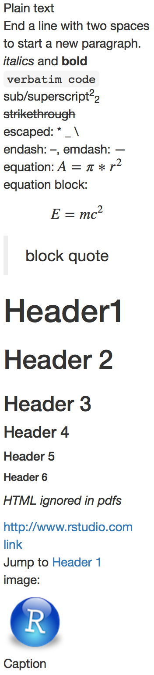

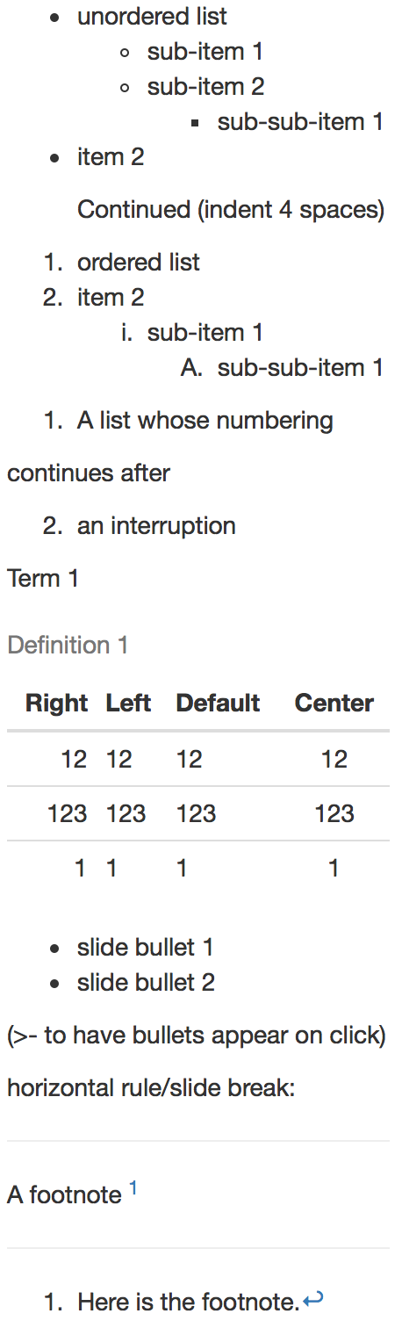
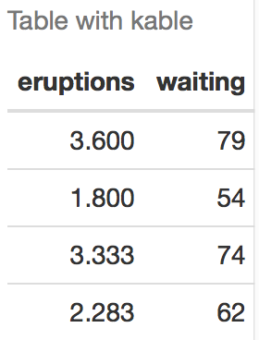
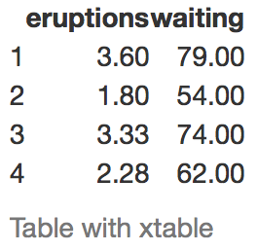
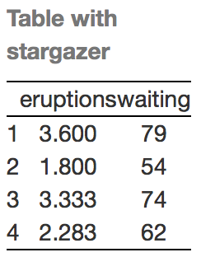
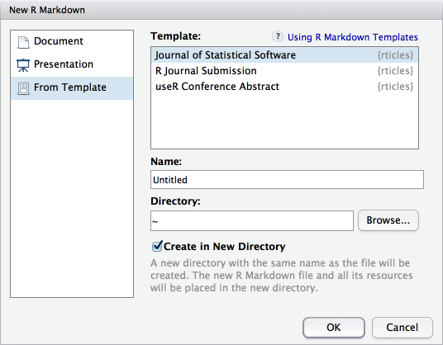
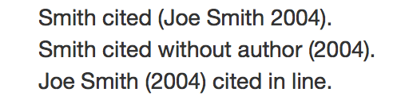
Pandoc’s Markdown
Set render options with YAML
Write with syntax on the left to create effect on right (after render)
When you render, R Markdown
runs the R code, embeds results and text into .md file with knitr
then converts the .md file into the finished format with pandoc
Plain text
End a line with two spaces
to start a new paragraph.
*italics* and **bold**
`verbatim code`
sub/superscript^2^~2~
~~strikethrough~~
escaped: \* \_ \\
endash: --, emdash: ---
equation: $A = \pi*r^{2}$
equation block:
$$E = mc^{2}$$
> block quote
# Header1 {#anchor}
## Header 2 {#css_id}
### Header 3 {.css_class}
#### Header 4
##### Header 5
###### Header 6
<!--Text comment-->
\textbf{Tex ignored in HTML}
<em>HTML ignored in pdfs</em>
<http://www.rstudio.com>
[link](www.rstudio.com)
Jump to [Header 1](#anchor)
image:
![Caption](smallorb.png)
* unordered list
+ sub-item 1
+ sub-item 2
- sub-sub-item 1
* item 2
Continued (indent 4 spaces)
1. ordered list
2. item 2
i) sub-item 1
A. sub-sub-item 1
(@) A list whose numbering
continues after
(@) an interruption
Term 1
: Definition 1
| Right | Left | Default | Center |
|------:|:-----|---------|:------:|
| 12 | 12 | 12 | 12 |
| 123 | 123 | 123 | 123 |
| 1 | 1 | 1 | 1 |
- slide bullet 1
- slide bullet 2
(>- to have bullets appear on click)
horizontal rule/slide break:
***
A footnote [^1]
[^1]: Here is the footnote.
ioslides
beamer
html
pdf
word
odt
gituhb
slidy
rtf
md
sub-option | description
citation_package | The LaTeX package to process citations, natbib, biblatex or none |  | X |  |  |  | X |  |  |  | X
code_folding | Let readers to toggle the display of R code, "none", "hide", or "show" | X
colortheme | Beamer color theme to use |  |  |  |  |  |  |  |  |  | X
css | CSS file to use to style document | X |  |  |  |  |  |  | X | X
dev | Graphics device to use for figure output (e.g. "png") | X | X |  |  |  | X | X | X | X | X
duration | Add a countdown timer (in minutes) to footer of slides |  |  |  |  |  |  |  |  | X
fig_caption | Should figures be rendered with captions? | X | X | X | X |  |  |  | X | X | X
fig_height, fig_width | Default figure height and width (in inches) for document | X | X | X | X | X | X | X | X | X | X
highlight | Syntax highlighting: "tango", "pygments", "kate","zenburn", "textmate" | X | X | X |  |  |  |  |  | X | X
includes | File of content to place in document (in_header, before_body, after_body) | X | X |  | X |  | X | X | X | X | X
incremental | Should bullets appear one at a time (on presenter mouse clicks)? |  |  |  |  |  |  |  | X | X | X
keep_md | Save a copy of .md file that contains knitr output | X |  | X | X | X |  |  | X | X
keep_tex | Save a copy of .tex file that contains knitr output |  | X |  |  |  |  |  |  |  | X
latex_engine | Engine to render latex, "pdflatex", "xelatex", or "lualatex" |  | X |  |  |  |  |  |  |  | X
lib_dir | Directory of dependency files to use (Bootstrap, MathJax, etc.) | X |  |  |  |  |  |  | X | X
mathjax | Set to local or a URL to use a local/URL version of MathJax to render equations | X |  |  |  |  |  |  | X | X
md_extensions | Markdown extensions to add to default definition or R Markdown | X | X | X | X | X | X | X | X | X | X
number_sections | Add section numbering to headers | X | X
pandoc_args | Additional arguments to pass to Pandoc | X | X | X | X | X | X | X | X | X | X
preserve_yaml | Preserve YAML front matter in final document? |  |  |  |  |  | X
reference_docx | docx file whose styles should be copied when producing docx output |  |  | X
self_contained | Embed dependencies into the doc | X |  |  |  |  |  |  | X | X
slide_level | The lowest heading level that defines individual slides |  |  |  |  |  |  |  |  |  | X
smaller | Use the smaller font size in the presentation? |  |  |  |  |  |  |  | X
smart | Convert straight quotes to curly, dashes to em-dashes, … to ellipses, etc. | X |  |  |  |  |  |  | X | X
template | Pandoc template to use when rendering file quarterly_report.html). | X | X |  | X |  |  |  |  | X | X
theme | Bootswatch or Beamer theme to use for page | X |  |  |  |  |  |  |  |  | X
toc | Add a table of contents at start of document | X | X | X |  | X | X | X |  |  | X
toc_depth | The lowest level of headings to add to table of contents | X | X | X |  | X | X | X
toc_float | Float the table of contents to the left of the main content | X
Set a document’s default output format in the YAML header:
---
output: html_document
---
# Body
output value | creates
html_document | html
pdf_document | pdf (requires Tex )
word_document | Microsoft Word (.docx)
odt_document | OpenDocument Text
rtf_document | Rich Text Format
md_document | Markdown
github_document | Github compatible markdown
ioslides_presentation | ioslides HTML slides
slidy_presentation | slidy HTML slides
beamer_presentation | Beamer pdf slides (requires Tex)
Indent 2 spaces
Indent 4 spaces
Customize output with sub-options (listed to the right):
---
output: html_document:
code_folding: hide
toc_float: TRUE
---
# Body
html tabsets
Use tablet css class to place sub-headers into tabs
# Tabset {.tabset .tabset-fade .tabset-pills}
## Tab 1
text 1
## Tab 2
text 2
### End tabset
Tabset
text 1
End tabset
Tab 1
Tab 2
Create a Reusable Template
Table Suggestions
Citations and Bibliographies
1. Create a new package with a inst/rmarkdown/templates directory
2. In the directory, Place a folder that contains: template.yaml (see below) skeleton.Rmd (contents of the template) any supporting files
3. Install the package
4. Access template in wizard at File ▶︎ New File ▶︎ R Markdown
template.yaml
Several functions format R data into tables
Create citations with .bib, .bibtex, .copac, .enl, .json,
.medline, .mods, .ris, .wos, and .xml files
Set bibliography file and CSL 1.0 Style file (optional) in the YAML header
2. Use citation keys in text
3. Render. Bibliography will be added to end of document
---
bibliography: refs.bib
csl: style.csl
---
data <- faithful[1:4, ]
Smith cited [@smith04].
Smith cited without author [-@smith04].
@smith04 cited in line.
---
name: My Template
—
```{r results = 'asis'}
knitr::kable(data, caption = "Table with kable”)
```
```{r results = "asis"}
print(xtable::xtable(data, caption = "Table with xtable”),
type = "html", html.table.attributes = "border=0"))
```
```{r results = "asis"}
stargazer::stargazer(data, type = "html", title = "Table
with stargazer")
```
Learn more in the stargazer, xtable, and knitr packages.
RStudio® is a trademark of RStudio, Inc. • CC BY RStudio • info@rstudio.com • 844-448-1212 • rstudio.com • Learn more at rmarkdown.rstudio.com • rmarkdown 1.6 • Updated: 2016-02

Slide 4
Pandoc’s Markdown
Set render options with YAML
Write with syntax on the left to create effect on right (after render)
When you render, R Markdown
runs the R code, embeds results and text into .md file with knitr
then converts the .md file into the finished format with pandoc
Plain text
End a line with two spaces
to start a new paragraph.
*italics* and **bold**
`verbatim code`
sub/superscript^2^~2~
~~strikethrough~~
escaped: \* \_ \\
endash: --, emdash: ---
equation: $A = \pi*r^{2}$
equation block:
$$E = mc^{2}$$
> block quote
# Header1 {#anchor}
## Header 2 {#css_id}
### Header 3 {.css_class}
#### Header 4
##### Header 5
###### Header 6
<!--Text comment-->
\textbf{Tex ignored in HTML}
<em>HTML ignored in pdfs</em>
<http://www.rstudio.com>
[link](www.rstudio.com)
Jump to [Header 1](#anchor)
image:
![Caption](smallorb.png)
* unordered list
+ sub-item 1
+ sub-item 2
- sub-sub-item 1
* item 2
Continued (indent 4 spaces)
1. ordered list
2. item 2
i) sub-item 1
A. sub-sub-item 1
(@) A list whose numbering
continues after
(@) an interruption
Term 1
: Definition 1
| Right | Left | Default | Center |
|------:|:-----|---------|:------:|
| 12 | 12 | 12 | 12 |
| 123 | 123 | 123 | 123 |
| 1 | 1 | 1 | 1 |
- slide bullet 1
- slide bullet 2
(>- to have bullets appear on click)
horizontal rule/slide break:
***
A footnote [^1]
[^1]: Here is the footnote.
ioslides
beamer
html
pdf
word
odt
gituhb
slidy
rtf
md
sub-option | description
citation_package | The LaTeX package to process citations, natbib, biblatex or none |  | X |  |  |  | X |  |  |  | X
code_folding | Let readers to toggle the display of R code, "none", "hide", or "show" | X
colortheme | Beamer color theme to use |  |  |  |  |  |  |  |  |  | X
css | CSS file to use to style document | X |  |  |  |  |  |  | X | X
dev | Graphics device to use for figure output (e.g. "png") | X | X |  |  |  | X | X | X | X | X
duration | Add a countdown timer (in minutes) to footer of slides |  |  |  |  |  |  |  |  | X
fig_caption | Should figures be rendered with captions? | X | X | X | X |  |  |  | X | X | X
fig_height, fig_width | Default figure height and width (in inches) for document | X | X | X | X | X | X | X | X | X | X
highlight | Syntax highlighting: "tango", "pygments", "kate","zenburn", "textmate" | X | X | X |  |  |  |  |  | X | X
includes | File of content to place in document (in_header, before_body, after_body) | X | X |  | X |  | X | X | X | X | X
incremental | Should bullets appear one at a time (on presenter mouse clicks)? |  |  |  |  |  |  |  | X | X | X
keep_md | Save a copy of .md file that contains knitr output | X |  | X | X | X |  |  | X | X
keep_tex | Save a copy of .tex file that contains knitr output |  | X |  |  |  |  |  |  |  | X
latex_engine | Engine to render latex, "pdflatex", "xelatex", or "lualatex" |  | X |  |  |  |  |  |  |  | X
lib_dir | Directory of dependency files to use (Bootstrap, MathJax, etc.) | X |  |  |  |  |  |  | X | X
mathjax | Set to local or a URL to use a local/URL version of MathJax to render equations | X |  |  |  |  |  |  | X | X
md_extensions | Markdown extensions to add to default definition or R Markdown | X | X | X | X | X | X | X | X | X | X
number_sections | Add section numbering to headers | X | X
pandoc_args | Additional arguments to pass to Pandoc | X | X | X | X | X | X | X | X | X | X
preserve_yaml | Preserve YAML front matter in final document? |  |  |  |  |  | X
reference_docx | docx file whose styles should be copied when producing docx output |  |  | X
self_contained | Embed dependencies into the doc | X |  |  |  |  |  |  | X | X
slide_level | The lowest heading level that defines individual slides |  |  |  |  |  |  |  |  |  | X
smaller | Use the smaller font size in the presentation? |  |  |  |  |  |  |  | X
smart | Convert straight quotes to curly, dashes to em-dashes, … to ellipses, etc. | X |  |  |  |  |  |  | X | X
template | Pandoc template to use when rendering file quarterly_report.html). | X | X |  | X |  |  |  |  | X | X
theme | Bootswatch or Beamer theme to use for page | X |  |  |  |  |  |  |  |  | X
toc | Add a table of contents at start of document | X | X | X |  | X | X | X |  |  | X
toc_depth | The lowest level of headings to add to table of contents | X | X | X |  | X | X | X
toc_float | Float the table of contents to the left of the main content | X
Set a document’s default output format in the YAML header:
---
output: html_document
---
# Body
output value | creates
html_document | html
pdf_document | pdf (requires Tex )
word_document | Microsoft Word (.docx)
odt_document | OpenDocument Text
rtf_document | Rich Text Format
md_document | Markdown
github_document | Github compatible markdown
ioslides_presentation | ioslides HTML slides
slidy_presentation | slidy HTML slides
beamer_presentation | Beamer pdf slides (requires Tex)
Indent 2 spaces
Indent 4 spaces
Customize output with sub-options (listed to the right):
---
output:
html_document:
code_folding: hide
toc_float: TRUE
---
# Body
html tabsets
Use tablet css class to place sub-headers into tabs
# Tabset {.tabset .tabset-fade .tabset-pills}
## Tab 1
text 1
## Tab 2
text 2
### End tabset
Tabset
text 1
End tabset
Tab 1
Tab 2
Create a Reusable Template
Table Suggestions
Citations and Bibliographies
1. Create a new package with a inst/rmarkdown/templates directory
2. In the directory, Place a folder that contains: template.yaml (see below) skeleton.Rmd (contents of the template) any supporting files
3. Install the package
4. Access template in wizard at File ▶︎ New File ▶︎ R Markdown
template.yaml
Several functions format R data into tables
Create citations with .bib, .bibtex, .copac, .enl, .json,
.medline, .mods, .ris, .wos, and .xml files
Set bibliography file and CSL 1.0 Style file (optional) in the YAML header
2. Use citation keys in text
3. Render. Bibliography will be added to end of document
---
bibliography: refs.bib
csl: style.csl
---
data <- faithful[1:4, ]
Smith cited [@smith04].
Smith cited without author [-@smith04].
@smith04 cited in line.
---
name: My Template
—
```{r results = 'asis'}
knitr::kable(data, caption = "Table with kable”)
```
```{r results = "asis"}
print(xtable::xtable(data, caption = "Table with xtable”),
type = "html", html.table.attributes = "border=0"))
```
```{r results = "asis"}
stargazer::stargazer(data, type = "html", title = "Table
with stargazer")
```
Learn more in the stargazer, xtable, and knitr packages.
RStudio® is a trademark of RStudio, Inc. • CC BY RStudio • info@rstudio.com • 844-448-1212 • rstudio.com • Learn more at rmarkdown.rstudio.com • rmarkdown 1.6 • Updated: 2016-02

