Slide 1





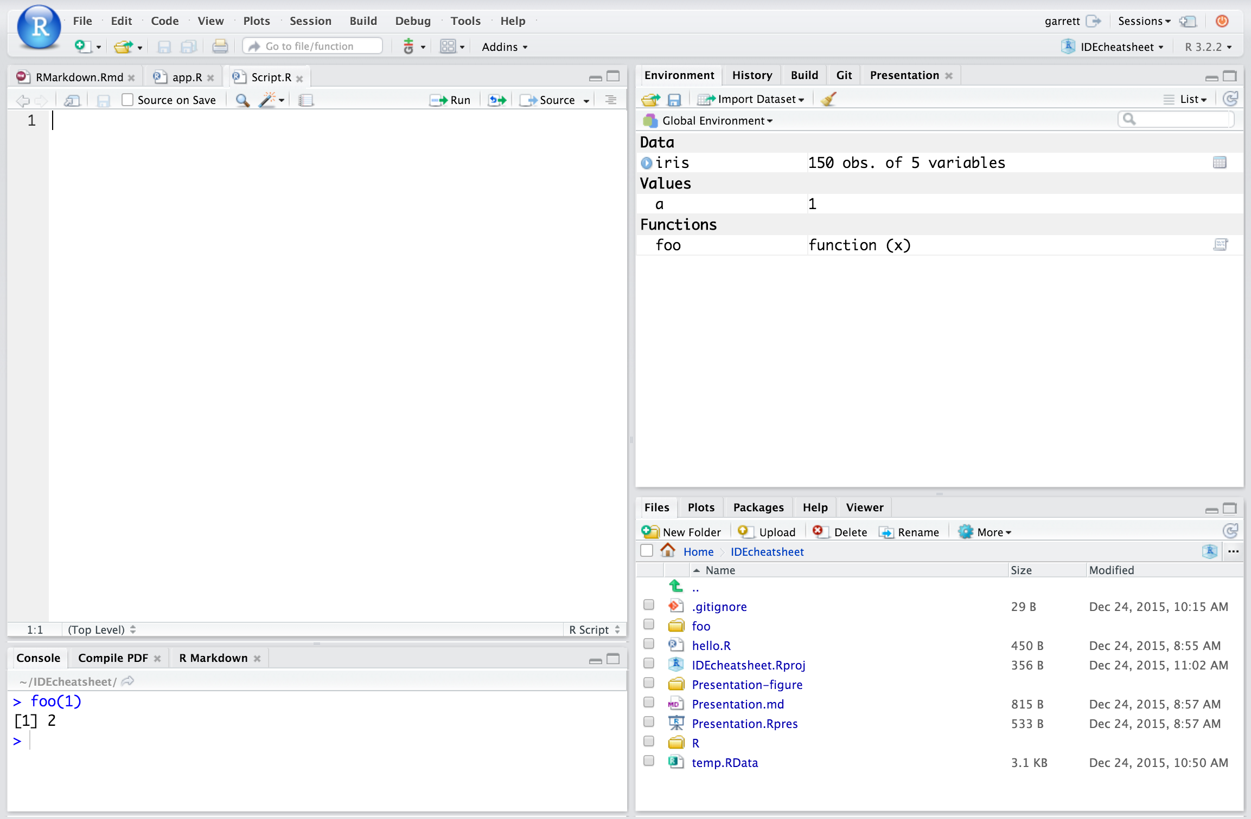
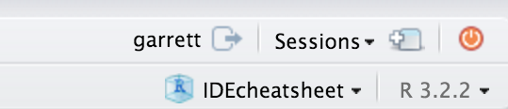
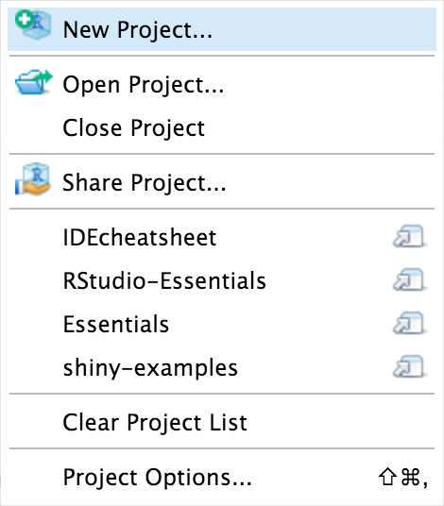
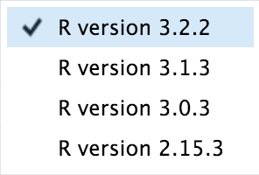
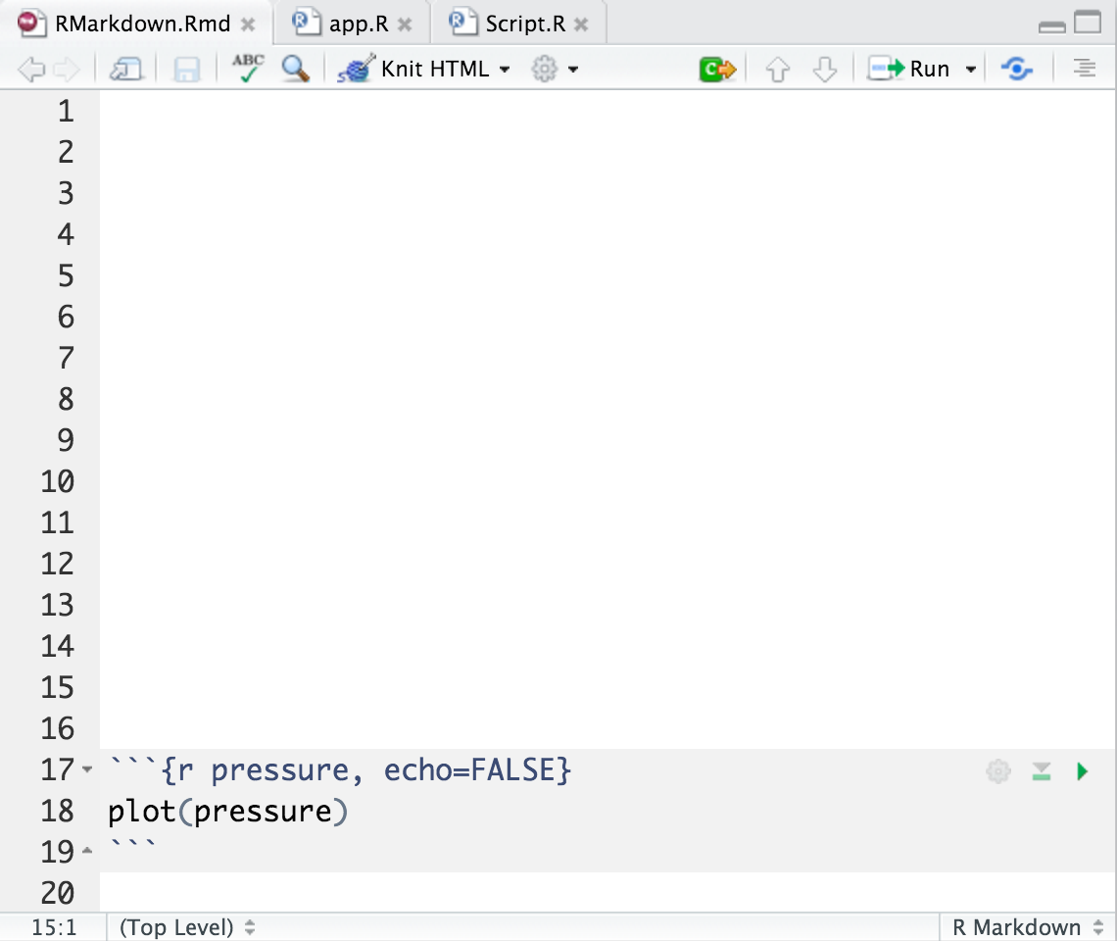
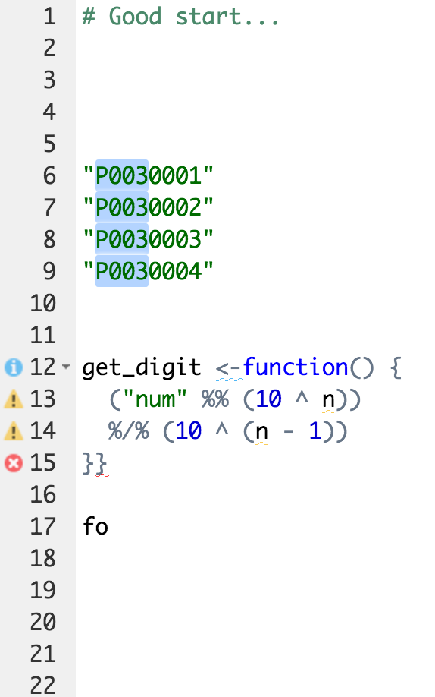

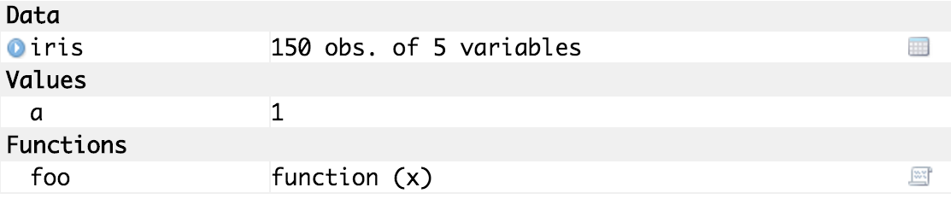
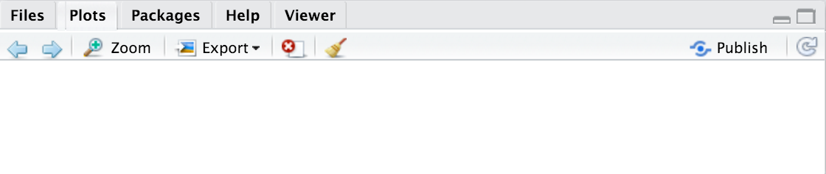
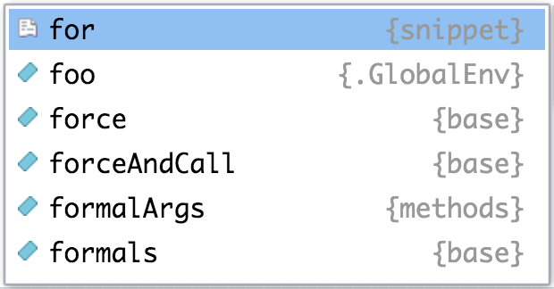
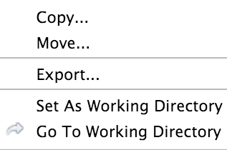
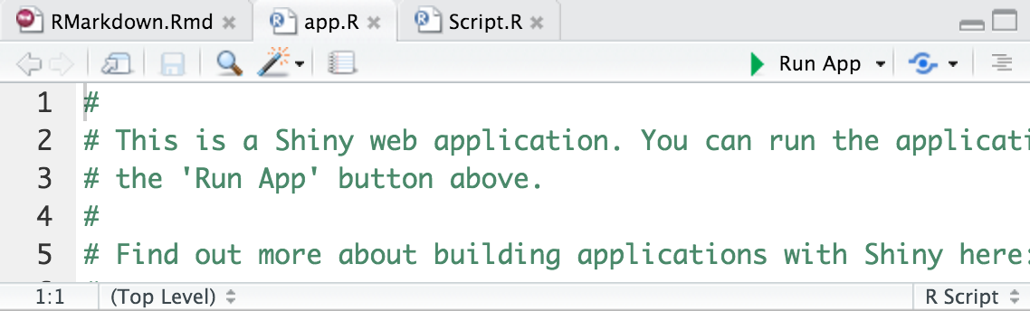
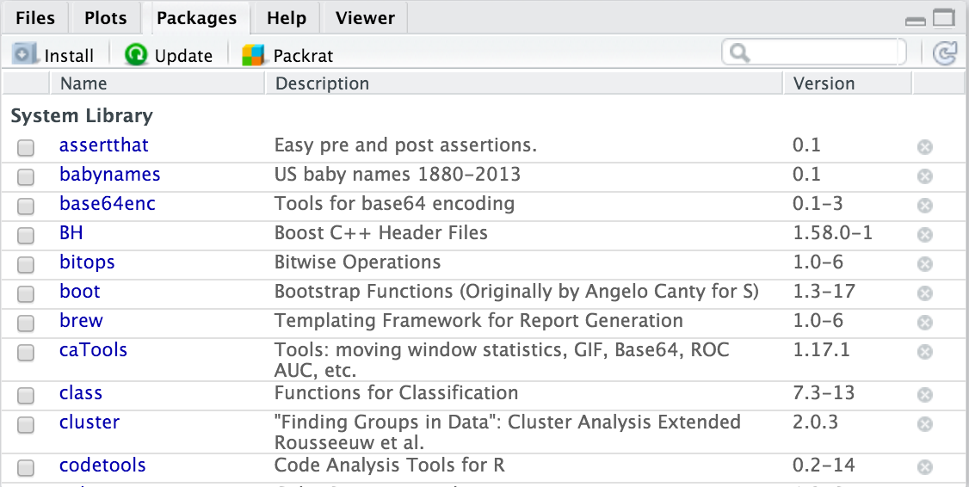
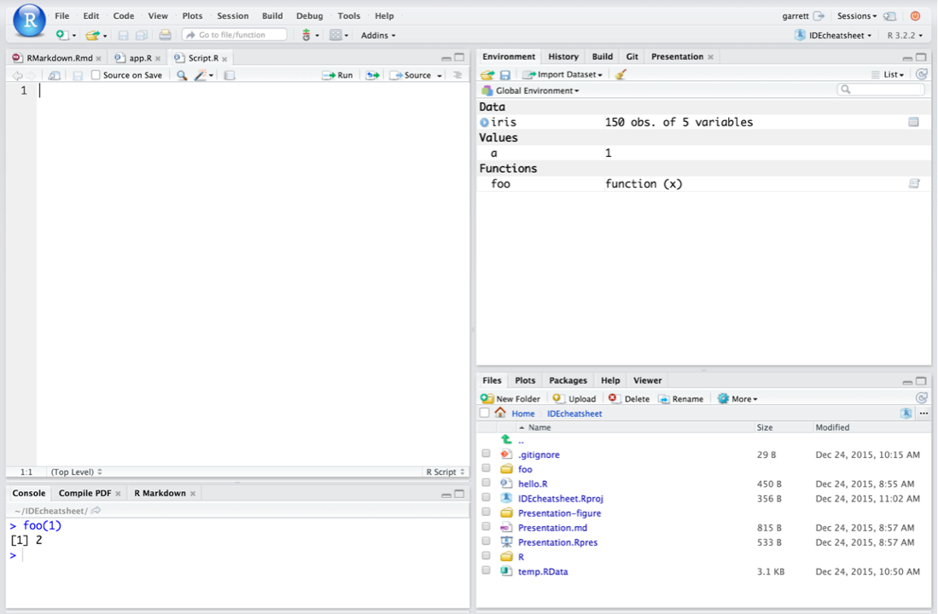

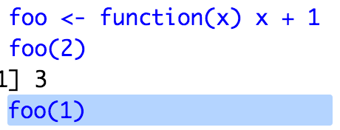

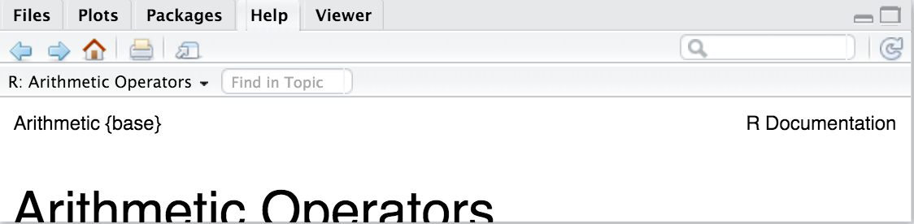
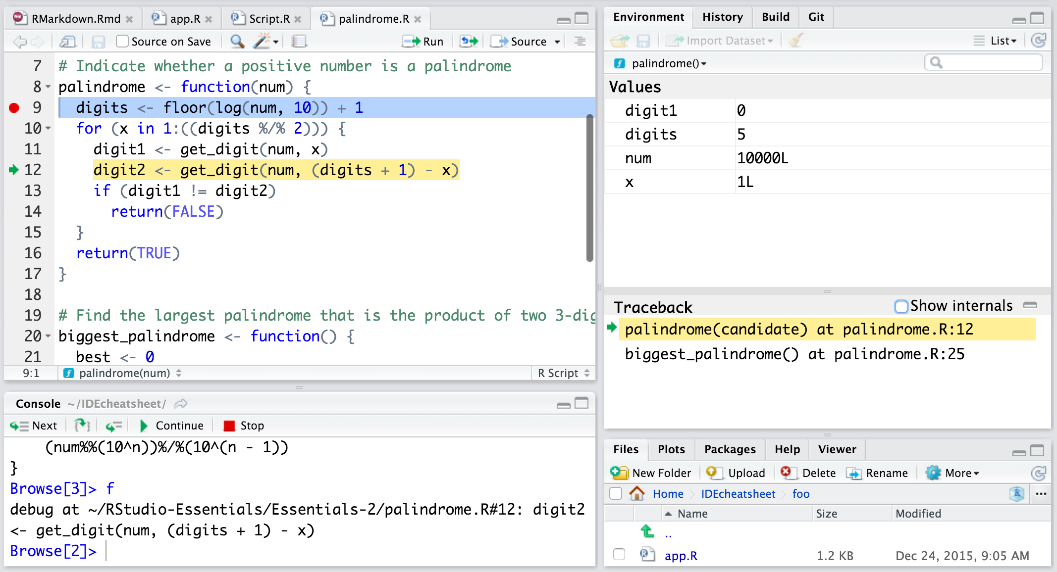
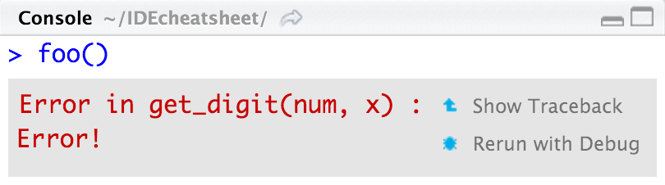
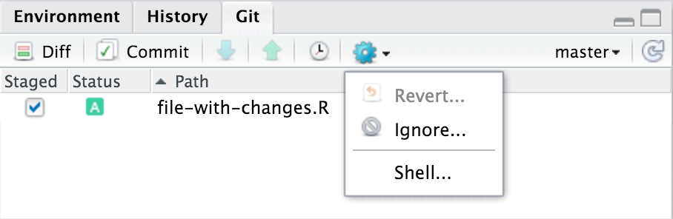
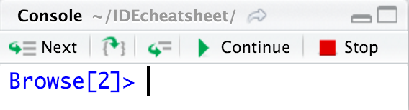
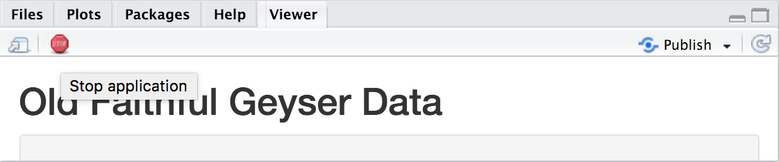
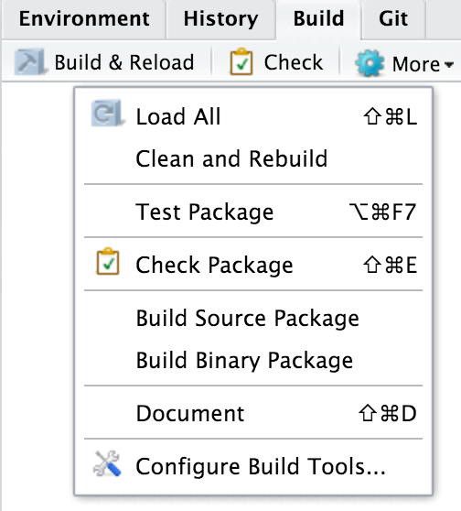
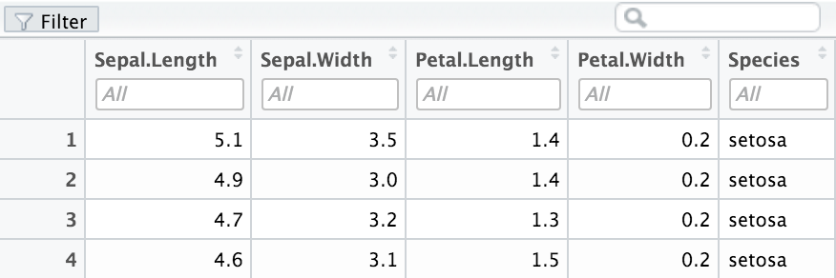

RStudio IDE : : CHEAT SHEET
Documents and Apps
Write Code
R Support
Pro Features
Open Shiny, R Markdown, knitr, Sweave, LaTeX, .Rd files and more in Source Pane
Navigate tabs
Open in new window
Save
Find and replace
Compile as notebook
Run selected code
Import data with wizard
History of past commands to run/copy
Display .RPres slideshows
File > New File >
R Presentation
Share Project with Collaborators
Active shared collaborators
Start new R Session in current project
Check spelling
Render output
Choose output format
Choose output location
Insert code chunk
T
H
J
T
H
J
Close R Session in project
Cursors of shared users
Re-run previous code
Source with or without Echo
Show file outline
Load workspace
Save workspace
Delete all saved objects
Search inside environment
Select
R Version
Jump to previous chunk
Jump to next chunk
Run selected lines
Publish to server
Show file outline
Multiple cursors/column selection with Alt + mouse drag.
Choose environment to display from list of parent environments
Display objects as list or grid
PROJECT SYSTEM
File > New Project
Access markdown guide at
Help > Markdown Quick Reference
Code diagnostics that appear in the margin. Hover over diagnostic symbols for details.
RStudio saves the call history, workspace, and working directory associated with a project. It reloads each when you re-open a project.
Jump to chunk
Set knitr chunk options
Run this and all previous code chunks
Run this code chunk
Syntax highlighting based on your file's extension
Name of current project
Tab completion to finish function names, file paths, arguments, and more.
Displays saved objects by type with short description
View in data viewer
View function source code
RStudio opens plots in a dedicated Plots pane
Multi-language code snippets to quickly use common blocks of code.
Navigate recent plots
Open in window
Export plot
Delete plot
Delete all plots
RStudio recognizes that files named app.R, server.R, ui.R, and global.R belong to a shiny app
Jump to function in file
Change file type
GUI Package manager lists every installed package
Create folder
Upload file
Delete file
Rename file
Change directory
Run app
Choose location to view app
Publish to shinyapps.io or server
Manage publish accounts
Working Directory
Maximize, minimize panes
Path to displayed directory
Install Packages
Update Packages
Create reproducible package library for your project
Press  to see command history
Drag pane boundaries
A File browser keyed to your working directory. Click on file or directory name to open.
Click to load package with library(). Unclick to detach package with detach()
Package version installed
Delete from library
Debug Mode
Version Control with Git or SVN
Launch debugger mode from origin of error
Open traceback to examine the functions that R called before the error occurred
Turn on at Tools > Project Options > Git/SVN
RStudio opens documentation in a dedicated Help pane
Open with debug(), browse(), or a breakpoint. RStudio will open the debugger mode when it encounters a breakpoint while executing code.
Stage files:
Show file diff
Commit staged files
Push/Pull to remote
View History
Click next to line number to add/remove a breakpoint.
Added
Deleted
Modified
Renamed
Untracked
Home page of helpful links
Search within help file
Search for help file
A
D
Viewer Pane displays HTML content, such as Shiny apps, RMarkdown reports, and interactive visualizations
M
Open shell to type commands
current branch
R
Highlighted line shows where execution has paused
?
Package Writing
Stop Shiny app
Publish to shinyapps.io, rpubs, RSConnect, …
Refresh
File > New Project >
New Directory > R Package
View(<data>) opens spreadsheet like view of data set
Run commands in environment where execution has paused
Examine variables in executing environment
Select function in traceback to debug
Step through code one line at a time
Step into and out of functions to run
Resume execution
Quit debug mode
Turn project into package,
Enable roxygen documentation with
Tools > Project Options > Build Tools
Roxygen guide at
Help > Roxygen Quick Reference
Filter rows by value or value range
Sort by values
Search for value
RStudio® is a trademark of RStudio, Inc. • CC BY RStudio • info@rstudio.com • 844-448-1212 • rstudio.com • Learn more at www.rstudio.com • RStudio IDE 0.99.832 • Updated: 2016-01

Slide 2

WHY RSTUDIO SERVER PRO?
1 LAYOUT | Windows/Linux | Mac
Move focus to Source Editor | Ctrl+1 | Ctrl+1
Move focus to Console | Ctrl+2 | Ctrl+2
Move focus to Help | Ctrl+3 | Ctrl+3
Show History | Ctrl+4 | Ctrl+4
Show Files | Ctrl+5 | Ctrl+5
Show Plots | Ctrl+6 | Ctrl+6
Show Packages | Ctrl+7 | Ctrl+7
Show Environment | Ctrl+8 | Ctrl+8
Show Git/SVN | Ctrl+9 | Ctrl+9
Show Build | Ctrl+0 | Ctrl+0
4 WRITE CODE | Windows /Linux | Mac
Attempt completion | Tab or Ctrl+Space | Tab or Cmd+Space
Navigate candidates | / | /
Accept candidate | Enter, Tab, or  | Enter, Tab, or 
Dismiss candidates | Esc | Esc
Undo | Ctrl+Z | Cmd+Z
Redo | Ctrl+Shift+Z | Cmd+Shift+Z
Cut | Ctrl+X | Cmd+X
Copy | Ctrl+C | Cmd+C
Paste | Ctrl+V | Cmd+V
Select All | Ctrl+A | Cmd+A
Delete Line | Ctrl+D | Cmd+D
Select | Shift+[Arrow] | Shift+[Arrow]
Select Word | Ctrl+Shift+ / | Option+Shift+ /
Select to Line Start | Alt+Shift+ | Cmd+Shift+
Select to Line End | Alt+Shift+ | Cmd+Shift+
Select Page Up/Down | Shift+PageUp/Down | Shift+PageUp/Down
Select to Start/End | Shift+Alt+/ | Cmd+Shift+/
Delete Word Left | Ctrl+Backspace | Ctrl+Opt+Backspace
Delete Word Right |  | Option+Delete
Delete to Line End |  | Ctrl+K
Delete to Line Start |  | Option+Backspace
Indent | Tab (at start of line) | Tab (at start of line)
Outdent | Shift+Tab | Shift+Tab
Yank line up to cursor | Ctrl+U | Ctrl+U
Yank line after cursor | Ctrl+K | Ctrl+K
Insert yanked text | Ctrl+Y | Ctrl+Y
Insert <- | Alt+- | Option+-
Insert %>% | Ctrl+Shift+M | Cmd+Shift+M
Show help for function | F1 | F1
Show source code unction | F2 | F2
New document | Ctrl+Shift+N | Cmd+Shift+N
New document (Chrome) | Ctrl+Alt+Shift+N | Cmd+Shift+Alt+N
Open document | Ctrl+O | Cmd+O
Save document | Ctrl+S | Cmd+S
Close document | Ctrl+W | Cmd+W
Close document (Chrome) | Ctrl+Alt+W | Cmd+Option+W
Close all documents | Ctrl+Shift+W | Cmd+Shift+W
Extract function | Ctrl+Alt+X | Cmd+Option+X
Extract variable | Ctrl+Alt+V | Cmd+Option+V
Reindent lines | Ctrl+I | Cmd+I
(Un)Comment lines | Ctrl+Shift+C | Cmd+Shift+C
Reflow Comment | Ctrl+Shift+/ | Cmd+Shift+/
Reformat Selection | Ctrl+Shift+A | Cmd+Shift+A
Select within braces | Ctrl+Shift+E | Ctrl+Shift+E
Show Diagnostics | Ctrl+Shift+Alt+P | Cmd+Shift+Alt+P
Transpose Letters |  | Ctrl+T
Move Lines Up/Down | Alt+/ | Option+/
Copy Lines Up/Down | Shift+Alt+/ | Cmd+Option+/
Add New Cursor Above | Ctrl+Alt+Up | Ctrl+Alt+Up
Add New Cursor Below | Ctrl+Alt+Down | Ctrl+Alt+Down
Move Active Cursor Up | Ctrl+Alt+Shift+Up | Ctrl+Alt+Shift+Up
Move Active Cursor Down | Ctrl+Alt+Shift+Down | Ctrl+Alt+Shift+Down
Find and Replace | Ctrl+F | Cmd+F
Use Selection for Find | Ctrl+F3 | Cmd+E
Replace and Find | Ctrl+Shift+J | Cmd+Shift+J
RSP extends the the open source server with a commercial license, support, and more:
open and run multiple R sessions at once
tune your resources to improve performance
edit the same project at the same time as others
see what you and others are doing on your server
switch easily from one version of R to a different version
integrate with your authentication, authorization, and audit practices
Download a free 45 day evaluation at
www.rstudio.com/products/rstudio-server-pro/
2 RUN CODE | Windows/Linux | Mac
Search command history | Ctrl+ | Cmd+
Navigate command history | / | /
Move cursor to start of line | Home | Cmd+
Move cursor to end of line | End | Cmd+ 
Change working directory | Ctrl+Shift+H | Ctrl+Shift+H
Interrupt current command | Esc | Esc
Clear console | Ctrl+L | Ctrl+L
Quit Session (desktop only) | Ctrl+Q | Cmd+Q
Restart R Session | Ctrl+Shift+F10 | Cmd+Shift+F10
Run current line/selection | Ctrl+Enter | Cmd+Enter
Run current (retain cursor) | Alt+Enter | Option+Enter
Run from current to end | Ctrl+Alt+E | Cmd+Option+E
Run the current function definition | Ctrl+Alt+F | Cmd+Option+F
Source a file | Ctrl+Shift+O | Cmd+Shift+O
Source the current file | Ctrl+Shift+S | Cmd+Shift+S
Source with echo | Ctrl+Shift+Enter | Cmd+Shift+Enter
5 DEBUG CODE | Windows/Linux | Mac
Toggle Breakpoint | Shift+F9 | Shift+F9
Execute Next Line | F10 | F10
Step Into Function | Shift+F4 | Shift+F4
Finish Function/Loop | Shift+F6 | Shift+F6
Continue | Shift+F5 | Shift+F5
Stop Debugging | Shift+F8 | Shift+F8
6 VERSION CONTROL | Windows/Linux | Mac
Show diff | Ctrl+Alt+D | Ctrl+Option+D
Commit changes | Ctrl+Alt+M | Ctrl+Option+M
Scroll diff view | Ctrl+/ | Ctrl+/
Stage/Unstage (Git) | Spacebar | Spacebar
Stage/Unstage and move to next | Enter | Enter
7 MAKE PACKAGES | Windows/Linux | Mac
Build and Reload | Ctrl+Shift+B | Cmd+Shift+B
Load All (devtools) | Ctrl+Shift+L | Cmd+Shift+L
Test Package (Desktop) | Ctrl+Shift+T | Cmd+Shift+T
Test Package (Web) | Ctrl+Alt+F7 | Cmd+Alt+F7
Check Package | Ctrl+Shift+E | Cmd+Shift+E
Document Package | Ctrl+Shift+D | Cmd+Shift+D
3 NAVIGATE CODE | Windows /Linux | Mac
Goto File/Function | Ctrl+. | Ctrl+.
Fold Selected | Alt+L | Cmd+Option+L
Unfold Selected | Shift+Alt+L | Cmd+Shift+Option+L
Fold All | Alt+O | Cmd+Option+O
Unfold All | Shift+Alt+O | Cmd+Shift+Option+O
Go to line | Shift+Alt+G | Cmd+Shift+Option+G
Jump to | Shift+Alt+J | Cmd+Shift+Option+J
Switch to tab | Ctrl+Shift+. | Ctrl+Shift+.
Previous tab | Ctrl+F11 | Ctrl+F11
Next tab | Ctrl+F12 | Ctrl+F12
First tab | Ctrl+Shift+F11 | Ctrl+Shift+F11
Last tab | Ctrl+Shift+F12 | Ctrl+Shift+F12
Navigate back | Ctrl+F9 | Cmd+F9
Navigate forward | Ctrl+F10 | Cmd+F10
Jump to Brace | Ctrl+P | Ctrl+P
Select within Braces | Ctrl+Shift+Alt+E | Ctrl+Shift+Alt+E
Use Selection for Find | Ctrl+F3 | Cmd+E
Find in Files | Ctrl+Shift+F | Cmd+Shift+F
Find Next | Win: F3, Linux: Ctrl+G | Cmd+G
Find Previous | W: Shift+F3, L: Ctrl+Shift+G | Cmd+Shift+G
Jump to Word | Ctrl+ / | Option+ /
Jump to Start/End | Ctrl+/ | Cmd+/
8 DOCUMENTS AND APPS | Windows/Linux | Mac
Preview HTML (Markdown, etc.) | Ctrl+Shift+K | Cmd+Shift+K
Knit Document (knitr) | Ctrl+Shift+K | Cmd+Shift+K
Compile Notebook | Ctrl+Shift+K | Cmd+Shift+K
Compile PDF (TeX and Sweave) | Ctrl+Shift+K | Cmd+Shift+K
Insert chunk (Sweave and Knitr) | Ctrl+Alt+I | Cmd+Option+I
Insert code section | Ctrl+Shift+R | Cmd+Shift+R
Re-run previous region | Ctrl+Shift+P | Cmd+Shift+P
Run current document | Ctrl+Alt+R | Cmd+Option+R
Run from start to current line | Ctrl+Alt+B | Cmd+Option+B
Run the current code section | Ctrl+Alt+T | Cmd+Option+T
Run previous Sweave/Rmd code | Ctrl+Alt+P | Cmd+Option+P
Run the current chunk | Ctrl+Alt+C | Cmd+Option+C
Run the next chunk | Ctrl+Alt+N | Cmd+Option+N
Sync Editor & PDF Preview | Ctrl+F8 | Cmd+F8
Previous plot | Ctrl+Alt+F11 | Cmd+Option+F11
Next plot | Ctrl+Alt+F12 | Cmd+Option+F12
Show Keyboard Shortcuts | Alt+Shift+K | Option+Shift+K
RStudio® is a trademark of RStudio, Inc. • CC BY RStudio • info@rstudio.com • 844-448-1212 • rstudio.com • Learn more at www.rstudio.com • RStudio IDE 0.99.832 • Updated: 2016-01

Slide 3
WHY RSTUDIO SERVER PRO?
1 LAYOUT | Windows/Linux | Mac
Move focus to Source Editor | Ctrl+1 | Ctrl+1
Move focus to Console | Ctrl+2 | Ctrl+2
Move focus to Help | Ctrl+3 | Ctrl+3
Show History | Ctrl+4 | Ctrl+4
Show Files | Ctrl+5 | Ctrl+5
Show Plots | Ctrl+6 | Ctrl+6
Show Packages | Ctrl+7 | Ctrl+7
Show Environment | Ctrl+8 | Ctrl+8
Show Git/SVN | Ctrl+9 | Ctrl+9
Show Build | Ctrl+0 | Ctrl+0
4 WRITE CODE | Windows /Linux | Mac
Attempt completion | Tab or Ctrl+Space | Tab or Cmd+Space
Navigate candidates | / | /
Accept candidate | Enter, Tab, or  | Enter, Tab, or 
Dismiss candidates | Esc | Esc
Undo | Ctrl+Z | Cmd+Z
Redo | Ctrl+Shift+Z | Cmd+Shift+Z
Cut | Ctrl+X | Cmd+X
Copy | Ctrl+C | Cmd+C
Paste | Ctrl+V | Cmd+V
Select All | Ctrl+A | Cmd+A
Delete Line | Ctrl+D | Cmd+D
Select | Shift+[Arrow] | Shift+[Arrow]
Select Word | Ctrl+Shift+ / | Option+Shift+ /
Select to Line Start | Alt+Shift+ | Cmd+Shift+
Select to Line End | Alt+Shift+ | Cmd+Shift+
Select Page Up/Down | Shift+PageUp/Down | Shift+PageUp/Down
Select to Start/End | Shift+Alt+/ | Cmd+Shift+/
Delete Word Left | Ctrl+Backspace | Ctrl+Opt+Backspace
Delete Word Right |  | Option+Delete
Delete to Line End |  | Ctrl+K
Delete to Line Start |  | Option+Backspace
Indent | Tab (at start of line) | Tab (at start of line)
Outdent | Shift+Tab | Shift+Tab
Yank line up to cursor | Ctrl+U | Ctrl+U
Yank line after cursor | Ctrl+K | Ctrl+K
Insert yanked text | Ctrl+Y | Ctrl+Y
Insert <- | Alt+- | Option+-
Insert %>% | Ctrl+Shift+M | Cmd+Shift+M
Show help for function | F1 | F1
Show source code unction | F2 | F2
New document | Ctrl+Shift+N | Cmd+Shift+N
New document (Chrome) | Ctrl+Alt+Shift+N | Cmd+Shift+Alt+N
Open document | Ctrl+O | Cmd+O
Save document | Ctrl+S | Cmd+S
Close document | Ctrl+W | Cmd+W
Close document (Chrome) | Ctrl+Alt+W | Cmd+Option+W
Close all documents | Ctrl+Shift+W | Cmd+Shift+W
Extract function | Ctrl+Alt+X | Cmd+Option+X
Extract variable | Ctrl+Alt+V | Cmd+Option+V
Reindent lines | Ctrl+I | Cmd+I
(Un)Comment lines | Ctrl+Shift+C | Cmd+Shift+C
Reflow Comment | Ctrl+Shift+/ | Cmd+Shift+/
Reformat Selection | Ctrl+Shift+A | Cmd+Shift+A
Select within braces | Ctrl+Shift+E | Ctrl+Shift+E
Show Diagnostics | Ctrl+Shift+Alt+P | Cmd+Shift+Alt+P
Transpose Letters |  | Ctrl+T
Move Lines Up/Down | Alt+/ | Option+/
Copy Lines Up/Down | Shift+Alt+/ | Cmd+Option+/
Add New Cursor Above | Ctrl+Alt+Up | Ctrl+Alt+Up
Add New Cursor Below | Ctrl+Alt+Down | Ctrl+Alt+Down
Move Active Cursor Up | Ctrl+Alt+Shift+Up | Ctrl+Alt+Shift+Up
Move Active Cursor Down | Ctrl+Alt+Shift+Down | Ctrl+Alt+Shift+Down
Find and Replace | Ctrl+F | Cmd+F
Use Selection for Find | Ctrl+F3 | Cmd+E
Replace and Find | Ctrl+Shift+J | Cmd+Shift+J
RSP extends the the open source server with a commercial license, support, and more:
open and run multiple R sessions at once
tune your resources to improve performance
edit the same project at the same time as others
see what you and others are doing on your server
switch easily from one version of R to a different version
integrate with your authentication, authorization, and audit practices
Download a free 45 day evaluation at
www.rstudio.com/products/rstudio-server-pro/
2 RUN CODE | Windows/Linux | Mac
Search command history | Ctrl+ | Cmd+
Navigate command history | / | /
Move cursor to start of line | Home | Cmd+
Move cursor to end of line | End | Cmd+ 
Change working directory | Ctrl+Shift+H | Ctrl+Shift+H
Interrupt current command | Esc | Esc
Clear console | Ctrl+L | Ctrl+L
Quit Session (desktop only) | Ctrl+Q | Cmd+Q
Restart R Session | Ctrl+Shift+F10 | Cmd+Shift+F10
Run current line/selection | Ctrl+Enter | Cmd+Enter
Run current (retain cursor) | Alt+Enter | Option+Enter
Run from current to end | Ctrl+Alt+E | Cmd+Option+E
Run the current function definition | Ctrl+Alt+F | Cmd+Option+F
Source a file | Ctrl+Shift+O | Cmd+Shift+O
Source the current file | Ctrl+Shift+S | Cmd+Shift+S
Source with echo | Ctrl+Shift+Enter | Cmd+Shift+Enter
5 DEBUG CODE | Windows/Linux | Mac
Toggle Breakpoint | Shift+F9 | Shift+F9
Execute Next Line | F10 | F10
Step Into Function | Shift+F4 | Shift+F4
Finish Function/Loop | Shift+F6 | Shift+F6
Continue | Shift+F5 | Shift+F5
Stop Debugging | Shift+F8 | Shift+F8
6 VERSION CONTROL | Windows/Linux | Mac
Show diff | Ctrl+Alt+D | Ctrl+Option+D
Commit changes | Ctrl+Alt+M | Ctrl+Option+M
Scroll diff view | Ctrl+/ | Ctrl+/
Stage/Unstage (Git) | Spacebar | Spacebar
Stage/Unstage and move to next | Enter | Enter
7 MAKE PACKAGES | Windows/Linux | Mac
Build and Reload | Ctrl+Shift+B | Cmd+Shift+B
Load All (devtools) | Ctrl+Shift+L | Cmd+Shift+L
Test Package (Desktop) | Ctrl+Shift+T | Cmd+Shift+T
Test Package (Web) | Ctrl+Alt+F7 | Cmd+Alt+F7
Check Package | Ctrl+Shift+E | Cmd+Shift+E
Document Package | Ctrl+Shift+D | Cmd+Shift+D
3 NAVIGATE CODE | Windows /Linux | Mac
Goto File/Function | Ctrl+. | Ctrl+.
Fold Selected | Alt+L | Cmd+Option+L
Unfold Selected | Shift+Alt+L | Cmd+Shift+Option+L
Fold All | Alt+O | Cmd+Option+O
Unfold All | Shift+Alt+O | Cmd+Shift+Option+O
Go to line | Shift+Alt+G | Cmd+Shift+Option+G
Jump to | Shift+Alt+J | Cmd+Shift+Option+J
Switch to tab | Ctrl+Shift+. | Ctrl+Shift+.
Previous tab | Ctrl+F11 | Ctrl+F11
Next tab | Ctrl+F12 | Ctrl+F12
First tab | Ctrl+Shift+F11 | Ctrl+Shift+F11
Last tab | Ctrl+Shift+F12 | Ctrl+Shift+F12
Navigate back | Ctrl+F9 | Cmd+F9
Navigate forward | Ctrl+F10 | Cmd+F10
Jump to Brace | Ctrl+P | Ctrl+P
Select within Braces | Ctrl+Shift+Alt+E | Ctrl+Shift+Alt+E
Use Selection for Find | Ctrl+F3 | Cmd+E
Find in Files | Ctrl+Shift+F | Cmd+Shift+F
Find Next | Win: F3, Linux: Ctrl+G | Cmd+G
Find Previous | W: Shift+F3, L: Ctrl+Shift+G | Cmd+Shift+G
Jump to Word | Ctrl+ / | Option+ /
Jump to Start/End | Ctrl+/ | Cmd+/
8 DOCUMENTS AND APPS | Windows/Linux | Mac
Preview HTML (Markdown, etc.) | Ctrl+Shift+K | Cmd+Shift+K
Knit Document (knitr) | Ctrl+Shift+K | Cmd+Shift+K
Compile Notebook | Ctrl+Shift+K | Cmd+Shift+K
Compile PDF (TeX and Sweave) | Ctrl+Shift+K | Cmd+Shift+K
Insert chunk (Sweave and Knitr) | Ctrl+Alt+I | Cmd+Option+I
Insert code section | Ctrl+Shift+R | Cmd+Shift+R
Re-run previous region | Ctrl+Shift+P | Cmd+Shift+P
Run current document | Ctrl+Alt+R | Cmd+Option+R
Run from start to current line | Ctrl+Alt+B | Cmd+Option+B
Run the current code section | Ctrl+Alt+T | Cmd+Option+T
Run previous Sweave/Rmd code | Ctrl+Alt+P | Cmd+Option+P
Run the current chunk | Ctrl+Alt+C | Cmd+Option+C
Run the next chunk | Ctrl+Alt+N | Cmd+Option+N
Sync Editor & PDF Preview | Ctrl+F8 | Cmd+F8
Previous plot | Ctrl+Alt+F11 | Cmd+Option+F11
Next plot | Ctrl+Alt+F12 | Cmd+Option+F12
Show Keyboard Shortcuts | Alt+Shift+K | Option+Shift+K
RStudio® is a trademark of RStudio, Inc. • CC BY RStudio • info@rstudio.com • 844-448-1212 • rstudio.com • Learn more at www.rstudio.com • RStudio IDE 0.99.832 • Updated: 2016-01

