Slide 1


















Project Review and Management System
Team Details
Under the guidance of:
Mrs. K. Swathi
22071A3245 - P. Sai Kruthik Royal
22071A3254 - T. Sriram
22071A3255 - T. Bhargav
22071A3262 - Y. Ratna Jashwanth

Slide 2
INTRODUCTION:
Project review systems in educational institutions are vital for streamlining collaboration and tracking progress in project-based learning. These systems facilitate effective communication between students, guides, and incharges, ensuring structured evaluations and organized feedback.
This project introduces a web-based platform built to modernize project review processes in colleges. It incorporates advanced features like role-based access control, dynamic notifications, Project tasks assignment, Monitor, manage and evaluate to enhance the experience for all stakeholders. Designed to handle various project categories like CBP, field projects, mini-projects, and major projects, the system fosters seamless collaboration and offers detailed progress tracking for efficient project management.

Slide 3
ABSTRACT
This project presents a web-based Project Review Management System to address the limitations of traditional project tracking in educational institutions. It ensures seamless communication among students, guides, and administrators through role-based access, enabling efficient review management, collaboration, and progress monitoring. Key features include real-time alerts, intuitive dashboards, structured feedback, and JWT-secured access, offering a transparent and scalable solution. With a cloud-based architecture and modern web technologies, the system delivers a responsive, interactive, and user-friendly experience that enhances overall project quality and engagement.

Slide 4
EXISTING SYSTEM
Limitations of Current Project Review Systems
Manual Tracking: Project reviews are traditionally tracked manually using spreadsheets or physical records.
Lack of Accessibility: Students and guides often face difficulties accessing real-time project updates.
Inefficiency: Communication gaps lead to delays in feedback and project completion.
Limited Transparency: Inconsistent tracking of progress and updates can result in disputes and confusion.
No Centralized System: Existing systems do not consolidate information for all stakeholders.

Slide 5
EXISTING SYSTEM
Challenges Faced by Stakeholders
For Students:
Limited visibility into project status.
Difficulties in tracking feedback and making required changes.
For Guides:
Challenges in managing multiple projects simultaneously.
No streamlined mechanism to communicate corrections and track progress.
For Incharges/Administrators:
Time-consuming evaluation processes.
No consolidated view of projects for efficient monitoring.
Technology Limitation:
Most systems lack integration of modern technologies such as AI for enhancing productivity.

Slide 6
PROPOSED SYSTEM
Web-Based Project Review and Management Platform
Overview: A centralized system for seamless project review and management.
Features:
Role-based access for students, guides, and incharges.
AI-powered insights for project feedback and suggestions.
Real-time notifications and updates.
Comprehensive review tracking with detailed feedback history.
Integration of Retrieval-Augmented Generation (RAG) models for dynamic report generation.
Advantages:
Increased efficiency, transparency, and collaboration.
Reduced dependency on manual processes.
Real-time updates and notifications for all stakeholders.

Slide 7
SYSTEM REQUIREMENTS:
Technical and Functional Requirements
Hardware Requirements:
Minimum 8GB RAM, i5 Processor, and 256GB SSD.
Software Requirements:
Operating System: Windows/Linux/MacOS.
Tools and Frameworks: Node.js, MongoDB, React.js, TailwindCSS.
AI Tools for Agents and RAG:
Vector Databases: Pinecone.
RAG Frameworks: LangChain.
AI Agents: Dialogflow CX.
Embedding Models: OpenAI Embedding API.
Functional Requirements:
Role-based access control.
Review table and notification system.
AI-powered insights and report generation.

Slide 8
OBJECTIVES:
Objectives :
Develop a unified platform for project management and review tracking.
Implement role-based access for students, guides, and incharges.
Enable real-time collaboration and communication between stakeholders.
Ensure scalability, accessibility, and user-friendly design.
Build a future-ready framework for seamless integration with emerging technologies.

Slide 9
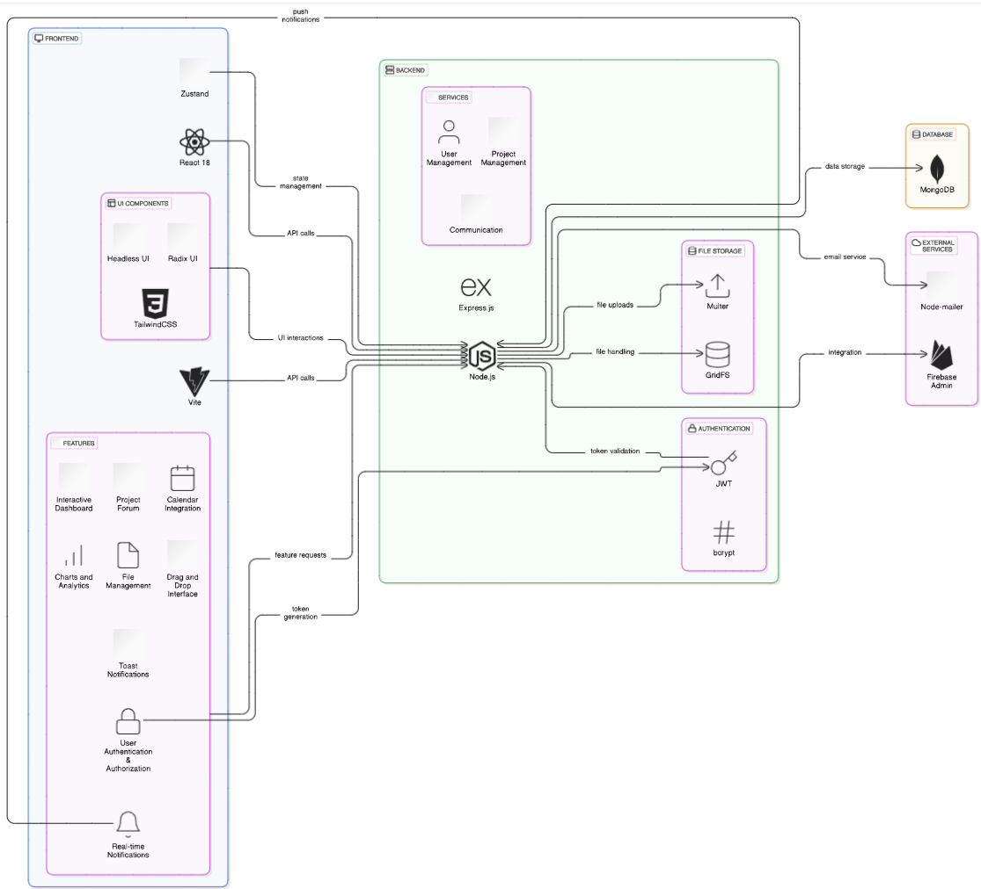
System Architecture

Slide 10
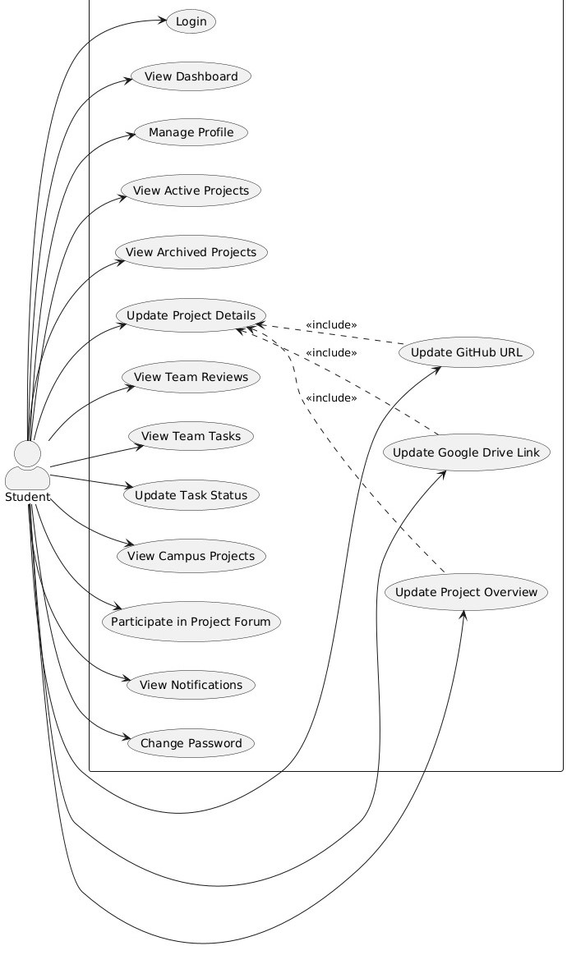
Student Use Case Diagram

Slide 11
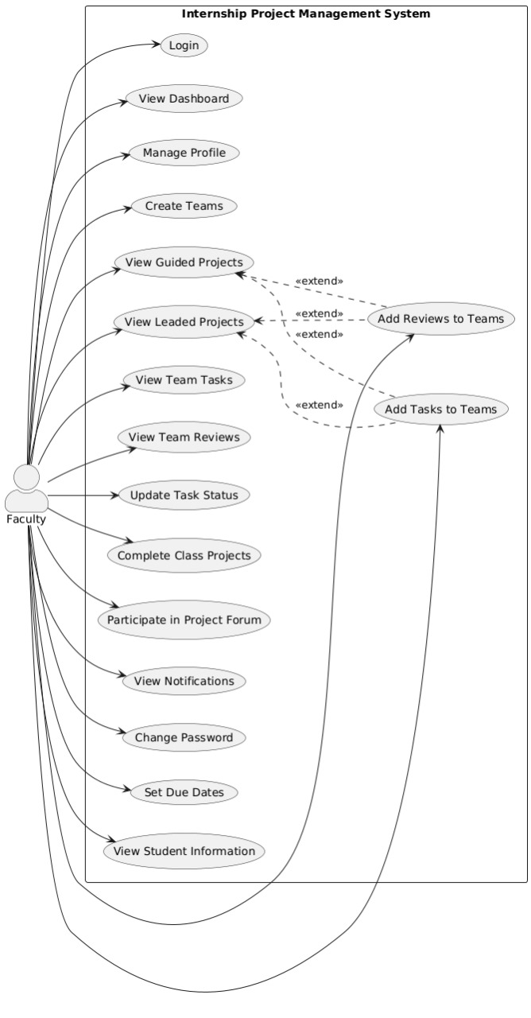
Faculty Use Case Diagram

Slide 12
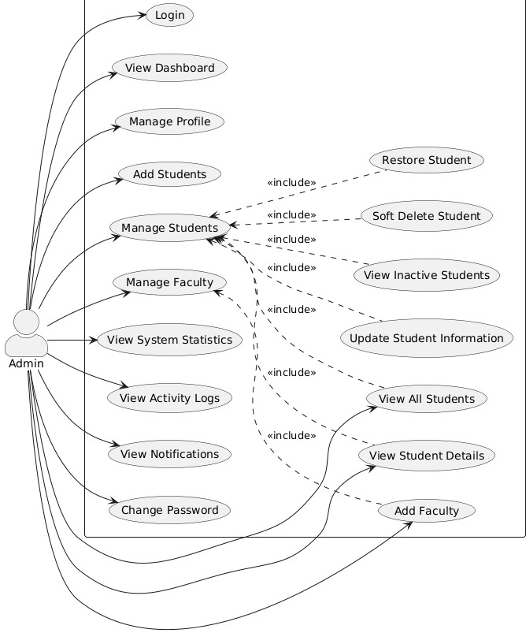
Admin Use Case Diagram

Slide 13
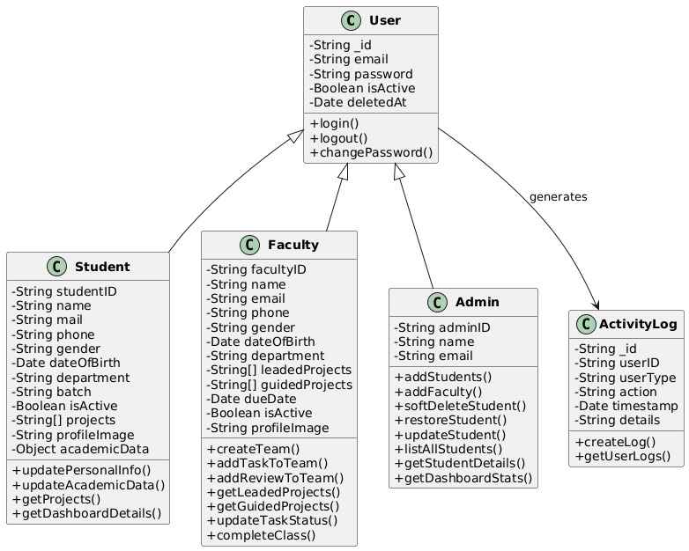
User Management Class Diagram

Slide 14
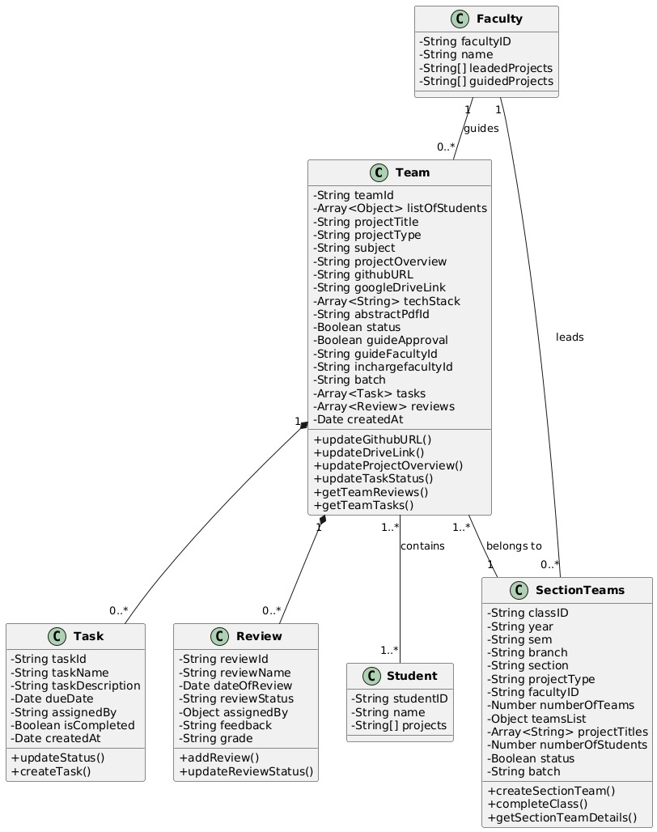
Project Management Class Diagram

Slide 15
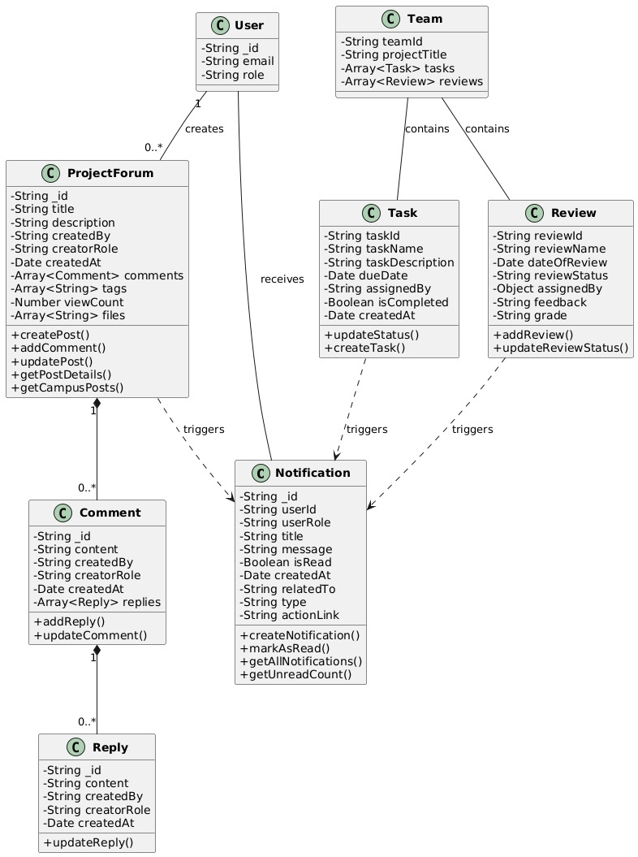
Collaboration and Communication Class Diagram

Slide 16
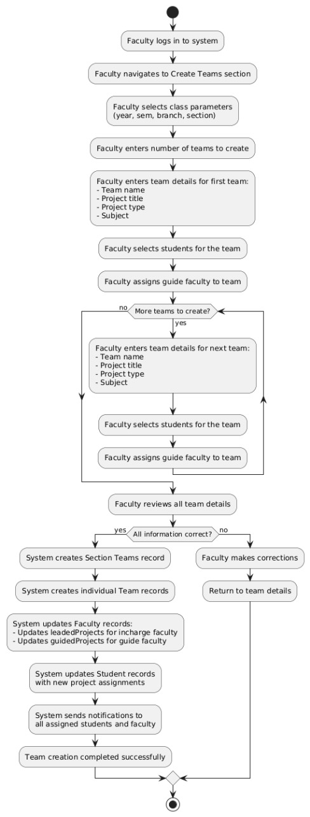
Faculty Team Creation Workflow Activity Diagram

Slide 17
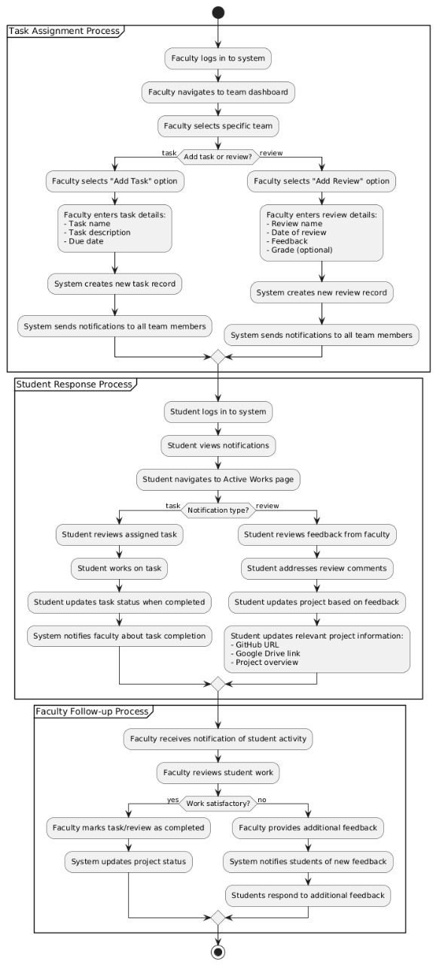
Review and Task Management Workflow Activity Diagram

Slide 18
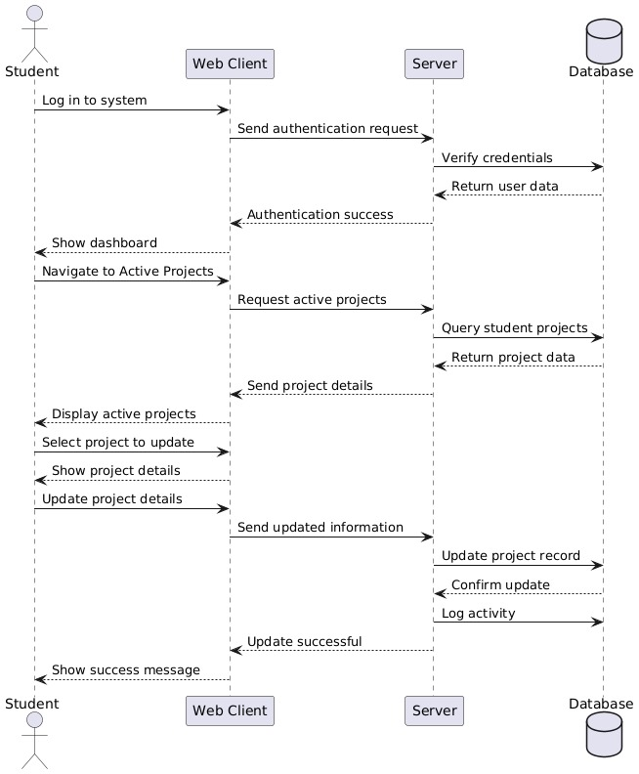
Student Project Update Sequence Diagram

Slide 19
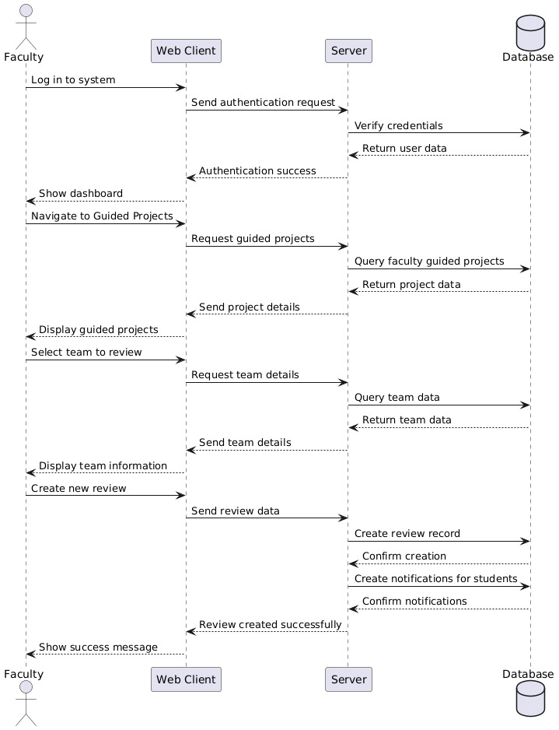
Faculty Review Assignment Sequence Diagram

Slide 20
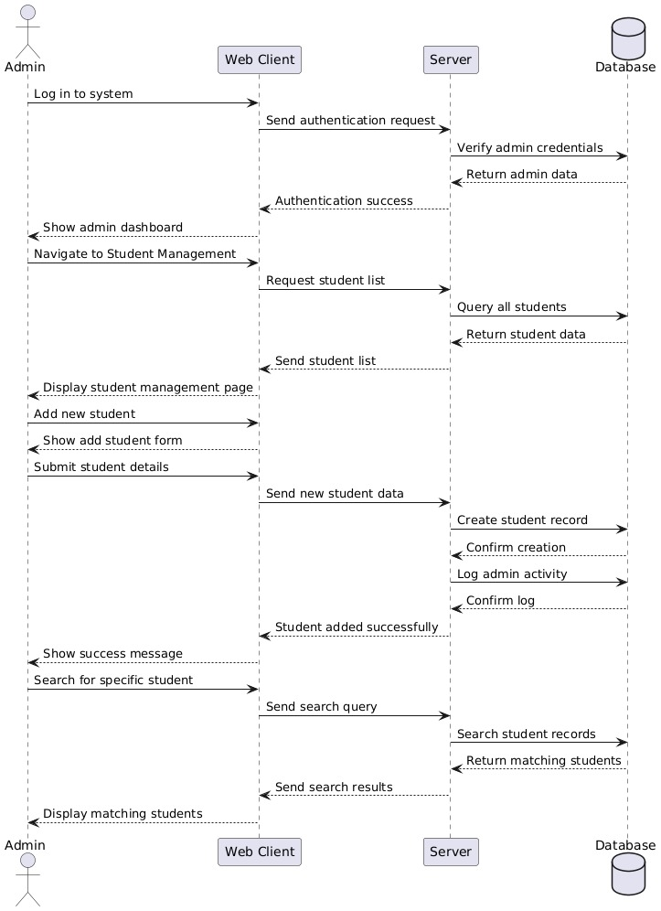
Admin Student Management Sequence Diagram

Slide 21
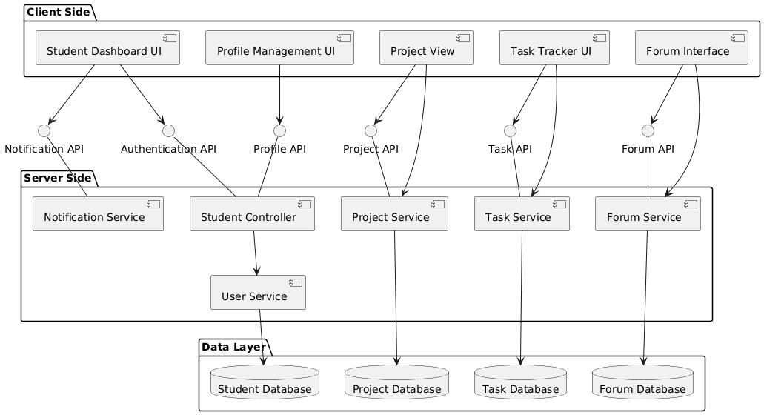
Student Subsystem Component Diagram

Slide 22
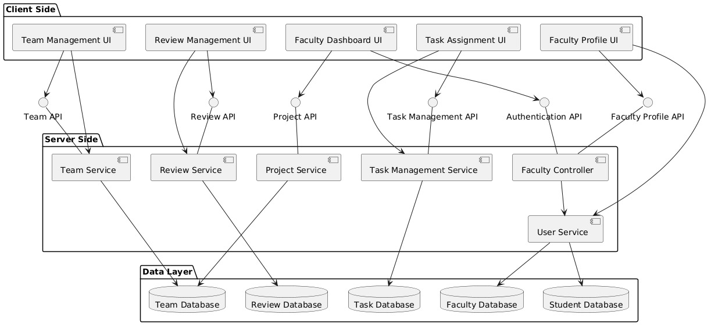
Faculty Subsystem Component Diagram

Slide 23
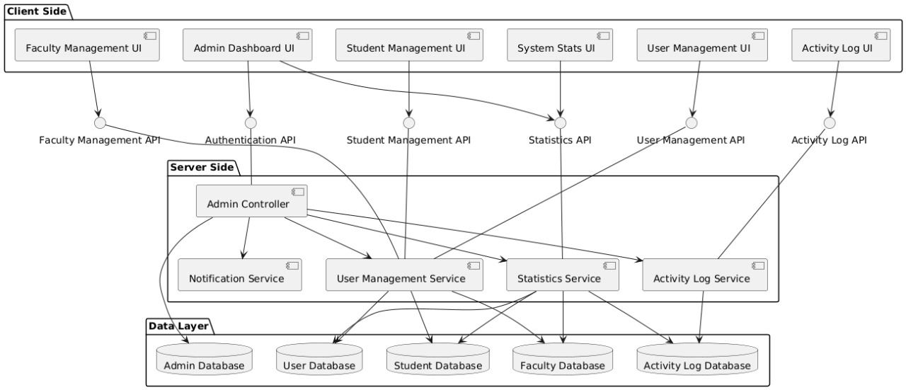
Admin Subsystem Component Diagram

Slide 24
Modules of Proposed System
Authentication Module
- Login/Register - Role-based Access - Password Reset
2. User Module
Student Management - Faculty Management - Admin Controls - Profile Management
3. Project Module
Project Creation - Forum Discussions - Progress Tracking - Documentation
4. Review Module
Guide Assignment - Review Scheduling - Feedback System - Evaluation
5. Notification Module
Real-time Alerts - Email Notifications - Announcements
6. Activity Module
Progress Tracking - Task Management - Timeline View
7. Admin Module
- System Settings - User Management - Access Control

Slide 25
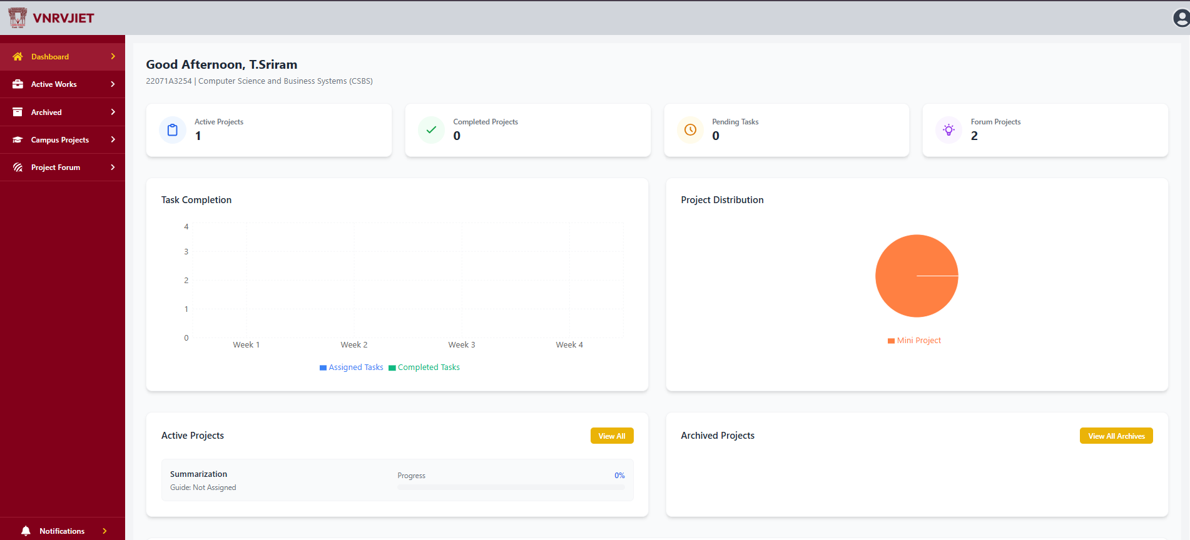
Implementation details

Slide 26
Conclusion
The Online Project Review and Management System successfully streamlines the end-to-end process of academic project supervision. By leveraging a modern tech stack—React, Node.js, and MongoDB—the system delivers a secure, responsive, and user-friendly experience for all stakeholders.
Key accomplishments such as automated project tracking, real-time student-faculty communication, centralized document management, and efficient review scheduling have significantly enhanced operational efficiency. As a result, the system reduces administrative workload, improves project oversight, and fosters better collaboration and resource organization, ultimately contributing to a more structured and productive academic environment.

Slide 27
Future Scope
Mobile Application Development
- Native Android and iOS apps - Offline functionality - Push notifications - Mobile-optimized interface
2. AI & Machine Learning Integration
Smart project recommendations - Automated progress assessment - Intelligent task scheduling - Chatbot for support
3. Advanced Analytics Dashboard
- Performance metrics visualization - Predictive analysis - Custom report generation - Real-time progress tracking
4. Enhanced Communication System
- Built-in video conferencing - Real-time chat - Group collaboration tools - Screen sharing
5. Integration with Academic Systems
Learning Management Systems (LMS) - Student Information Systems - Digital Libraries - Academic Calendar Systems
6. Advanced Security Features
- Multi-factor authentication - Biometric login - End-to-end

Slide 28
References
[1] S. S. N. Challapalli, B. D. Shivahare, P. Kaushik, V. Bibhu, S. Suman, and A. D. Gupta, “Web Development and Performance Comparison of Web Development Technologies in Node.js and Python,” Proc. 2021 Int. Conf. Technol. Adv. Innov. (ICTAI), 2021, pp. 303–310, doi: 10.1109/ICTAI53825.2021.9673464.
[2] M. Patel and A. Gupta, “MERN Stack-Based College ERP System for Project Tracking,” Int. J. Comput. Sci. Appl., vol. 15, no. 4, pp. 199–210, 2023.
[3] A. Smith, “Integration of Geospatial Data in eLearning Platforms,” J. Educ. Technol. Res., vol. 10, no. 2, pp. 105–120, 2022.
[4] L. Brown and R. Kumar, “Enhancing Collaborative Learning with Moodle and WhatsApp,” Proc. Int. Conf. Digital Learning, 2023, pp. 88–95, doi: 10.1109/ICDL57890.2023.9876543.
[5] R. Johnson, “Security Enhancement Using JWT, RBAC, and Encryption,” Cybersecurity Technol. J., vol. 5, no. 1, pp. 54–69, 2022.
[6] C. White, “Progressive Web Applications (PWA) for Streamlined Monitoring,” Proc. Web Eng. Conf., 2023, pp. 155–166, doi: 10.1145/WEB2023.1023456.

Slide 29
Thank You

