Slide 1
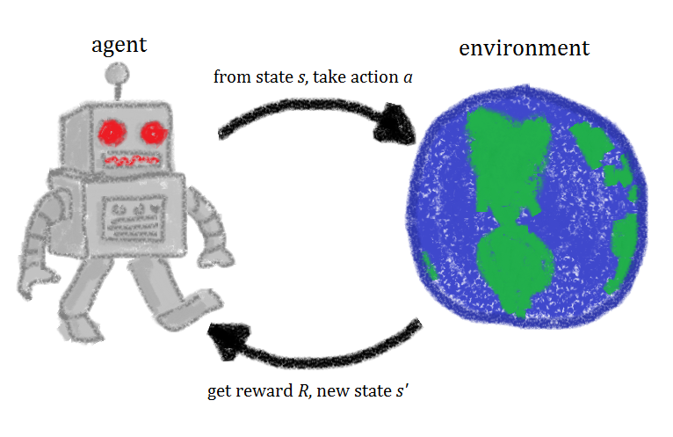
Reinforcement Learning David Stroud Learning best actions based on reward or punishment

Slide 2
Overview:
What is Reinforcement Learning?
How did Reinforcement Learning gain prominence?
Reinforcement learning terminology.
How is Reinforcement learning used?
Sample Reinforcement Learning problem ~ with code.
How does one get started in the Reinforcement Learning space?

Slide 3
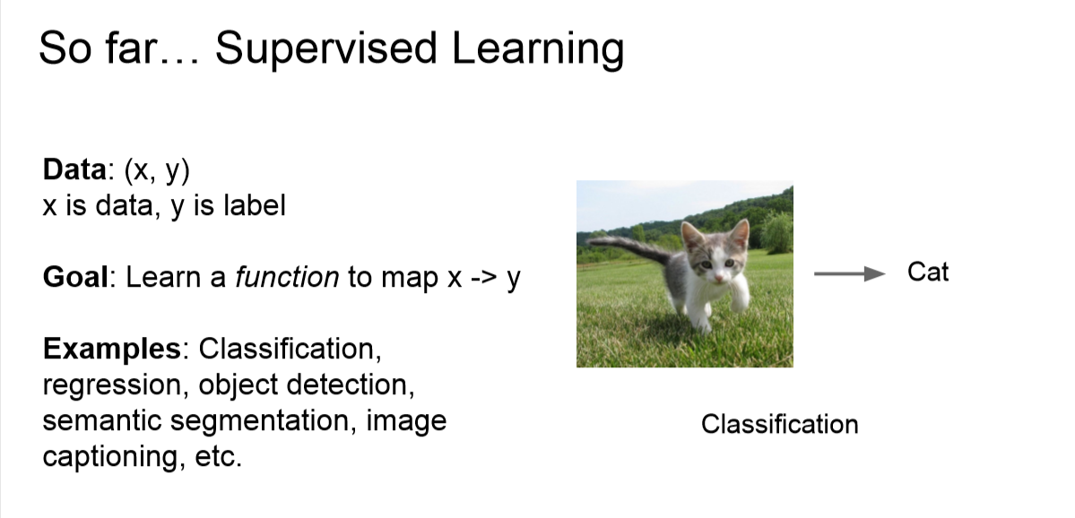

Slide 4
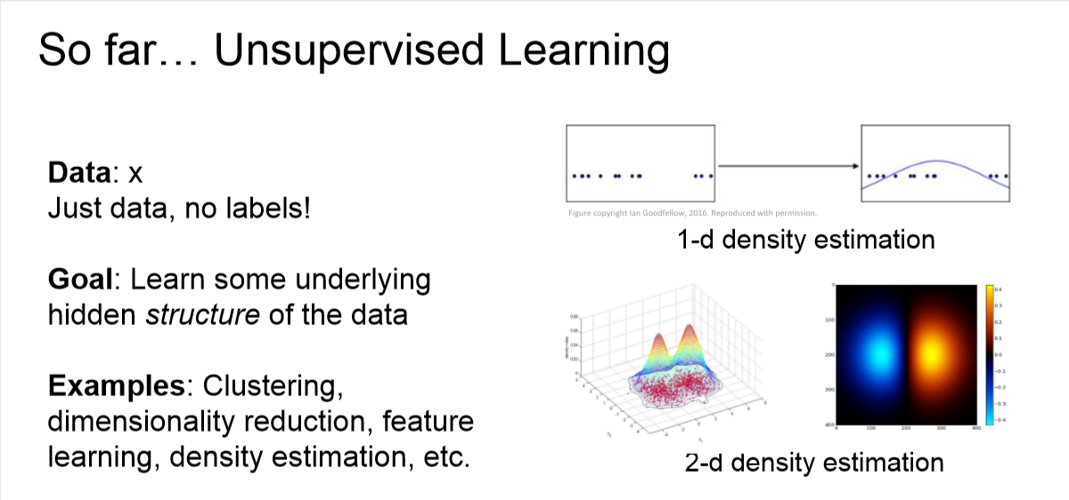

Slide 5
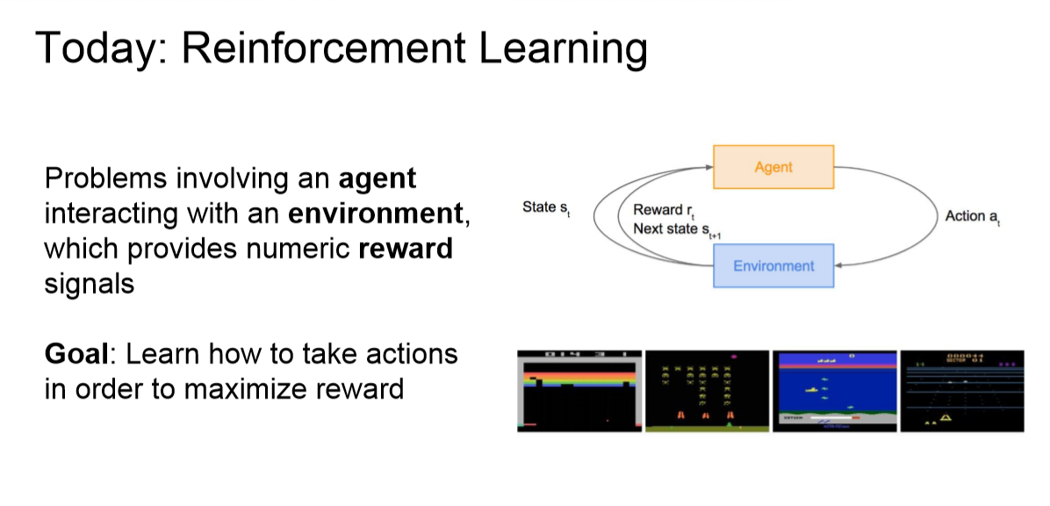
Notes:
What is Reinforcement Learning?
Reinforcement Learning is learning what to do – how to map situations to actions – so as to maximize a numerical reward system.
The learner is not told which actions to take, but instead must discover which actions yield the most reward by trying them.
In Reinforcement Learning, a software agent makes observations and takes actions within an environment, and in return it receives rewards. Its objective is to learn to act in a way that will maximize its expected rewards over time.
The agent acts in the environment and learns by trial and error to maximize its pleasure and minimize its pain.
In short, Reinforcement Learning is used to optimize rewards.

Slide 6
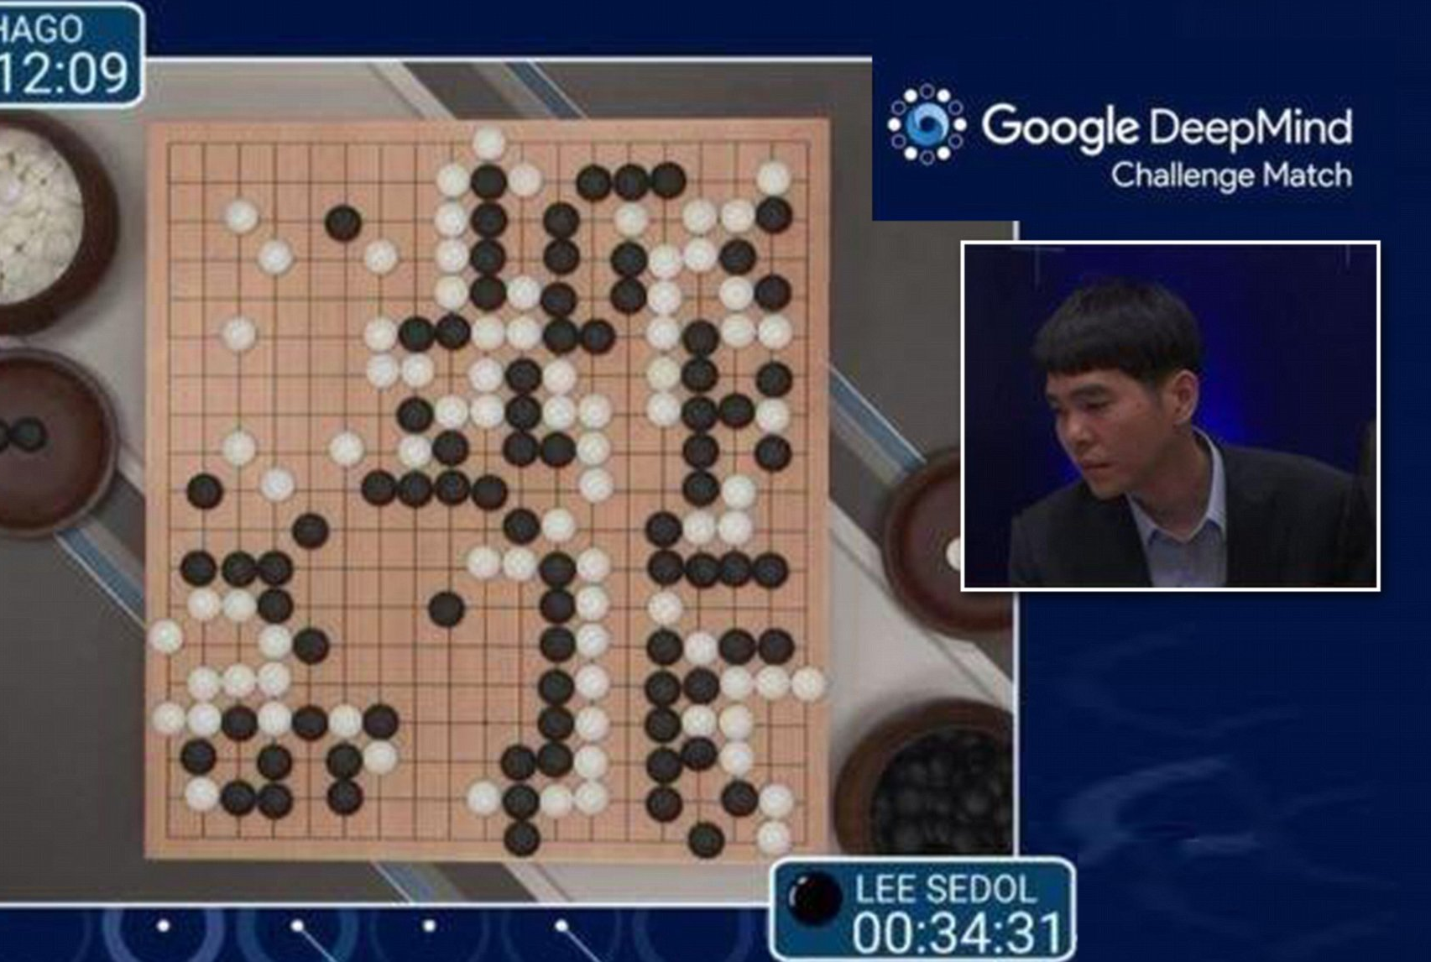
How did Reinforcement Learning gain prominence?
Notes:
It has been around since the 1950s, producing many interesting applications over the years, particularly in games (e.g., TD-Gammon, a Backgammon-playing program) and in machine control, but seldom making the headline news.
But a revolution took place in 2013, when researchers from a British startup called DeepMind demonstrated a system that could learn to play just about any Atari game from scratch, eventually outperforming humans in most of them, using only raw pixels as inputs and without any prior knowledge of the rules of the games.
This was the first of a series of amazing feats, culminating in March 2016 with the victory of their system AlphaGo against Lee Sedol, a legendary professional player of the game of Go, and in May 2017 against Ke Jie, the world champion

Slide 7
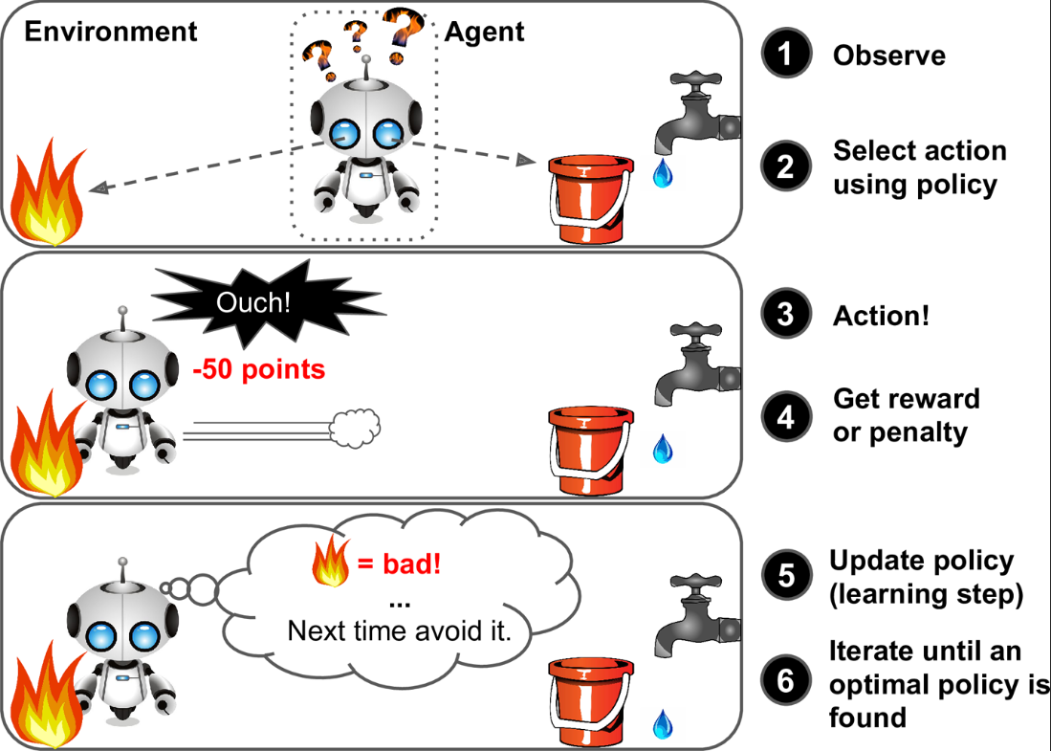

Slide 8
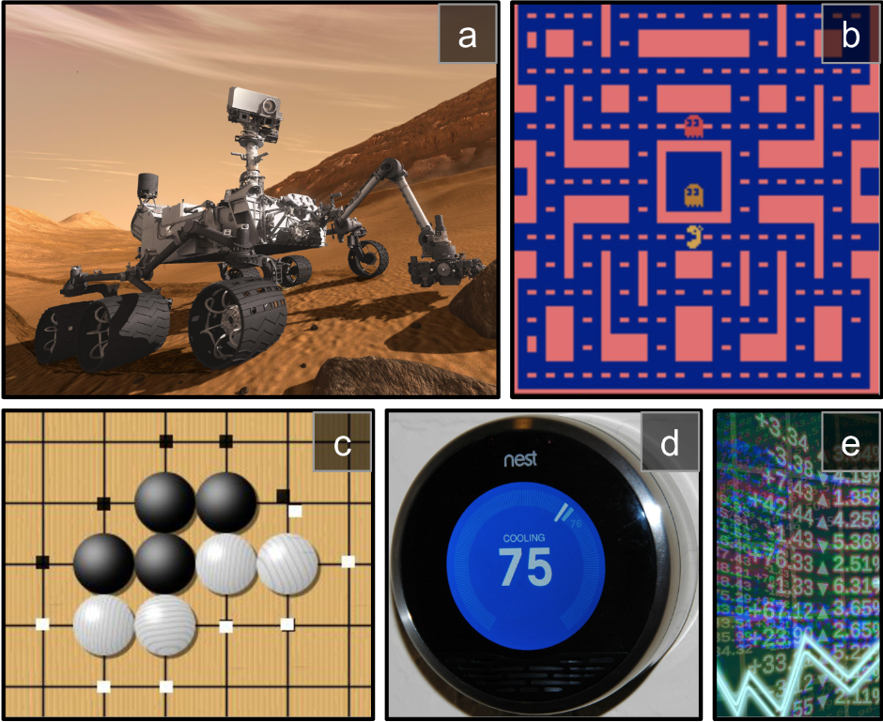
Notes:
The agent can be the program controlling a robot. In this case, the environment is the real world, the agent observes the environment through a set of sensors such as cameras and touch sensors, and its actions consist of sending signals to activate motors. It may be programmed to get positive rewards whenever it approaches the target destination, and negative rewards whenever it wastes time or goes in the wrong direction.
2. The agent can be the program controlling Ms. Pac-Man. In this case, the environment is a simulation of the Atari game, the actions are the nine possible joystick positions (upper left, down, center, and so on), the observations are screenshots, and the rewards are just the game points.
3. Similarly, the agent can be the program playing a board game such as Go.
4. The agent does not have to control a physically (or virtually) moving thing. For example, it can be a smart thermostat, getting positive rewards whenever it is close to the target temperature and saves energy, and negative rewards when humans need to tweak the temperature, so the agent must learn to anticipate human needs.
5. The agent can observe stock market prices and decide how much to buy or sell every second. Rewards are obviously the monetary gains and losses.

Slide 9
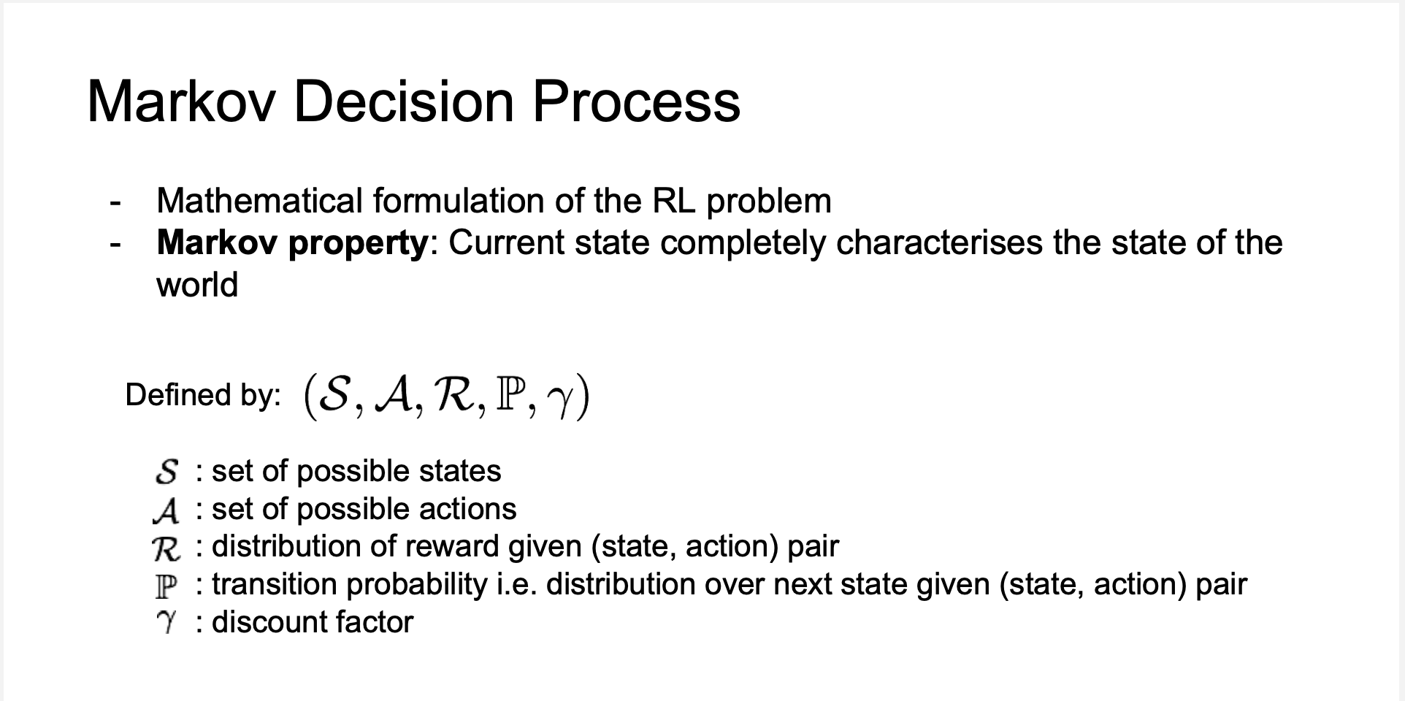
Only the present matters!

Slide 10
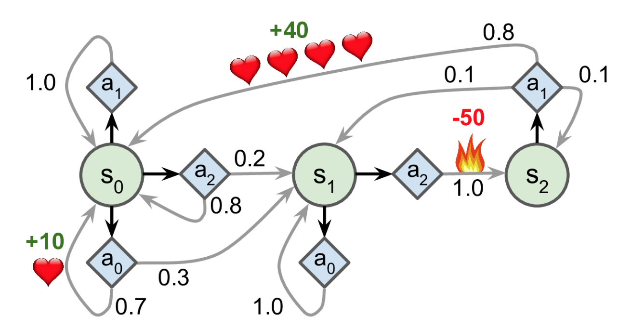
Markov Decision Process

Slide 11
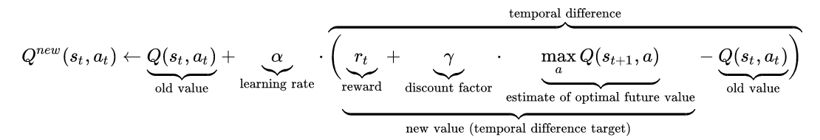
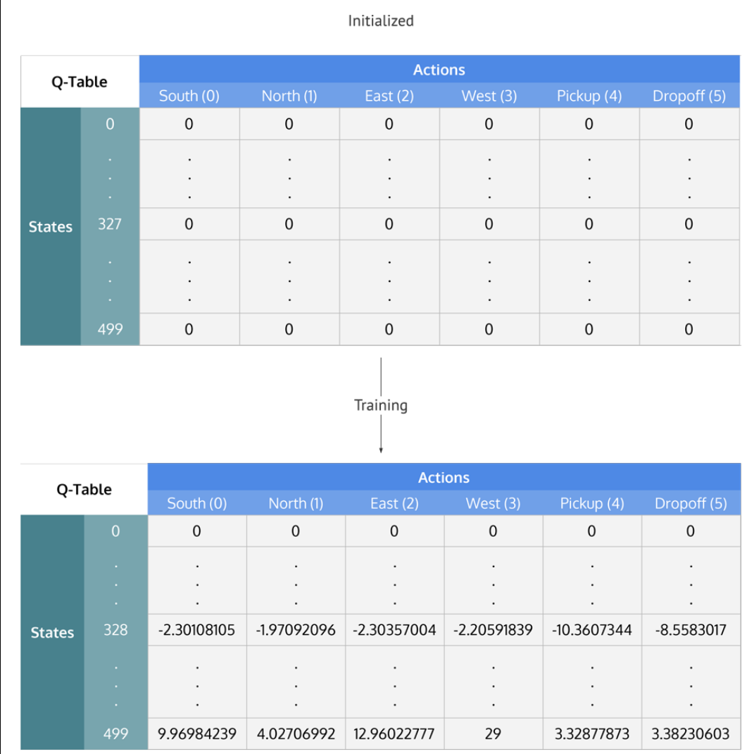
Q-Learning

Slide 12
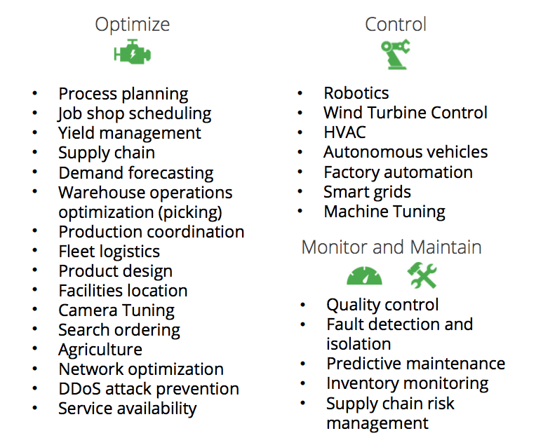
Identification of Reinforcement Learning applications in different industries.

Slide 13
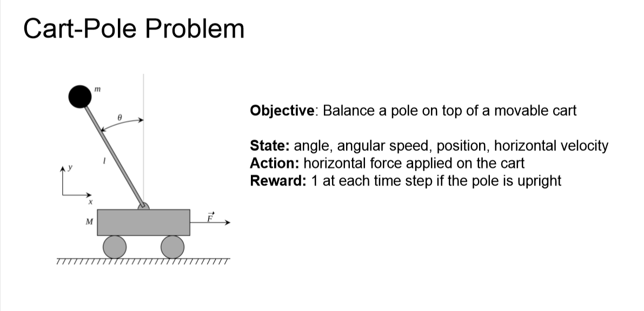

Slide 14
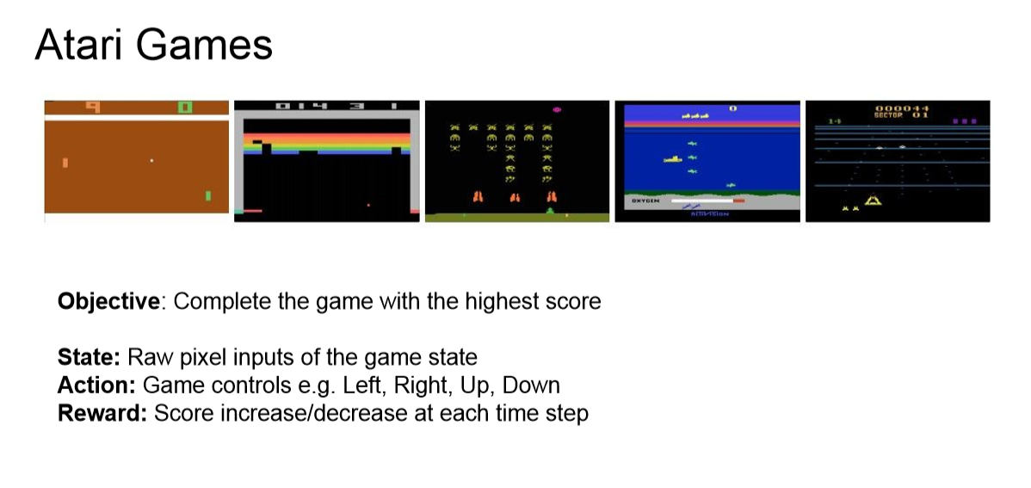

Slide 15

David Stroud
jdstroud@troy.edu
https://www.linkedin.com/in/davidstroudai/
https://twitter.com/davidstroud1123
https://github.com/davestroud
Links to Research:
https://scholar.google.com/citations?user=Y3MSzKgAAAAJ&hl=en

