Slide 1

Lesson 10
山丹县城关小学校
制作:李正洋

Slide 2
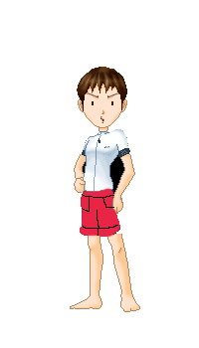
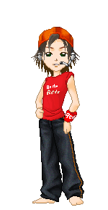
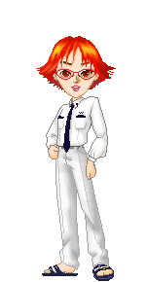
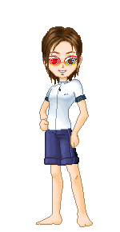
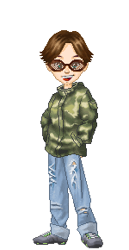
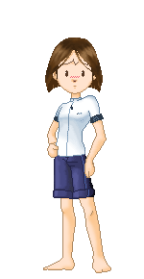
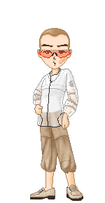

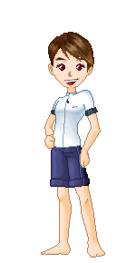
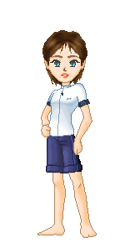
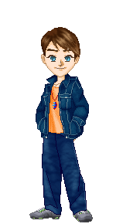
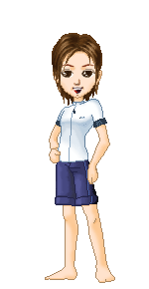

04
08
06
12
11
15
02
14
05
10
01
09

Slide 3


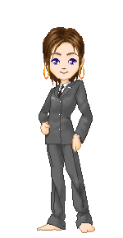

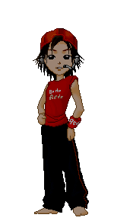
first
eighth
14
second
08
eleventh
02
02
third
01
seventh
15
tenth
15
12
06
twelfth
fourth
10
09
fifth
ninth
11
sixth
05
04

Slide 4

Sunday
Thursday
Wednesday
Tuesday
Monday
Saturday
Friday
Sunday
December
December
December
December
December
December
December
December
22
16
17
18
21
20
19
15

Slide 5
Tuesday
December
17

Slide 6
Sunday
December
15

Slide 7
What day is it?
Monday
Friday
Tuesday
March
May
July
8
2
3
It’s______
__________
Tuesday,
Monday
It’s______
__________
Friday
It’s______
__________
March third
May eighth
July second

