Slide 1
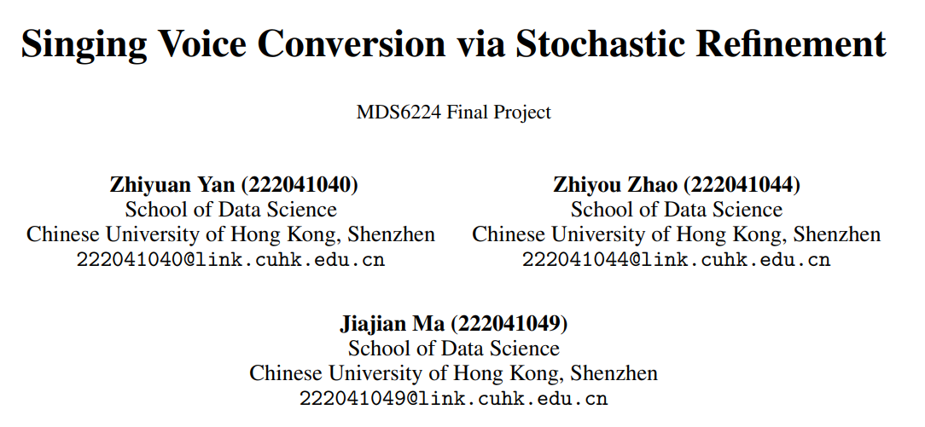
Notes:
Let’s talk about how we finish the final project.

Slide 2
Background: Task & Related work
Task: Singing voice conversion (any to one)
Singing voice conversion (SVC) is a technology aiming to convert the timbre （音色） of a song without changing the content and melody.
“Any to one”: Convert the timbre of any singer to a specific target singer.
Diffusion model
One of the most promising and powerful generative models
Diffusion model in audio signal processing
Achieving success in
State-of-the-art performance in natural images or video generation
text-to-speech synthesis (Natural Speech2)
audio editing (Audit)
singing voice synthesis (DiffSinger)
singing voice conversion (DiffSVC)
Typically a SVC system requires a generative model
Notes:
In the final project, we try to focus on the take called singing voice conversion, which is a technique try to convert the timbre of a song without changing the content or melody; specifically, we focus on “any to one” SVC, convert the timbre

Slide 3
Background: Motivation
Classical Framework
Sampling acoustic features directly from noise
Unsuccessful in generating conservative features (Like MCEP)
Require a long time to training
(a)
Noise
Content Conditions
Diffusion Denoising Network
Predicted Acoustic Features
(b)
Stochastic
Noise
Proposed Framework
Making the task much easier for the diffusion model
Using diffusion model to modify the initial prediction
Diffusion Denoising Network
Predicted Acoustic Features
Content Conditions
Initial Prediction Network
Initial Prediction
Deterministic
Notes:
Here is the result of our project, we can see Our model outperform any single classifier and very robust in 5-CV

Slide 4
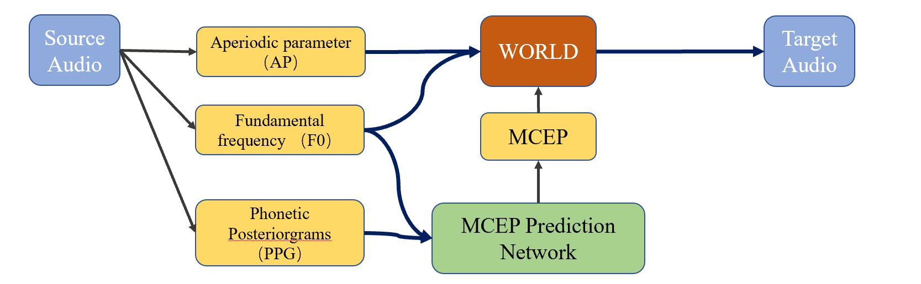

Model: Overall Structure
Singer-Independent Feature Extractor
Singer-Specific Synthesizer
Singer-Specific Feature Predictor
Replaced with a Diffusion model!
Our system is similar to other World-base SVC system
Notes:
Here is the result of our project, we can see Our model outperform any single classifier and very robust in 5-CV

Slide 5
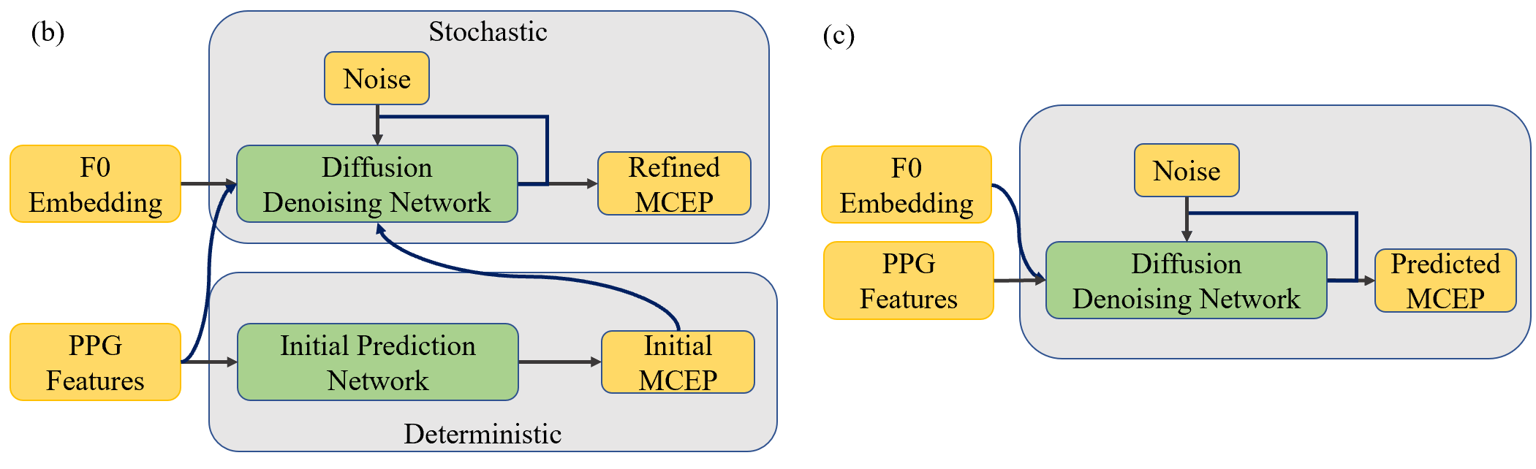
Model: MCEP Prediction Network
Proposed Framework
Classical Framework
Pitch Feature
Content Feature
Initial Prediction network is a 6-layer Transformer
Denoising Network could be 12-layer WaveNet or 4-layer Transformer
Denoising Process could happen in latent space or MCEP space

Slide 6
Dataset & Metric
Target Singer & Source Singer
Target Singer: the only one singer in Opencpop dataset
Source Singer: 20 singers in M4Singer dataset
Training & Validation set: Opencpop
Training: 3550 music segments
Testing set: M4Singer
20 × 5 = 100 music segments
Validation: 206 music segments
Metric
MSE of MCEP
Notes:
In the task 2, the text will
To deal with missing values, we replace the unknown in ‘marital’ with ‘married’ and unknown in ‘education’ with ‘high.school’, while other missing values are keep as unknown in other features.
For the categorical data, we used LabelEncoder to encode ‘marital’ and ‘job’, using OneHotEncoder to encode ‘month’, and using OrdinalEncoder to encode other features;
For numerical data, we replace 999 in pdays with -30 and using standardScaler to normalize the data.

Slide 7
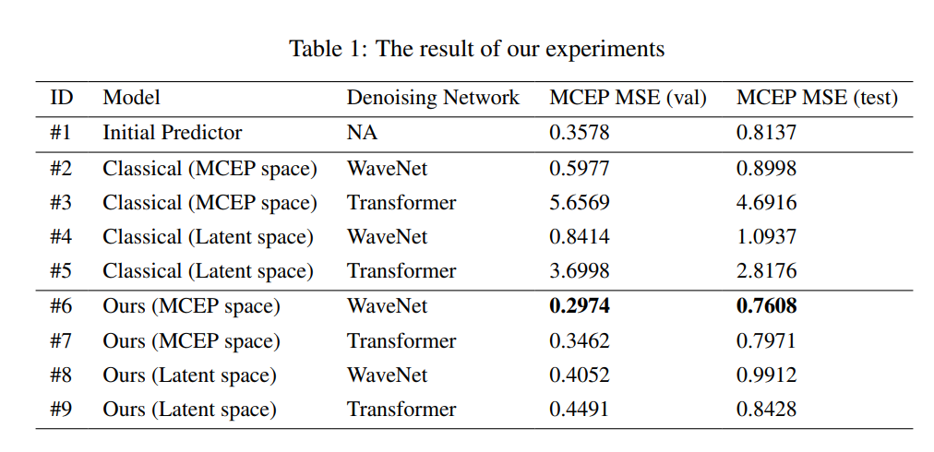
Results: Our framework
Our proposed framework reached the best performance in both validation and testing set
It also converge in about 20 epochs, much faster than about 200 epochs in classical framework
Notes:
Here is the result of task 2, we can see data preprocessing, Domain knowledge, and data augmentation can greatly improvement to the F1-score. By combining these methods, we obtain the best ML model, with F1-score = 0.864 in CV-5. Also, using DL method push the F1-score to be even better, with highest CV-5 F1-score reach 0.891.

Slide 8
Results: Classical framework
Classical framework perform even worse than the initial predictor
May caused by using MCEP as acoustic feature, which is derived from Mel-spectrogram and more sensitive to noise
Notes:
Here is the result of task 2, we can see data preprocessing, Domain knowledge, and data augmentation can greatly improvement to the F1-score. By combining these methods, we obtain the best ML model, with F1-score = 0.864 in CV-5. Also, using DL method push the F1-score to be even better, with highest CV-5 F1-score reach 0.891.

Slide 9
Results: MCEP space vs Latent space
Denoising in Latent space didn’t push the best performance to a better place
May caused by the VQ-VAE model we used, which is pre-trained on natural images and only finetuned on Opencpop
Notes:
Here is the result of task 2, we can see data preprocessing, Domain knowledge, and data augmentation can greatly improvement to the F1-score. By combining these methods, we obtain the best ML model, with F1-score = 0.864 in CV-5. Also, using DL method push the F1-score to be even better, with highest CV-5 F1-score reach 0.891.

Slide 10
Results: WaveNet vs Transformer
Uniformly better in using WaveNet, which is design for dealing with audio signals
Notes:
Here is the result of task 2, we can see data preprocessing, Domain knowledge, and data augmentation can greatly improvement to the F1-score. By combining these methods, we obtain the best ML model, with F1-score = 0.864 in CV-5. Also, using DL method push the F1-score to be even better, with highest CV-5 F1-score reach 0.891.

Slide 11
Conclusion
we proposed a new application framework for diffusion models in SVC, which utilize it to refine the initial predicted MCEP of a deterministic model, rather than predicting it from scratch.
Our proposed framework outperforms any diffusion model with the classical framework, in the quality of MCEP feature generation and training efficiency.
Limitations and future work
Limitations | Future work
Using MCEP as target acoustic feature | Using Mel-spectrogram or others
Using VQ-VAE pre-trained on Natural images | Using VQ-VAE pre-trained on acoustic feature
without exploring models like UNet or ViT | Try in the future
Lacking subjective metric for the result | Complete in the future
Notes:
Here is the result of task 2, we can see data preprocessing, Domain knowledge, and data augmentation can greatly improvement to the F1-score. By combining these methods, we obtain the best ML model, with F1-score = 0.864 in CV-5. Also, using DL method push the F1-score to be even better, with highest CV-5 F1-score reach 0.891.

Slide 12
Thank you!
Q & A
Notes:
That’s all of the presentation of our group, thanks for listening. Now we are welcome to questions.

