Slide 1

Camp OAC - B
Michael Boulanger
Sai Rohith Enumala
Paul Ranger
Baillie Stang

Slide 2
About our Software:
Mobile friendly website
Automates the process of obtaining firewood for the general public
The user will choose:
Location (from a list of available locations)
Number of bags of firewood desired
User automatically receives an invoice
Website makes payment (using square) or retains an invoice for cash payment upon pick up
Receipt is generated automatically

Slide 3
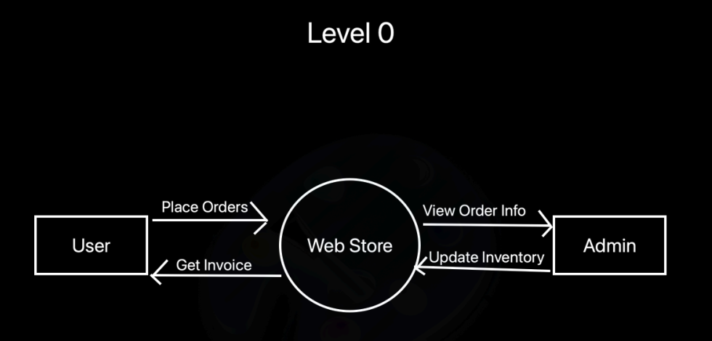
System Requirements : Data Flow Diagram (Level 0)

Slide 4
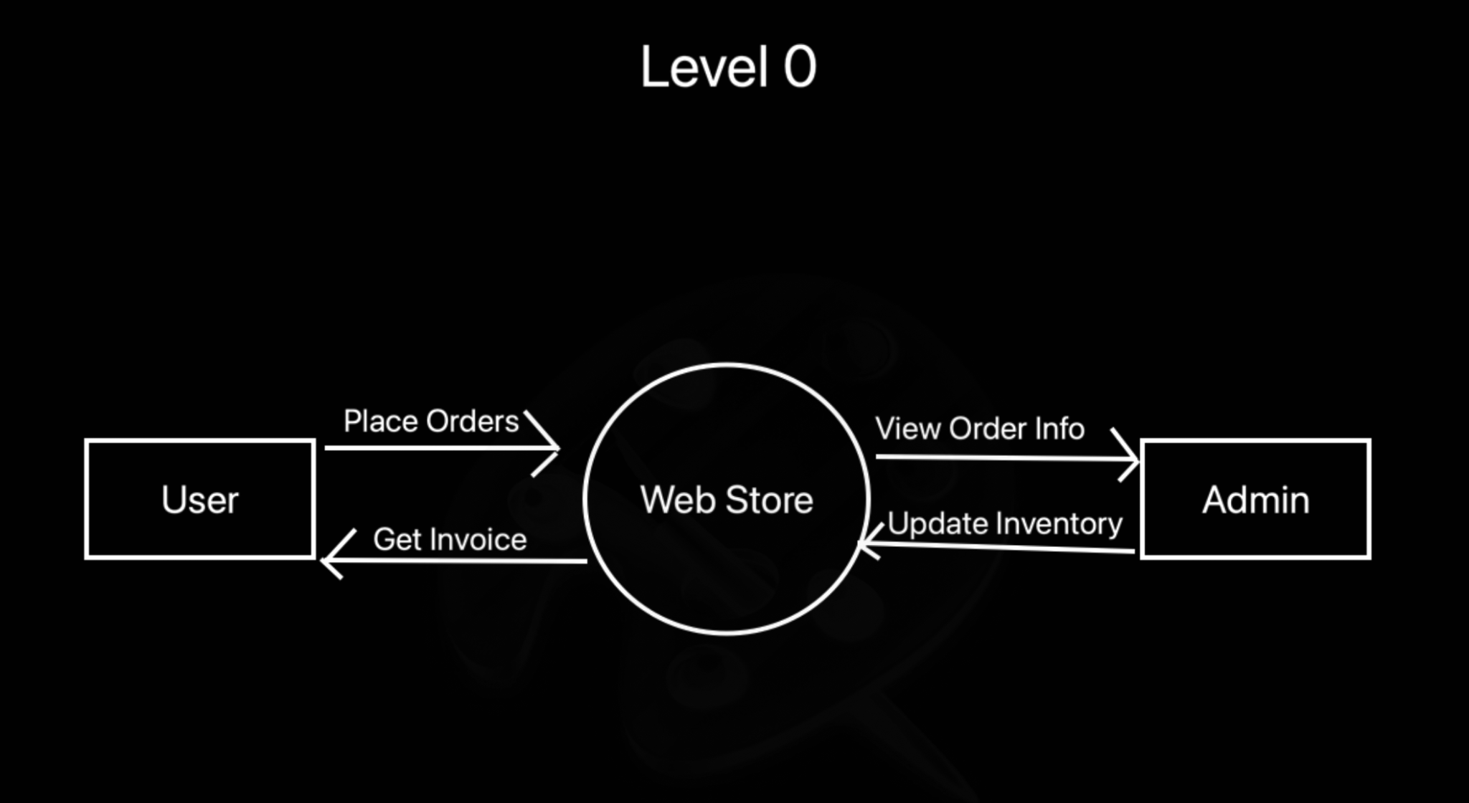
System Requirements : Data Flow Diagram (Level 0)
Text goes here
Explaining dfd lvl 0
Blahblahblah
Format
Format
format

Slide 5
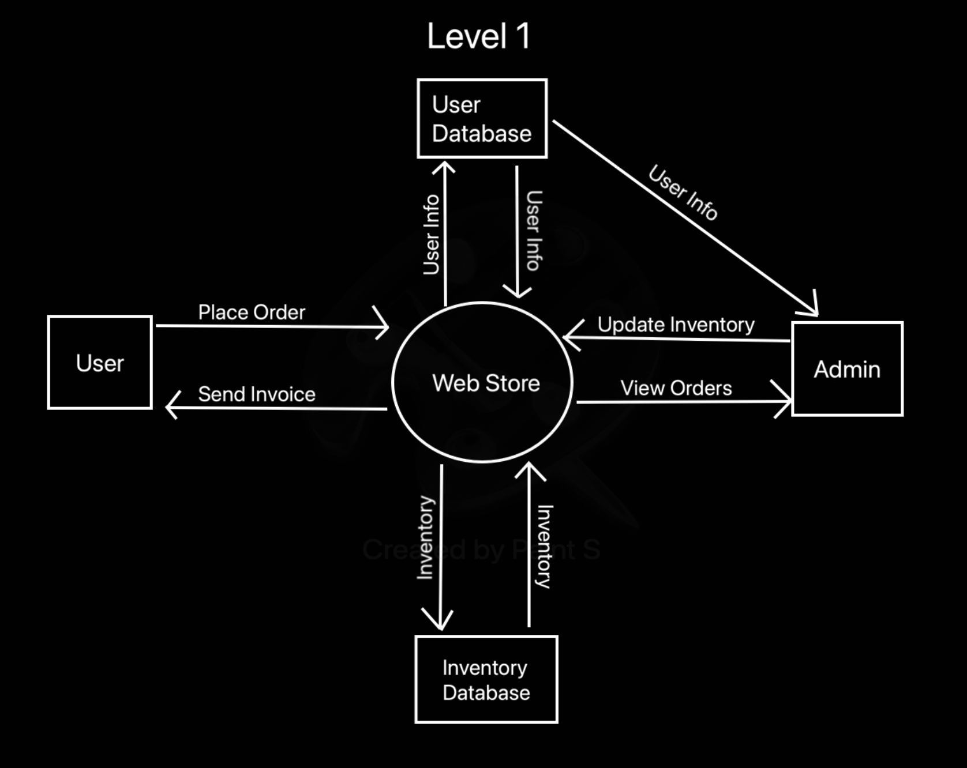
System Requirements : Data Flow Diagram (Level 1)

Slide 6
System Requirements : Data Flow Diagram (Level 1)
Text goes here
Explaining dfd lvl 1
Blahblahblah
Format
Format
format

Slide 7
Peer testing 1 Milestone
Has minimal backend interaction
A mobile-friendly storefront

Slide 8
Peer testing 2 Milestone
Storefront is good-looking & mobile-friendly
Has complete back-end integration
Has a fully functional database structure
Completed purchase form (no actual payment or order fulfillment)

Slide 9
Final deliverable
All prior milestone objectives
Proper payment processing
Fully functional invoice creation

Slide 10
Functional Requirements:
The user will choose:
Location (from a list of available locations)
Number of bags of firewood desired
User automatically receives an invoice
Website makes payment (using square) or retains an invoice for cash payment upon pick up
Receipt is generated automatically

Slide 11
Non-Functional Requirements:
Easy to use interface
Stock is automatically updated on sale
Out of stock locations hidden from pickup location list
Admin can login to confirm location restocks
Pickup address hidden until after purchase confirmation
Store customer purchase information

Slide 12

MERN tech stack
MongoDB
Express.js
React
Node.js

Slide 13
Why?
All the technology is open source, free, and used by a large community.
Extensive documentation means we can reduce time it takes to become proficient in certain development aspects.
MongoDB is a great option for our relatively small dataset in terms of human readability and functionality with our other javascript tech components. (JSON)
Express can serve our React app good enough with low performance overhead, a perfect fit for a low-cost hosting solution
React is perfect for the kind of look and feel we are going for, very easy to add intractability and scaling can be achieved with very little effort.
Node.js ties everything together with javascript which is simple to read and write, and has powerful package support which we can leverage to make development simpler. Great for prototyping new features quickly

Slide 14
Testing:
Our stack gives us lots of flexibility for testing based on the availability of testing libraries for JS
Back end:
Unit tests to ensure certain aspects of our API work
Front end:
Chrome's developer tools
Regression tests with different browsers
If something breaks, we can isolate the incident
Postman, a REST client, will ensure our API is secure and can’t be spoofed by hackers who would steal information

