Slide 1
The art of recon (w/ some networking)
Trevon

Slide 2
Announcements
National Cyber League Registration Opens TODAY (12 slots)
Have a question ?
Lab Hours (Check #lab for more postings)
Monday 12:00 – 5:30
Tuesday 2:30 – 6:00
Thursday 12:00 – 5
Friday 4:00 - 6:30
Competition Practice on Friday’s and Saturday’s (Open to Everyone)

Slide 3

Who Am I
Graduate Student
blackmanta (on slack)
Competition enthusiast
Linux Junky

Slide 4
What we covered last week…
Slides in #education_n_training slack channel
What the 49th is about
Creating a https://hackthebox.eu account
Build a methodology (kinda)
Some introductory ideas

Slide 5

Disclaimer
Please do not be afraid to ask questions (I can talk allot)
Please do not use what you learn here to hack things unethically
If you feel intimidated its ok

Slide 6
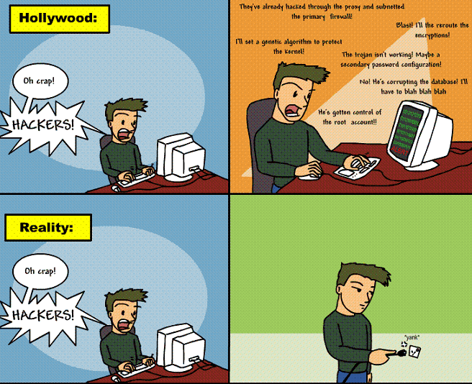
What is REcon
Not related to the question

Slide 7
Recon
Gathering information to know how to target systems
Fingerprinting, Scanning, Enumeration
Active and Passive Reconnaissance
Active Scanning requires consent
What about OSINT?

Slide 8
What is an Example Passive Recon?

Slide 9
What is an Example ACtive Recon?

Slide 10
Network Specific Tools
Not a comprehensive list
Networking
nmap (cli)/Zenmap (gui)
Wireshark (passive networking)
OWASP Zap, Burp
Enumeration (Active Scanning)
Gobuster, wfuzz, dirb, dirbuster etc.
Vuln scanner
Nmap, searchsploit, nessus etc.

Slide 11
Using NMAP
What can we use it for?
To find live hosts
Finding Vulns
Scripting with Lua

Slide 12
NMAP References
Nmap Book
Nmap Reference Guide
Nmap Documentation
Nmap: Network Exploration and Security Auditing

Slide 13
NMAP in the Wild (traverxec)

Slide 14
Some Extra Resources
Hacker methodology (MITRE ATT&CK)
Hacking NMAP – Defcon 13
Getting Started with Wireshark
OWASP Zap Documentation

