Slide 1
Logs and Other Important Systems Files
49th Security Division - Education Night

Slide 2

Announcements
Remote Competition Practices
https://vr0n.tech/ctf/ for the file
http://vr0n.tech:8000 for the CTF
Google meet will be provided in slack
PlaidCTF April 17th – April 19th
NCL Team Game April 17th – April 19th

Slide 3

Logs
What are Logs?
Who looks at logs?
Why are they important?

Slide 4

Root Cause Analysis

Slide 5
Root Cause Analysis
Questions to ask
What Changed?
What is Broken?
When did it broken (When is it broken)?
Etc.
Example (what would you do):
A service isn’t responding to specific requests, what do you do?
Real life example (Linux forums)

Slide 6
NCL (aws_vpc_flow.log)
Demo
How would you solve?
Find the IP with the 5th highest packet transfer recorded?
Bash Solution
sed 1d aws_vpc_flow.log | awk '{a[$4] += $9} END{for (i in a) print i, a[i]}' | sort -r -n -k 2 | head -n 5
Python Solution

Slide 7
System Specific
Unix
Log files
/var/log
Unix System Logging
Configuration Files
/etc
Windows
Event Viewer
Windows Cheat Sheet for Important Files
Mac OS

Slide 8

Tooling
Visualization Tools
Grafana (Open Source)
LogDNA
Indexing and Search
Apache Lucene (Open Source)
CLI Tools
GoAccess (Open Source)
Lnav (Open Source)
Roll it yourself…
Python (csv, json, etc.)
Bash
Awk (Open Source)

Slide 9
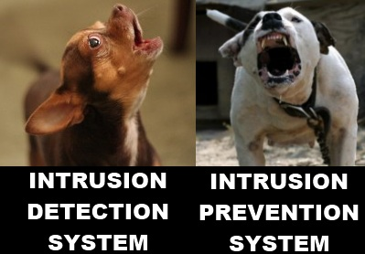
Management Tools, etc.
Analyzing Logs at Scale
SIEM
Splunk
(Free) vs (30 Day Enterprise Trial)
ELK Stack (Elasticsearch, Logstash, Kibana) (Open Source)
Graylog (Open Source)
Alien Vault

Slide 10
Interesting Projects
Loglizer
machine learning-based log analysis toolkit for automated anomaly detection
Dsiem
Security event correlation engine for ELK Stack
… Root Cause Analysis (Paper)

Slide 11
Resources
Github Awesome Log Analysis
Ultimate Guide to Logging
Trail of Bits CTF Reference
Parsing Log Files with Python example
Github Example
Blog Post
Linux Log Files
Getting Started with Kibana (ELK Stack)
PacketLife (CheatSheet)

