Slide 1
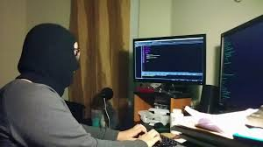
Getting Started
Linux, Labs and Fun

Slide 2

Who Am I?
Trevon (blackmanta)
Graduate Student
Linux Junky
MY KNOWLEDGE IS LIMITED

Slide 3
Structure of Education Nights
Small taste of a variety of topics
Place to find interest
Voice your opinion in #education_n_training
Plethora of resources
CTF challenges… *fingers crossed*

Slide 4
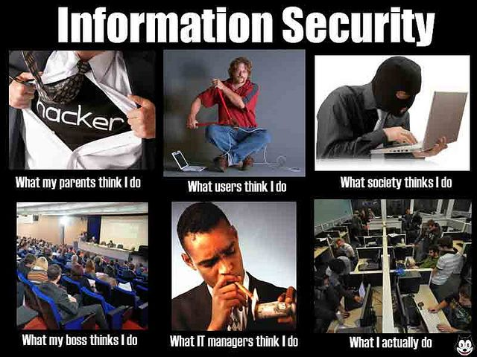
Information Security Fields
Computer Forensics
Malware/Reverse Engineer
Exploitation Developer
Incident Responder
Secure Programmer
Application Tester

Slide 5
What is Linux?
An Open Source Operating System (Kernel)
Powers 96.5 percent of the top one million domains in the world

Slide 6
What does this mean?
Learning Linux could be useful
It’s honestly not everything
The is more to security than Linux

Slide 7
Lab Setup
We won’t be using Kali :)
Download Vmware (Free with UNCC Account)
  https://e5.onthehub.com/WebStore/Welcome.aspx?ws=8da10652-aea5-e111-9b64-f04da23e67f6
Download VirtualBox
  https://www.virtualbox.org/wiki/Downloads
Download the latest ISO of Debian
  https://cdimage.debian.org/debian-cd/current/amd64/iso-cd/debian-10.1.0-amd64-netinst.iso
Create Virtual Machine for Debian
  https://www.howtogeek.com/196060/beginner-geek-how-to-create-and-use-virtual-machines/
Install Debian
http://leanpub.com/avatar (Free Book about setting up Security Labs)

Slide 8
Guest Additions
Why is my VM so small?
  Virtualbox guest additions installation
    https://kifarunix.com/install-virtualbox-guest-additions-on-debian-10-buster/
  Vmware Workstation/Player
    sudo apt install open-vm-tools linux-headers-$(uname -r)

Slide 9
Install Kali Repo’s
Repo list - https://docs.kali.org/general-use/kali-linux-sources-list-repositories
sudo vim or nano /etc/apt/source.list
Add the line
  deb http://http.kali.org/kali kali-rolling main non-free contrib
sudo apt update
Add the key which is giving the error
  gpg --keyserver pgpkeys.mit.edu --recv-key {KEY}
  gpg -a --export {KEY} | sudo apt-key add -
We are only going to install the tools we need

Slide 10
Why?
Light weight
Learn to use the tools you need
Custom VM

Slide 11
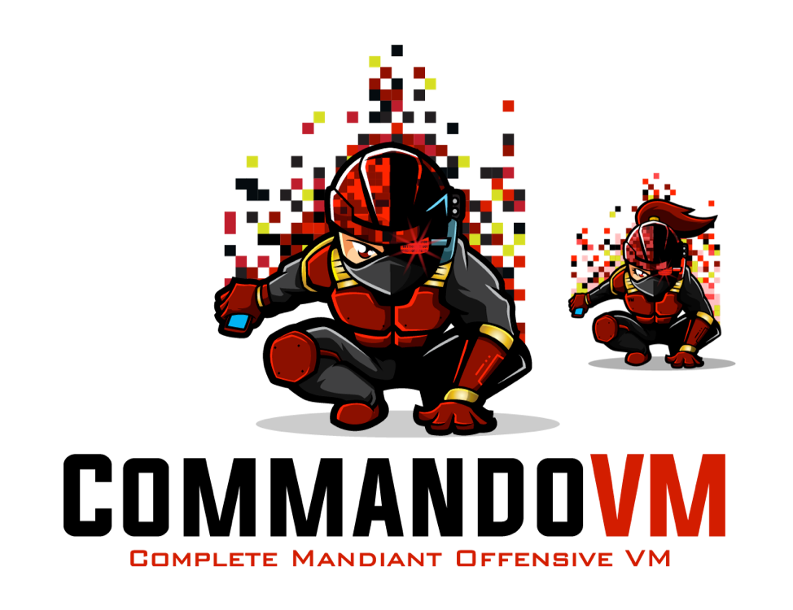
Windows Alternative
Offensive Windows Image
CommandoVM
  https://github.com/fireeye/commando-vm
  https://hacknews.co/tech/20190402/commando-vm-is-a-windows-based-kali-alternative-for-ethical-hacking.html

Slide 12
Learn Linux via Games
OverTheWire – Bandit
  http://overthewire.org/wargames/bandit/
CTF 365 (Hardcore Mode)
  https://ctf365.com
Terminus
  http://web.mit.edu/mprat/Public/web/Terminus/Web/main.html

