Slide 1

OSINT and Social Engineering

Slide 2

Who am I?
Trevon (blackmanta)
Graduate Student
Linux junky
Computer Enthusiast

Slide 3

What is OSINT?
Resources:
  https://osintframework.com/
  https://www.secjuice.com/introduction-to-open-source-intelligence-osint/

Slide 4
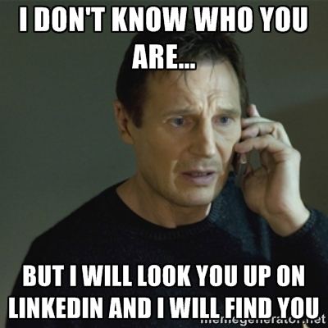
How is this related to Cybersecurity
Physical Penetration testing
Social Engineering
Not everyone is honest

Slide 5
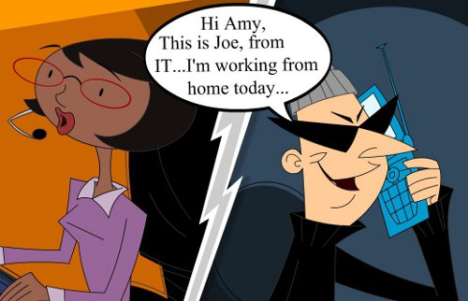
Live Social Engineering
What does it look like?
  Starbucks https://www.youtube.com/watch?v=h8kWcggio5A
  Jason Street https://www.youtube.com/watch?v=iLPI0EGs6kY

Slide 6
CTF
https://ctf.trevon.dev

