Slide 1
Networking CRASH Course

Slide 2
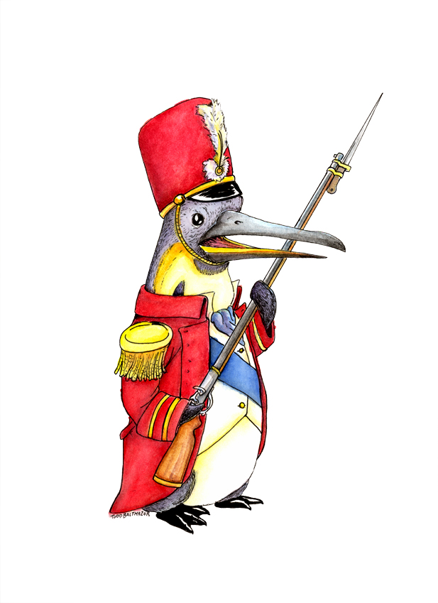
Who Am I?
Trevon (blackmanta)
Random graduate student
Linux Junky
Computer Enthusiast

Slide 3

Why is it important
Understanding System Communication
Good foundation
Find network abuse

Slide 4
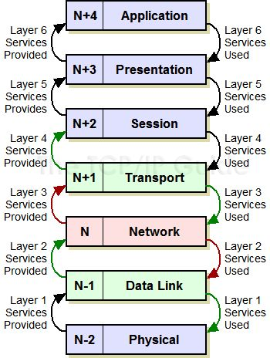
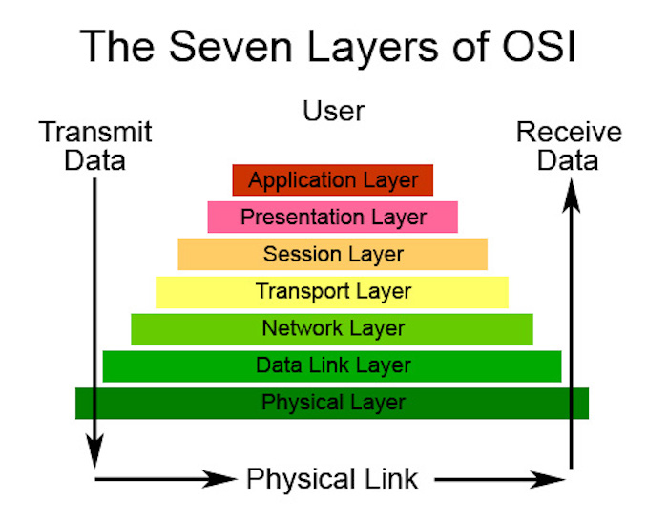
OSI (Open System Interconnection) Model

Slide 5
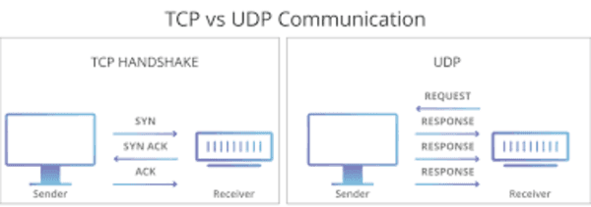
Important Layers (TCP/IP model)
Link
Network
Transport
Application
The 4-layer Internet Model Engineers Need to Know

Slide 6
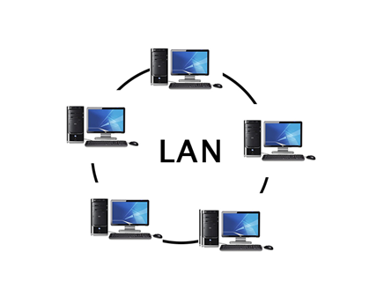
Types of Networks
Local area network (LAN)
Wide area network (WAN)
Wireless local area network (WLAN)
Storage area network (SAN)
Metropolitan area network (MAN)
Personal area network (PAN)

Slide 7
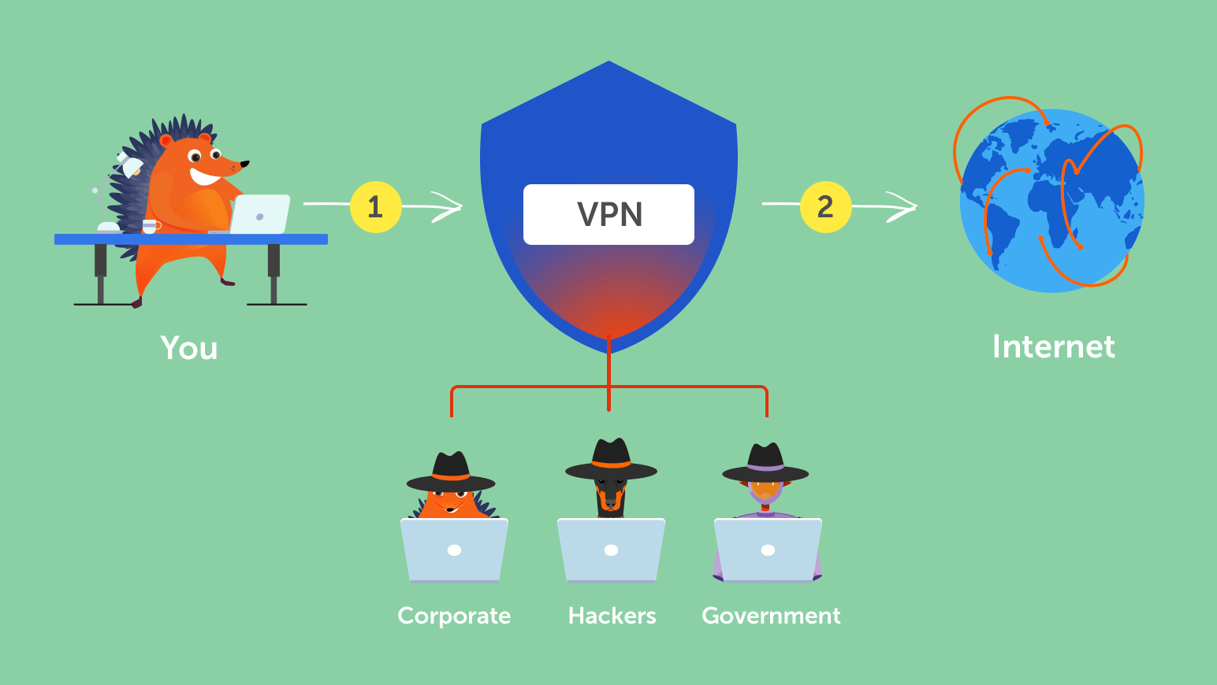
VPN
Virtual Private Network
Need help selecting one
(https://www.privacytools.io/)
https://docs.python.org/2/howto/sockets.html

Slide 8
Resources
Intro to Computer Networking | Stanford (FREE)
https://docs.python.org/2/howto/sockets.html (Socket Programming)

