Slide 1
Network Defense and System Hardening
49th Security Division – Education Night

Slide 2

Who am I?
Trevon (blackmanta)
Graduate Student
Linux Junky
HackerNews Lurker

Slide 3
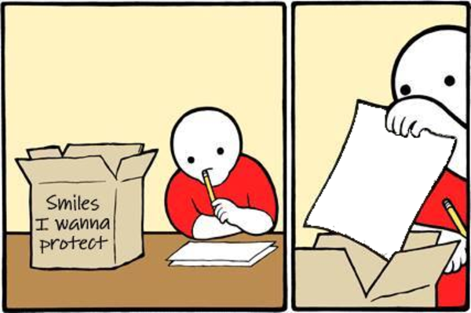
Why do we defend our systems?
To stop all the hackers
To protect data
To keep our ideas safe

Slide 4
What Network tools are used? (Opensource)
SIEM (ELK Stack)
IDS (Snort, Security Onion)
Alerting (Suricata)
Antivirus (ClamAV)

Slide 5
Setting up an Environment
Download docker
https://docs.docker.com/install/linux/docker-ce/debian/
ELK stack setup with docker
https://github.com/deviantony/docker-elk
Snort setup with docker
https://github.com/coolacid/docker-snort
Security Onion setup with docker
https://github.com/Security-Onion-Solutions/security-onion/wiki/Docker

Slide 6
Linux Specific
Open SCAP https://www.open-scap.org/
Lynis https://cisofy.com/lynis/
UFW
IP tables https://www.hackingarticles.in/beginner-guide-iptables/
Fail2ban https://linuxhandbook.com/fail2ban-basic/
Apparmor / SeLinux https://help.ubuntu.com/lts/serverguide/apparmor.html

Slide 7
Windows Specific
Hardening Windows
https://www.hardenwindows10forsecurity.com
Bit locker
Windows Defender’s or Malware Bytes
Windows Server Hardening Checklisthttps://wikis.utexas.edu/display/ISO/Windows+Server+2012+R2+Hardening+Checklist

Slide 8
Blue Team Practice
Understanding Logs
  https://ctf.trevon.dev

