Slide 1
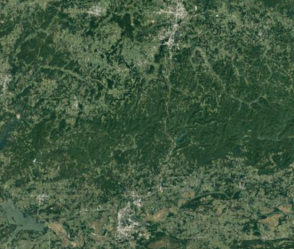

February 8th 2022
State of the art of rejection technics based on machine learning applied to images and videos
Eva Ethève
Julie Gonzalez
Léa Camusat
Lila Roig
1

Slide 2
INTRODUCTION
Objective : To describe current rejection methods carried out after supervised classification of video and images and to explore a strategy of classification with rejection option of tree species from hyperspectral and multispectral image
Keywords : supervised classification, rejection class, vegetation, hyperspectral image, multispectral image
Converting qualitative information into a quantitative information
Creation of a rejection class
Images from remote sensing :
*Hyperspectral imagery (from planes, with a high resolution)
*Multispectral (from satellite with a lower resolution)
Classification on each pixel with machine learning (SVM, RLR, RF)
Rejection method for plant species :
-isolated/uncommon
Unlabeled species
➔ Avoid assigment to the wrong class
Problem of handled classification of the pixels in the usually rejection class : time consuming
2

Slide 3
INTRODUCTION
Idées : peut être ranger en premier (déjà sûr ceux dont on est le plus sures), ceux qui réalisent la classification avant le rejet avec ses techniques, et ensuite ceux qu’il faudrait adapter un peu ???
3

Slide 4
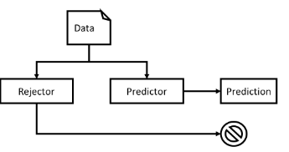
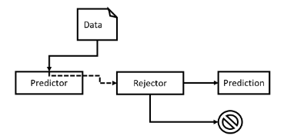
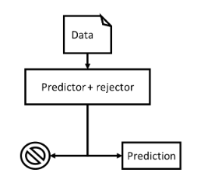
ARTICLE
Machine Learning with a Reject Option: A survey
Hendrickx Kilian ·Perini Lorenzo ·Van der
2021
Aim : state of the art of different rejection methods.
Technics :
Ambiguity rejection & Novelty rejection
What architectures are possible ?
1) Separated rejector
For novelty rejection
one-class classifier and treat finding outliers:
Support Vector Data Descriptor (SVDD) or OCSVM
density-based model: GMM
outlier detectors
For ambiguity rejection
2) Dependent rejector
3) Integrated rejector
Separated rejector
Dependent rejector
Integrated rejector
How do we learn the models ?
Sequential learning:
optimizing a specific criterion
rejecting a fixed predefined fraction of examples
taking advantage of heuristic methods
2) Simultaneous learning
4
Notes:
Ambiguity rejection: rejects when the predictor deviates a little from the real function followed by the data.
Novelty rejection: Reject when the prediction is totally different from the real function.
I) What architectures are possible ?
1) Separated rejector: rejector operates independently from the predictor. Stand-alone model that, at test time, decides whether to reject an example without considering the predictor.
Benefits : any type of predictor, rejector trained independently of the predictor, augment an existing predictor with a reject option.
Drawbacks: lower performance,
Can be used for any type of rejection.
For novelty rejection:
one-class classifier and treat finding outliers: Support Vector Data Descriptor (SVDD) or OCSVM
density-based model: GMM
outlier detectors
For ambiguity rejection:
only a handful of works are available that consider a separated rejector. This is probably because it requires the rejector to replicate the behavior of the predictor without having access to it.
Asif and Minhas (2020): exploit two separate Neural Networks that jointly train a predictor and a rejector.
2) Dependent rejector : the rejector depends on the output of the predictor.
Benefits : enables ambiguity rejections, the rejector can extend an existing model with a reject option. Often, this is done based on a confidence metric derived from the prediction.
Drawbacks : the quality of the rejector is highly influenced by the quality of the metric.
3) Integrated rejector: integrates the rejector and predictor into a single model
Benefits : fewer prediction errors
Drawbacks : on trivial to implement
II) How do we learn the models ?
Sequential learning: Algorithms that learn the rejector based on a priorly trained predictor. Useful for dependent rejectors. Less accurate predictions.
i) optimizing a specific criterion:
- 3 costs (cost of correct prediction, cost of rejection, cost of misprediction)
- risk-minimization (Chow’s rule with ROC curve)
- novel bootstrap algorithm
ii) rejecting a fixed predefined fraction of examples
The rejector can be set to reject a specific proportion of the training set.
iii) taking advantage of heuristic methods
based on the predictor’s performance on the training set (do not require knowledge about the application domain)
2) Simultaneous learning: the rejector and the predictor are jointly trained in a single algorithm. Cannot adapt to different predictor

Slide 5
ARTICLE
Classification of remote sensing data by multistage self-organizing maps with rejection schemes
Jaejoo Lee, Okan K. Ersoy
2005 IEEE Xplore Full-Text PDF: (univ-toulouse.fr)
Aim : Classification method for remote sensing data. It consists of several stage neural networks (SNN) and rejection schemes. The latter are used to decide whether the input vector is difficult to classify and then reduce the possibility of misclassification. – Use of 2 remote sensing dataset.
Technics : Such input vectors are rejected by rejection schemes in each SNN and fed into the next SNN.
Fields of application : Classification of trees/ crops in the U.S
Prons : No prior knowledge is needed about the statistical distributions of the classes in the data sources.
5

Slide 6
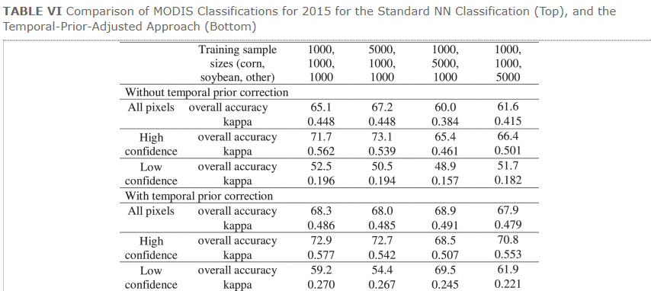
ARTICLE
Image Classification by Itegrating Reject Option and Prior Information
Gregory N. Taff, Yang Shao, Jie Ren and Ruoyu Zhang
2018
Aim : Classify, reject and relabel ambiguous pixels by using Neural Networks (NNs) and implementing prior probability-adjustment methods to improve the classification accuracy.
Technics : Ambiguous (low-confidence group LCG)/ Unambiguous (high-confidance group) pixel groups are identified by thresholding of NN output signals. Pixels defined as LCG were relabeled based on image spatial-prior probabilities, as estimated from the initial NN image classification, or temporal-prior probabilities derived from ancillary data.
Fields of application : Crop-specifid mapping application - multitemporal moderate resolution imaging spectroradiometer (MODIS) NDVI data are used as input to classify corn, soybean, and other crops (Interesting since corn and soybean are difficult to separate because both are summer crops)
Performance assessment :
6
Notes:
Chow and Bayes are often use for this kind of study

Slide 7
ARTICLE …
How to define a rejection class based on model learning?
Sarah Laroui, Xavier Descombes, Aurélia Vernay, Florent Villiers, François Villalba, Eric Debreuve
2020
Aim : to propose an innovative learning strategy for supervised classification that is able to reject a sample not belonging to any of the known classes, modeling each class as the combination of a probability density function (PDF) and a threshold that is computed with respect to the other classes. ➔ neighborhood between classes taken in account
Technics : 1) learn threshold and PDF 2) classification and rejection according to comparison to thresholds and FMF (Fuzzy membership function) value. Gaussian Mixture Model (GMM) to learn FMF and expectation–maximization (EM) algorithm to optimize position/variance. Classification ➔ CNN : convolutionnal neural network
Field of application : case study in biochemistry to recognize the phenotypes of anti-fungal molecules
Performance assessment : 93% accuracy on the known sample and 92% on the sample of new classes
Drawback : threshold and probability density function must be learnt. We should implement it after the classification in our project
7

Slide 8
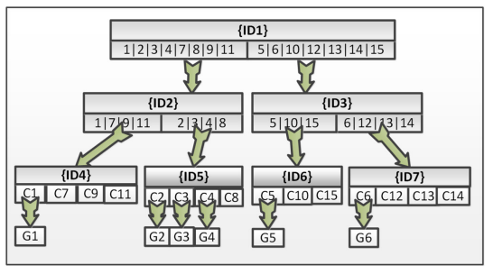
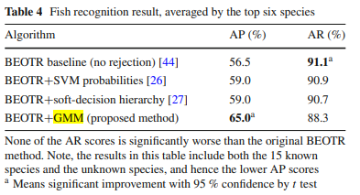
ARTICLE
Hierarchical classification with reject option for live fish recognition
Phoenix X. Huang, Bastiaan J. Boom, Robert B. Fisher
2014
Aim :to recognize the top 15 common species of fish and detects new species in an unrestricted natural envi-
ronment recorded by underwater cameras.
Technics :
-Classification method : Balance enforced optimized tree with reject option (BEOTR).
Classifiers used : SVM, PCA, classification and regression tree method, taxonomy tree, BEOTR
-Reject option : Gaussian mixture model (GMM) and Bayes rule as a reject option after the hierarchical classification
Fields of application : 24150 fish images. The training (3/5’s) and testing sets (1/5’s).
Performance assessment :
drawbacks/advantages : error accumulation of the hierarchical tree classifier
8

Slide 9
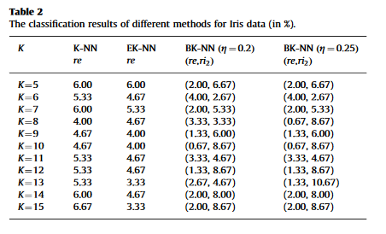
ARTICLE 1
A new belief-based K-nearest neighbor classification method
Zhun-ga Liu, Quan Pan, Jean Dezert
2012
Aim : Reduce misclassification errors by introducing metaclasses.
Technics : BK-NN : Construction of the bba’s (basic belief assignment) of one object according to the distances between the object and its KNNs and two thresholds (acceptance and rejection).
Fields of application : classification on 4 datasets : handwritten digits, Iris data, Ecoli (contains protein localization sites), Wine and recognition of Handwritten digits.
Performance assessment : r_{e} =error rate, r_{ij} =imprecision rate. BKNN is better than KNN and EKNN ➔reduce the misclassification errors by introducing the rejection classes and meta-classes
drawback : we don’t know if this method can be applied to map of probability/ reduce the specificity of the result (because of meta class)
Advantage : reduce misclassification
9

Slide 10
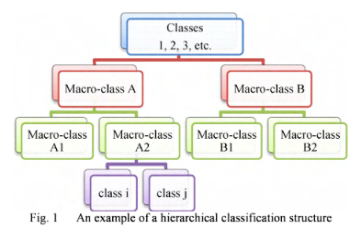
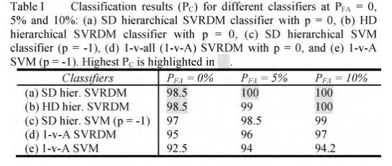
ARTICLE …
A support vector Hierarchical method for multi class
classification and rejection
Yu Chiang Frank Wang and David Casaent
2009
Aim : To define a new support vector clustering method SVRDM
(support vector representation and discrimination machine) to provide rejection ability
and generalization
Technics : hierarchical soft and hard SVRDM (from SVM) 1)to assign a confidence score (probability) to each path at each node in the hierarchy, all nodes and all paths are searched, and the test input is assigned to the class with the highest probability at the bottom node. 2)convert SVRDM outputs ➔ posterior probabilities for the two output paths.
Fields of application : Recognize objects from a database of 100 objects. Ten objects as true classes, and three objects as false classes from the same database to be rejected
Performance assessment :
Drawback : value of p must be optimized
Advantage : SVRDM : version of the SVM with good discrimination between the true classes and better rejection for false classes (better than the SVM can) because the sum of the two probability outputs at a node is not one as in SVM method + adapted to a high number of classes (coarse separation and finer decisions after)
10
Notes:
hard-decision (binary) hierarchical structure : rejection if a true class input gives no output above a fixed threshold T for one of its macro-classes in the upper levels of the hierarchy or if the largest output is above T for some wrong macro-class at some node ≠ In a soft-decision hierarchy, the final P(mlx) for that input's correct path will have the largest final probability output above some new soft-decision threshold Ts-

Slide 11
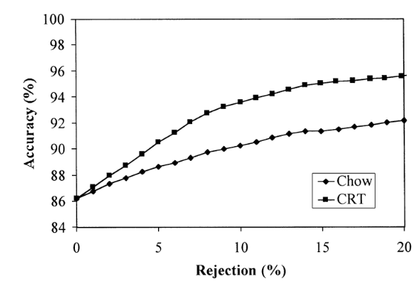
ARTICLE …
Reject option with multiple thresholds
Giorgio Fumera, Fabio Roli, Giorgio Giacinto
2000
Aim : to investigate the effects of estimate errors on Chow’s rule and propose the use of multiple thresholds to carry out rejection
Technics : multiple threshold rejection rule + classifiers : K-NN and multi-layer perceptron (MLP) neural network
Fields of application : set of multisensor remote-sensing images related to an agricultural area near the village of Feltwell (UK).
Performance assessment
Drawback : technic different from classification methods used by Rollin/ values of the CRTs must be estimated (using validation set)
Advantage : easy to carry out
11

Slide 12
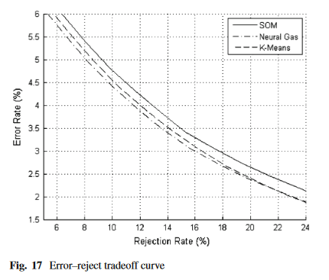
ARTICLE …
Hybrid model of clustering and kernel autoassociator for reliable vehicle type classification
Bailing Zhang ·Yifan Zhou ·Hao Pan ·Tammam Tillo
2014
Aim : to propose an innovative learning strategy for supervised classification that is able to reject a sample not belonging to any of the known classes, modeling each class as the combination of a probability density function (PDF) and a threshold that is computed with respect to the other classes. ➔ neighborhood between classes taken in account
Technics : SVM classifier, , hybrid model composed of clustering and kernel autoassociator(KAA) : maps the data into a high-dimensional feature space via the utilization of a kernel function, Kmeans. ➔ rejection by Chow and then by soft-max function defined from KAA thanks to a quotient of output reconstruction error
Field of application : Automatic vehicle classification
Performance assessment : performance of accuracy over 95 % with a rejection rate 8 %
and reliability over 98 % with a rejection rate of 20 %.
Drawback : σ value in Gaussian kernel function must be found, determine the threshold
Advantage : could probably be adapted for the algorithm used by Rollin
12
Notes:
Principle of KAA : Input patterns are projected to a kernel feature space H. Then, each kernel autoassociator learns to reconstruct [e.g., via F ()] a particular class of patterns from their kernel features.+ more precisions see https://citeseerx.ist.psu.edu/viewdoc/download?doi=10.1.1.467.7700&rep=rep1&type=pdf

Slide 13
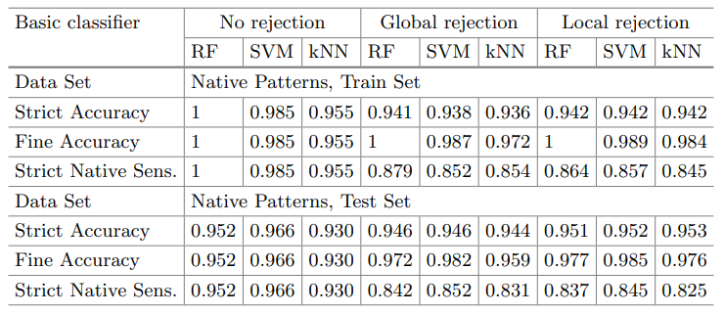
ARTICLE
Pattern Recognition with Rejection Combining Standard Classification Methods with Geometrical Rejecting
Wladyslaw Homenda, Agnieszka Jastrzebska, Piotr Waszkiewicz,and Anna Zawadzka
2016
Aim : To provide algorithmic approaches to distinguish proper patterns, from garbage and erroneous patterns in a pattern recognition problem. (rejection class) and to examine the cooperation of various standard classifiers (SVMs, random forests and kNNs) with geometric methods used for rejection => rejection implemented by design
Technics : combine classification and use of ellispoids (better to find area of rejection) => Minimum Volume Enclosing Ellipsoid (MVEE) algorithm
Fields of application : datasets of handwritten digits (native patterns) and handwritten Latin letters (foreign patterns)
Performance assessment : Local rejection (ie. after a first classification) is more efficient than global rejection
drawback : both rejection mechanisms rejected some native patterns => Strict Accuracy and Strict Native Sensitivity are
slightly higher without rejection
Advantage : Fine Accuracy improved for local and global rejection
schemes and for all classifiers => better recognition rate
Questions : SVM is used for classification, regression and outlier detection => is it possible with this classifier to implement the rejection method by design ?
13

Slide 14
ARTICLE
Supervised Hyperspectral Image Classification With Rejection
Filipe Condessa, José Bioucas-Dias and Jelena Kovacevic
2016
Aim :2 methods :
1) Jointly computing context and rejection (JCR): rejection = an extra class that models the probability of classifier failure.
2) Sequentially computing context and rejection (SCR): rejection results from the hidden field associated with a marginal maximum a posteriori classification of the image
Technics : SegSALSA algorithm – classification with context
Fields of application : Aviris Inidan Pines, ROSIS
Pavia University Scene (Hyperspectral dataset)
AVIRIS Indian Pines | nonrejected accuracy | rejected fraction | classification quality
LORSAL-SegSALSA-JCR-U | 80.31% | 20.65% | 78.56%
LORSAL-SegSALSA-JCR-E | 76.01% | 15.85% | 74.23%.
LORSAL-SegSALSA-SCR | 79.97% | 23.75% | 76.16%.
ROSES Pavia University | nonrejected accuracy | rejected fraction | classification quality
LORSAL-SegSALSA-JCR-U | 82.25% | 3.12% | 81.81%
LORSAL-SegSALSA-JCR-E | 86.45% | 12.75% | 82.93%.
LORSAL-SegSALSA-SCR | 84.54% | 9.16% | 82.08%.
Performance assessment : classification with context and rejection with small training sets achieves performances comparable to context only with larger training sets
drawbacks/advantages :
JCR achives higher performance than SCR but is more expensive.
classification with rejection does not affect all the classes equally;
14

Slide 15
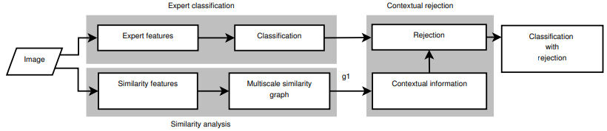
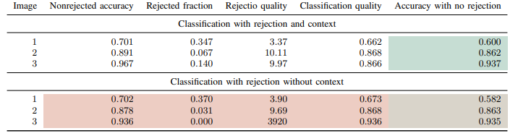
ARTICLE
Image classification with reject option using contextual information
Filipe Condessa, José Bioucas-Dias Carlos A. Castro, John A. Ozolek and Jelena Kovacevic
2015
Aim :to combine classification with rejection and classification using contextual information in an image classification framework
Rk : The basic assumption for classification with contextual information is that the data is not spatially independent: 2 neighboring pixels are likely to belong to the same class.
Technics :
MLL , DFR(Discriminative Random Field) , MRF (Markoc random field)
Fields of application : automated tissue identification (classification) in images from Hematoxylin and Eosin
(H&E) stained histopathological slide
advantage : combine classification with rejection and based on contextual information (neighboring labels) -> not only on a rejection threshold
drawbacks : increase the complexity + rejection by design, whereas we want to classify and then reject
Performance assessment : test on 3 images
15
Notes:
summary : they decided to carry out a classifier with rejection with first a general classifier and then a binary classifier which decides if the first classification was correct. 1) they classify and create an extra class (of rejection) based on rejection by risk minimization. ==> could be used in our case, with a method based on the ratio of highest component of the probability vector if it it enough or not and if not it can be assigned to the rejection class. + Expert knowledge : create superclass which group several subclasses (have a lower weight in the rejection process if they belong to the same superclass). + interaction function (local neighborhood : set of edges connecting partition with neighbors just next to them, and non local neigborhood set of edges with high similarity)

Slide 16
ARTICLE
Support Vector Machines with a Reject Option
Yves Grandvalet, Alain Rakotomamonjy, Joseph Keshet, Stephane Canu
2015
Aim : Applies to binary classification where the classifier may abstain instead of classifying each observation. The algorithm modifies the standard SVM optimization problem by replaced the hinge loss function with a double hinge loss function.
Technics :
The training criterion consists in deriving a loose approximation to the logistic regression model. Hence, this consists of minimizing a double hinge loss function that focuses on estimating conditional probabilities only in the vicinity of the threshold points of the optimal decision rule. This function reflects the 2 thresholds in Chow’s rule defined on posterior probabilities.
In the limit, learning with the double hinge loss is optimal in the sense that the risk for the learned decision rule converges to the Bayes’ risk.
advantage : simple to implement
drawbacks : we have to modify the classification algorithm
Performance assessment :
- Use of datasets from the UCI repository related to medical problems.
- Compare the performances of 3 different rejection schemes based on SVMs with the decision rule in this paper:
• The decision rules in this paper tend to classify more accurately the examples that are not rejected
• For noisy problems there is no significant gain
16

Slide 17
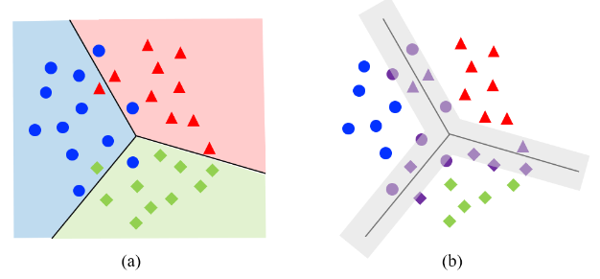
ARTICLE
Classification with Rejection Based on Cost-sensitive Classification
Yves Grandvalet, Alain Rakotomamonjy, Joseph Keshet, Stephane Canu
2015
Aim : Nontawat Charoenphakdee, Zhenghang Cui, Yivan Zhang, Masashi Sugiyama
Technics : Novel method of classification with rejection by learning an ensemble of cost-sensitive classifiers.
It does not require complicated modifications when using different losses and it is applicable to both binary and multiclass cases.
A method that can avoid estimating the class-posterior probabilities for solving this problem. p(y|x) = the class-posterior probability of a class y.
Binary classification: suggests that by solving two binary cost-sensitive classification based on Chow’s rule, binary classification with rejection can be solved.
Multiclass classification: They show that multiclass classification with rejection can be solved by learning an ensemble of K binary cost-sensitive classifiers. Directly minimizing the empirical risk is computationally infeasible. They propose the cost-sensitive surrogate loss for classification with rejection.
Performance assessment : For multiclass classification, they used :
Gas-Drift and Human activity recognition (HAR), which are tabular datasets
Image datasets, which are MNIST and Fashion-MNIST. Convolutional neural networks were used for all image datasets.
The performance depends on the loss function used.
17

Slide 18
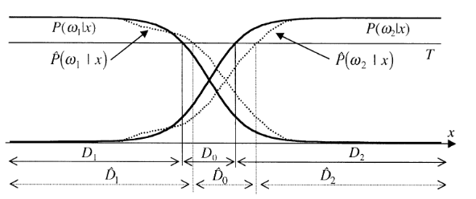
Conclusion : peut etre mettre les principales méthodes qu’on a repéré
Usual methods with a lack of efficiency
Bayes : assigning each pattern (pixel) to the class for which the probability is maximum. Issue : no rejection process
Chow’s rule : a pattern x is rejected if max P(wk|x)=P(wi|x)<T. Issue : errors if the probabilities of the data classes are unknown or too many patterns rejected
k=1,…N
G. Fumera et al. Pattern Recognition (2000)
Multiple threshold rejection rule
Other methods
Use threshold and probability density function (Gaussian Mixture Model (GMM))
When the classifiers uses KNN => use the distances between classes
Questions :
-Are the algorithms used by Rollin using context or not ?
-Do we have to implement the rejection method a posteriori because if it would be by design we would have to modify too much the already existing code ? Or is it related to the classification methods that Rollin has decided to use : SVM (Support Vector Machines), RLR (Regularized Logistic Regression), RF (Random Foret)
18

Slide 19
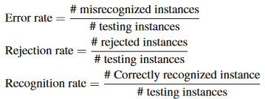
Slide pour nous
Assessment of the models of classification
Pc: classification rate
PFA: false alarm rate hard-decision =number of false alarms to the number of non-hazardous objects
Hard (binary) hierarchical structure, if a true class input gives no output above a fixed threshold T for one of its macro-classes in the upper levels of the hierarchy, it will be rejected. If the largest output is above T for some wrong macro-class at some node, then that input will be misclassified or rejected in a hard-decision hierarchical architecture DIFFERENT soft-decision hierarchy : for either case above, the final P(mlx) for that input's correct path can still have the largest final probability output above some new soft-decision threshold
19

Slide 20
Slide pour nous
Questions :
-Are the algorithms used by Rollin using context or not ?
-Do we have to implement the rejection method a posteriori because if it would be by design we would have to modify too much the already existing code ? Or is it related to the classification methods that Rollin has decided to use : SVM (Support Vector Machines), RLR (Regularized Logistic Regression), RF (Random Foret)
20

