Slide 1


Example 1

Slide 2
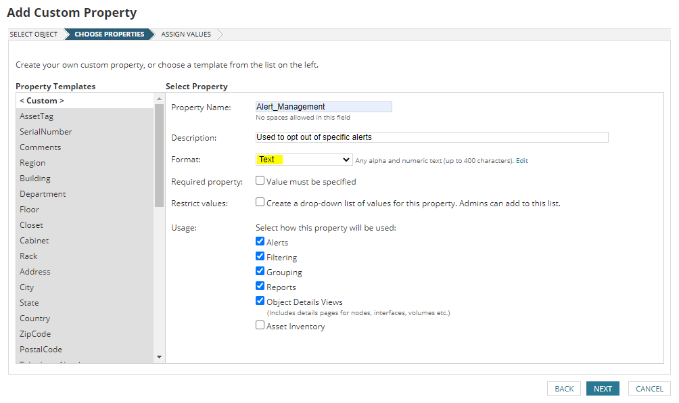
Example 1

Slide 3

Example 1

Slide 4
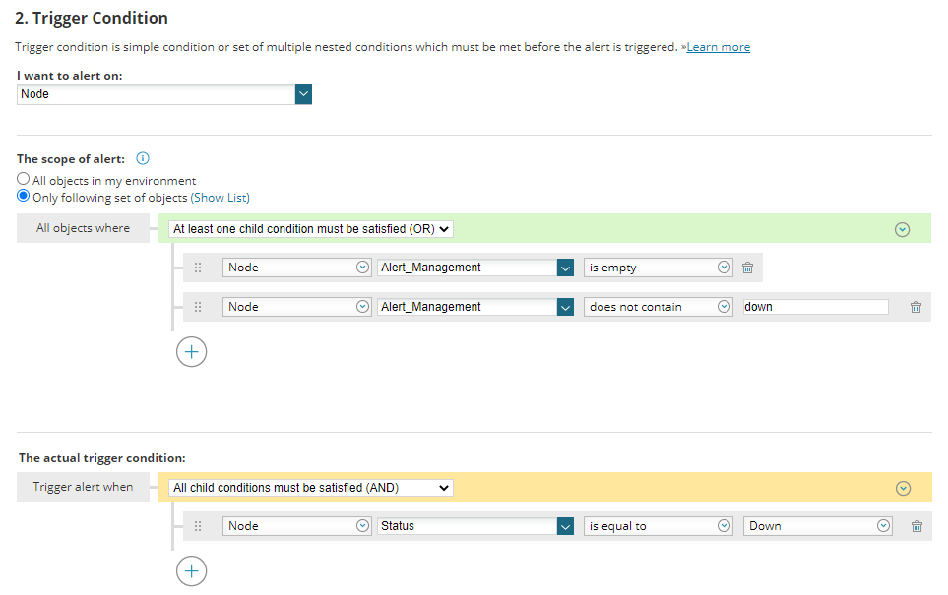

Slide 5
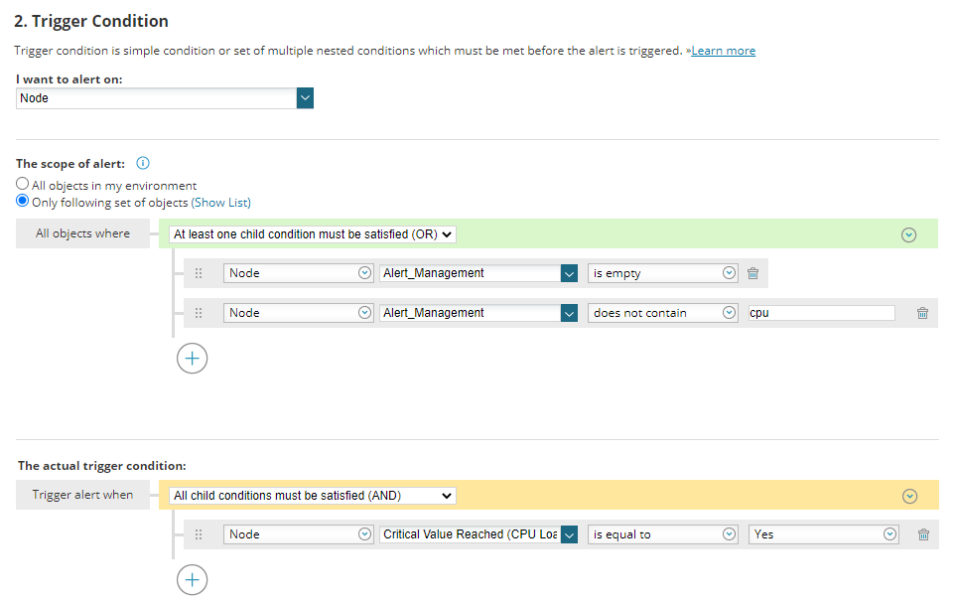

Slide 6
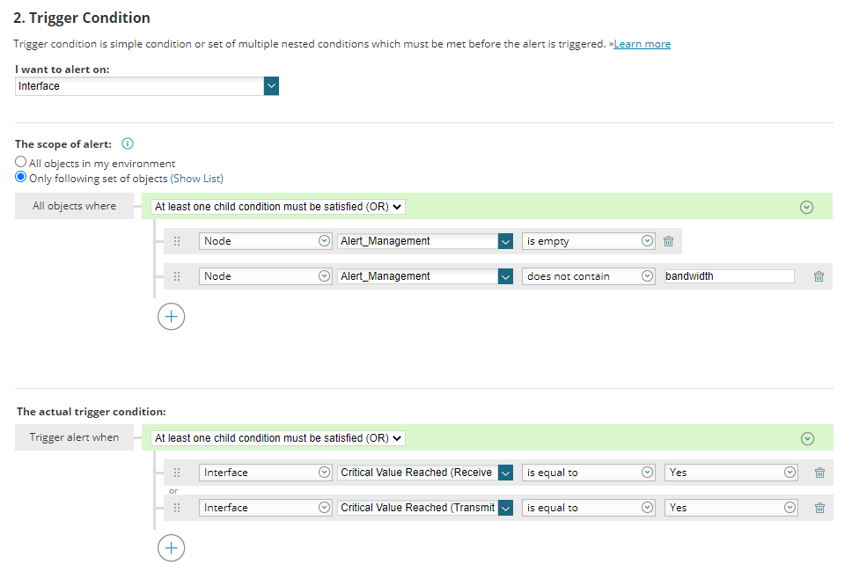

Slide 7


Example 2
Click “Add Custom Property”

Slide 8
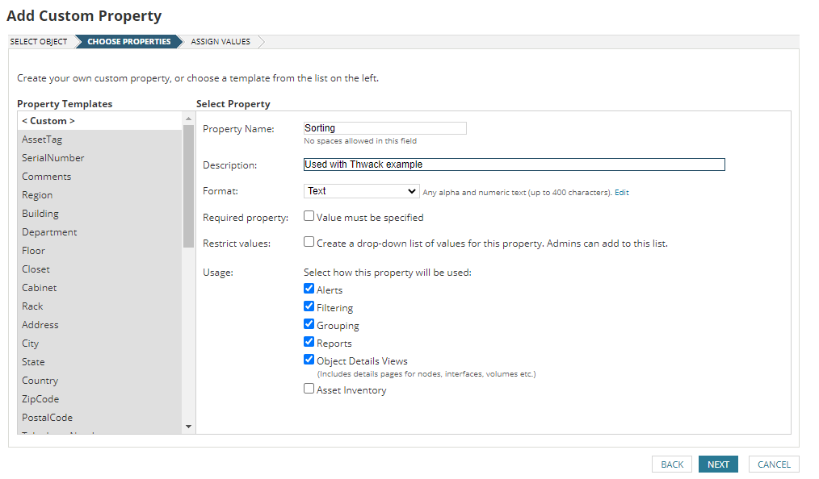
Example 2

Slide 9

Example 2

Slide 10

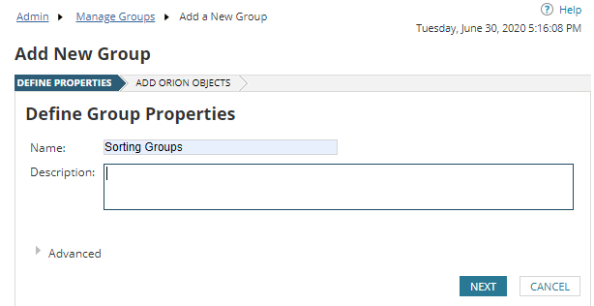
Click “Add New Group”

Slide 11



Slide 12


Slide 13
Click “Add New Group”

Slide 14



Slide 15
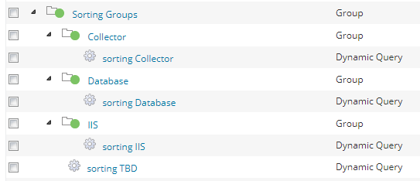

Slide 16



Slide 17


Slide 18
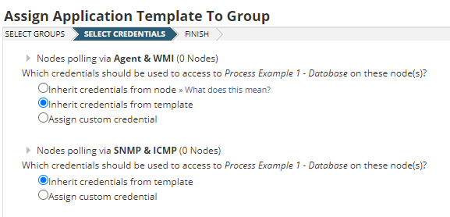

Slide 19


Slide 20
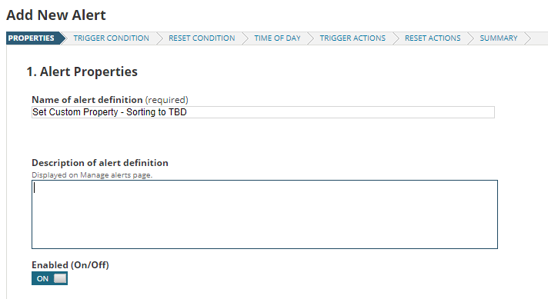

Slide 21
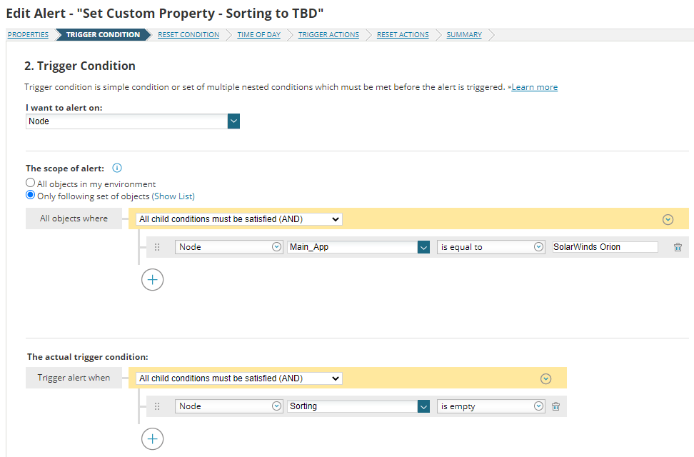

Slide 22
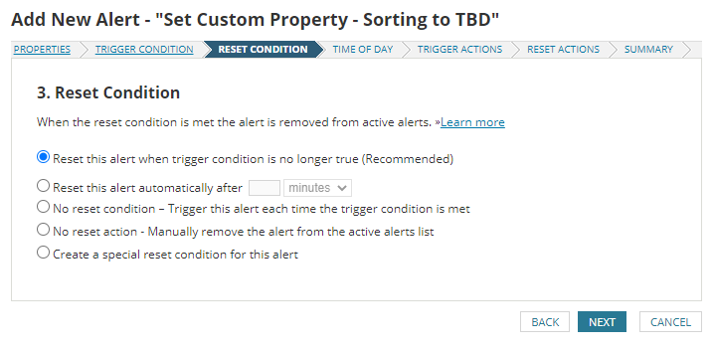

Slide 23
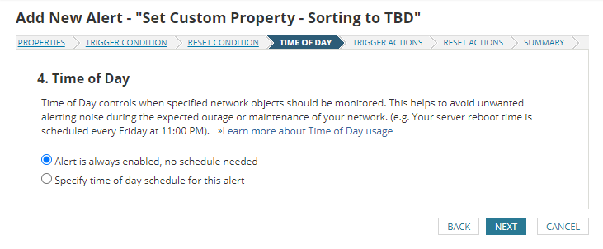

Slide 24

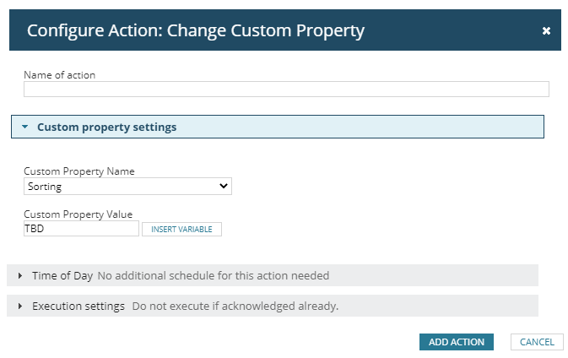

Slide 25
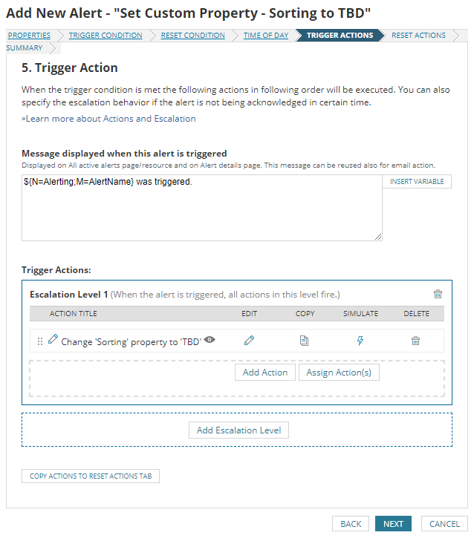

Slide 26
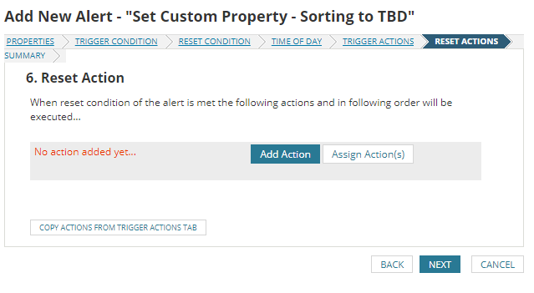

Slide 27


Slide 28
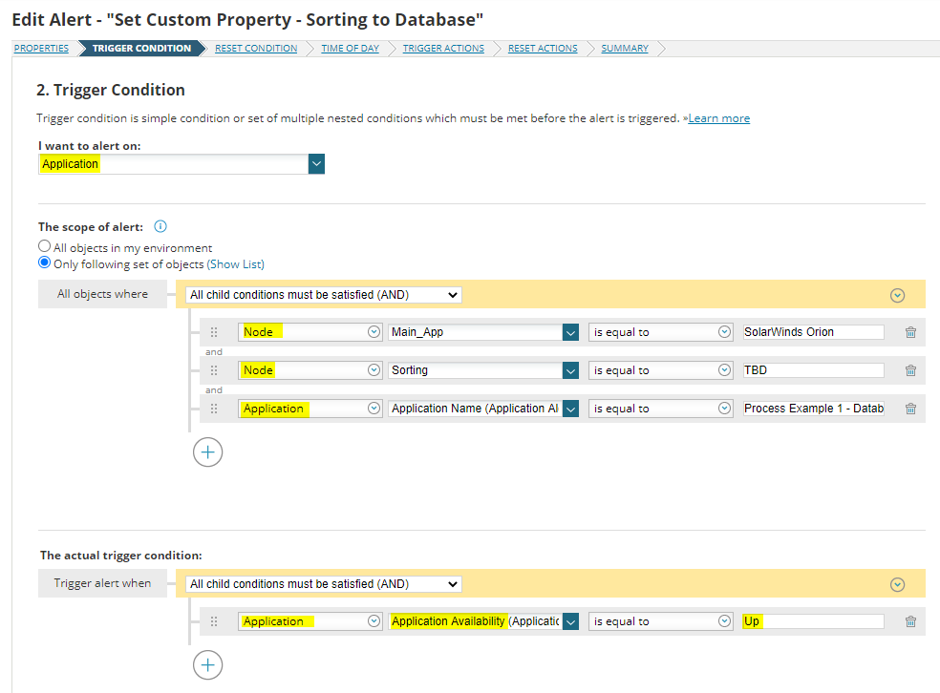

Slide 29

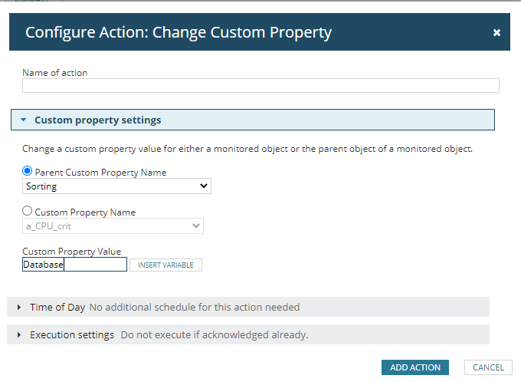

Slide 30



Slide 31
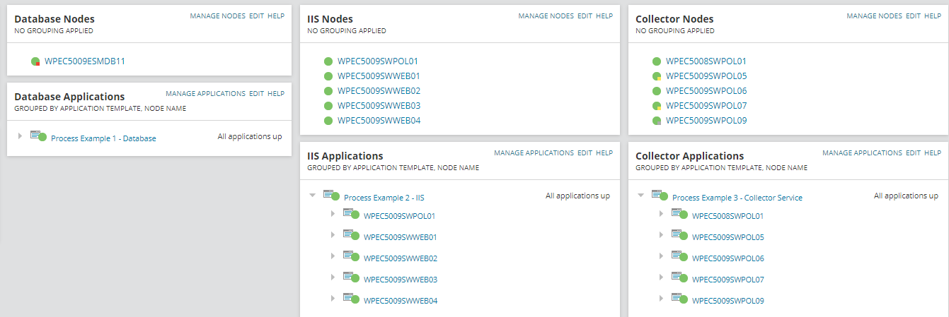

Slide 32


Slide 33

Questions?
Reach out on Thwack, search for Marc Netterfield.

