Slide 1
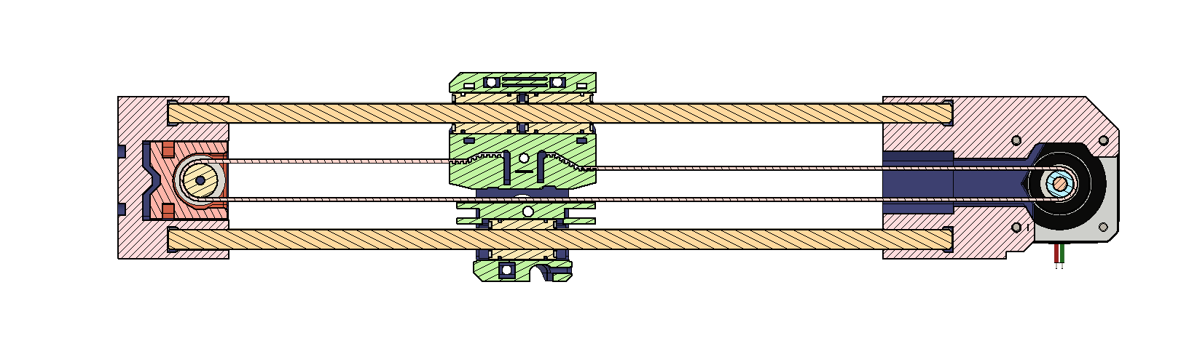
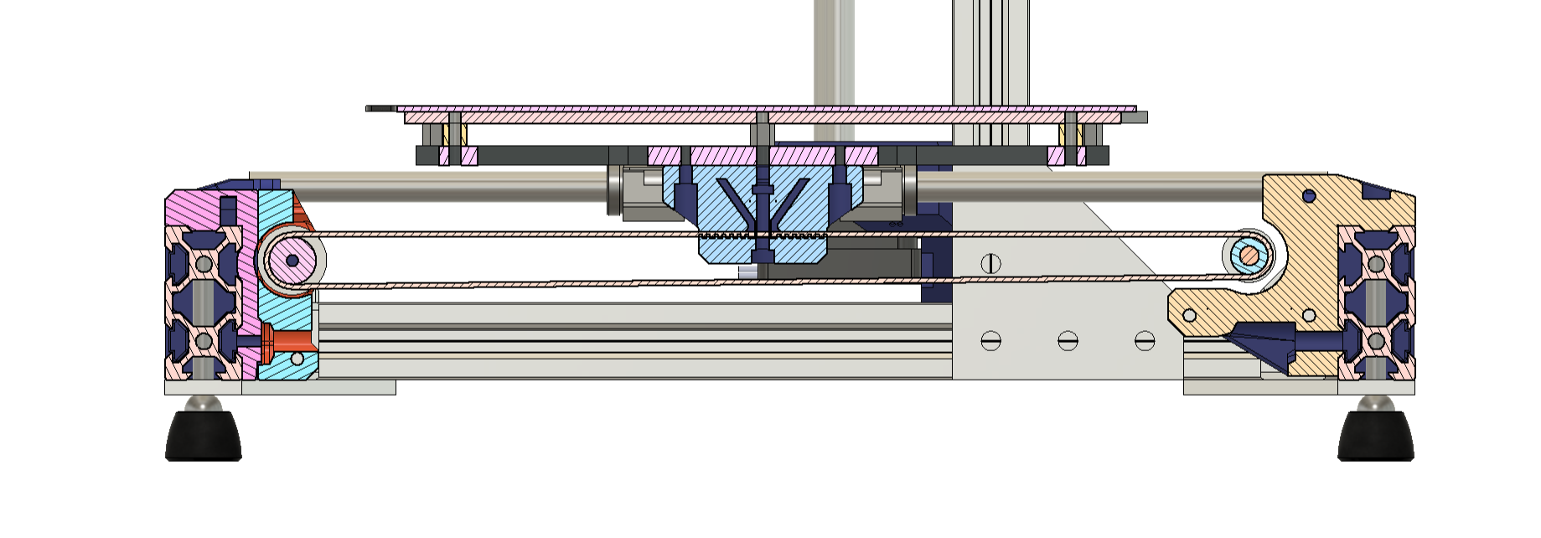
PARALLEL BELT MOTION
X-AXIS
Y-AXIS

Slide 2
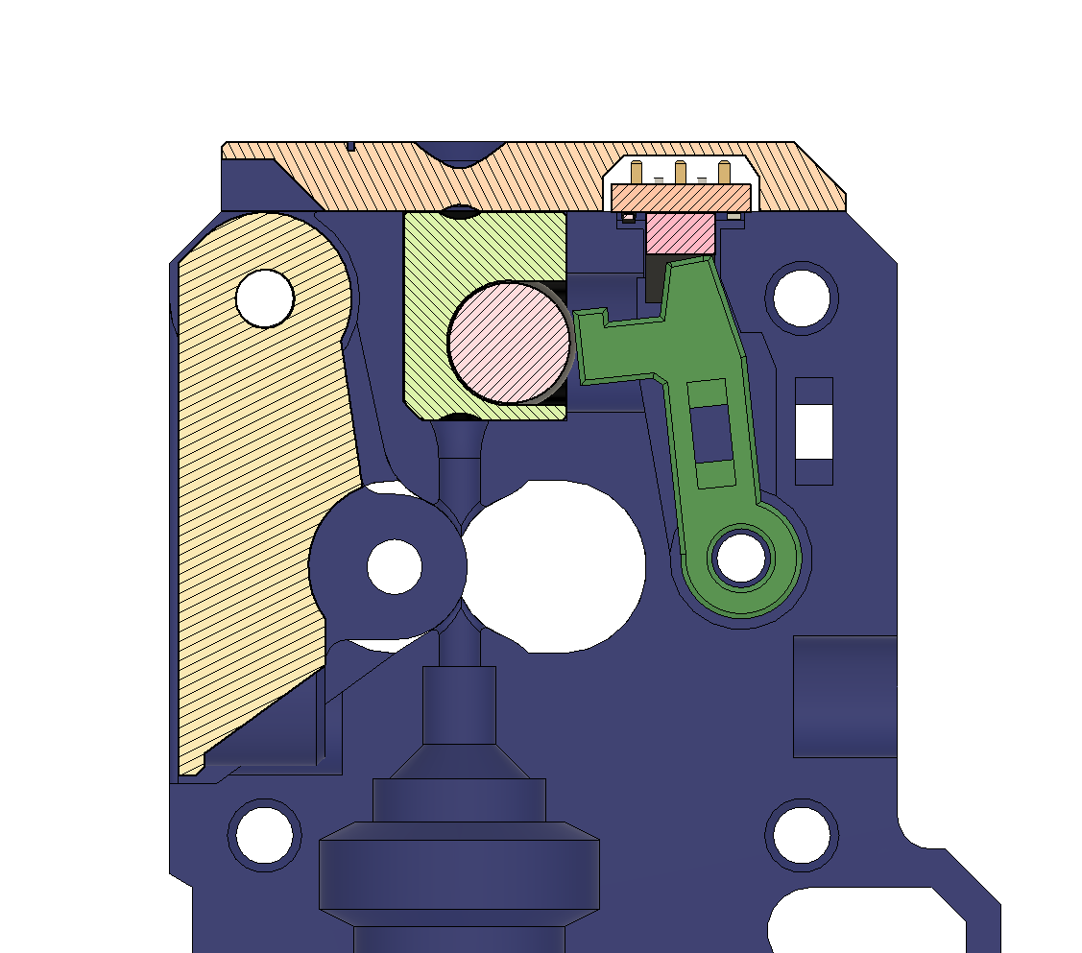
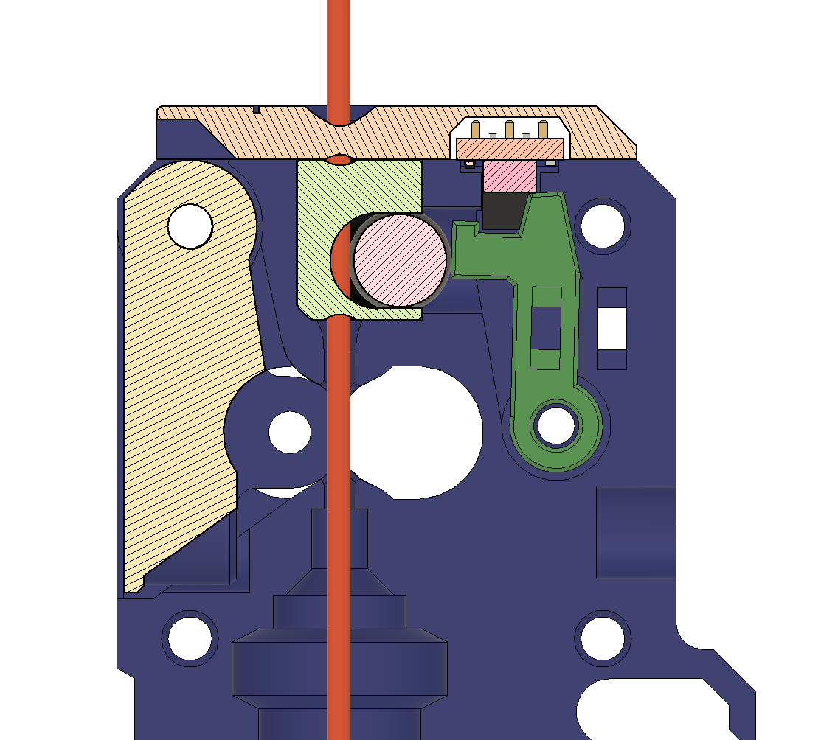
INVERTED FILAMENT SENSOR FUNCTION

